Slide 1
Airway and Respiratory Care
Basic Airway Difficulty Breathing Treatment
Chapin Area Rescue Squad/February 2013/Bryce McCormick, EMT-P

Slide 2
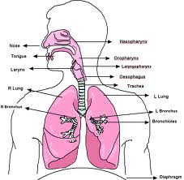
Anatomy of the Airway

Slide 3
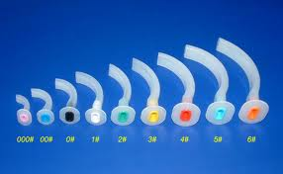
Open/Clear the Airway
Opening and Clearing the airway is primary concern
Suctioning must be done to ensure a clear airway in both trauma and medical pts.
Head-Tilt/Chin-Lift preferred method to open an airway
Use of an OPA and NPA to assist with BLS securing of an airway

Slide 4
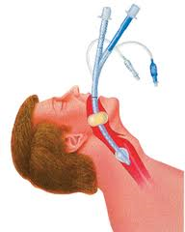
Securing the Airway
BLS allows for use of Combi-tube or similar dual lumen airway device (Blind Insertion)
ALS use of Endotracheal Tube

Slide 5
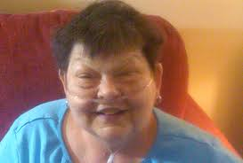
Respiratory Emergencies
Bread and Butter- Difficulty Breathing
COPD
Asthma
Smoke Inhalation
Cancer or Loss of Function

Slide 6
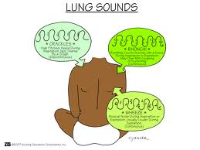
Lung Sounds
Upper Airway
Stridor
Lower Airway
Wheezes
Crackles
Rhonchi

Slide 7
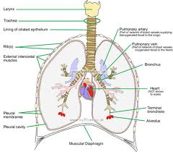
Initial Treatment
OXYGEN!!!!!!
Nasal Cannula
Non-Rebreather
Assist ventilations with BVM

Slide 8
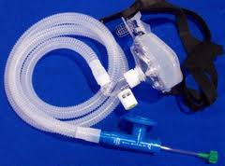
ALS Interventions
Medications
CPAP
Intubation

Slide 9
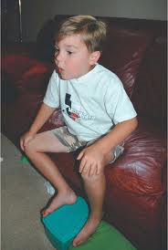
True Difficulty breathing
Tripoding
Not able to speak in complete sentences
Cyanosis
Accessory muscle usage

Slide 10
conclusion
Difficulty Breathing is a common response
Methods to assist with breathing
Treatment of difficulty breathing
Problems with breathing are number one reason kids go into cardiac arrest

