Slide 1
Draft Central Valley Flood Protection Plan Investment Strategy
California Central Valley Flood Control Association
Flood Forum
March 15, 2017
Presented by:
Mary Jimenez
Mary.Jimenez@water.ca.gov
Flood Planning Office
California Department of Water Resources

Slide 2
Today’s Discussion
Overview of the 2017 Central Valley Flood Protection Plan Update
CVFPP Investment Strategy Technical Memorandum
Potential Funding Mechanisms Included in Investment Strategy Considered for CVFPP Implementation

Slide 3
Overview of the 2017 Central Valley Flood Protection Plan Update

Slide 4
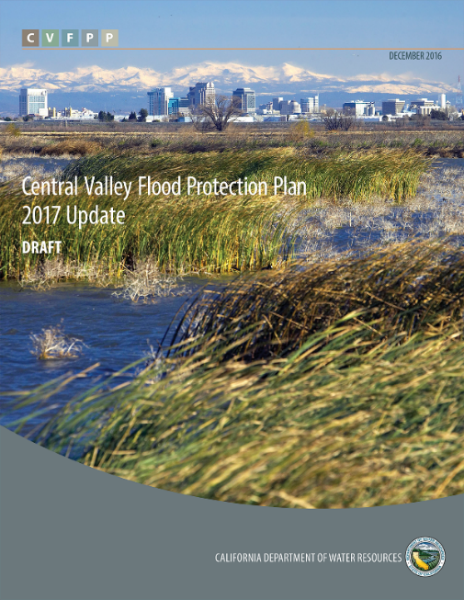
2017 Update to the CVFPP
Continues implementation of key concepts from 2012 CVFPP
Recommends refinements/changes where necessary
Brings together technical and policy- level information to refine SSIA and associated cost estimates, funding, phasing over next 30 years
Includes policy and funding recommendations to support comprehensive flood risk management actions

Slide 5
CVFPP Investment Strategy Technical Memorandum

Slide 6
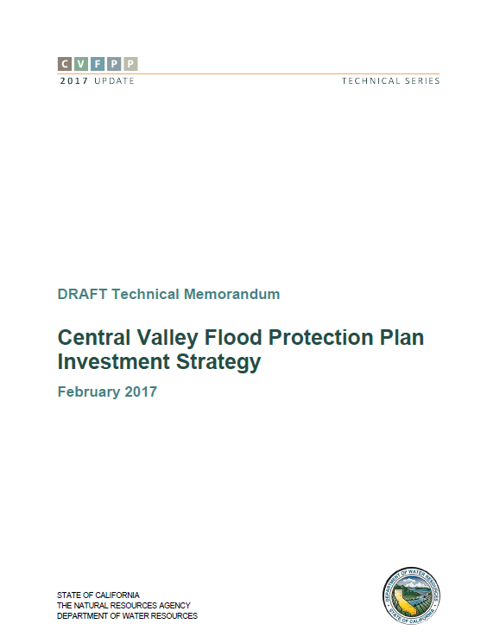
CVFPP Investment Strategy TM
One of fifteen 2017 CVFPP Update supporting documents that provide greater detail to support the plan
Provides detailed analysis to support CVFPP investment costs, phasing and funding
Strategy includes proposed CVFPP Funding Plan
Draft TM available now
http://www.water.ca.gov/cvfmp/2017-cvfpp-docs.cfm

Slide 7
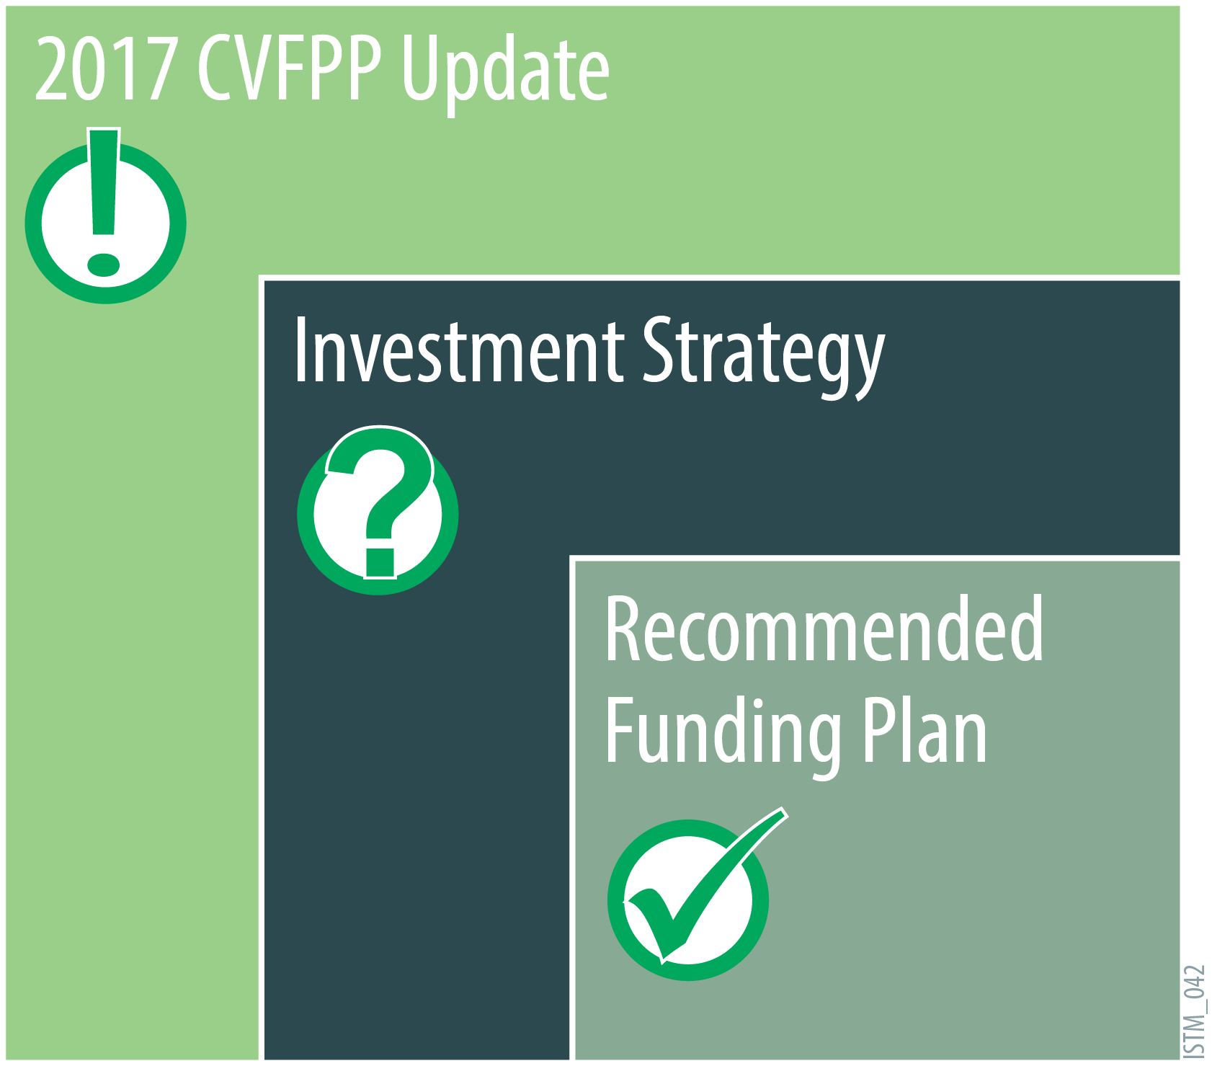
Describes why flood investments are needed
Describes what investments are needed
Explores how investments can be funded over
30-year planning horizon

Slide 8
Potential Funding Mechanisms for CVFPP Implementation
A host of potential existing and new funding mechanisms were considered
Each examined qualitatively for:
Applicability
What types of actions could be funded?
Inter-annual reliability
Is it a one-time source, or more consistent year-to year?
Political viability
Who could support this?

Slide 9
Potential Funding Mechanisms Included in Investment Strategy Considered for CVFPP Implementation

Slide 10
State Funding Mechanisms Considered
State General Fund | CVFPP funding plan recommends increasing general fund appropriations.
SAC/SJ Drainage District | Reutilize the Sacramento and San Joaquin Drainage District.
State River Basin Assessment | Assessment revenue would be returned to the watershed to be shared across the integrated water management activities.
State Flood Insurance Program | Augment/replace the National Flood Insurance Program (NFIP) program with a State-led program.
General Obligation Bond | Issue new State general obligation bonds.
New
New
New

Slide 11
Federal Funding Mechanisms Considered
USACE Programs | Water Resource Development Act (WRDA) authorizes Secretary of the Army to study and/or implement various projects and programs for improvements.
FEMA Programs | FEMA provides State and local governments with funding for emergency preparedness programs in the form of Non-Disaster Grants.
Federal Ecosystem Programs | Explore federal programs that provide grants for ecosystem purposes, such as Farm Bill conservation programs offered through Natural Resources Conservation Service (NRCS).

Slide 12
Local Funding Mechanisms Considered
Benefit Assessments and Special Taxes | Increases to benefit assessments and special taxes.

Slide 13
Recommended Timing of CVFPP Investments
 | Phase 1 | Phase 2 | Phase 3
Focus | Reactively address the highest levels of risk to lives and assets concentrated in the densely populated areas | Actively transition to more balanced investments | Proactively balance flood investments for both capital and ongoing activities in a sustainable manner
Anticipated Duration | 2017 to 2027 | 2027 to 2037 | 2037 to 2047

Slide 14
Total Investment of 2017 CVFPP Update
Timing of Total Investment
 | Phase 1 | Phase 2 | Phase 3
Capital Investment¹ | $4.7 - $5.7 billion | $4.6 - $5.6 billion | $5.0 - $5.6 billion
Annual Investment² | $138 - $169 million/year | $197- $240 million/year | $224 - $274 million/year
Notes:
1. All estimated dollar values are in 2016 dollars and indicate an investment over 30 years.
2. Estimated values are in 2016 dollars and indicate annual investments made over 30 years. They have not been discounted to present value nor escalated for inflation.

Slide 15
Draft Near-Term Funding Recommendations

Slide 16
Draft Central Valley Flood Protection Plan Investment Strategy
California Central Valley Flood Control Association
Flood Forum
March 15, 2017
Presented by:
Mary Jimenez
Mary.Jimenez@water.ca.gov
Flood Planning Office
California Department of Water Resources

Slide 17
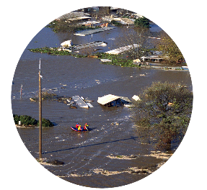
Chapter 1: Updating the CVFPP – Overview of Historical Context & Implementation Progress
Systemwide / large-scale
Encompassing multiple regions and/or land use types, up to the full extent of the flood management system in the Central Valley
Regional-scale / medium-scale
General scale of regions defined through Regional Flood Management Planning, according to delineation by hydrologic and administrative boundaries
Small-scale
A local area of limited geographic extent
Key Concept
Programmatic Planning at Different Scales
Notes:
Ch 1 clarifies the range of scales encompassed by actions in the CVFPP. These scales also existed in 2012.
Example systemwide – Yolo Bypass expansion, and routine operations and maintenance
Example regional scale – Sacramento and West Sacramento urban improvements
Example small-scale – Critical rural levee repair

Slide 18
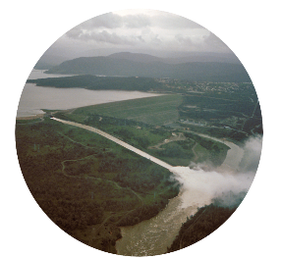
Chapter 3: Strategies to
Improve System Management
Investment Actions Included in the 2017 CVFPP Update
Area of Interest | Capital Investment | Ongoing Investment
Systemwide Actions
Urban Actions
Rural Actions
Small Community Actions
Please refer to 2017 CVFPP Update
Notes:
Four areas of interest (list them) are chosen because different actions may be selected for systemwide vs urban areas, for instance, and different outcomes may be achieved by them. Actions are further delineated between capital and ongoing investments.

Slide 19
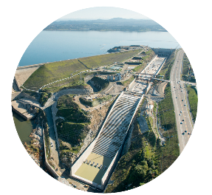
Chapter 4: Financing & Implementing the 2017 Refined SSIA Portfolio
Phase 1 (Near-Term) Actions
Anticipated Duration 2017 to 2027
Systemwide
Yolo Bypass Multi-Benefit Improvements (first phase)
Paradise Cut Multi-Benefit Improvements (land acquisition)
Reservoir and floodplain storage actions
Address deferred maintenance and increase routine maintenance (ongoing)
Emergency preparedness and flood risk awareness (ongoing)
Urban
Urban levee and infrastructure improvements
Rural
Rural levee and infrastructure repairs
Small Community
Small community improvements
Notes:
Investments are phased between near-term and longer-term. The near term (next 10 yrs) focuses on the actions highlighted here in each area of interest.
Example systemwide action – Yolo Bypass multi-benefit improvements
Example urban action – Actions to provide 200-year level of protection to Sacramento and West Sacramento urban area
Example rural – critical repair to levees protecting rural/agricultural area
Example small community – City of Colusa

