Slide 1
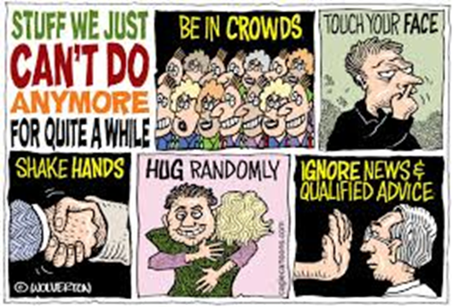
BUSI 406-3 (Didow): The top priority is your safety and your well being
Are you okay?
What do you need from me, the UBP, KFBS, or UNC?
Are you following the Federal and State guidelines to lessen the spread of coronavirus?
Stay at home if you can -- “Shelter in Place”
Practice social distancing
Wash your hands frequently
Cover your sneeze of cough
Avoid touching your eyes, nose, and mouth
How can you do some good in the world in this challenging and difficult circumstance?
Family
Friends
Neighbors

Slide 2
www.star.unc.edu It is likely STAR will offer several major virtual field consulting projects this summer. May 18-August 31, 3 credit hrs, 6-student teams + Faculty Advisor. Marketing strategy planning, COVID-19 recovery, …

Slide 3
BUSI 406-3 (Didow) Final Exam Information
Final exam will be taken online on Canvas through the “Quizzes” tab
Final exam will be available for you to take anytime within the following 48-hour window:
Exam will open at noon (EST) Tuesday, April 28
Exam will close at noon (EST) Thursday, April 30
You will have a maximum of 3 hours to complete the exam
Once you start the exam, the clock starts
You can submit the exam when you are done. Otherwise, the exam will close automatically at the end of 3 hours.
If you have technology issues, please email me immediately at nick_didow@unc.edu
I am happy to answer questions prior to noon on 4/28

Slide 4
Final Exam Information
Instructions
Honor and sign UNC Honor Code Pledge
Closed book, closed notes, closed Internet exam
NO smart device use (e.g., phone, watch, tablet, laptop) is permitted
You may use the calculator function on your computer.
The final exam will be on all class material covered in Chapters 8–19
Final Exam Format
50 Multiple Choice Questions (1 point each; total 50 points)
Choose the BEST answer
Case with several Short Answer Questions (total 50 points)
Word limits will be specified for each question
Please respect the word limits. Your words past the word limit will neither be read nor evaluated as part of your response.

