Slide 1
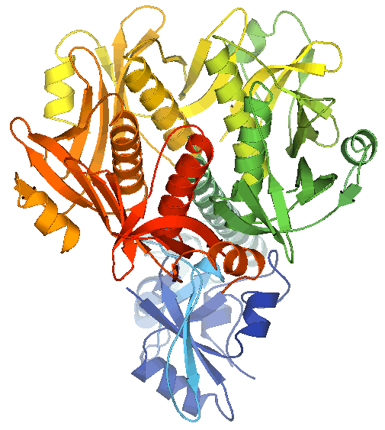
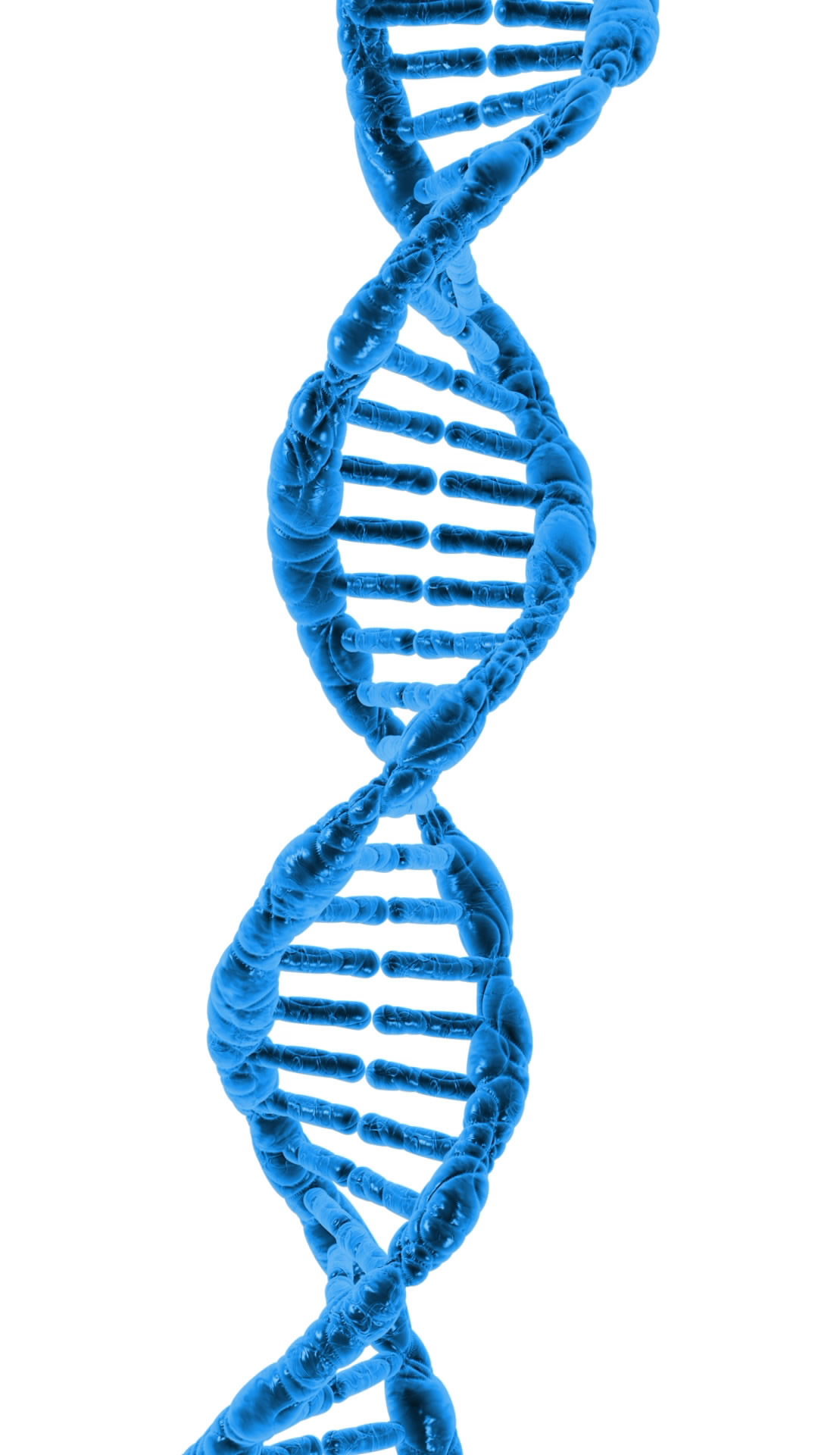
Gel Electrophoresis
Purpose: separate molecules by size and/or charge
In molecular biology these are usually DNA/RNA or proteins
Requires:
a matrix (gel) for molecules to travel through
(usually agarose or polyacrylamide)
2) A constant electrical current forcing molecules to move
Exhibit: home made agar gel electrophoresis
Separate food coloring by size in an agar matrix
Agar – agar agar from Li Ming Global Mart
Power supply – 9 V batteries
Paper clips
gel box – lid from pipette tip container
Gel comb – 3D printed
Running buffer – borax; loading buffer – corn syrup
Primary colors are
red, blue, yellow
Question is:
What colors are green and
purple made from?

