Slide 1
Why the Technology Student Association is so Important to SC Students?
Notes:
Mr. Scott is speaking

Slide 2
Our 2017-2018 State Officer Team
Jaan Nandwani - President
Marianna Moawad - Vice President
Roshni Nandwani - 2nd Vice President
Jared Clyburn - Secretary
Thomas Moir - Treasurer
Lorena Beltran - Reporter
Baylee Masonoff - Sergeant-at-Arms
Notes:
Quick intro of all officers-
Name, office, Grade, and school

Slide 3
What is a CTSO?
Notes:
Jaan - Discussion

Slide 4
What is the Technology Student Association?
The Technology Student Association (TSA) is a national, non-profit organization of middle and high school students engaged in science, technology, engineering, and mathematics (STEM).
Notes:
The Technology Student Association (TSA) is a national, non-profit organization of middle and high school students engaged in science, technology, engineering, and mathematics (STEM).
This organization was started in 1978 and has over 250,000 members from across the country (and even Turkey, Germany, and Japan)-Jaan

Slide 5
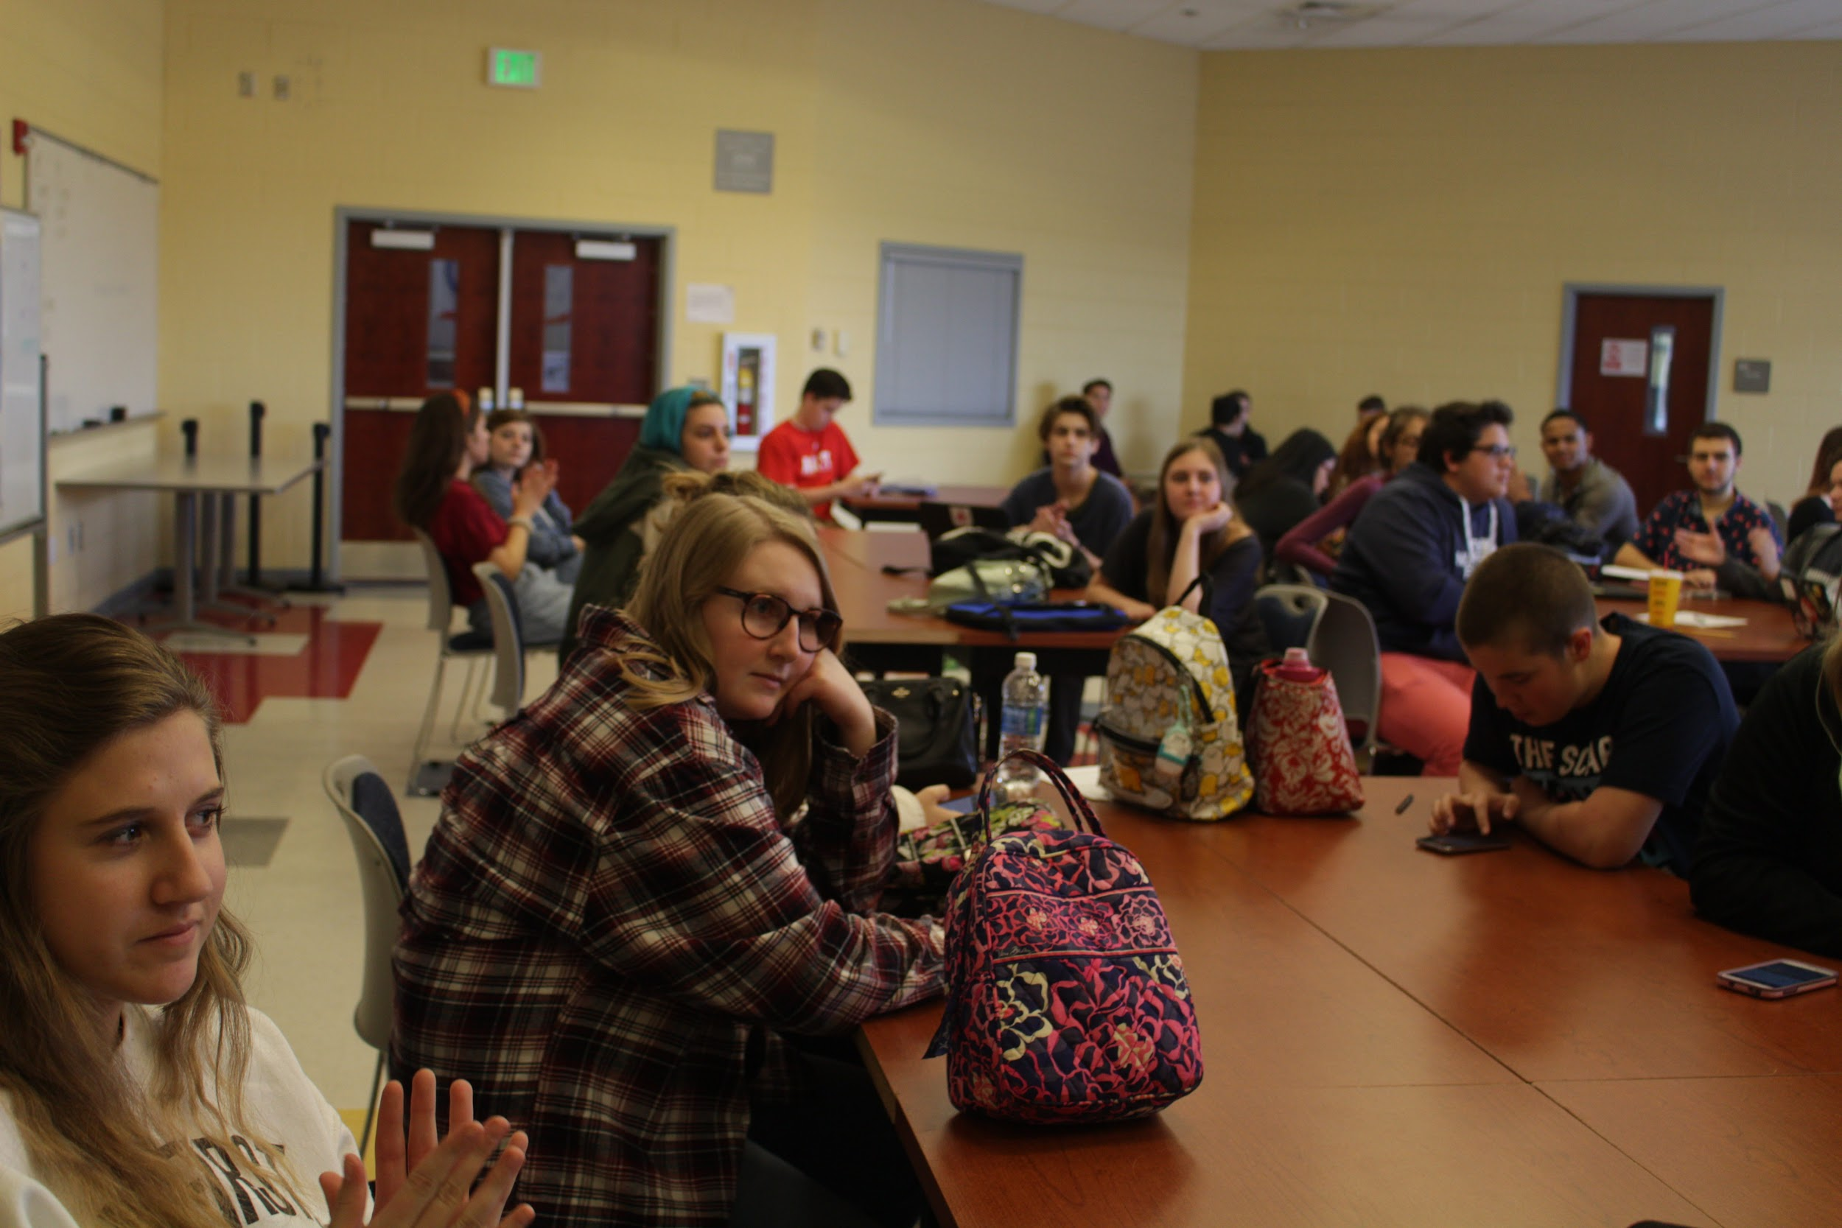
Why Join TSA?
Provides students with opportunity to gain leadership skills
Over 60 middle and high school STEM competitions
Ability to partake in community service and outreach
Notes:
Jared
Provides students with opportunity to gain leadership skills
Over 60 middle and high school STEM competitions
Ability to partake in community service and outreach

Slide 6
Learning Through Leadership: LEAP
LEAP (Leadership. Education. Achievement. Personal Growth.) is TSA’s comprehensive, three-part leadership program
Competition Engagement
Leap Legacy Chapter
Leadership Training
Notes:
Marianna
LEAP (Leadership. Education. Achievement. Personal Growth.)
three-part leadership program
LEAP is based on The Student Leadership Challenge — The Five Practices for Becoming an Exemplary Leader.
Model The Way
Inspire a Shared Vision
Challenge the Process
Enable Others to Act
Encourage the Heart
-Competition Engagement: Students demonstrate and are evaluated on leadership activities and skills as part of every TSA competition
-LEAP Legacy Chapter: Chapters submit a portfolio detailing leadership activities and skills and compete against other chapters around the nation at the national TSA conference with the goal of becoming the LEAP Legacy Chapter national winner. First through third place winning teams receive trophies and cash prizes on stage at the national TSA conference. Our AAST chapter was actually recognized at the National TSA conference for being a semifinalist
-Professional On-site Training: National TSA conference attendees have the chance to participate in on-site training at the national TSA conference.

Slide 7
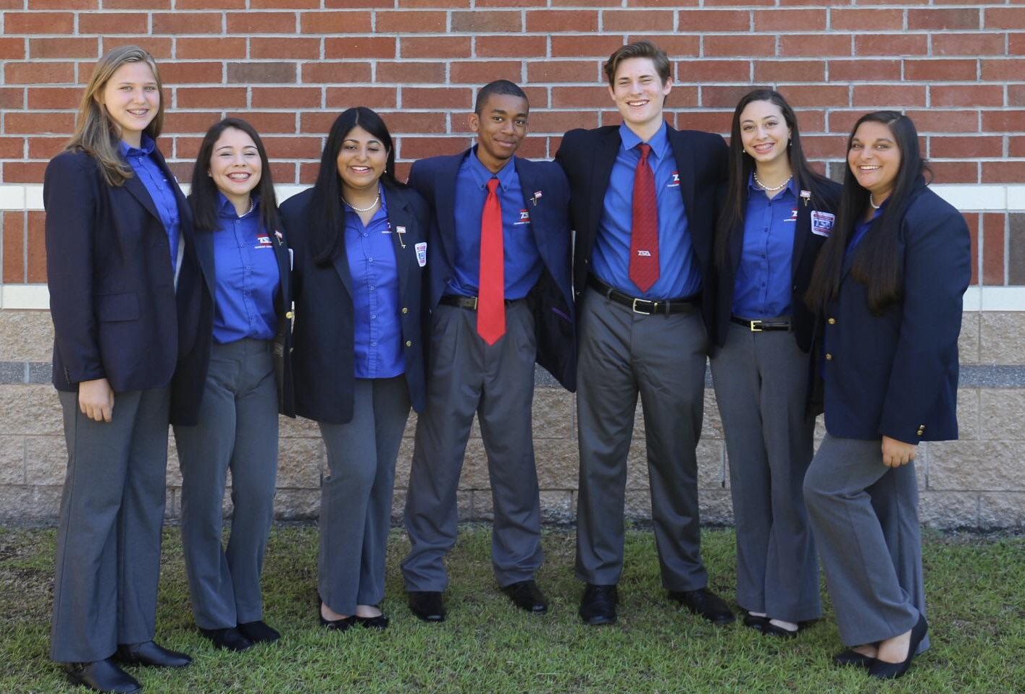
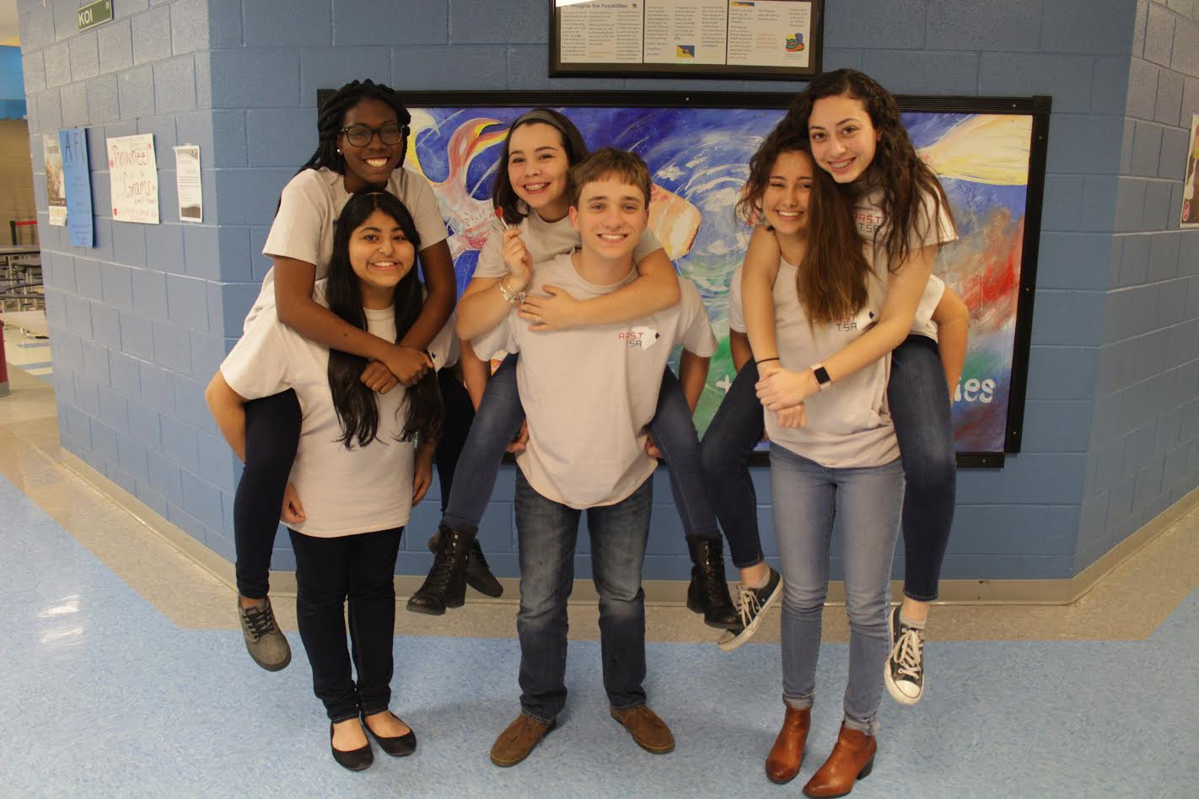
Learning Through Leadership: Running for Office
Running for a chapter, state or national office
Attain public speaking, leadership and communication skills
Notes:
Scott
Running for a chapter, state or national office
All members share experiences in serving as an officer
Attain public speaking, leadership and communication skills

Slide 8
TSA Competitions
TSA’s 60 plus competitions provide an opportunity for students to take learning outside the classroom and explore topics of interest to them
Examples of high school competitions:
Coding
Debating Technological Issues
Engineering Design
Examples of middle school competitions:
Inventions and Innovations
Medical Technology
Essays on Technology
Notes:
TSA provides students with opportunity to explore a wide variety of career interest areas in a hands-on environment that takes them outside school walls.
TSA offers over 60 middle and high school events combined − which are correlated with national STEM standards. Events range from coding to debating technological issues to engineering design to children's stories. There is a competitive event to interest nearly every student. These competitions are very impactful as they help students find their path.
TSA competitions can be integrated into and enhance STEM curriculums.

Slide 9
Computer Science
High School
Coding
Computer Integrated Manufacturing (CIM)
Software Development
System Control Design
Webmaster
Middle School
Geospatial Technology
Microcontroller Design
System Control Technology
Video Game Design
Website Design
Notes:
Baylee

Slide 10
Engineering
High School
Flight Endurance
Engineering Design
Animatronics
Architectural Design
Coding
CAD Architecture
CAD Engineering
Dragster Design
Structural Design and Engineering
Transportation Modeling
Technology Problem Solving
Middle School
Flight
CAD Foundations
Catapult Design
Construction Challenge
Dragster
Environmental Engineering
Inventions and Innovations
Junior Solar Sprint (sponsored by the army)
Mass Production
Problem Solving
Structural Engineering
Technical Design
Notes:
Thomas

Slide 11
Media
High School
Digital Video Production
Music Production
On Demand Video
Photographic Technology
Promotional Design
Video Game Design
3D animation
SciVis
Middle School
Community Service Video
Digital Photography
Promotional Marketing
STEM Animation
Notes:
Roshni

Slide 12
STE(A)M
High School
Children’s Stories
Chapter Team
Debating Technological Issues
Essays on Technology
Extemporaneous Speech
Fashion Design and Technology
Future Technology Teacher
Prepared Presentation
STEM Careers
Technology Bowl
Biotechnology Design
Middle School
Biotechnology
Career Prep
Challenging Technology Issues
Chapter Team
Children Stories
Electrical Applications
Essays on Technology
Forensic Technology
Leadership Strategies
Medical Technology
Prepared Speech
Tech Bowl
Notes:
Lorena

Slide 13
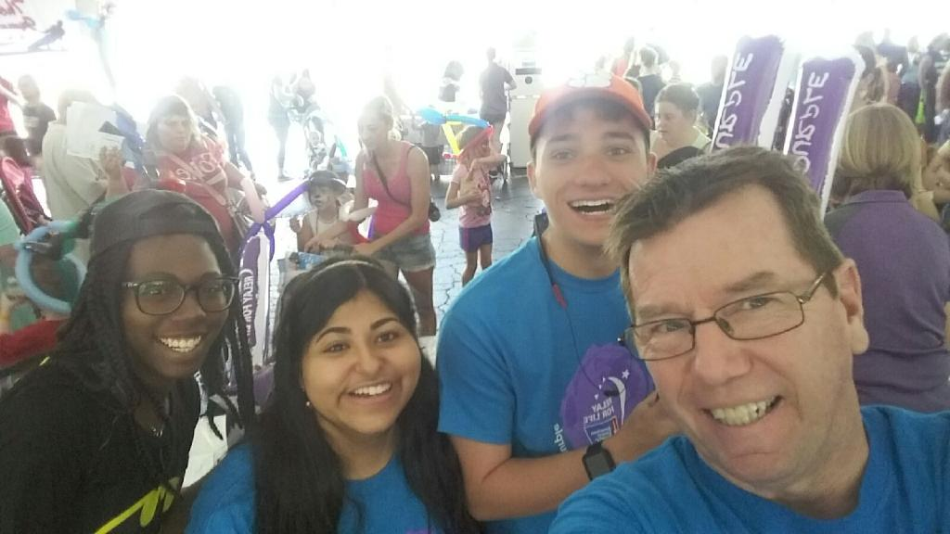
Community Service Outreach
Soles4Souls
American Cancer Society
Luminary Ceremony
ACS Relay for Life Feet
Raised over $11,000 as a state during 2016-2017 school year for ACS
Notes:
Soles4Souls - MM
American Cancer Society
Luminary Ceremony
ACS Relay for Life Feet
Raised over $11,000 as a state during 2016-2017 school year for ACS - Jaan

Slide 14
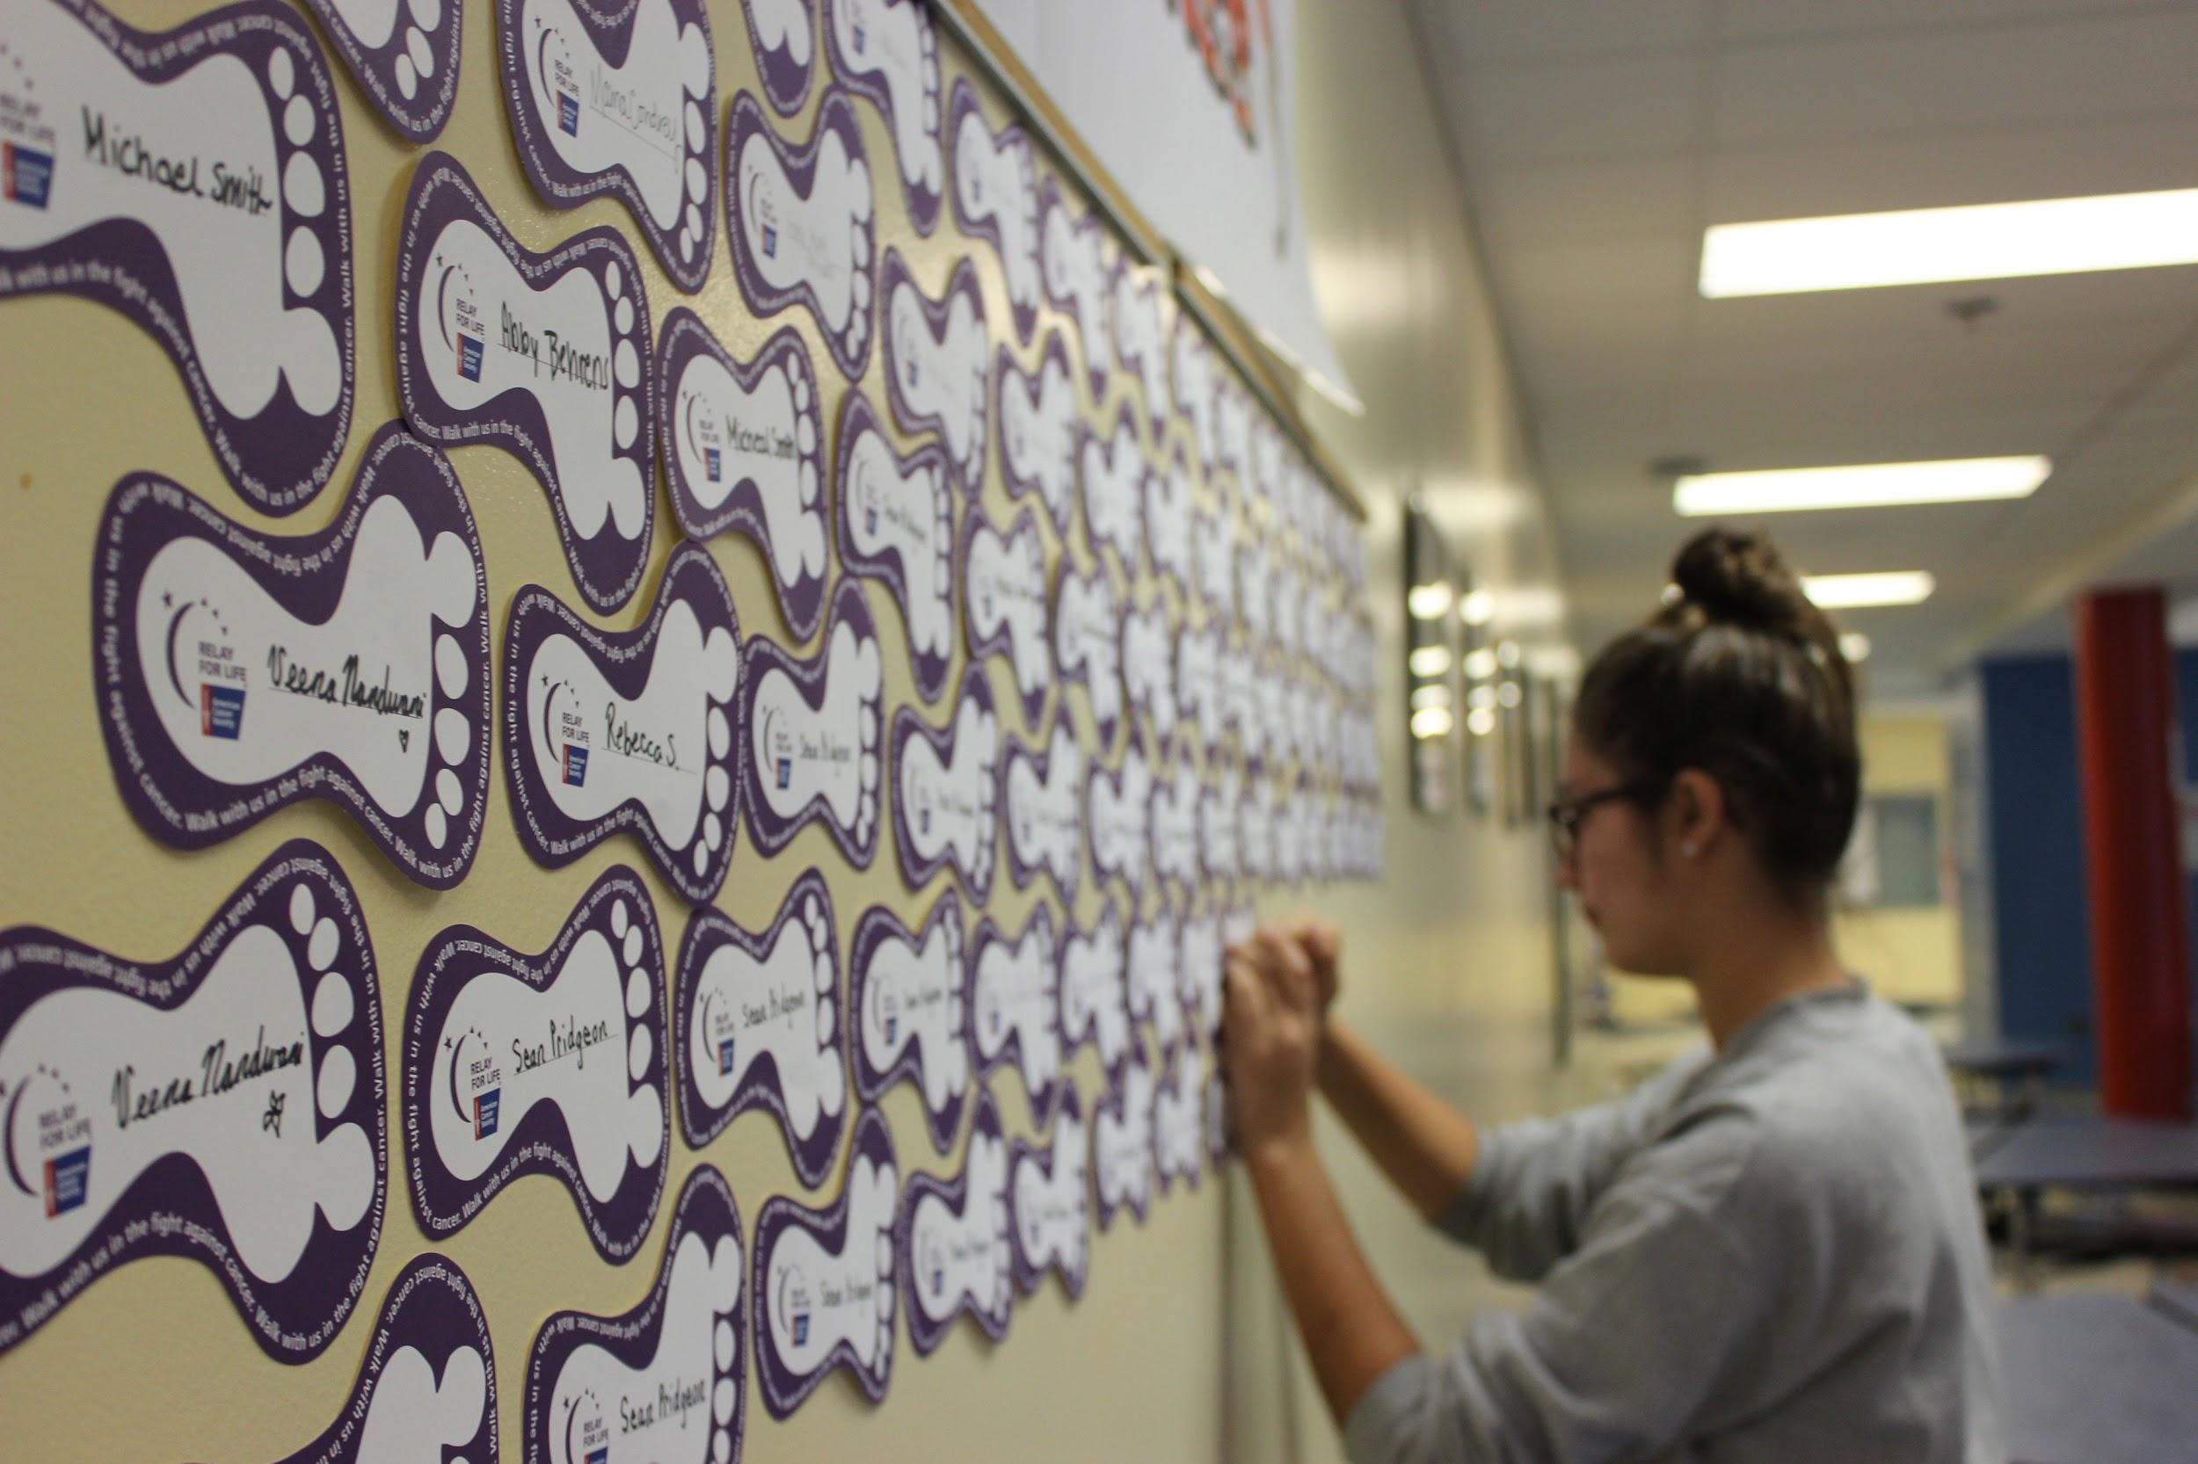
TSA Chapters
In order to have a strong TSA chapter, the chapter must have:
A motivated membership
An engaged instructor/advisor
A cooperative team of chapter officers
Endorsement of the school administration
Notes:
TSA members within a school operate as part of a TSA chapter
In order to have a strong TSA chapter, the chapter must have:
A motivated membership
An engaged instructor/advisor
A cooperative team of chapter officers
Endorsement of the school administration
In order to start a chapter, simply contact our state advisor, we can set up a meeting with a local state officer and more information will be given on the follow up process

Slide 15
Tips for Starting a New Chapter
PROMOTE, PROMOTE, PROMOTE
Contact SCTSA Officer Team to come and give a presentation at your school
Notes:
Use TSA handouts early in the year. a. TSA meeting announcement b. TSA “Making choices…” handout to invite students to attend a TSA meeting 4. Introduce competitive events early in the year so that members can get an idea of what events they may be interested in. This can be done by giving an overview of the events, but for events where it is feasible, it is more exciting to hold mini-competitions. You can continue to introduce events during the first half of the year.
During the first month of school, select key students as potential TSA members. Talk to them and their parents directly. • Have students make morning and afternoon announcements about TSA to help remind “forgetful” students about meetings and events. • Make sure to provide recognition for members throughout the year. School assemblies may provide a venue for recognizing those students who excel through TSA.

Slide 16
SC State Conference
SCTSA Conference will be in the Hilton Myrtle Beach Resort from March 23rd-25th, 2018
Meet with others from across the state
Leadership Sessions
Compete in various events
Keynote Speakers
Network with other STEM Professionals
Notes:
Jaan

Slide 17
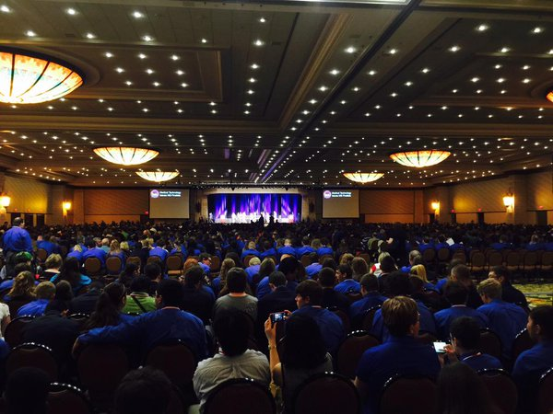
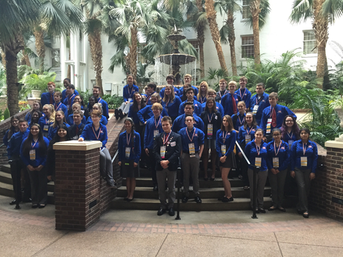
National TSA Conference
The national TSA conference is held annually at the end of the school year in June-July
Travel to new areas
Network with members from across the nation
Meet and vote for candidates
Notes:
Marianna
Best National TSA Experience-Everyone explains

Slide 18
Student Benefits
Challenging and diverse STEM competitions
Furthering career and technical skills
Attending state and national conferences
Developing teamwork and presentation skills
Participating in service projects
Recognition for accomplishments
Networking opportunities with members and industry professionals
Lifelong friends and memories
Notes:
Sum-up
Challenging and diverse STEM competitions
Furthering career and technical skills
Attending state and national conferences
Developing teamwork and presentation skills
Participating in service projects
Recognition for accomplishments
Networking opportunities with members and industry professionals
You have now heard the technical aspect of the Technology Student Association, however we would now like to share our personal TSA stories and how this organization has helped us grow!
All officers share personal story

Slide 19
Contact South Carolina TSA
Email: stateadvisor@southcarolinatsa.org
Website:
tsaweb.org southcarolinatsa.org
@officialsctsa @officialsctsa

Slide 20
Questions and Answers

