Slide 1
TDASC
TN Data and Attendance Supervisors Conference
Home School and Private School Responsibilities
September 12, 2018

Slide 2
School Choice Options
In Tennessee, parents may choose to send their child to public school or:
Home School TCA § 49-6-3050
Non-public School SBE Rule 0520-07-02
Traditional setting
Online School
Satellite/umbrella school

Slide 3
Home School Coordinators
http://www.tn.gov/education/topic/home-schooling-in-tn
Notes:
Please update contact info
Also I am planning to create a non-public contact for use when private schools are sending their lists of non-public students. Please look for an email from me.

Slide 4
LEA Responsibilities
Beginning of the School Year
Maintain annual information on all students (TCA 49-6-3007)
For Independent Home School Students:
Notify home schooling parents of their responsibilities under TCA 49-6-3050.
Collect and maintain file of students for whom you have an Intent to Home School form.
Document that parents have met the educational requirements of TCA 49-6-3050 and provide proof of student immunizations.
Notes:
Independent Home School Students wanting to play sports
August 1 – Register Intent to Home School form with LEA
August 15 - Make application for participation in athletics

Slide 5
LEA Responsibilities
Beginning of the School Year
For Students Enrolled in an Online School:
Notify parents of their responsibilities to report enrollment each year
Collect and maintain enrollment information of students enrolled in an online school

Slide 6
LEA Responsibilities
On or Around September 30
For Students Enrolled in a Non-Public School:
Receive Non-public Student Reports from private schools located in Tennessee
Collect and maintain enrollment information of students enrolled in private schools
A current listing of approved non-public schools can be found online at:
https://www.tn.gov/education/school-options/non-public-schools.html

Slide 7
Non-public School Reporting Form
Notes:
If Non-public School fails to report…

Slide 8
Student Truancy
Students in TN who are enrolled in a school that does not meet the requirements for approval are considered truant.
Independent home school students whose parents do not submit the Intent to home school form are considered truant.
Parents of school-age students who do not provide annual notice that their child is enrolled in homeschool, non-public, or online school are considered truant.

Slide 9
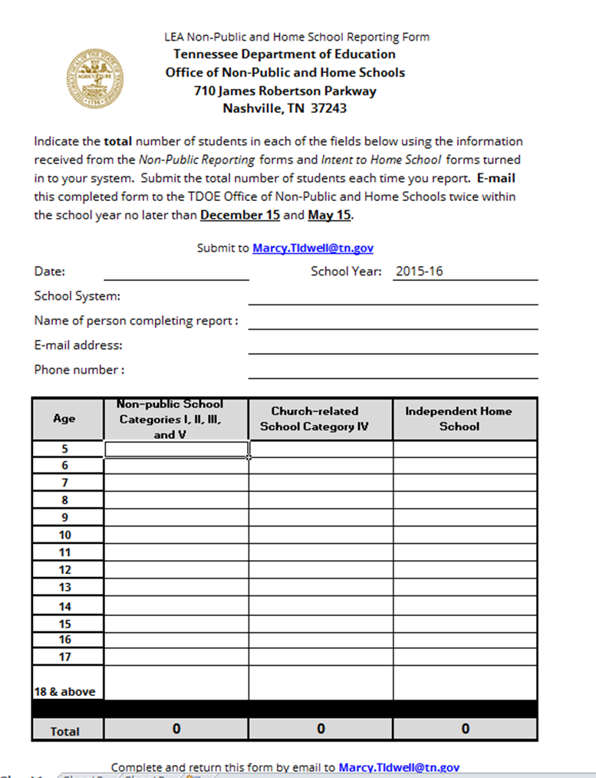
LEA Responsibilities
By December 15
Please provide TOTALS of students in all columns.

Slide 10
LEA Responsibilities
Early Spring
Notify home schooling parents of students in grades 5, 7, and 9 their child is required to be tested
Parent may choose to provide some other form of assessment rather than TCAP/EOC
Schedule testing for parents who choose TNReady
Notes:
LEA is not required to test students enrolled in Category IV church-related schools.

Slide 11
LEA Responsibilities
By May 15
Please provide TOTALS of students in all columns.

Slide 12
LEA Responsibilities
End of the School Year
Examine test results each year and establish a plan of action as described by TCA 49-6-3050 for students who do not meet the required standards.
Document attendance records for home school students.

Slide 13
Student Transfers
Category I, II, and III non-public schools (including on-line):
transcripts/credits are accepted (SBE 0520-1-3-.03)
no placement test required
Independent home school:
Student may be tested for placement or grade/class determination
Category IV & V non-public schools:
Student may be tested for placement or grade/class determination
Notes:
SBE 0520-7-1-.03
Students may transfer among public schools, or Category I, II, III non-public schools without loss of credit for completed work.

Slide 14
AP/PSAT Exams
What are the requirements for AP/PSAT testing?
The home school law requires LEAs to provide notice when AP exams are offered and allow independent homeschool students the chance to take offered AP exams. The notice shall include:
a. availability of exams
b. availability of outside financial assistance to low- income students to take the exams
The law does not require the LEA to provide additional AP exams that are not scheduled to be offered.
Notes:
Each public school that administers the AP and PSAT/NMSQT examinations shall provide notice of the dates on which the school will administer the examinations on the school's web site. The notice shall include:
(A) The availability of AP and PSAT/NMSQT examinations; and
(B) The availability of outside financial assistance to low-income and needy students to take the AP and PSAT/NMSQT examinations.
(3) Home school students shall be permitted to take the AP and PSAT/NMSQT examinations at any public school offering such examinations.
Can a home school student participate in the ACT test during the ACT Weekday test date?
No, LEAs receive no funding for home school or private school students to participate on the ACT weekday test date. The weekday opportunity is reserved for enrolled public students only.

Slide 15
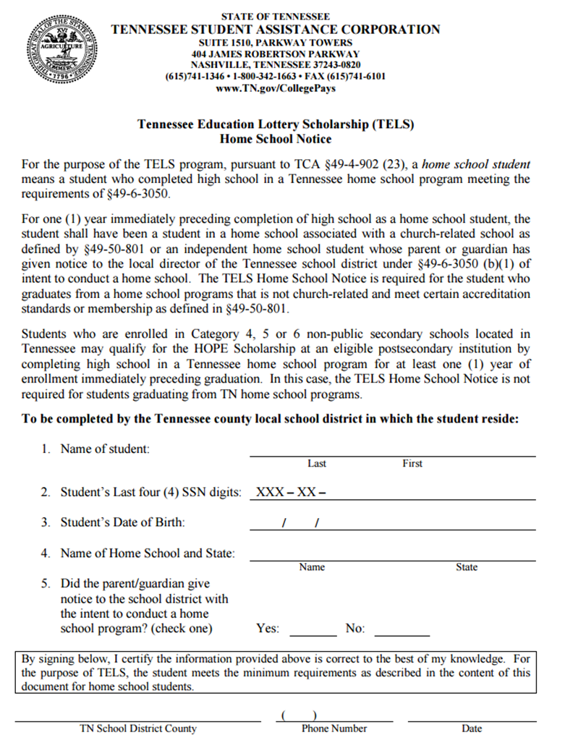
Lottery Scholarships
A student who is enrolled in a Category III online accredited school (that is not located within the state of Tennessee) must have “given notice to the school district with the intent to conduct a home school program.”
Robert Biggers Robert.Biggers@tn.gov 615-253-7453.
Notes:
This form available on the TSAC webpage

Slide 16
Documentation required for
TN Driver License
Independent Home School:
A letter from the Superintendent’s Office in the county/city of the applicant’s legal residence, confirming that the parent has registered their “Intent to Home School” form with the school system.
LEAs provide this letter ONLY for “independent” home school students
Non-Public Schools located in TN (with access to Form SF1010):
Non-public school completes a Certificate of Compulsory School Attendance (Form SF1010)
On-line Schools located outside of TN (or approved private or church schools in Tennessee without access to the SF1010 forms):
Statement from the school principal or headmaster on official school letterhead specifically confirming that the applicant is not truant and is making satisfactory progress in their school.

Slide 17
Non-public & Home School Websites
Non-Public Website:
https://www.tn.gov/education/school-options/non-public-schools.html
Home School Website:
http://www.tn.gov/education/topic/home-schooling-in-tn
PLEASE contact me if you are aware of non-public schools in operation within your districts who are not on the list or when a non-public school closes in your area.

Slide 18
Marcy Tidwell
Director of School Choice
Marcy.Tidwell@tn.gov
(615) 532-6274

