Slide 1
SEVEN MAJOR U.S. DEMOGRAPHIC TRENDS
Didow
AGING OF AMERICA www.census.gov
CONTINUED SLOWDOWN OF THE BIRTHRATE
UNEVEN REGIONAL GROWTH
NONTRADITIONAL HOUSEHOLD FORMATION
ASIAN AND HISPANIC DOMINATED IMMIGRATION www.ellisisland.org www.ancestry.com
RISING ETHNICITY AND MULTICULTURAL AWARENESS
EVOLVING SOCIAL METAPHOR FROM 1900-1960’S “MELTING POT” TO TODAY’S “SALAD BOWL”

Slide 2
The following slides draw from various sources of demographic data, including slides from Dr. John D. Kasarda’s Business Demographics series and Professor Nicholas Didow’s Consumer Behavior series
Sources are cited for most slides on the individual PowerPoint slides.
US Census Bureau www.census.gov/popclock/?intcmp=home_pop

Slide 3
US Fertility Rate
Total Fertility: Average number of births per woman over her lifetime
Source: U.S. National Center for Health Statistics. National Vital Statistics Report, Annual data World Population Data Sheet, 2011 & 2012
Notes:
Slide updated on 1/2/2013 with data from the Population Reference Bureau’s 2011 & 2012 World Population Data Sheets

Slide 4





Factors Depressing Fertility
Urbanization
More Education
Income
More Working Women
Career Pressures
Better Contraceptive Techniques
More Abortions Due to Legalization
Perceived High Costs of Children
More “Living Together” and DINKs
More Divorce
More Open Gay & Lesbian Lifestyles
Delayed Marriage
Delay of Birth of First Child
Increased Infertility
Notes:
DINKs = dual income, no kids

Slide 5

Creating a Life
2002 book from Sylvia Ann Hewlett
Based on nationally representative survey of 1,186 high-achieving career women ages 28 to 55, employed full-time or self-employed
“High-achieving” – women whose incomes place them in the top 10% for their age group
  Ages 28 to 40: at least $55,000 per year
  Ages 41 to 55: at least $65,000 per year
“Ultra-achievers” – women who make more than $100,000 per year
Notes:
Hewlett & her firm are now in an alliance with Booz & Company to “enhance their global talent pool” (May 2009) – her work, analytical skills & critical thinking are considered high value

Slide 6





Creating a Life
Percentage of women, childless at age 40, compared to men
Percent Childless, Age 40
Source: Creating A Life
Notes:
Elena Kagan, Supreme Court Justice
Diane Sawyer, ABC World News anchor
Betty White, actress
Carly Fiorina (has 2 stepchildren), business executive & politician
Oprah Winfrey, media proprietor

Slide 7
Creating a Life (cont’d)
Only 1% of high-achievers ages 41-55 had a first child after age 39
No ultra-achiever ages 41-55 had a first child after age 36
25% of childless high-achievers ages 41 to 55 still would like a child
31% of childless ultra-achievers ages 41 to 55 still want a child
89% of high-achievers under 40 believe that they will be able to get pregnant into their forties
Hewlitt – “After age 40 only 3% to 5% of those who use the new assisted reproductive technologies actually succeed in having a child, no matter how much they spend, no matter how hard they try.”
Source: Creating A Life
Notes:
Health risks to women are also much higher after 40 – recent article in Health magazine – some fertility clinics have a cut-off age of 55, while others stop at 44; risks to babies are also higher with women over 40

Slide 8
The boomer impact in the U.s.

Slide 9
Live Births, U.S.
Baby Bust
Gen X
41 million
(35-47)
Boomer
Grand-parents
44 million
(85+)
Baby Boom
78 million
(47-65)
Generation Z
61+ million
(0-17)
WWII Generation 56 million (65-85)
Baby Boomlet
Gen Y
76 million
(17-35)
1926
1946
1964
1976
1994
Source: U.S. Bureau of the Census. Historical Statistics of the United States, Colonial Times to 1970. U.S. National Center for Vital Statistics, National Vital Statistics Reports.
Notes:
Slide updated on 1/2/2013 to add 2010 data from http://www.cdc.gov/nchs/data/hestat/births_fertility_2010/births_fertility_2010.htm
Refer to class reading on “The Next 20 Years: How Customer and Workforce Attitudes Will Evolve”
with different cohorts and sizes of cohort groups as your customers, co-workers, and employees:
what are some of the things you will have to adapt to (communication styles, values, etc.)?
What adaptations do you need to start making now? 5 years from now?
From session 2 notes & Wikipedia:
Boomer grandparents: 1915-1926
WWII Generation: 1926-1946
Baby Boom 1946 – 1964
Baby Bust 1965 – 1976 (Generation X)
Baby Bulge 1977 – 1994 (Generation Y, Echo Boomers, Net Generation)
Boomer grandparents: 1915-1926; WWII Generation: 1926-1946; Baby Boomers: 1946-1964; Gen X: 1964-1976; Gen Y: 1976-1994; Millenials: 1994-

Slide 10




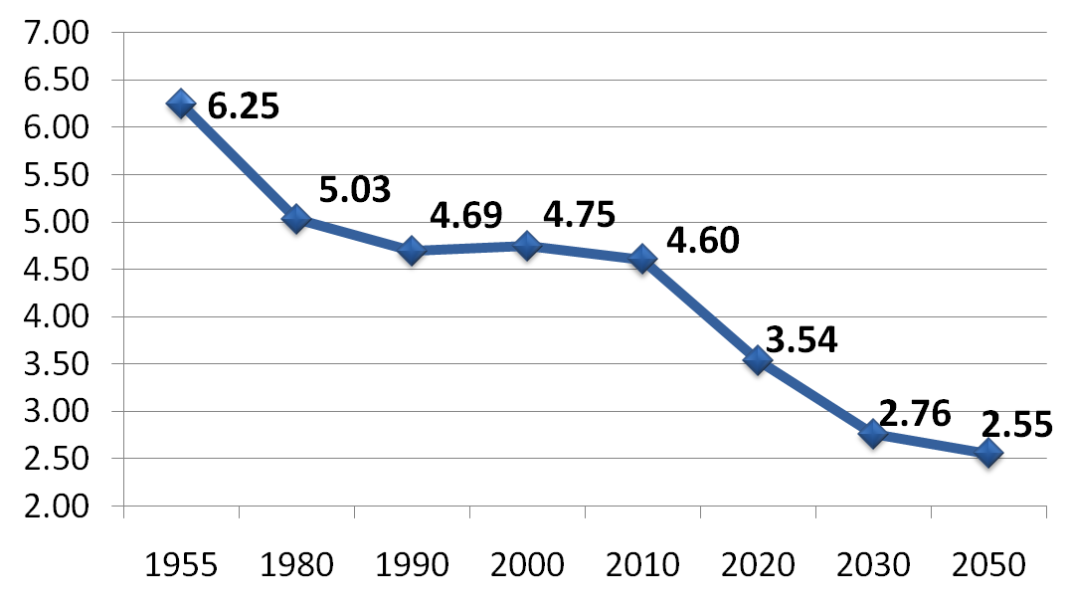
Working Life
Ratio of people ages 20-64
to people ages 65+
shrinks in coming decades!
Notes:
Source: http://www.bls.gov/opub/mlr/2009/11/art3full.pdf

Slide 11
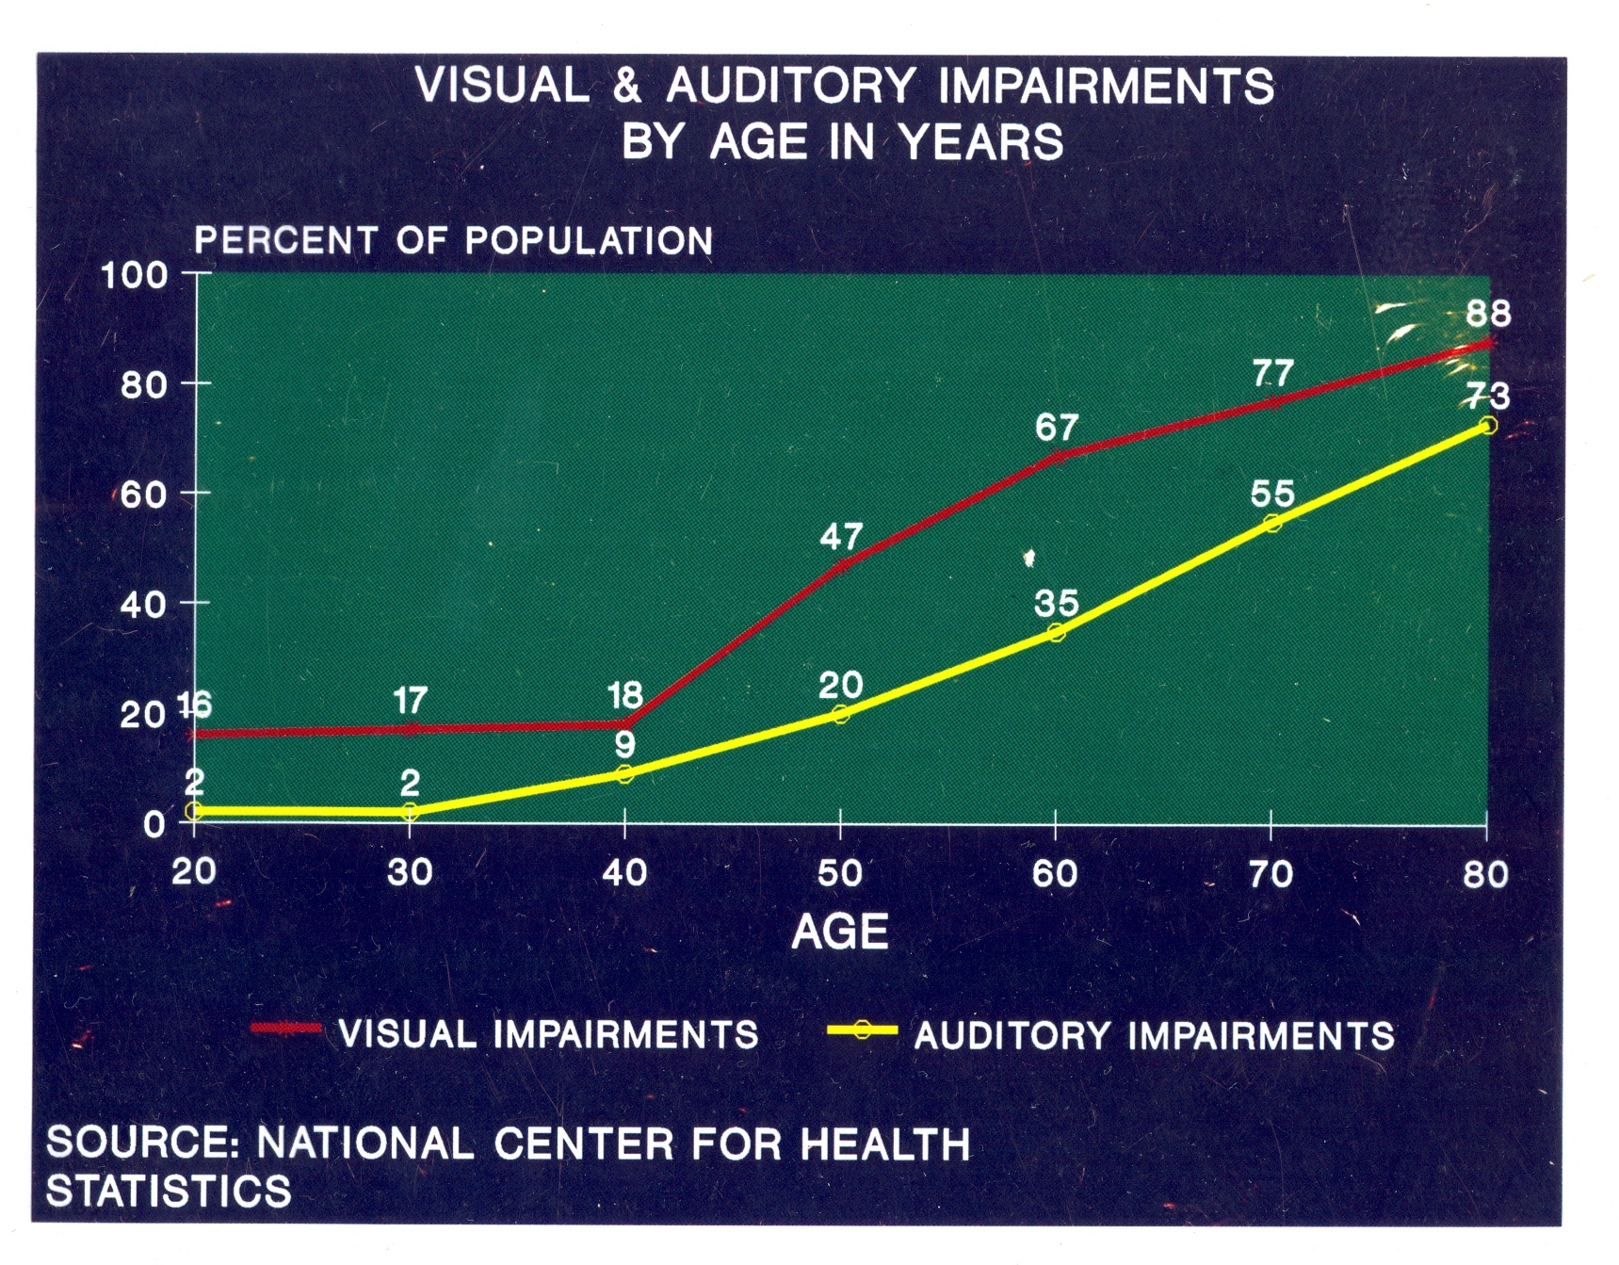

Slide 12
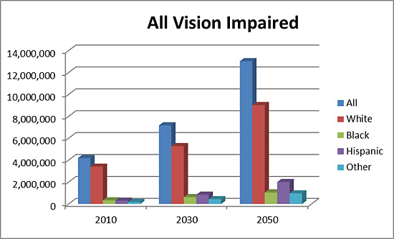
Projections for Vision Impairment
Year | All | White | Black | Hispanic | Other
2010 | 4,195,966 | 3,398,977 | 330,644 | 290,781 | 175,564
2030 | 7,169,680 | 5,277,689 | 618,110 | 840,497 | 433,383
2050 | 13,026,870 | 9,019,189 | 1,047,986 | 2,000,853 | 958,842
Notes:
Slide added 1/3/2013: National Institute of Health National Eye Institute, “Projections for Vision Impairment (2010-2030-2050).” Retrieved on 1/3/2013 from http://www.nei.nih.gov/eyedata/vision_impaired.asp#4.
Note: Vision impairment is defined as the best-corrected visual acuity less than 6/12 (‹20/40) in the better-seeing eye (excluding those who were categorized as being blind by the U.S. definition.)
The category "All Vision Impairment" includes both low vision and blindness.

Slide 13
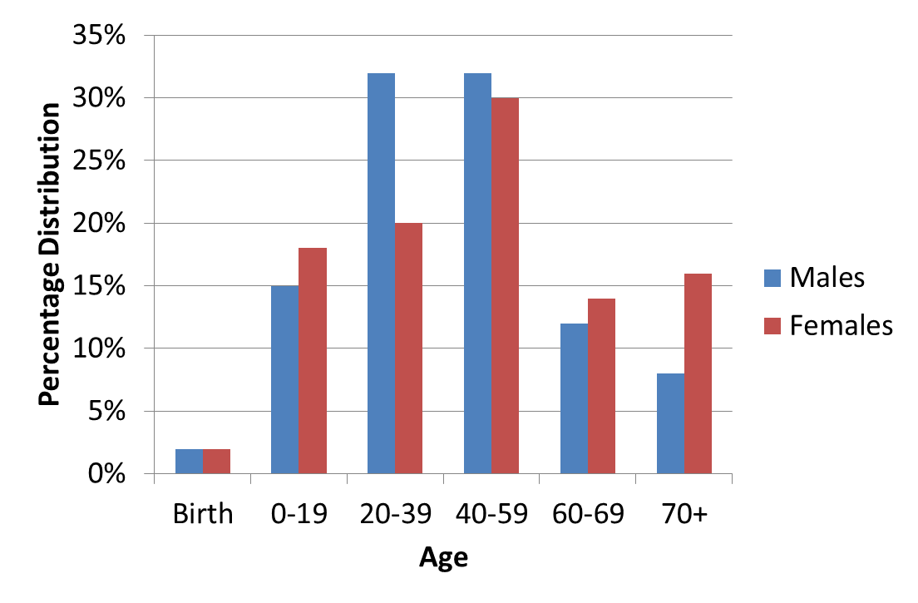
Age at Which Hearing Loss Begins
Notes:
Slide added on 1/3/2013, http://www.nidcd.nih.gov/health/statistics/Pages/begins.aspx
This chart shows the age at which hearing loss begins, based on subjects' report of any permanent hearing loss, with percentage distribution by sex (gender) and age.
Source: National Health Interview Survey, 2007. Chart created by the NIDCD Epidemiology and Statistics Program. Updated in November 2012.
Males Females
Birth 2% 2%
0-19 15% 18%
20-39 32% 20%
40-59 32% 30%
60-69 12% 14%
70+ 8% 16%

Slide 14


Slide 15


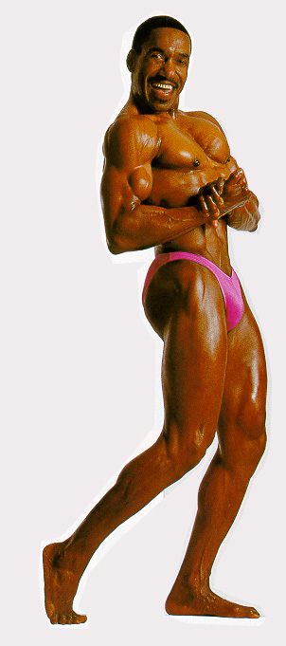


Maintaining Vitality and Appearance
Sam Gadless
Ran the NYC
Marathon at age 90
Harry Scott (Great Scott!)
At Age 65
174 pounds (8% fat)
30in waist
44in chest
17in biceps
Cher
age: 64 at 2010 MTV Music Video Awards
“Banana” George Blair
Living life with intensity at 80
Tina Turner
age: 71
On tour in 2008!
15
Notes:
“Banana” George Blair – Living Life with Intensity at 80
Reading for class on “Disruptive Demographics” – if you’re interested in consumer products, real estate, sustainability: how are you going to design for the huge market segment of the aging population? Housing (location, architecture), products for living at home longer, transportation, etc.
Blair born 1/22/1915 – still alive in Aug. 2009 - http://www.bananageorge.com/about.html
Banana Blair still alive. 24/8/2010
Cher’s age updated 24/8/2010

Slide 16
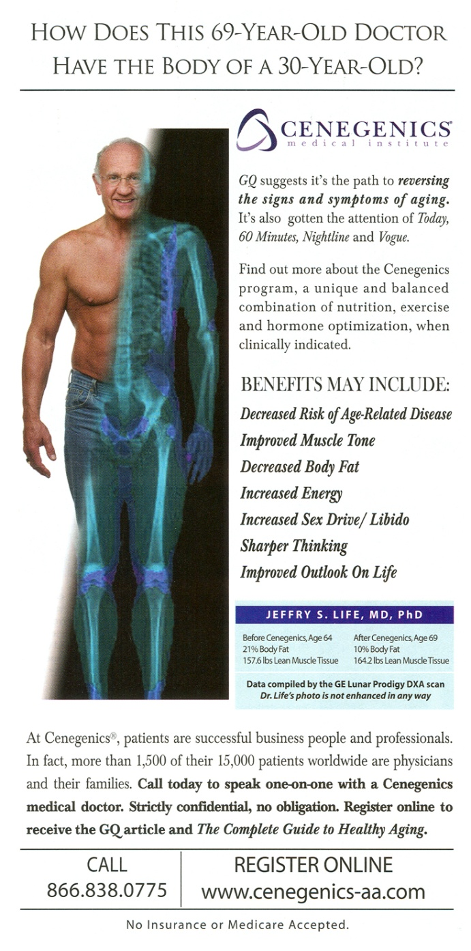
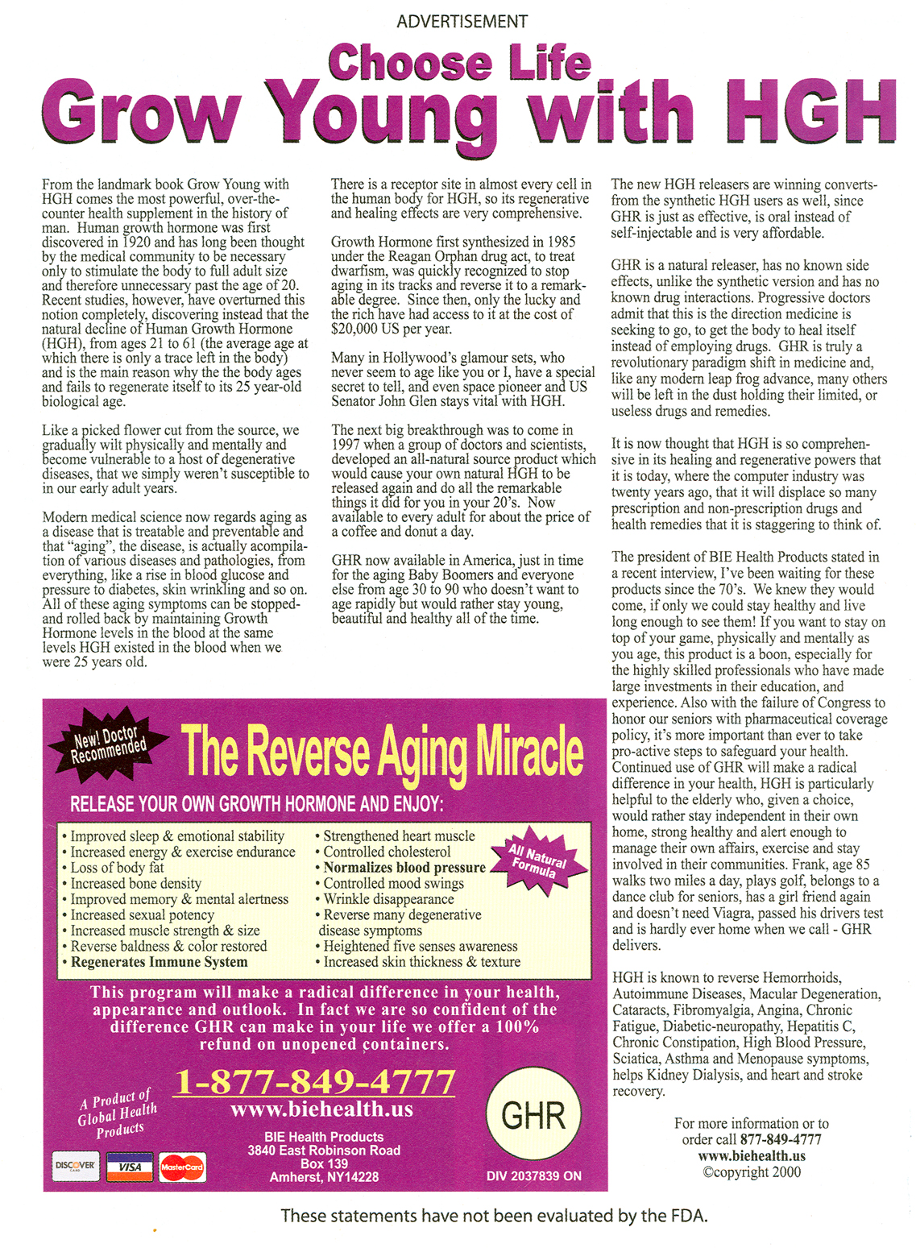
Aging: Quest for Youth
16
Notes:
Question for students: What products or services would you see being generated as the “pig in the python” goes to 55+?

Slide 17
BIRTH DEARTH:
THE GRAYING OF
THE INDUSTRIAL WORLD

Slide 18
Fertility Trends in Four Industrialized
Countries: 1950-2010
18
Source: World Bank. World Population Projections: 1994-95; 2002 World Development Indicators; Population Reference Bureau; 2010 World Population Data Sheet
Notes:
Slide updated on 1/2/2013 to include 2010 data.
18

Slide 19
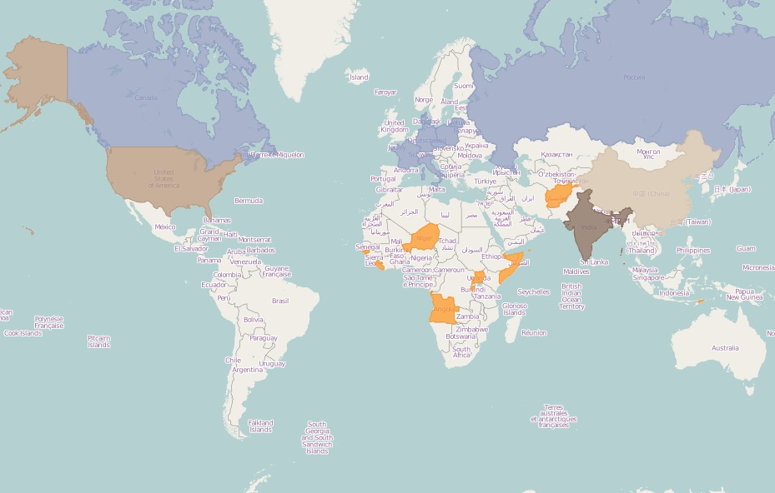
2010 World Fertility Rates
Total Worldwide = 2.5
Russia 1.5
Canada 1.7
Poland 1.4
Germany 1.3
France 2.0
U.S. 2.0
Italy 1.4
Afghanistan 5.7
China 1.5
Niger 7.4
India 2.6
Guinea-Bissau 5.8
Somalia 6.5
Liberia 5.9
Uganda 6.5
Angola 5.8
Source: Population Reference Bureau, 2010 World Population Data Sheet, http://www.prb.org/Datafinder/Topic/Map.aspx?variable=93
Notes:
September 2010: China may relax its one-child rule (USA Today: http://www.usatoday.com/news/world/2010-09-09-1Achinaonechild09_ST_N.htm)
“In 2011, China will start pilot projects in five provinces, all of which have low birth rates, to allow a second birth if at least one spouse is an only child, says He Yafu, an independent demographer who is in close contact with policymakers.
“Beijing, Shanghai and four other provinces will follow suit in 2012, with nationwide implementation by 2013 or 2014, he says.”

Slide 20
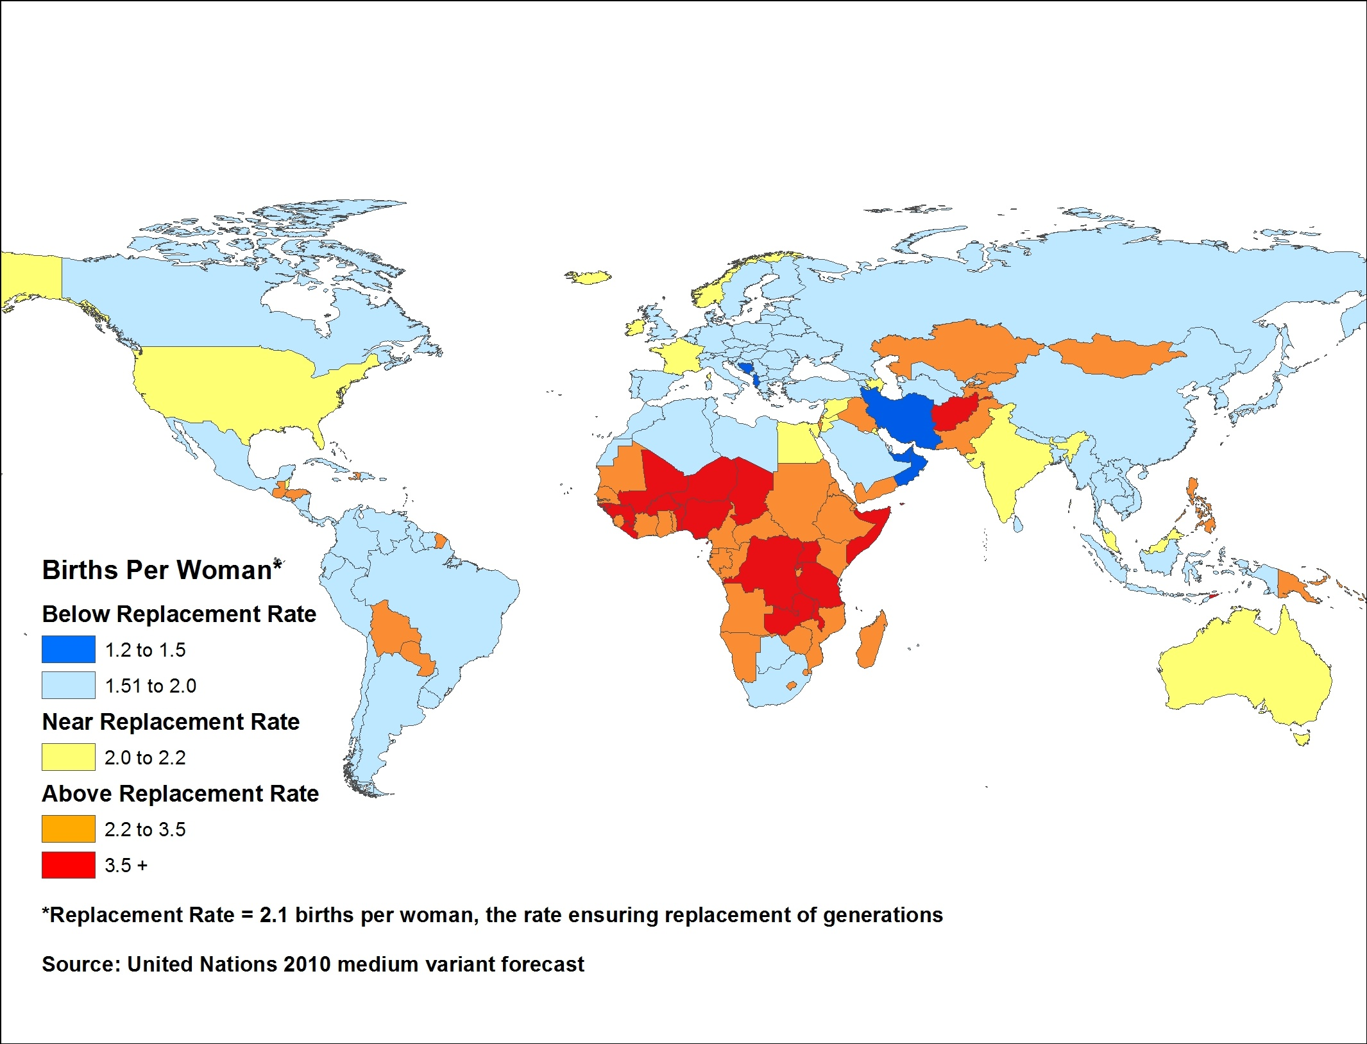
Fertility Worldwide: 2030-2035
Source: Kenan Institute of Private Enterprise/UN
Notes:
Slide updated on 1/9/2013
New map reflects the United Nations’ World Population Prospects, 2010 Revision.
Data source: http://esa.un.org/wpp/Excel-Data/fertility.htm
Map created using GeoCommons and ArcMap.

Slide 21
Distribution of World Births by Country
Other = about 220 countries
Source: US Census Bureau, International Database
Notes:
Updated 1/7/2013 to change 1996 graph to 2010.

Slide 22
World’s 10 Most Populous Nations:
2012 & 2050
2012 |  | Rank | 2050
Country | Population (millions) |  | Country | Population (millions)
China | 1,350 | 1 | India | 1,691
India | 1,260 | 2 | China | 1,311
United States | 314 | 3 | United States | 423
Indonesia | 241 | 4 | Nigeria | 402
Brazil | 194 | 5 | Pakistan | 314
Pakistan | 180 | 6 | Indonesia | 309
Nigeria | 170 | 7 | Bangladesh | 226
Bangladesh | 153 | 8 | Brazil | 213
Russia | 143 | 9 | Congo, Dem. Rep. | 194
Japan | 128 | 10 | Ethiopia | 166
Source: Population Reference Bureau, 2012 World Population Data Sheet
.
Notes:
Slide updated on 1/2/2013 with data from the Population Reference Bureau’s 2012 World Population Data Sheet: http://www.prb.org/pdf12/2012-population-data-sheet_eng.pdf

Slide 23


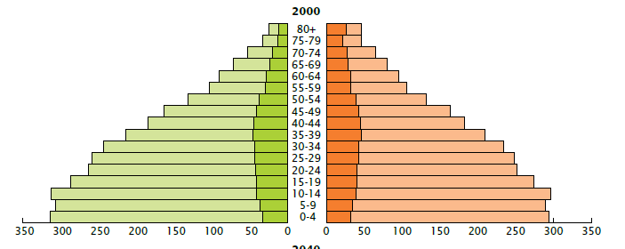
Age Distribution of the World’s Population, by Age and Sex, 2000 (in millions)
Sources: United Nations Department of Economic and Social Affairs, 2007b; and U.S. Census Bureau, International Data Base, accessed on December 28, 2007.
Notes:
http://esa.un.org/unpp/index.asp?panel=2

Slide 24
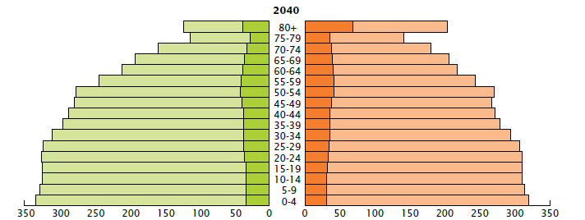
Age Distribution of the World’s Population, by Age and Sex, 2040 (in millions)
Sources: United Nations Department of Economic and Social Affairs, 2007b; and U.S. Census Bureau, International Data Base, accessed on December 28, 2007.
Notes:
http://esa.un.org/unpp/index.asp?panel=2

Slide 25
Whose Population is Aging the Fastest?
25
Source: United Nations Population Division. World Population Prospects, the 2010 Revision.
Notes:
Slide updated on 1/9/2013
Replaced selected country table with graph comparing regional median age projections.
Data source: http://esa.un.org/wpp/Excel-Data/population.htm
25

Slide 26
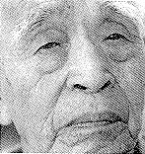
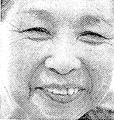
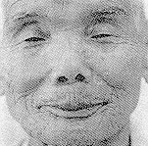



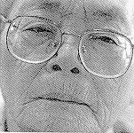

Japan: Face of the Future
Source: New York Times, September 2, 1997.

Slide 27
World Population Growth Through History
Billions
12
11
2100
10
9
Modern
8
Old
Age
Stone
Bronze
Iron
Middle
7
Age
New Stone Age
Age
Age
Ages
6
2000
Future
5
4
1975
3
1950
2
1900
1
Black Death
—
The Plague
1800
1+ million
7000
6000
5000
4000
3000
2000
1000
A.D.
A.D.
A.D.
A.D.
A.D.
A.D.
years
B.C.
B.C.
B.C.
B.C.
B.C.
B.C.
B.C.
1
1000
2000
3000
4000
5000
Source: Population Reference Bureau; and United Nations, World Population Projections to 2100 (1998).

Slide 28
World Population Growth, in Billions
Number of years to add each billion (year)
All of Human History
(1800)
130 (1930)
30 (1960)
15 (1975)
12 (1987)
12 (1999)
14 (2013)
14 (2027)
21 (2048)
Sources: First and second billion: Population Reference Bureau. Third through ninth billion: United Nations, World Population Prospects: The 2004 Revision (medium scenario), 2005.

Slide 29
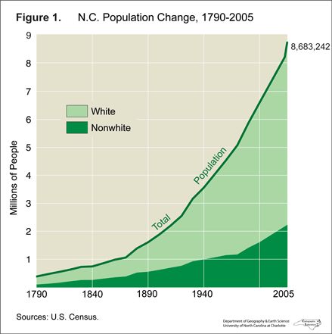

Slide 30
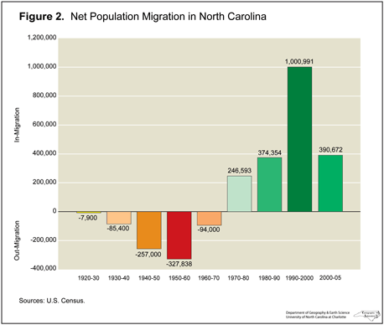

Slide 31
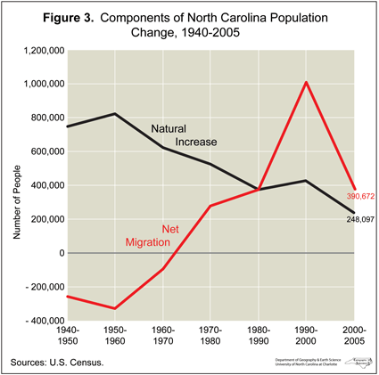

Slide 32
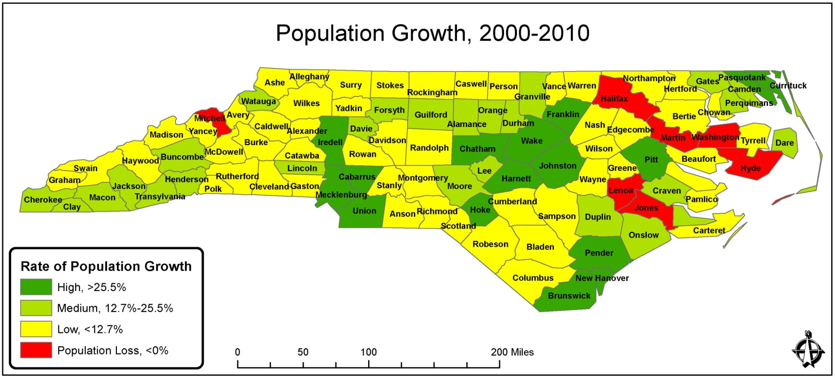
NC Population Growth, 2000-2010
Source: NC Office of State Budget and Management
Notes:
Slide updated on 1/7/2013 to change 1990-2000 map to 2000-2010 map.
Source: NC Office of State Budget and Management, Growth Maps 2000-2010
http://www.osbm.state.nc.us/ncosbm/facts_and_figures/socioeconomic_data/population_estimates/county_projections.shtm
http://www.osbm.state.nc.us/ncosbm/facts_and_figures/socioeconomic_data/population_estimates/demog/20002010growthmig.pdf

Slide 33
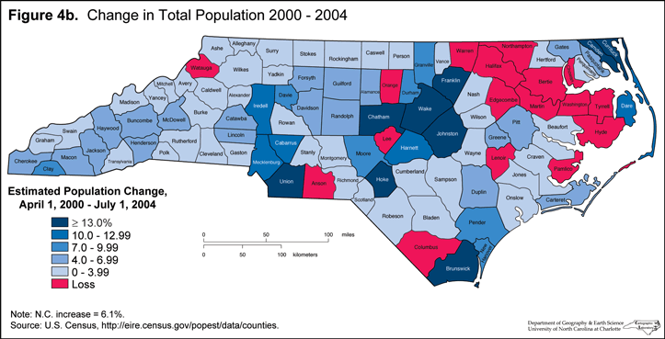

Slide 34
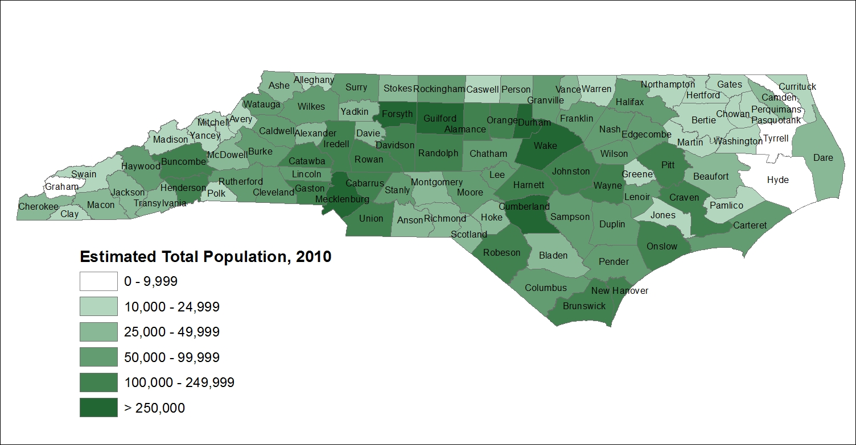
NC Population, 2010
2010 Total Population = 9,535,483
Notes:
Slide updated on 1/7/2013 to update population map to reflect 2010 data.
Data source: Census Bureau via LINC NC
Map produced using ESRI ArcMap

Slide 35
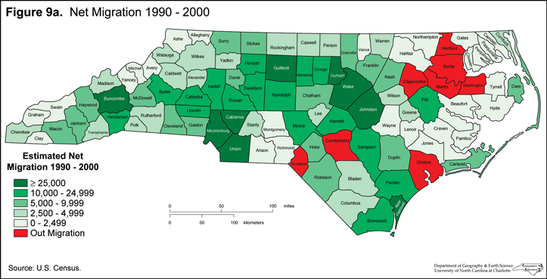

Slide 36
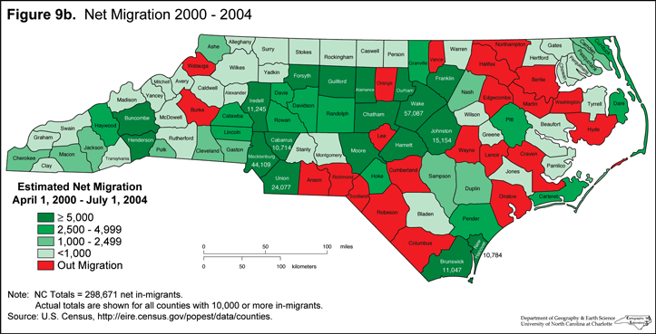

Slide 37
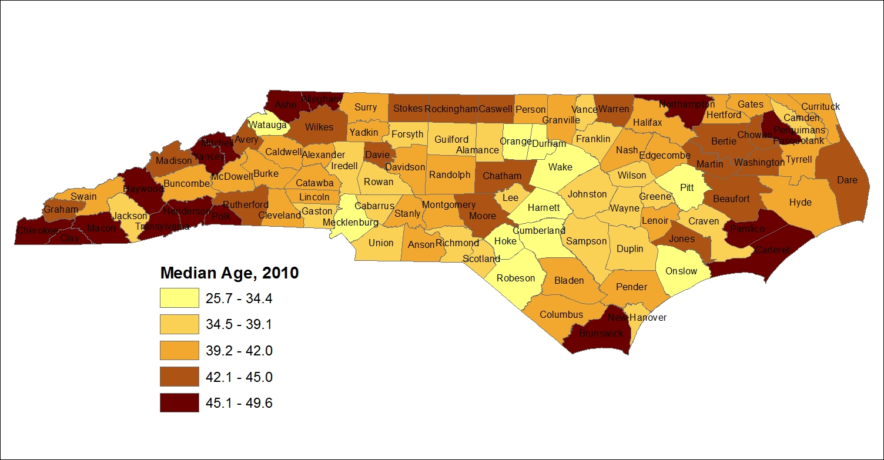
NC Median Age, 2010
The median age in 2010 was 37.4 years old.
Source: Kenan Institute of Private Enterprise/US Census Bureau
Notes:
Slide updated on 1/7/2013 to update median age map to reflect 2010 data.
Data source: Census Bureau via LINC NC
Map produced using ESRI ArcMap
State median age = 37.4 (2010 Census Demographic Profile for North Carolina: http://www.census.gov/newsroom/releases/archives/2010_census/cb11-cn139.html)

Slide 38
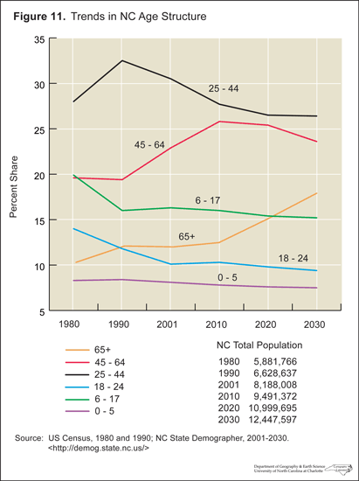

Slide 39
The Population of NC is Getting Older
Older adults are North Carolina's fastest growing segment of the population.
Reasons include: decreasing birth rates, improved life expectancies, and migration.
Next 3 slides illustrate the statewide trend

Slide 40
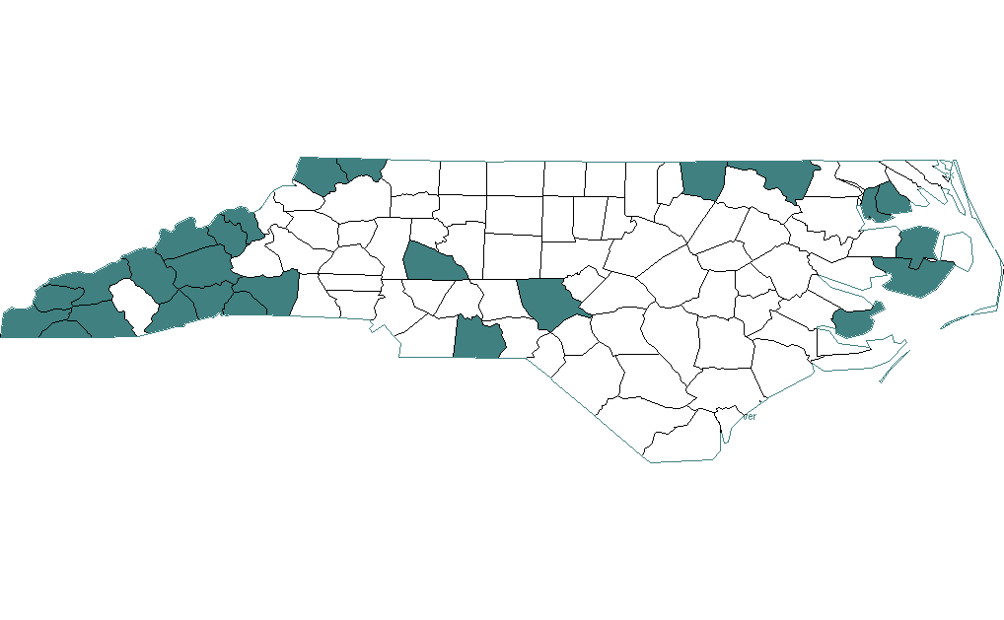
65+ Population in 1990
Counties with more than 15% of total population over age 65
Statewide:
12%
Source of data: NC Office of State Demographics, Census 1990
Prepared by the UNC Institute on Aging; Last updated: June 2001

Slide 41
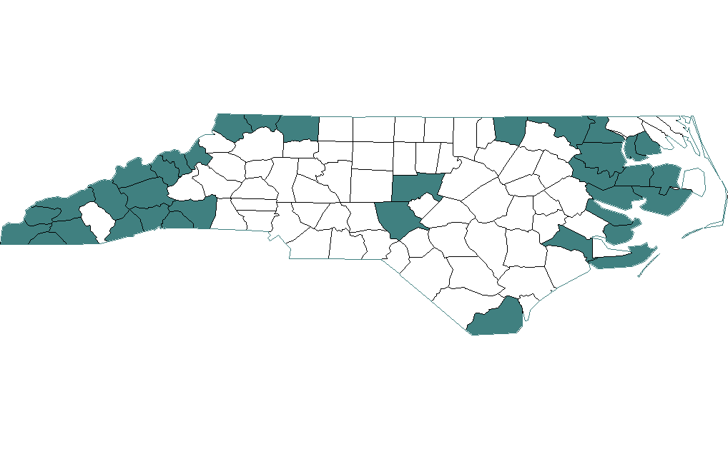
65+ Population in 2000
Counties with more than 15% of total population over age 65
Statewide:
12%
Source of data: NC Office of State Demographics, Census 2000
Prepared by the UNC Institute on Aging; Last updated: October 2007

Slide 42
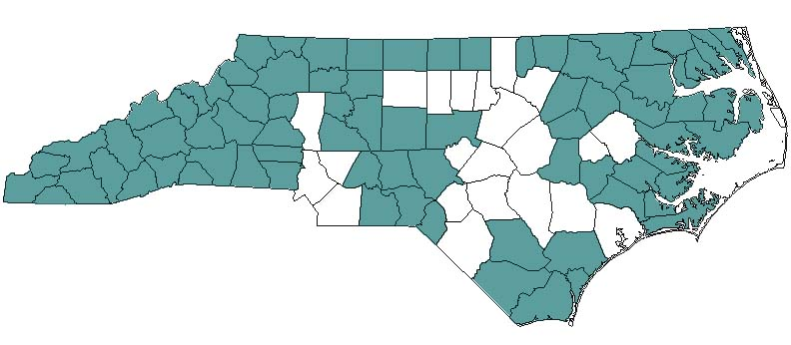
65+ Population in 2020
Counties projected to have more than 15% of total population over age 65
Statewide:
15%
Source of data: NC Office of State Demographics, projection
Prepared by the UNC Institute on Aging; Last updated: October 2007
Notes:
Slide updated on 1/4/2013 to reflect updated projection. Retrieved from www.aging.unc.edu/infocenter/slides/ncaging.ppt (slide 5).

Slide 43
Population Shift in North Carolina
Percent of Population by Age Groups (1970-2030)
Source of data: US Census Bureau Projections & NC State Demographics Unit
Prepared by the UNC Institute on Aging; Last updated: 2007
Notes:
Slide updated on 1/4/2013 to replace 2001 chart with 2007 version. Slide 6 from www.aging.unc.edu/infocenter/slides/ncaging.ppt.
Source of data: US Census Historical Annual Time Series of State Population Estimates, (1970-1980). North Carolina State Demographics Unit. “1990 County Census Totals by Age,” (1990). “Estimated 2000 County Totals by Age,” (2000). “Projected County Totals - Adult Age Groups,” (2010-2030). http://demog.state.nc.us/.
Last updated April 2007.

Slide 44
Life Expectancies in North Carolina (at Birth)
Source of data: NC State Demographics Unit
Prepared by the UNC Institute on Aging; Last updated: 2007
Notes:
Slide updated on 1/4/2013 to replace 2001 chart with 2007 version. Slide 7 from www.aging.unc.edu/infocenter/slides/ncaging.ppt.

Slide 45
Life Expectancies in North Carolina (At Age 65)
Source of data: NC State Demographics Unit
Prepared by the UNC Institute on Aging; Last updated: 2007
Notes:
Slide updated on 1/4/2013 to replace 2001 chart with 2007 version. Slide 8 from www.aging.unc.edu/infocenter/slides/ncaging.ppt.

Slide 46
Search for “Life Expectancy CIA”
www.cia.gov/library/publications/the-world-factbook/index.html

Slide 47
More Older Women than Older Men
Percent of NC population by Gender and Age in 2012
Female
51.0%
Female
59.9%
Female
74.1%
Source: North Carolina Office of State Budget and Management
Notes:
Slide updated 1/4/2013 to update 2001 data to 2012 data.
Data from Age, Race, and Sex Projections (Age Groups – Female, July 2012) and (Age Groups – Male, July 2012) both released December 2012. http://www.osbm.state.nc.us/ncosbm/facts_and_figures/socioeconomic_data/population_estimates/county_projections.shtm
All ages Population % of Population
Male 4,761,189 48.7%
Female 5,019,551 51.3%
Total 9,780,740
Age 65+
Male 579,960 43.0%
Female 769,202 57.0%
Total 1,349,162
Age 85+
Male 50,411 31.1%
Female 111,527 68.9%
Total 161,938
According to the NC Legislative Study Commission on Aging: “Older women represent 58.7 percent of the 65+ age group and 70.9 percent of the 85+ age group.”
[US Administration on Aging (2008). Population for States by Age Group: July 1, 2007 “ files stterr2007.xls:2007-50+x5,“
“stterr2005.xls:2007-50+x5-M” and “stterr2007.xls:2007-50+x5-F”]

Slide 48
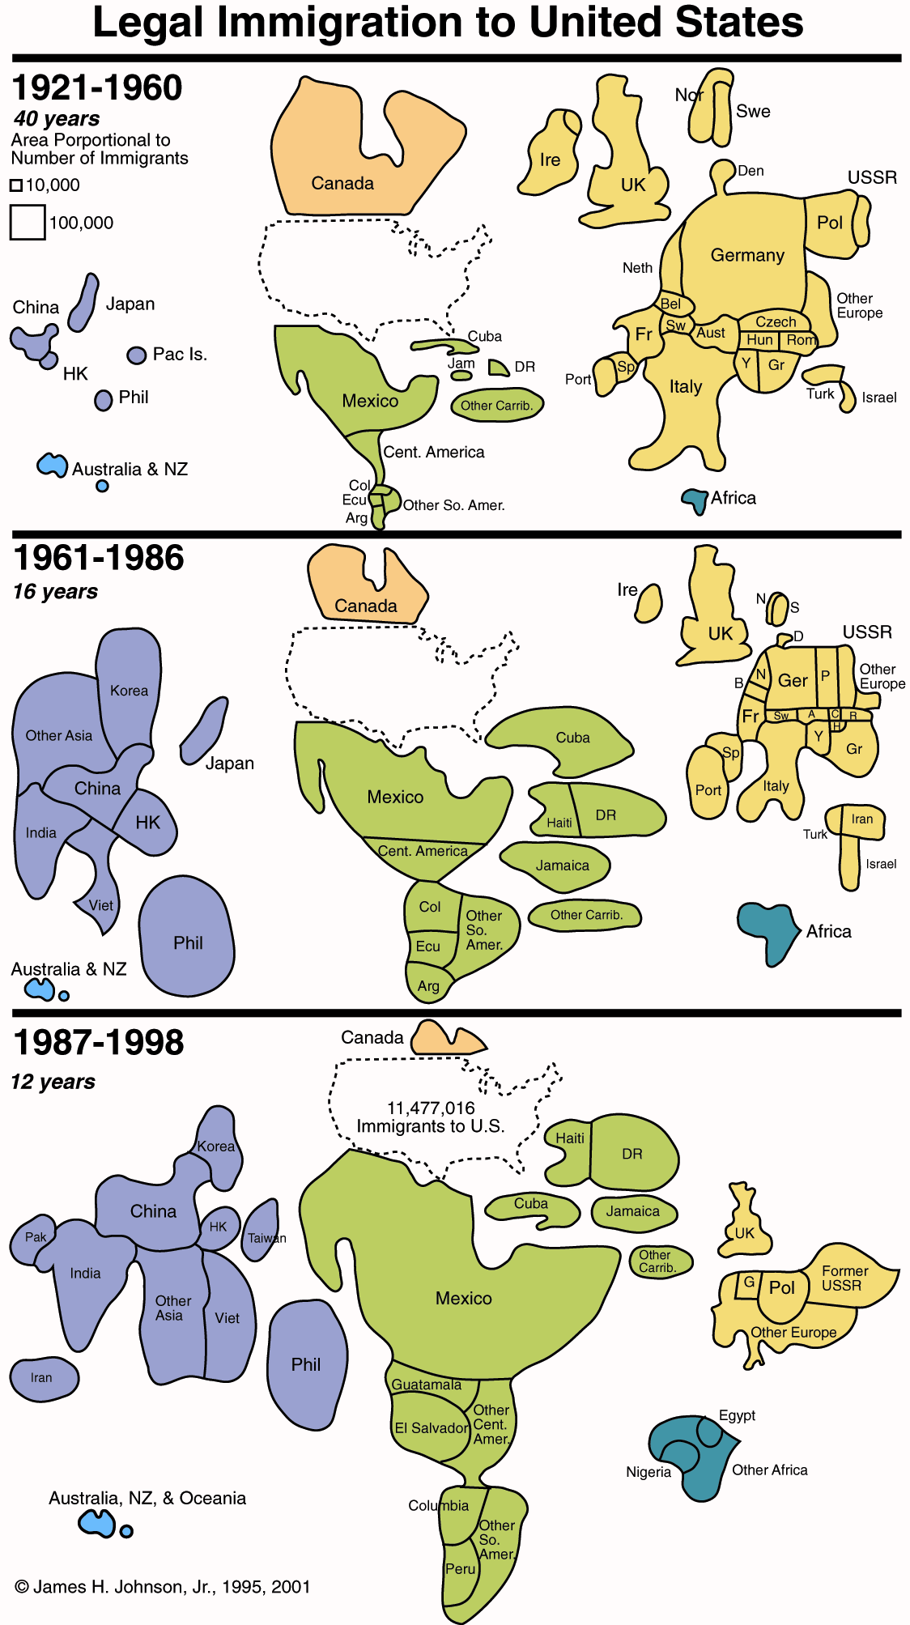

Slide 49
Immigration Population: 1900-2010
Source: Center for Immigration Studies
Notes:
Slide updated on 1/4/2013 to add 2010 data
http://cis.org/2012-profile-of-americas-foreign-born-population (Figure 1, Immigrants in the United States, Number and Percent, 1900-2010)

Slide 50
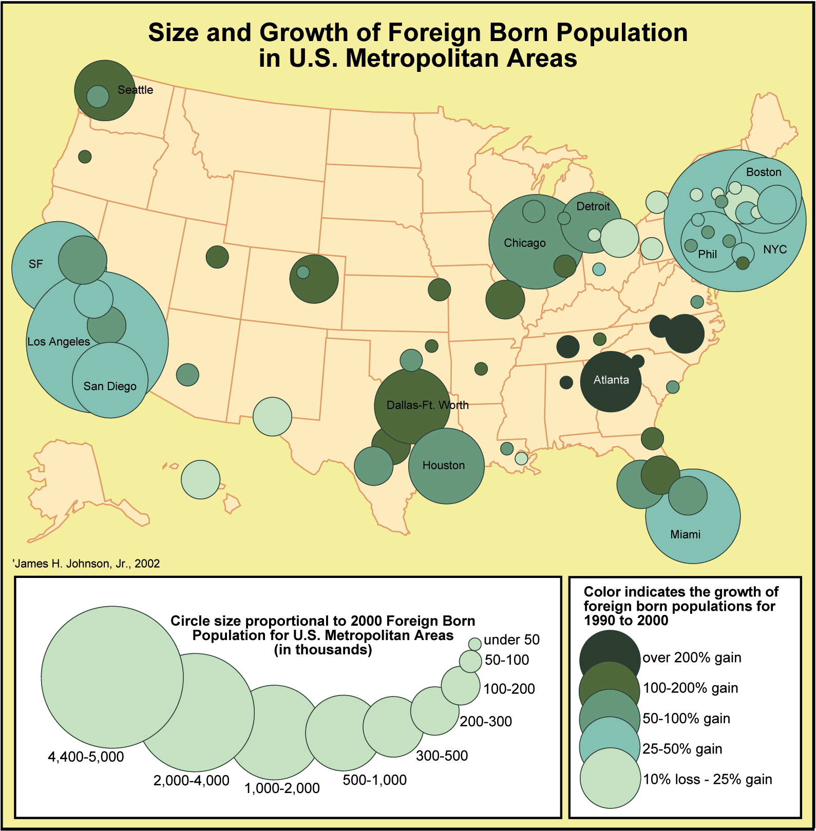
Notes:
As you can see from this slide, in a number of states, including CA, Illinois, New York, Pennsylvania, and New Jersey, the white population actually declined during the 1990s. What this means is that all of the population growth in these areas was due to increases in the nonwhite population. In nearly every state, except for a few in the mountain region, New England, and in Appalachia, nonwhite population increases accounted for more than half of new population growth.

Slide 51
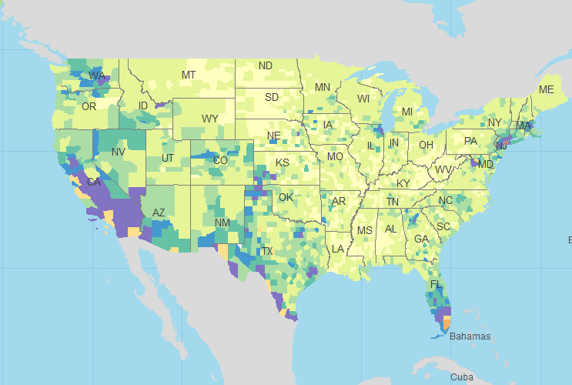
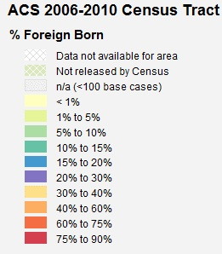
Foreign Born Population
Source: Social Explorer/American Community Survey data
Notes:
Slide added on 1/9/2013
ACS 2006-2010 Census Tract - % Foreign Born
Source: Social Explorer (http://www.socialexplorer.com/pub/maps/map3.aspx?g=0&mapi=SE0012)

Slide 52
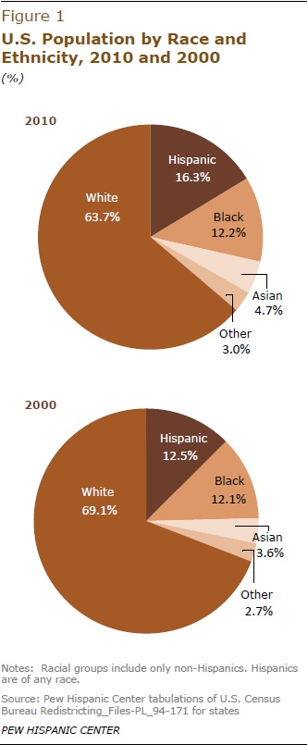
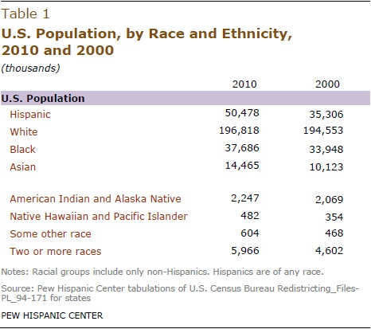
Ethnic Population Growth
Notes:
Slide updated on 1/9/2013
Replaces 1990-2002 NC ethnic population growth figure with figures from Pew that illustrate ethnic changes that took place in the U.S. between 2000 and 2010.
Source: Passel, Jeffrey; D’Vera Cohn and Mark Hugo Lopez. “Census 2010: Hispanics Account for More than Half of Nation’s Growth in Past Decade.” March 24, 2011. http://www.pewhispanic.org/2011/03/24/hispanics-account-for-more-than-half-of-nations-growth-in-past-decade/

Slide 53
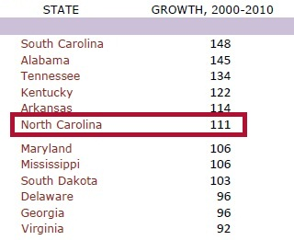
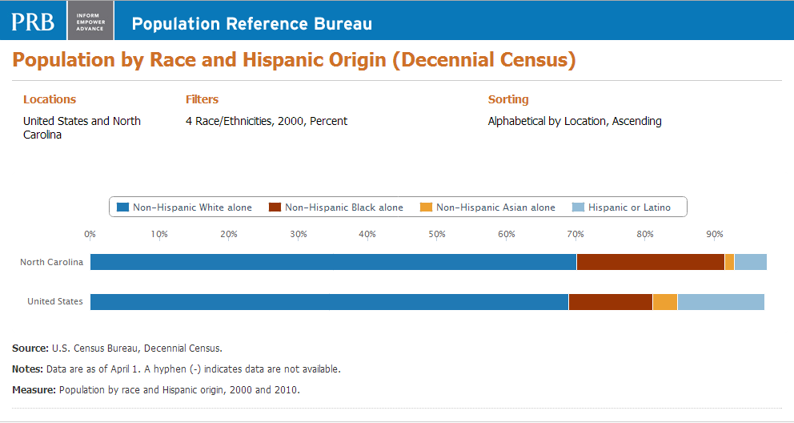
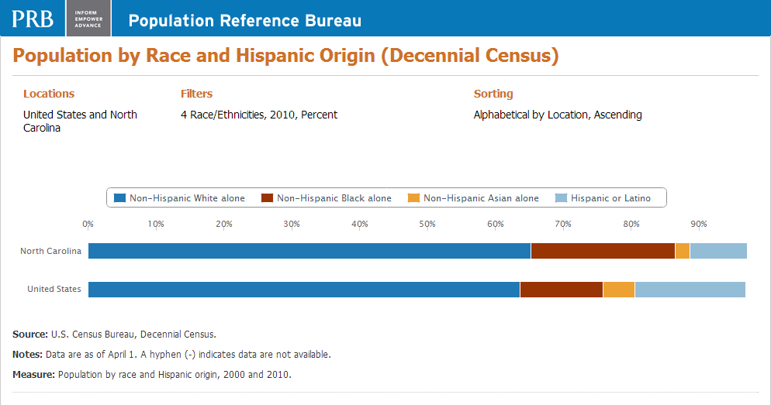
Ethnic Population Growth
States with Largest Hispanic Population Growth, 2000-2010 (%)
Source: Pew Hispanic Center
70.2%
21.4%
4.7%
2000
1.4%
2010
65.3%
21.2%
8.4%
2.2%
Source: Population Reference Bureau
Notes:
Slide updated on 1/9/2013
Replaces 1990-2002 NC ethnic population growth figure with figures from the Population Reference Bureau
Source: http://www.prb.org/DataFinder/Topic.aspx
And: Passel, Jeffrey; D’Vera Cohn and Mark Hugo Lopez. “Census 2010: Hispanics Account for More than Half of Nation’s Growth in Past Decade.” March 24, 2011. http://www.pewhispanic.org/2011/03/24/hispanics-account-for-more-than-half-of-nations-growth-in-past-decade/

Slide 54
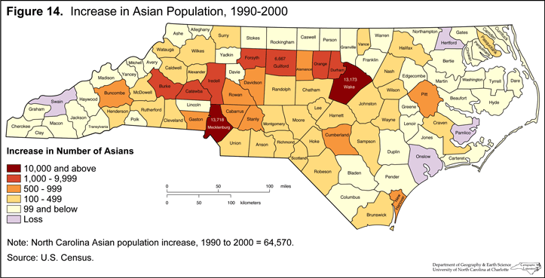

Slide 55
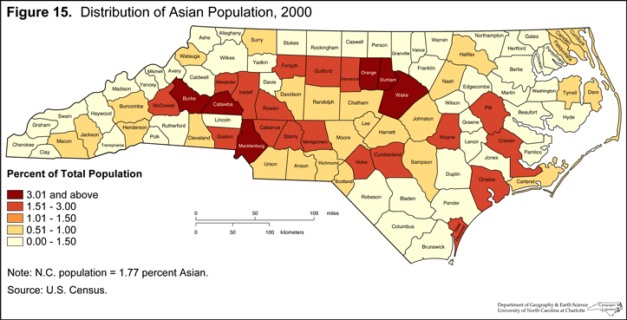

Slide 56
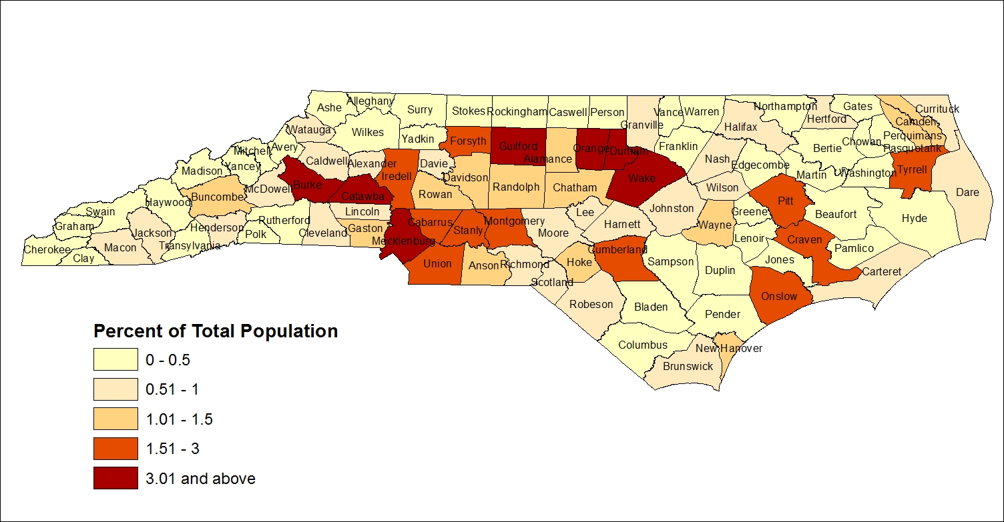
Distribution of Asian Population, 2010
Asian population = 2.19% of NC Total Population in 2010
Source: Kenan Institute of Private Enterprise/US Census Bureau
Notes:
Slide added on 1/7/2013
Data source: Census Bureau via LINC NC
Map produced using ESRI ArcMap

Slide 57
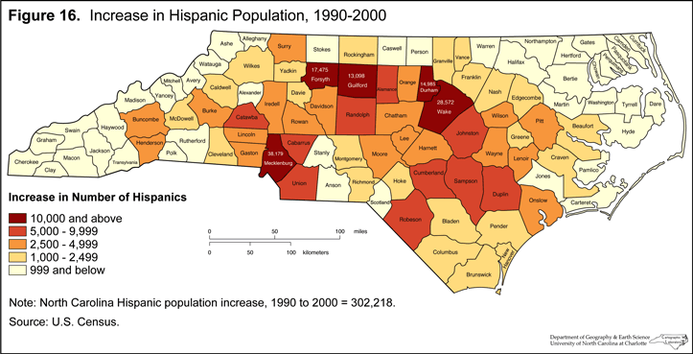

Slide 58
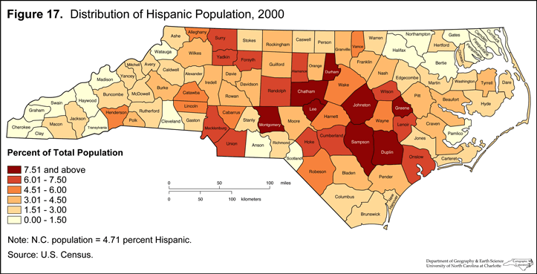

Slide 59
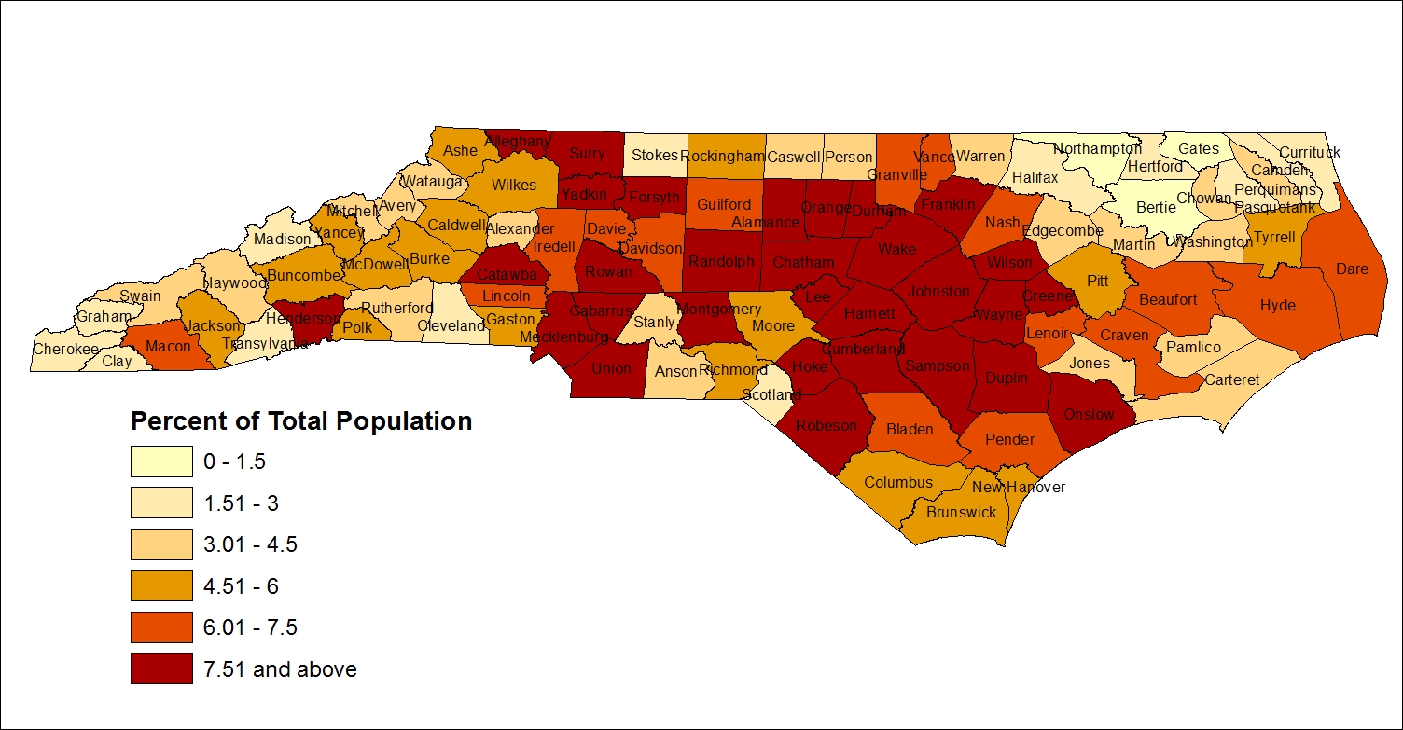
Distribution of Hispanic Population, 2010
Hispanic population = 8.39% of NC Total Population in 2010
Source: Kenan Institute of Private Enterprise/US Census Bureau
Notes:
Slide added on 1/7/2013
Data source: Census Bureau via LINC NC
Map produced using ESRI ArcMap

Slide 60
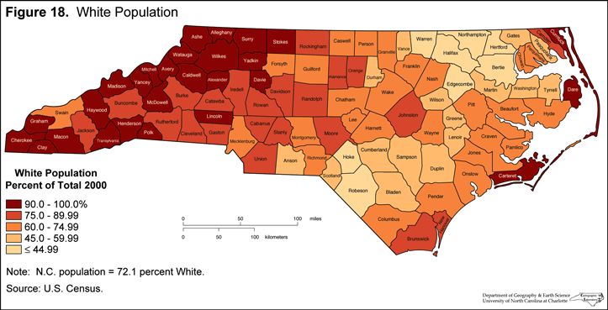

Slide 61
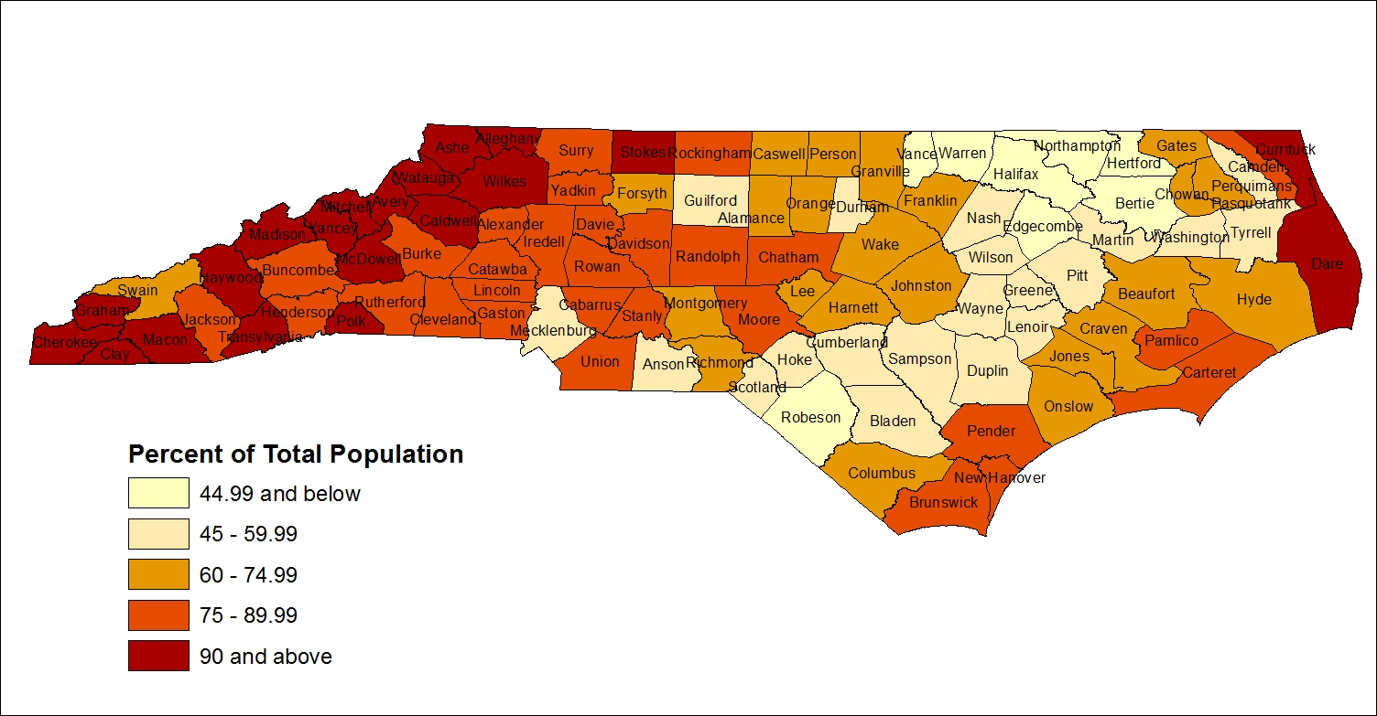
Distribution of White Population, 2010
White population = 68.47% of NC Total Population in 2010
Source: Kenan Institute of Private Enterprise/US Census Bureau
Notes:
Slide added on 1/7/2013
Data source: Census Bureau via LINC NC
Map produced using ESRI ArcMap

Slide 62
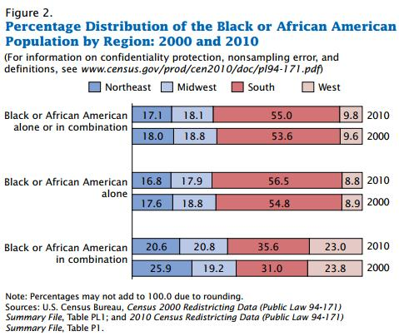
Blacks Return To The South
The Black population grew in every region between 2000 and 2010 with the Black in combination population contributing to this growth, particularly in the South.
Notes:
Slide updated on 1/8/2013 to add Figure 2. Percentage Distribution of the Black or African American Population by Region: 2000 and 2010.
Source: http://www.census.gov/prod/cen2010/briefs/c2010br-06.pdf

Slide 63
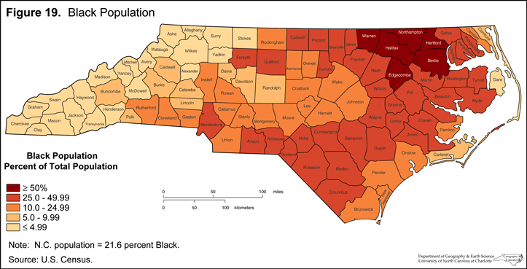

Slide 64
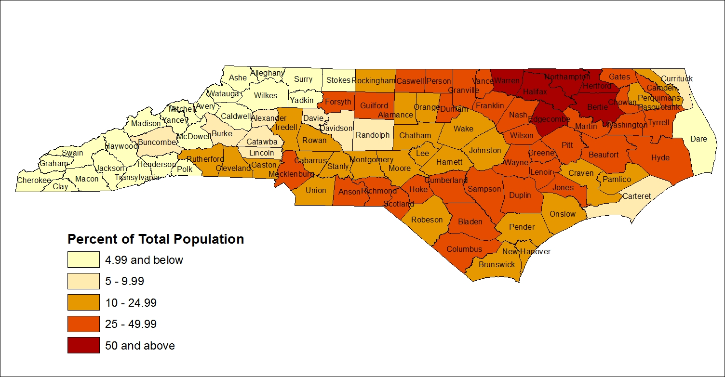
Distribution of Black Population, 2010
Black population = 21.48% of NC Total Population in 2010
Source: Kenan Institute of Private Enterprise/US Census Bureau
Notes:
Slide added on 1/7/2013
Data source: Census Bureau via LINC NC
Map produced using ESRI ArcMap

Slide 65
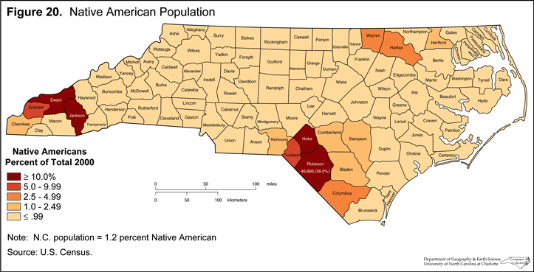

Slide 66
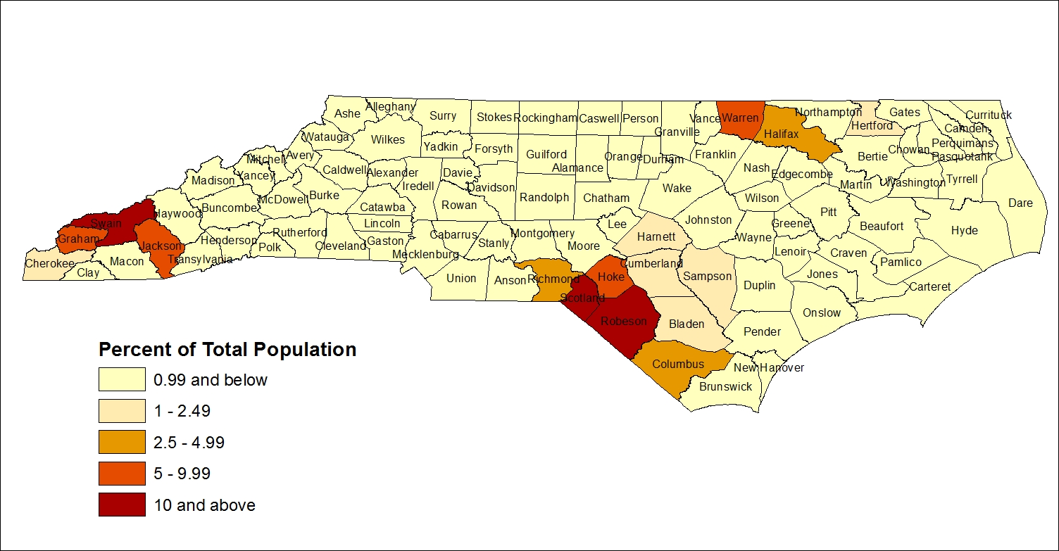
Distribution of Native American Population, 2010
American Indian population = 1.28% of NC Total Population in 2010
Source: Kenan Institute of Private Enterprise/US Census Bureau
Notes:
Slide added on 1/7/2013
Data source: Census Bureau via LINC NC
Map produced using ESRI ArcMap

Slide 67


Slide 68


Slide 69
Aging America: U.S. Median Age, 1820-2010
Source: U.S. Census Bureau, San Francisco Chronicle
Notes:
Slide updated on 1/4/2013 to add 2010 median age.
Source for update: U.S. Census Bureau, “Age and Sex Composition: 2010” (May 2011). http://www.census.gov/prod/cen2010/briefs/c2010br-03.pdf.

Slide 70


Slide 71


Slide 72


Slide 73


