Slide 1
Professor Nicholas Didow
Kenan Institute Faculty Fellow
Kenan-Flagler Business School
4516 McColl Building
University of North Carolina
Chapel Hill, NC 27599-3490
919.962.3189 nick_didow@unc.edu
June 11, 2014
Notes:
Quick slide of content in the hard drive.

Slide 2
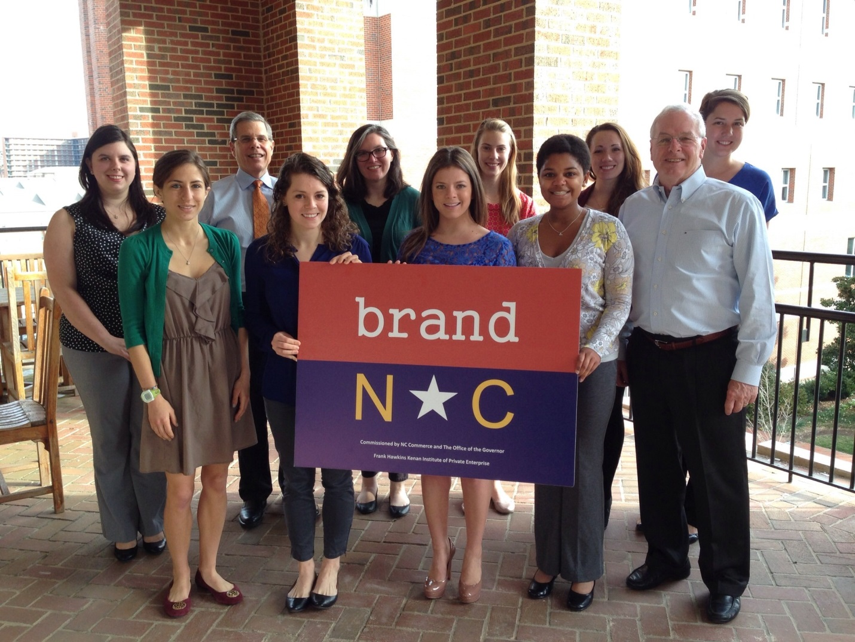
THE TEAM

Slide 3




WHAT WE’VE DONE
INTERVIEW
CONTESTS
SURVEYS
SECONDARY RESEARCH

Slide 4
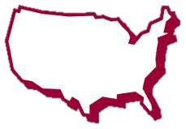
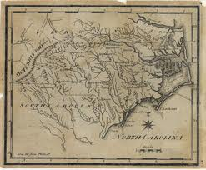
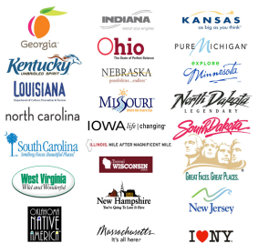

OUR FOCUS
HISTORY
COMPETITIVE
LANDSCAPE
PERCEPTIONS
Notes:
History Image Credit: http://www2.lib.unc.edu/dc/ncmaps/map_history_k12.html
Competitive Landscape Image Credit: http://freepages.genealogy.rootsweb.ancestry.com/~gentutor/trails.html
Perception Image Credit: http://sethtaylor.com/b2/

Slide 5
HISTORY

Slide 6
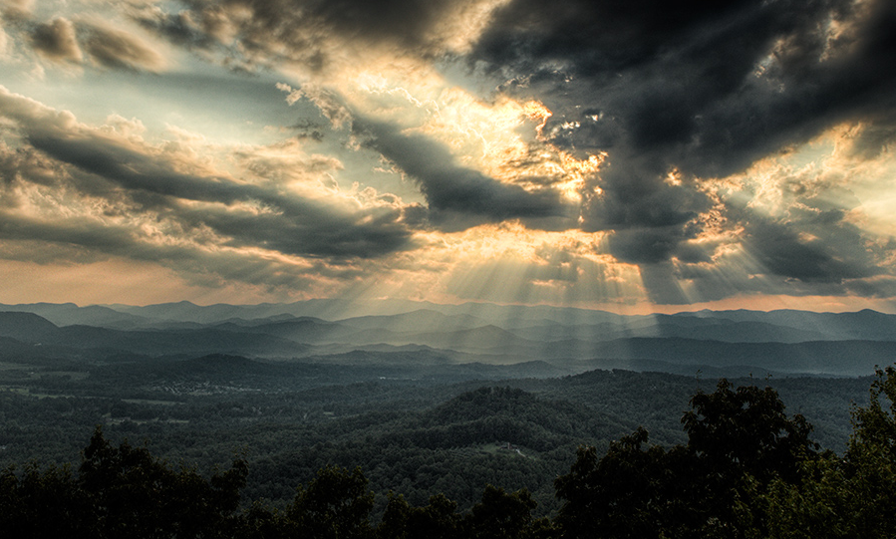
THE LAND OF SKY
Notes:
North Carolina is located at Lat’ and Lon’, covering XX square miles. This “Land of Sky” has it’s horizons rise over the Atlantic and set over the great Blue Ridge mountains. From sea to shore, North Carolina is a geographically and culturally diverse state whose 500 year history details how diversity can create the fertile ground for creativity, innovation, and community.

Slide 7
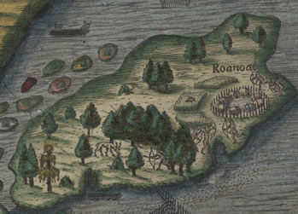
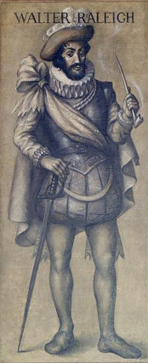
ROANOKE SETTLEMENT
The First Settlement
Notes:
Carolina, from Carolus, latin for the namesake King Charles II, was originally one man’s vision for the “New World.” Sir Walter Raleigh, the visionary man, would twice attempt his settlement here before succeeding in Jamestown, VA, however, our lost colony of Roanoke will remain the nations first settlement.

Slide 8
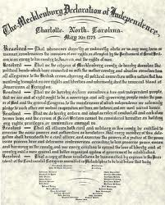

A FOCUS ON FREEDOM AND LEADERSHIP
Notes:
This land would eventually be home to many industrious people looking for fruitful lands and temperate climates. The state, however, would remain quietly humble between it’s neighboring peaks of conceit until 1775, becoming the first state to declare its independence from the crown in Mecklenburg, now Charlotte, though it would be one of the last state to ratify our new nation’s constitution—demanding additional amendments now known as the bills of rights before ratification.

Slide 9
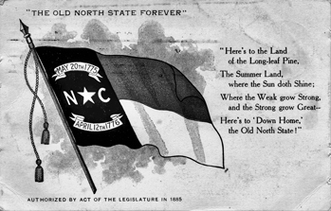
THE OLD NORTH STATE
Notes:
After sweeping legislation and organization in 1789, leading to a ratified constitution and a decision to create the nation’s first public university—ensuring an educated population would be able to continue the democracy drafted in 1775—North Carolina slipped into a period of stagnation, becoming known as the “Rip Van Winkle State” in the early 1800s, eroding the progressive reputation of the “Old North State.” This would continue until the 1830s/1840s when North Carolina would redraft their constitution.

Slide 10
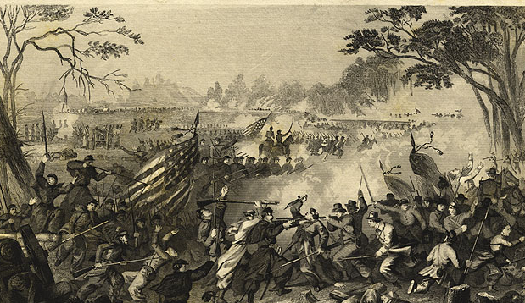
THE TARHEEL STATE
Notes:
In the 1850s, the South began to rise up against its nation and by the 1860s, would be in the midst of the nation’s first civil war. North Carolina, who already had given many soldiers to so many national battles, would again choose to send its troops to war in service now of the confederacy, but did not make this decision quickly. The last to succeed from the union, the decision for succession would be made based on state constitution rights—leading the government to vote for succession.
Story of “Tarheels” on slide?

Slide 11
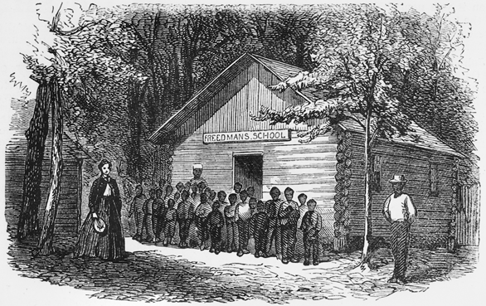
RECONSTRUCTING NORTH CAROLINA
Notes:
North Carolina, under reconstruction, would progress quickly compared to other states. Though under similar ordinances to other southern states in terms of minority and women’s rights, other strides christened the state with a progressive reputation among its peers. African American schools, though still separate, would remain a focus for state government, giving more attention to literacy and education programs and opportunities for African American populations.

Slide 12
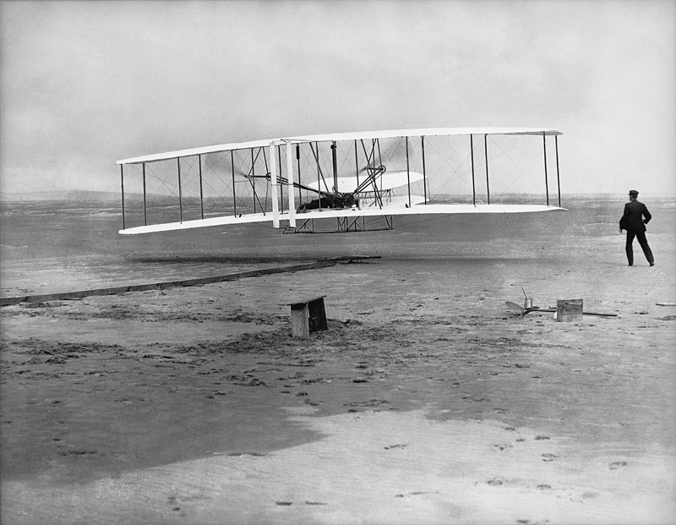
NORTH CAROLINA TAKES FLIGHT
Notes:
North Carolina is located at Lat’ and Lon’, covering XX square miles. This “Land of Sky” has it’s horizons rise over the Atlantic and set over the great Blue Ridge mountains. From sea to shore, North Carolina is a geographically and culturally diverse state whose 500 year history details how diversity can create the fertile ground for creativity, innovation, and community.

Slide 13
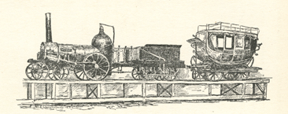
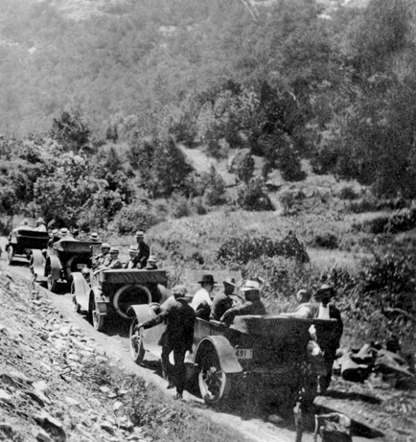
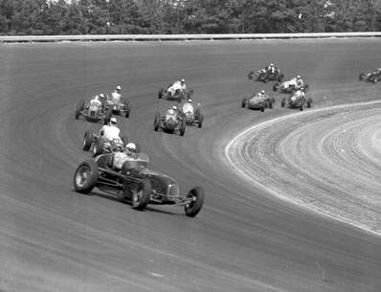
THE GOOD ROADS STATE
Notes:
Other progress was made as well in terms of science, technology, and infrastructure. Under federal land grants, North Carolina would institute its first technical and agricultural university, now known as “N.C. State.” North Carolina’s focus on roadways would also lead to another nickname—”The Good Roads State.” This tradition can now be seen in Kannapolis, North Carolina as millions gather to see the best drivers speed through track otherwise known as NASCAR.

Slide 14

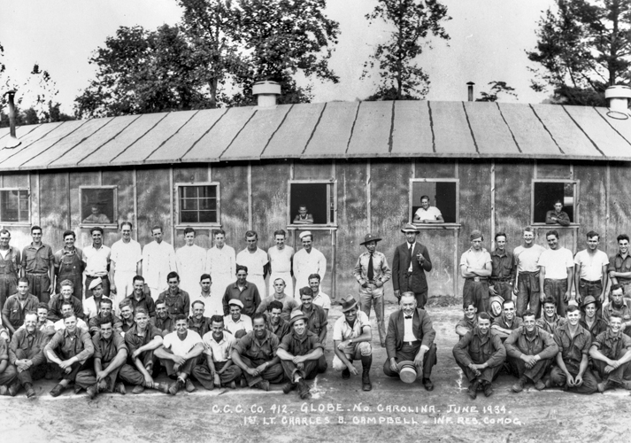
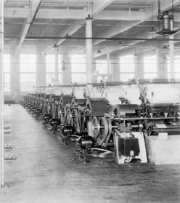
CREATING LEGACY OF HOSPITALITY
Notes:
Clyde Roark Hoey Image Credit: http://en.wikipedia.org/wiki/Clyde_R._Hoey
By the 1930s, North Carolina had pushed through many crises and tried many directions. Reconstruction, world wars, and now a Great Depression started to erode the progress made since the end of the Civil War. New, but fledging industries, such as textiles and furniture, were hit hard by the recent economic turmoil. Even Tobacco—the state’s cash crop—began to see slumps in production. The progress made over the last 50-60 years had led to the creation of new universities—including the new Ivy contender “Duke University” in Durham—and new leadership.
Note that the images, etc. on this slide should be moved to the next slide, Slide 15.

Slide 15
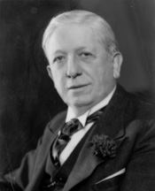
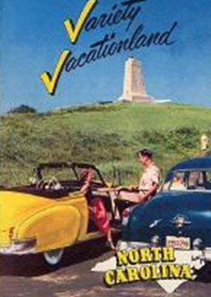
VARIETY VACATIONLAND
Commissioned Hospitality Committee
Employed ad agency that would develop “Variety Vacationland”
Developed state tours for business leaders
Governor Clyde Roark Hoey
Notes:
New leadership in 1937, under the direction of democratic Governor Clyde Hoey, would led to the state’s first branding attempt. A private ad agency was given the task of creating a tourism campaign to develop North Carolina as a vacation destination—to rival new tourist spots along the recent road culture of the United States including Florida and California. The company developed “Variety Vacationland” to speak to the diversity of the state in terms of geography and activities. However, the governor felt there was yet more to be done to ensure the state retained its residents and gained new members to the state family.
In 1937, he also commissioned a Hospitality Committee to ensure each county would have ambassadors to welcome visitors and newcomers to the state--this initiative was also meant to craft a friendly culture across the state as well, which remains perceived even today. Finally, through the Economic Development and Conservancy Department, business tours were developed and advertised to business leaders all over the country to encourage investment in the state. These campaigns would continue for the next two decades through the 1950s.

Slide 16
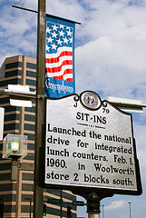
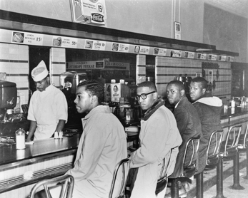
PROGRESS IN THE PROGRESSIVE STATE
Notes:
In the 1960s, civil rights would hit the racially progressive state in its new textile center—Greensboro—in store called Woolworths. The first sit-in of the movement would become a historically significant moment not only in North Carolina history, but in the nation’s history as well. It would be years before North Carolina would removed the segregation barriers, some culturally still erect today, but would still remain in the nation’s view as a progressive among its sister states.

Slide 17


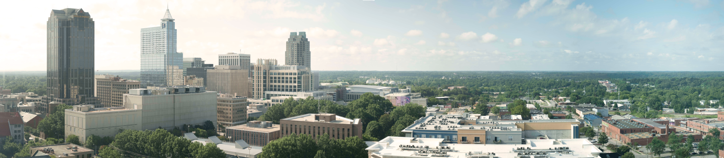
GROWING TO THE FUTURE
Notes:
Over the past 40-50 years, North Carolina has continued to develop its intellectual and physical assets—from its universities and research centers, to its agricultural, medical, and financial industries, North Carolina continues to grow and branch out across the state. This friendly state remains traditional, yet progressive, geographically separated, yet united by its state’s borders, and finally, and most importantly, all its citizens unite in its pride to be apart of North Carolina’s past and future—for its citizens know that it will always remain genuine despite the trend of other states to parade showmanship.

Slide 18
COMPETITIVE LANDSCAPE

Slide 19
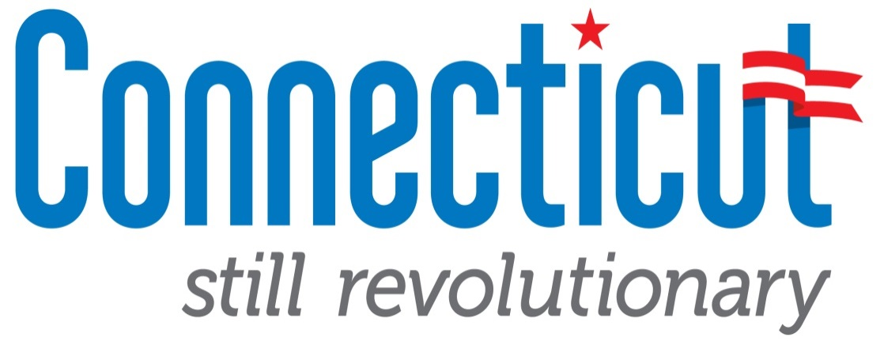
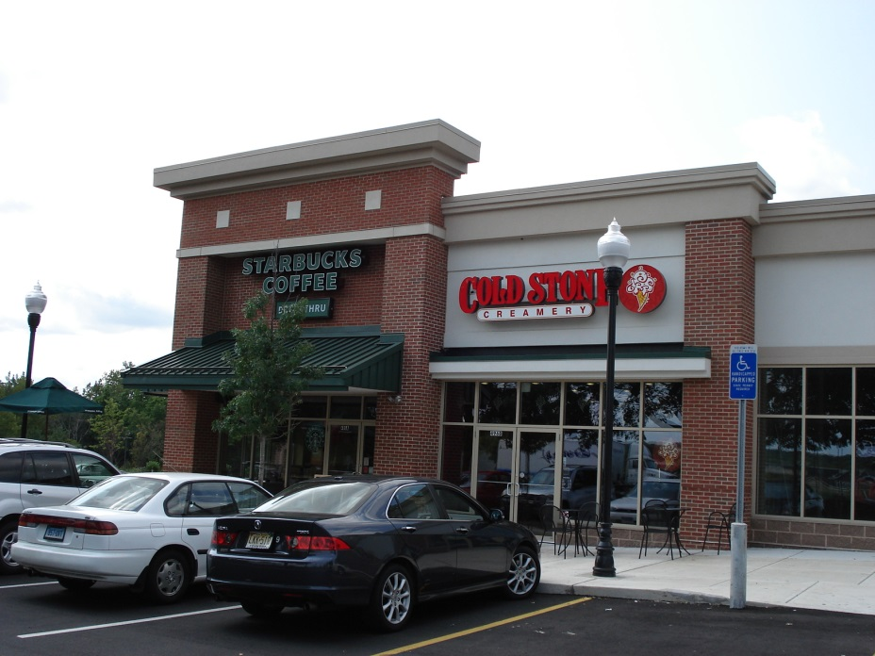
History can add to authenticity
Elements:
History
Tradition
Adventure
Arts and Culture
Take Aways:
Current developments don’t connect to the historical ties of the brand.
In developing a brand for North Carolina, we need to make sure it is something we can continue to uphold in the future.
Notes:
“Still Revolutionary” 2012
http://www.ctvisit.com
Elements:
History
Tradition
Adventure
Arts and culture
Take Aways:
Connecticut’s brand, builds off it’s historic past, but residents and visitors felt this was not authentic to current practices of the state.
Rather than build more “cookie-cutter” homes and strip malls, Connecticut should commit to the preservation of the places that made it revolutionary in the first place.
(http://articles.courant.com/2012-05-14/news/hc-ed-new-branding-campaign-20120511_1_discover-new-england-branding-tourism-marketing-budget)

Slide 20
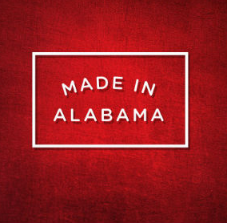

Frequent campaigns increase relevance
Elements:
Business oriented
A state of progress
Incorporates smaller campaigns such as: The Year of Alabama Food
Take Aways:
The Year of Alabama Food promoted tourism and business, while connecting to the “Made in Alabama” brand.
We should consider how smaller campaigns can be connected to North Carolina’s new brand.
Notes:
“Made in Alabama” 2013
http://www.madeinalabama.com
Elements:
Business oriented
State of progress
Innovation
Links to smaller campaigns
Take Aways:
http://www.yearofalabamafood.com
The Year of Alabama Food (originally established in 2005, and was brought back due to “Made in Alabama”)
Took the brand and applied it to smaller more focused campaign that drives business and tourism
We should consider how North Carolina’s brand can be used to drive tourism in smaller campaigns

Slide 21

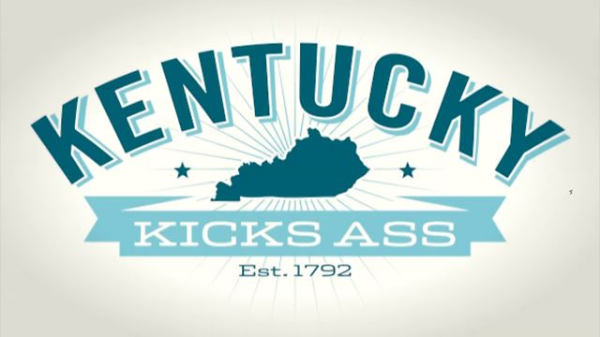
Emotional connections create traction
Elements:
Kentucky Derby
Horse history
Nature
Metropolitan life
Take Aways:
“Do the words Unbridled Spirit” mean anything to you?”
New unofficial campaign:
2013 Kentucky Kicks Ass attempts to showcase Kentucky pride.
Notes:
“Unbridled Spirit” 2004
http://kentucky.gov/Pages/home.aspx
http://www.kentuckytourism.com
Elements:
Derby and Derby events → bourbon and Alcohol distilleries
Nature: Mammoth Cave, Bluegrass region, State Parks
Metropolitan Life: Louisville, and Lexington
Take Aways:
“Unbridled Spirit” was selected through popular vote of the states citizens, however now some native Kentuckians did not feel connected to the “Unbridled Spirit” campaign
Kentucky marketing team began the “Kentucky Kicks Ass” campaign, with the purpose of diminishing stereotypes, unifying the state, and fostering pride (http://www.kentuckyforkentucky.com)
KKA campaign focuses on Kentucky’s history, fried chicken, and native celebrities
Utilizes sarcasm in campaign videos, seems to be targeting younger generation
While people chose the original campaign, ten years later people don’t feel connected to it. We need to choose a brand that can hopefully connect generations

Slide 22
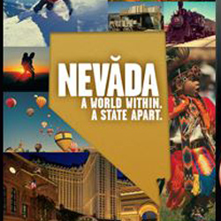
Diversity properly executed brings cohesion
Elements:
Natural
Culture
Business
Unifying the State
Celebrating contrasts
Take Aways:
Nevada faces a similar challenge to North Carolina in that it has a diverse state that is known for many different things. It utilized this diversity into one cohesive brand.
Notes:
A World Within A State Apart – 2013
Travelnevada.com
Elements:
Nature
Business
Unifying the diversity of the state
Take Aways:
Celebrate contrasts of the state and try to create a cohesive brand for them

Slide 23
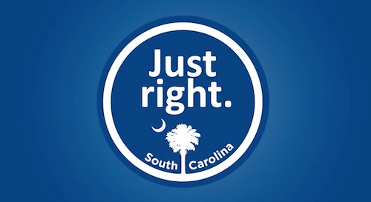
Invite continuous participation
Elements:
Business climate
Satisfaction
Ease
Take Aways:
South Carolina ties the “Just right” campaign to several pro-business initiatives to create authenticity.
The SC “Just right” page invites participation through brand website upload to create inclusion.
Notes:
http://freelandconstruction.com/resources/Videos/othervideos/SC%20is%20Just%20Right%20for%20Freeland%20Construction.mp4
http://www.scjustright.com/upload/

Slide 24
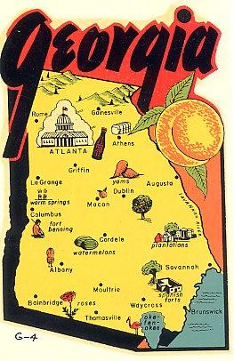
Multiple messages mean low recognition
Elements:
Motto
Peaches
Individual merchandising
Take Aways:
Leaving brand open for interpretation proves to be a missed opportunity.
Notes:
Motto: http://www.bettyssunsetthreads.com/florida__sunbonnet_collection.htm

Slide 25
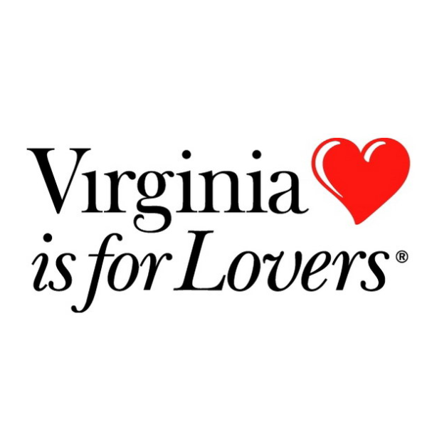
Long campaigns garner recognition
Elements:
Vacation
Warmth
History
Take Aways:
40+ year tourism campaign (Martin Agency in Richmond) that remains relevant today.
Branding package of fonts, photography, and traits drive consistent implementation
Notes:
Source: https://www.virginia.org/virginiaisforlovers/

Slide 26

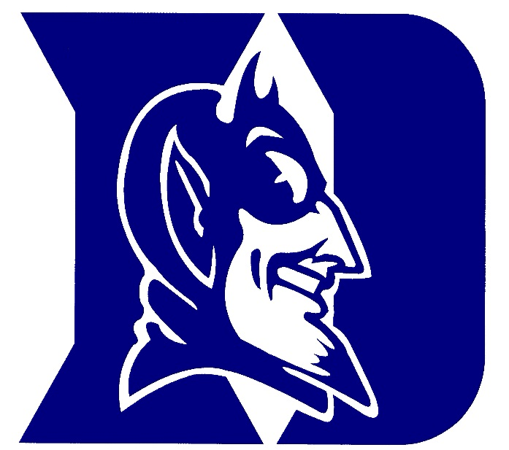
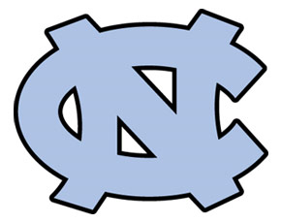

4 NC Universities are ranked in the top 125 universities nationally

Slide 27

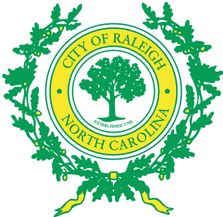


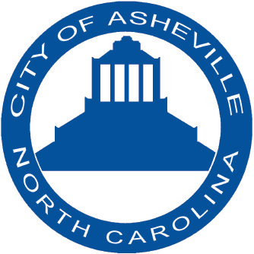

5 NC cities are in the top 100 cities to do business

Slide 28
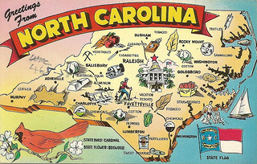
NC ranks #6 in top states for domestic travel

Slide 29
PERCEPTIONS

Slide 30
Anecdotal evidence, along with lack of awareness found in the 2009 Trone study, plus the arguments for the benefits of branding and integrated marketing communications statewide – all support the need for a new state branding effort.
Over the past three months, the brandNC Project team has
conducted three national general public and executives state perceptions surveys about NC, VA, SC, and GA (total N=1,945)
interviewed N=401 c-suite business executives about site selection in general and experience with NC in particular
tested NC’s state map shape recognition among N=1,001 people
polled N=806 North Carolinians about the state’s enduring core values.

Slide 31
2009 North Carolina Brand Awareness
2009 Trone study of “1,900 people across the US who had never lived, worked or vacationed in North Carolina” found that 42% said they knew nothing about the state.

Slide 32
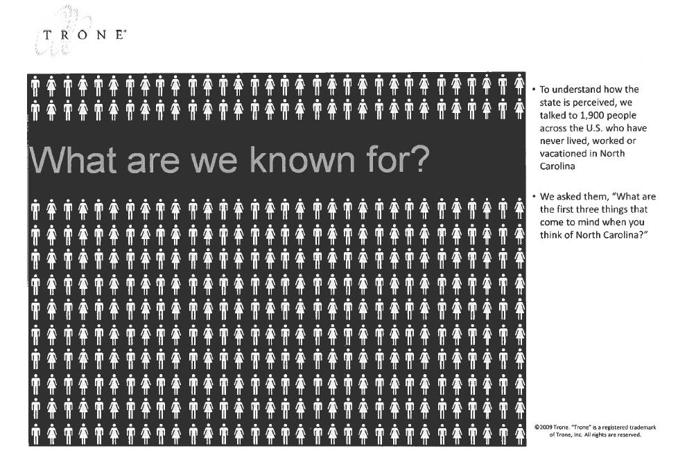

Slide 33
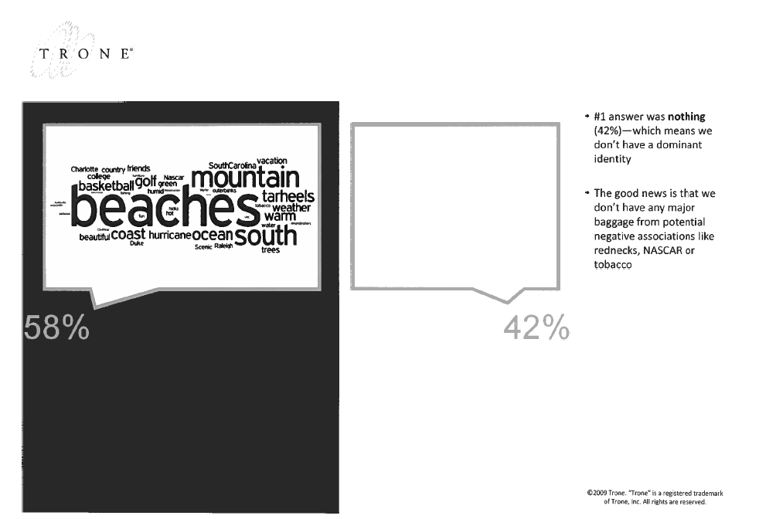

Slide 34
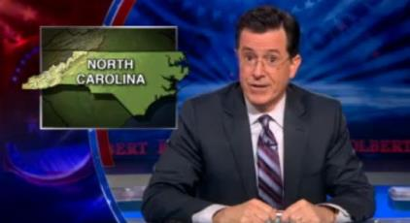



In the absence of proactively communicating who North Carolina is, others can, and will, fill that messaging gap
Recent opinion editorial pieces in national news media and satirical television programs may have begun to establish a “brand” for North Carolina.
“Scientists predict an economy-destroying, 39-inch sea level rise, but North Carolina drafts a law to make it eight inches.”
Video

Slide 35
PUBLIC PERCEPTION SURVEY

Slide 36
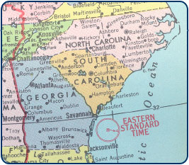
This nationwide General Public study with 789 respondents replicated the 2009 Trone “NC awareness” study and addressed four other key questions:
1. To what extent do people nationwide have positive, negative or mixed overall thoughts about North Carolina?
2. How do overall thoughts about North Carolina compare to those about Virginia, South Carolina and Georgia?
3. How many people inexperienced with North Carolina know something versus know nothing about the state?
4. To what extent have perceptions of North Carolina changed in the past year or so and, if perceptions have changed, have they become more positive or more negative?

Slide 37
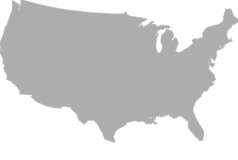
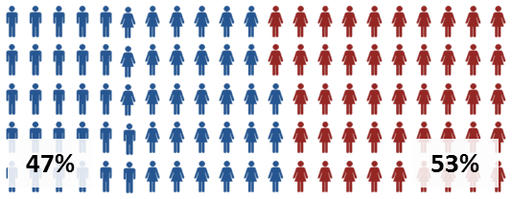
We surveyed 789 respondents, diverse and representative in terms of education, geography, gender and age, nationwide using general public online panel.
Base Sizes
Age
N=789
Education
Gender
Source: Primary Research
Notes:
EMI-ORS
Missing Age
Overlay dots.

Slide 38
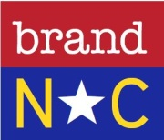

2009 Trone study of “1,900 people across the US who had never lived, worked or vacationed in North Carolina” found that 42% said they knew nothing about the state; today we find that to be about 26% to 27% of the General Public inexperienced with the state who know nothing about North Carolina.
(ALL 789 RESPONDENTS NATIONWIDE)
…overall thoughts about (STATE) | NC |  |  | VA |  |  | SC |  |  | GA
generally positive | 55 |  |  | 48 |  |  | 41 |  |  | 42
mixed | 23 |  |  | 28 |  |  | 25 |  |  | 35
generally negative | 7 |  |  | 6 |  |  | 13 |  |  | 13
know nothing about the state | 16 |  |  | 18 |  |  | 21 |  |  | 10
ever lived, worked vacationed in (STATE)? | Y= 322 | N= 463 |  | Y= 342 | N= 437 |  | Y= 262 | N= 516 |  | Y= 318 | N= 465
…overall thoughts about (STATE)
generally positive | 72 | 43 |  | 61 | 39 |  | 55 | 34 |  | 50 | 37
mixed | 20 | 24 |  | 33 | 25 |  | 30 | 23 |  | 36 | 35
generally negative | 7 | 7 |  | 6 | 6 |  | 14 | 12 |  | 14 | 12
know nothing about the state | 1 | 26 |  | 1 | 31 |  | 1 | 31 |  | 1 | 17
…perceptions changed in past year or so?
more positive | 13 | 7
unchanged | 72 | 58
more negative | 14 | 7
still know nothing about the state | 1 | 27
Overall thoughts about NC by those inexperienced with the state are somewhat more positive than neighboring states.
Perceptions of NC have changed minimally in the past year or so, becoming somewhat equally more positive AND more negative.

Slide 39
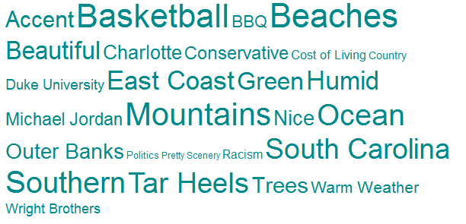
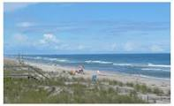

Those inexperienced with North Carolina who do have thoughts about the state think about “beaches” and “basketball”…
463 adults who have never lived, worked, or vacationed in North Carolina
“What three things come to mind when you think of North Carolina?” | FREQUENCY MENTION
Nothing | 120
Beaches | 71
Basketball | 45
Mountains | 36
Southern | 33
Ocean | 28
Tar Heels | 27
South Carolina | 25
East Coast | 22
Humid | 18
Beautiful | 18
Green | 17
Accent | 16
Trees | 15
Outer Banks | 13
Nice | 13
Charlotte | 12
Conservative | 11
Michael Jordan | 9
BBQ | 9
Warm Weather | 8
Duke University | 8
Chapel Hill | 6

Slide 40
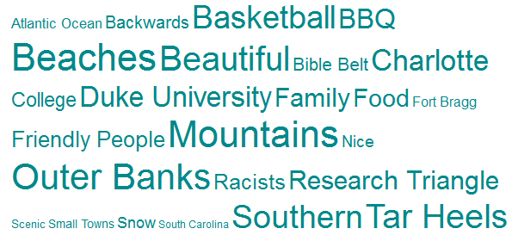

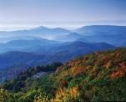
Those experienced with North Carolina think about “beaches” and “mountains”…
322 ADULTS WHO DO OR HAVE LIVED, WORKED OR VACATIONED IN NORTH CAROLINA
“What three things come to mind when you think of North Carolina?” | FREQUENCY MENTION
Beaches | 79
Mountains | 77
Outer Banks | 31
Beautiful | 24
Tar Heels | 19
Southern | 19
Basketball | 18
Trees | 18
Charlotte | 14
Duke University | 10
BBQ | 10
Research Triangle | 8
Family | 8
Food | 7
Warm | 7
Friendly People | 6
Racists | 6
UNC | 6
College | 5
Bible Belt | 4
Backwards | 4
Nice | 4
Snow | 4

Slide 41
C-SUITE EXECUTIVE PERCEPTIONS SURVEY (N=155)

Slide 42
This study replicated the 2009 Trone “NC awareness” study with executives and addressed four other key questions:
1. To what extent do executives nationwide have positive, negative or mixed overall thoughts about North Carolina?
2. How do overall thoughts about North Carolina compare to those about Virginia, South Carolina and Georgia?
3. How many executives inexperienced with North Carolina know something versus know nothing about the state?
4. What – if anything – do executives find distinctive and unique about North Carolina compared to other states like Virginia, South Carolina and Georgia?

Slide 43
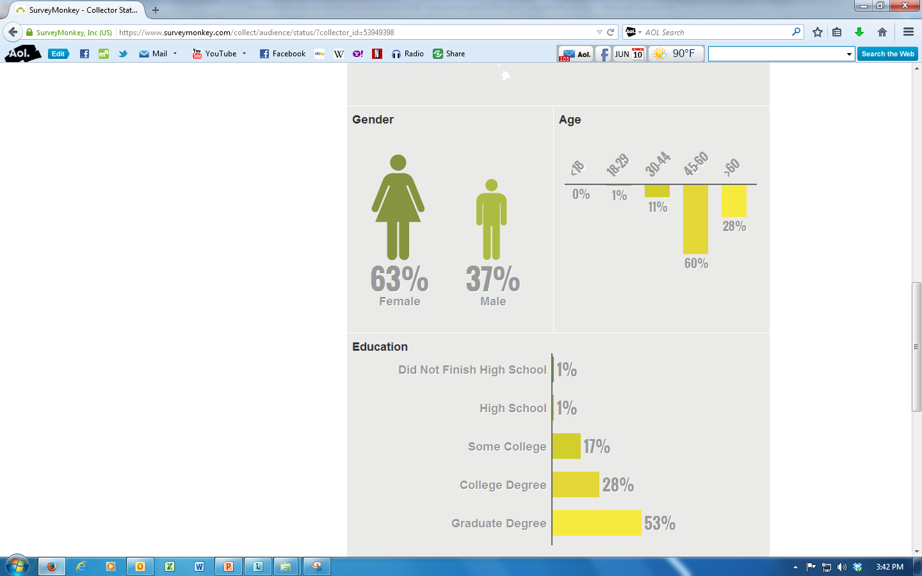
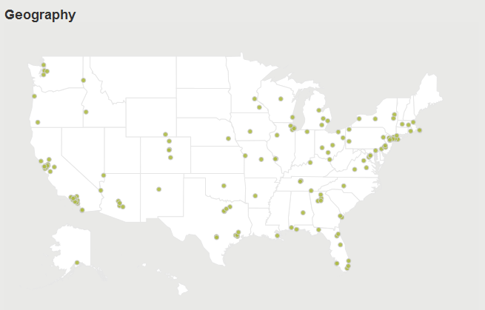
The 154 executive respondents to our May 2014 survey using Survey Monkey’s c-suite executive and business owner online panel were reasonably diverse and representative in terms of education, geography, gender and age.

Slide 44
2009 Trone General Public study of “1,900 people across the US who had never lived, worked or vacationed in North Carolina” found that 42% said they knew nothing about the state; today we find that about 14% of Executives inexperienced with the state know nothing about North Carolina.
Overall thoughts about NC by those Executives inexperienced with the state are somewhat more positive than neighboring states.
Perceptions of NC have changed minimally in the past year or so, becoming somewhat more positive than more negative.

Slide 45
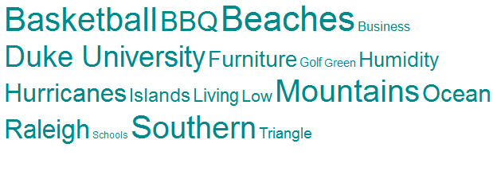
Many executives point to beaches and basketball when thinking about North Carolina
Those Executives inexperienced with North Carolina who do have thoughts about the state think about “beaches” and “basketball”…

Slide 46
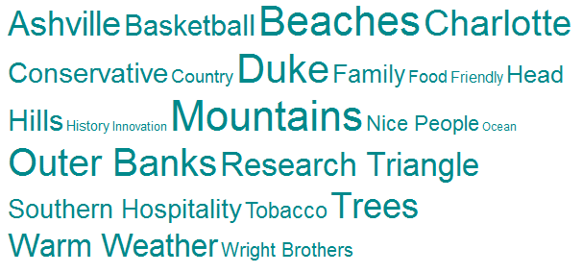
Those Executives experienced with North Carolina think about “mountains”, “beaches” and “Duke”…
Those Executives experienced with North Carolina think about “mountains”, “beaches” and “Duke”…

Slide 47

14% of Executives experienced with North Carolina say that “nothing” is distinctive and unique about NC compared to VA, SC and GA
14% of Executives experienced with North Carolina say that “nothing” is distinctive and unique about NC compared to VA, SC and GA; others say (11%) “beaches”, (11%) “mountains”, (7%) “universities”, and (6%) “progressive” is distinctive and unique about NC
11% say “beaches”, 11% “mountains”, 7% “universities”, and 6% “progressive” are distinctive and unique about North Carolina

Slide 48
Lastly, many executives inexperienced with NC lack knowledge of North Carolina’s unique assets
34% of Executives inexperienced with North Carolina say that “nothing” is distinctive and unique about NC compared to VA, SC and GA; other responses are all across the board…

Slide 49
C-SUITE EXEC AND BUSINESS OWNER SITE SELECTION DECISION SURVEY (N=401)

Slide 50
We surveyed 401executives using a nationwide research panel to gain perceptions of North Carolina through site selection.
Base Sizes
Miscellaneous
N=401
8%
41%
6%
National Respondents
Source: Primary Research
Notes:
EMI-ORS

Slide 51

86.7% Were in contact with state or local governments
Notes:
Redesign slide with middle line and picture.

Slide 52

Only 36% made use of state or local government economic or development resources.

Slide 53
Taxes were the most cited factor in determining site selection.
22%
of those surveyed cited Taxes
Other factors cited as important
in site selection included:
Primary and secondary education
Higher education
Cost of Living
Workforce Demographics

Slide 54


NCs most valuable asset is its low cost of living
NC Valuable Assets
Low cost of Living
UNC System
RTP Tech Industry
Coastal Location

Slide 55


Responders were concerned about
NC’s workforce and weather.
Notes:
Workforce Image Credit: http://www.liquidplanner.com/blog/next-generation-workforce/ change pics

Slide 56

Responders claimed that NC public primary and secondary education has created an untrained / unskilled workforce.
Notes:
Need #s

Slide 57

Responders also cited storms and hurricanes as a negative trait of NC.
brand NC
57
Notes:
Hurricane Image Credit: http://www.bloomberg.com/news/2011-08-27/hurricane-irene-crosses-north-carolina-coast-as-winds-slow-to-category-one.html
Need #s

Slide 58
Over half of respondents considered NC to be in the Top 25% of business friendly states.
Over 45% of respondents considered
North Carolina
in the to be in the
Top 10
Business Friendly States
Notes:
Bigger 45

Slide 59
C-Suite Executives
were involved in every step of the process from creating the list to narrowing it down.

Slide 60

Most said they did not utilize a site selection consultant but did mention the use of real estate agents.
Notes:
Real Estate Image Credit: http://www.allstate.com/tools-and-resources/home-insurance/finding-the-right-real-estate-agent.aspx

Slide 61
STATE SHAPE RECOGNITION SURVEY

Slide 62

We surveyed 1,001 respondents, divided between NC Residents and Non-Residents, using a nationwide online research panel
Base Sizes
NC Experience
501
500
8%
41%
6%
National Respondents
Source: Primary Research

Slide 63


Survey respondents were a fairly representative sample with a skew in favor of female and middle age participants
NC Resident Gender Breakdown
Non-Resident Gender Breakdown
27%
73%
38%
62%

Slide 64






Recognition of the state outline is strong for residents, but not “best-in-class” among non-residents
State Outline Recognition
Source: Primary Research

Slide 65
NC ENDURING CORE VALUES SURVEY

Slide 66
We surveyed 806 respondents, primarily in North Carolina, and asked them for their opinion of the state’s enduring core values.
Base Sizes
Type of Location
806
Location
Source: Primary Research
Notes:
EMI-ORS

Slide 67

Survey respondents were a fairly representative sample with a skew in favor of females and participants age 18-29.
Gender Breakdown

Slide 68
ENDURING CORE VALUES SURVEY RESULTS
(SA=5, SD=1)
Notes:
Put in the appendix.

Slide 69

North Carolinians strongly agree our enduring core values are ‘hospitality”, “friendliness”, “courtesy”, “community”, and “kindness.”
Hospitality
Friendliness
Courtesy
Community
Kindness
Notes:
4.32, 4.32, 4.15, 4.15, 4.07

Slide 70
North Carolinians less strongly agree we have core values of “equality”, “inclusiveness”, “fairness”, and “diversity.”
Equality
Inclusiveness
Fairness
Diversity
Notes:
4.32, 4.32, 4.15, 4.15, 4.07

Slide 71
CONCLUSION: Emerging Themes and Core Concepts

Slide 72



RECOGNITION OF DIVERSE NC GEOGRAPHY

Slide 73



RENAISSANCE – WE HAVE IT ALL!

Slide 74

HOSPITALITY, FRIENDLINESS, COURTESY, COMMUNITY, KINDNESS

Slide 75


NC DIVERSITY PARADOX? – GEOGRAPHY, ECONOMY, PEOPLE, POLITICS, HISTORY… -- WE ARE ALL SO INCREDIBALY DIFFERENT AND YET WE GENERALLY RESPECT EACH OTHER AND GET ALONG JUST FINE, THANK YOU.

Slide 76

ASPIRATIONS
Notes:
Picture: http://www.ncpolicywatch.com/2012/07/25/kids-count-2012-a-fresh-look-at-child-well-being/

Slide 77

“EASY”

Slide 78

GENUINE, REAL, AUTHENTIC – “TO BE, RATHER THAN TO SEEM”

Slide 79

WELCOME HOME…

Slide 80
APPENDIX

Slide 81


Exhibit 1: State of North State Carolina
Seal: 1871, revised 1971 and 1983
Flag: 1885
Motto: 1893 Esse quam videri (To be, rather than to seem)
Song: 1927 “The Old North State”
Colors: 1945 Red and Blue
Toast: 1957 The Tar Heel Toast*

Slide 82
Exhibit I: State of North Carolina
Nicknames, slogans, and sayings: Old North State
Tar Heel State/Tarheel State
The Goodliest Land (Under the Cope of Heaven)
Vale of Humility between Two Mountains of Conceit
Variety Vacationland
First in Flight
First in Freedom
A Better Place to Be
Cackalacky (or North Cackalacky)
The Rip Van Winkle State
Southern Part of Heaven
The Good Roads State
Turpentine State/ Naval Stores State
Tobacco Road
Furnitureland
Graveyard of the Atlantic
Land of the Sky
Manteo to Murphy
The Progressive Plutocracy

Slide 83
Exhibit II: Official Symbols
Flower: 1941 American Dogwood (Cornus Florida)
Tree: 1963 Pine (Pinus)
Wildflower: 2003 Carolina Lily (Lilium michauxii)
Christmas Tree:2005 Fraser Fir
Carnivorous plant:2005 Venus Flytrap
Bird: 1943 Cardinal (Cardinalis cardinalis)
Shell: 1965 Scotch Bonnet
Mammal: 1969 Eastern Gray Squirrel
Salt Water Fish:1971 Channel Bass (Sciaenops ocellatus)
Insect: 1973 Honey Bee (Apis Mellifera)
Reptile: 1979 Eastern Box Turtle
Dog: 1989 Plott Hound

Slide 84
State Symbols Cont.
Freshwater Fish: 2005 Southern Appalachian Brook Trout
Horse: 2010 Colonial Spanish Mustang
Butterfly: 2012 Eastern Tiger Swallowtail
Gemstone: 1973 Emerald
Rock: 1979 Granite
Mineral: 2011 Gold
Beverage: 1987 Milk
Vegetable: 1995 Sweet potato
Red berry: 2001 Strawberry
Blue berry: 2001 Blueberry
Fruit: 2001 Scuppernong grape
Folk dance: 2005 Clogging
Popular dance 2005 Shag
Historical boat 1987 Shad boat
Sport: 2011 Stock car racing
Tartan: 1991 Carolina Tartan
State Birthplace of Traditional Pottery: 2005 Seagrove

Slide 85
Exhibit III: North Carolina State Song
State Song: The Old North State (William Gaston; Collected and Arranged by Mrs. E. E. Randolph)
Carolina! Carolina! heaven's blessings attend her,
While we live we will cherish, protect and defend her,
Tho' the scorner may sneer at and witlings defame her,
Still our hearts swell with gladness whenever we name her.
Hurrah! Hurrah! the Old North State forever,
Hurrah! Hurrah! the good Old North State.
Tho' she envies not others, their merited glory,
Say whose name stands the foremost, in liberty's story,
Tho' too true to herself e'er to crouch to oppression,
Who can yield to just rule a more loyal submission.
Hurrah! Hurrah! the Old North State forever,
Hurrah! Hurrah! the good Old North State.
Then let all those who love us, love the land that we live in,
As happy a region as on this side of heaven,
Where plenty and peace, love and joy smile before us,
Raise aloud, raise together the heart thrilling chorus.
Hurrah! Hurrah! the Old North State forever,
Hurrah! Hurrah! the good Old North State.

Slide 86
Exhibit IV: North Carolina Toast
The following toast was officially adopted as the State Toast of North Carolina by the General Assembly of 1957.
Here's to the land of the long leaf pine,
The summer land where the sun doth shine,
Where the weak grow strong and the strong grow great,
Here's to "Down Home," the Old North State!
Here's to the land of the cotton bloom white,
Where the scuppernong perfumes the breeze at night,
Where the soft southern moss and jessamine mate,
'Neath the murmuring pines of the Old North State!
Here's to the land where the galax grows,
Where the rhododendron's rosette glows,
Where soars Mount Mitchell's summit great,
In the "Land of the Sky," in the Old North State!
Here's to the land where maidens are fair,
Where friends are true and cold hearts rare,
The near land, the dear land, whatever fate,
The blest land, the best land, the Old North State!

Slide 87
Exhibit V: Abridged History
North Carolina. The Old North State. The home of the Tarheels. The Goodliest Land with Good Roads. Since 1585, when Ralph Lace convinced the Queen and Sir Walter Raleigh to forge the first settlement at Roanoke Island, North Carolina has remained a place of abundance and beauty. Rich in resources, North Carolina’s tourism, history, culture, and arts have been shaped by its geological wealth. Today, North Carolina is the sixth most recognized state in the world. However, the diverse state that contains mountain ranges, white, sandy beaches, and strong research, education, and financial centers, currently lacks a cohesive image, giving birth to The North Carolina Brand Project.
Named for King Charles I, Carolina, from the latin Carolus, comprised the land between the modern day state boarders of North and South Carolina. These boarders were redrawn in 1600s, splitting the state into two states. From this point forward, the “northern state” was often referred to as the Old North State. Since this time, North Carolina has been transformed and branded as a wonderful location to settle down, siting the numerous natural resources and temperate weather as a perfect location for businesses and multiple industries, military training, artisans, and a place to make home.
Even though the Old North State has been seen as progressive in the last century, North Carolina has stayed true to its roots and its motto “rather to be than to seem.” The state has forged its own path and consistently made decisions based on the needs and people of the state and not on national trends.
In the past decade, North Carolina has sought to unify the state image—initially through a new slogan “A Better Place to Be” in the early 2000s and now again through The Brand North Carolina Project. Though the state seeks a unified, concise image, the culture of North Carolina has been well documented through our numerous natives—from Andy Griffith to Charles Kuralt—and this body of work illustrates the cultural and historical evolution of North Carolina over the past five centuries.

Slide 88
Exhibit V: Abridged History
1500s
In 1585, Ralph Lane, leader of one of Sir Walter Raleigh’s Roanoke voyages, describes Roanoke Island as “the Goodliest Land Under the Cope of Heaven” to Sir Walter Raleigh and Queen Elizabeth I. Eventually, Roanoke Island, famed for the mythical “Lost Colony,” would expand to include both North and South Carolina, as far as modern day Daytona, Florida, until the mid-1600s.
1600s
In 1663, King Charles II splits Carolina or Carolus, creating two separate colonies—now called North and South Carolina. Though some of the land was given to other states, the older “northern” settlement of Carolina is referred to as “the Old North State,” a title that continues even today.
1700s
In 1775, revolution was brewing. North Carolina, a site for military training, becomes the first state to declare their independence from the crown. This becomes known as the Mecklenburg Declaration and precedes the national declaration by almost a full year.
Though the first to succeed from England, our state would be the second to last colony to ratify the constitution on 1789, signing the document only after a complete set of Bill of Rights was attached to the document. North Carolina becomes the 12th state on November 21st, 1789.
On December 21, 1789, North Carolina would propose the first state university, siting the need to provide educated citizens to leadership that would serve their community, state, and nation. The University of North Carolina is formed.

Slide 89
Exhibit V: Abridged History
1800s
In the early part of the 1800s, North Carolina advances slowly and is coined “The Rip Van Winkle State” as it appeared to be as comatose as Rip Van Winkle due to its lack of progress. The state, described as “a state without foreign commerce, for want of seaports or a staple; without internal communication by rivers, roads, or canals; without a cash market for any article of agricultural product; without manufactures; in short, without any object to which native industry and active enterprise could be directed" (1830 Legislative Report). This period ended in 1835 after constitutional reforms lifted the “general political apathy under the state's Democrat-controlled one-party system” (NCpedia.org), and “paved the way for a quarter-century of remarkable development in the state” (NCpedia.org).
Developments, including the building of a state system of railroads and plank roads; support for a statewide system of public schools; the establishment of institutions for the care of the blind, deaf, and mentally ill; a reformed tax system; changes in the legal status of women; the improvement of agricultural and manufacturing conditions; and the growth of the University of North Carolina and other colleges, academies, and religious agencies, would provide the foundation for North Carolina to progress during this period of progress. However, the state would become the last state to succeed from the union in 1861, through constitutional amendment, and reconstruction would erode some of the progression made during this period.
During the civil war, North Carolina provided more soldiers than any other state—as it had in previous national wars—and would remain a training site for the confederacy until surrender. During this time, a new nickname would be attributed to the Old North State—The Tarheel State. It is said that “upon learning of the leading role of the North Carolina brigades in that signal Confederate victory, Gen. Robert E. Lee reportedly cried out, "Thank God for the Tar Heel boys" (NCpedia.org). However, this was initially a derogatory term used by union soldiers, referring to the main naval industries of tar, pitch, and turpentine in North Carolina and is dated back to 1862 during an exchange between the Northern Army of Virginia and North Carolina soldiers.

Slide 90
Exhibit V: Abridged History
1900s
At the turn of the century, North Carolina had undergone significant changes following reconstruction. The Wright Brothers discover flight in 1903. Prohibition was enacted over a decade before national prohibition in January of 1909. North Carolina entered its industrial period that would continue until 1929. Overall, North Carolina’s course would change drastically in the upcoming decades.
In 1937, the Governor commissioned a Hospitality Committee, a State Advertising Agency under the direction of the Department of Conservation and Development, and a state tour to promote the state for tourism and business investment. At the time, furniture and agriculture (namely tobacco) were the primary industries—both hit hard by the Great Depression. From this commission, Scott, Eastman, and Co. would create “Variety Vacationland”—the first branding and advertising effort to promote North Carolina. This campaign would continue until the 1960s, at which time, the government would overhaul the state constitution for a third time, concluding in 1971.
In the 1950s, plans for the RTP commenced and by the 1980s and 1990s, North Carolina would again be noted as an educational and research center. In addition, The University of North Carolina would provide multiple stars to the national basketball court in the 1984, 1988, and 1992 Olympics. Cities, such as Raleigh, Chapel Hill, Cary, and others would be placed in the top 20 as some of the “Best Places to Live” in the country. Charles Kuralt would provide a taste of his home state through his work “North Carolina is my Home” and James Taylor songs would continue to resonate that indeed Carolina was on the nation’s mind.
2000s
In the early part of the new century, North Carolina continued to rank high in best places to live, secondary education, and would prosper from the technology and pharmaceutical booms of the late 1990s. At this time, tourism and the government began using the slogan “A Better Place to Be.”
Currently, the state uses the brand and message platform “Beauty Amplified” to market the state as a tourist location (see example at www.visitnc.com) and “Thrive in North Carolina” to market the state as a business location (see example at www.ThriveNC.com).

Slide 91

Exhibit VI: Historical Timeline

Slide 92
Exhibit VII: Quick Facts
Population:
9.8 Million (ranked 10th in the United States)
66% net migration
196.1 persons per square mile
GDP:
$455.9 B (ranked 9th in the United States)
Geography:
48,710 square miles
Relative Location: “North Carolina is located in the Southeast region of the United States. The state is bordered by Virginia to the north, Tennessee to the west, South Carolina to the south and Georgia to the southwest. The Atlantic Ocean forms North Carolina’s eastern border.”
Landforms: “There are three distinct landforms of the Southeast and of North Carolina: the Coastal Plain, the Piedmont and the Appalachian Mountains. The Coastal Plain is low, flat to gently sloping land that extends along the Atlantic Ocean and the Gulf of Mexico. Much of the Southeast lies within the Coastal Plain. The Piedmont, characterized by hilly, rolling land, borders the Coastal Plain. The Piedmont extends from Virginia to Alabama. The Appalachian Mountains, the largest range in the eastern United States, stretch from Canada to northern Alabama.”

Slide 93
Exhibit VII: Quick Facts
Business:
Private nonfarm establishments (2010) 218,104
Private nonfarm employment (2010) 3,234,595
Private nonfarm employment, percent change (2000–2010) - 4.5%
Nonemployer establishments (2010) 640,686
Total number of firms (2007) 798,791
Black-owned firms, percent (2007) 10.5%
American Indian- and Alaska Native-owned firms, percent (2007) 1.0%
Asian-owned firms, percent (2007) 2.5%
Native Hawaiian- and Other Pacific Islander-owned firms, percent (2007) 0.1%
Hispanic-owned firms, percent (2007) 2.7%
Women-owned firms, percent (2007) 28.2%
Manufacturer’s shipments, (2007) ($1,000) 205,867,299
Merchant wholesaler sales, (2007) ($1,000) 88,795,885
Retail sales, (2007) ($1,000) 114,578,173
Retail sales per capita (2007) $12,641
Accommodation and food services sales, (2007) ($1,000) 16,126,939
Building permits, (2011) 32,804
Federal spending, (2009) ($1,000) 85,843,896
Gross state product, (2012) $40,289 (per capita)
Percent change in state real GDP, 2011–12: +2.7%
Unemployment rate, December 2013: 6.9%
Notes:
Source: www.thrivenc.com/whync.quickfacts

Slide 94

Exhibit IX: State Branding Examples
Michigan: Pure Michigan Campaign
The Pure Michigan Campaign was launched regionally in 2006 to bordering states and promoted nationally beginning in 2009. Currently, the Michigan Branding effort has produced $3 for very $1 spent. However, the branding effort has impacted more than just tourism in the state. Research has shown that Pure Michigan has value beyond the pure economic results, citing The Longwoods International data, based on interviews with travelers to the state, that has shown improvement in Michigan’s image across the nation. Improvements in the state’s image can also help to attract talent and business investments. The Michigan Economic Development Corp. now uses Pure Michigan is its business development efforts as well.
Notes:
Source: http://mibiz.com/item/19557-pure-michigan-roi-highest-in-campaign%E2%80%99s-history

Slide 95
Exhibit IX: State Branding Examples
The 40 year old campaign “Virginia is for Lovers,” launched in the 1970s, is now the longest running state tourism slogan in the country. The campaign was recently inducted into the National Advertising Walk of Fame in 2009. The overall message is: “Love is at the heart of every Virginia vacation.” The Love campaign is a great example of leveraging an existing brand or brand elements and creating a unified message. Virginia has also outlined the brand personality and traits associated with the brand. Elements from photography to font are outlined for those who want to use the brand for their purposes. Virginia’s branding package illustrates how a strong place branding concept would be implemented.
Notes:
Source: https://www.virginia.org/virginiaisforlovers/

Slide 96

Exhibit IX: State Branding Examples
BrandColorado, initially MakingColorado, was a branding effort put forth by the Governor to unify the state, creating a more efficient government and a shared vision developed by the state. In the past, due to new legislation, marketing for the state was cut drastically, which damaged the Colorado economy over time. To regain their tourism industry, photography and slogans were submitted by the state natives themselves to develop a new brand image. Extensive research was conducted and this helped inform those drafting the new concepts for Colorado’s brand image. Overall, the concept appeared to be headed for success, but lack of pre-testing has left many natives of Colorado unsatisfied with the new concept.
Notes:
Source: http://www.brandcolorado.gov/tour-the-brand

Slide 97

Exhibit IX: State Branding Examples
Visit California sought to focus its strategy on “recall” or the ability for different people to “recall” or remember some element of the advertising for California. Another large component of the campaign is a focus on bridging the gap between the actual drivers of visits and why individuals truly travel there. There is little on brand personality. However, consistent promotion appears to have achieved significant ROI for the already well known state. The literature and research indicate that most individuals and/or families pick between one and two places when determining where to travel, therefore recall is extremely important in the moment someone is willing to invest time in to considering an area for travel, business, or home life.
Notes:
Source: “Visit California Domestic Advertising Total 2011 ROI Research Summary”, Strategic Marketing & Research, Inc. (March 2012)

Slide 98

Exhibit IX: State Branding Examples
Kentucky recently conducted their own branding effort a few years ago, voting for “Unbridled Spirit” in 2004, thus creating the first multipurpose state branding campaign (differentiated from simply tourism). Kentucky defines its slogan “Unbridled Spirit” as “a place where spirits are free to soar and big dreams can be fulfilled. We relish competition and cherish our champions for their willingness to push beyond conventional boundaries to reach new heights of success.“ This has proven successful in improving the state’s image, and recall has succeeded among its citizens with 90% identifying the state brand correctly. This effort also has been successful on a budget. Though the brand is used for merchandise, advertising, and more, the cost of development was only $650,000. The main takeaway from the Kentucky branding campaign was the ability to differentiate themselves from other states. This was their primary focus and most successful part of the campaign.
Notes:
Source: http://kentucky.gov/about/Pages/unbridledspirit.aspx

Slide 99
Abridged Rankings of the State of North Carolina
Education
On a ranking of the “National Best Universities” – Duke (7), Wake Forest University (23), UNC Chapel Hill (30), North Carolina State University (101)
On a ranking of the best “Public Universities” – UNC Chapel Hill (5)
On a ranking of the best “National Liberal Arts Colleges” – Davidson (9)
On a ranking of the best universities “In the South” – Elon University (1), Appalachian State University (9), UNC Wilmington (15), Queens University (18), Campbell University (27)
On a ranking of the best universities in the “Regional Market” – High Point University (1), Meredith College (2)
On a ranking of the best “Historically Black Colleges” – seven schools ranked in North Carolina, including North Carolina A&T (8), North Carolina Central (12)
North Carolina ranks 48/51 on per-student support for public schools

Slide 100
Abridged Rankings of the State of North Carolina (Cont.)
Business
“Best States for Business and Careers” Forbes – North Carolina #4
“America’s Top States for Business” CNBC – 2013 (12), 2012 (4), 2011 (3)
“Best Business Climate” – 2013 (2), 2012 (1), 2011 (3)
“United States of Innovation” ranks North Carolina 24th
“Top 200 Cities to Do Business “– Raleigh (3), Durham (10), Charlotte (19), Asheville (29), Winston-Salem (70), Greensboro (71), Fayetteville (179), Hickory (195)
“Best Small Places for Business and Careers” – Greenville (6), Goldsboro (82), Burlington (93), Jacksonville (99), Rocky Mount (157)
“Top 200 Worst Cities for Jobs” – Hickory (196)
Notes:
.

Slide 101
Abridged Rankings of the State of North Carolina (Cont.)
Tourism
Top 6 States for Domestic Travel
North Carolina boasts 6 of the top 100 greatest golf courses according to Golf Digest
Ranked as a top “beautiful place to visit” with the Blue Ridge Parkway
Asheville ranks among the “Top 20 Cities to Visit in Your 20s”, the “Top Cities for Locavores”, and the “Top 10 Mountain Biking Towns”
“Essential Southern Road Trip Stops” – Wrightsville Beach, Asheville, Biltmore House, Bernardsville Navitat Canopy Adventure, Penland School of Crafts, Blue Ridge Parkway
Morehead City to be names the site of the newest luxury cruise port
Great place for beer, wine, and cider

Slide 102
Abridged Rankings of the State of North Carolina (Cont.)
Housing
North Carolina ranks 6th on states with biggest drops in foreclosures
Health
Four hospitals are nationally ranked
Seventeen other hospitals met standards for strong performance within the state
33rd in overall health rankings (up from 35th in 2011)
Quality of Life
Charlotte #32 on the Top 40 Cities for Singles
“Most Expensive Zip Codes” – Wrightsville Beach (292), Charlotte (390)

