Slide 1
Plate tectonics revision

Slide 2
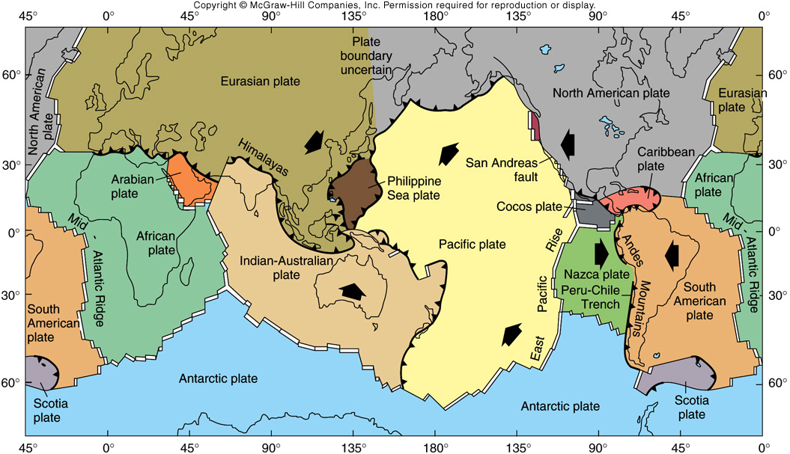
Current Plate Boundaries and Relative Motion

Slide 3
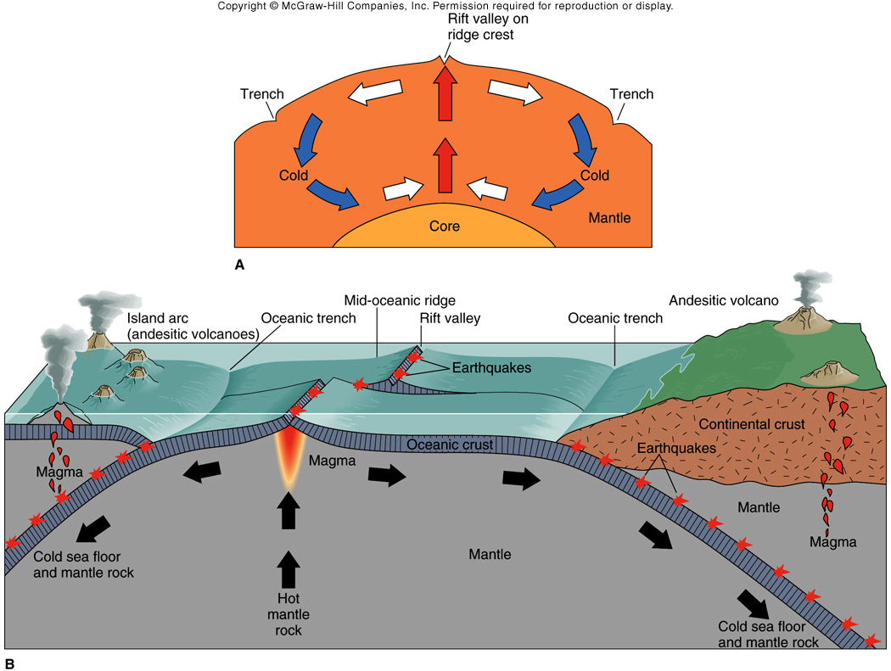
Hess Heat Engine

Slide 4
Convergent Plate Boundaries
Ocean-Ocean Convergence
Ocean-Continent Convergence
Continent-Continent Convergence

Slide 5
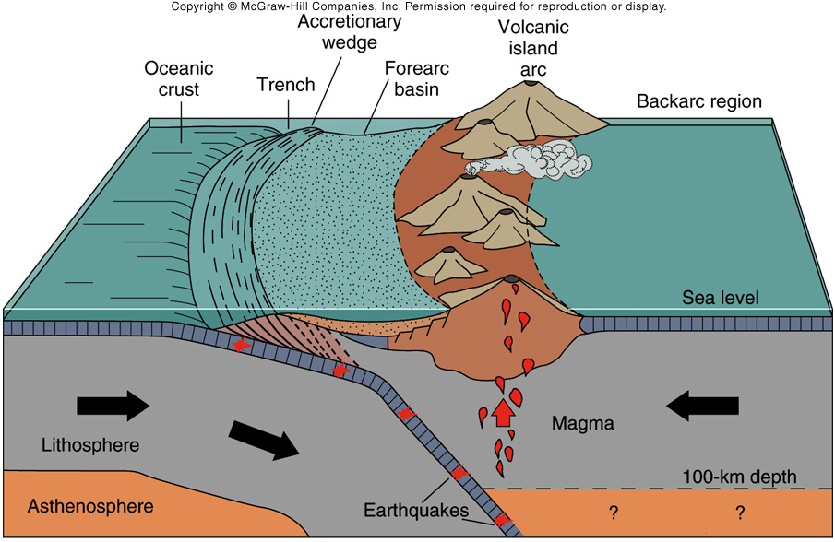
Ocean - Ocean Plate Convergence

Slide 6
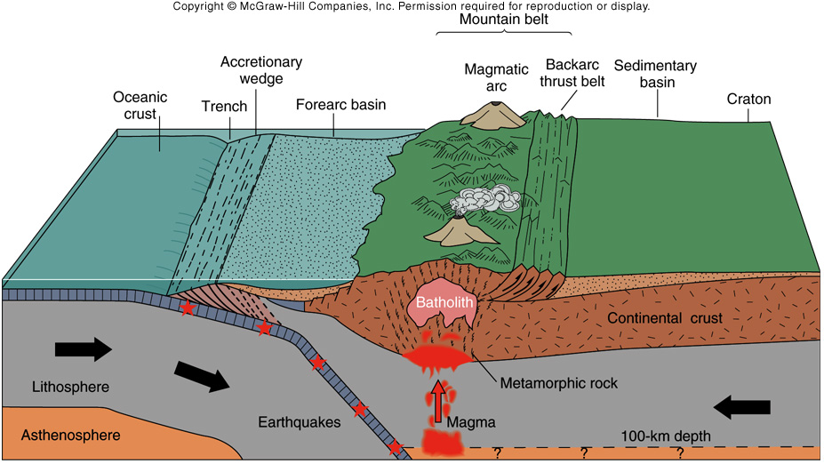
Ocean - Continent Convergence

Slide 7
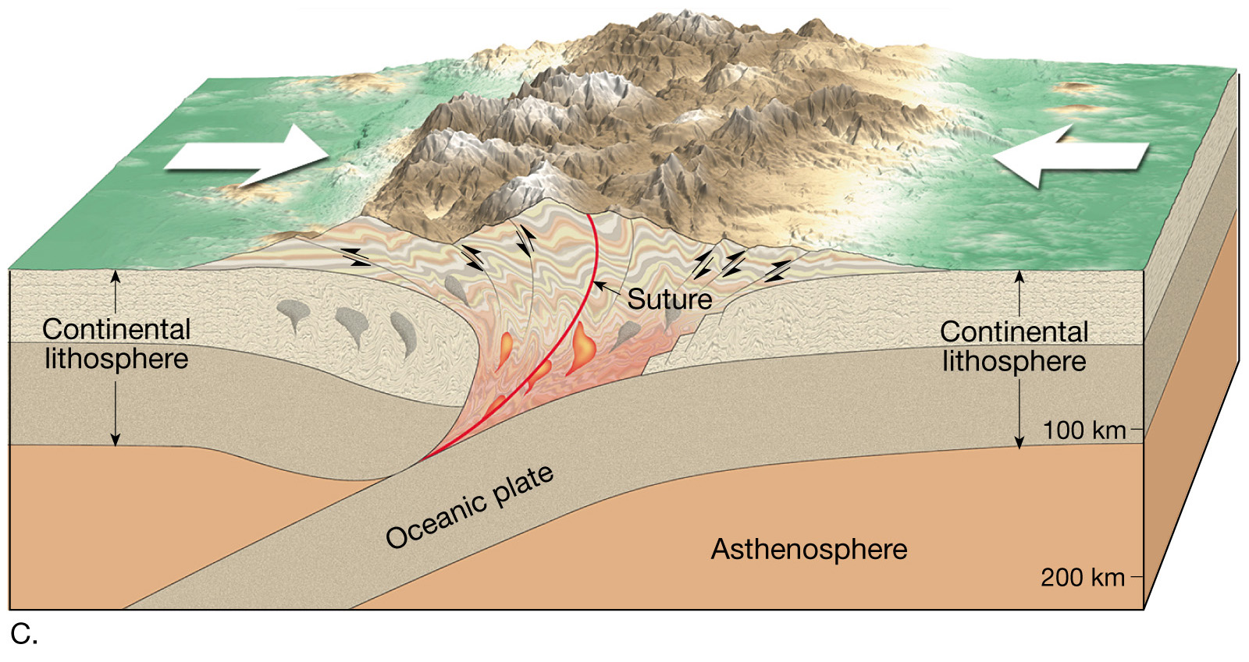
Continent-Continent Convergence

Slide 8
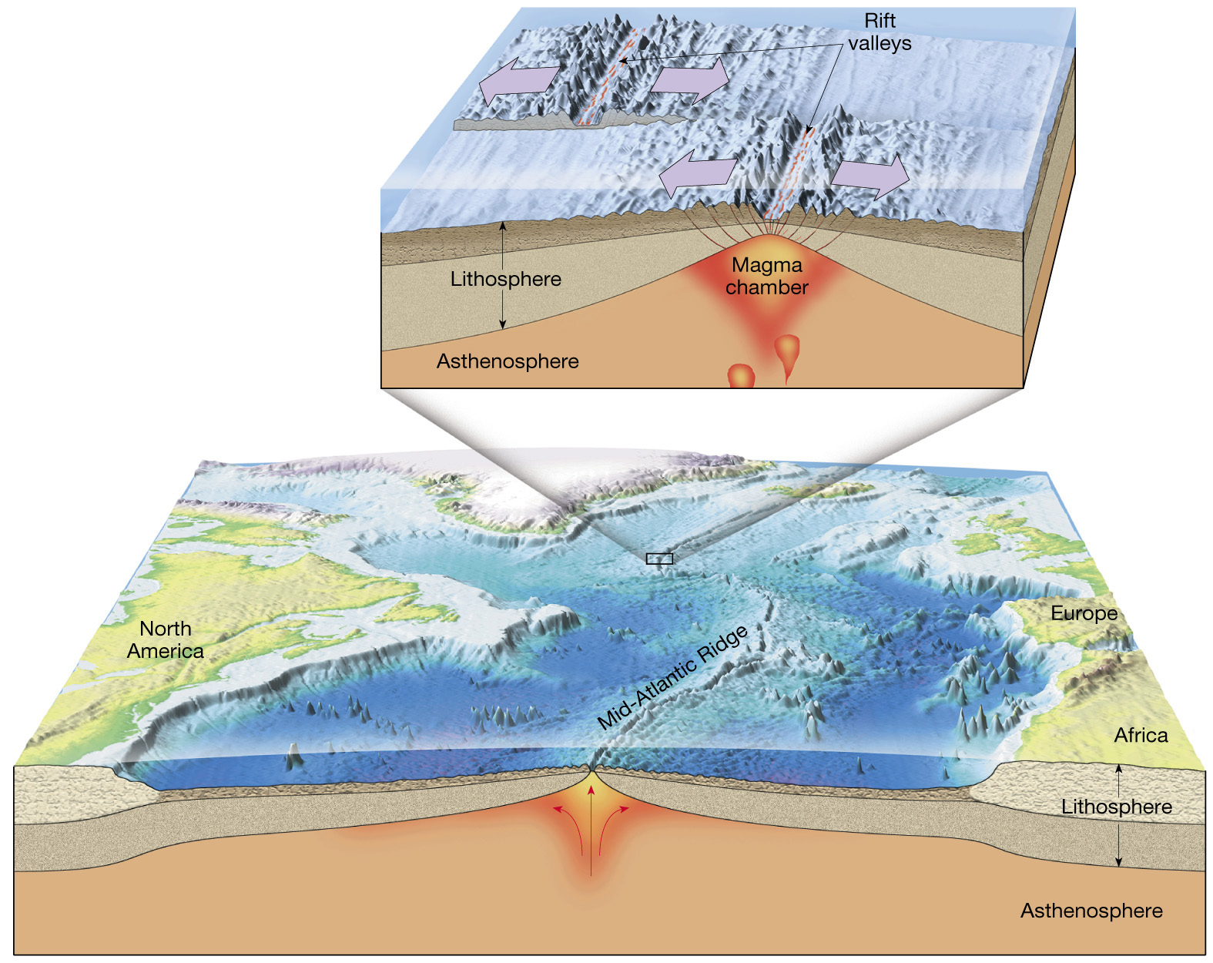
Constructive/diverging plate boundary

Slide 9
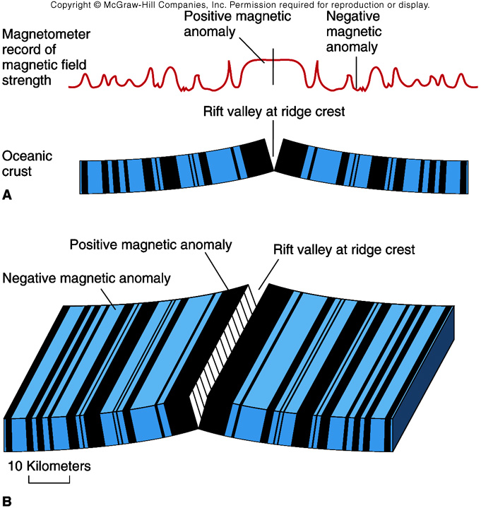
Marine Magnetic Anomalies

Slide 10
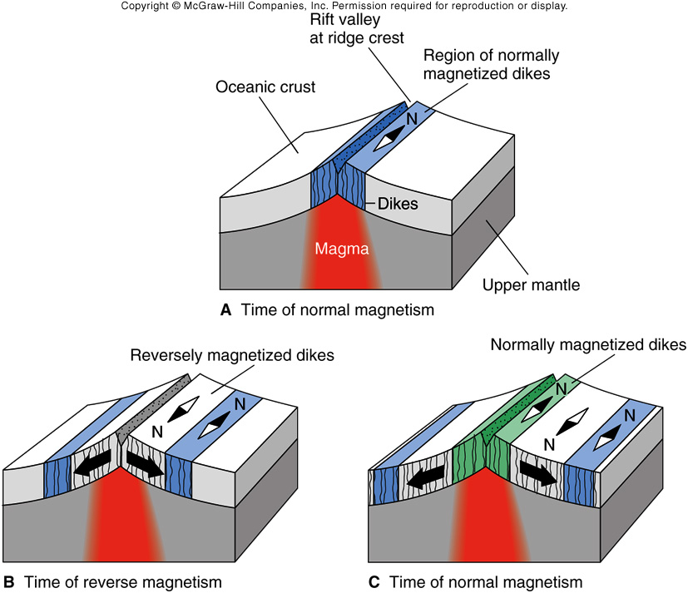
Magnetic Stripe Formation at Ridge Crest

Slide 11
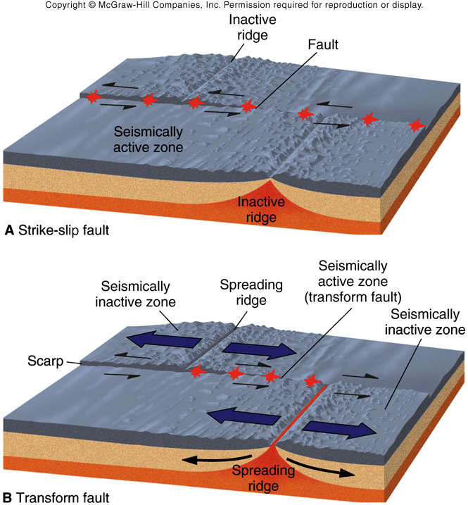

Slide 12
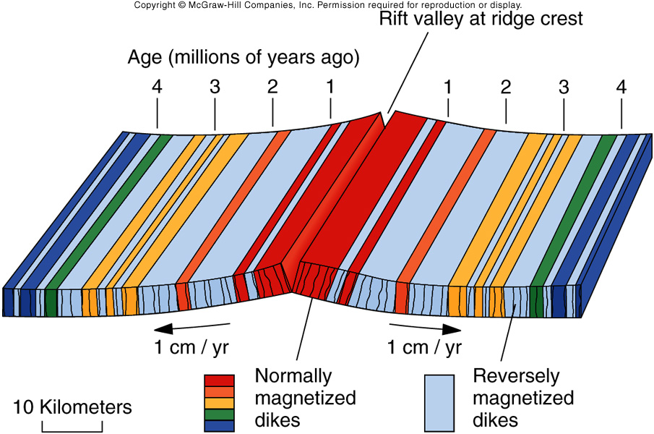
Age vs. Magnetic Polarization

Slide 13
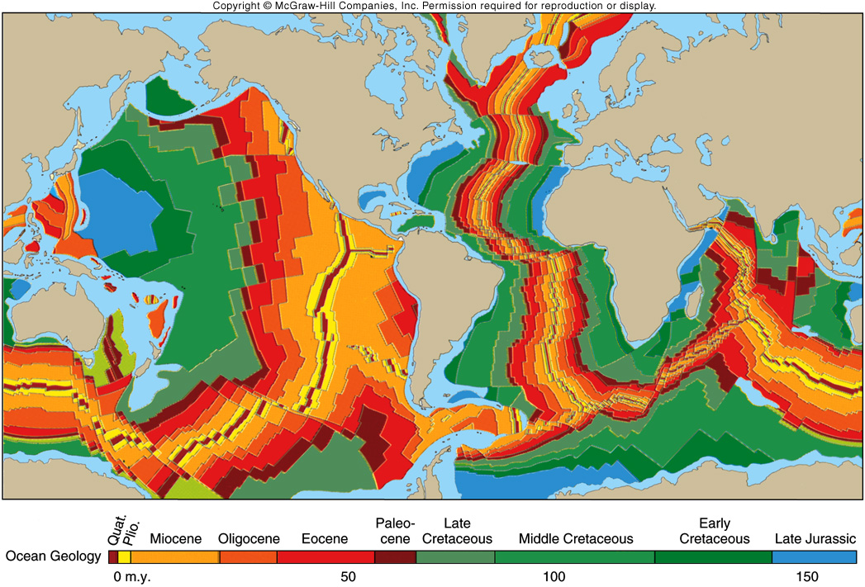
Sea Floor Age Map

Slide 14
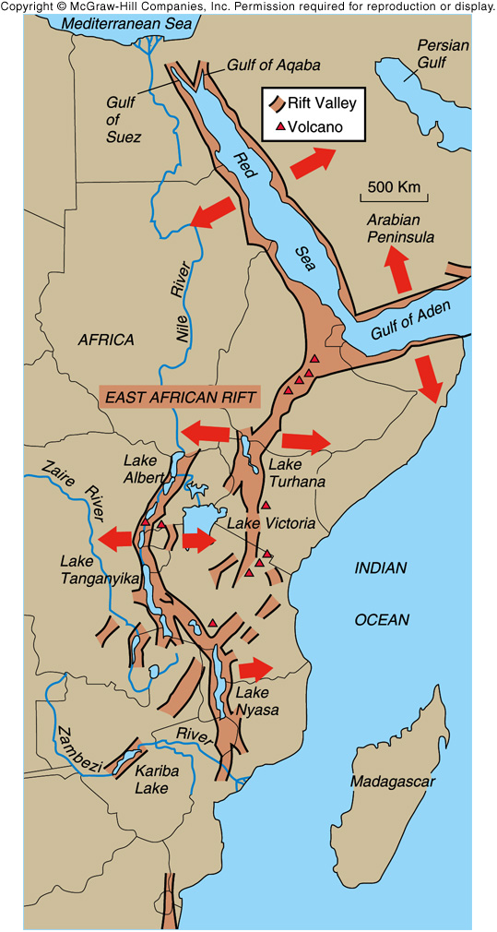
East African Rift System

Slide 15
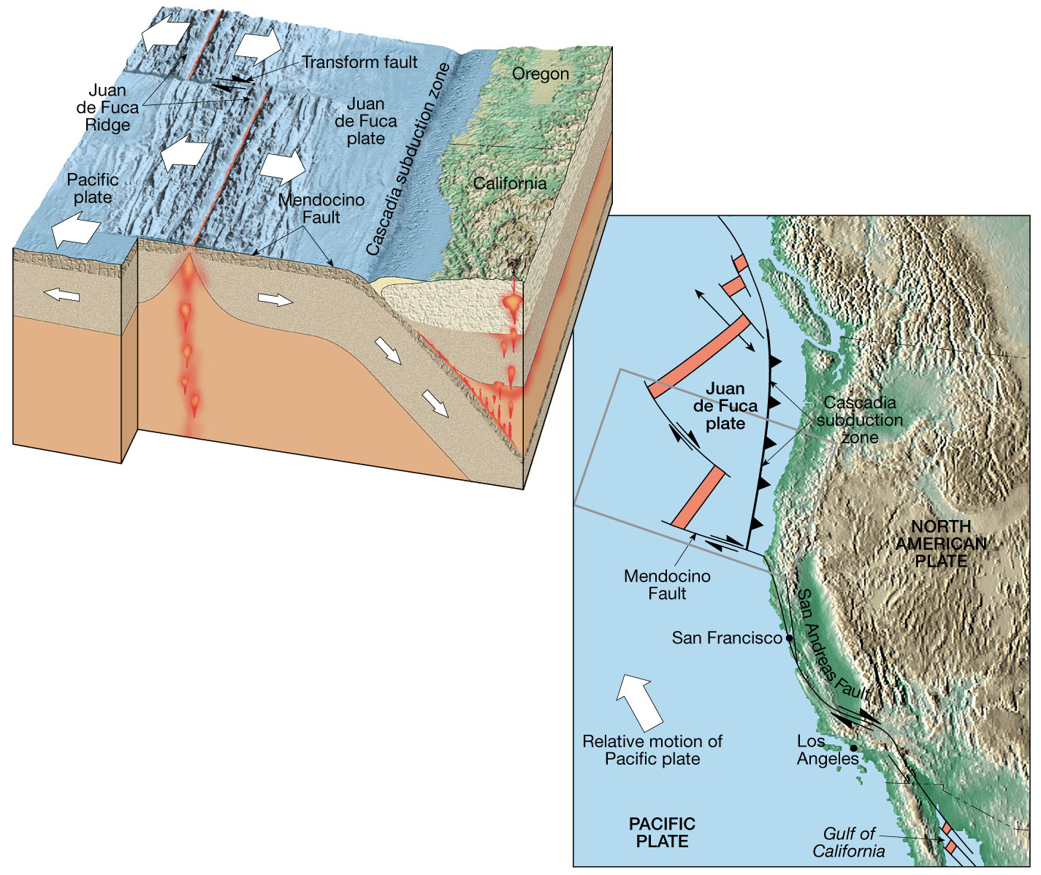
Transform Faults
Notes:
The Juan de Fuca Ridge is offset by several oceanic transform faults. Also shown is the San Andreas Fault, a continental transform fault connecting the Juan de Fuca Ridge and the spreading center in the Gulf of California. Reprinted by permission from Tarbuck, E. J., and Lutgens, F. K., The Earth: An Introduction to Physical Geology, 3rd Ed. (Figs. 18.22, 18.23), Merrill Publishing Company, 1990.

