Slide 1
State Technology Updates
Spring 2018
Steven Sanders, Director of District Technology

Slide 2
District Technology
Notes:
I’d like to start by talking about general district technology and then we’ll focus in a few areas of interest.

Slide 3
District Technology
Primary Customers:
Director of Schools
Technology Director / Coordinator
Instructional Technology Coordinator
EIS Administrator
Infrastructure Manager
Other district leadership

Slide 4
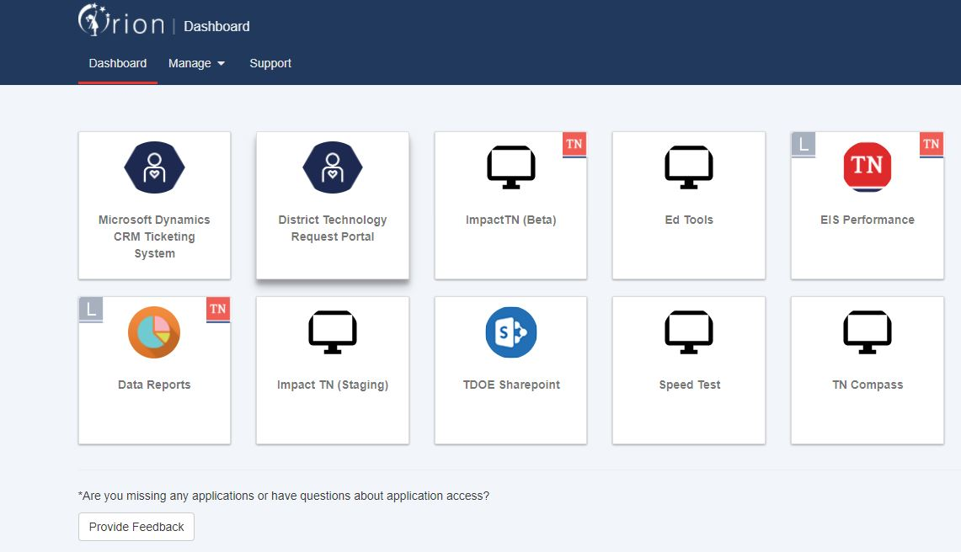
Single Sign On
Single Sign On (SSO) is a program that provides everyone in districts with a single set of credentials that provide access to every state system. The goal is to make it simpler to interact with state systems while improving overall security.
Notes:
Consolidating 23 state apps into 4, with single sign-on credentials (NOT 23)

Slide 5
District Tech Portal
First time sign on instructions
Notes:
Stress that every district user who uses this portal needs to take this step-EIS/SIS admin; Tech admin; Instructional Supervisors; DOS – you may not have logged in because you have not had a helpdesk issue. We still need you to log in to set up your credentials so that you will show up as a contact should you need to open a ticket. I believe it also gives you visibility into past tickets and resolution, etc.

Slide 6
Summary of Products
IT Planning and Policy – 25%
Tech Planning Assistance (AUP, Best Practices, etc.)
Erate Planning and Support
Infrastructure Management and Support – 10%
Helping districts with urgent or critical need where System, Network, Server or Critical Application is down and the situation is severely impacting district or school-wide operations or instruction.
Strategic Procurements – 50%
Statewide Contracts (Erate (32), Laptop Rental (2), SIS Contracts (5)
State Technology Support – 75%
District support and Help Desk (SSO, EIS, EdFi/ImpactTN, TNReady)
Training and Skills Development – 10%
Professional development opportunities, online trainings (EIS, Tech Integration)
Notes:
NEEDS ASSESSMENT – YOUR input!!!

Slide 7
State Communication
Office of District Technology Communication
District Technology Portal
Monthly district newsletters
Training webinars
List serve communications
Conferences
Organizational meetings (TETA)
Contact:
District Technology Service Desk
(800) 495-4154 or (615) 532-6215
Direct Login
DT.support@tn.gov

Slide 8
EIS Help Desk Rebranding
District Technology Service Desk
In an effort to provide additional services and products to districts, TDOE is expanding the EIS Help Desk to District Technology Support.
To make it more easily understood that the scope of the Help Desk has broadened, we are changing the email address from EIS.Help@tn.gov to DT.Support@tn.gov.

Slide 9
EIS Help Desk Rebranding
All Technology Help
Currently, EIS.Help@tn.gov is being forwarded to DT.Support@tn.gov but
beginning July 1, 2018 EIS.Help@tn.gov will no longer be supported.
Districts can begin using DT.Support@tn.gov immediately.

Slide 10
Email Domains
2017-18
We have been working with districts to obtain official district staff email domains. Beginning this spring, all email addresses sent to EIS that are not on the valid domain list will be rejected in extract 60. Please review the information sent to EIS to ensure your data is accurate and on the valid domain list.
2018-19
Additional Email Domain Requirements
Why are we requiring this?

Slide 11
Partnering for Success
The Existing contracts which expire in June 2018 have already been renewed with the existing terms and condition through June 2019. No changes to the contracts for next year.
The state will continue to offer a free hosting service in 2018-19.
Internally, the department has kicked-off the 2019-2020 procurement process, which will take through the 2021-2022 school year.

Slide 12
EdFi / ImpactTN
ImpactTN is an online dashboard for teachers and administrators that provides a cumulative look at a student’s academic performance and credits, as well as their attendance and discipline records.
General student information, such as parent contact information.
One-stop-shop for educators to access real-time information about students in order to make decisions and provide support more efficiently.
March 12, we turned ImpactTN on for all Edfi submitting districts.

Slide 13
Education data system (TEDS)
TEDS work is still underway, the reference architecture is complete, and it’s currently in the design and ‘component testing’ phase.
The name will not be TEDS!

Slide 14
Enhanced Data Entry
Always try to use SIS package first! This will ensure that the data will not be overwritten by the normal extract process.
Enhanced Data Entry will be available for last resort data correction next school year.

Slide 15
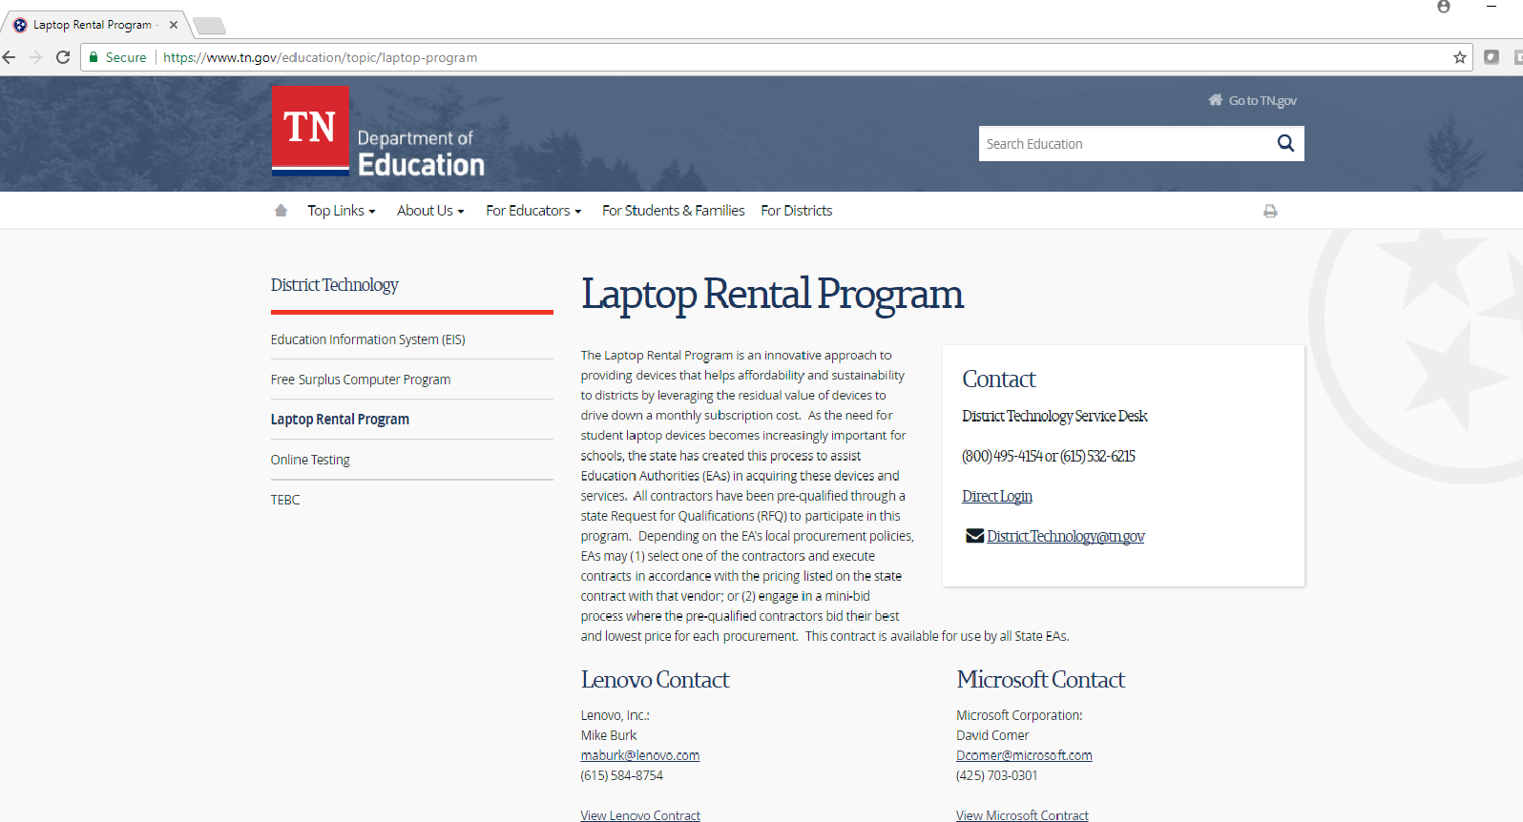
Laptop Rental Program
Notes:
More choices to come besides Lenovo and Microsoft. Procurement process Spring, 2018

Slide 16
2017-2018 Erate Program
136 Public School District Applicants
10 Charter School Consortia
38 Private/Charter/Special Schools
Total E-Rate Support Requested: $77,623,616.64

Slide 17
District Technology Integration
Learning from Lighthouse Districts all across Tennessee
Engage with thought Leaders from districts and organizations driving innovation in K12 technology and integration
School Districts are asking for more focused educational and professional development opportunities for specific school technologies and best practices.

Slide 18
Types of Technology Integration
Online Learning and Blended Learning
Game-Based Learning and Assessment
Learning with Mobile and Handheld Devices
Collaborative Online Tools
Project-Based Activities
Tennessee thought leaders who “get IT”
Connecting the dots

Slide 19
Other Support
You Decide!
Stakeholder Input!
For more information, contact
district.technology@tn.gov
Notes:
What does your district currently use for LMS? Procurement is about to begin at state level. Go back to buckets of services slide…

