Slide 1
Tennessee Succeeds: ESSA in Tennessee
Attendance Conference
Laura Encalade I Chief of Staff I April 20, 2017

Slide 2
Our Vision
Districts and schools in Tennessee will exemplify excellence and equity such that all students are equipped with the knowledge and skills to successfully embark upon their chosen path in life.

Slide 3
Our Big Goals

Slide 4
Our Priorities

Slide 5
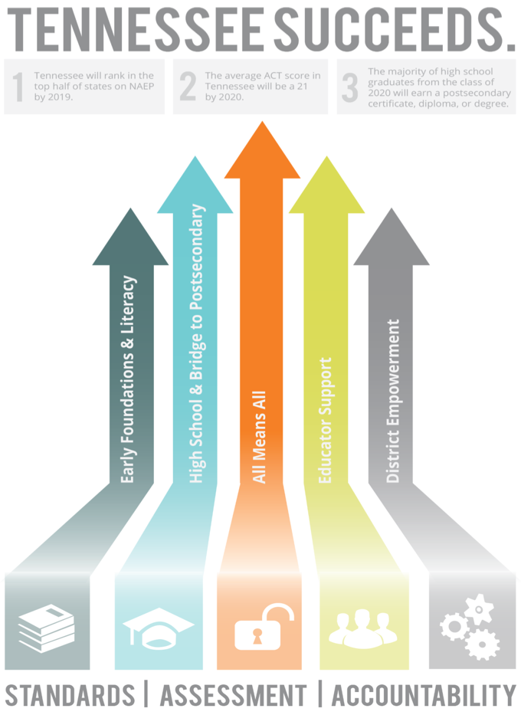
Highlights from the past year
Launched Tennessee Succeeds & Read to be Ready
Continue to be fastest improving state on NAEP
Notes:
Science
4th grade—19th
8th grade—21st
Closed the achievement gap for male and female students
RBTR
Summer grant program—20 programs, more than 100 programs
Coaching network in about 83 districts more than 200 coaches 330 schools

Slide 6
Highlights from the past year
Increased # of college credits attained among high school students – almost 7,500 more AP credits earned
7th among 18 states that require ACT for all students — up from 8th among 13 states last year
Notes:
Increased to 19.9 average ACT score with 3,000 more test takers - nationally scores declined as more students participated
Nearly 1,300 more students achieved 21 or higher
Almost 26,000 students participated in the ACT retake

Slide 7
Highlights from the past year
Improved graduation rate for fourth year in a row to 88.5%
Leader in FAFSA completion
Improved in college-going by 5% — this represents more than combined % increase from past 7 years
Notes:
All time high on grad rate
Continuing to improve the college going rate, less likely to need than in previous years remdiation in previous years

Slide 8
Highlights from the past year
Made historic investment in BEP
Approved new math and ELA standards
Moved several steps forward on assessment
First year of TNReady; changed baseline to match postsecondary and workforce expectations
Assessment Task Force: new optional 2nd grade assessment, ACT Retake, reduced test time for this year
Improved stakeholder feedback loops including CC Tour

Slide 9
ESSA in Tennessee

Slide 11
Notes:
The spirit of ESSA, the federal education law, is to shine a light on inequity and ensure equity for all students. By drafting our state plan aligned to our strategic plan, you can see that equity is a theme throughout every section.
Today, I’m going to walk through the five priority areas and highlight some of the ways in which we are supporting equity as a state.

Slide 12
Every Student Succeeds Act
The Every Student Succeeds Act was signed into law Dec. 2015 and replaced No Child Left Behind.
ESSA provides increased flexibility and contains new policies that will affect existing systems and structures for assessment, accountability, and reporting in Tennessee.
TDOE released a draft plan in Dec. 2016, based on stakeholder input, that aligns to Tennessee Succeeds.
Tennessee submitted its finalized ESSA plan on April 3, 2017.
Notes:
Key differences – highlight the shift to more control and decision making at the state and local level. New requirement for school quality and student success indicator in the accountability framework.

Slide 13
Timeline for Developing TN’s ESSA Plan
Kick- off
Stakeholder Input
Writing the Plan
Stakeholder Feedback
Approving the Plan
May 2016
June–Sept. 2016
Sept.–Nov.
2016
Dec. 2016– Jan. 2017
Feb.–March. 2017
Stakeholders included directors of schools, principals, educators, parents and students, legislators, governor’s office, state board of education, school board members, CORE offices, community organizations, and advocacy groups.

Slide 14
Stakeholder Engagement
Six working groups with 67 members across the state
3,000+ stakeholders provided input over the summer
Dozens of listening sessions and informational meetings with teachers, parents, community members, advocates, and legislators
Six town hall meetings over December and January
1,000+ stakeholders attended town halls
2,000+ comments received through online and written feedback

Slide 15
New Measure of School Quality and Student Success

Slide 16
Indicator: Measure of School Quality and Student Success
Chronically out of school indicator measures chronic absenteeism rate, including out of school suspension.
Schools will be measured based on either low chronic absenteeism rate or reducing the rate
A student is chronically absent if he/she misses 18 or more days of school, or about 10% of the school year
Additional measures for this indicator will continue to be reviewed for use in future years
Notes:
Two pathways on the chronically out of school measures—rate and growth (reducing rate)
ESSA requires school-level accountability to include a new measure of school quality and student success.
The new measure is in addition to academic indicators.
The department will continue to review ways to improve and incorporate discipline data
Students cannot learn if they are not in school. It is important we continue to refine school discipline practices and the collection of data

Slide 17
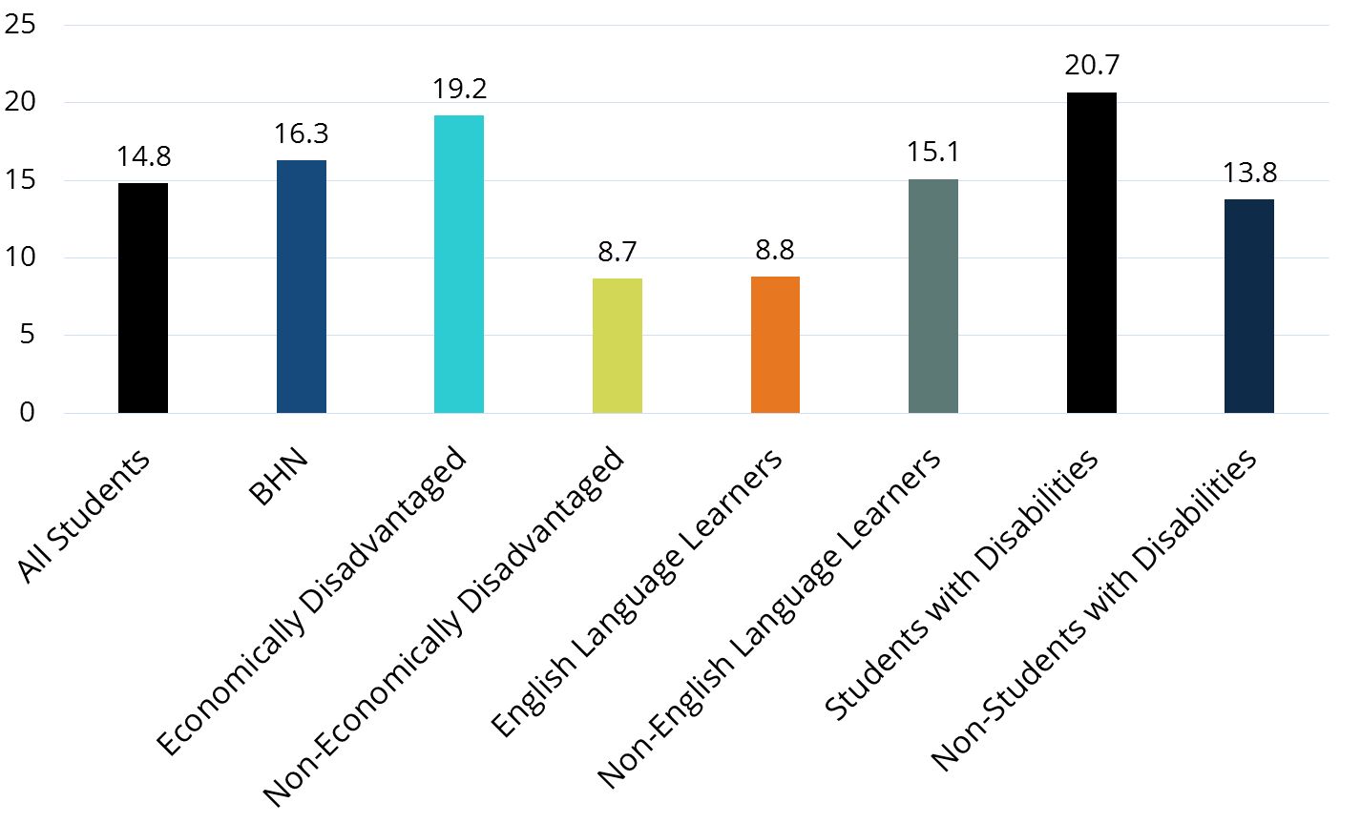
2014-15 Chronic Absent Rate
Notes:
Graph: Average of all students (all grades) in 2014-15. All students =14.8 % and non ED and EL have lower rates.
Multiple research studies link poor attendance with reduced academic outcomes. Harmful effects of poor attendance are cumulative and only looking at overall average daily attendance rates tend to mask attendance problems, particularly within subgroups. In fact, economically disadvantaged students are 3x more likely to be chronically absent than non-economically disadvantaged students. Similar trends exist with other historically underserved student groups including students with disabilities.
Tennessee attendance data for 2014-15 showed that 23.6% of P–4 students are chronically absent, and 25.4% of seniors are chronically absent. In addition, as absences increase in freshman year, the likelihood that a student will graduate on time decreases. 62% of ninth grade students were chronically absent. The data also showed that some student groups are overrepresented in the chronically-absent student population that includes students with disabilities 16.5%, economically disadvantaged 17.5%, and African American 17%.
As illustrated in the chart, during the 2014-15 school year, economically disadvantaged students in the third grade were chronically absent at a rate three-times higher than their non-economically disadvantaged peers. While around three percent of non-economically disadvantaged students are chronically absent in third grade, around 11% of economically disadvantaged students are chronically absent. Students with disabilities are also more likely to be chronically absent; over 12% of students who are classified as having a disability are chronically absent relative to 7% of non-SWD students.

Slide 18
District Accountability Areas
Six Areas
3-5 Success Rate* | 6-8 Success Rate* | 9-12 Success Rate*
Chronically Out of School | Graduation Rate + Ready Graduate | K-12 English Language Proficiency Assessment (ELPA)
*Success rate includes science, ELA, math and ACT/SAT composite. It may also include social studies in future years.
Notes:
Content areas aren’t the same as indicators. Pathways are similar to indicators.

Slide 19
Chronically Out of School Pathways
Absolute Performance: Percent of students who are chronically absent in the district
or
AMO Targets: Target to reduce the percent of students who are chronically absent in the district (cohort-level comparison)
and
Value-Added: Student-level comparison to measure reduction in chronic absenteeism for specific students who were chronically absent in the prior year
Growth expectation based on current year state performance

Slide 21
Supporting All Students

Slide 22
Multi-Tiered Systems of Supports
Definition:
Tennessee’s multi-tiered systems of supports (MTSS) framework is an over-arching overview of practices, programs, and interventions that meet students’ needs both within an individual classroom and across the school building.
Notes:
We are releasing this framework and an accompanying online toolkit on April 26. Note that this is not a new requirement; rather, it is a way to think about our existing strategies to support all students in a holistic fashion. As we know from RTI2, Tier I is appropriate for and benefits all students while Tiers II and III are designed to meet the needs of specific student groups. We can think about that in terms of academics, like we do with RTI2, or other topics like attendance. Positive school attendance norms benefit all students. Students who are chronically out of school for different reasons need different types of supports and interventions in a multi-tiered system.

Slide 23
MTSS Encompasses
Notes:
Many programs and initiatives you already do fall under the MTSS framework – some are instructional in nature, others are supports for well-rounded students. This list is not exhaustive – every school and district will prioritize different programs for each tier of the MTSS. The most important point is to intentionally use data about your students’ needs to tailor your suite of programs over time and use data and evidence to refine your practices. For example, you may review your existing programs and determine you have several character and leadership building programs in Tier I but lack critical tiered interventions for students who are chronically out of school. Perhaps you could limit your focus to the most effective Tier I programming and turn further attention to your tiered attendance supports.

Slide 24
Guiding Principles
Coherence is key.
Effective, engaging instruction is THE most important factor in supporting student success.
Implementation that is student-focused can and should vary intentionally in design between schools and even over time.
Notes:
When a school or district reviews the MTSS framework and determines how to implement it in their own context, there are three guiding principles.
Coherence is key. The MTSS framework will help schools organize and refine their existing practices within the MTSS umbrella to come to a coherent vision and strategy for supporting all students on their path to postsecondary success.
Effective, engaging instruction is THE most important factor in supporting student success. Strong Tier I practices are the backbone of an effective system of supports. Tier I encompasses all the work schools do with all students: standards-aligned academic instruction, school culture, attendance norms, behavior expectations, and more.
Implementation that is student-focused can and should vary in design between schools and even over time. School teams must review their data to determine focus areas each year to ensure that they continue to meet students’ needs, and district teams must ensure adequate time and resources for school teams to reflect and flexibly adjust their programming.

Slide 25
Next Steps
The MTSS Framework and online toolkit will be available on April 26 on the department website.
ESSA and Student Supports Webinar: April 26 at 2:00 pm. Access information is available: www.tn.gov/education/ESSA
Collaborate with your district and schools to ensure attendance is a priority and that clear, accurate data are available.

Slide 26
All of us ensure Tennessee Succeeds

