Slide 1
Pharmacology update 2024: What’s New in Cancer Treatment
Teresa Knoop, MSN, RN, AOCN®-Emeritus
Independent Nurse Consultant
teresaknoop44@gmail.com

Slide 2
Disclosures
Teresa Knoop is on the advisory board for Frenesius-Kabi and is a speaker receiving honoraria for McKesson, ​ION AmeriSource Bergen, and Physicians Education Resource
Relevant financial relationships have been mitigated.​

Slide 3
Session Objectives
Recognize current trends in cancer treatment
Identify new drugs/agents that have been FDA approved for cancer treatment in 2024
Identify how to gain information about new drugs based on the generic (non-proprietary) naming system
Recognize how new drugs/agents are given generic names, and how to gain information based on the naming system.

Slide 4
Progress in Cancer Therapy
New FDA Approved Cancer Treatment Agents (1/1/2024 to 9/26/2024)
8 new drugs
8 solid tumor indications; 0 hematologic indications
5 Molecularly Targeted/Immunotherapy
1 IL-15 agonist immunotherapy
2 Cellular Therapies
FDA, 2024

Slide 5
Progress in Cancer Therapy
Additional FDA Approved Cancer Treatment Agent Indications (1/1/2024 to 9/26/24)
26 drugs with 33 additional disease indications
FDA, 2024

Slide 6
Trends

Slide 7
Trends
Immunotherapy and Molecular Therapies
New Drugs and Expanded indications
Neoadjuvant/adjuvant
Metastatic and locally advanced treatment
Maintenance after primary treatment
New generations of drugs to treat drug resistance
New drugs and indications for pediatric patients
FDA, 2024

Slide 8
Trends
Subcutaneous Formulations of Immunotherapy and Molecular Therapies
First subcutaneous immunotherapy checkpoint inhibitor approved: atezolizumab and hyaluronidase-tqjs (NEW 2024)
Approved for non-small cell lung cancer (NSCLC), small cell lung cancer (SCLC), hepatocellular carcinoma (HCC), melanoma, and alveolar soft part sarcoma (ASPS)
FDA, 2024

Slide 9
Trends
Biosimilars
A biological product that is approved based on a showing that it is highly similar to an already-approved biological product, known as a reference or originator product. No clinically meaningful differences in terms of safety and effectiveness from the reference product. Only minor differences in clinically inactive components are allowable in biosimilar products. More cost effective.
As of 9/26/2024 the number of cancer biosimilars approved by the FDA include:
12 for cancer supportive care and 14 for cancer treatment
bevacizumab-tnjn Avzivi®: 5th biosimilar with bevacizumab as originator product
trastuzumab-strf Hercessi™: 6th biosimilar with trastuzumab as originator product
FDA, 2024

Slide 10
Trends
Cellular Therapies
8 new therapies FDA approved for cancer treatment since 2017, with expanding indications; more in clinical trials development: tisagenlecleucel, axicabtagene ciloleucel, brexucabtagene autoleucel, lisocabtagene maraleucel, idecabtagene vicleucel, ciltacabtagene autoleucel, lifileucel, afamitresgene autoleucel
Stem is “leucel”
First cellular therapy for a solid tumor (melanoma) approved in 2024: Tumor-derived autologous T cell immunotherapy lifileucel Amtagvi™
Second cellular therapy for solid tumor (sarcoma) approved in 2024: Tumor-derived autologous T cell immunotherapy afamitresgene autoleucel TECELRA®
FDA, 2024

Slide 11
Trends
Bispecific Immunomodulatory Drugs
Fusion Proteins
Monoclonal Antibodies
FDA, 2024

Slide 12
Trends
Genomic Taxonomy: Use of appropriate terminology to ensure patient safety and quality
A shift from use of “mutation” to “variant” Use of the term “mutation” can cause confusion and medical errors. A shift to “Biomarkers and Biomarker Testing” rather than terms such as molecular, tumor or genomic profiling
Biomarker may or may not be “actionable” which means there is a drug designed to target that biomarker
DNA sequencing technology has evolved rapidly and can detect multiple types of genomic variations which can be:
Benign
Likely benign
Of uncertain significance
Likely pathogenic
Pathogenic (disease causing)
ONS 2024

Slide 13
Trends
Tumor Agnostic Drugs: Drugs designed to treat Biomarkers; not tumor histology specific
selpercatinib Retevmo™ Eli Lilly and Company: locally advanced or metastatic solid tumors with a RET gene fusion, that have progressed on or following prior systemic treatment or who have no satisfactory alternative treatment options (2024)
fam-trastuzumab deruxtecan-nxki Enhertu® Daiichi Sankyo, Inc.: adult patients with unresectable or metastatic HER2-positive (IHC3+) solid tumors who have received prior systemic treatment and have no satisfactory alternative treatment options (2024)
FDA 2024

Slide 14
Trends
Tumor Agnostic Drugs (cont)
repotrectinib AUGTYRO™ Bristol-Myers Squibb Company: for adult and pediatric patients 12 years and older with solid tumors that have a neurotrophic tyrosine receptor kinase (NTRK) gene fusion, are locally advanced or metastatic or where surgical resection is likely to result in severe morbidity, and that have progressed following treatment or have no satisfactory alternative therapy. (2024)
FDA 2024

Slide 15
Trends
Tumor Agnostic Drugs (cont)
entrectinib Rozlytrek® Genentech Inc.: neurotrophic tyrosine receptor kinase (NTRK) gene fusion without a known acquired resistance mutation,
larotrectinib Vitrakvi ® Bayer Healthcare: neurotrophic receptor tyrosine kinase (NTRK) gene fusion without a known acquired resistance mutation
alpelisib Vijoice® Novartis Pharmaceuticals: PIK3CA-related overgrowth spectrum (PROS)
dabrafenib Tafinlar® Novartis: in combination with trametinib Mekinist® Novartis: BRAF V600E mutation
FDA 2024

Slide 16
Trends
Tumor Agnostic Drugs (cont)
dostarlimab Jemperli GlaxoSmithKline: defect in mismatch repair gene (dMMR)
pembrolizumab Keytruda ® Merck:
A high level of microsatellite instability (MSI-H) or a defect in a mismatch repair gene (dMMR)
A high tumor mutational burden (TMB-H), meaning the cancer cells have many gene mutations
FDA 2024

Slide 17
Disease-Specific Progress

Slide 18
Progress in Cancer Therapy
Breast
ribociclib Kisqali ® Novartis Pharmaceuticals Corporation: with an aromatase inhibitor for the adjuvant treatment of adults with hormone receptor (HR)-positive, human epidermal growth factor receptor 2 (HER2)-negative stage II and III early breast cancer at high risk of recurrence. Additionally, FDA also approved the ribociclib and letrozole co-pack Kisqali ® Femara ® Co-Pack, Novartis Pharmaceuticals Corporation) for the same indication (2024)
FDA 2024

Slide 19
Progress in Cancer Therapy
Non-Small Cell Lung Cancer (NSCLC)
lazertinib Lazcluze™ Janssen Biotech, Inc.: in combination with amivantamab-vmjw Rybrevant® Janssen Biotech, Inc.: for the first-line treatment of locally advanced or metastatic non-small cell lung cancer (NSCLC) with epidermal growth factor receptor (EGFR) exon 19 deletions or exon 21 L858R substitution mutations (NEW 2024)
atezolizumab and hyaluronidase-tqjs Tecentriq Hybreza™, Genentech, Inc. for subcutaneous injection for all the adult indications as the intravenous formulation of atezolizumab (Tecentriq®, Genentech, Inc.), including non-small cell lung cancer (NSCLC) (NEW 2024)
FDA 2024

Slide 20
Progress in Cancer Therapy
Non-Small Cell Lung Cancer (NSCLC cont)
osimertinib Tagrisso® AstraZeneca Pharmaceuticals LP: with platinum-based chemotherapy for patients with locally advanced or metastatic non-small cell lung cancer (la/mNSCLC) whose tumors have EGFR exon 19 deletions or exon 21 L858R mutations (2024)
osimertinib Tagrisso® AstraZeneca Pharmaceuticals: adult patients with locally advanced, unresectable (stage III) non-small cell lung cancer (NSCLC) whose disease has not progressed during or following concurrent or sequential platinum-based chemoradiation therapy and whose tumors have EGFR exon 19 deletions or exon 21 L858R mutations (2024)
FDA 2024

Slide 21
Progress in Cancer Therapy
Non-Small Cell Lung Cancer (NSCLC cont)
amivantamab-vmjw Rybrevant™ Janssen Biotech, Inc.: with carboplatin and pemetrexed for the first-line treatment of locally advanced or metastatic non-small cell lung cancer (NSCLC) with epidermal growth factor receptor (EGFR) exon 20 insertion mutations (2024)
amivantamab-vmjw Rybrevant™ Janssen Biotech, Inc.: with carboplatin and pemetrexed for adult patients with locally advanced or metastatic non-small cell lung cancer (NSCLC) with epidermal growth factor receptor (EGFR) exon 19 deletions or exon 21 L858R substitution mutations whose disease has progressed on or after treatment with an EGFR tyrosine kinase inhibitor (2024)
FDA 2024

Slide 22
Progress in Cancer Therapy
Non-Small Cell Lung Cancer (NSCLC cont)
alectinib Alecensa® Genentech, Inc: adjuvant treatment following tumor resection in patients with anaplastic lymphoma kinase (ALK)-positive non-small cell lung cancer (NSCLC) (2024)
tepotinib Tepmetko® EMD Serono, Inc.: adult patients with metastatic non-small cell lung cancer (NSCLC) harboring mesenchymal-epithelial transition (MET) exon 14 skipping alterations (2024)
durvalumab Imfinzi® AstraZeneca: with platinum-containing chemotherapy as neoadjuvant treatment, followed by single-agent durvalumab as adjuvant treatment after surgery for adults with resectable (tumors ≥ 4 cm and/or node positive) non-small cell lung cancer (NSCLC) and no known epidermal growth factor receptor (EGFR) mutations or anaplastic lymphoma kinase (ALK) rearrangements (2024)
FDA 2024

Slide 23
Progress in Cancer Therapy
Small Cell Lung Cancer (SCLC)
tarlatamab-dlle Imdelltra™ Amgen, Inc.: extensive stage small cell lung cancer (ES-SCLC) with disease progression on or after platinum-based chemotherapy (NEW 2024)
atezolizumab and hyaluronidase-tqjs Tecentriq Hybreza™, Genentech, Inc. for subcutaneous injection for all the adult indications as the intravenous formulation of atezolizumab (Tecentriq, Genentech, Inc.), including small cell lung cancer (SCLC) (NEW 2024)
FDA 2024

Slide 24
Progress in Cancer Therapy
Pleural Mesothelioma
pembrolizumab Keytruda® Merck: with pemetrexed and platinum chemotherapy as first-line treatment of unresectable advanced or metastatic malignant pleural mesothelioma (MPM) (2024)
FDA 2024

Slide 25
Progress in Cancer Therapy
Endometrial
durvalumab Imfinzi®, AstraZeneca UK Limited: with carboplatin plus paclitaxel followed by single-agent durvalumab for adult patients with primary advanced or recurrent endometrial cancer that is mismatch repair deficient (dMMR) (2024)
pembrolizumab Keytruda®, Merck: with carboplatin and paclitaxel, followed by single-agent pembrolizumab, for adult patients with primary advanced or recurrent endometrial carcinoma (2024)
dostarlimab-gxly Jemperli, GSK: with carboplatin and paclitaxel, followed by single-agent dostarlimab-gxly, for adult patients with primary advanced or recurrent endometrial cancer (EC) (2024)
FDA 2024

Slide 26
Progress in Cancer Therapy
Cervical
pembrolizumab Keytruda® Merck: with chemoradiotherapy (CRT) for patients with FIGO 2014 Stage III-IVA cervical cancer (2024)
tisotumab vedotin-tftv Tivdak® Seagen Inc.:[now a part of Pfizer Inc.]): recurrent or metastatic cervical cancer with disease progression on or after chemotherapy (2024 traditional approval)
Ovarian
mirvetuximab soravtansine-gynx Elahere™ ImmunoGen, Inc.(now a part of AbbVie]): adult patients with FRα positive, platinum-resistant epithelial ovarian, fallopian tube, or primary peritoneal cancer, who have received one to three prior systemic treatment regimens (2024)
FDA 2024

Slide 27
Progress in Cancer Therapy
Pancreatic
irinotecan liposome Onivyde® Ipsen Biopharmaceuticals, Inc.: with oxaliplatin, fluorouracil, and leucovorin, for the first-line treatment of metastatic pancreatic adenocarcinoma (2024)
Colorectal
adagrasib Krazati® Mirati Therapeutics, Inc. plus cetuximab for adults with KRAS G12C-mutated locally advanced or metastatic colorectal cancer (CRC), who have received prior treatment with fluoropyrimidine-, oxaliplatin-, and irinotecan-based chemotherapy (2024)
FDA 2024

Slide 28
Progress in Cancer Therapy
Hepatocellular
atezolizumab and hyaluronidase-tqjs Tecentriq Hybreza™, Genentech, Inc. for subcutaneous injection for all the adult indications as the intravenous formulation of atezolizumab (Tecentriq, Genentech, Inc.), including hepatocellular carcinoma (HCC) (NEW 2024)
FDA 2024

Slide 29
Progress in Cancer Therapy
Urothelial Carcinoma
erdafitinib Balversa® Janssen Biotech: adult patients with locally advanced or metastatic urothelial carcinoma (mUC) with susceptible FGFR3 genetic alterations, whose disease has progressed on or after at least one line of prior systemic therapy. Erdafitinib is not recommended for the treatment of patients who are eligible for and have not received prior PD-1 or PD-L1 inhibitor therapy. This approval amends the indication previously granted under accelerated approval for patients with mUC with susceptible FGFR3 or FGFR2 alterations after prior platinum-containing chemotherapy (2024)
nivolumab Opdivo® Bristol-Myers Squibb Company: in combination with cisplatin and gemcitabine for first-line treatment of adult patients with unresectable or metastatic urothelial carcinoma (UC) (2024)
FDA 2024

Slide 30
Progress in Cancer Therapy
Bladder
nogapendekin alfa inbakicept-pmln Anktiva®, Altor BioScience, LLC: with Bacillus Calmette-Guérin (BCG) for adult patients with BCG-unresponsive non-muscle invasive bladder cancer (NMIBC) with carcinoma in situ (CIS) with or without papillary tumors (NEW 2024)
FDA 2024

Slide 31
Progress in Cancer Therapy
Melanoma
lifileucel Amtagvi™ Iovance Biotherapeutics, Inc.: a tumor-derived autologous T cell immunotherapy, for adult patients with unresectable or metastatic melanoma previously treated with a PD-1 blocking antibody, and if BRAF V600 positive, a BRAF inhibitor with or without a MEK inhibitor (NEW 2024)
atezolizumab and hyaluronidase-tqjs Tecentriq Hybreza™, Genentech, Inc. for subcutaneous injection for all the adult indications as the intravenous formulation of atezolizumab (Tecentriq, Genentech, Inc.), including melanoma (NEW 2024)
FDA 2024

Slide 32
Progress in Cancer Therapy
Alveolar Soft Part Sarcoma
atezolizumab and hyaluronidase-tqjs Tecentriq Hybreza™, Genentech, Inc. for subcutaneous injection for all the adult indications as the intravenous formulation of atezolizumab (Tecentriq, Genentech, Inc.), including alveolar soft part sarcoma (ASPS) (NEW 2024)
Sarcoma
afamitresgene autoleucel TECELRA®, Adaptimmune, LLC: a melanoma-associated antigen A4 (MAGE-A4)-directed genetically modified autologous T cell immunotherapy, for adults with unresectable or metastatic synovial sarcoma who have received prior chemotherapy, are HLA-A*02:01P, -A*02:02P, -A*02:03P, or -A*02:06P positive and whose tumor expresses the MAGE-A4 antigen as determined by FDA-approved or cleared companion diagnostic devices (NEW 2024)
FDA 2024

Slide 33
Progress in Cancer Therapy
Pediatric low grade glioma
tovorafenib Ojemda™ Day One Biopharmaceuticals, Inc.: patients 6 months of age and older with relapsed or refractory pediatric low-grade glioma (LGG) harboring a BRAF fusion or rearrangement, or BRAF V600 mutation (NEW 2024)
Astrocytoma or Oligodendroglioma
vorasidenib Voranigo®, Servier Pharmaceuticals LLC: an isocitrate dehydrogenase-1 (IDH1) and isocitrate dehydrogenase-2 (IDH2) inhibitor, for adult and pediatric patients 12 years and older with Grade 2 astrocytoma or oligodendroglioma with a susceptible IDH1 or IDH2 mutation, following surgery including biopsy, sub-total resection, or gross total resection (NEW 2024)
FDA 2024

Slide 34
Progress in Cancer Therapy
Thyroid
selpercatinib Retevmo® Eli Lilly and Company: pediatric patients two years of age and older with the following (2024):
advanced or metastatic medullary thyroid cancer (MTC) with a RET mutation, as detected by an FDA-approved test, who require systemic therapy;
advanced or metastatic thyroid cancer with a RET gene fusion, as detected by an FDA-approved test, who require systemic therapy and who are radioactive iodine-refractory (if radioactive iodine is appropriate); and
locally advanced or metastatic solid tumors with a RET gene fusion, as detected by an FDA-approved test, that have progressed on or following prior systemic treatment or who have no satisfactory alternative treatment options.
FDA 2024

Slide 35
Progress in Cancer Therapy
Gastroenteropancreatic neuroendocrine tumors (GEP-NETs)
lutetium Lu 177 dotatate Lutathera®, Advanced Accelerator Applications USA, Inc., a Novartis company): pediatric patients 12 years and older with somatostatin receptor (SSTR)-positive gastroenteropancreatic neuroendocrine tumors (GEP-NETs), including foregut, midgut, and hindgut neuroendocrine tumors. Lutetium Lu 177 dotatate received approval for this indication for adults in 2018 (2024)
FDA 2024

Slide 36
Progress in Cancer Therapy
Acute Lymphoblastic Lymphoma
inotuzumab ozogamicin Besponsa®, Pfizer: pediatric patients 1 year and older with relapsed or refractory CD22-positive B-cell precursor acute lymphoblastic leukemia (ALL) (2024)
ponatinib Iclusig® Takeda Pharmaceuticals U.S.A., Inc.: with chemotherapy for adult patients with newly diagnosed Philadelphia chromosome-positive acute lymphoblastic leukemia (Ph+ ALL) (2024)
blinatumomab Blincyto® Amgen Inc.: adult and pediatric patients one month and older with CD19-positive Philadelphia chromosome-negative B-cell precursor acute lymphoblastic leukemia (Ph-negative BCP ALL) in the consolidation phase of multiphase chemotherapy (2024)
FDA 2024

Slide 37
Progress in Cancer Therapy
Acute Lymphoblastic Lymphoma (cont)
ponatinib Iclusig® Takeda Pharmaceuticals U.S.A., Inc.: with chemotherapy for adult patients with newly diagnosed Philadelphia chromosome-positive acute lymphoblastic leukemia (Ph+ ALL) (2024)
Acute Myeloid Leukemia
inotuzumab ozogamicin Besponsa™ Pfizer: pediatric patients 1 year and older with relapsed or refractory CD22-positive B-cell precursor acute lymphoblastic leukemia (ALL) (2024)
FDA 2024

Slide 38
Progress in Cancer Therapy
Follicular Lymphoma
zanubrutinib Brukinsa® BeiGene USA, Inc.: with obinutuzumab for relapsed or refractory follicular lymphoma (FL) after two or more lines of systemic therapy (2024)
lisocabtagene maraleucel Breyanzi® Juno Therapeutics, Inc.: for adults with relapsed or refractory follicular lymphoma (FL) who have received two or more prior lines of systemic therapy (2024)
epcoritamab-bysp Epkinly™ Genmab US, Inc.: a bispecific CD20-directed CD3 T-cell engager, for adult patients with relapsed or refractory follicular lymphoma (FL) after two or more lines of systemic therapy (2024)
FDA 2024

Slide 39
Progress in Cancer Therapy
Mantle Cell Lymphoma
lisocabtagene maraleucel Breyanzi® Juno Therapeutics, Inc.: adult patients with relapsed or refractory mantle cell lymphoma (MCL) who have received at least two prior lines of systemic therapy, including a Bruton tyrosine kinase inhibitor (BTKi) (2024)
FDA 2024

Slide 40
Progress in Cancer Therapy
Multiple Myeloma
daratumumab and hyaluronidase-fihj Darzalex Faspro® Janssen Research & Development, LLC: in combination with bortezomib, lenalidomide, and dexamethasone for induction and consolidation in patients with newly diagnosed multiple myeloma who are eligible for autologous stem cell transplant (ASCT) (2024)
isatuximab-irfc Sarclisa ® Sanofi-Aventis U.S. LLC) with bortezomib, lenalidomide, and dexamethasone for adults with newly diagnosed multiple myeloma who are not eligible for autologous stem cell transplant (ASCT) (2024)
FDA 2024

Slide 41
Progress in Cancer Therapy
Project Renewal
An Oncology Center of Excellence (OCE) pilot project initiative aimed at updating labeling information for older oncology drugs to ensure information is clinically meaningful and scientifically up-to-date.
The first drug that received approval under Project Renewal was capecitabine Xeloda® Hoffman La Roche (2022)
Updated labeling for temozolomide Temodar® Merck (2023)
FDA 2024

Slide 42
Tips for Learning about New Cancer Therapies
Know the type of drug/agent
Small molecule, monoclonal antibody, cellular gene therapy, vaccine, cytotoxic, fusion protein
Know the generic (non-proprietary) name
Know the target and what is does normally in the body/what other FDA approved drugs are similar
Know if the drug is genomically specific to an actionable variant and if biomarker testing is needed before administration

Slide 43
I know the generic name; but how do I pronounce it and how do I learn more?
http://www.cancer.gov/dictionary
http://www.fda.gov/Drugs/InformationOnDrugs/ApprovedDrugs/ucm279174.htm (you can sign up for alerts)
https://www.ons.org/learning-libraries/drug-development
Search and “2 click” method for any drug

Slide 44
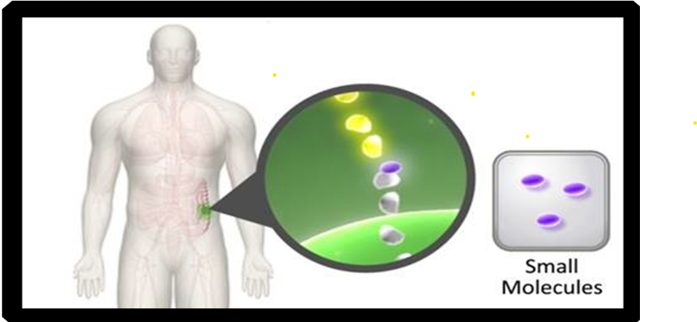
Once potential targets are identified, drugs are designed to best attack the tumor
NCI 2024

Slide 45
Small Molecules
Majority are oral, although a few are IV or subcutaneous
Implications for orals:
Adherence
Possible drug/food , drug/drug interactions
Patient education regarding taking medication correctly
Targets vary and side effects are related to targets
Chemically made
AMA 2024

Slide 46
Small Molecules Naming Conventions
tinibs:
kinase inhibitors
erlotinib, sunitinib, ponatinib, imatinib, dasatinib, ruxolitinib, dacomitinib, lorlatinib, larotrectinib, gilteritinib, neratinib, erdafitinib, pexidartinib, fedratinib, entrectinib, avapritinib, tucatinib, pemigatinib, ripretinib, selpercatinib, pralsetinib, cabozantinib, tepotinib, infigratinib, mobocertinib , pacritinib, futibatinib, quizartinib, fruquitinib, repotrectinib, lazertinib
rafenib
raf inhibitors
tovorafenib
sidenibs:
IDH inhibitors
vorasidenib
AMA 2024

Slide 47
tovorafenib Ojemda™ Day One Biopharmaceuticals, Inc.: patients 6 months of age and older with relapsed or refractory pediatric low-grade glioma (LGG) harboring a BRAF fusion or rearrangement, or BRAF V600 mutation (NEW 2024)
www.ojemda.com

Slide 48
tovorafenib Ojemda™
tovorafenib Ojemda™ Day One Biopharmaceuticals, Inc.: patients 6 months of age and older with relapsed or refractory pediatric low-grade glioma (LGG) harboring a BRAF fusion or rearrangement, or BRAF V600 mutation (NEW 2024)
Oral kinase inhibitor, small molecule
Drug interactions with strong and moderate CYP3A inhibitors, plus strong and moderate CYP3A inducers, certain CYP3A substrates, and hormonal contraceptives
Targets BRAF fusion or rearrangement or BRAF V600 mutation
Biomarker testing needed prior to administration
www.ojemda.com

Slide 49
lazertinib Lazcluze™ Janssen Biotech, Inc.: in combination with amivantamab-vmjw Rybrevant® Janssen Biotech, Inc.: for the first-line treatment of locally advanced or metastatic non-small cell lung cancer (NSCLC) with epidermal growth factor receptor (EGFR) exon 19 deletions or exon 21 L858R substitution mutations (NEW 2024)
www.lazcluze.com

Slide 50
lazertinib Lazcluze™
lazertinib Lazcluze™ Janssen Biotech, Inc.: in combination with amivantamab-vmjw Rybrevant® Janssen Biotech, Inc.: for the first-line treatment of locally advanced or metastatic non-small cell lung cancer (NSCLC) with epidermal growth factor receptor (EGFR) exon 19 deletions or exon 21 L858R substitution mutations (NEW 2024)
Oral kinase inhibitor, small molecule
Drug interactions strong and moderate CYP3A inducers
Targets epidermal growth factor receptor (EGFR) exon 19 deletions or exon 21 L858R substitution mutations
Biomarker testing needed prior to administration
www.lazcluze.com

Slide 51
vorasidenib Voranigo®, Servier Pharmaceuticals LLC: an isocitrate dehydrogenase-1 (IDH1) and isocitrate dehydrogenase-2 (IDH2) inhibitor, for adult and pediatric patients 12 years and older with Grade 2 astrocytoma or oligodendroglioma with a susceptible IDH1 or IDH2 mutation, following surgery including biopsy, sub-total resection, or gross total resection (NEW 2024)
www.voranigo.com

Slide 52
vorasidenib Voranigo®
vorasidenib Voranigo®, Servier Pharmaceuticals LLC: an isocitrate dehydrogenase-1 (IDH1) and isocitrate dehydrogenase-2 (IDH2) inhibitor, for adult and pediatric patients 12 years and older with Grade 2 astrocytoma or oligodendroglioma with a susceptible IDH1 or IDH2 mutation, following surgery including biopsy, sub-total resection, or gross total resection (NEW 2024)
Oral IDH1 and IDH2 inhibitor, small molecule
Drug interactions with strong and moderate CYP1A2 inhibitors, moderate CYP1A2 inducers, smoking tobacco, certain CYP3A substrates, and hormonal contraceptives
Targets isocitrate dehydrogenase-1 (IDH1) and isocitrate dehydrogenase-2 (IDH2)
Biomarker testing needed prior to administration
www.voranigo.com

Slide 53
IL-15 agonist immunotherapy

Slide 54
nogapendekin alfa inbakicept-pmln Anktiva®, Altor BioScience, LLC: with Bacillus Calmette-Guérin (BCG) for adult patients with BCG-unresponsive non-muscle invasive bladder cancer (NMIBC) with carcinoma in situ (CIS) with or without papillary tumors (NEW 2024)
www.anktiva.com

Slide 55
nogapendekin alfa inbakicept-pmln Anktiva®
nogapendekin alfa inbakicept-pmln Anktiva®, Altor BioScience, LLC: with Bacillus Calmette-Guérin (BCG) for adult patients with BCG-unresponsive non-muscle invasive bladder cancer (NMIBC) with carcinoma in situ (CIS) with or without papillary tumors (NEW 2024)
First in class Interleukin-15 (IL-15) receptor agonist immunotherapy, intravesical
IL-15 receptor agonist that generates IL-15 activated natural killer cells, killer T cells and memory T cells, without proliferation of immune-suppressive Treg cells
No biomarker testing needed prior to administration
www.anktiva.com

Slide 56
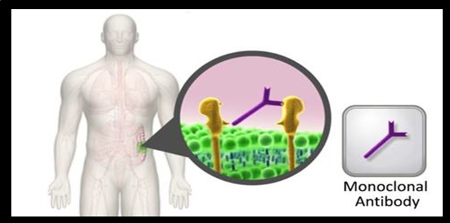
Once potential targets are identified, drugs are designed to best attack the tumor
NCI 2024

Slide 57
Monoclonal Antibody Naming Conventions
t , ta, or tu = tumor
trastuzumab
ci = circulatory
bevacizumab
li or l = immunomodulator
ipilimumab
AMA, 2024

Slide 58
What does the name mean?
In 2017, the FDA made the decision to name all new biologics (not just biosimilars) with“4 lower case letters devoid of meaning” attached by a hyphen as a suffix
The decision was made to go forward from 2017 with the naming structure and not go back and change biologics approved before the decision
Example: atezolizumab IV formulation (2016) versus atezolizumab and hyaluronidase-tqjs SubQ formulation (2024)
AMA, 2024

Slide 59
atezolizumab and hyaluronidase-tqjs Tecentriq Hybreza™, Genentech, Inc. for subcutaneous injection for all the adult indications as the intravenous formulation of atezolizumab (Tecentriq®, Genentech, Inc.), including non-small cell lung cancer (NSCLC), small cell lung cancer (SCLC), hepatocellular carcinoma (HCC), melanoma, and alveolar soft part sarcoma (ASPS) (NEW 2024)
www.tecentriqhybreza.com

Slide 60
atezolizumab and hyaluronidase-tqjs Tecentriq Hybreza™
atezolizumab and hyaluronidase-tqjs Tecentriq Hybreza™, Genentech, Inc. for subcutaneous injection for all the adult indications as the intravenous formulation of atezolizumab (Tecentriq, Genentech, Inc.), including non-small cell lung cancer (NSCLC), small cell lung cancer (SCLC), hepatocellular carcinoma (HCC), melanoma, and alveolar soft part sarcoma (ASPS) (NEW 2024)
Monoclonal antibody combined with hyaluronidase for subcutaneous injections. First subcutaneous immunotherapy checkpoint inhibitor (PD-L1)
Monitor for infusion related reactions and immune related adverse events
Targets PD-L1
No biomarker testing needed prior to administration
www. www.tecentriqhybreza.com

Slide 61
Bispecific Immunomodulatory Drugs: Monoclonal Antibodies Fusion Proteins

Slide 62
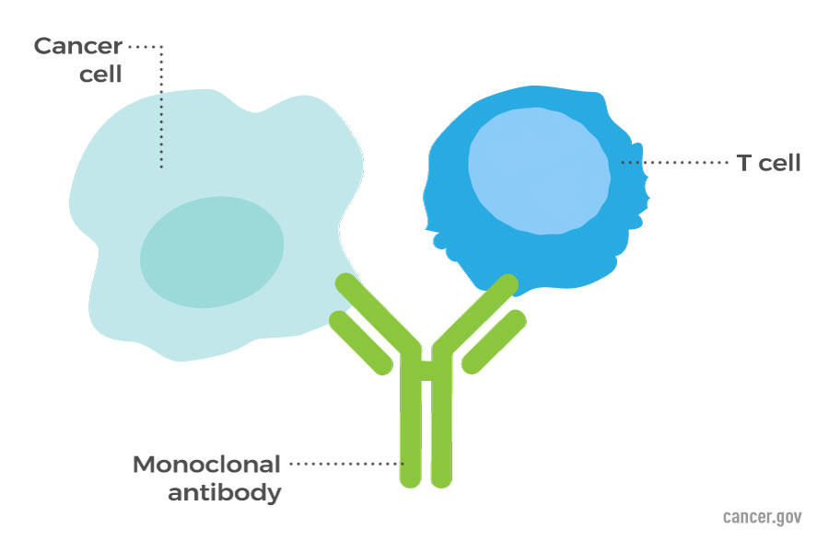
Types of Immune Therapy:
Bispecific T Cell Engagers (BiTEs™)
Monoclonal antibodies: May bring T-cells close to cancer cells, helping the immune system kill the cells
NCI, 2024

Slide 63
BiSpecific T-cell engagers
Targets involve both tumor and immune system
Can be IV or SC
May be monoclonal antibodies or fusion proteins
Step up dosing
Premedicate for potential cytokine release syndrome (CRS) and monitor for immune effector associated neurotoxicity syndrome (ICANS)
No Biomarker testing needed prior to administration
NCI, 2024

Slide 64
tarlatamab-dlle Imdelltra™ Amgen, Inc.: extensive stage small cell lung cancer (ES-SCLC) with disease progression on or after platinum-based chemotherapy (NEW 2024)
www.imdelltra.com

Slide 65
tarlatamab-dlle Imdelltra™
tarlatamab-dlle Imdelltra™ Amgen, Inc.: extensive stage small cell lung cancer (ES-SCLC) with disease progression on or after platinum-based chemotherapy (NEW 2024)
Bispecific monoclonal antibody; targets in immune system and tumor; intravenous with step up dosing
Targets delta-like ligand 3 (DLL3) on the surface of the tumor cells and CD3 T-cell receptor
Premedicate for potential cytokine release syndrome (CRS) and monitor for immune effector associated neurotoxicity syndrome (ICANS)
No Biomarker testing needed prior to administration
www.imdelltra.com

Slide 66
Other BiSpecific T-cell engagers
Fusion Proteins
tebentafusp-tebn (2022)
Monoclonal antibodies:
epcoritamab-bysp Epkinly™ Genmab US, Inc (2023)
glofitamab-gxbm Columvi™ Genentech, Inc.: (2023)
talquetamab-tgvs Talvey™ Janssen Biotech, Inc.: (2023)
elranatamab-bcmm Elrexfio™ Pfizer, Inc.: (2023)
mosunetuzumab-axgb Lunsumio™ Genentech (2022)
blinatumomab Blincyto®, Amgen (2014)
FDA, 2024

Slide 67
Cellular Therapy (Adoptive T Cell Transfer Therapy, Immune Effector Cell Therapy)

Slide 68
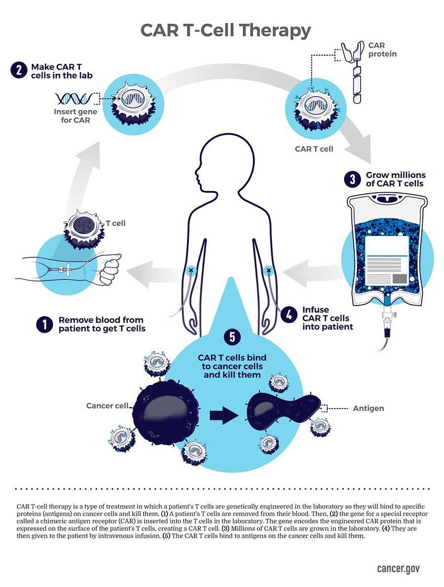
NCI, 2024

Slide 69
lifileucel Amtagvi™ Iovance Biotherapeutics, Inc.: a tumor-derived autologous T cell immunotherapy, for adult patients with unresectable or metastatic melanoma previously treated with a PD-1 blocking antibody, and if BRAF V600 positive, a BRAF inhibitor with or without a MEK inhibitor (NEW 2024)
www.amtagvi.com

Slide 70
lifileucel Amtagvi™
lifileucel Amtagvi™ Iovance Biotherapeutics, Inc.: a tumor-derived autologous T cell immunotherapy, for adult patients with unresectable or metastatic melanoma previously treated with a PD-1 blocking antibody, and if BRAF V600 positive, a BRAF inhibitor with or without a MEK inhibitor (NEW 2024)
First cellular therapy for a solid tumor: Tumor-derived autologous T cell immunotherapy
Tumor-infiltrating lymphocytes (TILs) collected surgically from patient’s tumor tissue; not circulating blood as in CAR-T. TIL number is expanded in a lab, but not genetically changed. This differs from CAR-T therapy
No Biomarker testing needed prior to administration
Administer a lymphodepleting chemo regimen the week prior to the TIL
www.amtagvi.com

Slide 71
lifileucel Amtagvi™ (cont)
lifileucel Amtagvi™ Iovance Biotherapeutics, Inc.: a tumor-derived autologous T cell immunotherapy, for adult patients with unresectable or metastatic melanoma previously treated with a PD-1 blocking antibody, and if BRAF V600 positive, a BRAF inhibitor with or without a MEK inhibitor (NEW 2024)
Premedicate and monitor for cardiopulmonary and renal function, severe cytopenias, internal organ hemorrhage; but less likely to see CRS or ICANS. Side effects seen are generally from the lymphodepleting chemotherapy and the post dose IL-2.
Cell suspension for IV infusion; must be given in an inpatient hospital setting with an intensive care facility
High dose IL-2 given after infusion (stimulating cytokine)
www.amtagvi.com

Slide 72
afamitresgene autoleucel TECELRA®, Adaptimmune, LLC: a melanoma-associated antigen A4 (MAGE-A4)-directed genetically modified autologous T cell immunotherapy, for adults with unresectable or metastatic synovial sarcoma who have received prior chemotherapy, are HLA-A*02:01P, -A*02:02P, -A*02:03P, or -A*02:06P positive and whose tumor expresses the MAGE-A4 antigen (NEW 2024)
www.tecelra.com

Slide 73
afamitresgene autoleucel TECELRA®
afamitresgene autoleucel TECELRA®, Adaptimmune, LLC: a melanoma-associated antigen A4 (MAGE-A4)-directed genetically modified autologous T cell immunotherapy, for adults with unresectable or metastatic synovial sarcoma who have received prior chemotherapy, are HLA-A*02:01P, -A*02:02P, -A*02:03P, or -A*02:06P positive and whose tumor expresses the MAGE-A4 antigen (NEW 2024)
Second cellular therapy for a solid tumor: Tumor-derived autologous T cell immunotherapy
Tumor-infiltrating lymphocytes (TILs) collected from patient via leukapheresis, as in CAR-T. TIL number is expanded in a lab and genetically modified to be specific to MAGE-A4 antigen on the sarcoma cell surface
No Biomarker testing needed prior to administration
www.tecelra.com

Slide 74
afamitresgene autoleucel TECELRA® (cont)
afamitresgene autoleucel TECELRA®, Adaptimmune, LLC: a melanoma-associated antigen A4 (MAGE-A4)-directed genetically modified autologous T cell immunotherapy, for adults with unresectable or metastatic synovial sarcoma who have received prior chemotherapy, are HLA-A*02:01P, -A*02:02P, -A*02:03P, or -A*02:06P positive and whose tumor expresses the MAGE-A4 antigen (NEW 2024)
Administer a lymphodepleting chemo regimen the week prior to the administration
Premedicate and monitor for CRS or ICANS
Cell suspension for IV infusion; patients must be monitored closely for 7 days and remain within proximity of a healthcare facility for at least 4 weeks following infusion.
www.tecelra.com

Slide 75
Key Takeaways
Try not to be overwhelmed as the new drugs get approved
Actionable items
Try to look at the non-proprietary name first as you become familiar with the drug
Use the search and 2 click method to get detailed information about any of the drugs
Use ONS and other resources available to you

Slide 77
References
https://www.ama-assn.org/about/united-states-adopted-names/united-states-adopted-names-naming-guidelines. Retrieved January 17, 2024
https://www.cancer.gov/about-cancer/treatment/types/immunotherapy. . Retrieved September 14, 2024
https://www.fda.gov/about-fda/oncology-center-excellence/project-renewal-faq. Retrieved September 14, 2024.
http://www.cancer.gov/cancertopics/understandingcancer/targetedtherapies. Retrieved January 2, 2004.
http://www.cancer.gov/dictionary. Retrieved September 14, 2024.
https://www.fda.gov/drugs/biosimilars/biosimilar-product-information. Retrieved September 11, 2024.

Slide 78
References
http://www.fda.gov/Drugs/InformationOnDrugs/ApprovedDrugs/ucm279174. htm. Retrieved September 11, 2024.
http://www.mycancergenome.org/content/molecular- medicine/overview-of-targeted-therapies-for-cancer/. Retrieved January 17, 2024.
https://www.ons.org/genomics-taxonomy. Retrieved January 17, 2024.
https://www.ons.org/learning-libraries/drug-development. Retrieved January 17, 2024
www.amtagvi.com. Retrieved April 28, 2024
www.anktiva.com. Retrieved April 26, 2024

Slide 79
References
www.imdelltra.com/ Retrieved June 11, 2024
www.ojemda.com. Retrieved January 17, 2024
www.lazcluze.com. Retrieved September 14, 2024.
www.tecelra.com. Retrieved September 14, 2024
www.tecentriqhybreza.com. Retrieved September 14, 2024
www.vorangio.com. Retrieved September 14, 2024

