Slide 1
Mashing Content, Information Literacy, and 21st Century Skills
FAPSC Orlando Region Faculty conference 2015

Slide 2
“… positive correlation between multimedia and student achievement.” Jonassen, 1995

Slide 3
TodaysMeet --- https://todaysmeet.com/FAPSC-Orlando

Slide 4
21st Century Skills

Slide 5
21st Century Skills
Use technology and digital media strategically and capably
Integrate and evaluate information from diverse media and formats
Integrate and evaluate information presented visually, orally, and quantitatively
Make strategic use of digital media to express ideas and information

Slide 6
Smart Phones & Tablets
Interview
Oral Speaking
Picture Prompt
Apps

Slide 7
Common Free Sites
YouTube
TeacherTube
Khan Academy
TED Talks
Google Docs
Google Scholar

Slide 8
Poll Everywhere http://www.polleverywhere.com/

Slide 9
Poll Everywhere http://www.polleverywhere.com/
Lecture
To create KWL

Slide 10
Before Getting Started……
Screen Capture Tools
Screencast O Matic http://www.screencast-o-matic.com/
CamStudio http://camstudio.org/
EZVid http://www.ezvid.com/
Group Behavior
Netiquette Primer http://www.bucks.edu/old_docs/online/dlresources/Netiquette-quiz-results.html
Netiquette Quiz
http://www.nku.edu/~rkdrury/experiment/netiquette_quiz.htm

Slide 11
Victorian Crime and Punishment http://vcp.e2bn.org/

Slide 12
History’s Heros http://historysheroes.e2bn.org/

Slide 13
Steve Spangler Science http://www.stevespanglerscience.com/lab/experiments/category/food-science
Collage
FX Photo

Slide 14
L'Oreal Hair Science http://www.hair-science.com/_int/_en/index.aspx
Concept Map
Instagrok Instagrok Instagrok http://www.instagrok.com/

Slide 15
Instagrok http://www.instagrok.com/
Notes:
Creates interactive concept map links to content searched las vegas

Slide 16
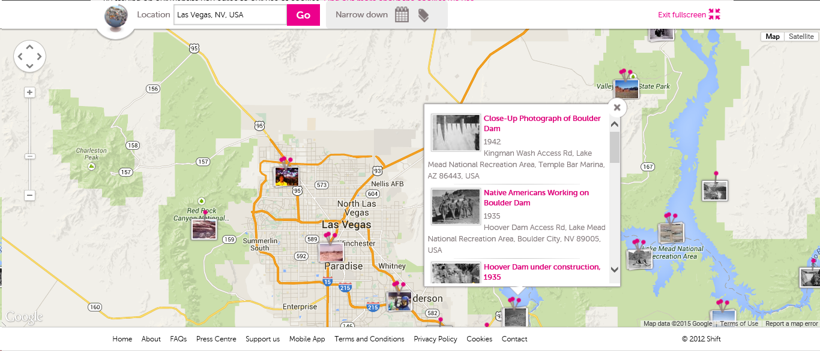
Historypin http://www.historypin.org
Like pintrest
Notes:
Like Pinterest but with historical photos
Searched for Las Vegas… Boulder and Hoover Dam --close up photos, native americans, working on the dam, under construction etc

Slide 17
Historypin http://www.historypin.org
Multimedia Brochure
Glogster
http://edu.glogster.com/
Top 10 List
Use phone to create video
Comic Book http://www.makebeliefscomix.com/Apple/index.php
Notes:
Like Pinterest but with historical photos
Searched for Las Vegas… Boulder and Hoover Dam --close up photos, native americans, working on the dam, under construction etc

Slide 18
Glogster http://edu.glogster.com/
Notes:
Already created libraries
templates

Slide 19
Pocket Universe http://pocketuniverse.info/
Learn / Interesting / Questions
audioBoom https://audioboom.com/
Group Presentation
Coggle https://coggle.it/
Interact https://www.tryinteract.com/
©Craic Design
Notes:
audioBoom also has prerecorded libraries of topics – can combine student audio with library audio
Interact – online quiz creator

Slide 20
Coggle https://coggle.it/

Slide 21
Student Society for Science https://student.societyforscience.org/article/makeup-science
Tutorial
Book Creator https://edshelf.com/tool/book-creator

Slide 22
Biodigital Human https://www.biodigital.com/
Presentation / Quiz
eduCanon http://www.educanon.com/
InterAct https://www.tryinteract.com/
Flashcards
Flashcard Machine http://www.flashcardmachine.com/
Notes:
Educanon - Create a video, add questions, flipped classroom or have students create lectures / quizzes

Slide 23
Smithsonian Digital Collection http://library.si.edu/digital-library
Museum Box http://museumbox.e2bn.org/
Concept Map
Instagrok Instagrok Instagrok http://www.instagrok.com/
Cacoo https://cacoo.com/

Slide 24
Library of Congress Digital Collection http://loc.gov/library/libarch-digital.html
Notate With Original Ideas
Explain Everything https://itunes.apple.com/us/app/explain-everything/id431493086?mt=8
Make a Timeline
Timemapper http://timemapper.okfnlabs.org/
Group Presentation
Wiggio https://wiggio.com
Mash Audio Files http://soundcloud.com/apps/myna
Teaching With Primary Sources at UCF http://loc-ucf-site-2015.weebly.com/
Notes:
Wiggio – conf calls, shared calendar, to do lists, assign tasks, poll in real time, email, tesxr, shared online folder

Slide 25
TimeMapper http://timemapper.okfnlabs.org/

Slide 26
Google Art Project https://www.google.com/culturalinstitute/project/art-project
Masher http://masher.com/
Timetoast http://www.timetoast.com/
Paper https://www.fiftythree.com/paper
Storybird http://storybird.com/
Creaza http://www.creazaeducation.com/
Notes:
Paper – iPad app for drawing etc
Storybirt - read, write, share books

Slide 27
The Big History Project https://www.bighistoryproject.com/home
Use with Facing History and Ourselves https://www.facinghistory.org/ to design a concept web.
Gliffy https://www.gliffy.com
Using graphics, create a video
Loopster https://www.loopster.com/
Graph Statistics
Create A Graph http://nces.ed.gov/nceskids/createagraph/
Quiz Quizlet http://quizlet.com/
Notes:
Facing History - Resource collections has links to sites, videos, print materials, lessons
Loopster is a video editor and an app

Slide 28
Exploratorium http://www.exploratorium.edu/explore
Online Labs
Videos
Audio
Mind Map
Text to Mind Map https://www.text2mindmap.com/
Collaborative Presentation
StormBoard https://www.stormboard.com/tour
Notes:
Food mindmap

Slide 29
StormBoard https://www.stormboard.com/tour

Slide 30
MIT App Inventor http://appinventor.mit.edu/explore/front.html
Notes:
Open source code for creating apps.

Slide 31
Other Content Sites……
Online Tangrams - http://www.abcya.com/tangrams.htm
BBC Learning Zone - http://www.bbc.co.uk/programmes/p01b8f09
Languages Online - http://www.education.vic.gov.au/languagesonline/default.htm
New York Times Teaching Today’s News - http://learning.blogs.nytimes.com/teaching-topics/teaching-topics-great-ways-to-teach-any-days-times/
Spelling Test – https://edshelf.com/tool/spelling-test
Penn State Food Science - http://foodscience.psu.edu/youth
Science Behind Cosmetology - http://www.thesciencebehindcosmetology.com/
Cosmetic Science Technology - http://www.cosmeticsciencetechnology.com/index.php?flash=no

Slide 32
Thank you! Kristi@dr-bordelon.com http://www.dr-bordelon.com/research.html

