Slide 1
Kitchen Activism: Digitally Representing Detroit’s Global Cuisine Dr. Kim Lacey Saginaw Valley State University

Slide 3
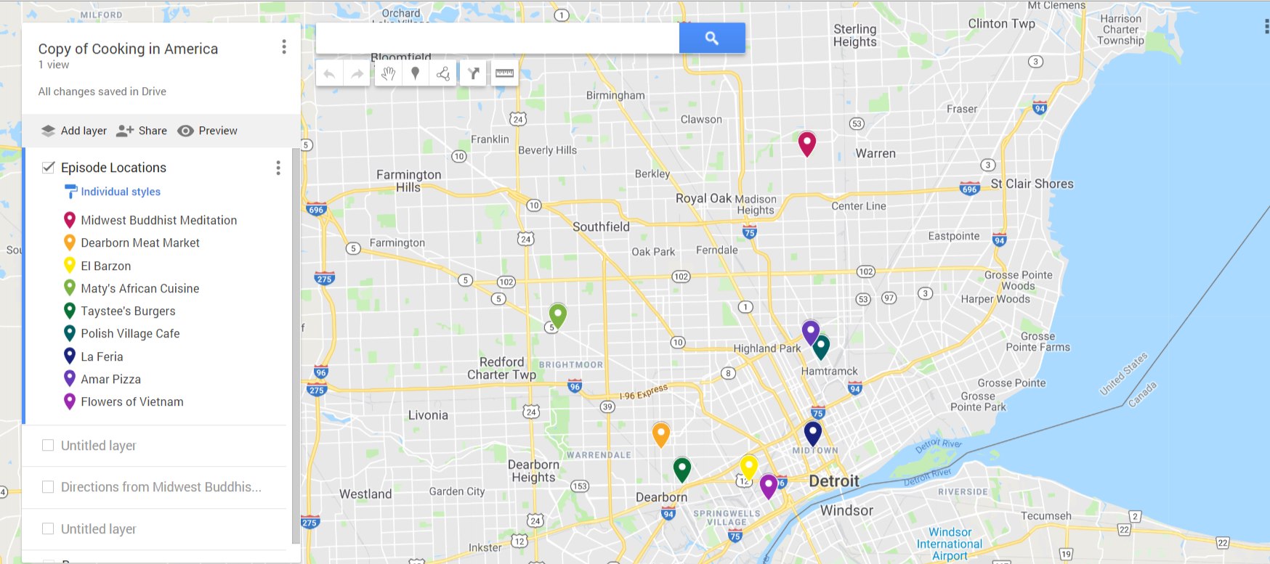

Slide 4
Midwest Buddhist Meditation

Slide 5
Midwest Buddhist Meditation

Slide 6
Dearborn Meat Market

Slide 7
Dearborn Meat Market

Slide 8
El Barzon

Slide 9
Maty’s

Slide 10
Maty’s

Slide 11
Taystee’s Burgers

Slide 12
Taystee’s Burgers

Slide 13
Polish Village Cafe

Slide 14
Polish Village Cafe

Slide 15
La Feria

Slide 16
La Feria

Slide 17
Amar’s Pizza

Slide 18
Amar’s Pizza

Slide 19
Flowers of Vietnam

Slide 20
Flowers of Vietnam

Slide 21
Thank you!

