Slide 1
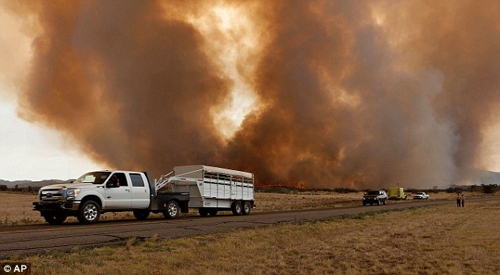
DECHC 2023

Slide 2
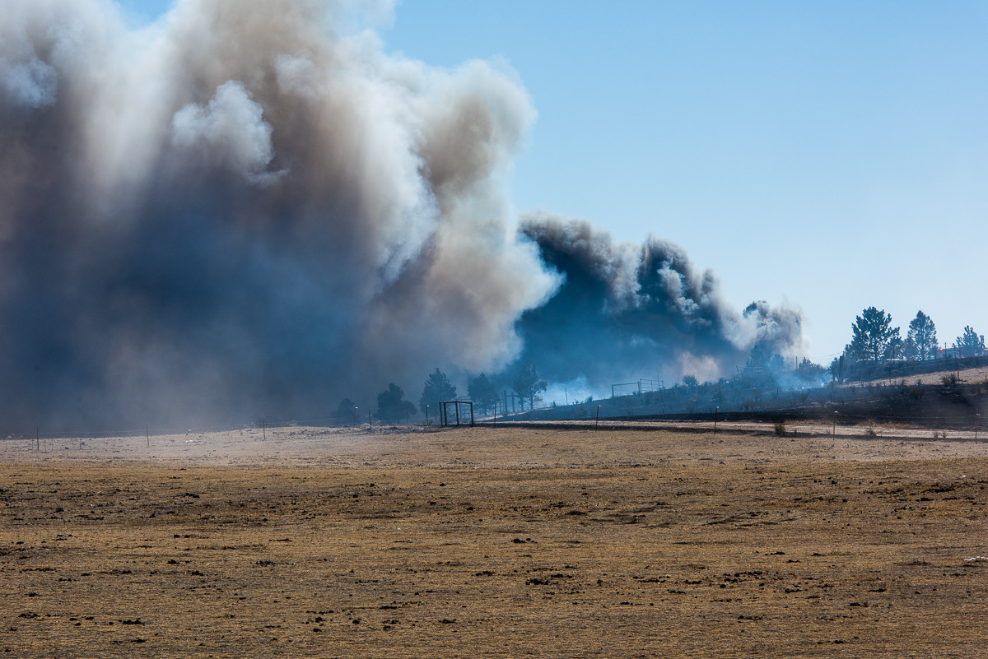
Animal (and Human) Evacuation
How You Can Succeed in a Disaster

Slide 3
TODAY’S OBJECTIVES
OUR FIRES
UNDERSTANDING OUR FIRES
ANIMAL AND HUMAN EVACUATION
GETTING TO WORK
HOW WILL WE PREPARE?
HOW WILL WE RESPOND?

Slide 4
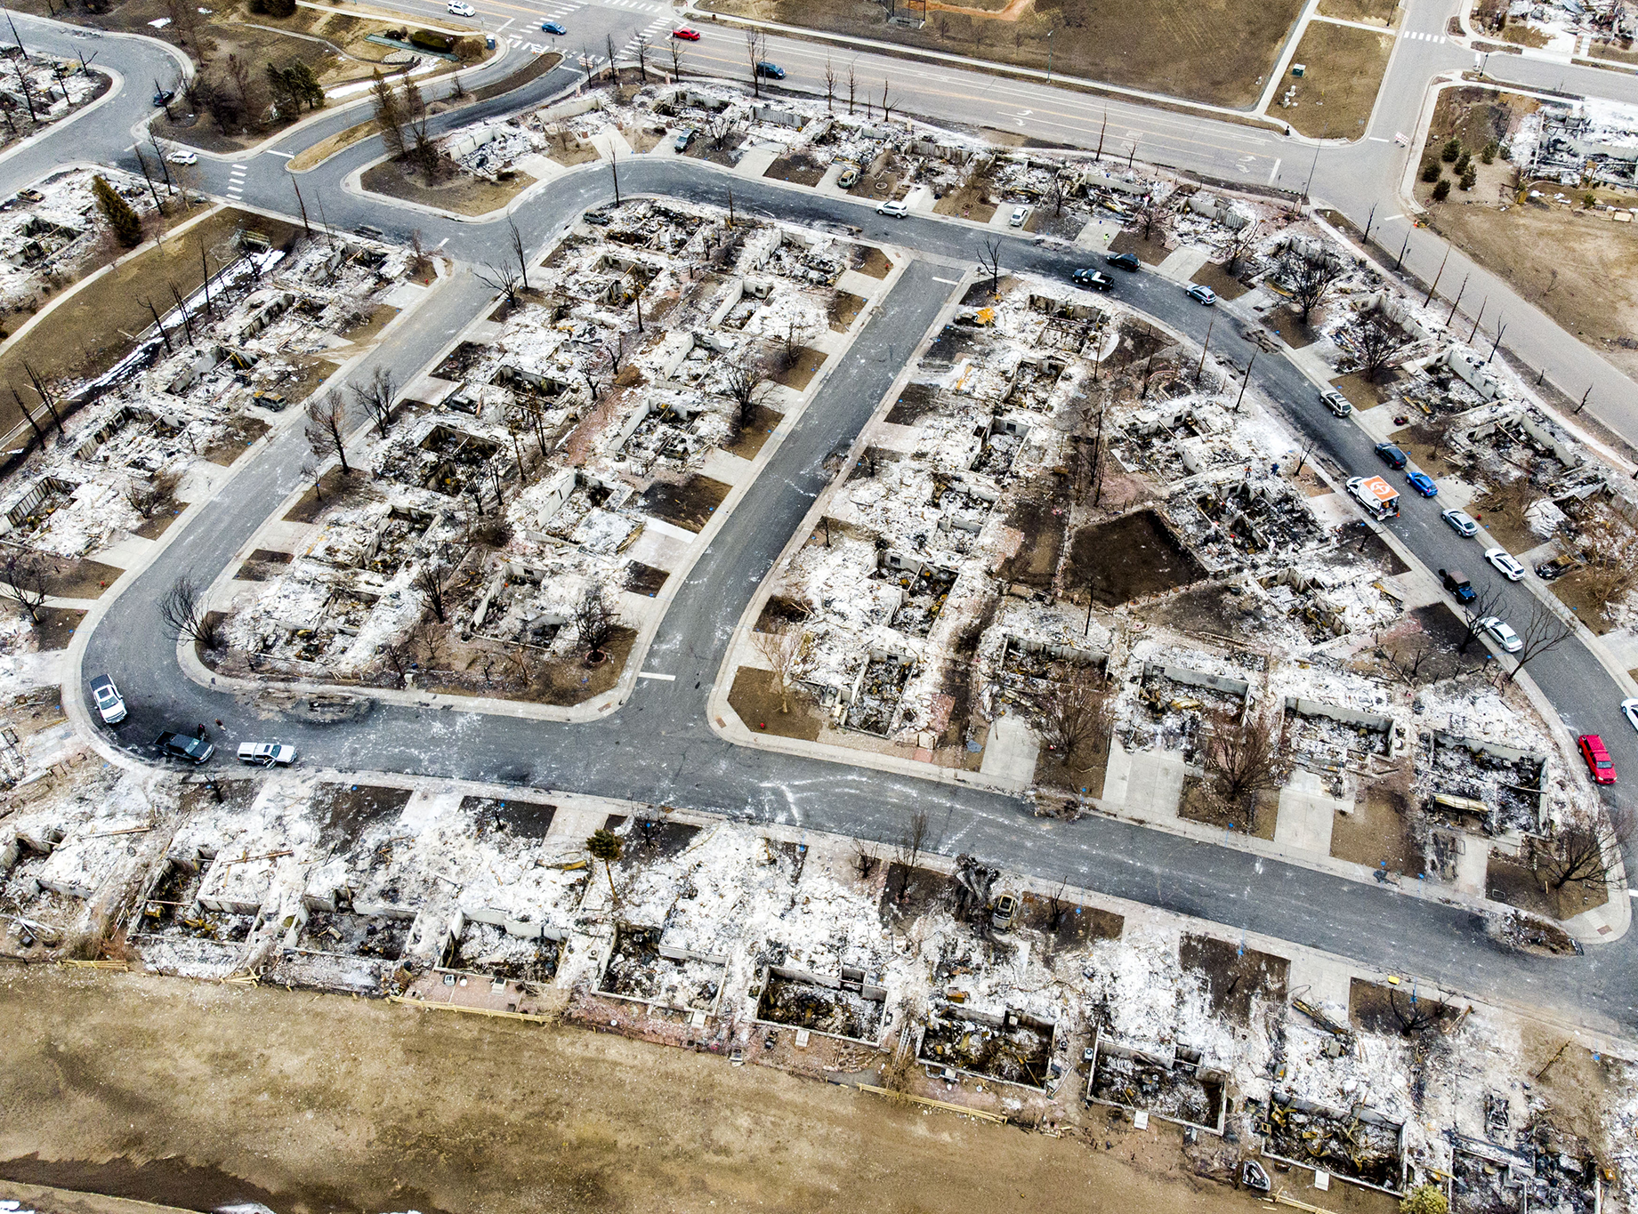
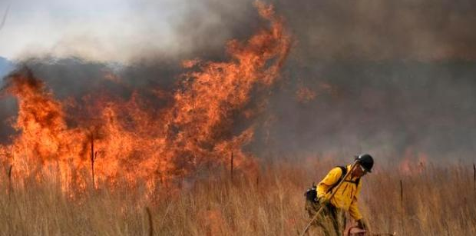
WHAT ARE WE FIGHTING?

Slide 5
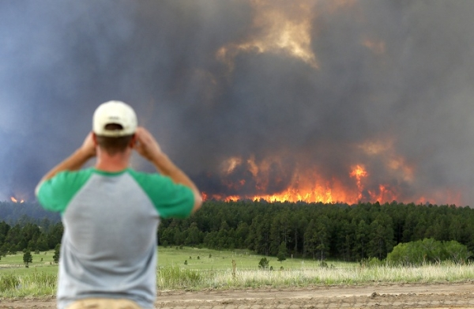
BLACK FOREST FIRE

Slide 6
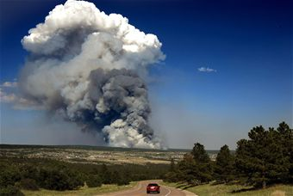
June 11th, 2013 @1300hrs
Fire Breaks Out at Hwy 83 and Shoupe Road.
Red Flag Conditions (Heavy Winds and Low Humidity) create aggressive fire behavior.
Fire Agencies respond and begin direct suppression efforts.
Fire Burning Hundreds of Acres in Day 1.

Slide 7
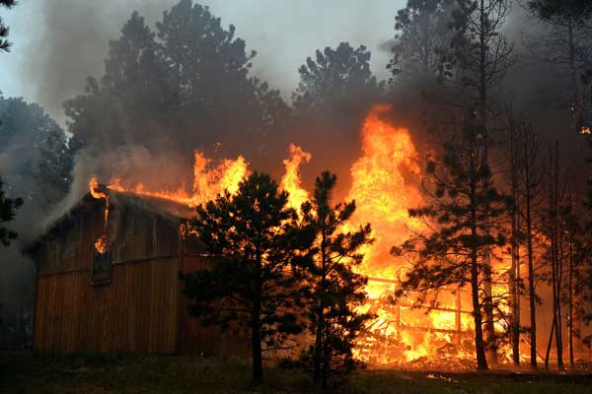
JUNE 12TH – 20TH , 2013
Fire Ultimately Grows to 14,000 acres (22.3 sq miles)
509 Homes Destroyed
2 Lives lost
The Evacuation Area covered 94,000 acres, 13,000 homes and 38,000 people.

Slide 8
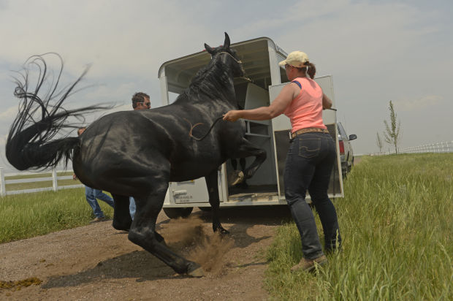
EVACUATION CONCERNS
WHO EVACUATES THE ANIMALS?
Notes:
THE PEOPLE WERE EVACUATED, THE OFFICIALS DIDN’T WANT UNTRAINED AND UNSAFE PEOPLE IN THE FIRE AREA, THE FIREFIGHTERS WERE TRYING TO MEET THEIR PRIORITIES.

Slide 9
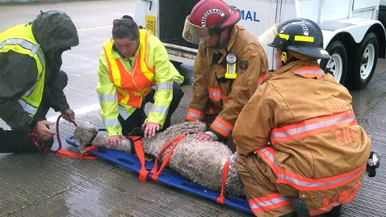
EVACUATION CONCERNS
SPECIALIZED ANIMAL HANDLING?

Slide 10
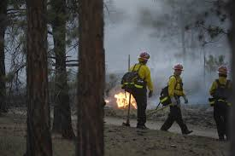
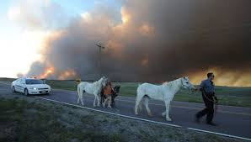
OUR ROLES CHANGED
Initial Attack Fire Suppression
Strike Team of Fire Engines
“Border Patrol”
Human Evacuation

Slide 11
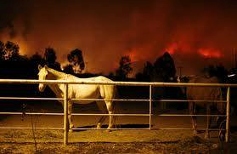
OPERATION NOAHS ARK

Slide 12
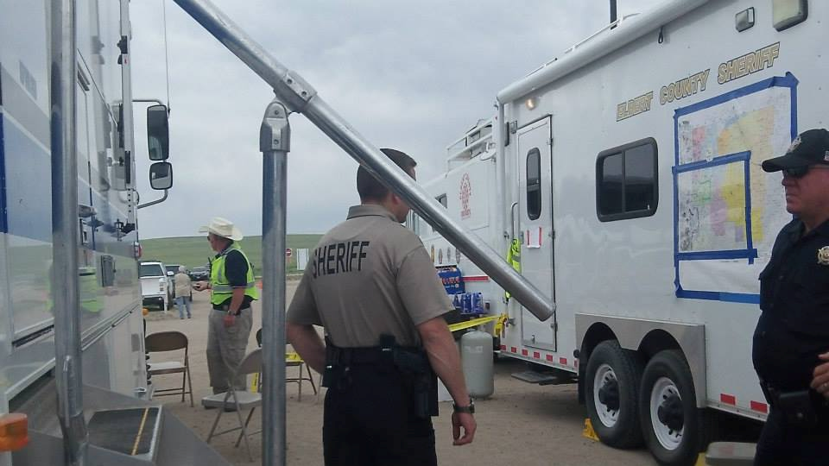
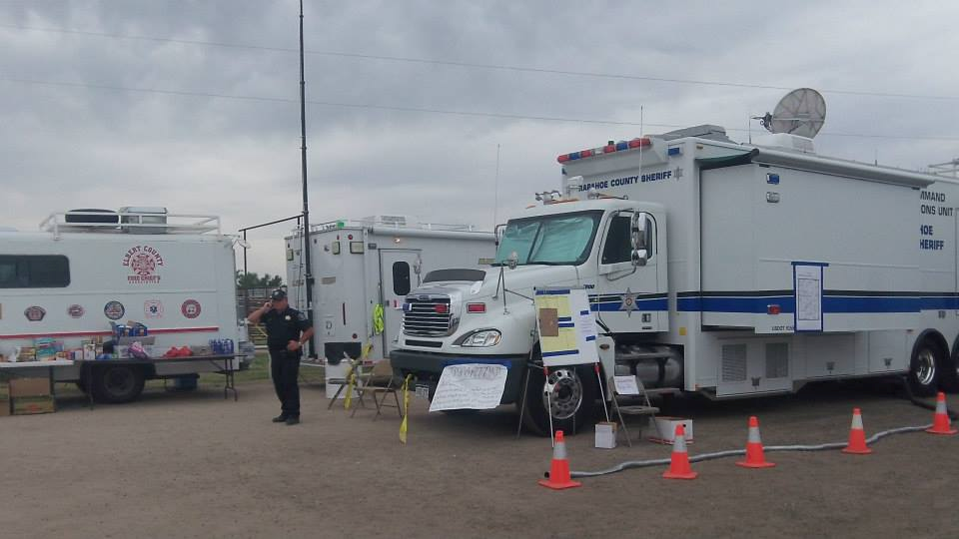
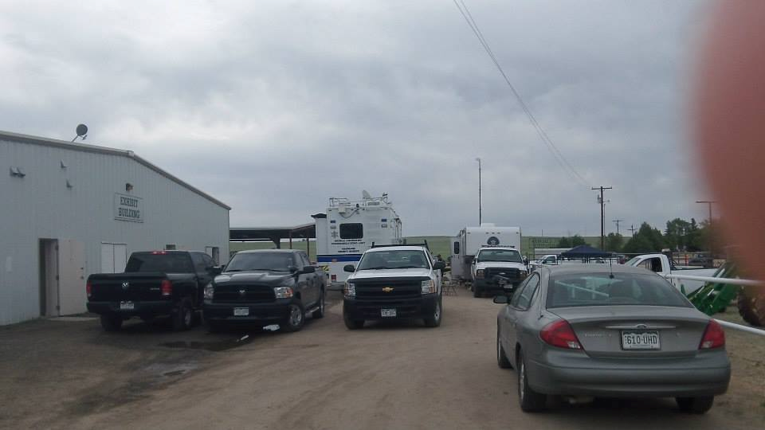

Slide 13
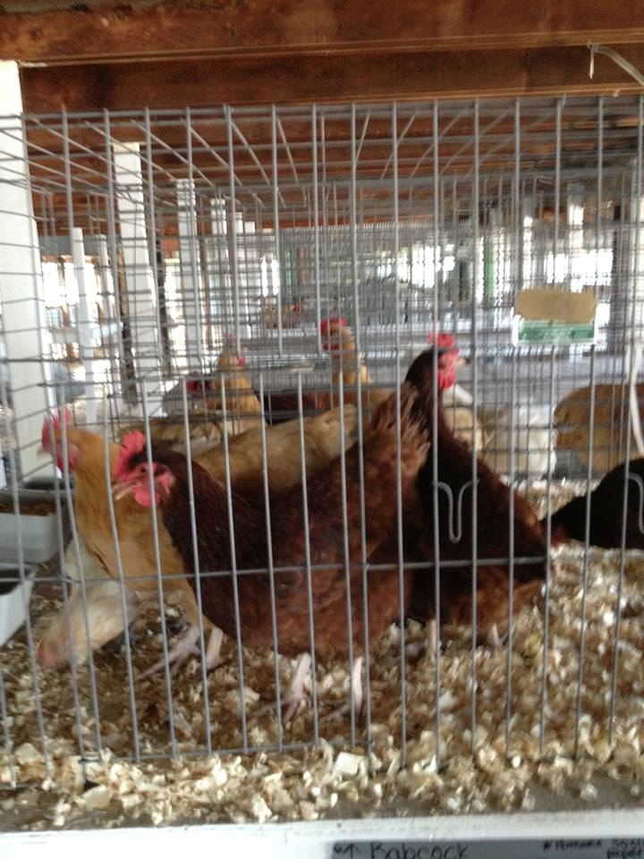
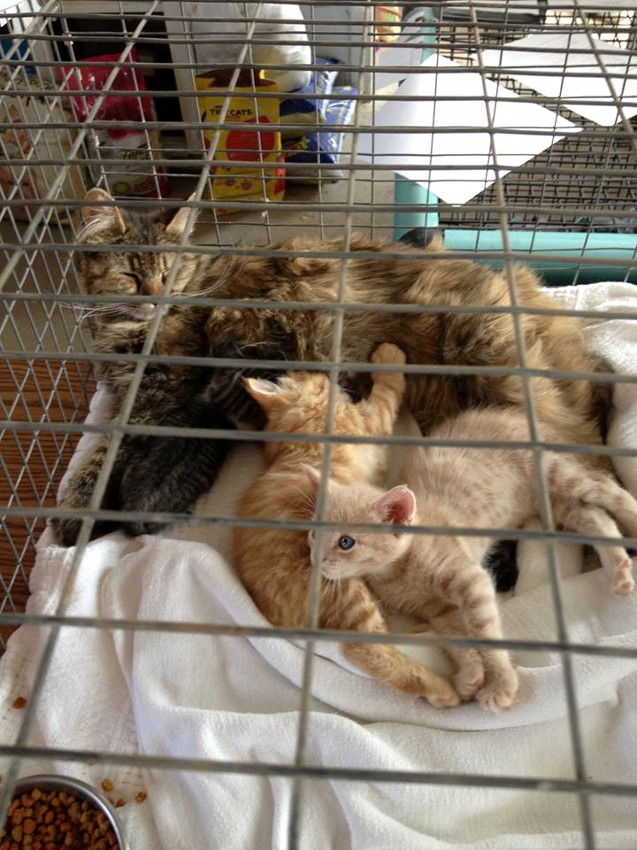
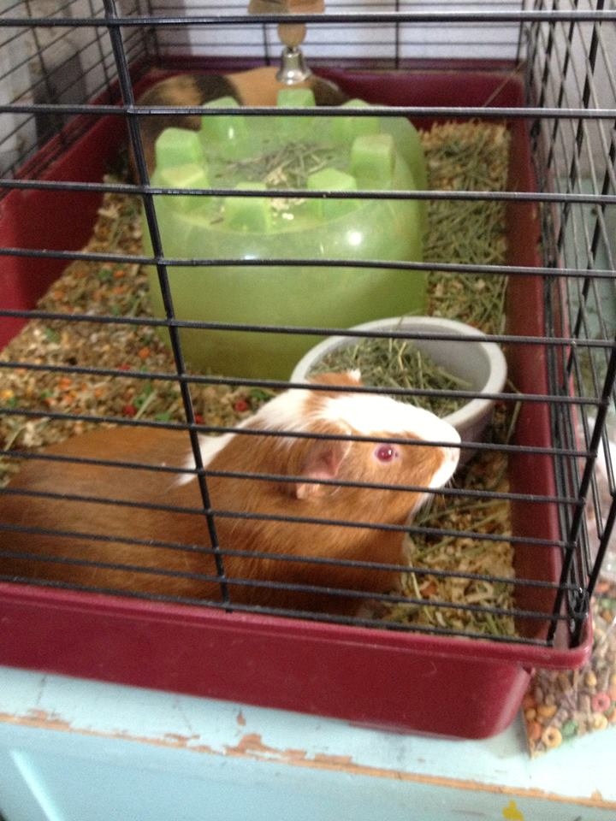
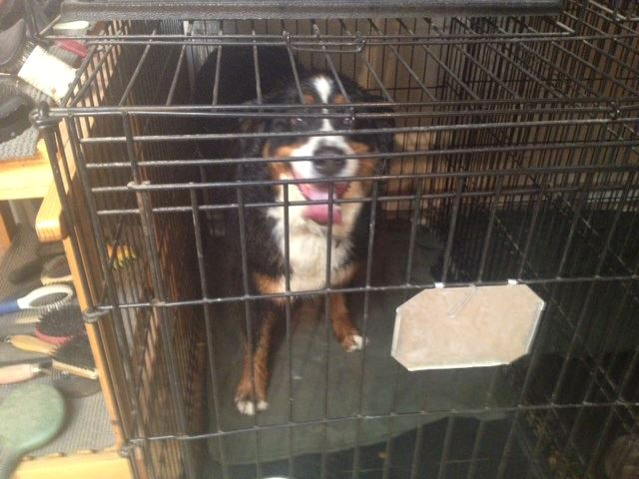

Slide 14
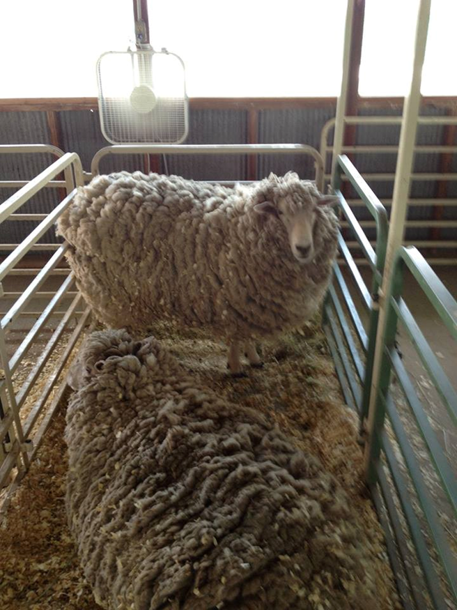
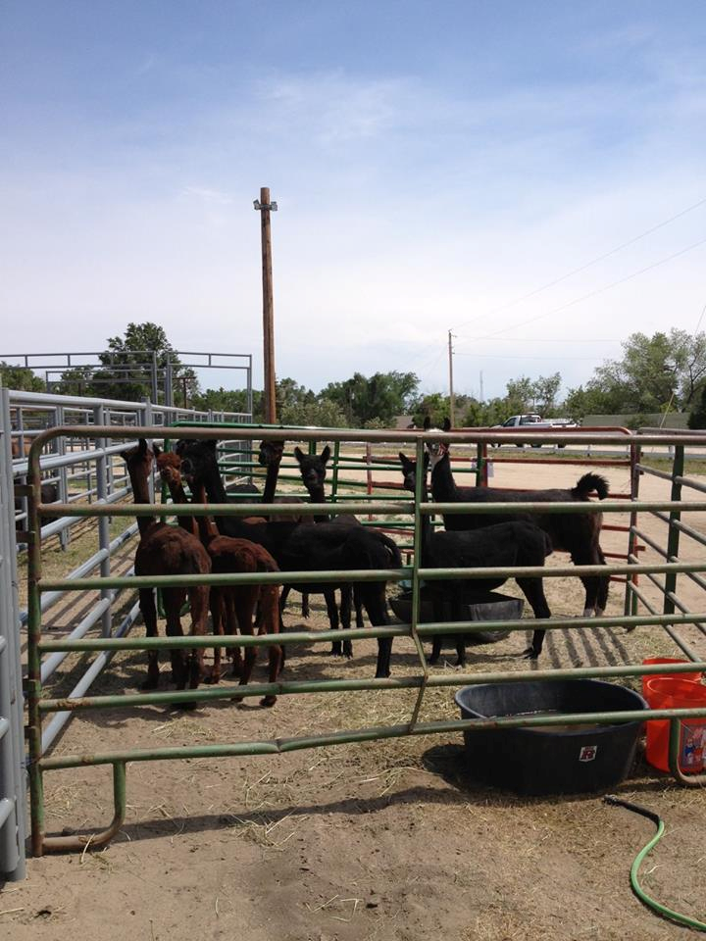
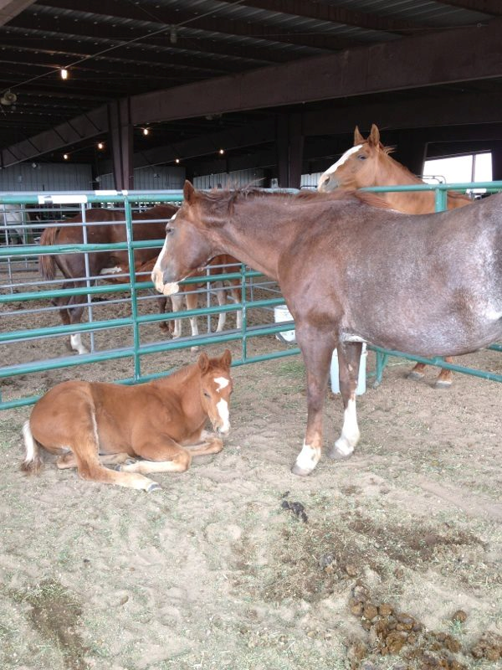
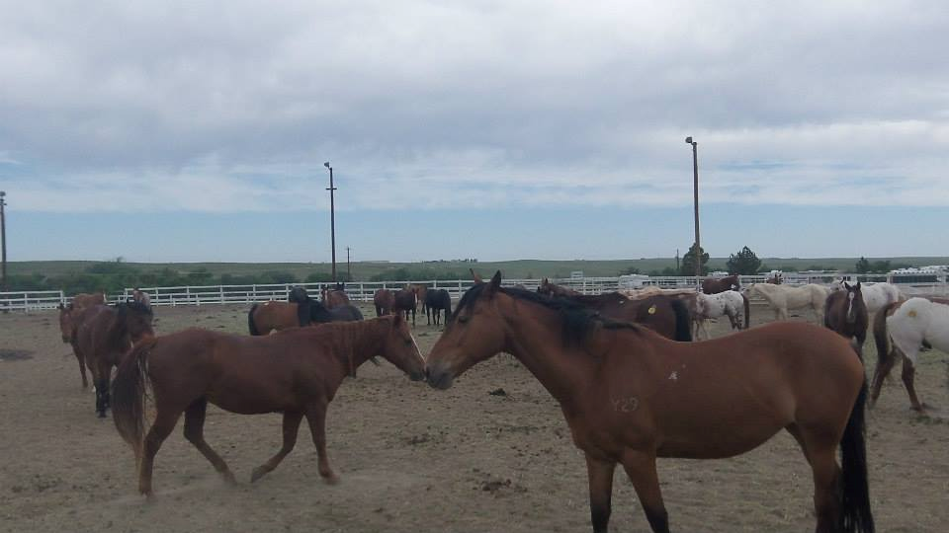

Slide 15
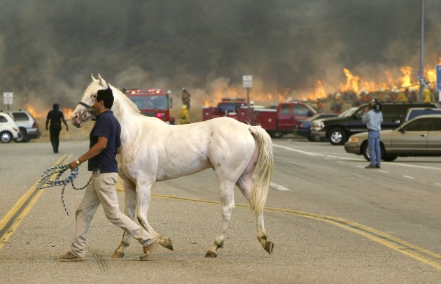
Operation Noah’s Ark
567 Total Animals - 26 Species
Horses - 240 Kittens - 5 Human Owners - 350
Draft Horses – 4 Sheep - 8 Non Owners - 2500
Donkey - 1 Geese - 1 Responders/Workers -30-45
Foals - 14 Guinea Pigs - 2
Yaks - 2 Goats - 28
Cattle - 20 Turkeys - 2
Mini Horses – 17 Mice - 2
Mules - 20 Rabbits - 9
Llama - 6 Dogs - 26
Alpacas - 40 Ducks - 3
Chickens – 51 Cats - 51
Snakes – 2 Pigs – 11
Pot Belly Pigs - 2

Slide 16
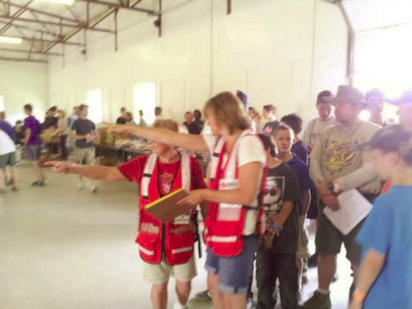
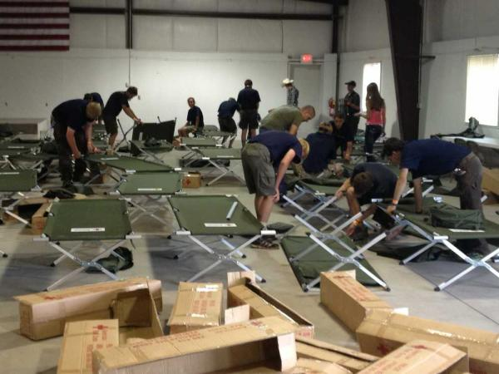
SHELTER EXPERIENCES
Facility Needs for Humans and Animals
Long Term Considerations
Feed Donations
Specialty Feed Needs
Regular Information for Evacuees
Re-unification process

Slide 17
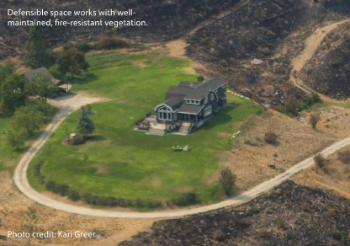
Mitigation
Unmanaged and overgrown vegetation between and around homes increases the risk of wildland fire spreading.
Embers are light enough to travel long distances and are the primary reason homes ignite, often far from the actual flame front

Slide 18
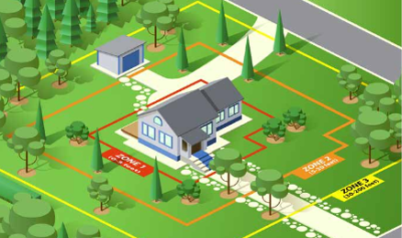
Defensible Space Zones 1, 2, and 3

Slide 19
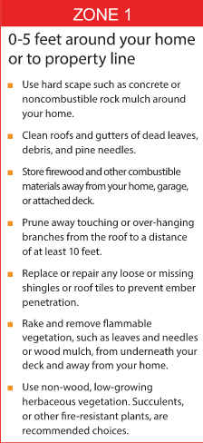
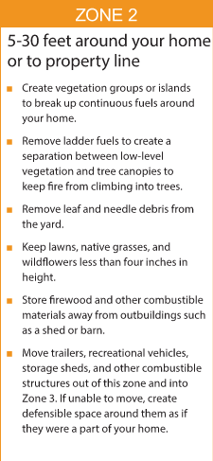
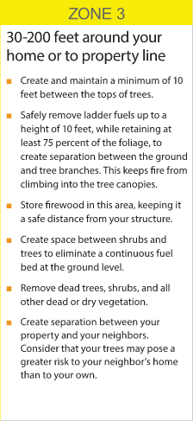
Defensible Space Zones

Slide 20
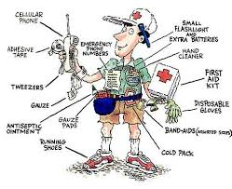
Get familiar with early season changes and how these reflect to your surroundings.
Get plugged into warning systems and alert systems. Get in touch with local OEM
Understand that our pets are our own responsibility, and we must plan for their care
Have fun and put together a Go Bag for you, your family, and your animals
Get involved in organizations that spend time focusing on emergency preparedness and response.
Preparedness

Slide 21
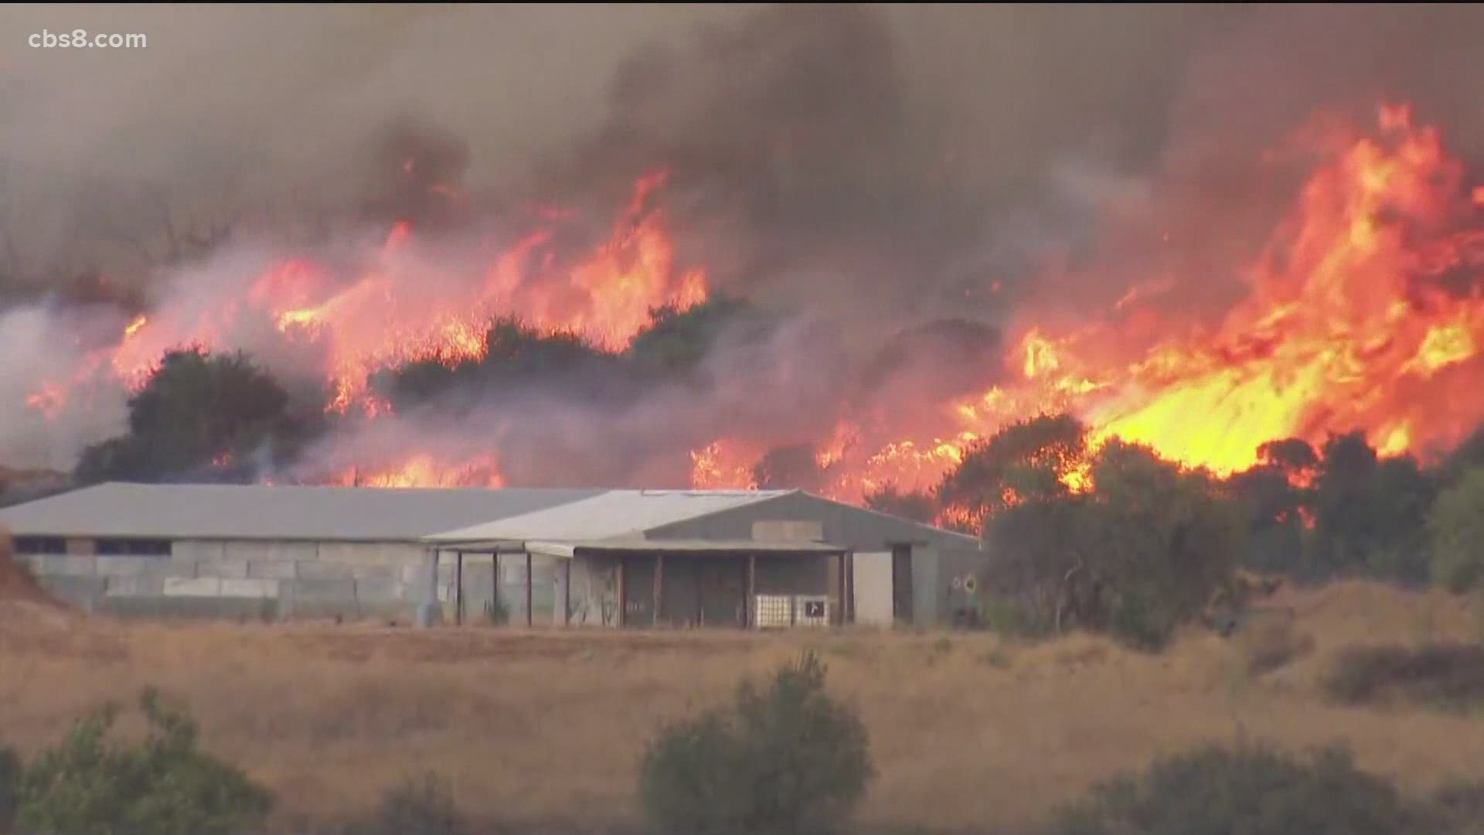
Key Factors to Consider in Preparing:
Have a go bag! Can you go for 3 days?
Do you have a good neighborhood network?
Have you developed a comprehensive documentation packet and veterinary contact list?
Have you identified a good communications plan and do people know where you will be?
Telegram and Signal
Have you made your equipment road worthy and ready for the possibility of evacuation?
Have you trained your animals to load under stress
Is your insurance coverage up to date?
Learn shelter locations early, get to know them.

Slide 22
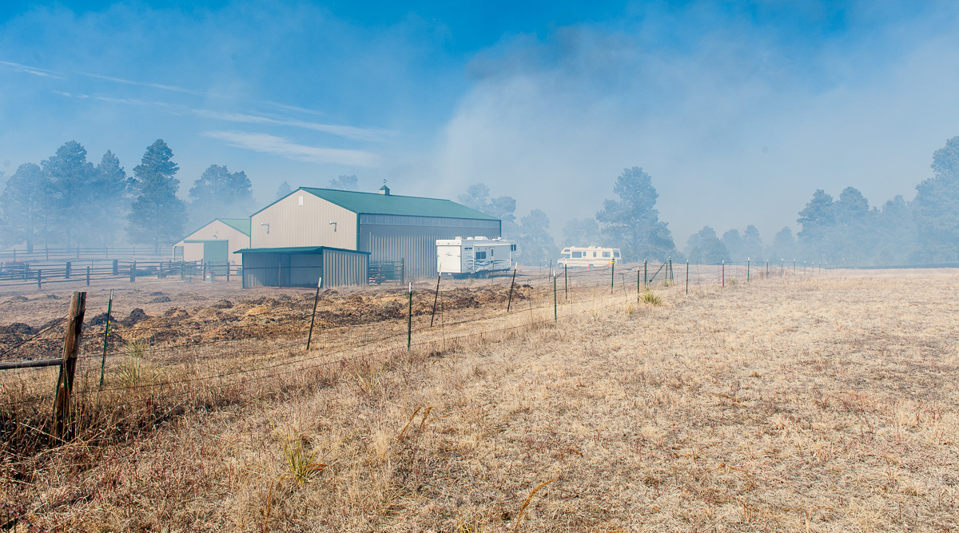
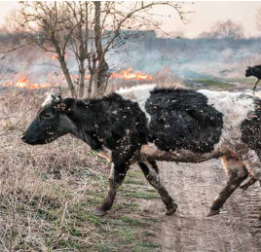
RESPONSE

Slide 23
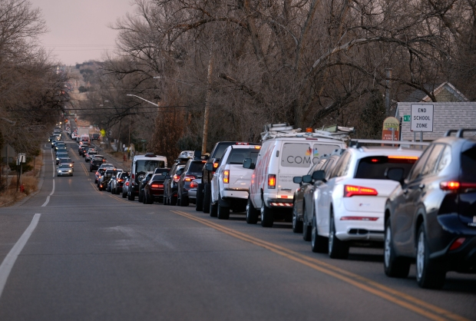
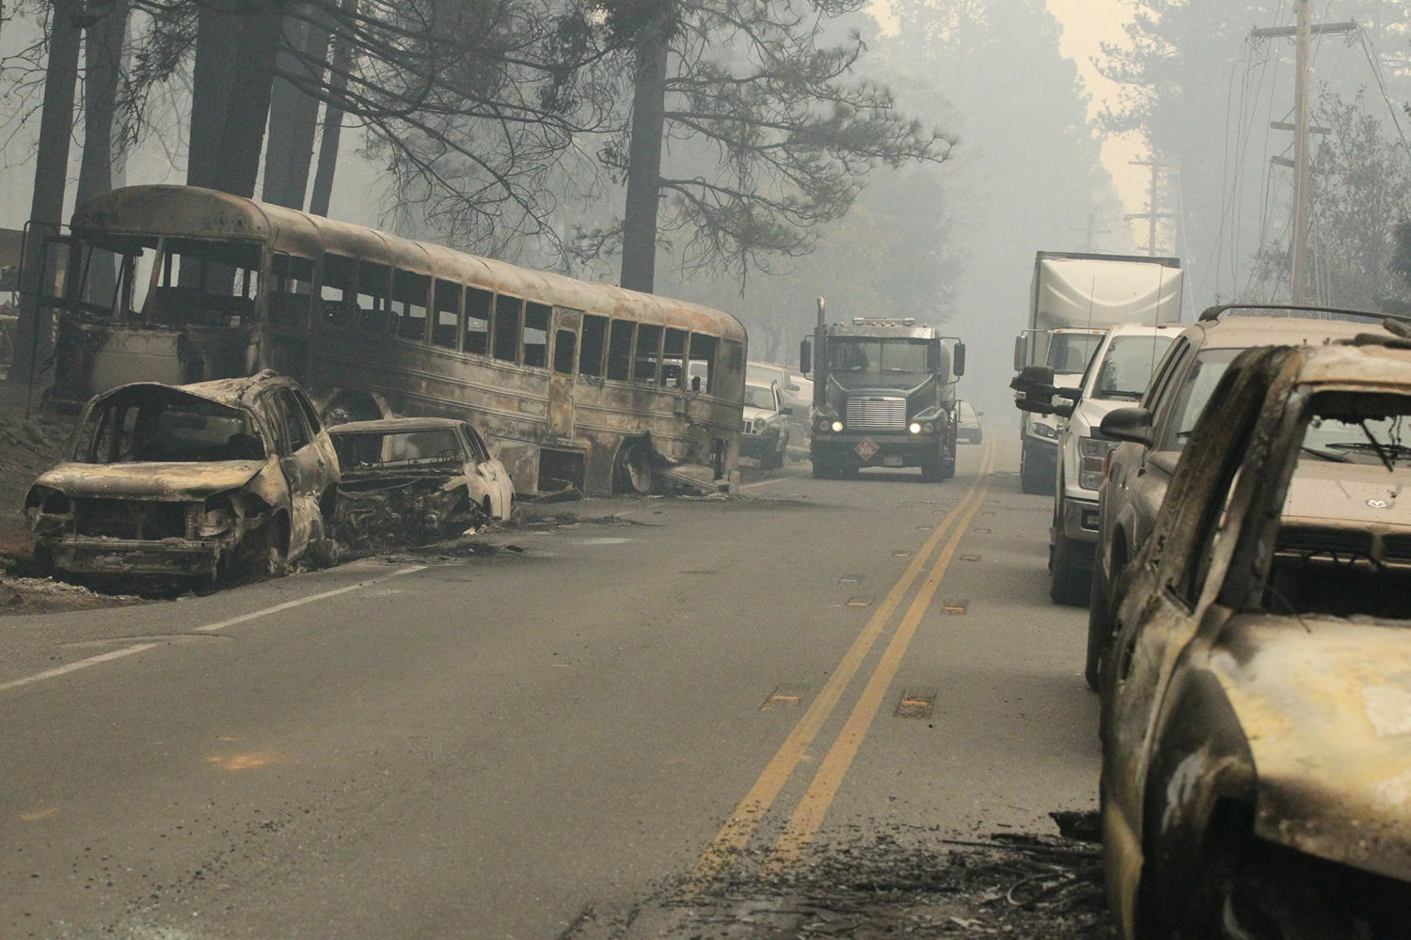
Getting Ready to Evacuate
Shut all windows and doors and turn lights on
Shut off Propane Tanks
Turn on irrigation
Know 2 ways out and practice them!
Signs “Animals are Gone” - "Evacuated"
Leave Shovels, Rakes, Hoses and Ladders Accessible
Leave gates open for firefighter access

Slide 24
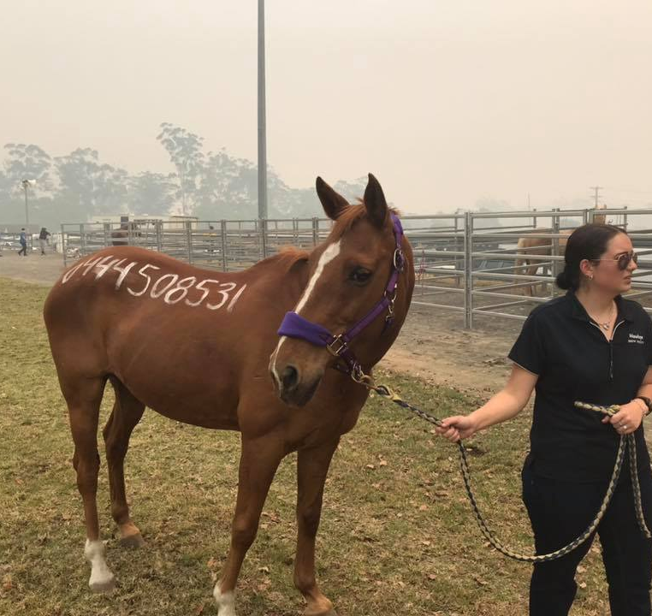
Evacuate
Go Early
Stay Informed!
Do not go back in
Know 2 (or 3) ways out.
Don’t rely only on Apps
Go Early!

Slide 25
Go Bag Basics - Humans
Medications
Toiletries
Visa Gift Card – non expiring
Cell Phone Chargers
Emergency Contact List
Snacks
Eye Glasses/Contacts
Socks, Underwear
Insurance Cards
72 HOURS

Slide 26
Go Bag Basics - Animals
Animal Medications
Specialty Feeds
Signage – Gone? Where?
Medical History Documentation
Bridals, Lead Ropes, Protective Equipment
Insurance Cards
Branding, Ownership Copies
PICTURES
Cloud Access (Google Drive, One Drive, Drop Box)
72 HOURS

Slide 27
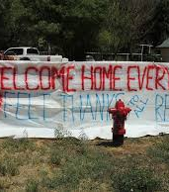
Recovery Considerations
Insurance
Relocation
Long Term Feed and Care
Well Water? Electricity?
Alternative Internet / Phone
What If Your Home or Ranch Is gone?

Slide 28
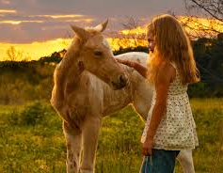
Have a Fire Safe Summer
T.J. Steck - tjs@elizabethfire.org
Kara Gerczynski – kara@elizabethfire.org
www.firewise.org
www.ready.gov
www.wildlandfirersg.org
https://dcsheriff.net/codered/
https://www.elbertcounty-co.gov/177/Public-Emergency-Notifications-CodeRED

