Slide 1
Basic Dermatology Review

Slide 3
Actinic Keratosis
“Pre cancers”
No Cure - chronic disease
Risk of SCC > BCC
10% in 10 years
0.6% per year
2.5% per 4 years
Types
Hypertrophic AK (*)
Pigmented AK (x)
Actinic cheilitis
Follow up visits
Every 3-6 months
Every 1-3 months – if severe
HAK (*) → Recheck 1 month

Slide 4
AK Treatment
Liquid Nitrogen – LN2
Creams
5-FU (Effudex / Fluoroplex / Carac)
Imiquimod (Aldara / Zyclara)
Diclofenac (Solaraze)
Ingenol Mebutate (Picato)
PDT – Photodynamic Therapy
TCA Peels / CO2 laser

Slide 5
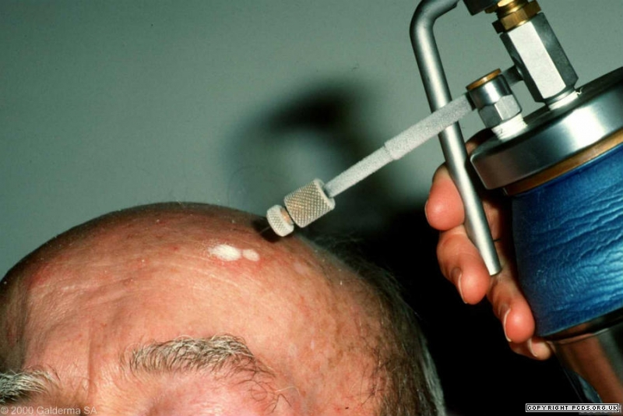
Liquid Nitrogen
-195 Celcius
Keratinocyte death at -50 Celcius
Melanocytes more sensitive
68-88% Effective

Slide 6
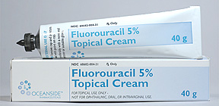
5-FU (5-Fluorouracil)
Field Treatment
FDA Approved
AK
Superficial BCC
Tx – Topical Steroids / Aquaphor / Mupirocin
Notes:
AK - Face – 2-4 weeks
Trunk/Ext – 4 weeks
BCC – about 4 weeks (until lesions cleared) - may take upto 12 weeks

Slide 7
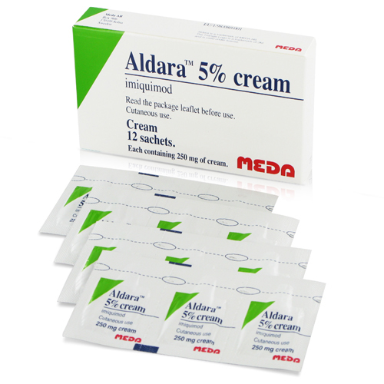
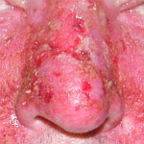
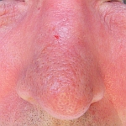
Imiquimod
FDA Approved
AK
Superficial BCC
Condyloma
2-2-2
Tx – Aquphor / Mupirocin
? Topical Steroids
MEMORY / REMISSION
Notes:
FDA – Non HK AK at Face/Scalp (<25cm squared) - AK –> M & F x 16 weeks
Less Irritating than 5-FU
Non FDA – Nodular BCC / Bowens / Keloids / Lentigo Maligna / VV / MC
Zyclara – less effective but less irritating than Aldara

Slide 9
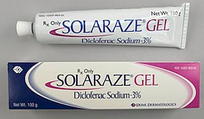
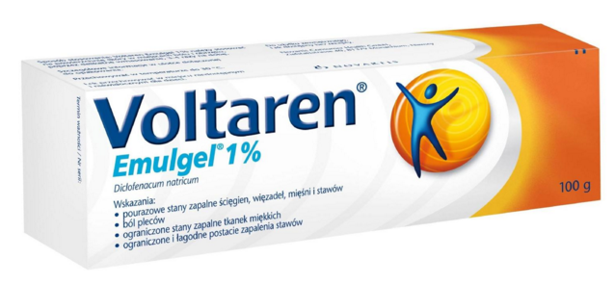
Cox-2 Inhibitor
FDA Approval – Actinic Keratosis – BID for 60-90days
Little to no inflammation

Slide 10
Botanical – sap of Euphorbia plant
Cytotoxic & Immune response modifier
0.015% Gel to Face & Scalp – apply for 3 days
0.05% Gel Trunk & Extremities – apply for 2 days
Peak Irritation ~1 week
Down-time ~20 days
Less applications → Better compliance
Notes:
Being studies for BCC/SCC

Slide 11
Photodynamic Therapy
FDA Approved : Actinic Keratosis
Off Label : BCC / Bowens / Photorejuvenation / Acne Vulgaris
Notes:
Best for Aks at Face/Scalp

Slide 12
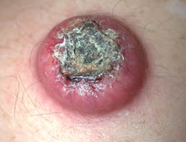

Slide 13
Skin Cancer Treatment Options
 | Indications | Advantage | Disadvantage
Topicals | BCC Superficial –FDA <2cm Trunk/Ext BCC nodular – OFF LABEL SCC in situ – OFF LABEL | Avoid procedure Home treatment | No margins Lower cure rate (80-90%) Prolonged Thx
ED&C | BCC Superficial <2cm at Trunk/Ext <1cm at Peripheral face SCC in situ <1cm at Trunk/Ext Not at face | No sutures | No margins Wound care Bad scar Hypopigmentated Hypertrophic (limit follow-up) Operator dependent
Excision | BCC / SCC – 5mm margins (7mm if aggressive histology) | Margin control Linear scar | Surgical risk False (-) margins
Mohs | Face / Scalp / Digits / Genitals >2cm / Aggressive histology Recurrent / Positive margins Immunocompromised | 100% margin evaluation Up to 98% cure rate Smaller scar | Surgical risk May take up to 2-3 hrs Operator dependent
XRT | Poor surgical candidates Elderly | Avoid surgery Less disfiguring | No margins Wound care Radiation dermatitis Cancer risk Multiple visits

Slide 14
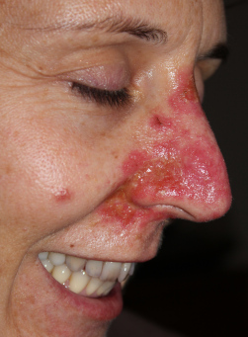
Topical Therapy
 | Indications | Advantage | Disadvantage
 | BCC Superficial – FDA <2cm Trunk/Ext BCC nodular – OFF LABEL SCC in situ – OFF LABEL | Avoid procedure Home treatment | No margins Lower cure rate (80-90%) Prolonged Thx

Slide 15
Relative Contraindications to Topicals
AK spot treatment without cryotherapy
Basal Cell Carcinoma with aggressive histology
Nodular – Not aggressive histology
Studies show unacceptable cure rate
Micronodular
Infiltrative
Morpheaform
Invasive Squamous Cell Carcinoma
Aggressive histology
Poorly differentiated
Prior to Mohs surgery
Studies have not shown benefit of less layers
Theoretical risk of false negative skip area

Slide 16
ED&C
 | Indications | Advantage | Disadvantage
 | BCC Superficial <2cm at Trunk/Ext <1cm at Peripheral face SCC in situ <1cm at Trunk/Ext Not at face | No sutures | No margins Wound care Bad scar Hypopigmentation Hypertrophic (limit follow-up) Operator dependent
Cure rate ~ 90%
Imiquimod for 6 weeks after
Cure rate up to 95%
Also less chance of hypertrophic/keloid scars

Slide 17
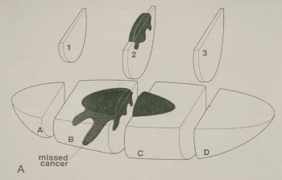
Excision
 | Indications | Advantage | Disadvantage
 | BCC / SCC – 5mm margins (7mm if aggressive histology) | Margin control Linear scar | Surgical risk False (-) Margins

Slide 18
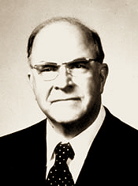
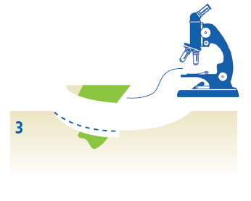
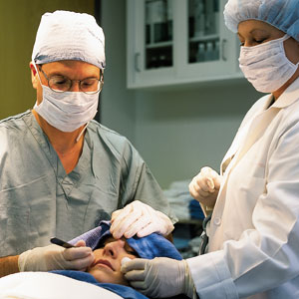
Mohs Micrographic Surgery
 | Indications | Advantage | Disadvantage
 | Face / Scalp Digits / Genitals >2cm Aggressive histology Recurrent Positive margins Immunosuppressed | 100% margin evaluation Up to 98% cure rate Smaller scar | Time consuming Up to 2-3 hrs Operator dependent Surgical risk
Frederic E. Mohs

Slide 19
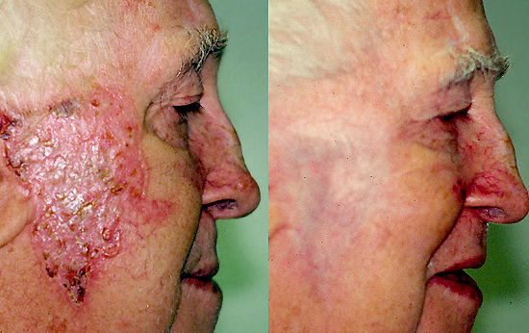
Radiation Therapy
 | Indications | Advantage | Disadvantage
 | Poor surgical candidates Elderly | Avoid surgery Less disfiguring | No margins Wound care Radiation Dermatitis Cancer Risk Multiple visits
Cure rate 85-95%
SCC / Sarcoma ~15-20 yrs later
Notes:
Brachy / XRT devise

Slide 20
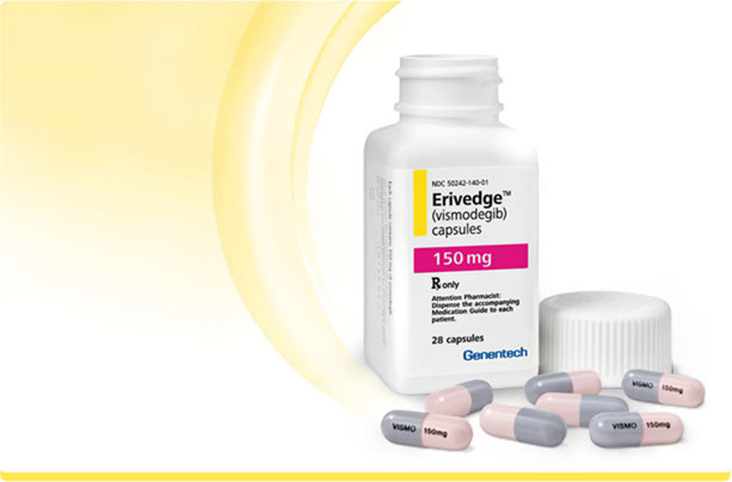
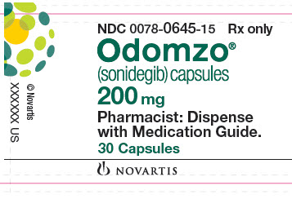
Hedgehog Pathway Inhibitor
Indications
Metastatic BCC
Recurrent locally advanced BCC
Poor surgical & radiation candidate
Options
Vismodegib (Erivedge) – FDA 2012
150mg PO qd
Sonidegib (Odomzo) – FDA 2015
200mg PO qd
Teratogenic
Female – 20 mos after last dose
Male – 8 mos after last dose

Slide 21
Vitamin B3
Vitamin B3
Forms
Nicotinamide (Niacinamide)
Anti-inflammatory – 1.5g qd in Bullous Pemphigoid
Nicotinic acid (Niacin)
Vasodilatory effects - HA / Flushing / Hypotension
20mg – recommended daily intake
Deficiency – Pellegra
Photo-dermatitis / Diarrhea / Dementia / Death
Alcoholism / Dietary restriction / Malabsorption

Slide 22
Vitamin B3
UV Radiation
Pyrimidine Dimers (more UVB)
Oxidative DNA damage (more UVA)
Age
DNA repair efficiency declines with age
DNA Repair
Energy intensive and needs ATP
Nicotinamide is essential co-factor for ATP production

Slide 23
ONTRAC study
Oral Nicotinamide To Reduce Actinic Cancer
Vitamin B3 PO 500mg bid
n=386
Patient with at least 2 NMSC in last 5 years
23% rate reduction in NMSC
Benefit lost in 6 months after stopping Vit B3
Why recommend after result of one small study
Inexpensive
Excellent safety profile
No drug interactions

Slide 24
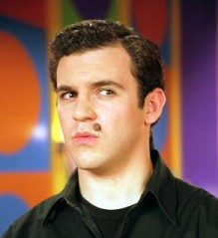
Suspicious mole ????
New ?
Changing ?

Slide 25
“Ugly Duckling”

Slide 26
Dysplastic Nevus (DN)
“Atypical Nevus”, “Abnormal Mole”
Risk Factor for Melanoma > Progression to MM
Mild DN → Re-check in 3-6 months
Excise 2mm margins
Recurrent
Clinically very suspicious
History of Melanoma
Patient preference
Moderate DN → Excise 3-4mm margins
Severe DN → Excise 5mm margins
Same margins as Melanoma in situ

Slide 27
Recurrent Mild DN

Slide 28
Negative Margins

Slide 29
Congenital Melanocytic Nevus
Birth
Tardive CMN – Onset by 1-2yo
Risk of MM
Also psychological & cosmetic problem
Types
Small <1.5cm
Medium 1.5-19.9cm
Large >20cm
Clinical
Patch (Flat/Tan) → Plaque → Verrucous with time
Terminal hairs (75%)

Slide 30
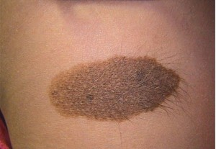
Small / Medium CMN
MM Risk – Very Low
Post Puberty
Recommendation - Close clinical f/u
Remove
Clinical change
Cosmetic reason
Parent concern

Slide 31
Large CMN
MM Risk- Low
More difficult to clinically Dx
MM can arise in deep location
Need palpatory exam
Risk of NCM
Size at Birth
Head – 12cm
Trunk & Extremities – 6cm

Slide 32
CMN – Imperfect Data
SIZE | FREQUENCY | MM RISK | NCM
Small / Medium CMN | Up to 30% | <1% (Up to 5%) Superficial Post Puberty | Low
Large/ Giant CMN | 1:20,000 to 1:50,000 | <5% (Up to 15%) Deep Pre Puberty | Up to 45%

Slide 33
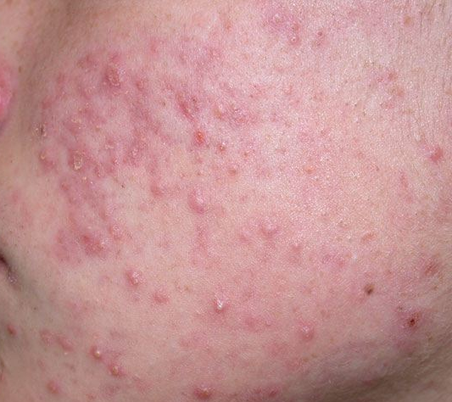
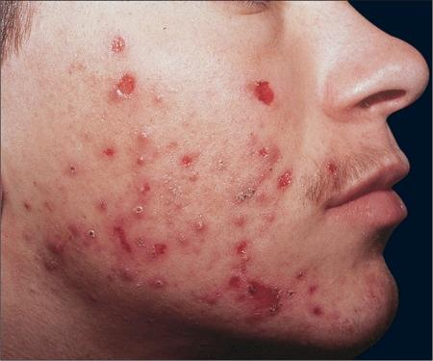
Comedonal / Papulopustular Acne
Excoriated Acne
Nodulocystic Acne

Slide 34
ACNE
Topicals
Oral Antibiotics
Isotretinoin
Oral Contraceptive
Aldactone
Lasers $$$$$$
Cystic Acne
Scarring Acne
Resistant Acne

Slide 35
Acne Therapy
Tretinoin - qhs | BPO/Clinda - qam | Oral Antibiotics
 |  | (Stop after 3 months)
Retina Micro Tazorac Atralin Epiduo (+BPO) Ziana (+Clinda) Veltin (+Clinda) Tretinoin (Generic) Adapalene (Generic) | Benzaclin Acanya Onexton Aktipak (BPO/Erythro) Duac (Generic) Benzamycin (Generic) | Doryx Monodox Adoxa Acticlate Solodyn Minocyn Doxycycline (Generic) Minocycline (Generic)
 |  | Not take with dairy
CREAM | Less irritating | Less effective
GEL | More irritating | More effective
Avoid oral antibiotics → Age < 8yo (MCN not <12yo)
Notes:
Accutane >12yo

Slide 36
Acne Treatment
Oral Antibiotics
Topicals -------------------------------------------------------------------------------------------------→

Slide 37
Aldactone
Block androgen receptor
Acne / Androgenetic Alopecia / PCOS / Hirsutism
Female “hormonal” acne
Resistant to antibiotics
Lower face/neck
Papulocystic
Dose in am - b/c diuretic effect
25mg PO qam → 50mg PO qam after 2 weeks
Up to 100mg qam
Women age >18yo – for acne

Slide 38
Aldactone
Combo with OCP
-FDA for Acne Yaz / Ortho Tri-Cyclen / Estrostep
Keep menses regular
Lower breast tenderness
Prevent pregnancy
Adverse effects
Teratogenic / Irregular menses / Breast tenderness
HA / Dizzyness / Hypotension
Hyer K / Mg – baseline & q 6 months

Slide 39
Female Hormonal Acne
Lower jawline - cystic
Also neck and cheeks
Also with increased oiliness
Flares with cycles
Endocrine work-up
History
Alopecia
Hirsutism
Irregular menses
Difficulty getting pregnant
Short remission after isotretinoin

Slide 40
Isotretinoin
Not a cure
Remission (2 month → 2 years)
Recurrence should be less severe
Total dose (120-150mg/kg)
About 5-6 months
Indication
Resistant
Nodulocystic
Scarring
Age >12 yo

Slide 41
Isotretinoin – Adverse Effects
Patient
Xerosis / Cheilitis → Moisturize / Aquahpor
Photosensitivity → Sunblock / Skip dose if on vacation
Epistaxis → Vaseline
Dry eyes → Eye drops (Contacts can cause corneal abrasions)
Getting labs monthly
Mom
Pregnancy - 2 forms of contraception
NO NEW DOSE – until HCG (-)
Depression / Suicide
IBDz – U.C./Crohns
Physician
Labs – CBC / CMP / Lipids / HCG

Slide 42
Acne Therapy – Patient Education
No cure to acne
“Not your fault” you have acne
Not your diet
Your face is not dirty
Topicals may irritate
Use less often / Moisturize more often
May not see benefit for 6 weeks
May get worse before you get better
Pregnancy B
Azaleic Acid (Finacea) / Clindamycin/ Metrogel
Notes:
Metrogel shown effective in Acne

Slide 43
Resistant Acne
Poor compliance
Not using medications
Spot treatment
Patient perception
Post inflammatory erythema vs. active lesions
Control not cure
Resistance
Add topicals
Aczone
Na Sulfacetamide & Sulfur
Aldactone / OCP
Isotretinoin

Slide 44
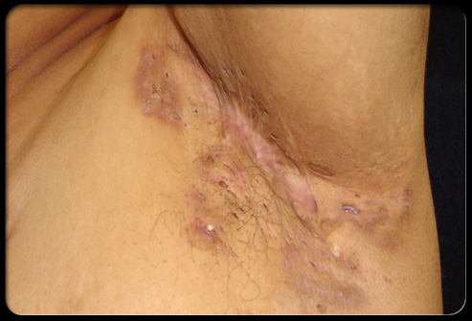
Hydradenitis Suppuritiva
1% of population – Female > Male
Onset age 22yo – delay in diagnosis ~12 yrs
Risk factors – no causal relationship
Smoking / Obesity / Stress / Friction
Lithium
First line treatment
Doxycycline PO / Topical Clindamycin
ILK – Cysts / Keloids
Chlorhexidine – bath / wash
Alternative
Combo PO
Rifampin 300mg & Clindamycin 300mg BID
Soriatane – little data
Biologics – TNF Inhibitors
Remicade IV – best efficacy
Humira (higher doses as used for Crohns) – FDA 2015
Little benefit shown with Enbrel

Slide 45
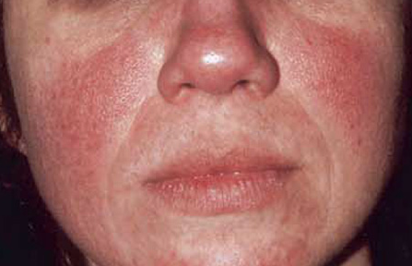
Rosaea
Primary features
Flushing
Persistent erythema
Papulopustules / Nodules
Telangiectasia
Secondary features
Burning / Stinging
May be eczematous or scaling
Edema
Ocular
Foreign body sensation / Burning / Stinging
Hyperemia / Styes

Slide 46
Rosacea Triggers
Sun exposure
Emotional stress
Hot or cold weather
Wind
Heavy exercise
Alcohol
Hot baths / Humidity
Certain skin care products
Certain foods

Slide 47
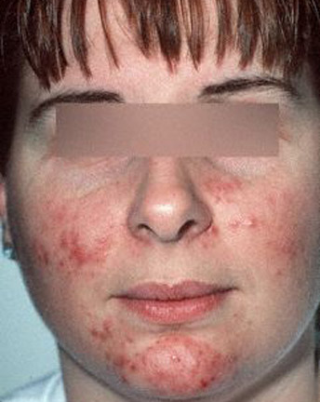
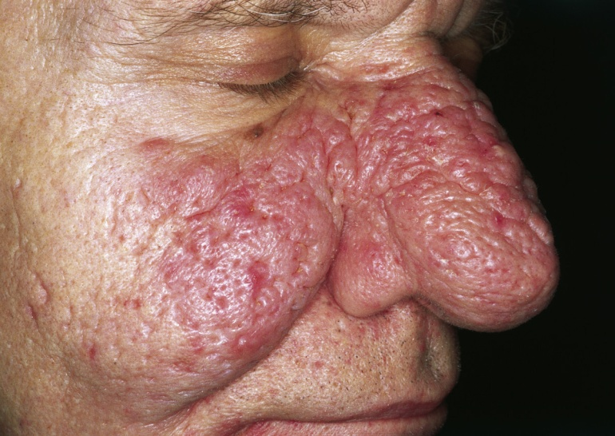
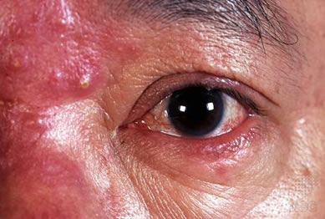
Rosacea Types
Erythematotelangectatic
Papulopustular
Rhinophyma
Ocular
Notes:
Flushing – Rosacea / Lupus / Niacin / Perimenopausal
Rare – Carcinoid / Pheochromocytoma / Thyroid cancer (medullary) / Pancreatic tumor / Systemic Mastocytosis
Tx Flushing Rosacea – No-selective BB (Alpha and Beta receptor blocking ability) – Propanolol / Nadolol / Carvidilol

Slide 48
Rosacea Therapy
Topicals |  | Oral Antibiotics
 |  | (Stop after 3 months)
Azaleic Acid (Finacea) Metronidazole Ivermectin (Soolantra) Na Sulfacetamide & Sulfur Brimonidine (Mirvaso) Alpha 2 agonist – Vasoconstriction Oxymetazoline (Rhophade) Alpha 1 agonist – Vasoconstriction |  | Doryx Monodox Adoxa Acticlate Solodyn Minocyn Doxycycline (Generic) Minocycline (Generic)
Trigger avoidance
Sunblock (Physical > Chemical) |  | Oracea (Doxy 40mg)

Slide 49
Rosacea Treatment
Oral Antibiotics
Topicals -------------------------------------------------------------------------------------------------→

Slide 50
Rosacea Therapy
No Cure
Trigger Avoidance - Sunblock (Physical)
Moisturize
Topicals
Metronidazole
Azaleic Acid (Finacea) – gel / foam
Ivermectin (Soolantra)
Sodium Sulfacetamide & Sulfur
Brimonidine (Mirvaso)
Oral Antibiotics
Minocycline
Doxycycline
Oracea (Doxycycline 40mg) – Sub-microbial dose
Laser – Pulse Dye Laser (V Beam) – 585nm / 595nm

Slide 51
Seborrheic Dermatitis
Mild dandruff / Itchy ears → Severe dermatitis
Sebaceous areas - Malasezia
Face
Brows / Lashes / NL folds
Scalp
Post auricular
Upper Trunk
Chest / Axilla
Umbilicus / Anogenital
Triggers
Stress
Weather (Humidity / Cold / Wind)

Slide 52
Seborrheic Dermatitis

Slide 53
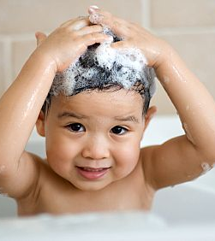
Seborrheic Dermatitis
Stop – Hairspary / Pomades
Frequent washing
Longer period of lathering → remove scale
Increase contact time

Slide 54
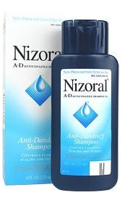
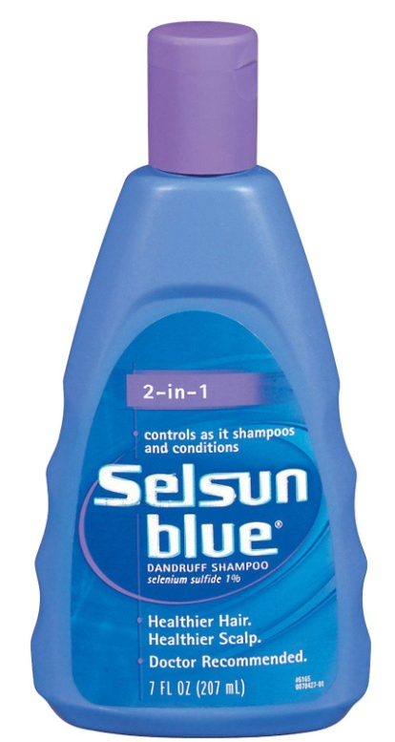
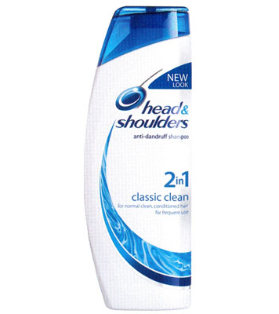
Seborrheic Dermatitis Maintenance Thx
Antifungals
Ketoconazole 2% (Nizoral) – cream or shampoo
Extina Foam / Xolegel
Pregnancy C
Ciclopirox 1% (Loprox) – cream or shampoo
Pregnancy B
Selenium suflide (Selsun Blue OTC) shampoo
Zinc (Head & Shoulders OTC) shampoo

Slide 55
Seborrheic Dermatitis Maintenance Thx
Na Sulfacedamide & Sulfure
Cleanser / Wash / Cream
Plexion / Rosula / Rosac / Avar
Salicylic Acid OTC
Scalpicin 3% Solution (+/- HC 1%)
Salex 6% shampoo or cream
Tar Shampoo OTC (T-Gel / T-Sal / DHS )
Metronidzole – Rosacea overlap

Slide 56
Seborrheic Dermatitis

Slide 57
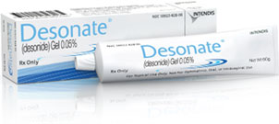
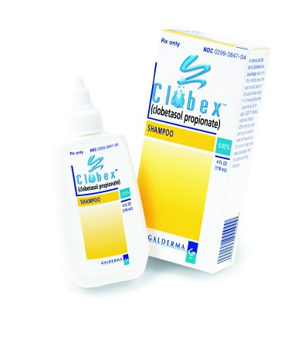
Seborrheic Dermatitis – Flare Thx
Topical Corticosteroids
Only during flares
Face
Desonide (Cream / Ointment)
Desonate Gel / Verdeso Foam
Scalp
Clobetasol Solution
Clobex shampoo / Olux Foam
Dermasmooth Scalp Oil (Fluocinolone)
Lidex Solution (Fluocinonide)

Slide 59
Tinea Versicolor
Young Adults
2-8% of population
Malassezia - Normal skin flora
Infants 15% → Adults 90-100%
Lipophilic – High sebaceous areas
Risk Factors
Family History (20%) – more recurrences
Warm / Humid / Hyperhidrosis / Oily
Immunosuppresion / Prednisone / Antibiotics

Slide 60
Tinea Versicolor
Hypopigmentation
Persist after treatment
Hyperpigmentation
Red / Pink / Brown
Fine Scale
Mild Pruritus

Slide 61
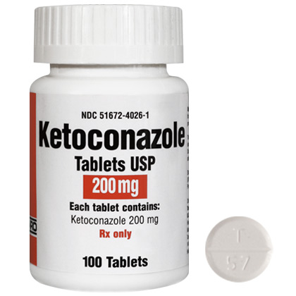
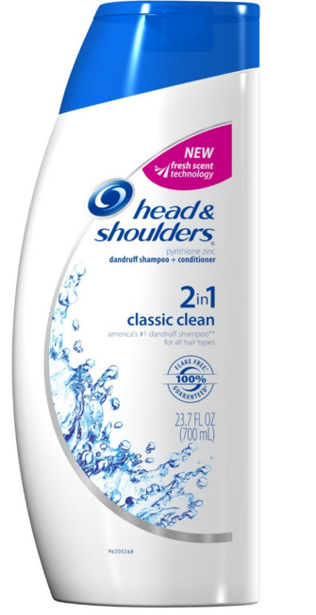

Slide 63
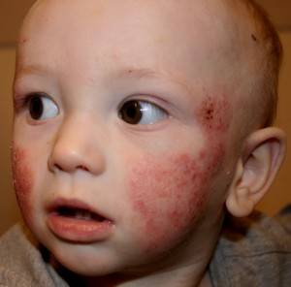
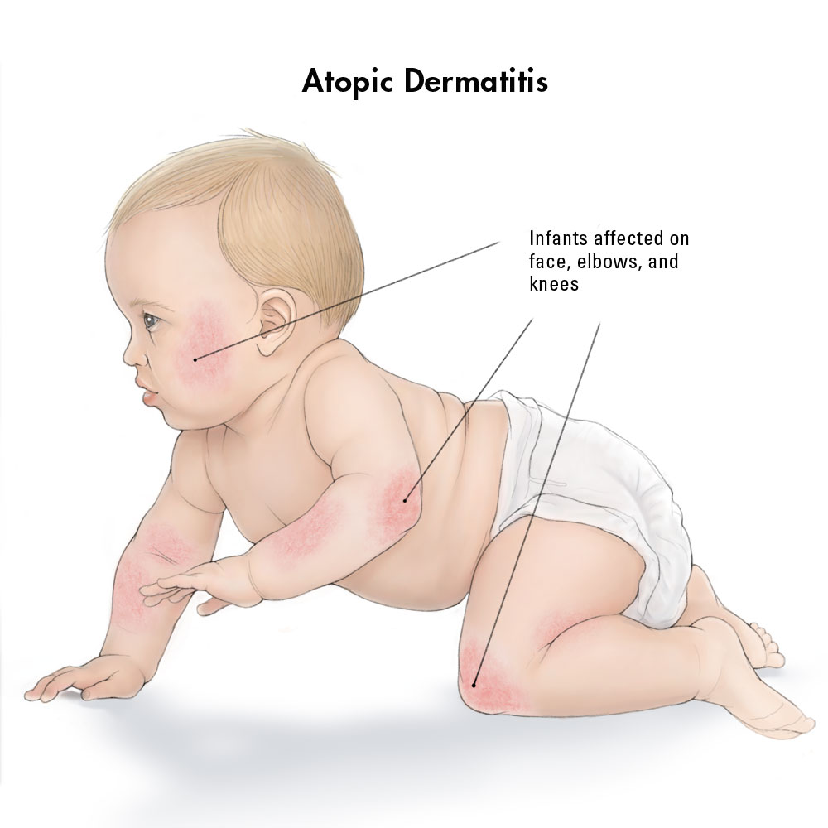
Atopic Dermatitis
Atopic Triad (Atopic march)
AD → Asthma → Allergic Rhinitis
10-20% of Pediatrics
Infants – Face & Extensors
Children – Flexural / Neck
1-2% of Adults
Peri-ocular / Palmo-plantar / Neck
Generalized

Slide 64
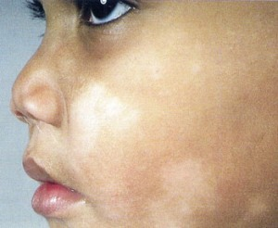
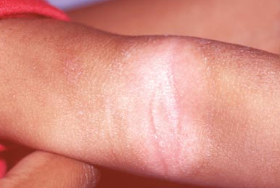
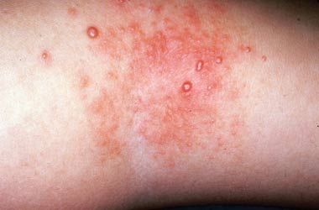
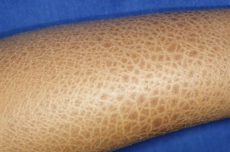
Pityriasis Alba
Post Inflammatory Hypopigmentation
Molluscum Contagiosum
Keratosis Pilaris
Ichthyosis
Notes:
Df Dx – Hypopigmentation in kids
Vitiligo / PIPA / P Alba / TV
Hypopigmeted MF / Hansens
Progressive Macular Hypopigmentation

Slide 65
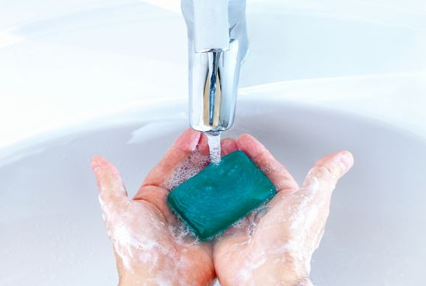
Atopic Dermatitis Triggers
Xerosis
Climate – Dry / Windy / Humid
Exercise – local humidity
Contact Irritants
Soaps
Preservatives / Perfumes
Wool
Contact Allergens

Slide 66
Atopic Dermatitis Therapy
NO CURE
Goal → Symptom control
Moisturize
Cetaphil / Aveeno / Neutrogena
Cerave
Aquaphor
Bathing
Short / Warm / No bubble baths
No Wash cloths / No Loofah
Mild Soaps – only flexural areas
Topicals within 3 minutes

Slide 67
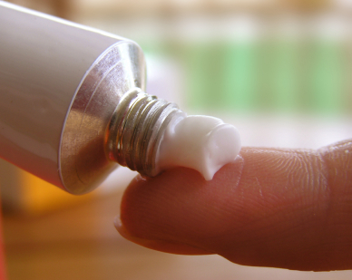
AD Treatment
Rx - Barrier Repair
Atopiclair / Mimyx / Eletone / Epiceram
Topical Corticosteroids
HPA Axis Suppression – High Surface:Volume ratio
Low Potency – Infants / Face / Folds
Ointments – most potent / less user friendly
Creams – less potent / more user friendly
Lotions – drying (evaporation effect)
Contain alcohol & may cause burning
Oral Antibiotics – super-infection / super-antigen

Slide 68
CLASS | TOPICAL CORTICOSTEROIDS
I | Clobetasol (Temovate / Clobex / Olux) Halobetasol (Ultravate) Betamethasone(Diprolene) Diflorasone (Psorcon) Fluronderonolide (Cordran Tape)
II | Fluocinonide (Lidex / Vanos) Desoximetasone (Topicort)
III | Triamcinolone 0.5% (Kenalog / Aristocort) Mometasone-O (Elocon) Fluticasone-O (Cutivate)
IV | Triamcinlone-O 0.1% (Kenalog / Aristocort) Fluocinolone 0.2% (Synalar) Flurandrenolide (Cordran) Mometasone – C (Elocon) Hydrocortisone (Locoid)
V | Triamcinolone-C 0.1% (Kenalog / Aristocort) Desonide-O (Desowen) Fluticasone-C (Cutivate)
VI | Fluocinolone 0.01% (Capex / Dermasmooth) Desonide-C (Desowen) Alclometasone (Aclovate)
VI | Hydrocortisone (OTC 1% / Rx 2.5%)

Slide 69
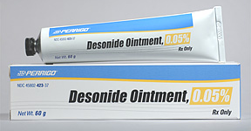
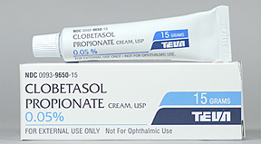
Low Potency
Medium Potency
High Potency

Slide 70
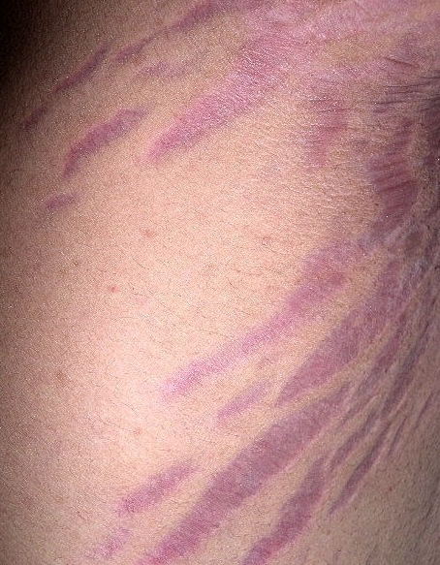
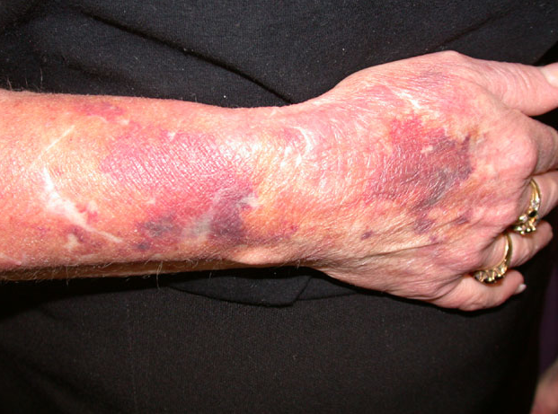
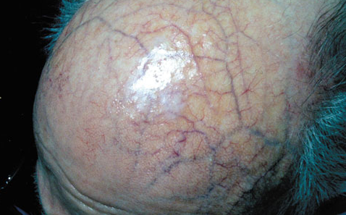
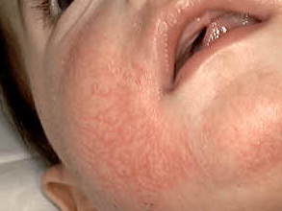
Corticosteroid Atrophy

Slide 71
Eczema / Dermatitis
Topical Corticosteroids
Moisturize --------------------------------------------------------→

Slide 73
Calcineurin Inhibitors
No risk of steroid induced atrophy
Black Box Warning – Link to skin cancer & lymphoma
(high dose in animal studies)
Indication – Adjunct to topical corticosteroids for AD

Slide 74
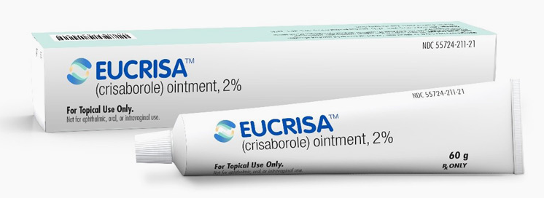
Crisaborole (Eucrisa)
FDA 2016
Atopic Dermatitis / Eczema – mild to moderate
Age >2yo
MOA
Phosphodiesterase 4 (PDE-4) Inhibitor
Increased intracellular cAMP levels
2% ointment bid
Non steroidal anti-inflammatory

Slide 75
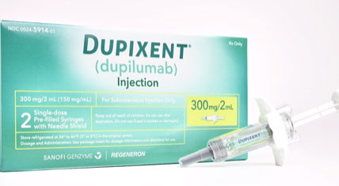
Dupixent (Dupilumab)
FDA 2017
Adults with mod-severe Atopic Dermatitis
MOA – Human monoclonal Ab
Inhibits IL4 & IL-13 signaling
Binding to IL-4Ra subunit shared by IL-4 and IL-13
SQ injection– 300mg qow
Adverse effects
Injection site reaction
Conjunctivitis / Blepharitis
Oral herpes

Slide 76
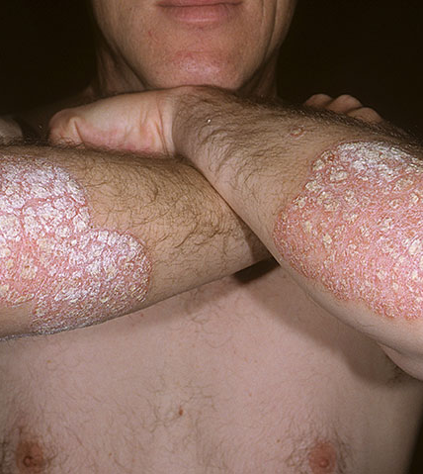
Psoriasis
Plaque – Extensors / Scalp
Guttate – “drops”
Trigger → Strep Pharyngitis
May be self limited / May progress to Plaque Psoriasis
Inverse – Intertriginous / No scale
More pruritic
Palmoplantar
Pustular
Generalized – Von Zumbusch
Systemic symptoms / Mortality
Triggers → Prednisone withdrawal / Infection
Palmoplantar
Erythrodermic

Slide 77
Psoriasis Treatment
No Benefit for Arthritis
Benefit for Arthritis
Topicals
Topical Corticosteroids
ILK → Scalp / Thick lesions
Maintenance – Dovonex / Tar
Thick scale - Urea / Tazarac
Adverse Effects
Less effective / Difficult to use
UV Thx
UVB / NbUVB / PUVA
Adverse Effects
Skin cancer
Multiple visits per week
Oral
Soriatane – not to females
Otezla
GI upset / Depression
Renal failure
Methotrexate / Cyclosporine
Adverse Effects
Organ Toxic
Biologics - Injections
Humira / Enbrel
Adverse Effects
TB / MS / Lupus / Lymphoma

Slide 78
Plaque Psoriasis
Clobetasol / Triamcinolone (Cream / Ointment )
Dovonex / Tazarac / Urea -----------------------------→

Slide 79
Scalp Psoriasis
Clobetasol (Solution / Foam) / ILK
Tar Shampoo (T-Gel / T-Sal / DHS) ------------------------------→

Slide 80
Guttate Psoriasis
Inverse Psoriasis

Slide 81
Palmoplantar Psoriasis

Slide 82
Pustular Psoriasis - Palmplantar

Slide 83
Erythrodermic Psoriasis
Pustular Psoriasis

Slide 84
Psoriasis Nails
Oil drop sign
Pitting
Seen in 90% of patient with Psoriatic Arthritis
Splinter hemorrhage

Slide 85
Psoriatic Arthritis
Arthralgia
Acral / Knees / Back
Worse in am (stiffness)
Worse with Psoriasis flares
Sausage digits - Dactylitis
Refer to Rheumotology
Dx Arthritis (20-30% of pts)
May result in joint destruction
Mutilating arthritis (rare)
Systemic medications

Slide 87
Granuloma Annulare
Etiology – unknown
Benign & usually self limited (50% in 2 years)
Mostly in pediatrics
2/3 of patients <30yo
Female:Male 2:1
Clinical subtypes
Localized (75%)
Most common
Generalized (Disseminated)
More common in adults
A/w – Lipid dz / Thyroid dz / DM / HIV / Malignancy (Heme>Solid)
Subcutaneous GA / Perforating GA
Actinic Granuloma
aka Annular Elastolytic Giant Cell Granuloma

Slide 88
Granuloma Annulare
Clinical
Asymptomatic
Small papule → Annular plaques
Skin colored → Pink → Violaceous
Extremities > Trunk
Thx
High potency corticosteroids
ILK
Cryotherapy
PUVA / UVA1

Slide 89
GA Clinical Subtypes
Generalized GA
Perforating GA
Subcutaneous GA
aka Pseudo Rheumatoid Nodule
(Peds / Acral / Self limited)

Slide 90
Scabies
Delayed HSN Rxn
Allergy to mite, eggs, feces
Extremely pruritic
Worse at night
“Want to tear my skin off”
Contagious
Close contact / STD
Family members may not have symptoms
May mimic any rash
Eczematous or lichenoid with time

Slide 91
Scabies
Papular eruption
Rarely contain mite
Trunk / Extremity / Genitals
Rare → Face & scalp
Linear Burrows
Hands / Axilla
Genitals / Nipples

Slide 92
Scabies Thx
Tx → Patient & household
Symptoms may persist ~ 1
Rule out recurrence
Sheets & clothing
Wash in hot water
Dry in hot temperature
May isolate for 5 days – trash bag / closet
Mites die if not human contact
Topical Steroids
Symptomatic relief
Triamcinolone ointment bid x 2weeks – 1 pound jar

Slide 93
Scabies Thx
Permethrin (Elimite) 5% cream
Neck to toe → wash off in am
Rub into all folds
Repeat in 1 week
Contraindicated
Peds < 2mos / Pregnancy B
Ivermectin (Stromectol) 3mg tabs
Not FDA for scabies but CDC recommended as 1st line treatment
200 microgram/kg
Repeat in 1 week
Contraindicated
Peds < 5yo / Pregnancy C
Sulfur 6% in petrolatum
Infants / Pregnancy / Lactation

Slide 94
Hypersensitivity Reaction
Pathologic finding - Not a clinical diagnosis
SPVLI with eosinophils
With or without epidermal spongiosis
Differential Diagnosis
Allergic contact dermatitis
Arthropod reaction
Drug Reaction
Tx
Exposure history
Contact exposures / Medications / Drug chart
Allergen avoidance
Topical corticosteroids
Scabies treatment if indicated
Allergist referral
UV Therapy – resistant cases

Slide 95
Pityriasis Rosea
HHV 7
Pediatrics / Young adults
Prodrome (5% of pts)
Oral lesions (Rare)
Self limited - ~ 8 wks
PR Perstans – up to 3-6 months
Papulosquamous - Rule out
PR-like medication reactions
Syphilis

Slide 96
Pityriasis Rosea
Salmon colored plaques
Peripheral collaret scale
Oval
Long axis along cleavage lines
Trunk / Extremities
“Christmas tree pattern”
Spares face, hands & feet
Pruritus (25-75%)
Non scarring – may have PIPA

Slide 97
Pityriasis Rosea
“Herald patch” (2-10cm) – 50-90%
Central clearing / Collaret of scale
Resemble Tinea – PR scale does not go to lesion border
Weeks prior to eruption
No Herald Patch (10-50%)
More frequent in drug induced PR
Multiple Herald Patches
Only Herald Patch – no rash

Slide 98
Pityriasis Rosea
PR in Pregnancy
Risk of premature delivery & miscarriage
Specially if <15 weeks of gestation

Slide 99
Pityriasis Rosea

Slide 101
Molluscum Contagiosum
Dome shaped umbilicated papules
Transmission
Skin to skin / Fomites
Baths / Swimming pools / Schools / Playgrounds
Types
Pediatrics (Atopic Dermatitis)
Adults – Sexually active
Immunosuppressed – Disseminated or Giant MC

Slide 102
Mollucsum Contagiosum

Slide 103
Molluscum Contagiosum Therapy
Self limited – 9-18 months
Up to 5 years reported
Observation
Liquid Nitrogen – scarring potential
Canthacur – scarring potential
Currette – scarring potential
Home Thx
Salicylic Acid OTC
Tretinoin
Imiquimod - ? Benefit / ? scarring potential
Vaseline to non-treated areas

Slide 104
Parent Education
Multiple visits
Scarring potential
Doughnut wart
MC
Wash off in 15 min – in office
May increase to 30 minutes
VV
Wash off in 1 hour
May increase to 2-3 hours
Verruca Plantaris
Wash off in 2 hours
May increase to 3-4 hours

Slide 105
Verruca Vulgaris – Office Thx
Paring
Liquid Nitrogen
Canthacur
Resistant Warts
Shave removal / Excision
Intralesional
Bleomycin / Candida Ag
Lasers
CO2 / Pulse Dye / Nd:Yag
Thrombosed vessels – “Seeds”

Slide 106
Resistant Verruca
Periungual VV
Plantar VV

Slide 107
Verruca Vulgaris – Home Thx
Salicylic Acid OTC 5-40%
Duct Tape
Tretinoin / Adapalene / Tazarac
Imiquimod / 5-FU
Cimetidine (high dose -20-40mg/kg)
No benefit in double blind controlled studies
Anectodal benefit in pediatrics
Zinc (10mg/kg to max dose 600 mg/day x 2 mos)
Benefit shown in zinc deficient patients

Slide 108
Condyloma Acuminata
Incidence
1% of population - most common STD
Subclinical infection
80-90% of sexually active adults
Incubation
Months to years
New lesions not a sign of recent infidelity
May flare with pregnancy
Viral shedding
Duration unknown
Children - R/o sexual abuse
50% due to viral inoculation at birth or autoinoculation

Slide 109
Condyloma Acuminata
External
Genitalia / Perineum / Anus
Internal
Cervix / Urethra / Vagina
Peri-Anal - r/o rectal spread
Need anoscopy
Female – need PAP smears yearly
Males – may have urethral involvement
Not → Condyloma Lata (Secondary Syphilis)
Condyloma Lata →

Slide 110
Condyloma Acuminata
Neoplastic potential
Least – HPV 6/11
90% of condylomas
Rarely incorporate DNA into host
Highest – HPV 16/18
70% of cervical cancers
Bowenoid Papulosis
Bowens / SCC
Moderate
HPV 33 / 35 / 39 / 40 / 43 / 51
Mixed in 10-15%

Slide 111
Immunotherapy
Imiquimod (Aldara 5% cream)
Immune response modifier
FDA for Condyloma - M/W/F qhs – max of 16 weeks
Female cure rate → 75% - better penetration
Males cure rate → 40%
Off label for Verruca
Application site reaction (Inflammation / Erosions)
2/3 of patients
Correlate with benefit, but not needed for benefit
May cause PIPA/Scarring
Effective in immunosuppressed & HIV patients

Slide 112
Immunotherapy
Sinacatechin (Veregan 15% ointment)
Natural botanical therapy - Green tea leaves
Unknown MOA
FDA for Condyloma - tid – max of 16 weeks
Application site reaction (Inflammation / Erosions)
Correlate with benefit, but not needed for benefit
May stain clothing
Compared to imiquimod
Better efficacy & lower recurrence
Not head to head data

Slide 113
HPV Vaccination
Gardisil (Quadrivalent) – 3 dose series - HPV 6/11/16/18
FDA 2006 – Females age >12yo
FDA 2009 – Males age > 12yo
Prior to age of sexual activity
Ceravix (Bivalent) – 3 dose series - HPV 16/18
FDA 2009
Not approved for prevention of condyloma
Vaccinated patients still require pap smears
Does not prevent 30% of cervical cancers
Benefit in older patients already with genital lesions
May not have been exposed to the above subtypes
May also be used in immunocompromised
Benefit
Penile, anal , vulvar, vaginal & oropharyngeal carcinomas

Slide 114
HPV Vaccination
Gardasil 9 (nano-valent)
3 dose series
FDA 2014
Female & males age 9-26yo
HPV 6/11/16/18/31/33/45/52/58
Notes:
Gardisil 4 will probably no longer be available in future

Slide 115
Alopecia
History
Duration ?
Symptoms ?
Hair loss or hair shedding ?
Exam
Location of hair loss ? Scalp ? Brows ? Body ?
Focal or diffuse ?
Hair-pull test ?
May be negative if patient used shampoo that day
Surface change ?
Erythema / Scale / Peri-follicular (LP) / Crust / Pustules
Scarring ?
Loss of follicular ostia

Slide 116
Alopecia
Non scarring – No surface change / No symptoms
Androgenetic – more hair loss
Telogen Effluvium – more hair shedding
Alopecia Areata
Anagen effluvium – 1-2 weeks post Rx/Chemo Thx
Scarring – Erythema-Scale / Scar (loss of follicular ostia)
Discoid Lupus (DLE)
Lichen Planopilaris (LPP) / Frontal Fibrosing Alopecia(FFA)
CCCA
Folliculitis Decalvans (FDC)
Dissecting Cellulitis (DC)
Pseudoplaude of Broque (PPB)

Slide 117
Alopecia
Alopecia Areata
Telogen Effluvium

Slide 118
Androgenetic Alopecia
Androgenetic Alopecia
Hair loss
No family hx in 10%
Male
Fronto-temporal / Vertex
Female
Maintain frontal hairline / Widening of part
Now called Female Pattern Hairloss
Androgens play less of a role
Tx
Minoxidil 2% or 5% solution/foam
Propecia (men) – no benefit in post menopausal women
Senescent Alopecia
Age related
After 60yo
Not DHT mediated
Men taking Finasteride for BPH not improving

Slide 119
Telogen Efluvium
Hair shedding - Hairpull (+)
May be negative in shampoo that day
“Hair on pillow” / “Hair in kitchen”
Stress (3-6 month prior)
Psychological - BBB – Bereavement / Breakup / Bankruptcy
Physiologic – Severe illness / Surgery / Fasting / Pregnancy
New medication (1-3 month prior)
Heparin / Warfarin / Lithium / NSAIDS
Tamoxifen / Cardiac Rx / Statins / OCP
Soy milk / St Johns Wort
Labs – Alopecia panel
Bx – Persistent >6-9 months
Tx
Minoxidil
Ketoconazole shampoo – control seborrheic dermatitis
Notes:
Labs – Fe / ANA / RPR / TSH / Zinc / Vit D / Biotin / B12 / Chronic Hepato-renal dz / Prolactin
20% - pt notice
30-50% others notice
Not >50% hair loss

Slide 120
Alopecia Areata
Patches of alopecia
Scalp / Beard / Brow / Lashes
R/o Tinea Capitis
May see poliosis (white hairs)
Patient education
50% regrowth in 1 year
Alopecia Totalis & Universalis
Tx
ILK
Clobetasol / Minoxidil soln
Anthralin / Squaric Acid / DPCP
Peds / Severe dz >50%
Prednisone – severe progressive disease
PUVA – Alopecia Totalis / Universalis

Slide 121
Alopecia / Seborrheic Dermatitis
May co-exist
Not confuse with inflammatory alopecia
Etiology
Washing too gently b/c fear of more hair falling
Seborrheic Dermatitits
Itself can cause more shedding due to inflammation
Can lower penetration of minoxidil
Tx – Ketoconzaole shampoo

Slide 122
Scarring Alopecia
Patient education
“What is gone is gone” / “can’t bring it back”
Treat to prevent worsening
Intra-lesional kenalog
Erythematous inflammatory areas
No benefit over scar areas
Biopsy
Erythematous areas
No benefit over scar areas

Slide 123
Scarring Alopecia
Notes:
Always ask about symptoms – Itching / Burning / Pain / Tenderness

Slide 125
Scarring Alopecia
DLE
Rule out and monitor for SLE / Check other areas & ear concha / Risk of SCC
Tx
SPF
ILK / Clobetasol / Hydroxychloroquine
Cellcept / Cyclosporine
LPP
Rapid hair loss / Itchy & tender / Central scalp / Perifollicular erythema & scale
Tx
ILK / Clobetasol / Doxy / Hydroxychloroquine
Cellcept / Cyclosporine
Glitizones (DMII Rx) – safe to use in non-DM - ? benefit
FFA
Perimenopausal women / Also brows and arm hair / May also present at posterior scalp
Tx
ILK / Clobetasol / Doxy
Hydroxycholorquine
Finasteride or Dusateride
Notes:
Treatment – may take 6 months prior to seeing clinical result

Slide 126
DLE
LPP
Peri-follicular Erythema
Peri-follilucar scale

Slide 127
ILK
DLE
Central
LPP / FFA
Peripheral
AA
Central & peripheral

Slide 128
Scarring Alopecia
CCCA
Rule out in all black women with central alopecia
Often asymptomatic
May describe “pins and needles”
Exam – lack inflammation
Treat – Deficiencies (Vit D / Fe / Zinc) and Thyroid dz
Tx
ILK / Clobetasol / Doxy
Avoid certain hair care practice
Chemical relaxers / Heat / Traction
Wearing wig or hair piece for 6-12 months may help
Hydroxychloroquine / Cellcept
Notes:
CCCA - Hair relaxers – use less often (no more than q 2 months) / Don’t color hair same time as relaxer / Use milder relaxer as possible

Slide 129
Scarring Alopecia
FDC
“Pimples” & hair loss / Symptomatic (pain/itching/burning)
Follicular papules at crown → Pustules slowly expand
Culture pustules to fine tune antibiotics
Tx
ILK / Clobetasol
Mupirocin (scalp & nares) / Clinda topical / Aczone
Doxycycline +/- Keflex
Clinda PO & Rifampin x 2 months <--> Doxy
Dissecting Cellulitis
Black men 20-40yo / Boggy nodules with sinus tracts
Culture any purulent material to fine tune antibiotics – often negataive
Tx
ILK / Doxy +/- Keflex / I&D
Isotretinoin 10-20mg/kg
Dapsone / Topical Aczone
Notes:
10 weeks of - Rifampin 300mg BID & Clinda 300mg bid
If can’t tolerate Rifampin/Clinda → Cipro 750 bid or just Keflex 500 bid

Slide 130
Scarring Alopecia
Dissecting Cellulitis
CCCA

Slide 131
FDC

Slide 132
Erosive Pustular Dermatoses
Elderly individuals
May mimic SCC
Etiology
Actinic damage
Trauma / Cryo therapy
Tx
High potency topical steroids
ILK

Slide 133
Hormonal work-up
Indications
Acne – usually female hormonal jawline acne
Alopecia – usually male pattern bi-termporal
Hirsutism
Also ask…
Irregular menses
Infertility

Slide 134
Hormonal work-up
Hyperandrogen states
PCOS (most common – 80%)
Exogenous
Steroids / Progesterone secreting IUD
Tumor - Adrenal or Gonadal (Ovary / Testes)
Congenital Adrenal Hyperplasia – also adult type
Prolactinoma
Galactorrhea actually a rare finding
Cushings syndrome
Notes:
PCOS – Risk of endometrial carcinoma

Slide 135
Hormonal work-up
DHEAS
Adrenal source
DHEAS → Testosterone
Testosterone → DHT
5 alpha-reductase
>4000 – Congenital Adrenal Hyperplasia
>8000 – Adrenal Tumor
DHT
More potent androgen
DHT 1 – Sebaceous glands
DHT 2 – Hair follicles

Slide 136
Hormonal work-up
Testosterone
Total
Best for malignancy screening
Free
Best for functional disorders
May have normal total testosterone
>100 – PCOS
LH/FSH > 3
Trans-vaginal ultrasound
>200 – Malignancy - Gonad (Ovary / Testes)

Slide 137
Diffuse Hyperpigmentation
PIH – Post Inflammatory Hyperpigmentation
Medication induced
Minocycline / Amiodarone / Hydroxyurea / Plaquanil
OCP / AZT / Clofazamine / Psychotropics
Biopsy
Ashy dermatoses – Erythema Dyschromicum Perstans
Labs
Hemochromatosis – Ferritin (Liver Biopsy)
Adrenal insufficiency – Cortisol am → Stim test (ACTH)
Hyper Thyroid – TSH / T4
Tx – Triamcinolone ointment / HQ / Sun protection

Slide 138
Onychomycosis
Up to 60% of nail dz
Trauma / Psoriasis / LP / etc.
Mixed
Treatment indications
Diabetes – nidus of infection
Immunosuppression – nidus of infection
PVDz – nidus of infection
Discomfort
Cosmetic

Slide 139
Onychomycosis
Confirm diagnosis prior to therapy
KOH
Cultures (70% sensitive)
Nail crumbs – Sterile urine cup
Can identify species
Histology – PAS (90% sensitive)
Need nail fragment → Formalin bottle
Repeat if negative & high clinical suspicion
Labs
CMP (LFT) / CBC (WBC)
Prior & 2 weeks after starting therapy

Slide 140
Onychomycosis
Recurrence ~25%
Treatment resistance
Non compliance
Mixed problem
Trauma / Psoriasis
Terbinafine resistance
Non dermatophyte mold
Matrix scarring

Slide 141
Topical Treatment for OM
Rx | Duration | Mycologic Cure | Clinical Cure | Complete Cure
Ciclopirox (Penlac) 8% Needs debridement | 48 wks | 36% | 12% | 9%
Eficonazole (Jublia) 10% | 48 wks | 56% | 28% | 19%
Tavaborole (Kerydin) 5% | 48 wks | 36% | 28% | 9%
More beneficial in pediatrics
thinner & faster growing nails
May add Lamisil tabs

Slide 142
Systemic Treatment for OM
 | Terbinafine (250mg qd) | Itraconazole (Pulse dose) | Fluconazole (150mg qwk)
Clinical Cure Rate | 81% | 78% | 38%
Mycologic Cure Rate | 75% | 61% | 31%
9 month trial – 3 month treatment & 6 month follow-up (Head to head trial)
Terbinafine (Lamisil)
250mg po qd
6 wks - finger nails
12 wks - toe nails
Little drug interactions
Labs – CBC / CMP
Baseline & at 2 wks
Itraconazole (Sporonox)
Pulse – 200mg bid 1wk/month
Total of 3 cycles
Drug interactions
Labs not needed
Fluconazole (Diflucan)
200mg qwk
12 wks – finger nails
24 wks – toe nails
“Fungal Fridays”
Notes:
Liver
Asymptomatic elevation LFT in 0.2-0.5% - No clinical significance
Liver injury 1:50,000 – 1:120,000 – mostly reversible

Slide 143
Generalized Pruritus
Type 1 – Inflammatory (Primary lesions)
Xerosis / Atopic eczema / Scabies
Contact - Chemicals
Invisible MF
Type 2 – Metabolic (Secondary lesions – excoriation)
Medications
Psychogenic / Delusion of Parasitosis
Uremic / Hepatic
Thyroid (Hyper/Hypo) / Fe deficiency
DM / HIV / Pregnancy
Malignancy (Solid / Liquid)
Type 3 – Neurogenic
LSC / PN
Notalgia paresthetica / Amyloid – Macular or Lichenoid
Anogenital pruritus / Brachioradial pruritus

Slide 144
Localized Pruritus
Scalp Pruritus
Triggers – Stress / Fatigue
Pruritus Ani
Rule out secondary cause
Irritant Contact Dermatitis
Diarrhea / Fecal incontinence
Pin worms – most common in pediatrics
Hemorrhoids / Fissures
Skin dz - Intertrigo (Contact – Candida) / Psoriasis
Rule out- Extrammary Paget's
Pruritus Vulva / Scroti
Rule out secondary cause
Skin dz - Intertrigo (Contact - Candida) / Psoriasis / LS&A / Lichen Planus
Rule out - SCC / Extrammary Paget's

Slide 145
Uremia Pruritus
Etiology
CRI – not in acute renal insufficiency
ESRD on HD
Improve post dialysis
Hemodialysis > Peritoneal dialysis
May also have xerosis or neuropathy
Tx
Optimize HD – more often
Neurontin – renal dose post HD
UVB – Broad band
Phosphate binders
Fix anemia and treat hyper-PTH
Notes:
PN Df Dx – Perforating d/o / Nodular scabies / Pemphigoid nodularis / Hypertrophic LP / Hypertrophic LE

Slide 146
Hepatic Pruritus
Etiology
Hepatitis C
With or without jaundice
Biliary obstruction
Primary Biliary Cirrhosis
Cholestasis of Pregnancy
Check bile salts
Tx
Opiate antagonist - Nalaxone

Slide 147
Malignancy Pruritus
Etiology
Any malignancy (Solid or Liquid)
Polycythemia Vera
Worse with hot bathing – lower extremities
Tx - Low dose ASA / PUVA
Lymphoma
Hodgkins dz >>> NHL
May burn more than itch
More nocturnal
Leukemia (CLL) / MDS
Tx
Paxil

Slide 148
Generalized Pruritus - Workup
Most common etiology
Xerosis - Moisturize / Bathing tips
New medication (Rx / OTC)
Secondary lesion – Excoriations / Prurigo / LSC / Lichenification
Consider treating scabies
Burning
Consider Neuropathy
CXR – r/o Lymphoma
Metabolic – check labs
CBC / CMP / Mg / Phos / Ca / PTH / TSH / Fe / TIBC / Ferritin
HCV / HBV / HIV / SPEP / UPEP
Persistent
Biopsy – r/o Invisible MF/CTCL
Age appropriate malignancy screening
Bile Duct Malignancy (Rare)
Psychogenic – Dx of exclusion
Intensity parallels emotional stress
May lead to further anxiety, depression or psychosis (delusions of parasitosis)

Slide 149
Pruritus Therapy
Non Rx
Ice bags
Cut nails
Bathing
Short / Warm
Less soap / No wash cloth
Moisturize
Topical corticosteroids
Antihistamines
UVB
Persistent & all workup is negative

Slide 150
Dysethesia
Abnormal sensation
Pruritus / Burning / Tingling / Numbness
Types
Neurogenic – CNS (Tumors / CVA / MS)
Localized - Chin / Nose
Neuropathic – Peripheral
Brachioradial Pruritus – Solar exposure / Cervical DJD
Notalgia Paresthetica – Medial scapula
Meralgia Paresthetica – Anterolateral thigh
Burning Mouth Syndrome / Burning Scalp Syndrome
Reflex Sympathetic Dystrophy (Complex Regional Pain Syndrome)
Upper > Lower extremities
Trigeminal Neuralgia – tic douloureux
Notes:
Burning Mouth Syndrome –Orodynia – no oral lesions – mostly bilateral
Rule out secondary cause – SCC / ill fitting dentures / Thrush / Xerostomia / Contact dermatitis to dental work / Rx-OTC
Burning Scalp Syndrome – Diffuse burning pain, pruritus numbness or tingling
Allodynia – increased sensitivity to light touch

Slide 151
Penile Dermatoses (Balanitis)
Intertrigo
ICD / ACD / Candida
Inflammatory Dx
Psoriasis / Seborrheic dermatitis
Lichen Planus / Lichen Sclerosis
Zoon’s / FDE / Circinate Balanitis (Reiter’s)
Neoplastic
Erythroplasia of Querat / SCC
Tx
Topical steroids & anti-fungals until clear exam
If not able to clear with topicals → Biopsy
Diagnose inflammatory process
Rule out SCC

Slide 152
Vulvar Dermatoses
Difficult diagnosis
Difficult for patients
Psychosocial distress
Concerns – Poor hygiene / STD / Cancer
Interfere – Daily activities / Exercise / Sexual activity
Difficult area to examine
Awkward to ask family members to look
Pruritus – desire to scratch or rub (can eventually lead to pain)
Pain – no desire to scratch or rub
Difficult for providers
Area is difficult to examine
Require time & effort to adequately inspect genitals
Morphology changes in moist environment & friction
Difficult to appreciate scale
Easy to miss small fissures or ulcers
Multiple inflammatory conditions with similar exam findings

Slide 153
Vulvar Dermatoses
All may lead to LSC changes
Diagnosis may be multifactorial
Intertrigo – may be secondary to underlying inflammatory condition
Candida
ICD / ACD - already using OTC products at visit
Inflammatory Dx
Lichen Sclerosis / Lichen Planus
Atopic Derm / Psoriasis / Seb Derm / Folliculitis / FDE
Neoplastic
Extra-mammary Paget dz
SCC
Low Estrogen state - Prepubetral / Postmenopausal
Vaginitis
Neuropathy
Notes:
Vulvar Ulcers – Excoriation / HSV / Bechets / SCC / Immunobullous dzm Apthous ulcer / Crohs / FDE / Erosive LS / Syphilis / Chancroid / LGV

Slide 154
Vulvar Dermatoses- Intertrigo
Candida
Risk factors – DM / Antibx / Corticosteroids / Estrogen / Super-infection
Consider other infections
Trichomoniasis / Vaginal Pinworm
Irritant Contact Dermatitis
Frequent wiping or washing / Harsh cleansers or soaps
Friction – Skin folds / Clothing / Activity / Intercourse
Urine / Feces
Allergic Contact Dermatitis
Wipes (preservatives)
Douche (fragrance)
Antiperspirant (fragrance)
Condoms (rubber accelerants)
Vagisil (Benzocaine)
Topical antibiotics (Neosporin / Bacitracin)

Slide 155
Vulvar Dermatoses Therapy
Moisturize – Vaseline / Aquaphor
Restore skin barrier – penetration of irritants, allergens & bugs
Mild cleansers / Water alone / Pat dry after bathing
Minimize - Scratching / Rubbing / Scrubbing
Loose fitting absorbent underwear
Avoid
Wipes / Sanitary products / Antiperspirants / Personal hygiene products
Avoid riding bicycles or horses
Medications
Topical
Corticosteroids – Ointment (creams may cause burning)
Antifungals / Estrogen (Atrophic vaginitis)
Oral – Prednisone / Antifungals (Diflucan)
Patch Testing
Biopsy

Slide 156
Lichen Sclerosis
Bimodal peaks
Low estrogen states
Prepubertal / Postmenopausal
Atrophic hypo-pigmented plaques
Figures 8 pattern
Secondary LSC changes may mask atrophy
Pruritus → Pain
Late findings
Purpura / Erosions
Reabsorption labia minora / Fusion of clitoral hood
SCC (2-5%)
Tx
Clobetasol ointment bid – RTC in 4 weeks
Taper to qd and then stop, if symptoms resolve
2x per week for maintenance

Slide 157
THANK YOU !

