Slide 1
How to start a Lifesharing Program
A Comprehensive Guide
6th Annual Lifesharing Conference, October 15 and 16, 2018

Slide 2
PART I: Foundations
Values,
Definitions
Expectations
Roles
Why do they do what they do!

Slide 3
What is Lifesharing?
Lifesharing involves people with developmental disabilities living and sharing life experiences with supportive persons who form a caring household. Lifesharing is recognized as being both a close personal relationship and a place to live. Lifesharing enhances and enriches the lives of individuals and families by offering an alternative to traditional residential living.
Notes:
Elevator speech

Slide 4
The History of Lifesharing
In 1982, the Office of Mental Retardation (now the Office of Developmental Programs) started to view the concept of individuals with MR living in families as opposed to community living arrangements in the community as a viable option for residential services.
Threshold of Berks County started a pilot program in fiscal year 82-83. The ARC of Philadelphia started serving young people in Lifesharing (known as Family Living at that time) in 1984.
By 1997, Lifesharing had spread to virtually every county in the state.
In the mid 1980’s the state Family Living Subcommittee began meeting as a way for agencies to provide support to each other and serve as a forum in which to exchange ideas. Over the years, it has developed guidelines, responded to regulatory changes and held trainings for coordinators. When the state disbanded the subcommittee, it reorganized into the Lifesharing Coalition. The Coalition is open to anyone interested in Lifesharing--families, individuals receiving supports, ODP personnel, agency personnel, Supports Coordinator Organizations and Administrative Entities.

Slide 5
Lifesharing or Family Living?
Over the years, there has been a great deal of discussion about the name “Family Living.” Some felt Family Living seemed like an attempt to replace birth families. To better describe the support, the State Subcommittee (now the Lifesharing Coalition) voted to change the name to Lifesharing through Family Living. When/if the new regulations are approved and take affect, the service will be re-named
Life Sharing.

Slide 6
Values and Culture
Relationships
Family
Community
Where there are close relationships, there is development
Notes:
Story about relationship helps growth, community relationships

Slide 7
Values and Culture
Notes:
Respect for individual’s idiosyncrasies, preferences

Slide 8
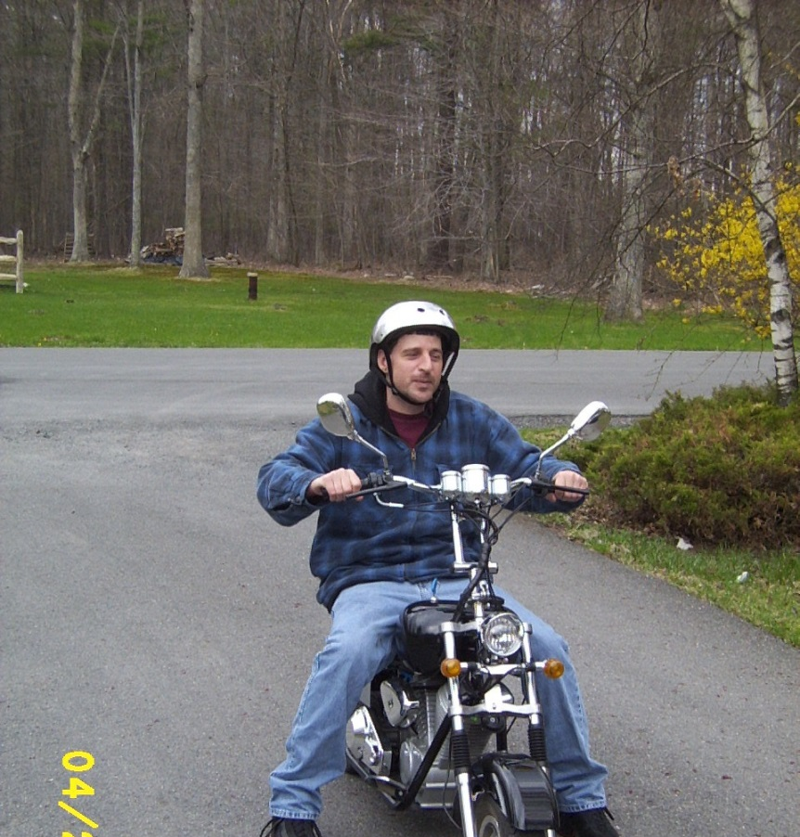
Values and Culture
Person Centered
Notes:
Person centered planning.

Slide 9
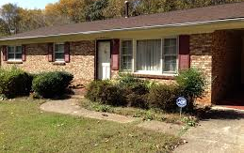
Values and Culture
Not a small CLA
Notes:
No shifts, no staff, choice of housemates/living situation. Leave own values at the door.

Slide 10
How do people benefit from Lifesharing?
Stability
Consistency
Growth
Relationships
Sense of self
Being part of a family
Feeling needed—reciprocal relationships

Slide 11
What would it take to add to your family?
Notes:
How would your work schedule be affected? How do you help with appointments, personal care? Adjust to added utilities, drive times, food expenses? If you sleep until noon on Saturday, how does the person get medications and breakfast? How willing are you to change your home? How do you feel about professionals coming into your home, needing access to the person? How do you handle stress? Think about family dynamics changing.
Play Balance Game?

Slide 13
How to start a Lifesharing Program
A Comprehensive Guide
Session 2
6th Annual Lifesharing Conference, October 15 and 16, 2018

Slide 14
PART 2: STEPS
Recruiting provider families,
Homestudies
Orientation
On‐boarding process

Slide 15
What does an individual need to participate?
Individual wants to be in Lifesharing
Funding—Consolidated Waiver, private pay, Community Waiver
Meets regulated requirements
Support from natural family and other supports

Slide 16
Talking about Lifesharing
Natural Families
Individuals
Augments natural families
Relationships in community
Allows family members to have an adult relationship with loved one
More stability and consistency in supports
Regulated and supported by trained professionals
Talk about family
Living with the person they choose
Flexibility
Stable relationships, less change
More like everyone else’s life

Slide 17
Get to know the individual
Spend time
Build a trusting relationship
Notes:
Spend time with individual and people who know the individual well if possible. Request ISP, previous assessment, Psychological evaluation, physical within past year, past medical history, list of doctors, medical protocols and when next appointments are due. Relationship will help individual trust you enough to report anything.

Slide 18
How to Find Lifesharing Families
MOST DIFFICULT WHEN STARTING A NEW PROGRAM
WORD OF MOUTH
ADVERTISEMENTS
RELIGIOUS, SOCIAL GROUPS
DAY PROGRAMS
BE OPEN MINDED
COMMUNITY EVENTS
Notes:
Develop an elevator pitch. Examples of how each recruits, provider staff, discuss recent training. Family members

Slide 19
Natural Families as Lifesharers
Go through the same process as non-related families, homestudy, background checks, etc.
Natural families need to understand all of the rules and be willing to follow them
Notes:
Reference source, new natural family pre-service agreement

Slide 20
Families need to understand up front
Becoming a Lifesharing Family is a process
Lifesharing is not a job
Provide a long-term home
Maintain a loving household with close personal relationships
Provide supports that respond to the needs , interests, wants, and desires of the individual
Facilitate relationships between individual and natural family
Be willing to make a COMMITMENT

Slide 21
Interest: Now what?
Family completes application
Check references, get clearances
Use the homestudy as a guide
Spend time getting to know the family
Complete physical site portion of licensing inspection instrument (and/or the physical site portion of homestudy)
Contiguous site
Notes:
GO THROUGH THE HOMESTUDY, TALK ABOUT OTHER THINGS AGENCIES HAVE FOUND USEFUL TO ASK DURING HOMESTUDIES, TALK ABOUT DOING SUBSTITUTE CARE UNTIL MATCH IS FOUND, TRY TO KEEP A SENSE OF COMMUNITY/MEET OTHER LIFESHARING FAMILIES CLEARANCES FIRST

Slide 22
Pre-service requirements
Background checks for all members of household over 18—Childline if under 18 served in home, FBI clearance, Medicaid Fraud check, drivers license check
Family physicals including Mantoux TB test for all family members within one year prior to placement
24 hours of training
Certification in CPR and First Aid

Slide 23
Medication Training
My ODP—Giving Medications at Home
Source of healthcare trains provider and they use form signed by the doctor to train anyone else who gives meds.

Slide 24
24 Hours of Training
MENTAL RETARDATION
FAMILY DYNAMICS/PERSONAL RELATIONSHIPS
COMMUNITY PARTICIPATION
ISP PLANNING AND IMPLEMENTATION
RELATIONSHIP BUILDING
REQUIREMENTS RELATED TO THEIR RESPONSIBILITIES
MEDICATION TRAINING
EVERYDAY LIVES
FIRE SAFETY
INCIDENT MANAGEMENT

Slide 25
Matching
Notes:
Coordinating, can fit a square in a circle if the circle is big enough to accommodate it, can’t force one into the other if it doesn’t fit, and watch out for the family which exclaims in has found its missing piece, only to find it is much happier without it.

Slide 26
MATCHING
BE OBJECTIVE
BE OPEN TO NEW OR DIFFERENT IDEAS
THINK ABOUT ALL THE POSSIBILITIES
RECOGNIZE YOUR OWN PERSONAL BIASES
TIME SPENT NOW PAYS OFF IN BETTER MATCHES
INDIVIDUALIZE PROCESS TO INDIVIDUAL AND FAMILY
Notes:
THE REASON FOR ALL THE TIME SPENT ON THE HOMESTUDY AND GETTING TO KNOW THE INDIVIDUAL

Slide 27
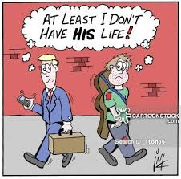
Choices
PEOPLE SHOULD GENERALLY HAVE THE OPPORTUNITY TO INTERVIEW MORE THAN ONE POTENTIAL LIFESHARER AND HAVE THE OPPORTUNITY TO VISIT MORE THAN ONE HOME BEFORE MAKING A LIFESHARING CHOICE
OFFER CHOICE EVEN IF THE PERSON AND FAMILY HAVE CHOSEN SOMEONE TO BE THEIR LIFESHARER.
OFFER CHOICE EVEN WHEN INITIAL VISITS INDICATE THAT THERE IS AN APPROPRIATE MATCH.

Slide 29
How to start a Lifesharing Program
A Comprehensive Guide
Session 3
6th Annual Lifesharing Conference, October 15 and 16, 2018

Slide 30
SESSION 3: BUDGETS
Budgeting
Cost reporting
Developing contracts

Slide 31
SIS needs level Licensed or unlicensed One or two person home
BUDGET

Slide 32
Stipend Start up costs Administration
Notes:
Stipend--Transportation, sub care/respite, home adaptations, level of care/supervision/need
Administrative
PRESERVICE AND ANNUAL TRAINING FOR FAMILY AND FOR ADMINISTRATIVE STAFF
PORTION OF THE COST OF LIFESHARING SPECIALIST, DIRECTOR, OTHER OFFICE SUPPORT
PORTION OF OFFICE SPACE RENTAL, UTILITIES, INSURANCE, LIABILITY INSURANCE, FIRE EXTINGUISHERS AND SMOKE DETECTORS, ADVERTISING, OFFICE SUPPLIES, MILEAGE REIMBURSEMENTS AND OTHER COSTS ASSOCIATED WITH RUNNING A BUSINESS.

Slide 33
LICENSING, HCSIS AND PROMISE
NON CONTIGUOUS APPROVAL
SELF INSPECTION
APPROVED PROGRAM CAPACITY
ADD THE ADDRESS TO YOUR LICENSE IN HCSIS
ADD THE SERVICES TO THE ADDRESS – choose the funding county
COMPLETE THE PROMISE APPLICATION AFTER THE HOME IS LICENSED
IN THE ISP, THE SUPPORT COORDINATOR CAN CHOOSE THE SERVICE AND LOCATION AFTER THE RATE IS ASSIGNED BY PROMISE

Slide 34
Lifesharing Agreements and Contracts
Identifies stipend amount
Lists responsibilities for each party
Lifesharer
Agency
Identifies Substitute Care
Lists reasons for termination of contract by both parties
Specifies Lifesharer is a subcontractor not employee
Delineates difference between employee role and Lifesharer role if applicable
Signed annually or automatically renews clause

Slide 35
Room and Board
May be included in stipend
Room includes a bed, dresser, mirror, closet space in a bedroom (household furniture), utilities including basic cable, land line telephone (telephone with local telephone service), (internet) electric, garbage removal, cleaning supplies, bed linens, towels, (standard toiletries), (laundry of towels, bedding and individual clothing), (incontinence products if not covered by individual’s insurance)
Board includes meals, snacks within reason, (food choices with consideration of food cost and nutrition, preference, culture, religion and beliefs and prescribed diet if not covered by healthcare plan) ensure and other dietary items, meals provided away from home in lieu of meal at home

Slide 36
Not Included in Room and Board
Individual’s clothing
Premium cable services requested by individual
Long distance calls made by the individual
Going out to dinner at individual’s request
Extra phone or TV/cable in individual’s room at individual’s request
Camp/vacation at individual’s request
Admission to activities

Slide 37
REVERSE Lifesharing
INDIVIDUAL, FAMILY OR TRUST OWNS OR RENTS A HOME FOR THE INDIVIDUAL.
LIFESHARER MOVES INTO THE HOME AND PAYS RENT TO THE INDIVIDUAL, FAMILY OR TRUST.
LIFESHARER IS ALSO RESPONSIBLE FOR HALF THE UTILITIES AND ALL OF THE FOOD.
LIFESHARER AND INDIVIDUAL OR TRUST HAVE A CONTRACT WITH EACH OTHER TO MAINTAIN TAX-FREE STIPEND STATUS.

Slide 38
Substitute Care/Respite
Paid relief for the lifesharer who is the person’s primary caregiver when the lifesharer is temporily absent or unable to offer needed services
Can be someone the family finds
Can be someone the agency finds
Can be someone the individual designates
Agreed on by team
Notes:
SUB CARE REQUIREMENTS APPLY TO ALL RELATIVES, NEIGHBORS, ADULT HOUSEHOLD MEMBERS,COMPANIONS AND FRIENDS OF THE LIFESHARER, AS WELL AS STAFF AND DIRECT SUPPORT PROFESSIONALS, WHO ARE PAID TO PROVIDE SERVICES FOR THE PERSON
Participant can use any type of respite that meets his or her needs and is ok with team. If it is provided in a lifesharing home licensed or unlicensed, then service is 24 hour respite--in-home respite and unlicensed out of home respite services W9795-W9801
Add what Joe finds out.

Slide 39
Substitute care/Respite
Substitute care provider must meet the same clearance guidelines, including criminal checks and child abuse clearances and other criteria
Must meet certain physical site requirements
Med administration

Slide 40
Substitute care/Respite: Payment
Payment is taxable
Payment options
Included in Lifesharer stipend, Lifesharer pays for Substitute Care
Paid by agency
Respite Services
30 days

Slide 41
Substitute Care/Respite: Emergency Information
PICTURE
DEMOGRAPHIC INFORMATION
HEALTH ISSUES, INCLUDING MEDS AND DIAGNOSES AND MEDICATION INSTRUCTIONS
INSURANCE INFORMATION
EMERGENCY CONTACT INFORMATION
SUBSTITUTE DECISION MAKING ISSUES/ACT 169
INCIDENT MANAGEMENT INFORMATION

Slide 42
IS IT RESPITE OR SUBSTITUTE CARE?
Alternate temporary care can occur in the Lifesharing Home, in another Lifesharing Home or in an unlicensed private home.
Substitute Care has no regulations or requirements except those set by the agency. A day or 15 minute unit of Substitute Care is billed as a Lifesharing day.
Respite has requirements both in the Chapter 6500 regulations and in Chapter 51/6100. A day or 15 minute unit of respite must be authorized in the ISP as a separate service in advance.

Slide 43
Opening a new Life Sharing Provider License
Check in with your regional licensing office for specific details and guidance
General requirements include but are not limited to legal corporation papers, completed application, profit status, civil rights compliance policies and procedures, Lifesharing policies and procedures

Slide 44
Stipend
MR Bulletin 00-02-10
ODP Informational memo
095-10
IRS 2018 Instructions for Form 1099 - MISC
Documents are available on the palifesharing.com website under the tab FAQ and Additional Resources
Notes:
Sources listed on website—several older sources, plus 2016 1099=Misc instructions reiterating that difficulty of care payments are not taxable

Slide 46
How to start a Lifesharing Program
A Comprehensive Guide
Session 4
6th Annual Lifesharing Conference, October 15 and 16, 2018

Slide 47
SESSION 4
Keep your program running
Program Specialist requirements
Staffing
Caseloads
Licensing
Questions and answers.

Slide 48
Lifesharing Program Specialist
Qualified
Maximum caseload of 8 homes or 16 individuals, including individuals in other services
Responsible for
Assessments (completing, reviewing, signing and distributing)
Developing, reviewing, updating, revising ISP
Attending ISP
Reporting content discrepancies
Implementing the ISP as written
Supervising, monitoring and evaluating services
Reviewing documentation
Coordinating services and supports to individual and family
Notes:
Qualifications—Masters and one year, bachelors and 2 years, associates or 60 hours and 4 years, high school and 6 years
Qualifications—
6500.43(e) A family living specialist shall have one of the following groups of qualifications:
(1) A master’s degree or above from an accredited college or university and 1 year work experience working directly with persons with an intellectual disability.
(2) A bachelor’s degree from an accredited college or university and 2 years work experience working directly with persons with an intellectual disability.
(3) An associate’s degree or 60 credit hours from an accredited college or university and 4 years work experience working directly with persons with an intellectual disability.
(4) A high school diploma or general education development certificate and 6 years work experience working directly with persons with an intellectual disability.
§ 6500.43. Family living specialist.
(a) There shall be a family living specialist for each individual.
(b) A family living specialist shall be assigned to no more than 8 homes.
(c) A family living specialist shall be responsible for a maximum of 16 people, including people served in other types of services.

Slide 49
Lifesharing Program Specialist
Provide support—family and individual
Assure that supervision requirements are understood and met by the family
Assure individual is attending all medical and social service appointments
Assure individual is attending job, school, or other non-residential programming identified in ISP
Provide support, technical assistance and training to family and individual as needed
Notes:
*Upon admission, be in the home frequently (maybe weekly), then decrease visits as everyone becomes more comfortable together
*Best Practice to be in the home at least monthly, while also maintaining other avenues of communications-phone calls, text, email, etc.
*Spend time with the individual separate from the LSP to check in with them in a neutral/safe area-
*Find ways to make things easier for the LSP…..medical appointment tracking form, providing copies of needed documents/forms, act as a liaison as needed to advocate for the individual, be a resource to the family
*Respond to the LSP, on-call?

Slide 50
Lifesharing Family
Respect individual as member of family
Help the individual develop relationships and connect to the family and their community
Meet the individual’s health, safety and welfare
Meet requirements of contract
Participate in ISP process
Meet documentation requirements
Provide access to home and individual at agency, county or state request
Notes:
*Help the LSP family to incorporate aspects of the individual’s life into the family’s. It takes time to mesh as a new family-type unit. Don’t expect the individual to give up what they like to participate in only what the LSP wants to do
*Provide training to the LSP regarding documentation requirements and work with them at the start to figure it out.
*You may need to work closely with SCs who are unfamiliar with Lifesharing and tend to treat the home as a CLA. They may need reminders that the lifesharing home is a private home and should be treated accordingly

Slide 51
Lifesharing Family
ALWAYS provide for supervision needs
Facilitate medical/social service appointments
Medication Administration
Get and document 24 hours of training each year
Assure proper financial documentation
Maintain home to meet licensing standards

Slide 52
Lifesharing Agency
Assure lifesharing family meets qualifications, background checks, provides family physicals
Maintain training record
Provide on-call system 24/7
Provide access to training resources
Provide supports for the family
Assure ISP is followed
Balance: Regulations, family
SUPPORT—Lifesharing Program Specialist, family, and individual
Notes:
In the business of building families, not tearing them apart

Slide 53
Lifesharing: The Service
Lifesharing home
6500 regulations
Chapter 51/6100 regulations
Approved Program Capacity & Noncontiguous Clearance
Self Inspection
Promise
Contract
Monitoring

Slide 54
Licensing
6500 Regulations
Most records reviewed off-site
Physical site
Fire safety—extinguishers, smoke detectors, exits, furnace
First aid kit
Medications currently given
Financial records for current month
Any problems noted can spark a more invasive evaluation
Notes:
Fire Safety—what is needed
6500.110. Fire safety training.
(a) A written fire safety training plan shall be developed for all family members and individuals including children.
(b) The training plan shall include training in general fire safety, evacuation procedures, responsibilities during fire drills, the designated meeting place outside the home, smoking safety procedures if any individuals or family members smoke in the home, the use of fire extinguishers and smoke detectors and notification of the local fire department as soon as possible after a fire is discovered.
(c) Family members and individuals, including children, shall be trained within 31 calendar days of an individual living in the home and retrained annually, in accordance with the training plan specified in subsection (a).
(d) A written record of fire safety training, including the content of the training and the individuals attending shall be kept.

Slide 55
Opening a new Lifesharing home
After 30 days in a new home, the home must be licensed
Contiguous site
Licensing form
At next scheduled license review, the home will be inspected
Notes:
Home can also be licensed before the individual is admitted. Do this during the latter stages of the matching process.

Slide 56
Requirements
FAMILY CLEARANCES AND PHYSICALS
24 HOURS OF TRAINING FOR THE PRIMARY PROVIDER
FIRE SAFETY
FIRE EXTINGUISHERS
SMOKE DETECTORS
FURNACE CLEANING
UNOBSTRUCTED EGRESS
Notes:
Some of the training topics are mandated by the regulations, otherwise trainings are caregiver topics, general knowledge, etc. This was covered in Session 2.

Slide 57
First aid kit
ASSORTMENT OF ADHESIVE BANDAGES
STERILE GAUZE PADS
ANTISEPTIC
TWEEZERS
TAPE
SCISSORS
NOTE EXPIRATION DATES ON OTHER MISC. ITEMS IN THE KIT
Notes:
First Aid Kit
6500.77. First aid materials.
Each home shall have antiseptic, an assortment of adhesive bandages, sterile gauze pads, tweezers, tape, scissors

Slide 58
Other considerations
Guns and ammunition
Pool access
Room size
Closet space
Posted phone numbers
Land line
Notes:
§ 6500.84. Firearms.
Firearms shall be kept unloaded in a locked cabinet. Ammunition shall be kept in a locked cabinet that is separate from firearms.
§ 6500.83. Swimming pools.
(a) An in-ground swimming pool shall be fenced with a gate that is locked when the pool is not in use.
(b) An aboveground swimming pool shall be made inaccessible to individuals when the pool is not in use.
(c) A swimming pool does not need to be locked or inaccessible if all individuals in the home understand water safety and can swim. Documentation of each individual’s understanding and ability shall be in each individual’s assessment.
§ 6500.79. Individual bedrooms.
(a) An individual’s bedroom may not be located in basements. Any level from which there is a standard door leading from that level directly outside to grade level is not considered a basement.
(b) An individual sharing a bedroom shall have a minimum of 50 square feet of bedroom space, measured wall to wall, including space occupied by furniture. An individual with a single bedroom shall have a minimum of 60 square feet of bedroom space, measured wall to wall, including space occupied by furniture.
(c) A bedroom shall have at least one exterior window that permits a view of the outside.
(d) Bedroom windows shall have drapes, curtains, shades, blinds or shutters.
(e) Bedrooms shall have doors at all entrances for privacy.
(f) In bedrooms, each individual shall have the following:
(1) A bed of size appropriate to the needs of the individual. Cots and portable beds are not permitted. Bunkbeds are not permitted for individuals 18 years of age or older.
(2) A clean, comfortable mattress and solid foundation.
(3) Bedding, including a pillow, linens and blankets appropriate for the season.
(4) A chest of drawers.
(5) Closet or wardrobe space with clothing racks and shelves accessible to the individual.
(g) Beds and cribs, with solid sides over 12 inches high or with closed domes or tops, are not permitted.
(h) An individual 10 years of age or older may not be required to share a bedroom with a person of the opposite sex.

Slide 60
Resources
http://www.dhs.pa.gov/provider/human-services-licensing/developmental-programs/index.htm
https://s3-us-west-2.amazonaws.com/palms-awss3-repository/MyODP_Content/Course+Content/Licensing/New+Provider+License+Process+Flow+Chart_2018.pdf
http://www.palifesharing.com/
http://www.myodp.org/

