Slide 1
Lesson Plans You Can Use Now!
W. Lynne Clarke, Ed.D., RN
W.L. Clarke Consulting
President, Georgia Health Science Technology Educators Association

Slide 2
Lesson and Activities Correlated with National Consortium for Health Science Education Foundation Standards

Slide 3
Lesson Plan #1 Cultural Diversity Standards Co-curricular connection: Sociology
2.12 Identify common barriers to communication.
b. Psychological barriers (attitudes, bias, prejudice, stereotyping)
2.31 Utilize proper elements of written and electronic communication (spelling, grammar, and formatting).
2.32 Prepare examples of technical, informative, and creative writing.
6.21 Discuss religious and cultural values as they impact healthcare (such as: ethnicity, race, religion, gender).
6.22 Demonstrate respectful and empathetic treatment of ALL patients/clients (such as: customer service, patient satisfaction, civility).

Slide 4
Cultural Diversity Activities
Short lecture introducing major concepts and terminology OR
Have students read chapter from text and complete worksheets
Cultural Diversity Project
Students pretend they are working at a large hospital and have been
assigned to produce a 2 page fact sheet or a tri-fold brochure to help
educate the staff about a group of persons from a different country/culture
that will soon be moving into the area and may be seeking healthcare.

Slide 5
Cultural Diversity Project
You are working in at ______________________ (insert healthcare facility of your choice) and you have been notified that a large group of families from the country of ____________________________ will be moving into the area and will likely be seeking care in your facility. You have been asked to do a brochure or fact sheet to help familiarize the entire staff with the cultural beliefs and norms of this group. Your brochure should include:
Map showing location of country
Races present
Ethnicities present
Religions present
Languages spoken
Marriage customs
Family/Child-rearing customs
Death/dying beliefs
Burial customs
Communication customs
Housing
Economy
Education
Other interesting facts/pictures
You must site all sources – you may attach an appendix for sources.
You may use Publisher (trifold brochure with information on front and back) or Word (one sheet with information on both sides).

Slide 6
Title/Format/Illustration/Overall appeal: Amazing: 10______________ Good: 8 _____________ Better than nothing: 5______________ Nothing: 0_________________ | Spelling/Grammar: No errors: 15_______________________ 1-4 errors: 10___________________ 5-9 errors: 5_________________ Over 10 errors: 0 __________________
Map: Great – gives perspective of where country is in relation to continent: 5 ________ Good: 2 _____________ Nothing: 0_________________ | Races/Ethnicities: Good: 5 _____________ Better than nothing: 2______________ Nothing: 0_________________
Religions: Good: 5_____________ Better than nothing: 2______________ Nothing: 0_________________ | Languages Spoken: Good: 5 _____________ Better than nothing: 2______________ Nothing: 0_________________
Marriage Customs: Good: 5_____________ Better than nothing: 2______________ Nothing: 0_________________ | Family/Child-rearing Customs: Good: 5_____________ Better than nothing: 2______________ Nothing: 0_________________
Death and Dying Beliefs/Burial Customs: Good: 5 _____________ Better than nothing: 2______________ Nothing: 0_________________ | Communication Customs: Good: 10_____________ Better than nothing: 5______________ Nothing: 0 _________________
Housing and Economy Information: Good: 5_____________ Better than nothing: 2______________ Nothing: 0 _________________ | Education Customs and Information: Good: 5 _____________ Better than nothing: 2______________ Nothing: 0_________________
Other Interesting Facts/Information: Amazing: 5 + 10 bonus points______________ Good: 5_____________ Better than nothing: 2 _________________ Nothing: 0 _________________ | Sources Clearly Sited: Reader can clearly see which source used for specific info: 15 _____________ Sources listed but not easily connected to info: 7 _____________ No sources shown: 0 ______________

Slide 7
Lesson Plan #2 Career Exploration Co-curricular connection: ELA
4.31 Research levels of education, credentialing requirements, and employment trends in health professions

Slide 8
Career Exploration Activities
Short lecture on concepts and terminology related to career exploration OR
Have students read chapter from text and complete worksheets
Explain Career Path Project –
- you may give entire packet at one time or give it out as sections
- students may submit electronically or paper copy

Slide 9
Personal Career Path Project Workbook This is the only copy of the workbook you will get! Please keep up with it!
Scoring rubric MUST be attached.
NAME _______________________________________________
CAREER GOAL _______________________________________
Please let ALL degrees you will need after high school to accomplish this goal:
DEGREE(S) SCHOOL you will attend
__________________________ ______________________
__________________________ ______________________
__________________________ ______________________
__________________________ ______________________
Where do you want to work:
City and state?:
Setting (i.e. hospital, office, private practice, etc.)?:

Slide 10
UNDERGRADUATE INFORMATION SHEET (Use this sheet for Associate Degree or Bachelors Degree)
School _____________________________ Degree _________________________________
Website _________________________________
A. What are the basic requirements for getting accepted into the undergraduate or technical school where the program you are interested in is taught?
Specific high school courses required:
GPA:
SAT or ACT:
Compass (Technical Schools only)
Other requirements:
List any statistics given on the school website about number of applicants, number accepted, average SAT or GPA,
etc.?
B. What core (general education requirements) courses will you be required to take during your undergraduate or
technical school training? List types of courses and number of semester hours required for each type)?
C. What is the minimum grade you have to make in your core courses?
D. What courses will you have to take for your major (concentration)? List all course numbers and titles

Slide 11
GRADUATE SCHOOL INFORMATION This form required only for Medical Social Workers, Physical Therapists, Occupational Therapists, Physicians Assistants, Nurse Practioners
School _______________________________ Degree_____________________. School website _______________________________
1. List the admission requirements for getting into the graduate school you have chosen.
Special undergraduate courses required:
Undergraduate GPA
GRE, MCAT or other national exam score
Work experience – (please list type and years)
How long will it likely take you to achieve your goal after you graduate from high school?
Note below the statistics from the school website for the latest year available for your area indicating number applied, number accepted, etc.
List any other special or interesting information you find at the school’s website.
List ALL courses you will have to take including course number and name.

Slide 12
MEDICAL SCHOOL INFORMATION This form required for doctors, dentists, and veterinarians only.
1. List the admission requirements for the school you have chosen.
Special undergraduate courses
Undergraduate GPA required
GRE, MCAT or other national exam score
Work experience – (please list type and years)
How long will it likely take you to achieve your goal after you graduate from high school?
Note below the statistics for the latest year available for your area indicating number applied, number accepted, etc.
List ALL courses you will have to take including course number and name.
What area do you intend to specialize in?
Where could you do that residency?
List any other information you can find about the residency.

Slide 13
LICENSING or CERTIFICATION
What is the name of the government agency that oversees the license you will need?
What is the web site address for this agency?
If you can do so, please print out an application for certification.
What is the fee for the certification test?
What type of test do you have to take (written, oral, practical)?
If there is a sample test on the site please print it out.
Are there any other requirements to apply for licensing?
How often does the license have to be renewed?

Slide 14
SALARY PROJECTION SHEET
Show the yearly projected starting salary for your profession from at least 2 different sources.
#1 Source ______________________________________
Salary Range or Projection ______________________________
#2 Source ______________________________________
Salary Range or Projection ______________________________
Find the midpoint of each salary range and write below:
Midpoint #1__________
Midpoint #2__________
Total: _____________
Divide this total by 2 to get an average yearly starting salary: ___________
Divide by 12 to get monthly gross salary ___________
Is this what you expected?
What is the job forecast for this occupation?
Source for job forecast information: ___________________________________

Slide 15
LIFE STYLE PREDICTIONS
Housing – Please assume you will be buying a house. Provide a description (you may
also include a picture) of the house in the space below. House price __________
Use the Internet to find out an approximate monthly payment amount.
Source used: _________________________________ Monthly payment: _________
Car – Please assume you will be buying a car. Provide a description (you may also
include a picture) of the car in the space below. Car price ______________
Use the Internet to find out an approximate monthly payment amount.
Source used: _________________________________ Monthly payment: _________

Slide 16
Can you afford it?
Monthly gross salary _________________
30% of monthly gross salary (A)______________
House payment ______________
Car payment ________________
Total payments (B)________________
Is the amount on line (A) greater than the amount on line (B)?
If yes then you can afford your choices!
You are done with this project when you complete the final reflection!
If no then you must rethink your career choice or your house/car choices.
Please ask for additional forms and continue your research.
In order to complete this project you MUST be able to afford your
choices.

Slide 17
FINAL REFLECTIONS
What subject will be your biggest challenge as you are working toward your goals?
What can you do about that now?
What personal trait, if any, will make it difficult for you to meet your goals?
What is the most surprising thing you learned while completing this project?
Has this project caused you to reassess or change your goals? Why or why not?

Slide 18
Lesson Plan #3 Human Growth and Development Co-curricular connection: Psychology
2.16 Modify communication to meet the needs of the patient/client and be appropriate to the situation.

Slide 19
Human Growth and Development Activities
Short lecture on concepts and terminology related to Human Growth and Development OR
Have students read chapter from text and complete worksheets OR
Have students define terms
Explain HGD Booklet –

Slide 20
Human Growth and Development Booklet
You are to make a book to help you understand Human Growth and Development. Your book must include the seven life stages and information about the four main types of growth and development that occur in each stage. Your book must be put together as follows:
Book covers- Front and Back with art work (please put your name on back cover ONLY)
At least one page on each life stage.
No more than 10 words should be visible at one time on any page. You may use flip ups and other interactive to cover up some of your words. Be creative!
NO cutting or pasting of text – information must be handwritten. You may print pictures.
We will be working on the book in class, but you must also work on the project at home to be able to get it done correctly and on time. Your reference will be Chapter 8 – Human Growth and Development (pp 228-249) in our textbook

Slide 21
Front Cover/Title Stage Amazing: ______________ Good: _____________ Better than nothing:______________ Nothing:_________________ | Overall appeal: Amazing: ______________ Good: _____________ Better than nothing:______________ Nothing:_________________
Infancy: Age ranges shown: _____________ Physical growth: ______________ Emotional growth: ______________ Social Growth: __________________ Mental/Cognitive Growth: _____________ One interactive per stage: ____________ At least one illustration per stage: ____________ | Early Childhood: Age ranges shown: _____________ Physical growth: ______________ Emotional growth: ______________ Social Growth: __________________ Mental/Cognitive Growth: _____________ One interactive per stage: ____________ At least one illustration per stage: ____________
Late Childhood: Age ranges shown: _____________ Physical growth: ______________ Emotional growth: ______________ Social Growth: __________________ Mental/Cognitive Growth: _____________ One interactive per stage: ____________ At least one illustration per stage: ___________ | Adolescence: Age ranges shown: _____________ Physical growth: ______________ Emotional growth: ______________ Social Growth: __________________ Mental/Cognitive Growth: _____________ One interactive per stage: ____________ At least one illustration per stage: ____________
Early Adulthood: Age ranges shown: _____________ Physical growth: ______________ Emotional growth: ______________ Social Growth: __________________ Mental/Cognitive Growth: _____________ One interactive per stage: ____________ At least one illustration per stage: ____________ | Middle Adulthood: Age ranges shown: _____________ Physical growth: ______________ Emotional growth: ______________ Social Growth: __________________ Mental/Cognitive Growth: _____________ One interactive per stage: ____________ At least one illustration per stage: ____________
Late Adulthood: Age ranges shown: _____________ Physical growth: ______________ Emotional growth: ______________ Social Growth: __________________ Mental/Cognitive Growth: _____________ One interactive per stage: ____________ At least one illustration per stage: ____________ | Back Cover: Name on work: ____________________

Slide 22
Additional Ideas (if time permits)
Have students add information about the implications for healthcare providers
Have students add information about growth and development theories
Allow students to use their booklets on test

Slide 23
Lesson Plan #4 Personal Portfolio
4.41 Develop components of a personal portfolio.
2.31 Utilize proper elements of written and electronic communication (spelling, grammar, and formatting).
2.32 Prepare examples of technical, informative, and creative writing.

Slide 24
Personal Portfolio
Discuss with senior students at the beginning of the year
Assign due dates for various parts of the projects throughout the school year
Can be done electronically
Students must present portfolio to community panel

Slide 25
Portfolio Content
1. Letter of Introduction
2. Resume
3. Project
4. Writing Sample
5. Work-Based Learning
6. Service Learning (Community Service)
8. Credentials
9. Technology
10. Leadership

Slide 26
Letter of Introduction
Narrative format
Includes information on the contents of the portfolio and any other relevant information of interest to the portfolio evaluators.

Slide 27
LOI tips
Don’t talk about what you don’t have – highlight what you DO have!
Don’t use abbreviations
i.e. C.N.A., PCT, CPT, CMLA
Use complete school name
Use proper grammar

Slide 28
Resume
One or two page resume
Should include career goals, educational and work experiences, awards, honors and other activities.

Slide 29
Project
Student should plan and carry out a healthcare knowledge/skills application project
Will be required to use HOSA rubric if they wish to do intensive shadowing or an educational presentation
A student who competes at the HOSA state level can use their competitive event as the project portion of the portfolio

Slide 30
HOSA Rubrics
The following slides are variations of HOSA rubrics to be used by students who are NOT competing in HOSA

Slide 31
HOSA Project – Clinical Specialty (for Intensive Shadowing)
Page 1 - Career Summary
Page 2 - Education, Training, Credentialing, and Career-related Data and Statistics
(Including resources)
Page 3 - Professional Association
Page 4 - Interview (Summary of interview conducted by the competitor with a
professional in the chosen career field.)
Page 5 - Career Evaluation (List/explain 5 strengths and 5 weaknesses of the career.)
Page 6 - Work-based Learning Summary (Who, what, where, when, and for how long.)
Page 7 - Learning Outcomes (What you learned in the work-based learning experience.)
Page 8 - Professional Verification (One page evaluation of work performance from the
professional you shadowed on letterhead of the facility)
Pages 9 – 10 Other information that you feel might add to your
project

Slide 32
HOSA Project – Community Awareness
Page 1: Title page must include the name of the project, chapter, school address and state.
Page 2: Table of Contents (Maximum of one page)
Pages 3 – 4: A summary (Maximum of 2 pages) reflecting the selection of the project issue,
goals and objectives of the project and accomplishments, effectiveness and
impact of the project. (Included in page count) The summary should be typed or
word processed, double spaced with 12 pt. Times New Roman font and have 1 inch
margins.
Pages 5 – 14: The following items must be included as a part of portfolio documentation
section: (Maximum of 10 pages)
• Documentation of the activities conducted as a part of the community awareness
project.
• Publicity regarding the community awareness project activities, the local HOSA chapter
and Health Science program, which may include newspaper articles, flyers, website
announcements, etc.
• Programs, pictures or other verification of students presenting the project should be
included and dated.
- a maximum of three (3) items.
o Pamphlets
o Copies of media articles, radio or TV spot and the program script.

Slide 33
HOSA Project – Community Awareness or Health Education
MUST use HOSA rubric for Health Education or Community Awareness
Develop a project to promote community awareness using health issues that may be of local, state, and/or national interest.
Assist communities to become more aware of the pros and cons of the health issue selected.
Promote goodwill and public relations for local HOSA chapters.
Evaluate the effectiveness and impact of the project on the community.
See format and requirements for this type of project on attached file or see Dr. Clarke
Be aware – this is much more than just collecting a box of “stuff”

Slide 34
Senior Portfolio – Project Info for Community Contribution Projects
Page One – Information on Agency you are assisting including but not limited to:
Name of agency
Physical address
Type of agency
When established
Local, state or national affiliation
Specific name with contact phone and email for your contact
Page Two – Service area – county, state, etc.
Service population - Including but not limited to:
Age, gender, etc. that qualifies someone for services
Page Three – Explain how a person would qualify and apply for services
Page Four – Agency funding sources – explain in detail
Page Five – Coordinating or complimentary agencies
Page Six/Seven – Interviews with two persons from the agency
**Compose your questions and have them approved prior to interview***
– choose two of the following: Supervisor or officer with agency, Worker with agency,
Longtime volunteer with agency or Person served by agency
Page Eight – Detailed description of your contribution
Page Nine – Letter from organization on letterhead signed by supervisor or officer
Acknowledging your contribution.
Page Ten - One page reflection of your experience.
Page Eleven/Twelve – Optional pictures or other artifacts

Slide 35
Writing Sample
Six essay questions
Demonstrates ability to form coherent thought, follow accepted structural format for written work, use proper grammar.
Must be handwritten – 1 question per sheet of lined paper
Response should be at least one half page.

Slide 36
Questions
1. Discuss your reasons for wishing to pursue a health care career.
2. What have you already done to begin to accomplish the goals you described in the first question?
3. What lesson have you learned from your experiences in preparing for a health care career that will help you become successful in the future?
4. Describe a character in fiction, an historical figure, a hero, or a creative work that has had an influence on you and explain that influence.
5. Discuss some issue of personal, local or national concern and its importance to you.
6. Evaluate a significant experience, achievement, or risk you have taken and its impact on you.

Slide 37
Work-Based Learning
Summary of the exact hours, dates, person(s) shadowed and narrative description of the experience.
May include; job shadowing, career exploration, internships and/or volunteering.

Slide 38
Service Learning/Community Service
Must be documented by a summary of the experience to include dates, hours, location, learning outcomes, and benefits to the community at large.
May include newspaper coverage, brochures, certificates, letters, etc.

Slide 39
Service Learning/Community Service Opportunities through HOSA or school
Multiple events available though the year
Must sign up prior to event
Must follow though with commitment you make
Must meet dress code
No call no show may result in loss of opportunity to participate in HOSA/School sponsored events
Do not bring friends, siblings, etc. to event

Slide 40
Technology
Evidence will be examples of technology created by the student such as a web site, electronic newsletter, PowerPoint presentation, or other evidence of advanced technology skills certificate.
Must be from senior year!

Slide 41
Technology
Evidence will be examples of technology created by the student such as a web site, electronic newsletter, PowerPoint presentation, or other evidence of advanced technology skills certificate.
Must be from senior year!

Slide 42
Leadership
Demonstrated by participation as a HOSA officer, class officer, student council, church or scout officer, or other leadership position in the arts, athletics, or other organized school or community activities.
Must be verified by adult in charge of organization
Alternative Leadership
Volunteer for a leadership role in an event sponsored by HOSA/School
Must request Leadership role PRIOR to day of event

Slide 43
Other content
May be added to strengthen the portfolio
May include; high school diploma, special awards, recognitions and/or certificates.

Slide 44
Notebook
1 to 1 ½ 3 ring binder
Page protectors
Dividers for sections
Table of contents suggested
May do cover but should be professional

Slide 45
Presentation of Portfolio
Will be presented to panel of 2-4 professionals from community
Professional dress required
May do short Power Point
Be sure to see rubrics for portfolio and presentation

Slide 46
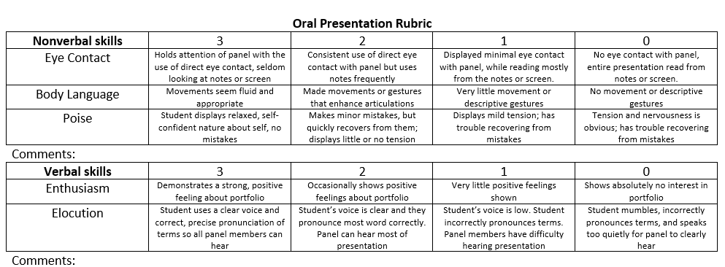

Slide 47
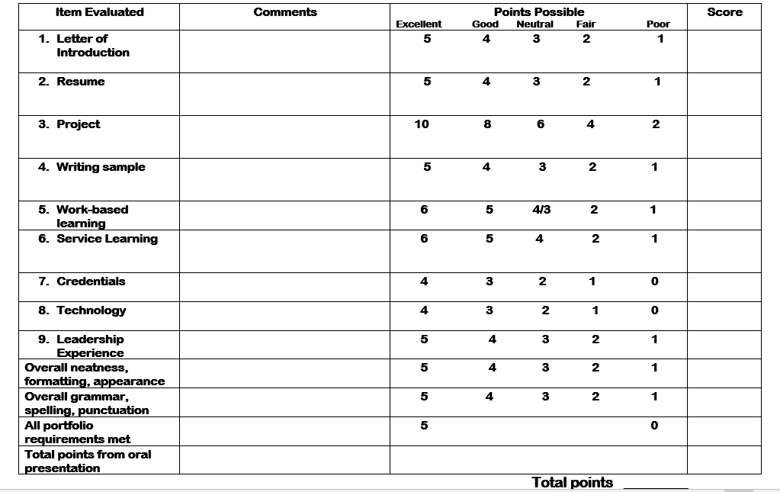

Slide 48
Lesson Plan #4 Medical Math Co-curricular connection: Math
1.31 Demonstrate competency in basic math skills and mathematical conversions as they relate to healthcare.
a. Metric system (such as: centi, milli, kilo)
b. Mathematical (average, ratios, fractions, percentages, addition, subtraction,
multiplication, division)
c. Conversions (height, weight/mass, length, volume, temperature, household
measurements)

Slide 49
Activities
Use review sheets from textbook for basic math review
Assemble long bones from disarticulated skeleton
Work out math using regression formula for each bone
Use my Power Point as introduction example
Create a “Missing Person” scenario based on the bones you have and let the students determine if the bones they have belong to the missing person
Have students identify the bone they are working with

Slide 51
Regression Formula for Body ID
Height of individual can be approximated by length of long bones in arms or legs
Tables and formulas developed after years of research with human bodies

Slide 52
Lesson #5 Healthy Behaviors Co-curricular connection: Health, Visual Arts
9.11 Promote behaviors of health and wellness (such as: nutrition, weight control, exercise, sleep habits).
9.12 Describe strategies for prevention of disease.
a. Routine physical exams
b. Medical, dental, and mental health screenings
c. Community health education outreach programs
d. Immunizations
e. Stress management
f. Avoid risky behaviors

Slide 53
Healthy Behavior Activities
Students can research issues related to healthy behaviors using the CDC, NIH, or your
state health department websites OR
Teacher can research list of unhealthy behaviors common to teenagers in the
county/state/etc. OR
Have students brainstorm to make list of common unhealthy behaviors
Form students into teams of 3 or 4 (You will need a different topic for each group)
Place topics in envelopes and give students their “mission”
Use HOSA Extemporaneous Health Poster rubric to judge posters

Slide 54
TO: _________________________________________________________________
Your mission:
Healthcare Providers are an important part of Public Health. They should be familiar with public health resources. They should also participate in
educational activities that promote health and prevent accidents and illness. Your group should develop a poster aimed at address the issue
shown below:
Seat Belt and Car Seat Use
You should use the attached HOSA Extemporaneous Health Poster rubric as a guide – the idea is that the poster be appealing
and easily understood.
You may use print off any pictures, etc. Your poster should include the following:
Why this topic is an issue – include possible legal issues.
Several statistics (use stats for Georgia or even Richmond County if you can find them) about how this issue affects teenagers .
Several ways to prevent this issue from occurring.
A list of your sources and the names of the team members should be on the back of the poster

Slide 55
HOSA Extemporaneous Poster Rubric

Slide 56
Lesson Plan #6 E-Day Co-Curricular Connection: Life Science, Anatomy and Physiology
1.21 Describe common diseases and disorders of each body system
a. Etiology
b. Pathology
c. Diagnosis
d. Treatment
e. Prevention
1.22 Discuss research related to emerging diseases and disorders.
7.11 Explain principles of infection control.
a. Chain of infection
b. Mode of transmission (direct, indirect, vectors, common vehicle [air, food, water], healthcare associated infections [nosocomial], opportunistic)
c. Microorganisms (non-pathogenic, pathogenic, aerobic, anaerobic)
d. Classifications (bacteria, protozoa, fungi, viruses, parasites)
7.12 Differentiate methods of controlling the spread and growth of microorganisms.
a. Aseptic control (antisepsis, disinfection, sterilization, sterile technique)
b. Standard precautions
c. Isolation precautions
d. Blood borne pathogen precautions
e. Vaccinations
7.21 Apply personal safety procedures based on Occupational Safety and Health Administration (OSHA) and Centers for Disease Control (CDC) regulations.

Slide 57
E-Day Activities
Short lecture on concepts and terminology related to Infection Control OR
Have students read chapter from text and complete worksheets OR
Have students define terms related to Infection Control
2. Show “Ebola” documentary
3. Explain E-Day Project

Slide 58
Project Directions
You and your team should assume you are in area where there has been an unexpected Ebola outbreak. You have minimal supplies – some gloves and masks – but no other PPE. You do have access to trash bags, tape, etc. You have some basic knowledge of infection control but not specifically familiar with Ebola. Your facility team must research information to train others as well as take care of persons stricken with Ebola. Your plan should include isolation precautions, facility modifications, training materials, improvised PPE, etc. You will test your preparations on E-Day!

Slide 59
Training Materials
http://prezi.com/hgwtpwnyx-hg/?utm_campaign=share&utm_medium=copy&rc=ex0share

Slide 60
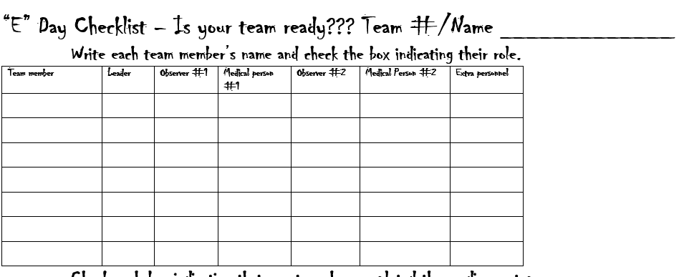

Slide 61
Teacher Prep
Supplies – large trash bags, small trash bags, duct tape or package tape, masks, gloves
Cover beds with paint drop cloths
Have students use masking tape on floor to mark various areas or rooms they would like to have
Use old manikins or allow students to make life-size, disposable human forms
Add small portion of Glo-germ powder into chocolate pudding/water mixture
Pour mixture over manikins to simulate body fluids
Have students simulate care of patient – check for Glo-germ when they are done

Slide 62
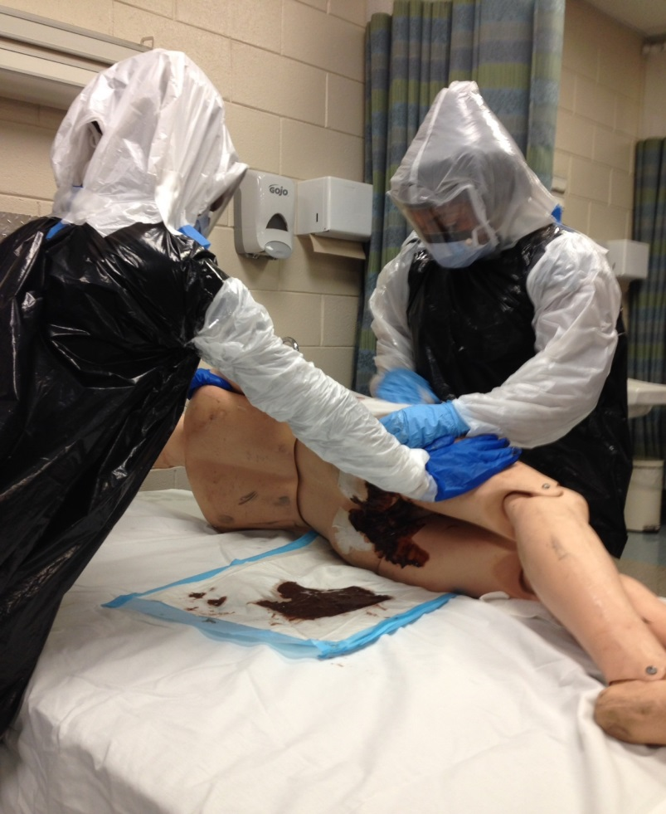
E-Day!

Slide 63
Lesson Plan #7 Health Screening Co-curricular connection: Health, Anatomy and Physiology
1.13 Analyze basic structures and functions of
Cardiovascular (components of blood, structures and functions of blood components, structures and functions of the cardiovascular system, conduction system of the heart, cardiac cycle) of eye, ear, nose and tongue; identify senses for sight, hearing, smell, taste, touch)
Endocrine (endocrine versus exocrine, structures and functions of endocrine system, hormones, regulation of hormones)
5.24 Define informed consent.
7.21 Apply personal safety procedures based on Occupational Safety and Health Administration (OSHA) and Centers for Disease Control (CDC) regulations.
7.31 Apply safety techniques in the work environment.
a. Ergonomics
b. Safe operation of equipment
c. Patient/client safety measures (check area for safety)
9.11 Promote behaviors of health and wellness (such as: nutrition, weight control, exercise, sleep habits).

Slide 64
Activities
Students complete textbook chapter on Cardiovascular System
Students complete textbook chapter on Endocrine System related to diabetes
Students learn basic EKG terminology and rhythm identification
Students learn to do blood pressure
Students learn to do height, weight and BMI
Students learn to perform 12-lead EKG
Students learn to perform finger stick glucose, total cholesterol and A1C

Slide 65
Teacher Prep
Order supplies
Moore Medical www.mooremedical.com
Hanson Medical http://www.hansonmedicalsystems.com/
Offer free use of machines when you purchase supplies – must reserve in advance
Coordinate with local cardiologists and/or hospitals
Some companies will loan 12 lead machines for the screening
Consider screening echocardiograms if you can get volunteers to perform and cardiologist on-site to read
Let students develop forms, etc.
Assign student leaders

Slide 66
