Slide 1
Summer Movies at the Beach
2017 Partner Opportunities
to support HB Friends of the Parks

Slide 2
THE PERFECT SETTING FOR A MOVIE.
Located on the sand of one of USA Today’s top-ten California beaches, Friends of the Parks Movies at the Beach prides itself on being a favorite event held in a beach community recognized for its pristine coastline and amazing outdoor activities, festivals, and events. The spirit of a small beach town resonates with the residents as well as international tourists who seek out Hermosa Beach as a “must visit” destination.
Movies at the Beach is sponsored by the City of Hermosa Beach, produced by LiveList and supports Friends of the Parks, a 501 (c) (3) non-profit foundation.

Slide 3
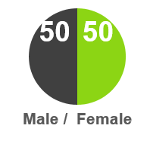
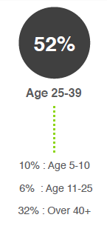
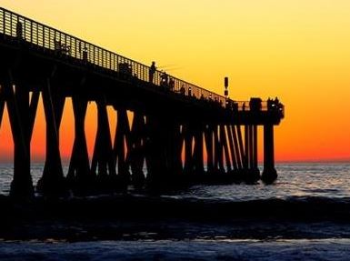
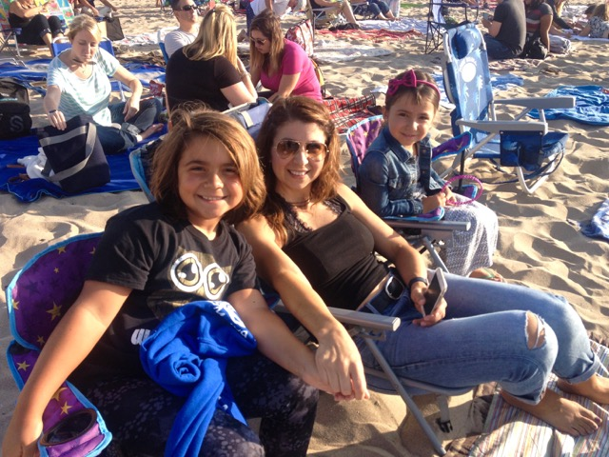
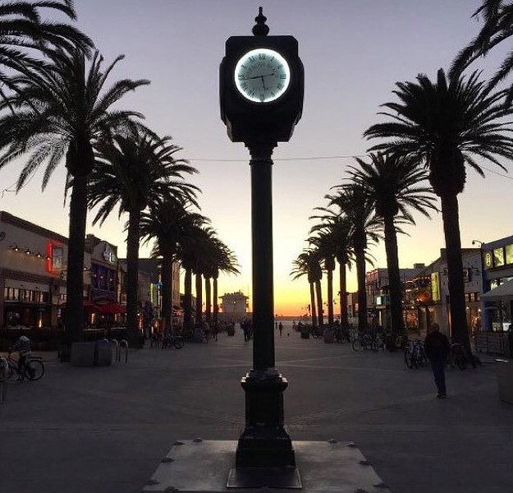
ATTENDEES
Attendees of HB Friends of the Parks Movies at the Beach have made this a popular community tradition. The audience ranges from ages 1 to 99. A highly desirable beach town demographic with disposable income & inherent gratitude towards sponsors of this event.
15,000 TOTAL EVENT ATTENDEES

Slide 4
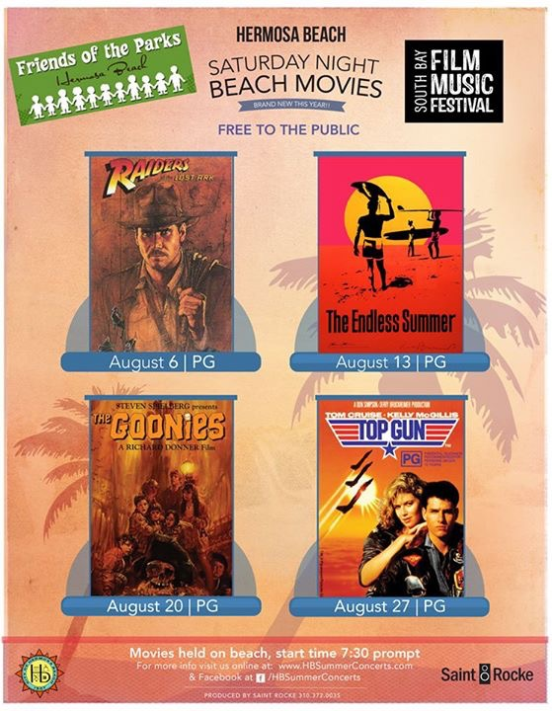
REACH
FOP.org Website- 9K+ views in July & August
Hermosa Beach City website + Press Release
City Postcard Mailer to 9,550 Hermosa Households
FB paid advertising with a reach of 7.4K people
Banner at Skate Park on Pier Avenue
City Marquee @ PCH with 20K impressions daily
Local Paper write-ups
Local Media Calendars ( Beach Report, Easy Reader, Our South Bay, South Bay by Jackie, Daily Breeze)
Concerts on the Beach Website
Pier Plaza and Pier Avenue street banners with 100,000+impressions

Slide 5
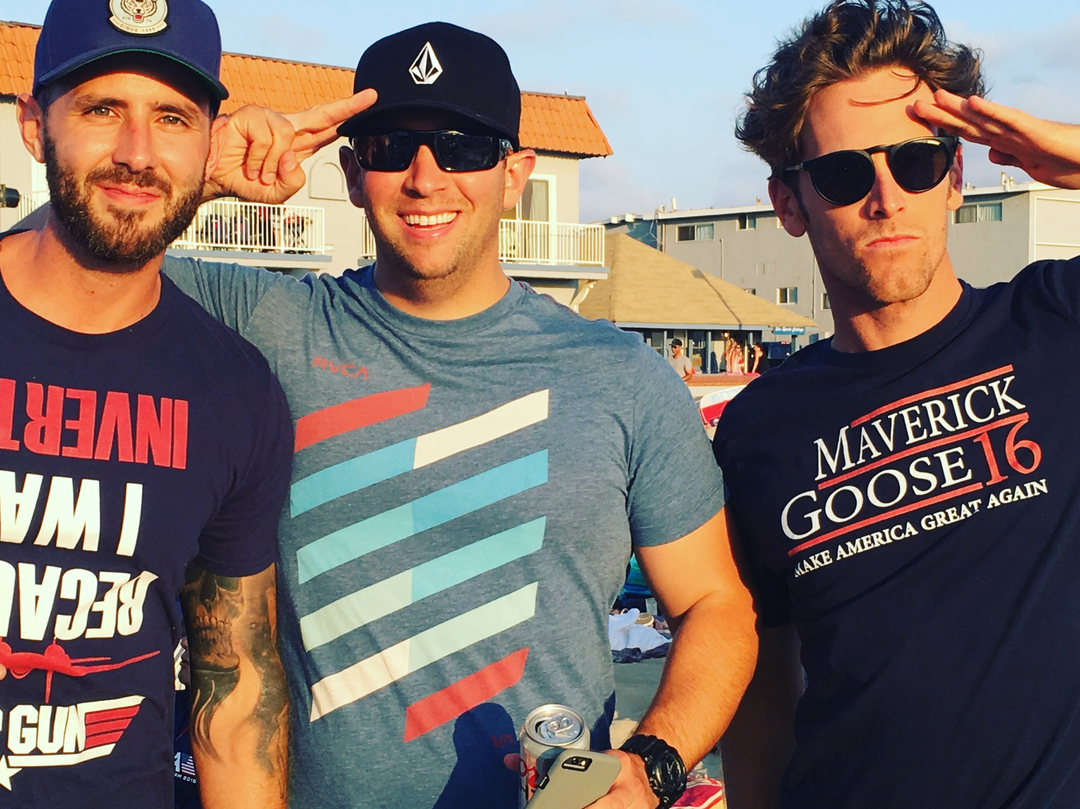
SPONSORSHIP TIERS

Slide 6
BLOCKBUSTER SPONSORSHIP(1)
Logo 30’ Banner over Pier Plaza & Pier Avenue at Ardmore
Sponsor Signage on Stage Banners
10’ X 10’ Booth Activation on Hermosa Beach for all 4 Saturday Movie Nights
On Stage Thank You before all 4 movies
1-3 minute Pre-Roll Video (production not included)
Company Logo inclusion in all PR/ Flyers /Posters
Sampling and/or Coupons encouraged
Company logo on FOP website homepage and all Social Media efforts
Reserved area for 20 people
$15K

Slide 7
FEATURE SPONSORSHIP (2)
Logo included on 30’ Banner over Pier Plaza & Pier Avenue at Ardmore
10’ X 10’ Booth Activation on Hermosa Beach for all 4 Saturday Movie Nights
On-Stage product/ brand shout out before movie begins
Sponsor logo included on all stage banners
60 second pre-roll video (Production not included)
Company/Logo inclusion on all PR/Media outreach
Sampling Encouraged
Brand/ Logo on FOP Homepage and all Social Media
$4K

Slide 8
INDEPENDENT SPONSORSHIP (4)
This sponsor will have a 10’x 10’ booth activation on the beach for 2 Saturday nights (choice is first come, first served)
Inclusion on stage signage at the event On-Stage product shout-outs
Sponsor logo on Stage banners
30 second pre-roll video (production not included)
Company /Logo inclusion on PR/ Flyers
Sampling encouraged
Company Logo on Website Homepage and all social media including FB
$2K

Slide 9
ART HOUSE SPONSORSHIP (4)
This sponsor will have a 10’x 10’ booth activation on the beach for 1 Saturday night (choice is first come, first served)
On-Stage product shout-outs
Sponsor logo on Stage banners
30 second pre-roll video (production not included)
Company /Logo inclusion on PR/ Flyers
Sampling encouraged
Company Logo on Website Homepage and all social media including FB
Inclusion in 30’ Banner and all signage at the event
$1K

Slide 10
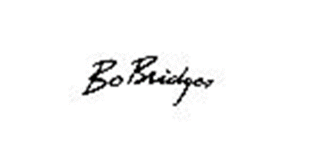
PAST SPONSORS

Slide 11
COMMUNITY FEEDBACK
Bravo!
Please do this every Saturday!
The perfect event for our entire family!
This is so much fun!
I can’t get enough of that Popcorn!
Best date night in ages!
This is what makes Hermosa so special!

Slide 12
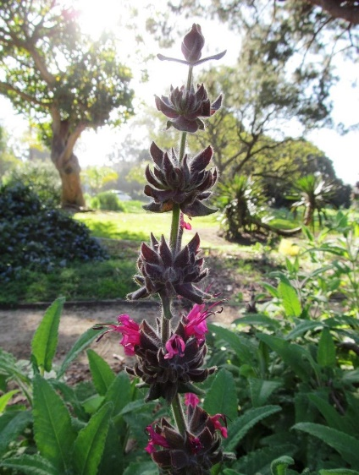
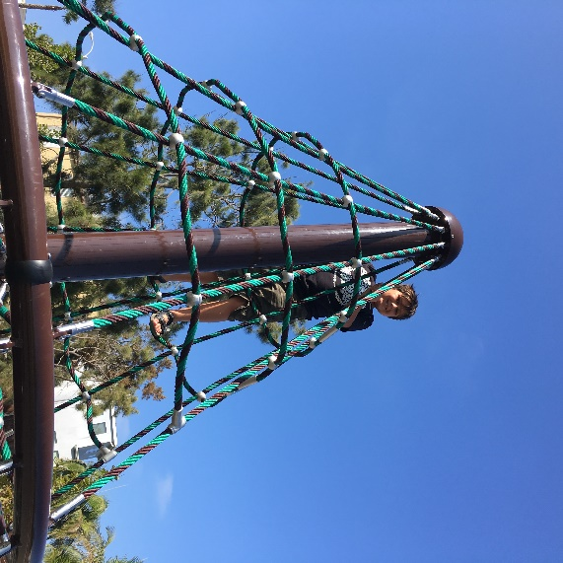
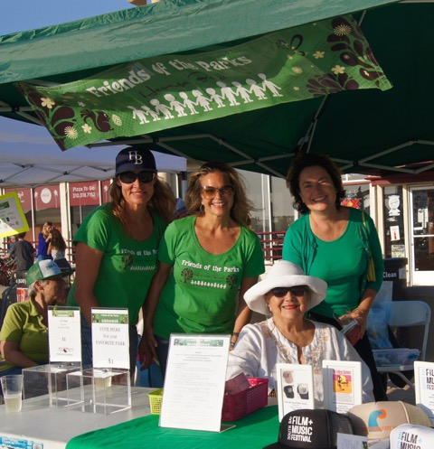
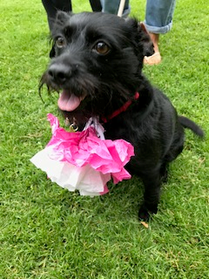
ABOUT FRIENDS OF THE PARKS
Hermosa Beach Friends of the Parks (FOP) is a 501 (c) (3) non-profit corporation, #77-0610050, dedicated to identifying, prioritizing and fundraising for park and recreation improvements throughout the City of Hermosa Beach. In addition, FOP promotes the use of Hermosa Beach parks to the community and promotes the parks as a valuable resource to the city's residents and visitors.
Creating Community Through People, Parks, and Programs

