Slide 1
Glaucoma Update for Primary Care
Madhav Vempali
Consultant Ophthalmic Surgeon
Rivers Hospital
2016

Slide 2
Definition
Glaucoma is a condition which can affect sight, usually due to build up of pressure within the eye.

Slide 3
Distribution of IOP

Slide 4
Optic Nerve Damage

Slide 5
Visual Field Defects

Slide 6
Driving Fields

Slide 7
Types of Glaucoma
chronic open-angle glaucoma
primary angle-closure glaucoma
secondary glaucoma
Developmental glaucoma (congenital glaucoma)

Slide 8
How common is POAG ?
There is an estimated overall prevalence of POAG for the age group > 40 years in the population of the United Kingdom of 2%
5000 list of > 40 years = 100 patients
National Institute for Health and Clinical Excellence, April 2009

Slide 9
Relevance to General Practice
Chronic Disease
with potential blinding complications
Quality of Life issues ( DVLA driving )
Diagnosis depends on other professionals
Life Long Treatment implications
Cost
Comorbidity
Complications

Slide 10
Glaucoma Update Aim
How does the damage occur?
Update on Clinical Diagnostic Methods
Current Medical Treatments
Current Interventional Procedures
Future Potential treatments

Slide 11
Damage In Glaucoma
Elevated Intraocular Pressure
Optic Nerve Damage due to Ganglion Cell Death
Progressive Visual Field Defect

Slide 12
Clinical Measurements in Glaucoma
Intraocular Pressure
Corneal Thickness – Pachymetry
Gonioscopy – Angle Configuration
Optic Disc Analysis
Visual Field Analysis

Slide 13
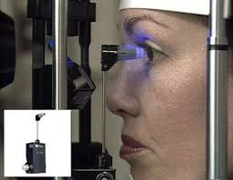
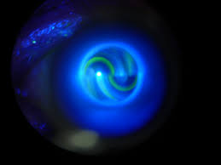
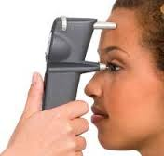
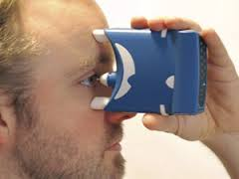
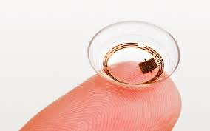
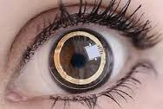
Intraocular Pressure

Slide 14
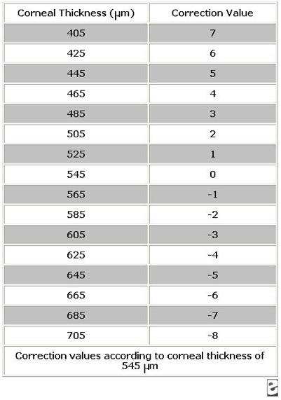
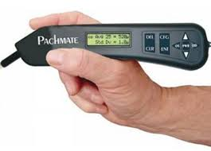
Central Corneal Thickness

Slide 15
IOP measurement and CCT
Range- 06 to 21 mm of Hg
< 06 Ocular Hypotony
> 21 Ocular Hypertension
Post LASIK & Corneal Crosslinking patients

Slide 16
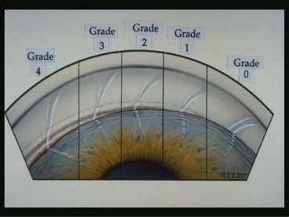
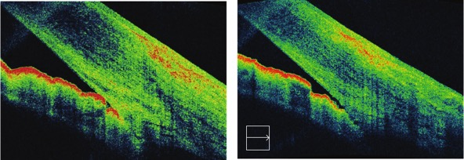
Angle Configuration

Slide 17
Optic Nerve Assessment

Slide 18
Confocal Microscopy Heidelberg Retina Tomograph (HRT)

Slide 19
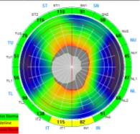
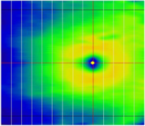
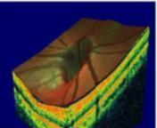
OCT Glaucoma Scans
Optic Nerve Head Map (ONH) Ganglion Cell Complex(GCC) 3-D Optic Disc
Data Captured: 14,241 A scans (pixels)
Time: 0.55 sec
Area covered: 4.9 mm diameter circle
Data Captured: 14,810 A scans (pixels)
Time: 0.57 sec
Area covered: 7 x 7 mm
Data Captured: 51,712 A scans (pixels)
Time: 2 seconds
Area covered: 5 x 5 X 2 mm
Provides
Cup Area
Rim Area
RNFL Map
Provides
Ganglion cell complex assessment in macula
Inner retina thickness is:
NFL (axons)
Ganglion cell body
IPL (dendrites)
Provides
3 D map
Comprehensive assessment
Thickness Maps
En-face evaluation
ACCURATE Disc boundaries and BASELINE
TSNIT graph
Notes:
3-D Baseline essential and acts a baseline

Slide 20
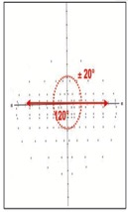
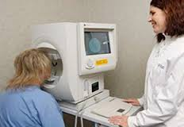
Visual Fields in Glaucoma

Slide 21
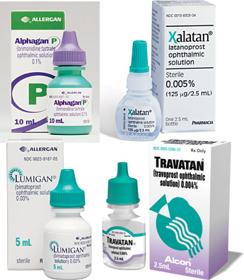
Medical Treatments

Slide 22
Pharmacotherapy Options
Drug Class
Examples
Prostaglandin analogues
b-adrenergic blockers
Carbonic anhydase inhibitors
α adrenergic agonists
Miotics
Latanoprost
Travaprost
Bimetaprost
Tafluoprost
Unoprostone
Timolol
Betaxolol
Dorzolamide
Brinzolamide
Acetazolamide
Apraclonidine
Brimonidine
Pilocarpine

Slide 23
Medical Treatments
Most Effective for the type of glaucoma
Ease of Use – Mono-therapy / Single dose
Adverse Reactions - Topical & Systemic
Co-Morbidity - IHD / COPD
Cost Effective – Generic vs Branded
Compliance Issues

Slide 24
Lasers
Argon Laser Trabeculoplasty
Selective Laser Trabeculoplasty
Cyclodiode Endocyclophotocoagulation / External cyclophotocoaculation
YAG Laser

Slide 25
Surgical Management
Trabeculectomy / 5 fu or Mitomycin C
Deep Sclerectomy
Viscocanalostomy
Minimally Invasive Glaucoma Surgery
Trabectome / iStent / Hydrus stent
Cypass Suprachoroidal Bypass
XEN subconjunctival Drainage
Conventional Shunts – Ahmed / Molteno

Slide 26
Future
Advances in Neuropathology
Advances in Early Detection of Progression
Medical Therapy Advances
Rho / ROCK Pathway Inhibitors
Novel Drug delivery systems
Stem Cell - HiPSC trabecular & RGC Regeneration
Genes - CRISPR/Cas9 targeted genome treatment of causative genes
(Myocilin, Optineurin, and WDR36)

Slide 27
Glaucoma Update Aim
How does the damage occur?
Update on Clinical Diagnostic Methods
Current Medical Treatments
Review of Current Interventional Procedures
Lasers / Filtration Surgery / Minimal Invasive Glaucoma Surgery MIGS
Future Potential treatments
Genes / ROCK / Stem Cells

Slide 28
Thank You
www.vempali.com

