Slide 1
Crucial Conversations in Cancer Care:
Management of Patients Undergoing Immunotherapy Treatments
Patricia Mangan, RN MSN CRNP
Abramson Cancer Center
University of Pennsylvania
Philadelphia, PA

Slide 2
Commercial Disclosure
This activity is supported by an educational grant from Kite Pharmaceuticals.

Slide 3
Faculty Disclosure
Ms. Mangan reports the following:
Promotional Speaker’s Bureau – Kite Pharmaceuticals

Slide 4
Objectives
Describe the mechanisms of action of newer immunotherapy agents
Identify immune-related adverse events (AEs) and the mechanisms behind them
Implement early assessment and management strategies to address immune-related AEs
Identify crucial conversations to engage in shared decision making addressing treatments and patient care

Slide 5
History of Cancer Care
Notes:
This cartoon depicts the evolution of treatments for cancer Surgery where cancer is cut out Cytotoxic therapies starting with the WWI with the use of chemical weapons Nitrogen mustard and alklating agent
Late 90s precision or targeted therapies this include these small molecules that target the genetic changes in the cancer cell TKIs and FLT 3 IDH 1 and 2
More recent immunotherapy, using ones own immune system to more directly alter immune system to be increase anti cancer activity MOABs and BITES and PD1 inhibitors and CART

Slide 6
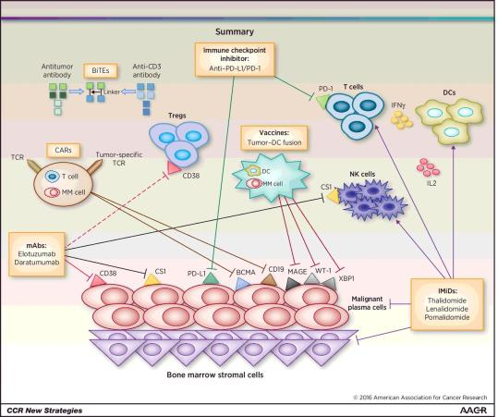
Immunotherapy for Lymphoid Malignancies: Targets and Tools
ADCs
GSK2857916
Neri P et al. Clin Cancer Res. 2016;22:5959-5965.
©2016 by American Association for Cancer Research

Slide 7
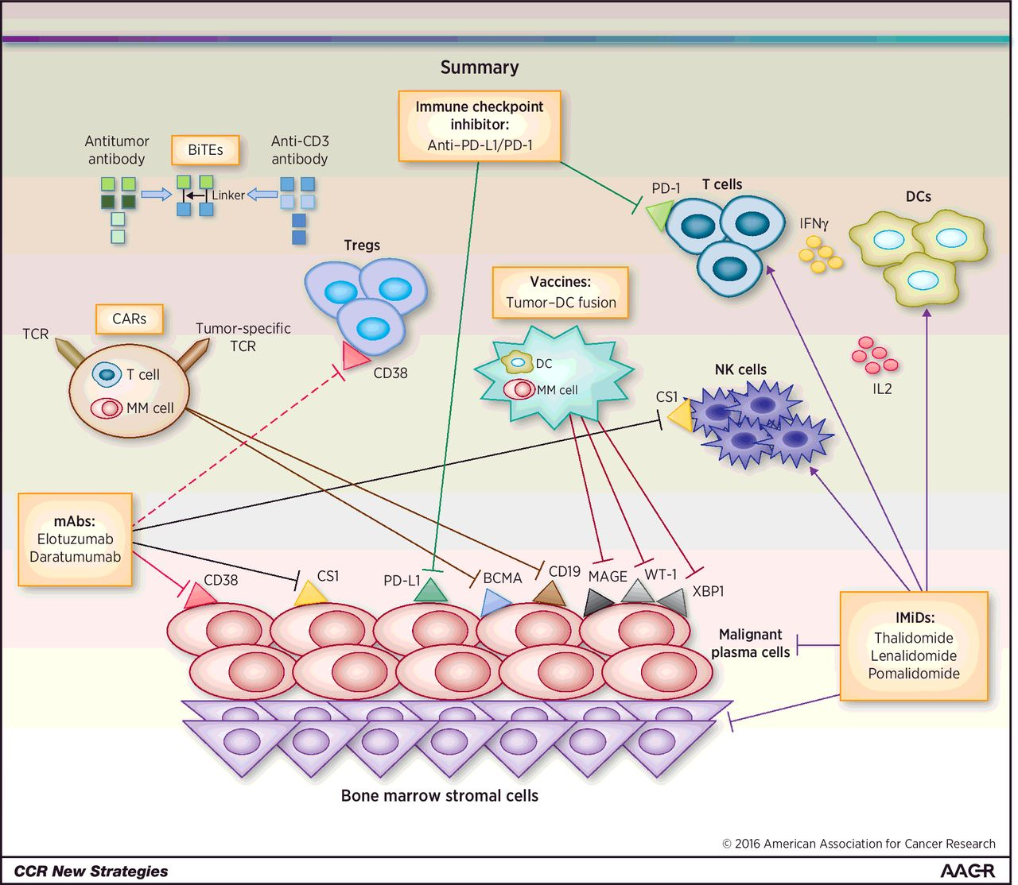
Immunotherapy for Lymphoid Malignancies: Targets and Tools
Neri P et al. Clin Cancer Res. 2016;22:5959-5965.
©2016 by American Association for Cancer Research
Notes:
Overiew of novel immunotherapeutic approaches in multiple myeloma (MM). Shown here are the cellular components of the bone marrow microenvironment and host immunity. The novel immunotherapeutic targets and treatment options discussed in this revew article are highlighted here.

Slide 8
Understanding Immunotherapies
PD-1 and PD-L1
Programmed Death Receptor-1
Programmed Death Receptor Ligand-1
CTLA-4
Cytotoxic T-Lymphocyte-Associated Antigen 4
CAR T-cell Therapy
Chimeric Antigen Receptor T-cells
Oncolytic Virus Therapy
BiSpecific T-Cell engagers
BiTES

Slide 9
PD-1 and PD-L1
PD-1 receptor on T cells interact with PD-L1 and PD-L2 expressed on tumor cells
Interaction is necessary to maintain cellular homeostasis in setting of infection or inflammation; and to prevent autoimmunity
In cancer, this interaction provides immune escape allowing:
Immune suppression
Tumor cell proliferation
Davies M. J Adv Pract Oncol. 2016;7:498-509.
Peterson JJ, Steele-Moses SK. Clin J Oncol Nurs. 2016;20(4):405-410.

Slide 10
PD-L1/PD-1 Inhibits T-cell activity
Image courtesy Terese Winslow LLC

Slide 11
CTLA-4
Involved in initial phases of T-cell activation
Down-regulate T-cell activation in lymphatic tissues in early immune response
CTLA-4 binds to CD80 and CD86
Davies M. J Adv Pract Oncol. 2016;7:498-509.
Peterson JJ, Steele-Moses SK. Clin J Oncol Nurs. 2016;20(4):405-410.

Slide 12
CTLA-4 Inhibition
Blocking CTLA-4
Activate and stimulate T-cell proliferation
Reduce immune-suppressing activity of T-Regs
Davies M. J Adv Pract Oncol. 2016;7:498-509.
Peterson JJ, Steele-Moses SK. Clin J Oncol Nurs. 2016;20(4):405-410.

Slide 13
CTLA-4 and PD-1/PD-L1 Checkpoint Blockade for Cancer Treatment
Priming phase (lymph node)
Effector phase (peripheral tissue)
T-cell migration
Dendritic cell
T cell
Cancer cell
T cell
MHC
TCR
TCR
MHC
Dendritic cell
CD28
T cell
PD-1
T cell
Cancer cell
B7
PD-L1
CTLA-4
Ribas A. N Engl J Med. 2012;366:2517-2519.
Notes:
CTLA-4, cytotoxic T-lymphocyte antigen-4; MHC, major histocompatibility complex; PD-1, programmed death-1; TCR, T-cell receptor.

Slide 14
PD-1, PD-L1, and CTLA-4 Therapies
Generic Name | Trade Name | Blocks PD-1 | Blocks PD-L1 | Blocks CTLA-4
Atezolizumab | Tecentriq |  | X
Avelumab | Bevencia |  | X
Durvalumab | Imvinzi |  | X
Ipilimumab | Yervoy |  |  | X
Nivolumab | Opdivo | X
Pembrolizumab | Keytruda | X
Tremelimumab | Not yet named |  |  | X

Slide 15
Audience Response Question
Checkpoint inhibitors have been approved for which type of cancer?
Solid tumors
Hematologic cancer
Both
Notes:
Both

Slide 16
Currently Approved Indications for Checkpoint Inhibitor Therapy
Melanoma
Ipilimumab (Adjuvant, metastatic)
Pembrolizumab (Any line)
Nivolumab (Adjuvant, metastatic)
Non-small cell lung cancer
Pembrolizumab (1st and 2nd line)
Nivolumab (2nd line)
Atezolizumab (2nd line)
Durvalumab (Adjuvant)
Bladder cancer (Transitional cell)
Pembrolizumab (2nd line)
Atezolizumab (2nd line or cisplatin ineligible)
Nivolumab (2nd line)
Avelumab (2nd line)
Durvalumab (2nd line)
Kidney cancer (Renal Cell)
Nivolumab + Ipilimumab ( 1st line)
Nivolumab (2nd line)
Head and neck cancer
Nivolumab
Pembrolizumab
Hodgkin lymphoma
Nivolumab
Pembrolizumab
Merkel cell carcinoma
Avelumab
Liver cancer (Hepatocellular)
Nivolumab
Gastric cancer
Pembrolizumab
Colorectal cancer, MSI high
Nivolumab
MSI-high cancer (any lineage)
Pembrolizumab

Slide 17
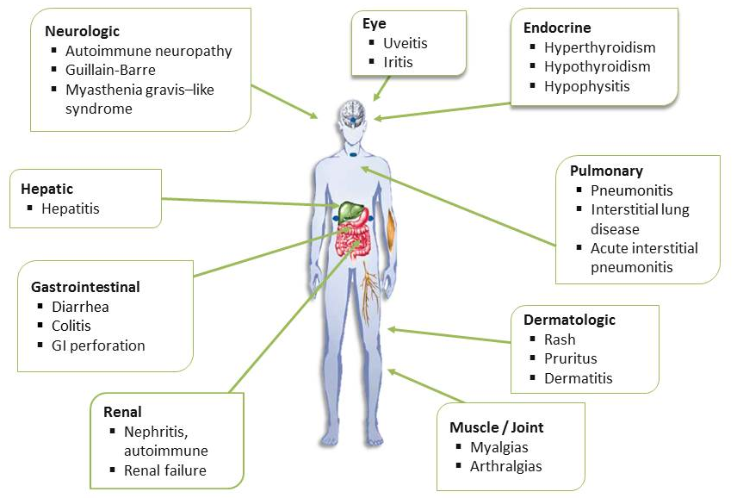
Immune-related Adverse Events: CTLA-4, PD-L, and PD-L1 therapies
Adapted from Michot JM et al. Eur J Cancer. 2015;54:139-148.
Notes:
Michot JM, Bigenwald C, Champiat S, Collins M, Carbonnel F, et al. 2015. Immune-related adverse events with immune checkpoint blockade: a comprehensive review. Eur J Cancer;54:139-148.

Slide 18
General Guidelines
Early recognition of symptoms and frequent monitoring
Establish correct diagnosis
Presentation can be subtle
Other causes must be ruled out
irAEs can become severe and life threatening if diagnosis and appropriate treatment are delayed
Fecher LA et al. The Oncologist. 2013;18(6):733-743.

Slide 19
Audience Response Question
irAEs can appear up to how many months after discontinuing therapy?
1 month
2 months
4 months
6 months
Notes:
ANS: D

Slide 20
Kinetics of Appearance of irAEs
Weber JS et al. J Clin Oncol. 2012;30:2691-2697.

Slide 21
Distribution of Grade 1-2 irAEs
Michot JM et al. Eur J Cancer. 2015;54:139-148.

Slide 22
Distribution of Grade 3-4 irAEs
Michot JM et al. Eur J Cancer. 2015;54:139-148.

Slide 23
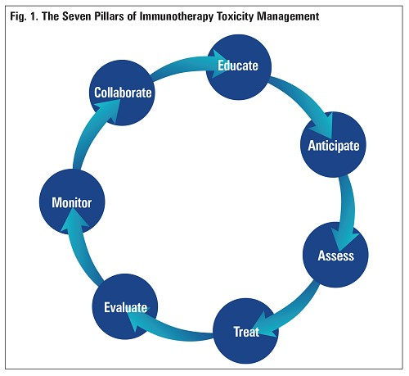
Toxicity Management
Adapted from Champiat S et al. Ann Oncol. 2016;27(4):559-574.
Wood LS. ASCO-SITC News 2018.

Slide 24
Management of Mild irAEs
Patient education
Prior to initiation of treatment and at every visit
Primary treatment is supportive care
Close monitoring
Clinical status
Laboratory monitoring
Creatinine, hepatic panel
Thyroid function testing
Fasting glucose
Amylase, lipase

Slide 25
Moderate-to-Severe irAEs
Treatment interruption required for moderate (grade 2) irAEs
High-dose steroids for severe (grade 3) irAEs
irAEs generally improve with high-dose steroids followed by slow taper
The optimal dose, schedule, and course of steroids remains unclear

Slide 26
Moderate-to-Severe irAEs
Multidisciplinary care may be appropriate
Gastroenterology
Dermatology
Endocrinology
Rheumatology
Ophthalmology

Slide 27
Late-onset irAEs
Be aware that irAEs may come
Early
Late
After discontinuation of treatment
Any time!
Must educate patients and HCPs of potential for late-onset irAEs
Should be incorporated into survivorship plans

Slide 28
irAE Guidelines and Resources
ESMO Guidelines:
Haanen JBAG et al. Annals of Oncol. 2017;28(suppl 4):iv119-iv142.
SITC Guidelines:
Puzanov I et al. J for ImmunoTherapy of Cancer, 2017;5:95.
ASCO Guidelines:
Brahmer JR et al. J Clini Oncol. 2018;36(17):1714-1768.
NCCN: National Comprehensive Cancer Network:
Management of Immunotherapy-Related Toxicities v1.2018
NCCN.org
AIM at Melanoma: Melanoma Nursing Initiative
http://themelanomanurse.org/

Slide 29
Anatomy of a Chimeric Antigen Receptor
Gene transfer technology is used to stably express CARs on T-cells, conferring novel antigen specificity
CARs combine antigen recognition domain (anti-CD19) with intracellular signaling domain
Intracellular signaling domain:
Same functionality as endogenous T-cells
Co-stimulatory endodomain mediates potent antileukemia effects and promotes persistence

Slide 30
Building CAR-T cells
T cell
CTL019 cell
Lentiviral vector
Native TCR
Anti-CD19
CAR construct
CD19
Dead tumor cell
Tumor cell
Image courtesy of David Porter, MD

Slide 31
CD19: An Ideal Tumor Target
CD19 is expressed on surface of most B-cell malignancies
CD19 expression is restricted to B-cells and their precursors
CD19 is not expressed on pluripotent bone marrow stem cells
On target expected SE is B-cell aplasia
B cell lymphomas and leukemias
preB-ALL
myelomas
Y
Y
Y
Y
Y
Y
Y
Y
Y
Y
Y
Y
Y
Y
Y
Y
Y
Y
Stem Cell
pro B
pre B
immature B
mature B
plasma cell
CD19
CD22
CD20
1. Scheuermann RH, et al. Leuk Lymphoma. 1995;18:385-397.
Image adapted from Janeway CA, Travers P, Walport M, et al. Immunobiology. 5th ed. New York, NY: Garland Science; 2001:221-293; Scheuermann RH, et al. Leuk Lymphoma. 1995;18:385-397; and Feldman M, Marini JC. Cell cooperation in the antibody response. In: Roitt I, Brostoff J, Male D, eds. Immunology. 6th ed. Maryland Heights, Missouri: Mosby;2001:131-146.
Notes:
31

Slide 32
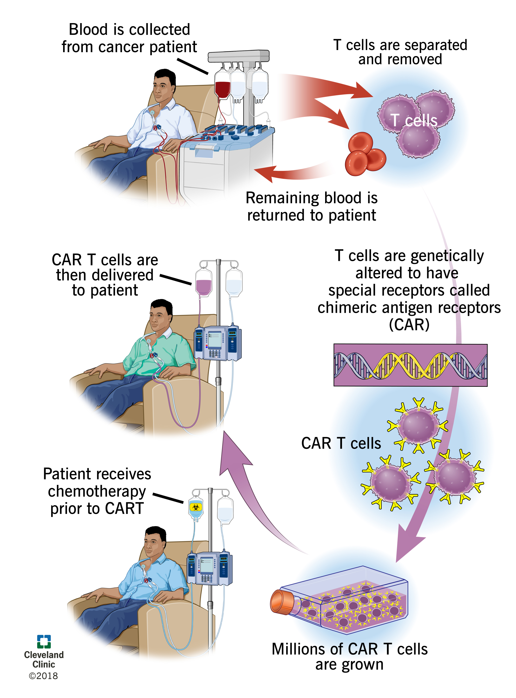
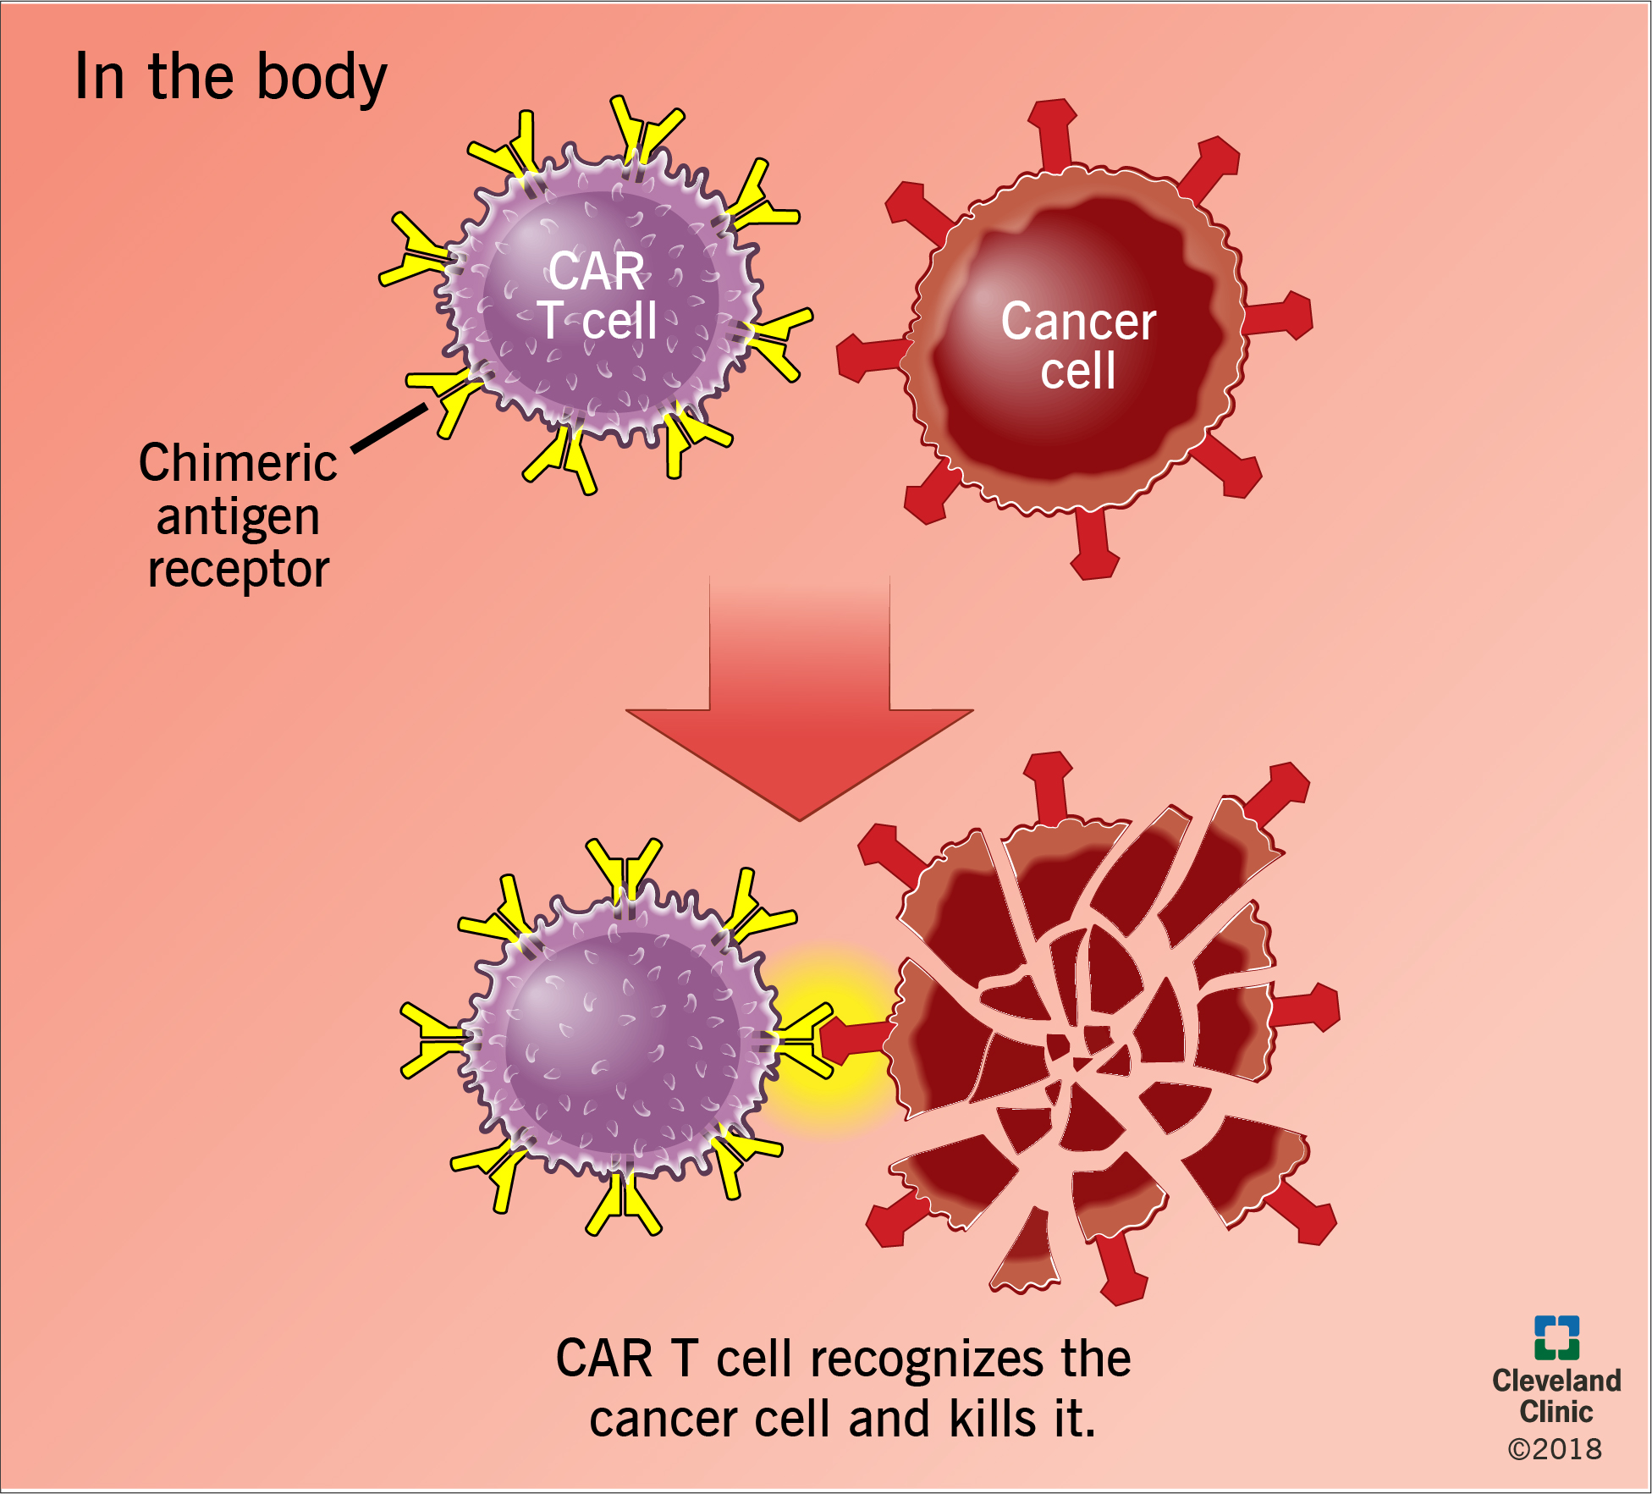
CAR-T Cells: Autologous Approach

Slide 33
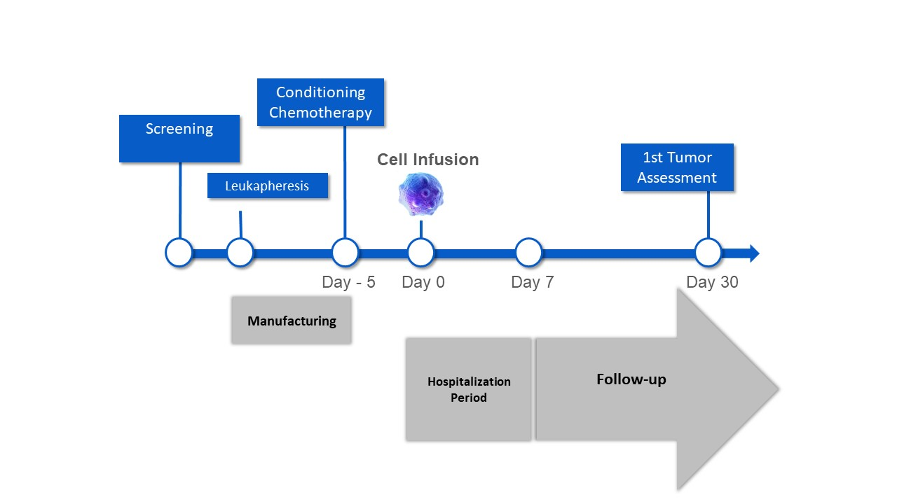
CAR-T Cells: Typical Treatment Plan
Lympho-depleting chemotherapy:
Cyclophosphamide 500 mg/m² IV and Fludarabine 30 mg/m² IV daily x 3 days
Administered on D -5, D -4, D -3 before anti-CD19 CAR T cells are infused on D + 0
Image provided by Brian T. Hill MD, PhD. Cleveland Clinic Taussig Cancer Center. Used with permission.

Slide 34
CD19-targeted CAR-T cells for B-cell Malignancies
Experience from numerous national and international trials
Responses seen in heavily-pretreated CLL, ALL, and B-cell NHL
40-50% in CLL
80% in ALL
50-80% in NHL
Some durable CRs >5 years
1. Maude SL et al. N Engl J Med. 2014;371:1507-1517. 2. Davila ML et al. Science Trans Med.2014;6(224):224ra25. 3. Porter DL et al. Proc ASH. 2013;Abstract #873. 4. Maus MV et al. Blood. 2014;123(17):2625-2635.

Slide 35
CAR-T Cell Therapy: Tisagenlecleucel
Indications
Patients up to age 25 with B-cell precursor acute lymphoblastic leukemia (ALL) refractory or in 2nd or later relapse
Relapsed or refractory diffuse large B-cell lymphoma
Tisagenlecleucel PI. 2018. Available at https://www.fda.gov/downloads/UCM573941.pdf.

Slide 36
CAR-T Cell Therapy: Axicabtagene Ciloleucel
Indication
Adults with relapsed or refractory diffuse large B-cell lymphoma after 2 or more lines of systemic therapy
Diffuse large B-cell lymphoma (DLBCL)
Primary mediastinal large B-cell lymphoma
High-grade B-cell lymphoma
DLBCL arising from follicular lymphoma
Axicabtagene Ciloleucel PI. 2017. Available at https://www.fda.gov/downloads/UCM581226.pdf.

Slide 37
But Not Without Toxicity
On-target toxicities^{1,2}:
Tumor lysis syndrome
B-cell aplasia
Hypogammaglobulinemia
Off target toxicities^{1,2}:
Cytokine Release Syndrome (CRS)
Discussed on next slide
CNS toxicity
Causative pathophysiology of these neurologic side effects is unknown, similar events reported with blinatumomab³
Neurologic toxicity has been reversible in a majority of cases
1. Tisagenlecleucel PI. 2018. Available at https://www.fda.gov/downloads/UCM573941.pdf. 2. Axicabtagene Ciloleucel PI. 2017. Available at https://www.fda.gov/downloads/UCM581226.pdf. 3. Blinatumomab PI. 2014. Available at https://www.accessdata.fda.gov/drugsatfda_docs/label/2014/125557lbl.pdf.

Slide 38
Cytokine Release Syndrome (CRS)
Correlates with:
CAR-T19 activation and expansion
Dramatic cytokine elevations (very high levels of IL6, IL10, IFNɤ, CRP, ferritin)
Almost all responding patients developed a CRS
Clinical syndrome:
Onset 1-14 days after infusion
Duration 1-10 days
Monitor VS, ferritin level, and CRP level
Fevers come first and get very high (105°F/41°C)
Myalgias, fatigue, anorexia
Capillary leak, hypoxia and hypotension
May require ICU support
Associated with HLH/macrophage activation syndrome
Altered mental status, seizures, DIC
Ferritin >500,000
Self-limited or anti-cytokine intervention

Slide 39
“The Antidote”: Tocilizumab
Humanized monoclonal antibody to IL-6 which can rapidly reverse CRS¹
August 30, 2017: FDA expanded the indication for tocilizumab for the treatment of CAR-T cell-induced severe or life-threatening CRS in patients ≥2 years of age²
Ensure that 2 doses of tocilizumab are available prior to infusion of CAR-T cells
Monitor patients at least daily for 7 days at the certified healthcare facility following infusion for signs and symptoms of CRS.
Monitor patients for signs or symptoms of CRS for 4 weeks after infusion.
Counsel patients to seek immediate medical attention should signs or symptoms of CRS occur at any time.
At the first sign of CRS, institute treatment with supportive care, tocilizumab or tocilizumab and corticosteroids as indicated.
Responds to steroids → but lose CAR-T cells
Will early treatment for CRS abrogate response?
1. Tocilizumab PI. 2017. Available at https://www.accessdata.fda.gov/drugsatfda_docs/label/2017/125276s114lbl.pdf. 2. Le RQ et al. Oncologist. 2018;23(8):943-947.

Slide 40
Temperature Response to Tocilizumab
Tocilizumab
Source: Patricia Mangan, RN, MSN, CRNP

Slide 41
Ferritin Response to Tocilizumab
Tocilizumab: d10
Ferritin
CRS, Pt 04409-09
Source: Patricia Mangan, RN, MSN, CRNP

Slide 42
Neurotoxicity
Range of toxicity from headache to encephalopathy, and seizures^{1,2,3}
Decreased attentiveness, anxiety, tremors, somnolence, disorientation, aphasia, non-sensical/tangential speech
Mechanism of toxicity is unclear
T-cell vs cytokine mediated??
CAR-T cells are seen in the CSF^{1,2}
Predictors^{1,2,3}
High disease burden
High IL6 on Day 1
Neuro assessments
Treatment^{1,2,3}
No clear response to anti-cytokine treatment
Use of steroids and anti-seizure medicines
1. Turtle JC et al. J Clin Oncol. 2017;35(15 suppl);3020. 2. Santomasso B et al. Neurology. 2018;90(15 Supplement):S23.008. 3. Wang Z, Han W. Biomarker Research. 2018;6:4

Slide 43
CART19: B-cell Aplasia
On-target expected SE is B-cell aplasia
Correlates with CART19 persistence
Successfully managed with IVIG replacement
No excessive or frequent infections
B cell lymphomas and leukemias
preB-ALL
myelomas
Y
Y
Y
Y
Y
Y
Y
Y
Y
Y
Y
Y
Y
Y
Y
Y
Y
Y
Stem Cell
pro B
pre B
immature B
mature B
plasma cell
CD19
CD22
CD20
1. Scheuermann RH, et al. Leuk Lymphoma. 1995;18:385-397
Image adapted from Janeway CA, Travers P, Walport M, et al. Immunobiology. 5th ed. New York, NY: Garland Science; 2001:221-293; Scheuermann RH, et al. Leuk Lymphoma. 1995;18:385-397; and Feldman M, Marini JC. Cell cooperation in the antibody response. In: Roitt I, Brostoff J, Male D, eds. Immunology. 6th ed. Maryland Heights, Missouri: Mosby;2001:131-146.
Notes:
43

Slide 44
Toxicities of CAR-T Cell Therapy
Cytokine Release Syndrome
Fever, chills / rigors, tachycardia, hypotension, hypoxia, fluid retention, rash, nausea, anorexia, fatigue
Capillary leak syndrome
Neurotoxicity
Headache, confusion, aphasia, tremors, somnolence
Acute kidney injury
Inflammation leading to decreased renal blood flow
Coagulopathy
Prolonged PT/PTT, increased D-dimer
Inflammatory response rather than DIC
Halton E et al. Clin J Oncol Nurs. 2017;21(suppl):35-40.
Smith LT, Venella K. Clin J Oncol Nurs. 2017;21(suppl):29-34.

Slide 45
Toxicities of CAR-T Cell Therapy
Toxicities
SOB | Diarrhea
Fever | Myalgias
Chills | Arthralgias
Confusion | Dizziness
Nausea | Lightheadedness
Vomiting

Slide 46
Toxicities of CAR-T cell Therapy
Cytokine release syndrome:
Immune activation – elevated inflammatory cytokines
High fever, chills, tachycardia, hypotension, arrhythmias, capillary leak syndrome, renal impairment
occurs range 1-12 days
Bonifant CL et al. Molec-Therapy Oncolytics. 2016;3:1-7.
Axicabtagene Ciloleucel PI. 2017. Available at https://www.fda.gov/downloads/UCM581226.pdf.
Tisagenlecleucel PI. 2018. Available at https://www.fda.gov/downloads/UCM573941.pdf.
Notes:
Incidence during trials 93% 100%

Slide 47
CAR-T cell Therapy: Cytokine Release Syndrome
Lymphocytes and myeloid cells become activated and release inflammatory cytokines
Similar to the less severe reaction observed with rituximab
Onset and severity depend on the drug and magnitude of immune cell activation
Incidence and severity greater in patients with larger tumor burden due to higher levels of T-cell activation
Lee DW et al. Blood. 2018;124:188-195.

Slide 48
Management of AEs with CAR-T cell Therapy
AE Treatment - complicated – potential for immunosuppressive therapy to interfere with anti-malignancy activity of CAR-T cells
Tocilizumab 8 mg/kg
Methylprednisolone or dexamethasone (grade 2 or higher)
Brundo JN, Kochenderfer JN. Blood. 2016;27:3321-3330.
Axicabtagene Ciloleucel PI. 2017. Available at https://www.fda.gov/downloads/UCM581226.pdf.
Tisagenlecleucel PI. 2018. Available at https://www.fda.gov/downloads/UCM573941.pdf.

Slide 49
Management of AEs with CAR-T cell Therapy: Preparation
Patient and caregiver education
Emergency equipment available
Hypersensitivity meds at the bedside
IV hydration
Administer pre-medications
Acetaminophen, Diphenhydramine
MUST have 2 doses of tocilizumab on hand in institution prior to given infusion of product to patient.
Halton E et al. Clin J Oncol Nurs. 2017;21(suppl):35-40.
Smith LT, Venella K. Clin J Oncol Nurs. 2017;21(suppl):29-34.

Slide 50
Management of AEs with CAR-T cell Therapy: Assessment
Frequent monitoring
Vital signs
Intake and output every 4 hours
Clinical assessment every 4 hours
Neurological assessment every 4 hours
Daily weight
Increase frequency of above as clinically indicated
Prompt reporting of toxicity-related signs and symptoms
Brundo JN, Kochenderfer JN. Blood. 2016;27:3321-3330.
Halton E et al. Clin J Oncol Nurs. 2017;21(suppl):35-40.
Smith LT, Venella K. Clin J Oncol Nurs. 2017;21(suppl):29-34.

Slide 51
Management of AEs with CAR-T cell Therapy
Frequent assessment
Supportive care of fever, chills, myalgias, headache: acetaminophen, opioid medications
Coagulopathies: cryoprecipitate and fresh frozen plasma to maintain fibrinogen level >150 mg/dL
Halton E et al. Clin J Oncol Nurs. 2017;21(suppl):35-40.
Smith LT, Venella K. Clin J Oncol Nurs. 2017;21(suppl):29-34.

Slide 52
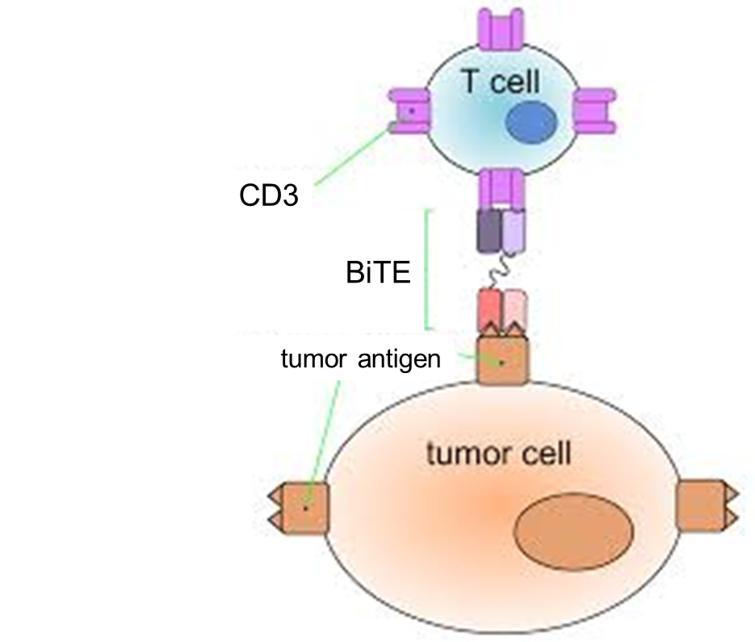
BiTE: Bispecific T-cell Engagers
Image source https://en.wikipedia.org/wiki/Bi-specific_T-cell_engager#References.

Slide 53
Blinatumomab
A constructed monoclonial antibody known as bispecific T-cell engagers (BiTEs)
Exert action selectively and direct the human immune system to act against tumor cells
Blinatumomab targets CD19
FDA approved 12/2014 for treatment of relapsed refractory Ph-B-cell
Blinatumomab PI. 2014. Available at https://www.accessdata.fda.gov/drugsatfda_docs/label/2014/125557lbl.pdf.

Slide 54
Blinatumomab: Potential Side Effects
Flu-like symptoms
Fever
Headache
Fatigue
Tremor
Weight increase
Hypokalemia
Decrease of blood immunoglobulin
CNS
Seizure
Encephalopathy
Tremor
Apraxia
Speech disorders
Disorientation
Blinatumomab PI. 2014. Available at https://www.accessdata.fda.gov/drugsatfda_docs/label/2014/125557lbl.pdf.

Slide 55
Oncolytic Virus Immunotherapy
Utilize native or genetically modified viruses that selectively replicate within tumor cells
Do not require defined antigens to be included in the vector
Tumor-associated antigens may be released by dying tumor cells
Directly kill tumor cells
Kaufman HL et al. Nature. 2015;14:642-662.

Slide 56
Oncolytic Viruses: Mechanism of Action
Mediate antitumor activity through interactions between
Virus
Tumor microenvironment
Host immune system
Selective replication within neoplastic cells
Results in direct lysis of tumor cells
Induction of systemic antitumor immunity
Rehman H et al. J Immunother Cancer. 2016;4(53):1-8.
Kaufman HL et al. Nature. 2015;14:642-662.

Slide 57
Oncolytic Vaccines
Talimogene laherparepvec (T-VEC)
Trade name: Imlygic
Local treatment of unresectable cutaneous, subcutaneous, and nodal lesions in patients with melanoma following surgical resection
Intra-tumoral injection
Rehman H et al. J Immunother Cancer. 2016;4(53):1-8.
Kaufman HL et al. Nature. 2015;14:642-662.

Slide 58
Talimogene Laherparepvec (T-VEC)
Herpes simplex virus (HSV-1) modified to replicate specifically within tumor cells leading to cell lysis
Cell lysis leads to release of tumor cell antigens which stimulate anti-tumor immune response.
Rehman H et al. J Immunother Cancer. 2016;4(53):1-8.
Kaufman HL et al. Nature. 2015;14:642-662.

Slide 59
Talimogene Laherparepvec (T-VEC): Dosing
Initial dose:
10⁶ plaque-forming units (PFU) per mL
Inject lesions largest to smallest until either the maximum volume of 4 mL is reached, or until all injectable lesions have been treated
Dose 2 and all subsequent doses (every 2 weeks)
10⁸ PFU per mL
First inject newly formed lesion(s)
Then inject lesions largest to smallest until either the maximum injection volume of 4 mL is reached, or until all injectable lesions have been treated
3 weeks
Talimogene Laherparepvec PI. 2015. Available at https://www.fda.gov/downloads/BiologicsBloodVaccines/CellularGeneTherapyProducts/ApprovedProducts/UCM469575.pdf.

Slide 60
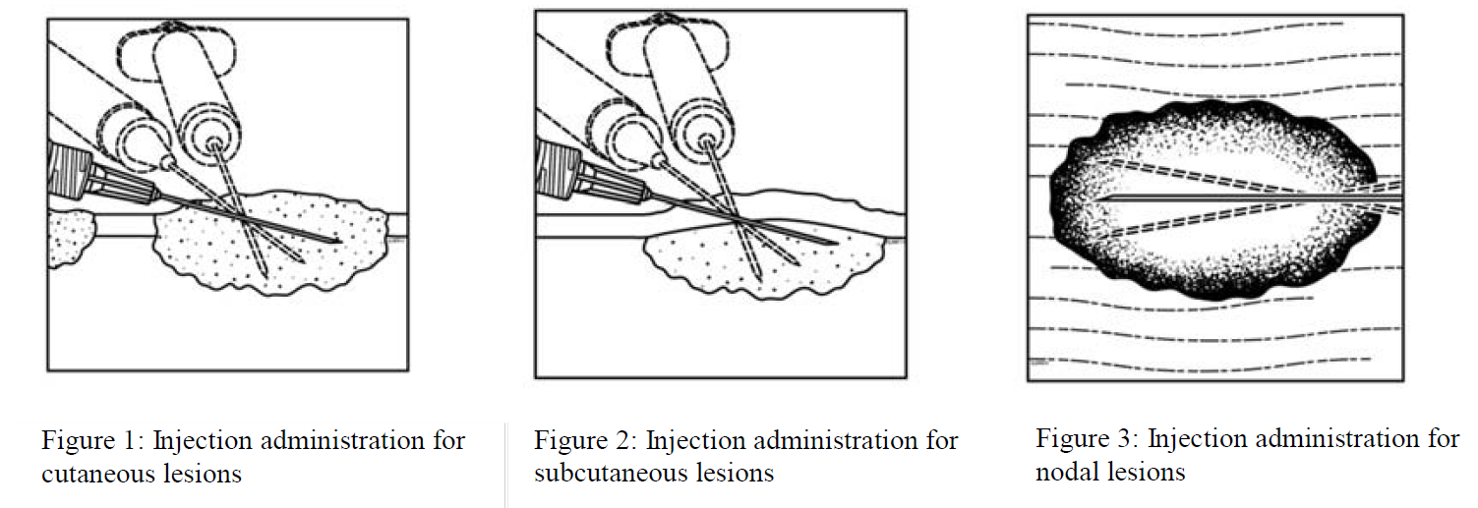
Talimogene Laherparepvec (T-VEC): Administration
Talimogene Laherparepvec PI. 2015. Available at https://www.fda.gov/downloads/BiologicsBloodVaccines/CellularGeneTherapyProducts/ApprovedProducts/UCM469575.pdf.

Slide 61
Talimogene Laherparepvec (T-VEC): Injection Volume Based on Tumor Size
The number of vials and concentration are dependent on the number and size of injectable lesions.
Total volume of T-VEC injection for each lesion should be determined by chart below.
Lesion size
Injection volume
Talimogene Laherparepvec PI. 2015. Available at https://www.fda.gov/downloads/BiologicsBloodVaccines/CellularGeneTherapyProducts/ApprovedProducts/UCM469575.pdf.

Slide 62
Audience Response Question
Patients receiving oncolytic viral therapy need to receive education about which of the following?
Treatment-specific therapy
Early detection of irAEs
Risk of viral exposure
All of the above
Notes:
ANS: D

Slide 63
Toxicities of Oncolytic Virus Therapy Talimogene Laherparepvec (T-VEC)
Toxicities
Fatigue | Diarrhea
Chills | Constipation
Pyrexia | Headache
Injection site pain | Myalgia
Nausea | Arthralgia
Vomiting | Pain in extremity

Slide 64
Audience Response Question
Which of the following best describes toxicities relating to immunotherapies?
They are related to specific drug classes
They are therapy-specific
The severity and frequency varies with different cancers
All of the above
Notes:
ANS: d

Slide 65
Understanding Toxicities and irAEs
Class toxicities
PD-1 and PD-L1 inhibitors
CTLA-4 inhibitors
Therapy-specific toxicities
CAR-T cell therapy
BiTES
Oncolytic virus therapy
Emergence in different cancers
Incidence and severity of irAEs varies between cancers

Slide 66
Patient Education Overview
General education for patients receiving immunotherapy
Treatment-specific education
Tools to facilitate early detection and rapid communication regarding treatment and irAEs

Slide 67
Patient Education
Education prior to initiation of treatment
Treatment plan
Treatment-specific education
Mechanism of action
How immunotherapy is different from chemotherapy
Potential side effects
Focus on early communication with oncology team
Side effects can be subtle
Side effects can develop at any time

Slide 68
Patient Education: CAR-T cell Therapy and BiSpecific T-cell engagers
Signs and symptoms of CRS
Awareness of temporary memory and coordination problems, sleepiness, confusion, weakness, dizziness, and potential for seizures
Halton E et al. Clin J Oncol Nurs. 2017;21(suppl):35-40.
Smith LT, Venella K. Clin J Oncol Nurs. 2017;21(suppl):29-34.

Slide 69
Patient Education: Vaccine Therapy
Mechanism of action
Administration
Injection directly into the tumor
Treatment plan
2 injections 3 weeks apart
Injections every 2 weeks
Risk of exposure
Injected virus can spread to other areas of your body or to others with direct contact to injection site, dressings, or body fluids
Rubin K. Clin J Oncol Nurs. 2017;21(suppl):7-10.
Seery V. Clin J Oncol Nurs. 2017;21(suppl):76-86.
Hoffner B et al. Onc Nurs Forum. 2016;43:219-226.

Slide 70
Patient Education: Vaccine Therapy
Injection site care
Avoid touching or scratching treatment sites
Keep treatment site covered with airtight and watertight dressings for at least 1 week
Until treatment site is no longer weeping or oozing
Replace loose dressing immediately
Discard dressings in a sealed plastic bag
Notify oncology team immediately
Pain, burning, or blister around mouth, fingers, ears, or genitals
Eye pain, photophobia, eye drainage, blurry vision
Extreme fatigue or confusion
Rubin K. Clin J Oncol Nurs. 2017;21(suppl):7-10.
Seery V. Clin J Oncol Nurs. 2017;21(suppl):76-86.
Hoffner B et al. Onc Nurs Forum. 2016;43:219-226.

Slide 71
Tools to Facilitate Early Detection and Rapid Communication
Patient education
Written information
Verbal review of written information
Contact information sheet for patient
Oncologist office phone number
Nurse phone number
Number to call after hours and holidays

Slide 72
Immunotherapy Wallet Card

Slide 73
Patient Education Sheet
Source: Laura Woods, RN, MSN, OCN

Slide 74
Nursing Assessment Sheet
Source: Laura Woods, RN, MSN, OCN

Slide 75
Chart Documentation
Cycle 1 Atezolizumab 2/3/17
Atezolizumab held 4/28/17
Prednisone since 4/28/17
Prednisone 60mg 4/28 – 4/30
Prednisone 40mg 5/1 – 5/7
Prednisone 30mg 5/5 – 5/7
Prednisone 20mg 5/8 – 5/11
Prednisone 10mg 5/12 – 5/25
Atezolizumab restarted 5/19/17
Prednisone 7.5mg 5/26 – 6/29
Prednisone 5mg 6/30 – 7/6
Prednisone 4mg 7/7 – 8/5

Slide 76
Lab and Treatment Tracker
Source: Laura Woods, RN, MSN, OCN

Slide 77
Management of Patients Undergoing Immunotherapy Treatments
Advances in therapeutic strategies continues to transform the landscape of cancer treatment
Oncology nurses must expand their knowledge and expertise to meet these advances and the needs of our patients and their loved ones

Slide 78
Take-Home Points
Patient and caregiver education is critical to improve early awareness and intervention for adverse events
Ongoing assessment of irAEs must be incorporated into long-term and survivorship plans

