Slide 1
A YEAR LATER – MCPS and the USM entrance requirements For Discussion: 11/7/2018 Cynthia Simonson, MCCPTA VP of Educational Issues

Slide 2
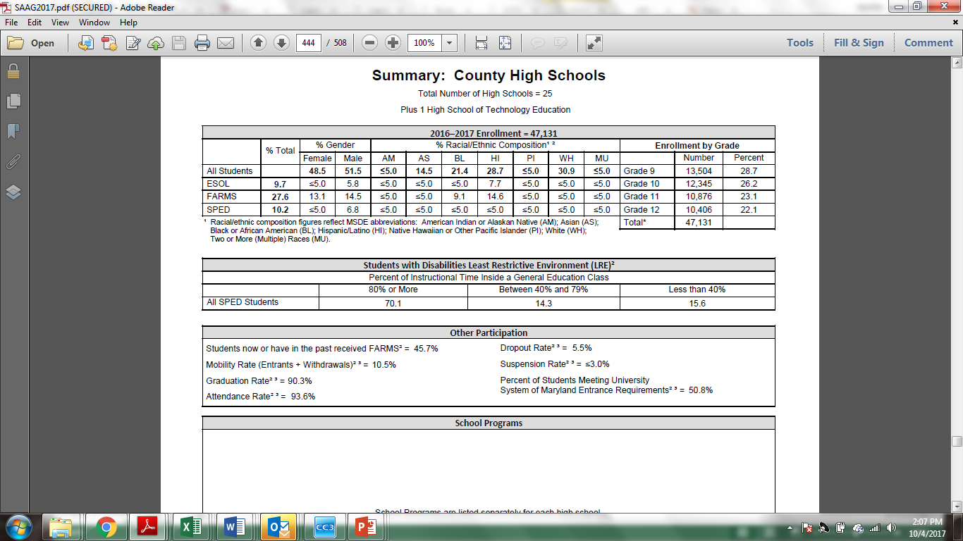
Student-At-A-Glance Reports
http://www.montgomeryschoolsmd.org/departments/sharedaccountability/glance/

Slide 3
MCCPTA Concern:
The drop in MCPS Graduates for USM Entrance Requirements from Class of ‘15 to Class of ’16 was a reporting change. Okay...
But what explains the drop from Class of ’16 to the Class of ‘17?
http://www.montgomeryschoolsmd.org/departments/sharedaccountability/glance/
Percentage of Students Meeting University System of Maryland (USM) Entrance Requirements:
2016 (2014-15 data) | 2017 (2015-16 data) | 2018 (2016-17 data)
80.4% | 50.8% | 41.0%

Slide 4
BACKGROUND: MSDE vs. MCPS vs. USM
Maryland State Department of Education (MSDE) – minimum requirements to receive MD diploma. http://www.marylandpublicschools.org/programs/Documents/Testing/GradRegFAQ051517.pdf
MCPS – sets requirements that must meet all MSDE requirements and may include additional elements.
http://www.montgomeryschoolsmd.org/curriculum/graduation-requirements.aspx
USM – governed by the Board of Regents, sets the minimum requirements for admission to schools that are members (12 of 14 MD state universities)
USM Bylaws, Policies and Procedures of the Board of Regents, III-4.00 - POLICY ON UNDERGRADUATE ADMISSIONS

Slide 5
Background: University System of Maryland (USM) includes…
Bowie State University | Bowie, MD
Coppin State University | Baltimore, MD
Frostburg State University | Frostburg, MD
Salisbury University | Salisbury, MD
Towson University | Towson, MD
University of Baltimore | Baltimore, MD
University of Maryland, Baltimore | Baltimore, MD
University of Maryland, Baltimore County | Baltimore County, MD
University of Maryland, College Park | College Park, MD
University of Maryland Eastern Shore | Princess Anne, MD
University of Maryland University College | Headquarters in Adelphi, MD
University of Maryland Center for Environmental Science | Headquarters in Cambridge, MD
http://www.usmd.edu/institutions/

Slide 6
%, by School (pg 1)
School | 2017 Report – (reflecting 2015-16 school year) –Meeting USM req. | Class of ‘16 % change meeting USM entrance reqs from prior year | 2018 Report -- (reflecting 2016-17 school year) –Meeting USM req. |  | Class of ‘17 % change meeting USM entrance reqs from prior year
Bethesda-Chevy Chase | 62 | -25.9 | 46.8 |  | -15.2
Montgomery Blair | 48.3 | -36.3 | 31.5 |  | -16.8
Blake | 45.1 | -34.8 | 39 |  | -6.1
Churchill | 78.1 | -13.9 | 71.5 |  | -6.6
Clarksburg | 47 | -28.9 | 42.3 |  | -4.7
Damascus | 51 | -22.5 | 45.2 |  | -5.8
Edison | n/a | n/a | n/a |  | n/a
Einstein | 36.7 | -34.9 | 22.3 |  | -14.4
Gaithersburg | 32.7 | -35.7 | 21.6 |  | -11.1
Walter Johnson | 64.5 | -17.3 | 50 |  | -14.5
Kennedy | 23.4 | -49.2 | 16.8 |  | -6.6
Magruder | 39 | -38.6 | 37.8 |  | -1.2
Richard Montgomery | 63.9 | -15.1 | 37.4 |  | -26.5
Sources:
http://www.montgomeryschoolsmd.org/departments/regulatoryaccountability/glance/currentyear/SAAG2017.pdf
http://www.montgomeryschoolsmd.org/departments/regulatoryaccountability/glance/fy2016/SAAG2016.pdf
http://www.montgomeryschoolsmd.org/departments/regulatoryaccountability/glance/fy2015/SAAG2015.pdf

Slide 7
%, by School (pg 2)
School | 2017 Report – (reflecting 2015-16 school year) –Meeting USM req. | Class of ‘16 % change meeting USM entrance reqs from prior year | 2018 Report -- (reflecting 2016-17 school year) –Meeting USM req. |  | Class of ‘17 % change meeting USM entrance reqs from prior year
Northwest | 54.3 | -33.3 | 44.9 |  | -9.4
Northwood | 27.8 | -46.4 | 15.7 |  | -12.1
Paint Branch | 41.8 | -37.9 | 32.6 |  | -9.2
Poolesville | 81.5 | -8.4 | 60.6 |  | -20.9
Quince Orchard | 55.6 | -29.2 | 53.8 |  | -1.8
Rockville | 35.5 | -40.6 | 23.9 |  | -11.6
Seneca Valley | 26.8 | -39.9 | 28.7 |  | 1.9
Sherwood | 59.3 | -25.6 | 56.3 |  | -3.0
Springbrook | 32.1 | -43.8 | 28 |  | -4.1
Watkins Mill | 25.7 | -46.6 | 16.4 |  | -9.3
Wheaton | 27.6 | -45.4 | 30.9 |  | 3.3
Whitman | 75.8 | -11.3 | 57.6 |  | -18.2
Wootton | 77.2 | -14.7 | 74.7 |  | -2.5
Sources:
http://www.montgomeryschoolsmd.org/departments/regulatoryaccountability/glance/currentyear/SAAG2017.pdf
http://www.montgomeryschoolsmd.org/departments/regulatoryaccountability/glance/fy2016/SAAG2016.pdf
http://www.montgomeryschoolsmd.org/departments/regulatoryaccountability/glance/fy2015/SAAG2015.pdf

Slide 8
Hold it right there...
This can’t be right!
“I know WAAAAAAY more kids go to college than that percentage showing up next to my school. I’m sure of it!”
Indeed...
So, you are telling me... WAIT, what are you telling me?
I’m telling you, something isn’t making sense...

Slide 9
USM Minimum Credit Qualifications for Regular Admission (rev 6/17/2011)
HIGH SCHOOL DIPLOMA (or equivalent)
GRADE POINT AVERAGE (C or better)
TEST SCORE (on a nationally standardized exam such as the SAT or ACT)
MINIMUM CORE CONTENT
ENGLISH -- 4
MATH -- 4 Alg 1, Geometry, Alg 2. Students who complete Algebra 2 prior to their final year must complete the four-year mathematics requirement by taking a course or courses that utilize non-trivial Algebra (defined in footnote 4 as precalculus, calculus and successor courses, statistics, and college algebra).
SCIENCE -- 3 Must be in two different subject areas; 2 of 3 must include a lab experience.
SOCIAL SCIENCE/HISTORY -- 3 OTHER -- 2 Language other than English; Adv Tech Ed electives (accepted at 5 of the 12 universities)
http://www.usmd.edu/regents/bylaws/SectionIII/ -- “Policy on Undergraduate Admissions”

Slide 10
Where do we go from here?
Last year’s MPIA results did not point conclusively to one area of concern.
Class of 2017 was last class that was not REQUIRED to take a math class in final year.
Class of 2019 is the first class that ACT/SAT was funded by MCPS
Of interest:
In class of 2016 --
50.8% met USM entrance requirements
53.6% scored 3+ on AP or 4+ on IB test
In class of 2017 --
41% met USM entrance requirements
54.5% scored 3+ on AP or 4+ on IB test
Could kids stretching themselves (taking AP/IB classes in multiple disciplines) explain the continued drop?

