Slide 1
Mr. McSymphony™’s
Sponsored by “The Steinway Society of Riverside”
“Music of Medieval and
Early Modern Times”
A Mr. McSymphony™ Program
©2015 all right reserved

Slide 2
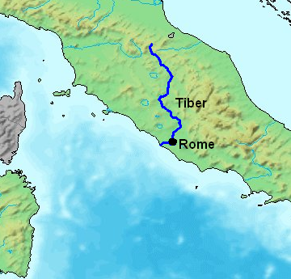
THE ROMAN EMPIRE
The Roman Empire began along the Tiber River and lasted from 31BCE to 476CE
1

Slide 3
MONOPHONIC MUSIC SCORE
2
ONLY ONE NOTE PLAYED AT A TIME

Slide 4
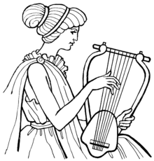
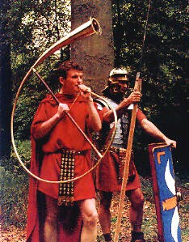
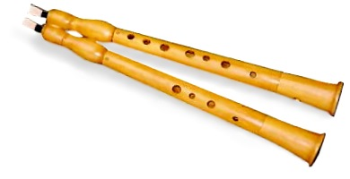
ROMAN SOLDIERS AND INSTRUMENTS
LYRE
CORNU
AULOS
3
AULOS

Slide 5
MAP OF ASIA
4

Slide 6
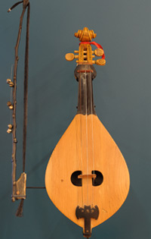
STRINGED INSRUMENTS OF ASIA
5
BIWA
THREE STRING BOWED LUTE

Slide 7
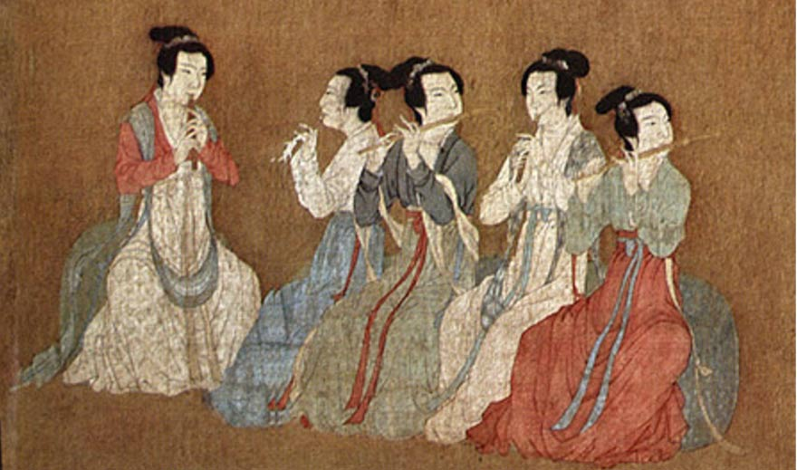
MUSIC OF CHINA
SICHUAN FOLK SONG
CHINESE BRONZE BELLS
BAMBOO ENSEMBLE
BAMBOO FLUTES
6

Slide 8
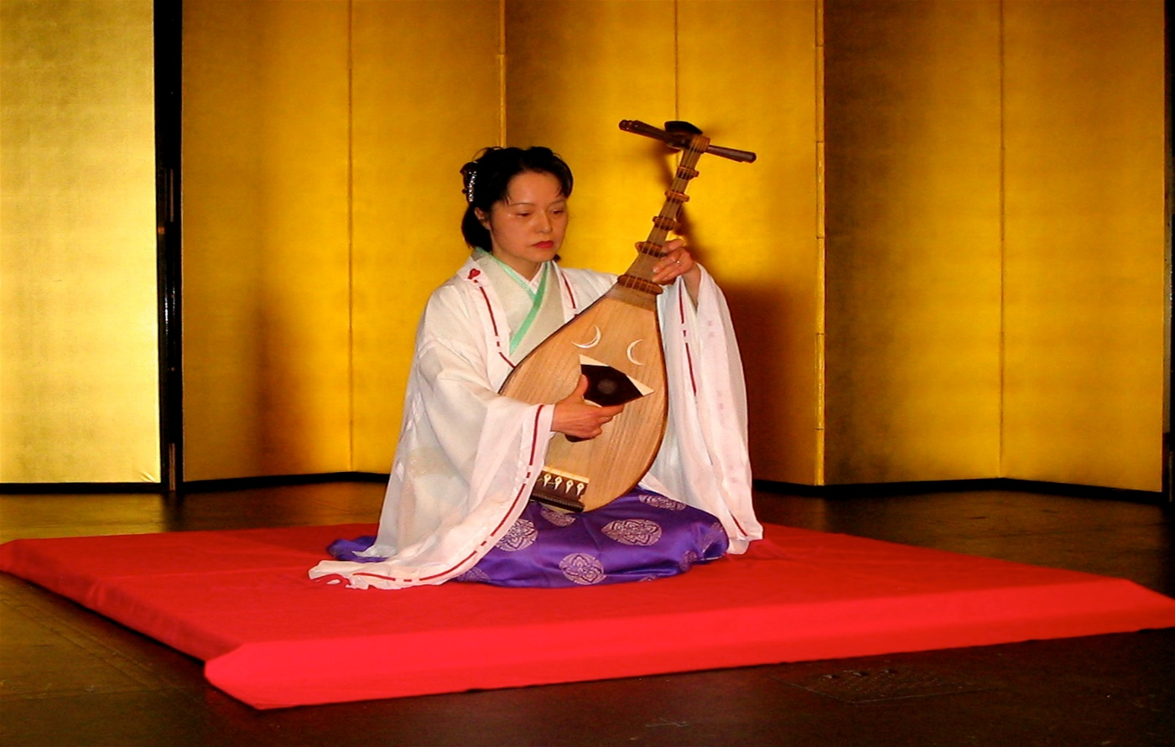
MUSIC OF JAPAN
7
“THE FOLDING OF THE FAN AS A TARGET”
BIWA INSTRUMENT

Slide 9
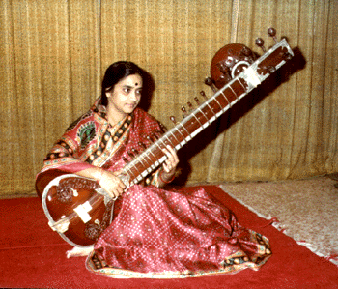
MUSIC OF INDIA
SITAR
A PLUCKED STRING INSTRUMENT
8

Slide 10
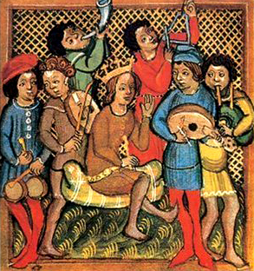
MEDIEVAL EUROPE
MEDIEVAL EUROPE- 950-1300
TRAVELING TROUBADOURS
9

Slide 11
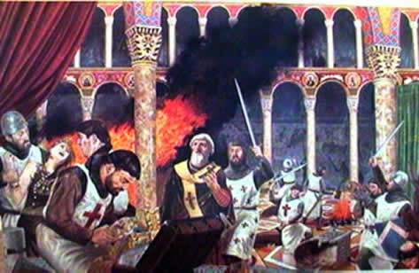
MUSIC OF THE THIRD CRUSADE (1189)
CRUSADERS COMBAT READY
MUSIC OF
LUTE, FLUTE AND SOPRANO
10
PATH OF THE CRUSADES TO JERUSALEM

Slide 12
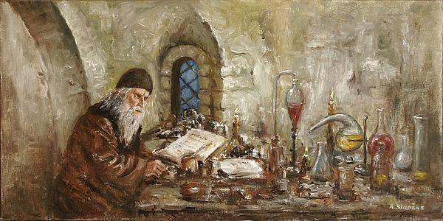
MUSIC OF THE LUTE
LUTE PLAYERS
ALCHEMIST AT WORIK
11

Slide 13
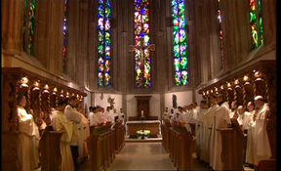
GREGORIAN CHANT
TWO GREGORIAN CHANTS OF MONKS SINGING IN A MONOPHONIC TONE
12

Slide 14
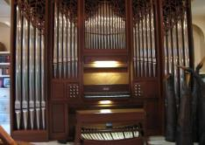
CHURCH ORGAN MUSIC OF THE MIDDLE AGES
MUSIC PLAYED WITH THE HANDS AND THE FEET
VIEW OF MULTI PIPE ORGAN
13

Slide 15
SOUTH AMERICA
ANDES MOUNTAIN RANGE EXTENDS 4,500 MILES FROM
THE SOUTHERN TIP TO PANAMA
14

Slide 16
MUSIC OF THE ANDES
CHARANGO
THE SOUND BOX IS MADE FROM THE SHELL OF AN ARMADILLO
ARMADILLO
15

Slide 17
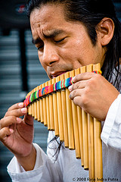
FLUTE MUSIC OF THE ANDES
QUENA FLUTE
PAN FLUTE
16

Slide 18
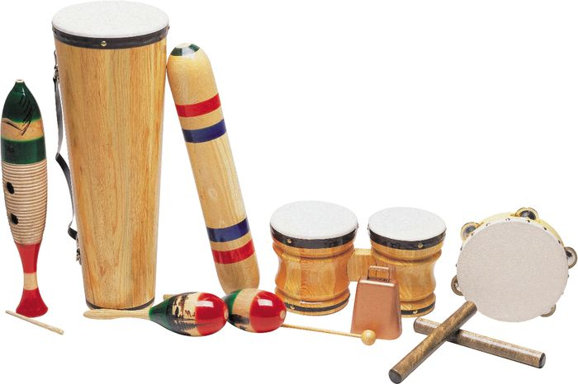
THE SPANISH INFLUENCE THE GUITAR
SOUTH AMERICAN PERCUSSION INSTRUMENTS
INTRODUCED IN THE 15TH & 16TH CENTURIES
17

Slide 19
THE END

