Slide 1
“Ball on the Tic” Ball-Spotting Procedure

Slide 2
“Ball on the Tic”
If you watch NFL & College games, you RARELY see measurements any more. This is because they utilize the “Ball on Tic” procedures.
It is NOT MANDATORY to spot the ball on a Tic on every play, but it is preferable.
By spotting the ball on a Tic after other plays, it allows the Umpire to quickly and easily find the spot at the hash. This is very important due to the new 40”/25” play clock rule.

Slide 3
“Ball on the Tic” The Basics
WING OFFICIALS - If working on a field with marks indicating all of the yard lines (not just lines every five yards), spot the ball with its nose on a yard line (Tic) when the play ends.
UMPIRES – If the wing official does not spot the ball on a tic, YOU SHOULD.
Every time we give a progress spot it’s a “best guess”. Some official’s “best guesses” are better than others. You’ll never find coaches that agree with the spot when it’s close to a 1st down. We know this by the way he’s yelling about it. When the spot is not close to a 1st down, most coaches don’t pay any particular attention.

Slide 4
“Ball on the Tic” Why?
Why Place the Ball on a Tic?
Chains are Easily Set Up.
Penalty Enforcement is Quicker and Easier.
Easier to Determine when the Line-to-Gain has been Reached (Reduces Measurements).
Allows Wing Officials to easily Remember where the Line-to-Gain is.
Allows the Umpire to Spot the Ball Quickly and Easily.
Following Incomplete Passes.
Using Cross Field Mechanics.

Slide 5
“Ball on the Tic” WhEN?
When do we Place the Ball on a Tic?
After A Free Kick.
After a Punt.
After an Interception.
After a Fumble Recovery Resulting in Change of Possession.
On an Obvious First Down.
ALMOST Every Play

Slide 6
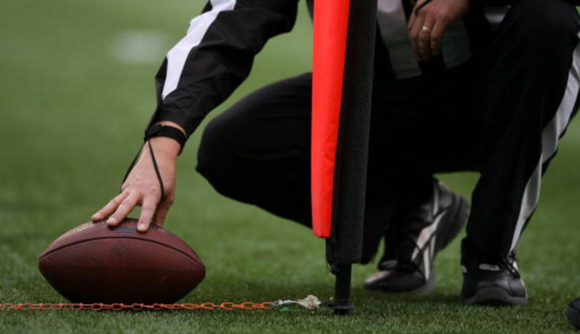
“Ball on the Tic” WhEN NOT TO?
When do We NOT Place the Ball on a Tic?
First Down (Line-to-Gain) is in Question.
Ball is Downed inside the 1 Yard Line.
Sideline play where the player stretches the ball out as he is being tackled or run out of bounds and the coach is standing right there.
Common Sense – DO NOT TEMPT FATE

Slide 7
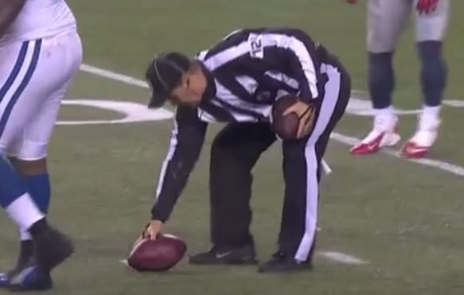
“Ball on the Tic” WING OFFICIALS
Things for Wing Officials to Remember
Verbalizing to the Umpire (“We’re on the 33”) helps to expedite the process when the wing is in towards the numbers.
Stay Wide and do not come in unless needed.
Wings should never be in further than the numbers for a spot unless it’s close to the LTG, in which case the wings should “crash” to the spot and NEVER use a Tic. This of course also applies on the Goal Line.

Slide 8
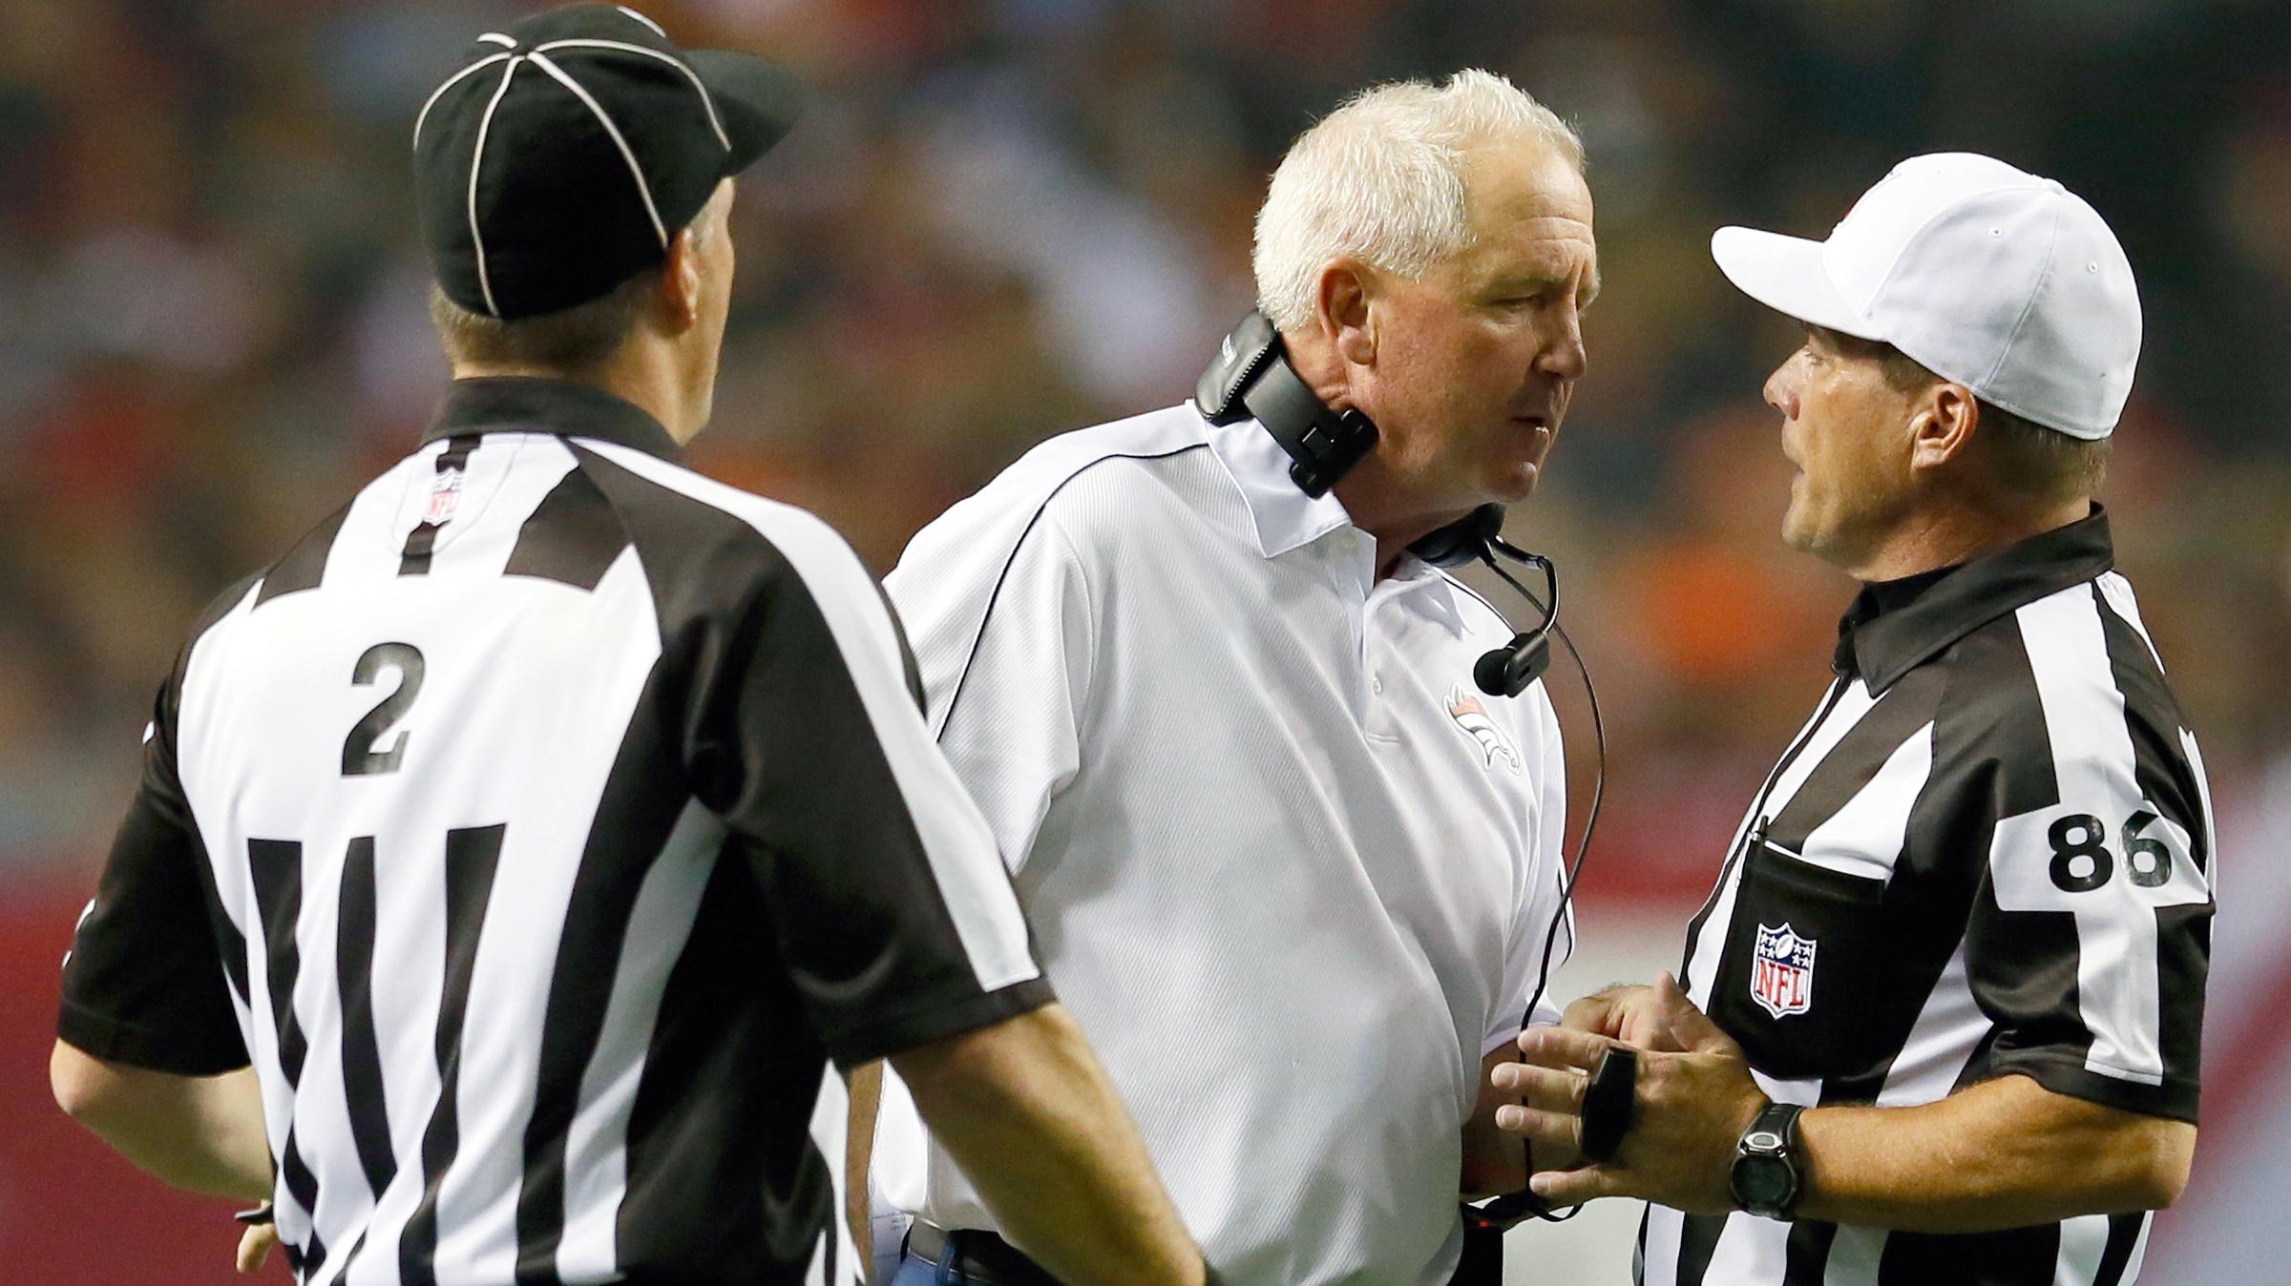
“Ball on the Tic” WRAP-UP
Don’t overthink the Tic thing.
It can help us administer the game in a much quicker, much more efficient way, but it’s not the end of the world if we don’t get the ball on a Tic every play.
Common sense and experience using the procedure will make it easier and more comfortable to use.
If you find yourself in a situation where you think using a Tic could cause a problem, you’re probably right – don’t use it!

Slide 9
“Ball on the Tic”

