Slide 1
SANSKRIT WORDS

Slide 2
A few things we offer God
Phalam
Pushpam
Dhoopam
Deepam
Naivedyam

Slide 3
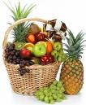
PHALAM
PHALA means FRUIT
(Also, Phala)
General term that refers to all types of fruit.

Slide 4
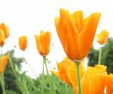
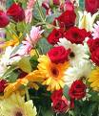
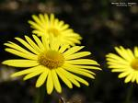
PUSHPAM
PUSHPA means FLOWER
(Also, Pushpa)
General term that refers to all types of flowers

Slide 5
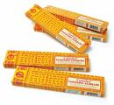
DHOOPAM
DHOOPA means INSENCE (like Agarbathi)
Also, Dhoopa
Generally something that has a calming influence with a sweet smell

Slide 6
DEEPAM
DEEPA means LAMP
(Also, Deepa)
JYOTHI means LIGHT
DIWALI the festival of lights is also called Deepavali

Slide 7
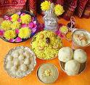
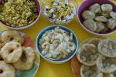
NAIVEDYAM
Cooked food offered before eating , generally sweets or rice/wheat based items
(Also, Naivedya)
After pooja, Naivedya is offered to everyone as Prasadam or Prasada

Slide 8
A few things we offer God
Aasanam
Paadyam/Arghyam
Snanam
Vastram
Gandham
Kumkumam
Haridra

Slide 9
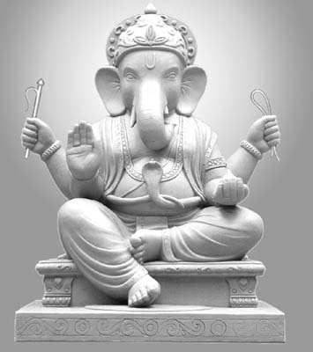
AASANAM
Aasanam means SEAT like a chair, generally an elevated place to sit.
(also, Aasana)
Simhasana means throne:
Simha = Lion; Aasana = Seat
King’s Seat or Throne

Slide 10
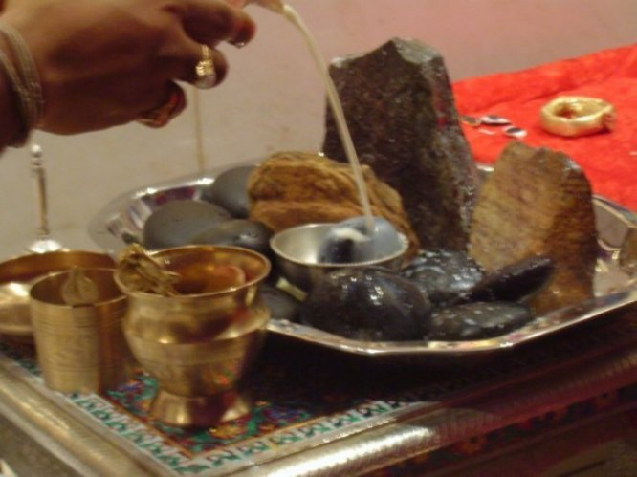
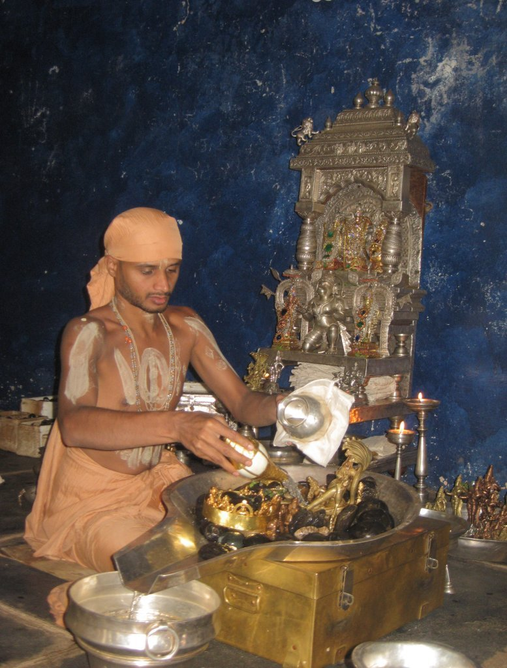
ARGHYAM PAADYAM
ARGHYAM
Water offered to God during pooja to wash hands
(Also, Arghya)
PAADYAM
Water offered to God during pooja to wash feet
(Also, Paadya)

Slide 11
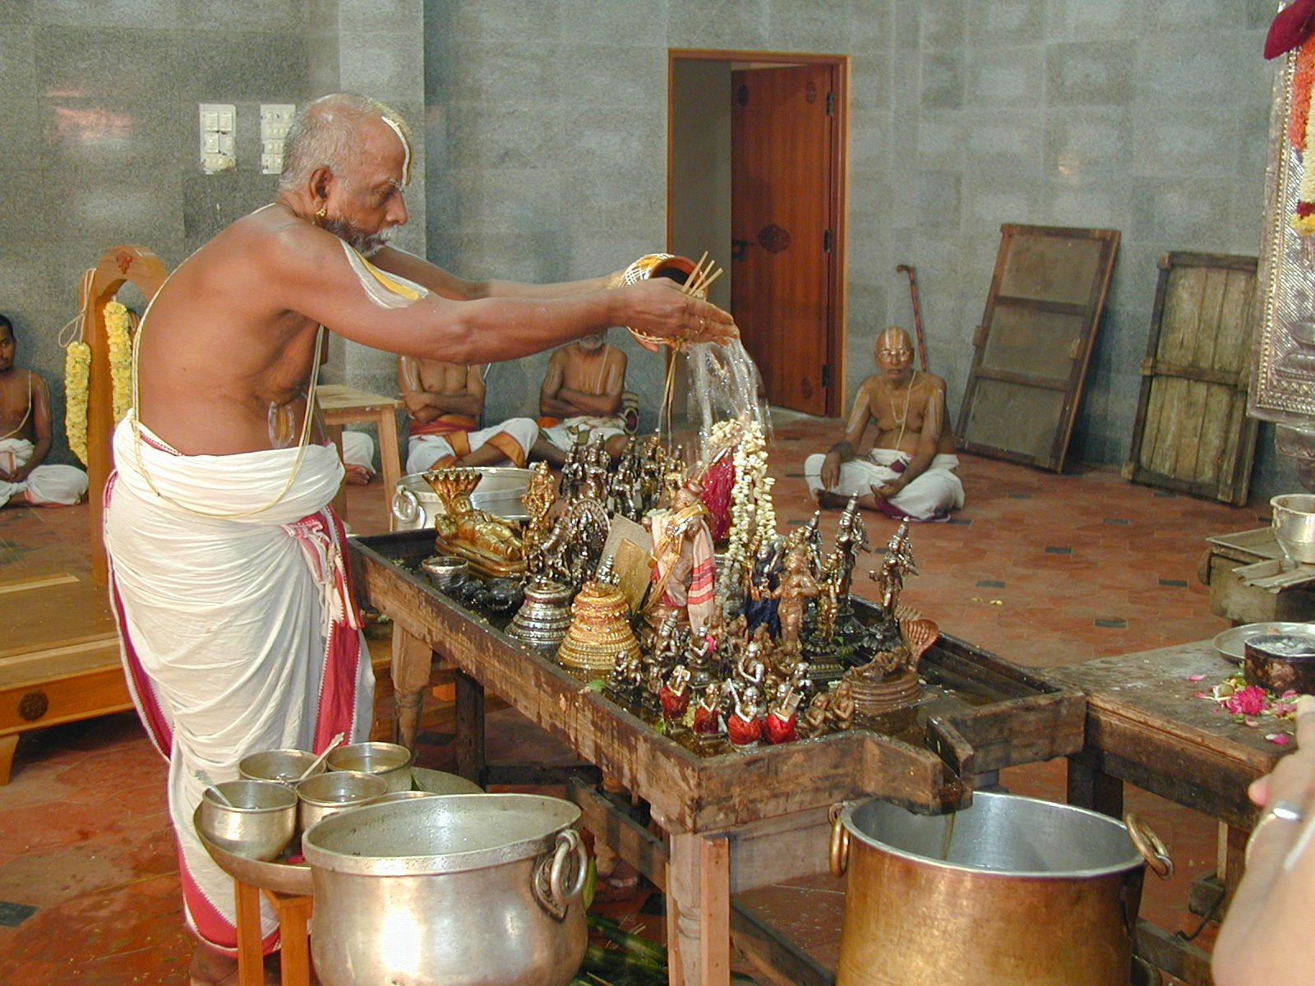
SNANAM
Means BATH
(Also, Snana)
Idols are bathed in water before Pooja.
The water used to bathe idols is sometimes offered as THEERTHA or holy water.

Slide 12
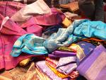
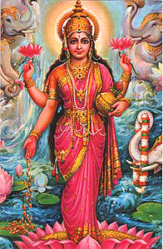
VASTRAM
Means CLOTHING or FABRIC
(Also, Vastra)
Idols are adorned with decorative clothing in temples.
Silk or cotton fabric is generally offered during Poojas.

Slide 13
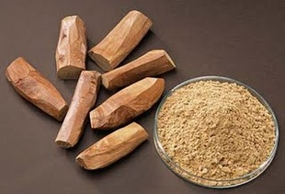
GANDHAM
SANDALWOOD PASTE
(Also, Gandha)
Idols are adorned with decorative clothing in temples.
Silk or cotton fabric is generally offered during Poojas.

Slide 14
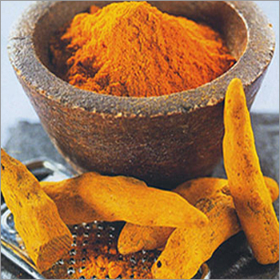
HARIDRA
TURMERIC POWDER - a yellow powder made from dried turmeric roots.
Turmeric is a root like ginger. It is valued for its medicinal properties.
Turmeric powder is used widely in Indian cooking.

Slide 15
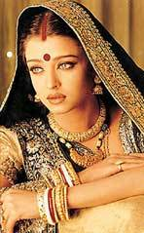
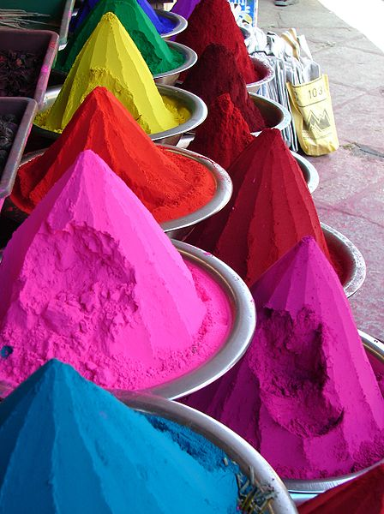
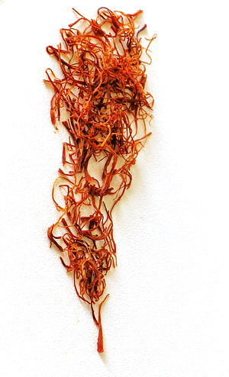
KUMKUMAM
RED COLORED POWDER
(Also, Kumkuma)
Made with a mixture of turmeric and saffron. Traditionally red, but are also made in many colors.
Used in Holi. Also, worn on forehead as bindi or tilak.

Slide 16
A few things we offer God
Akshatha
Pradakshina
Mantra
Aarathi
Geetha
Nrithya

Slide 17
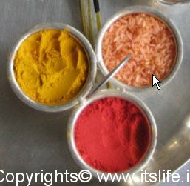
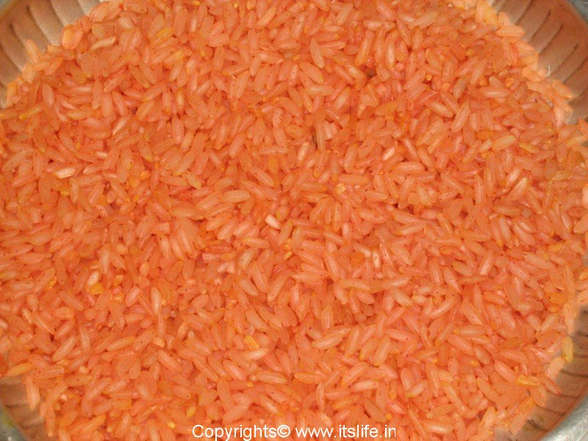
AKSHATHA
A mixture of uncooked rice with kumkum or turmeric
Symbolizes prosperity
Mixture is sprinkled on auspicious occasions as a blessing (eg. on bride and groom at a wedding)

Slide 18
PRADAKSHINA
Means circumambulation or walking around in a circle around the deity
The ritual of pradakshina or moving in circles around the deity recognizes God as the focal point in our lives.
Pradakshinas are always in a clockwise direction around the idol.

Slide 19
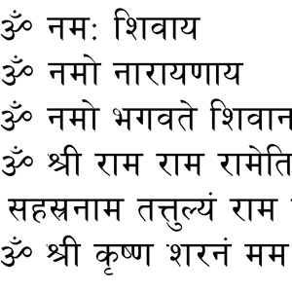
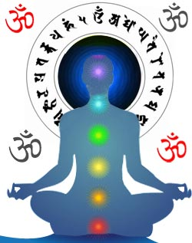
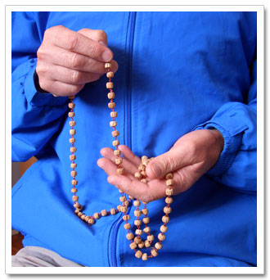
MANTRA
Repeated chanting of verses or shlokas
A sound, syllable, word or group of words capable of creating a spiritual transformation by repeating over and over

Slide 20
AARATHI
Waving light with camphor or with wicks soaked in ghee
Aarthis are normally done while singing a song in praise of the deity

Slide 21
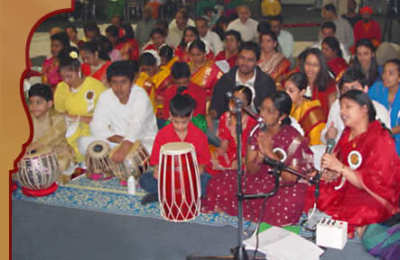
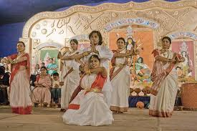
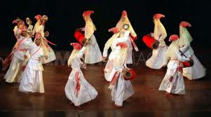
GEETA & NRITYA
Geeta – Song
Nritya – Dance
Songs and dances in praise of the deities are traditionally offered as part of elaborate pooja rituals.

Slide 22
Common Words
Pooja
Archana
Havana
Abhisheka
Shloka
Bhajana

Slide 23
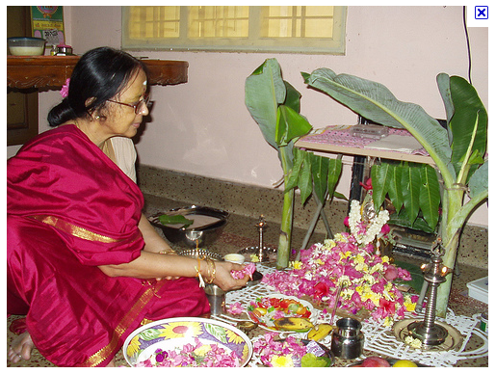
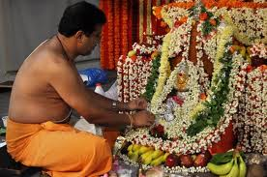
POOJA
Worship – Devotional service offered to God or any other chosen deity
Puja in the temple -Puja usually involves bathing and dressing the deity and offering various auspicious items, such as water, perfume, and flowers. It often culminates in the offering of food, and is immediately followed by the arti ceremony. Puja generally includes a minimum of 16 devotional acts.
Puja at home is usually a scaled-down version of the grand temple services. It may be offered daily or just once a week, whereas scheduled temple worship must continue daily from early morning to late evening.
The person that professionally performs poojas is called pujari

Slide 24
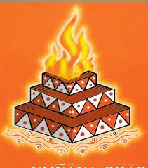
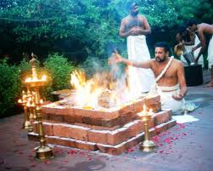
HAVANA (HOMA)
Offering prayers in the presence of fire
This devotional activity or ritual involves offering prayers with other symbolic offerings to Agni or fire. Havanas are performed amidst chanting of mantras for a deity.

Slide 25
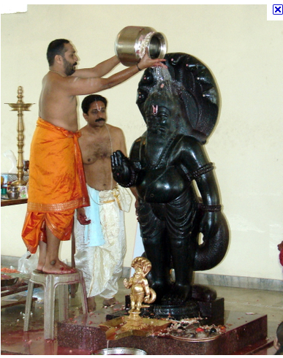
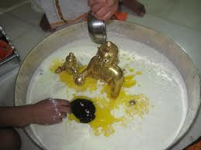
ABHISHEKAM
Sacred bathing by pouring water, milk, honey, yoghurt, ghee, rosewater, etc on the idol of the deity
This devotional activity or ritual is performed amidst chanting of mantras for the deity
Liquids used for the abhisheka are collected and offered as teertha after the abhisheka

Slide 26
SHLOKA
Verse – generally two-lines (couplet) in Sanskrit poetry
Stotras used to perform poojas are a collection of shlokas in praise of chosen Gods or deities.
Ramayana and Mahabharatha are both written in shlokas

Slide 27
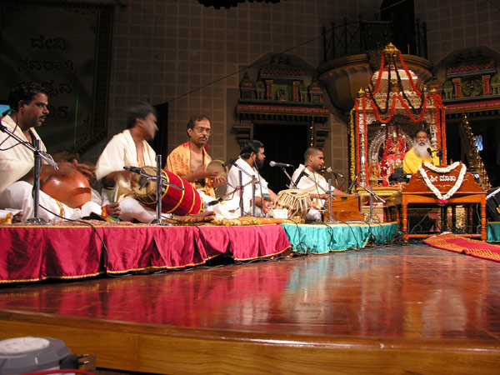
BHAJANA
Singing in groups
Congregational worship in the form of group singing with symbols & percussion instruments to create a lively upbeat experience

Slide 28
Commonly Occurring Words in Poojas
Swaaha
Namana/Namaskara
Prarthana
Arpana/Samarpana/Samarpayaami
Karomi/Karishyaami
Mangalam/Shubham

Slide 29
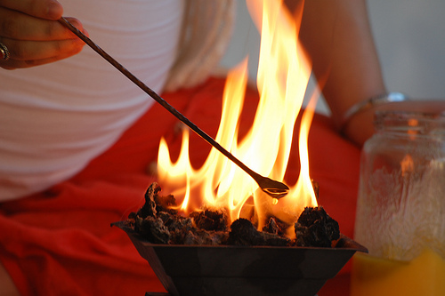
SWAAHA
Swaaha – approximately translates to “hail”; it is an interjection in mantras commonly chanted during havanas (or homas) when ritual offerings are made to the fire
Swaaha is also said to be the
wife of Agni, the God of Fire

Slide 30
NAMANA NAMASTE
Namana – Salutations
Bowing down or surrendering ones ego to God.
Namaste: is the common Indian greeting (gesture with folded hands and bowed down head) which means “I bow to the God within you”.

Slide 31
PRARTHANA
Simply means - Prayer
Prarthana is often used to refer to a collection of shlokas recited to a certain deity
Eg: Ganesha Prarthana, Maha Vishnu Prarthana

Slide 32
ARPANA/SAMARPANA
Arpana | To offer
Samarpana | To offer completely (A wholesome offering)
Samarpayaami | I offer

Slide 33
KAROMI KARISHYAMI
Karomi | I will do; I will perform
Karishyami | I am doing

Slide 34
Spiritual Words
Shanthi
Dhyana
Jnana
Aathma
Bhakthi
Mukthi/Moksha
Dharma and Karma

Slide 35
AATHMAN
Also - Aathma
SOUL (an inner consciousness)
Philosophical term in Hinduism to identify the soul whether in global sense (world’s soul) or in individual sense (of a persons own soul).

Slide 36
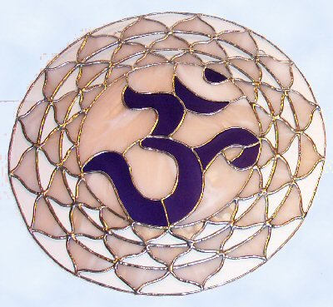
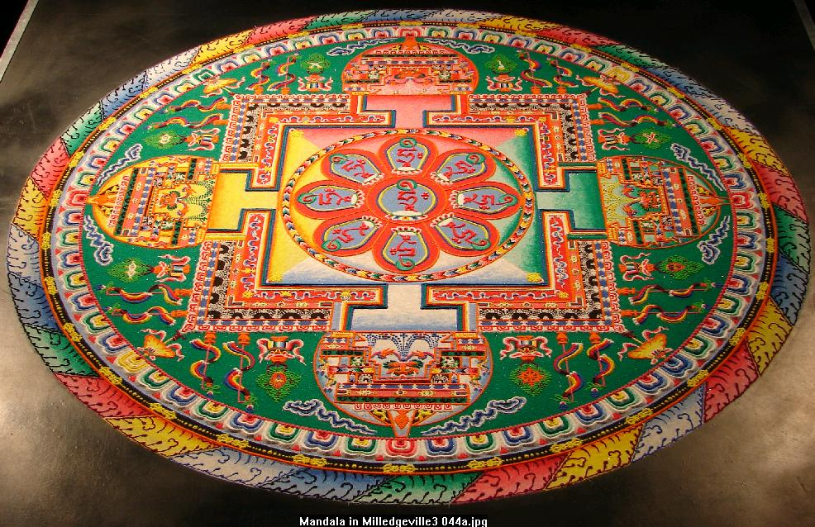
SHANTHI
Peace, rest, calmness, tranquility, bliss
Om Shanthi Shanthi Shanthi Hi – the three shanthis chanted at the end of mantras is a prayer for peace in the world around us.

Slide 37
DHYANA
Meditation
Meditation often involves invoking and cultivating a feeling or internal state of contemplation.
Dhyana mantras are chanted to enter a deep state of meditation
Dhyani – A person in meditation

Slide 38
JNANA
In general - Knowledge or Wisdom or Intellect
Particularly refers to a divine knowledge that relates the individual to the universe as a whole
JNANI– A person with the divine knowledge

Slide 39
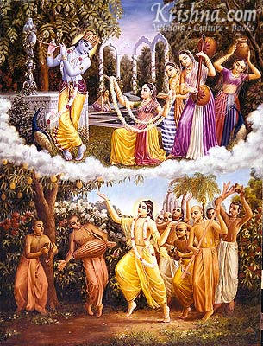
BHAKTI
Devotion
Bhakti or devotion is expressed is commonly through prayers, songs, dance, and serving people around us
Bhakta - Devotee

Slide 40
DHARMA
Righteousness or Duty
There is no proper equivalent word in English for Dharma. Although, generally defined as ‘righteousness’ or ‘duty’, Dharma includes all external deeds as well as thoughts that tend to elevate the character of man.
Adharma: Antonym

Slide 41
KARMA
Action or Deed
There is no proper equivalent word in English for Karma.
Although, it means action or deed, Karma is sometimes used in reference to a "moral law of cause and effect." The moral law of Karma maintains that good deeds will be returned with good; evil deeds with evil

Slide 42
MUKTI/MOKSHA
Mukti or Moksha literally means ‘to release’ or ‘to let go’ or Liberation
Reincarnation is believed to occur when the soul or spirit, after the death of the body comes back to life in a newborn body. Hinduism, as well as other Indian religions such as Jainism, Buddhism and Sikhism believe in reincarnation. Hinduism believes that the universal cycle of death and rebirth, governed by Karma.
Moksha/Mukti means liberation from the cycle of births and deaths. (Also, Nirvana or Salvation)

Slide 43
Common Words
Maathru, Pithru, Bhrathru
Bandhu
Guru
Deva/Devi
Ahimsa
Sathya
Swasti/Mangalam/Shubham/Kalyanam

Slide 44
Common Words
Maathru | Mother | Latin: Mater
Pithru | Father | Latin: Pater
Bhrathru | Brother | Latin : Frater
Bandhu | Binding or Relation Term commonly used to refer to one’s relatives or well-wishers

Slide 45
Common Words
Guru | One who is regarded as having great knowledge, wisdom and authority in a certain area; and uses it to guide others. Although the word guru is used to describe a spiritual teacher/guide, in contemporary India it is widely used to describe any “teacher”
Deva Devi | A God or Deity - Male Can be loosely interpreted as a benevolent supernatural being (Devas are also called Suras, and are often warring with their equally powerful destructive counterparts, the Asuras) A God or Deity - Female

Slide 46
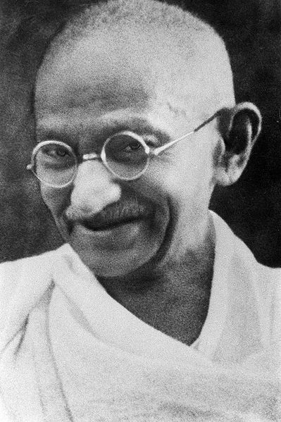
AHIMSA
Ahimsa literally means to do no harm or to avoid violence (to include physical and verbal) The practice of Ahimsa requires kindness towards all living beings including animals.
This principle of non-violence was popularized by Mahatma Gandhi in India’s fight for independence against the British.
Jainism and Buddhism preach Ahimsa
Antonym: Himsa – to do harm (violence)

Slide 47
SATHYA
Sathya means Truthfulness
Sathyameva Jayathe – Truth Alone Triumphs
is the national motto of India
and is inscribed on the national emblem.
Antonym: Asathya - Untruth

Slide 48
SWASTI
Auspiciousness or a state of wellbeing
Su – “good, well” Asti – “to be”
Su + Asti = Swasti means wellbeing
Swastika is used as symbol of well-being by Hindus. Its use traces back to at least 3,000 years. It was also used as a good luck charm in antique ornaments found in Greece, Rome and certain other parts of Europe.
The Swastika was adopted as the emblem of the Nazis
in Germany, and since the 1930s has been associated with
Hitler’s Anti-Semetism. Today, the Nazi Swastika is a taboo
in the western culture and its use is banned in Germany.

Slide 49
MANGALAM SHUBHAM KALYANAM
Auspiciousness or a sense of wellbeing
Mangalam/Shubham/Kalyanam are often used in prayers
Eg. Sarvesham Mangalam Bhavatu means may the sense of well being pervade everything around us.

