Slide 1

MCCPTA – Presidents Training Session #1
Montgomery Blair HS
Saturday, 9/10/16
10:10 -11:10 am
Rm 141

Slide 2

Agenda Topics
The Handover – 4 min
(From previous admin to current admin: What’s your vision?)
Creating & building your team – 4 min
(Mantras, motivation and team mind-set)
Setting the tone of your team – 4 min
(Positivity and encouragement goes a long way)
Gaining the voice of your parents, students & team – 4 min
(Surveys, conversation & active listening – What does your school need? How can you respond to the need?)
Building the relationship w/your Principal & his/her Sect’y – 4 min
(Monthly or bi-Monthly meetings, drop by and say “Hi!”, an occasional lunch, attending & touching base at events)
 Know your money – 4 min
(Membership Cost, Staff Appreciation, Funding Student needs & efforts, Fees & Insurance)
Questions? Comments? Concerns? – 5 min

Slide 3


Agenda Topics
Effective Communication – 4 min
(timely releases, debrief of meetings with Principal to your team, random group thank-yous and specific celebrations/shout-outs)
Agenda Releases – 4 min
(create your model for the secretary, release the day before the meeting)
Let Technology work to your advantage – 4 min
(your School’s webpage, Facebook, Twitter, Instagram, Connect Ed calls, Electronic Message Board)
Executive Board Meetings – 4 min
The By-Laws & Roberts Rules of Order– 4 min
(Conducting your meetings & voting by quorom)
Building Community through Cultural Proficiency – 4 min
(You represent & advocate for all kids & families,
regardless of color & culture)
Closure & Wrap Up

Slide 4

PTSA Monthly Meeting
Paint Branch High School – SY 2016 - 2017
Meeting Schedule for the year
Our PTSA is Paint Branch Proud, Partnership Strong
Date | Topic | Process | Owner/Volunteer
August, 2016 | Welcome Back to Another Year Team ☺ Bienvenido (Spa) bienvenue (Fr) 歡迎 (Ch) ようこそ (Ja) 환영 (Kor) chào mừng (Vie) akeyi (Haitian Creole) willkommen (Ger) dobrodošli (Cro) خوشامد گفتن (Per) welkom (Afr) καλωσόρισμα (Gr) kuwakaribisha (Swa)  ki o kaabo (Yor) | Welcome Celebrate | Liz Anthony
Thurs. 8/25 | 9th Grade Picnic | Welcome Appreciate Membership Boost | Janet Wanda Anthony Liz
Fri. 8/26 | Welcome Back Staff Luncheon (Subway) | Welcome Appreciate Membership Boost | Eshigo Dave & Gegi Anthony Liz
 | We must meet to discuss & agree on financial topics for our budget approval PRIOR TO 9/20. Our budget approval occurs on Tues. 9/20
Thur. 9/15 | PBHS Back to School Night | Welcome Membership Boost
Tues. 9/20 | Kick Off Meeting!: Welcome, Membership Boost, Approval of Budget, Meeting of Chairpersons, Survey of Parent Interests | Welcome, Celebrate, Membership Boost Approve Survey

Slide 5
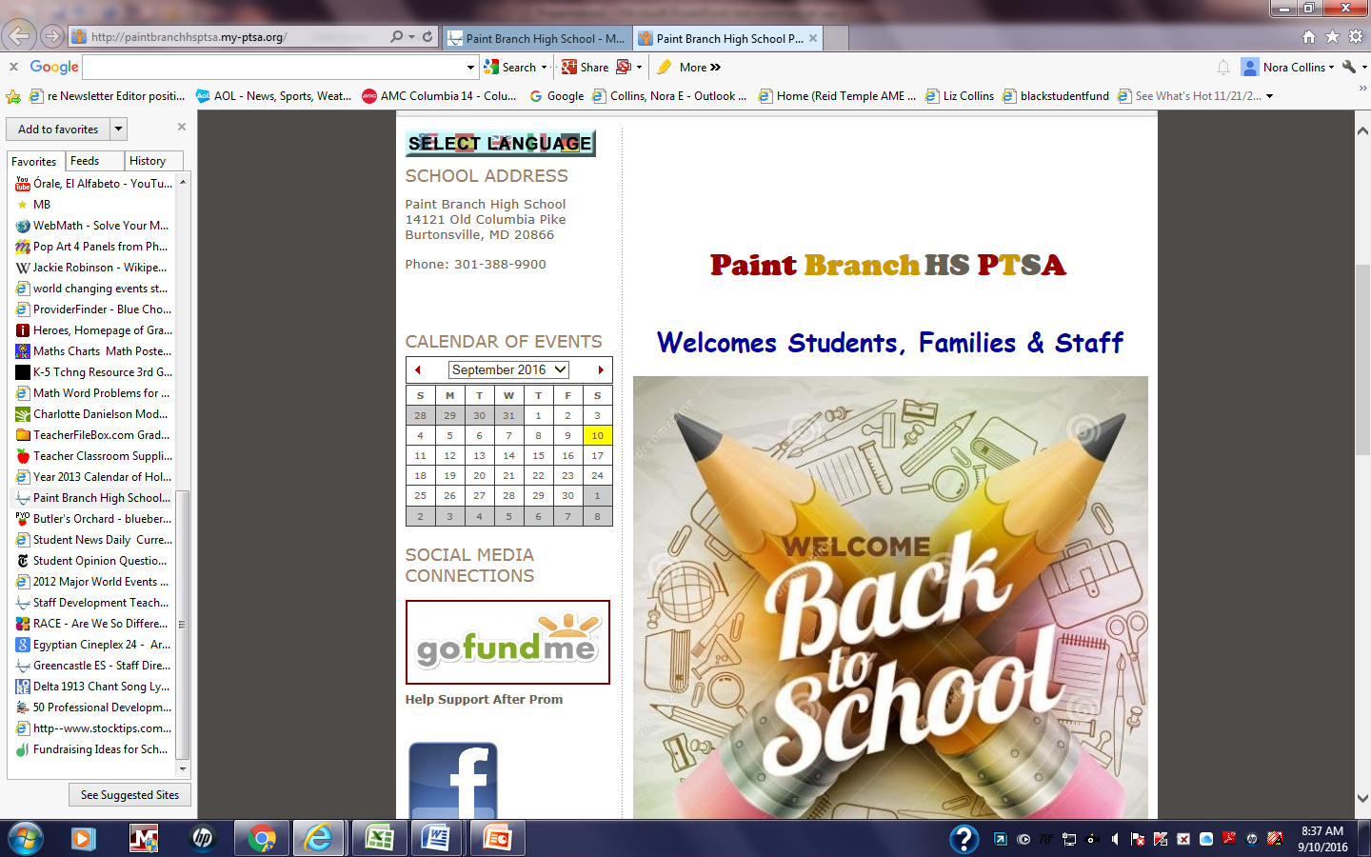
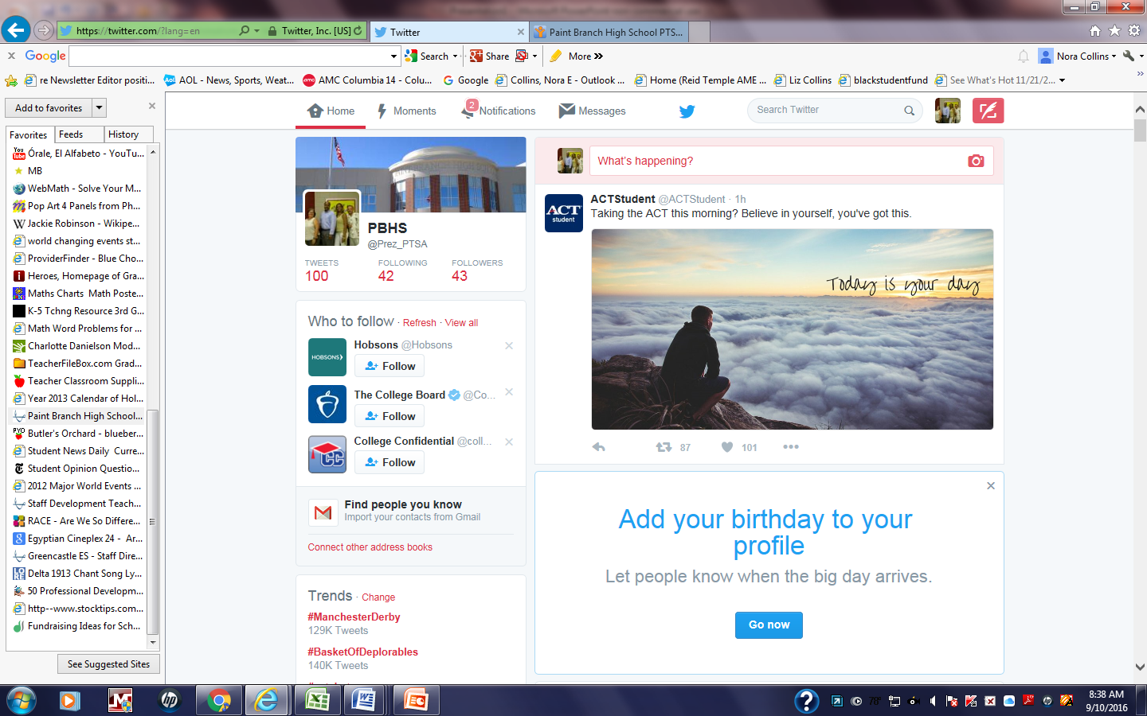

Slide 6
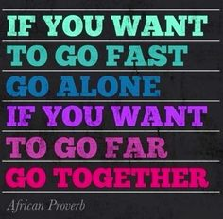
Free Conference Call Sign Up (844) 844-1322 | The Power of the Group
Technology Hootsuite (Social Media Mgmt Dashboard) Thanks to Drew Cohen @ Einstein HS for this contribution!

