Slide 1
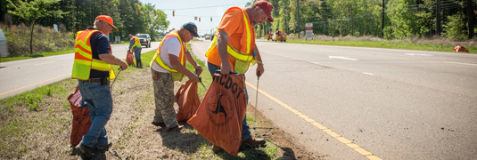
STREET CLEANING TIME Saturday, June 9, 2018 Meet at 9:00 am in the parking lot of Greater Bethel AME Church 5232 The Plaza Sponsored by the Carolina Cardinals Optimist Club You do not have to be a member to help out, but we do need your name for insurance purposes by June 4th. We will be cleaning The Plaza from Eastway Drive to Milton Road Great for a youth who needs community service volunteer hours.
For more information, call 980-202-1949

