Slide 1
THE SOCIAL CONSTRUCTION OF REALITY and SEXUALITY
Human sexuality Robert Wonser

Slide 2
The Social Construction of Reality
Reality is constructed socially.
Reify – to make real
social construction, that is, it is an idea created by humans (i.e. doesn’t exist in the biological world but only in the social world) through social interaction and given a reality through our understanding of it and our collective actions.
Does California exist empirically?

Slide 3
“… a social construct is an idea or notion that appears to be natural and obvious to people who accept it but may or may not represent reality, so it remains largely an invention or artifice of a given society.”
Notes:
encyclopedia.com

Slide 4
Example: “Take, for example, the concept of marriage: what this term includes and doesn't include and what it means to society does not exist ‘out there’ in the world, but only in and through the social institutions that give it meaning within a culture.”
What is the social construction of love?
  Who defines it?
  How has it changed over time?
  How does this construction serve patriarchy and homophobia?
Notes:
wikipedia.org

Slide 5
“Natural vs Unnatural”
“Natural” vs. “Unnatural”
“There is no ‘natural’ human sexuality. This is not to say that our sexual feelings are ‘unnatural’ but that whatever feelings and activities our society interprets as sexual are channeled from birth into socially acceptable forms of expression.” Hubbard
What role does power play in this process?

Slide 6
Despite a popular perception that male-female pairings are the only "natural" way, the animal kingdom is actually full of examples of same-sex couples. Penguins, dolphins, bison, swans, giraffes and chimpanzees are just a few of the many species that sometimes pair up with same-sex partners. Researchers are still mulling over the evolutionary reason, if any, for gay animal sex, since it doesn't produce offspring. Some ideas are that it helps strengthen social bonds or encourages some individuals to focus their resources on nurturing their nieces and nephews, thus boosting their own genes indirectly. Or, it may simply be fun.

Slide 7
Toward a nondeterministic model of sexuality
“The society in which we live channels, guides and limits our imagination in sexual as well as other matters. Why some of us give ourselves permission to love people of our own sex whereas others cannot even imagine doing so is an interesting question…People fall in love with individuals, not with sex. Gender need not be a significant factor in our choice, although for some of us it may be.” (Hubbard, p. 68)

Slide 8
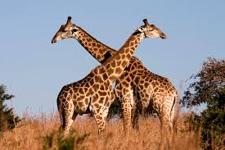
Giraffes!
"Not every sexual act has a reproductive function," said Janet Mann, a biologist at Georgetown University. Male courtships are frequent amongst these long-necked mammals. Often a male will start necking with another before proceeding to mount him.
This affectionate play can take up to an hour. According to one study, one in every 20 male giraffes will be found necking with another male at any instant. In many cases, homosexual activity is said to be more common than heterosexual.8

Slide 9
Human Sexuality
The capacity to have erotic experiences and responses.
What about sexual orientation?
Sexual interest and attraction to other people
What does it mean to say that sexuality is socially constructed?

Slide 10
gender
Surprise! Also a social construction!
Sex refers to an individual’s membership in one of two biologically distinct categories—male or female.
Gender refers to the physical, behavioral, and personality traits that a group considers normal for its male and female members.

Slide 11
sexuality
You guessed it… also a social construction!
Sexual orientation a person's sexual identity in relation to the gender to which they are attracted; the fact of being heterosexual, homosexual, or bisexual.

Slide 12
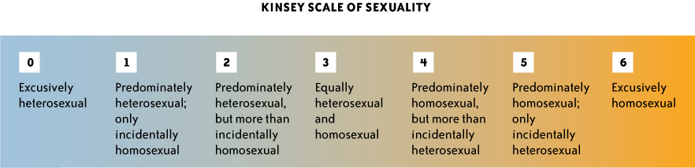
Sexual Orientation
12
Is sexual orientation a continuum rather than a few simple categories?
Those who are asexual may simply reject any sexual identity at all.
Notes:
Alfred Kinsey was suggesting that human sexuality was far more diverse than was commonly assumed. His own studies led him to believe that people were not exclusively heterosexual or homosexual but could fall along a wide spectrum.
12

Slide 13
Our Cultural Legacy
Two Themes
Sex for procreation
  Definition of sex and intercourse used synonymously
Male and female gender roles
What importance do the historical themes of sex for procreation and male/female gender roles have today?
Notes:
Discussion on how we “define” sex and key points in history that were pivotal to this. How clearly do we define male/female gender roles currently? Rigid gender-role conditioning can limit each person’s potential and can harm their sexuality.

Slide 14
Sexual Attitudes
Victorian Era
Women’s role constrained; women as asexual
Emotional & physical distance between husband and wife
Prostitution flourished
Continued polarized view of women as Madonna or whore
Mosher’s research contradicts prevailing view
-Victorian women experienced sexual desire, enjoyed intercourse, and experienced orgasm

Slide 15
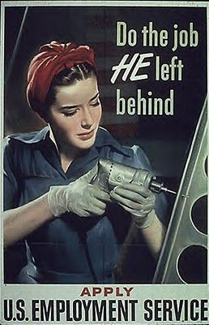
20th Century Sexuality
The beginning of the 20th century
  Suffrage movement
  19th amendment gives women the right to vote
World War II
  Gender roles were expanded & more flexible
  Postwar return to stricter roles
Notes:
“Another WW2 Propaganda poster to have women take up jobs. The use of tools in this poster gives empowerment to females and show that females are just as capable as men but at the same time reinforcing traditional gender roles using the fad fashion trends such as the hair wrap.”

Slide 16
20th Century Sexuality
The 1960s and 1970s
  The “sexual revolution”
  Attitudes begin to change toward homosexuality

Slide 17
The Media and Sexuality
How have mass media reflected and influenced sexual norms?
What elements are unique to sexuality on the Internet compared with other mass media?

Slide 18
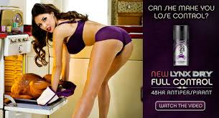
The Media and Sexuality
Television
  News, advice, and educational programs
  Increased access to sexual material
    Percentages of sexual content
  Cable and music videos
  Video games
  Determining of social norms
Advertising
Magazines

Slide 19
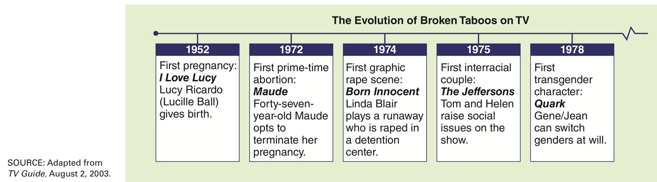
Sexual Taboos and Television
Notes:
Caption: The evolution of broken taboos on TV.

Slide 20
Sexuality
Where the Personal is Political
Impact of social norms
Freedoms and responsibilities today
Controversies facing human sexuality?
How can something as personal as sex be political?

