Slide 1
Blogs and Badges
The Future of Learning

Slide 2
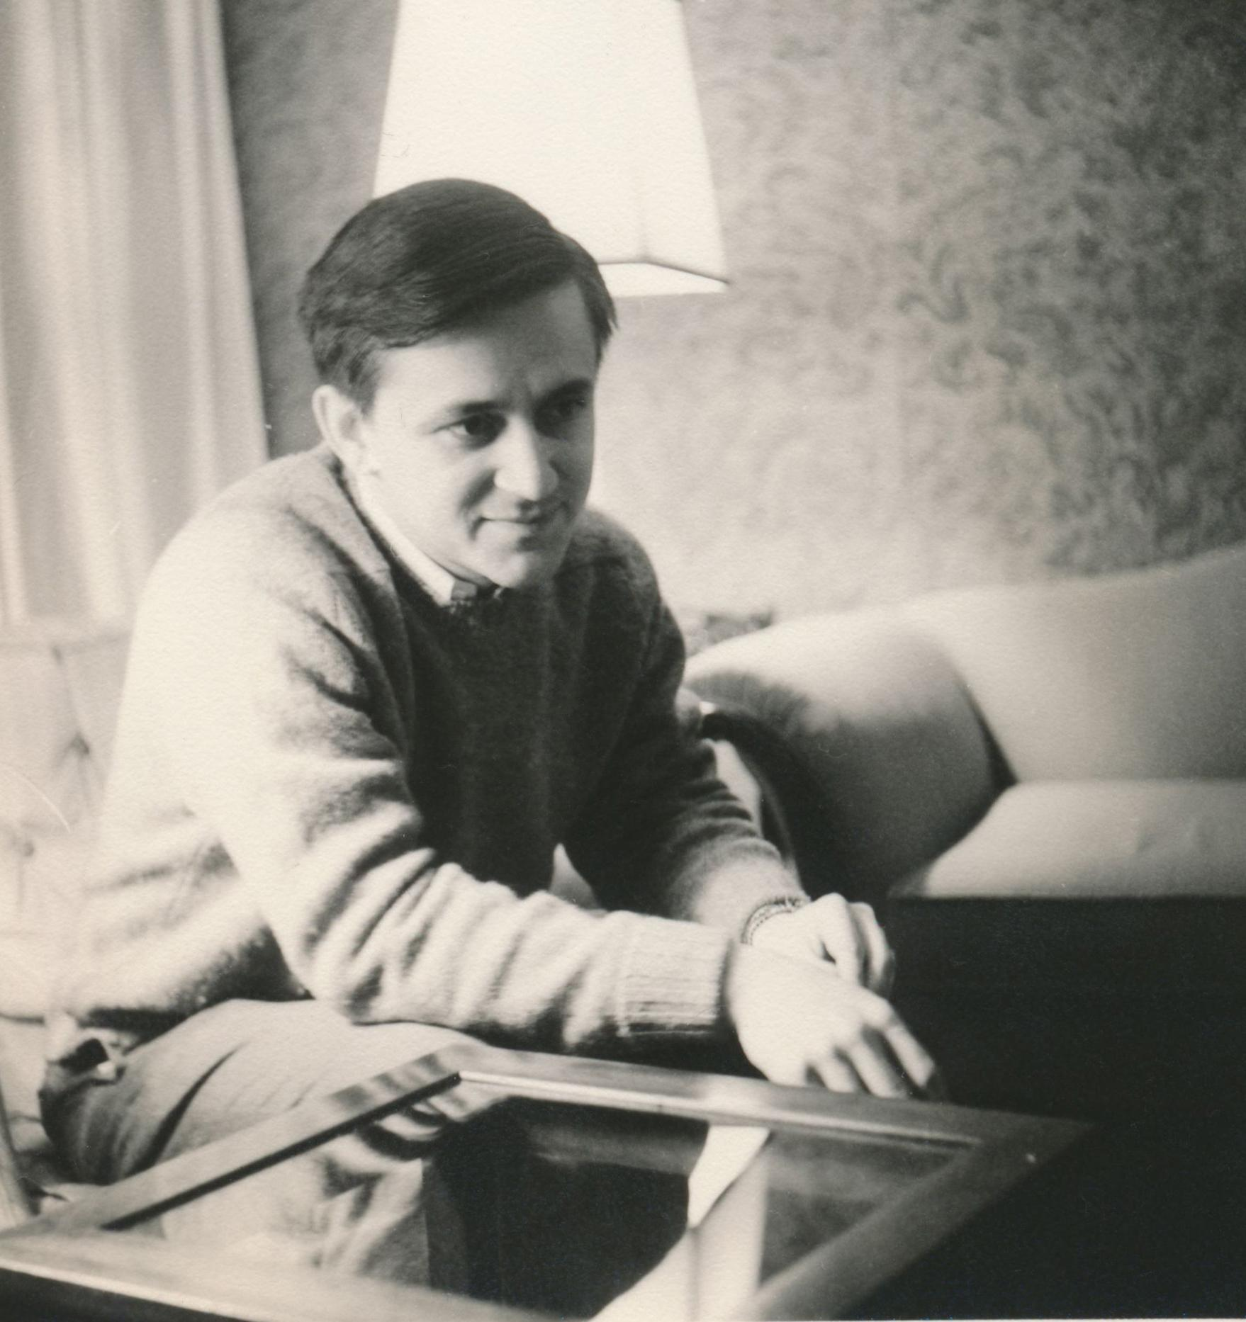
Doug Nadeau 1940 - 2004

Slide 3
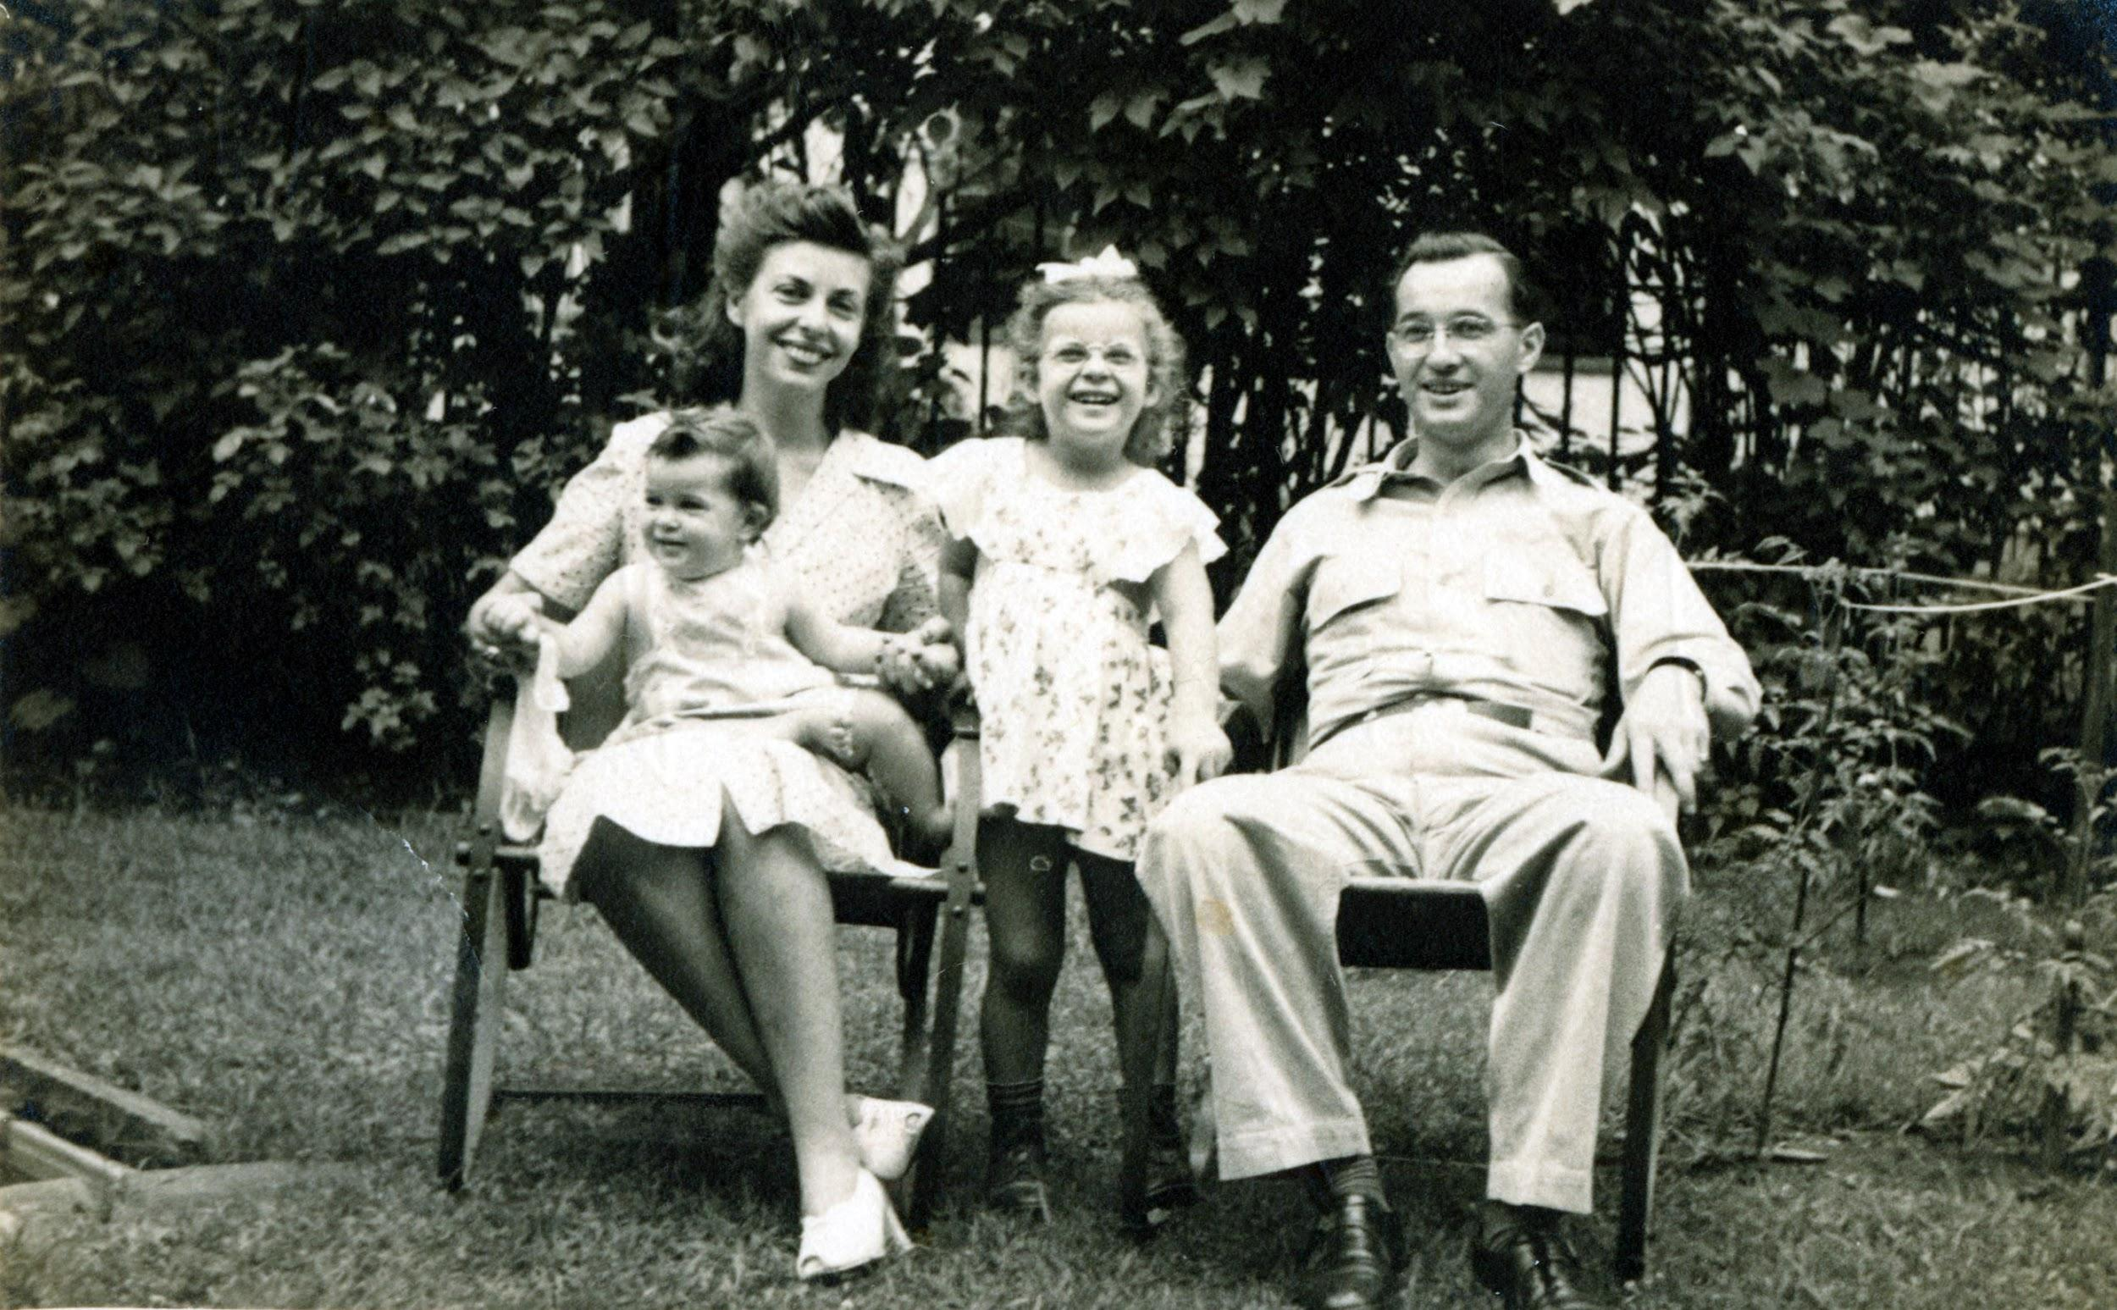
Doris & Harry Lebow with Kids

Slide 4
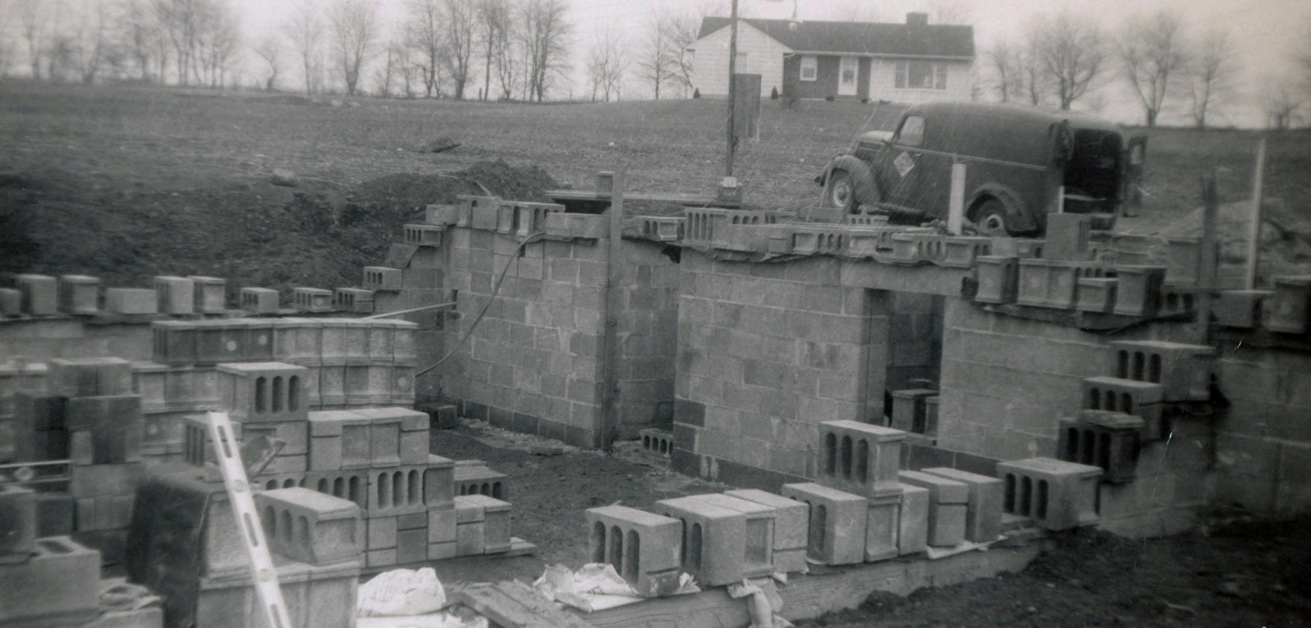
White House, NJ 1957

Slide 5
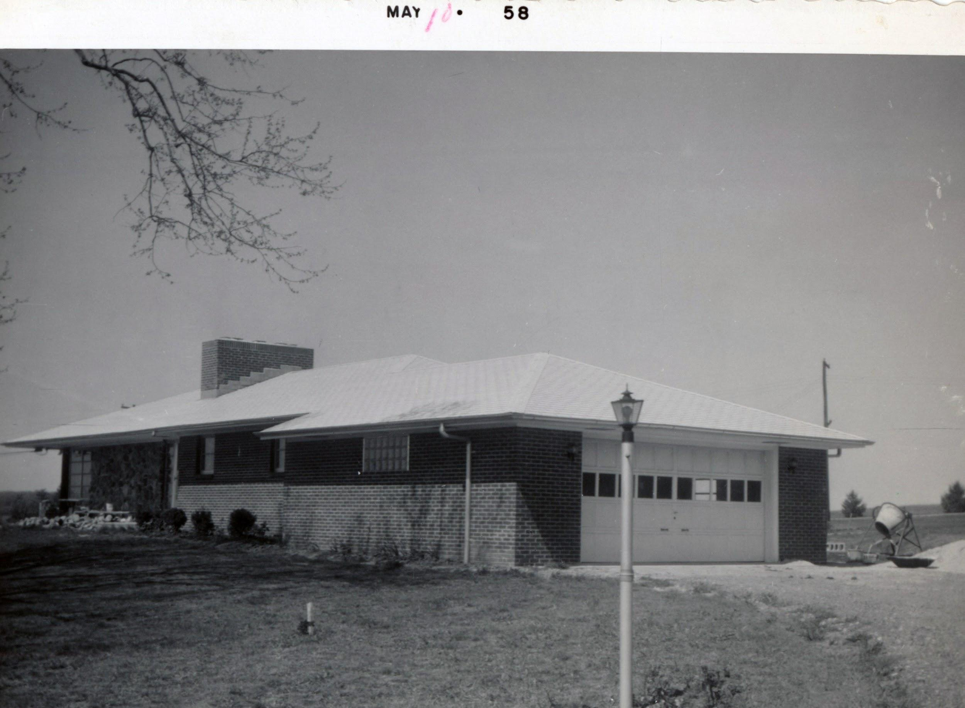

Slide 6
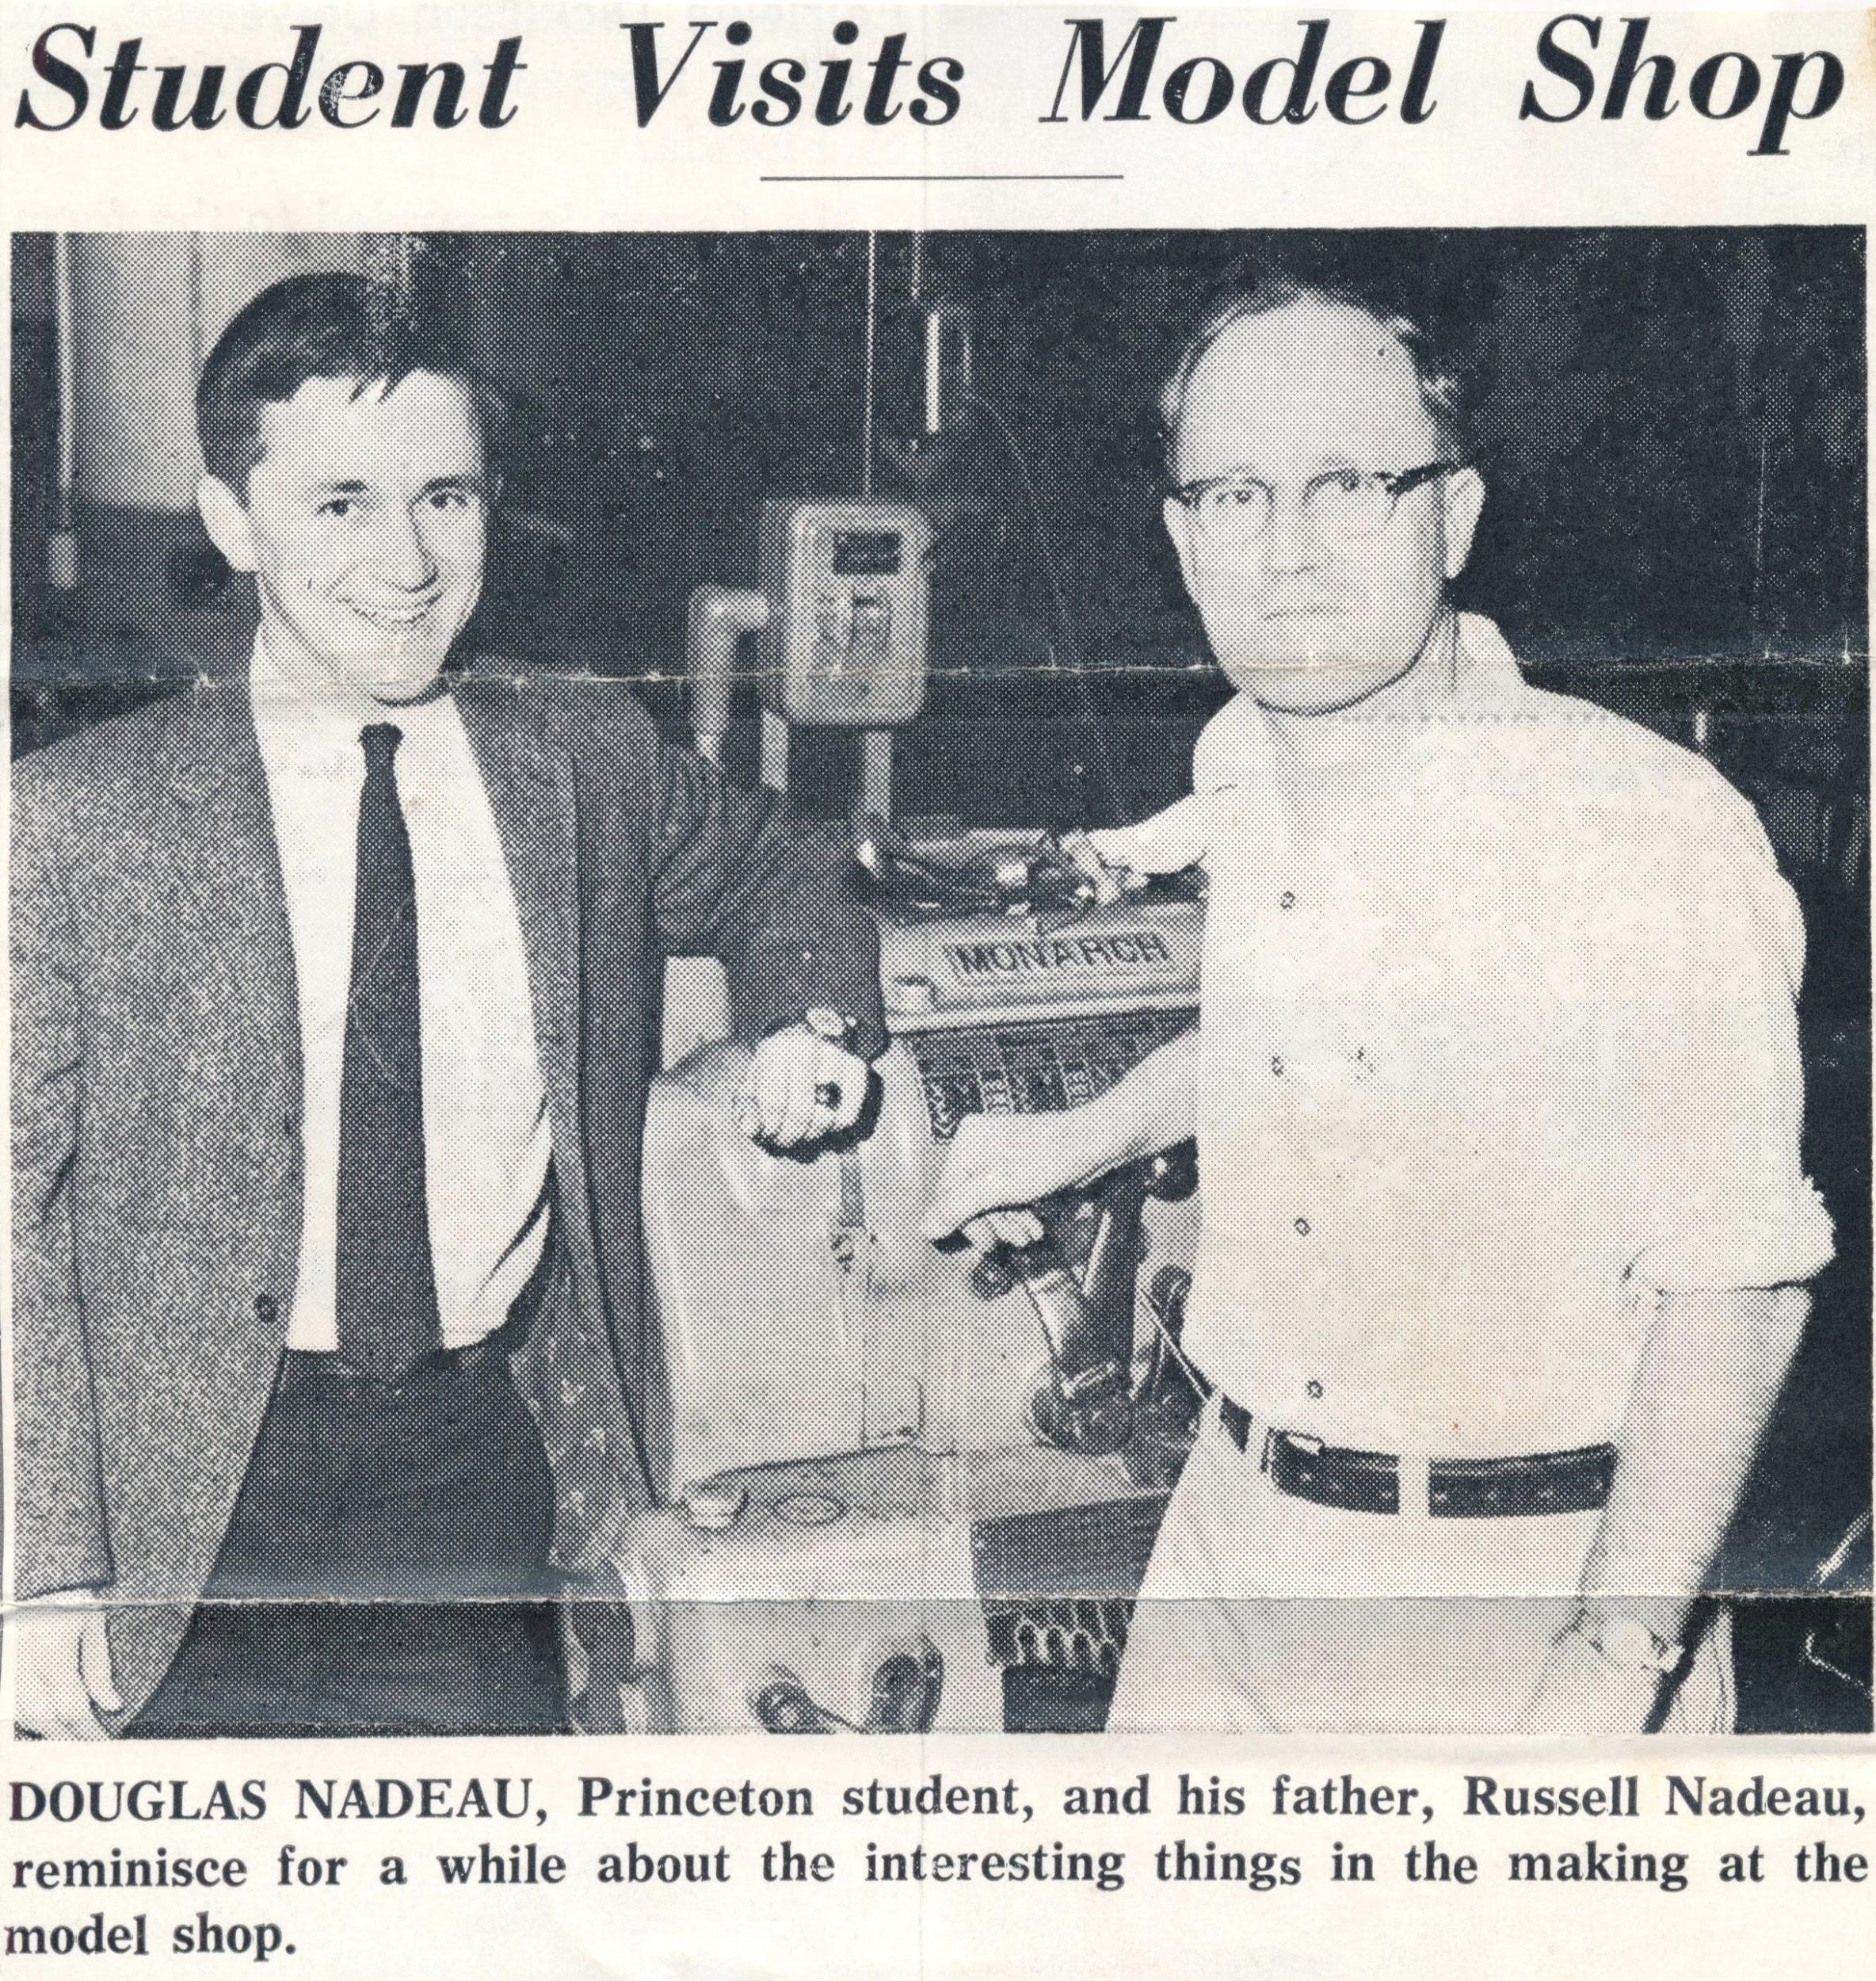

Slide 7
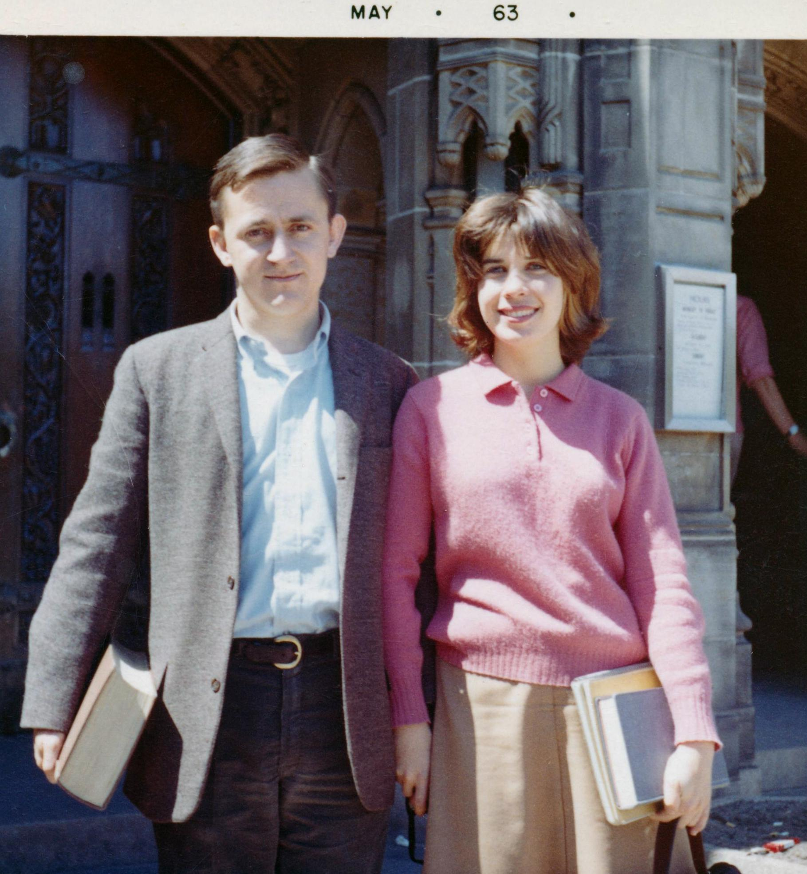

Slide 9
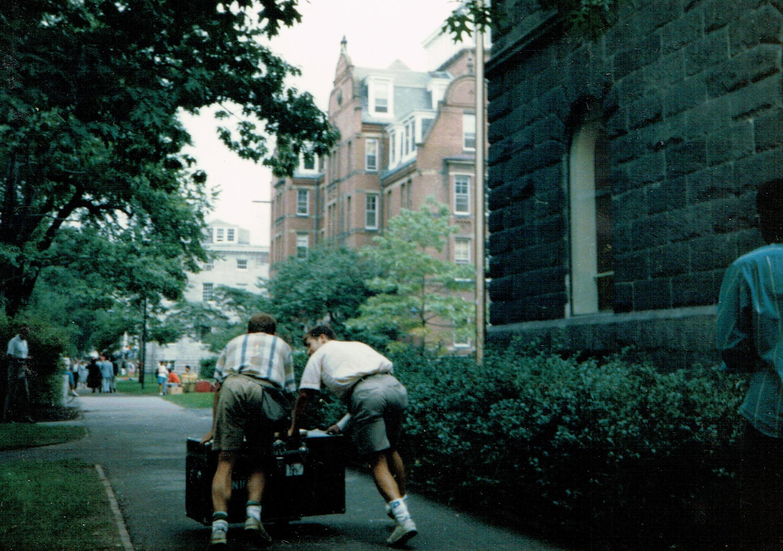

Slide 10
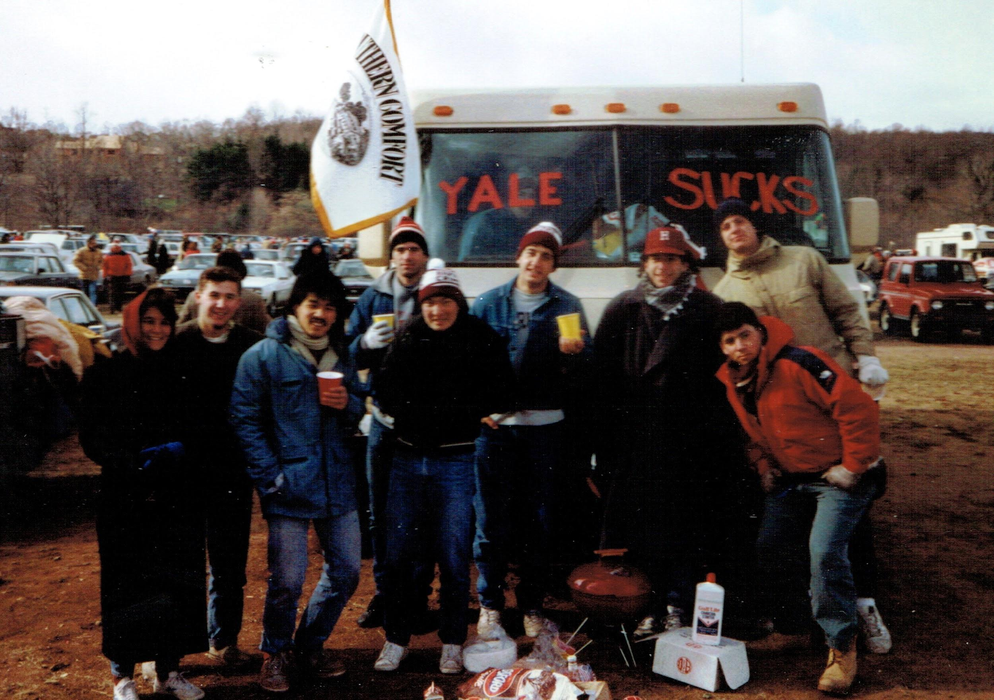

Slide 13
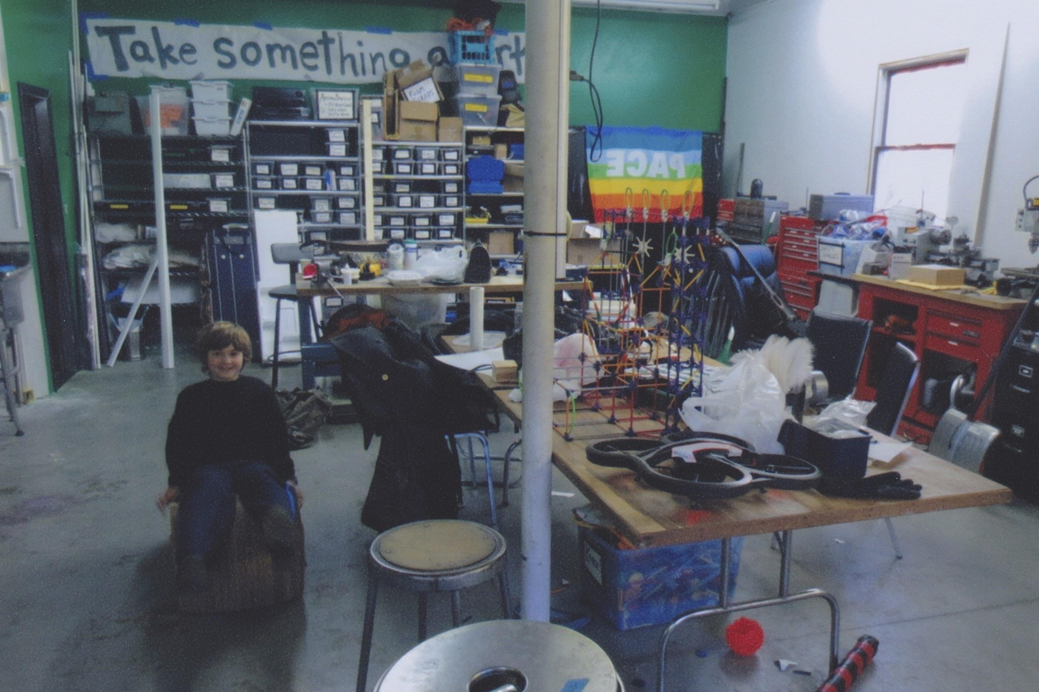

Slide 16
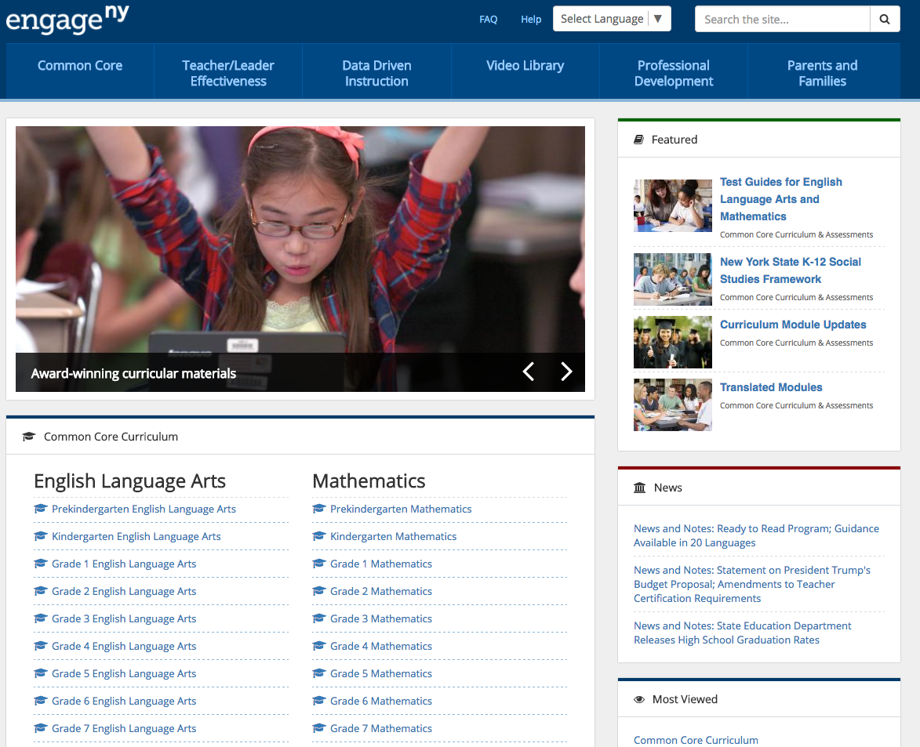

Slide 17
RTW180.com

Slide 18
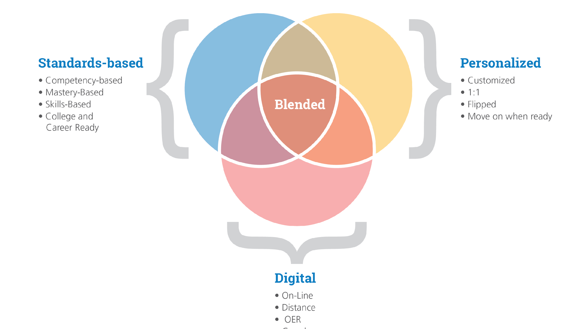
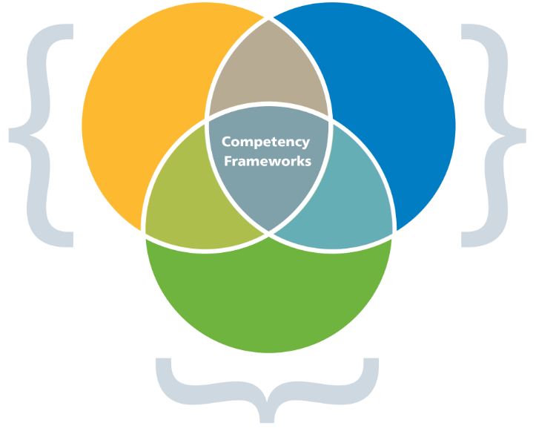
Standards-Aligned
Instruction
Digital
Materials
Personalized,
Competency-Based Learning
Blended Learning - US K12 Education Ecosystem

Slide 19
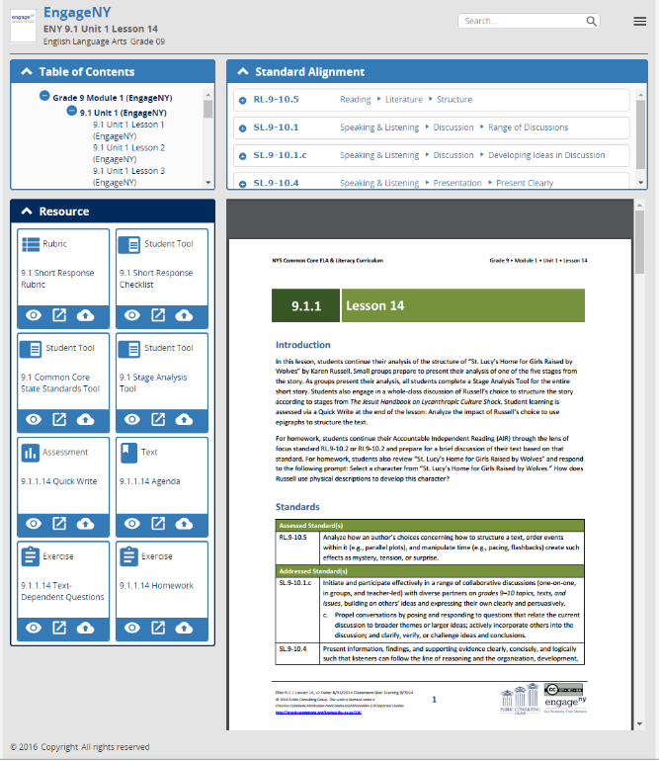
General Info
Package
Table of Contents
Standards Alignment
Actionable Resources
Package
PDF
PCG Open Source Content Curation Tool

Slide 20
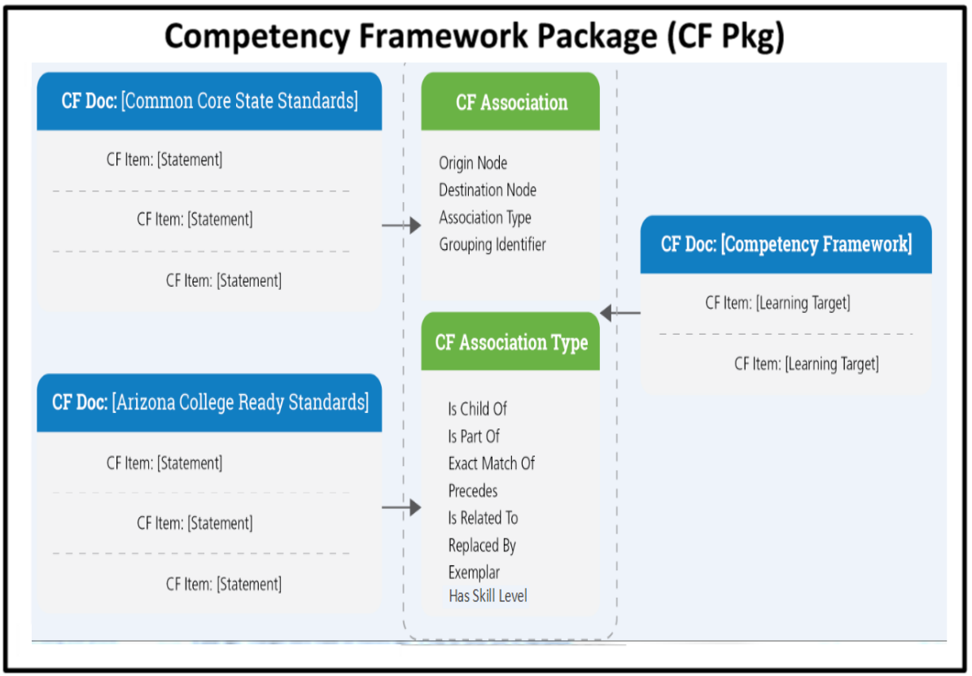
CASE
IMS Global Competency and Academic Standards Exchange (CASE)

Slide 21
CASE
IMS Global Competency and Academic Standards Exchange (CASE)

Slide 22
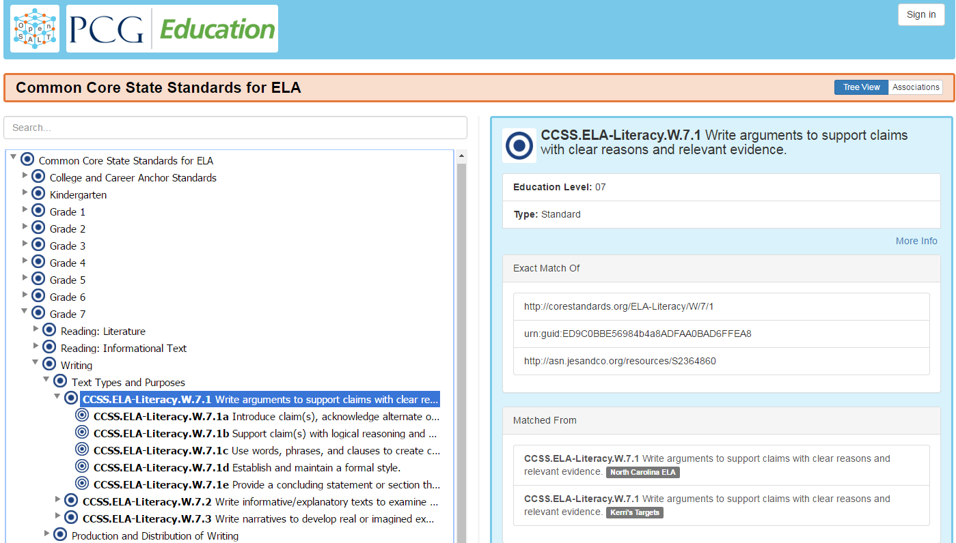
OpenSALT
CASE management tool (fully MIT open source licensed)

Slide 23
General Info
Package
Table of Contents
Standards Alignment
Actionable Resources
Package
PDF
PCG Open Source Content Curation Tool

Slide 24
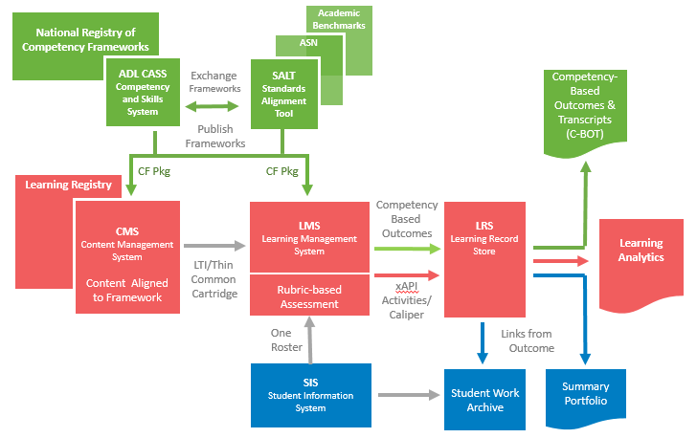
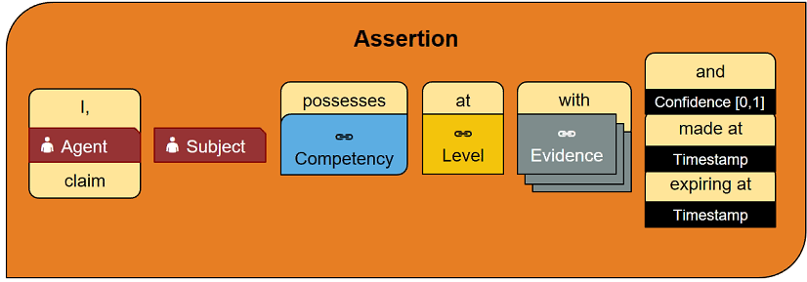
Personalized, Competency-Based Learning

Slide 26
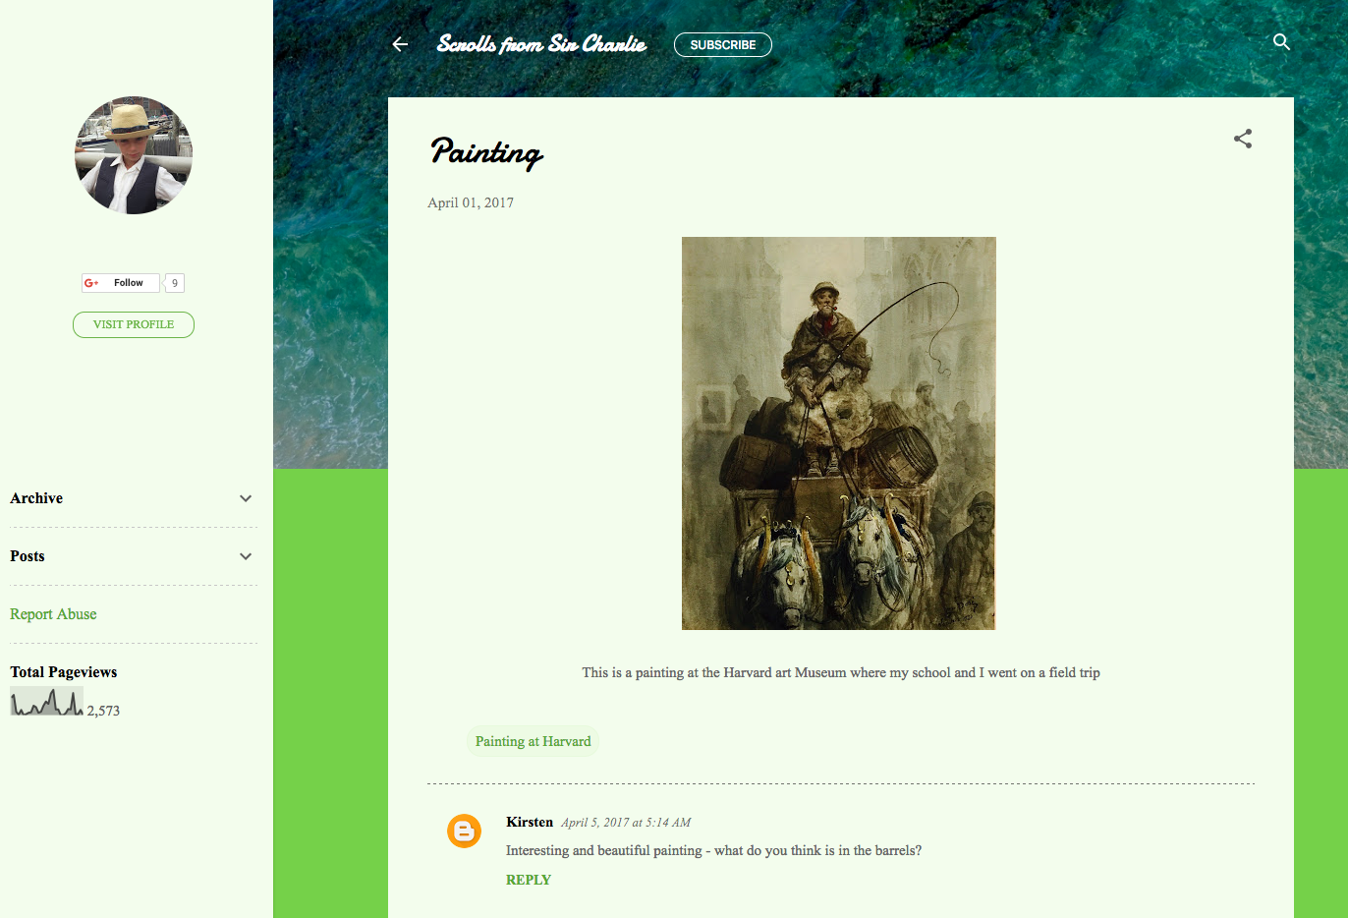

Slide 27
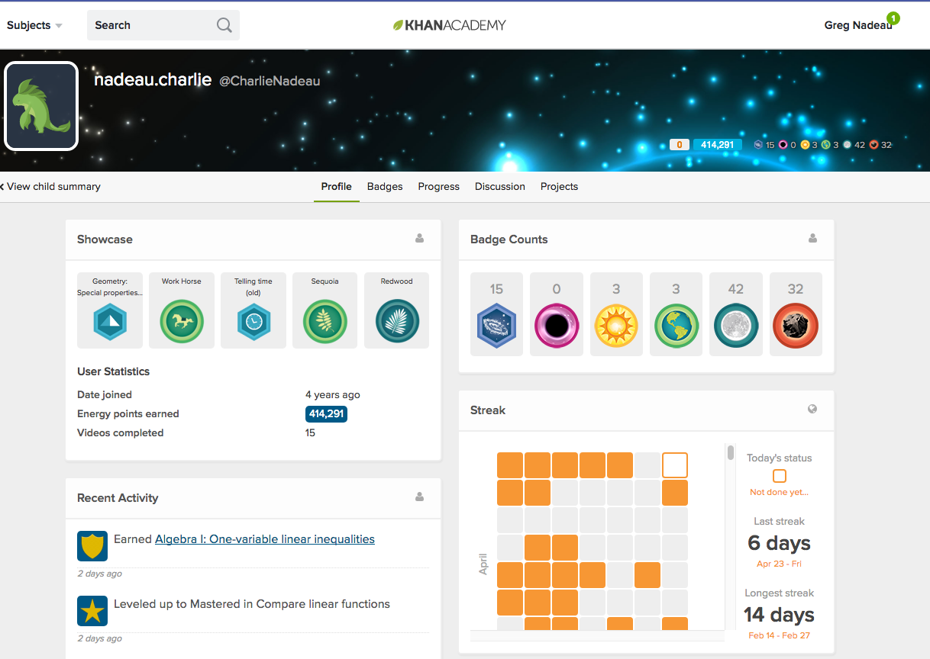

Slide 28
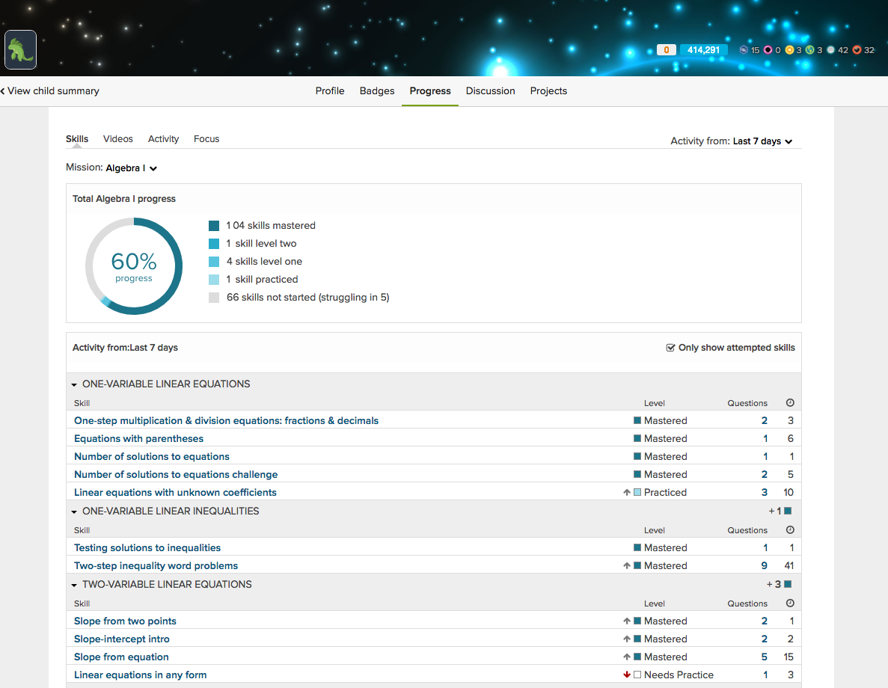

Slide 29
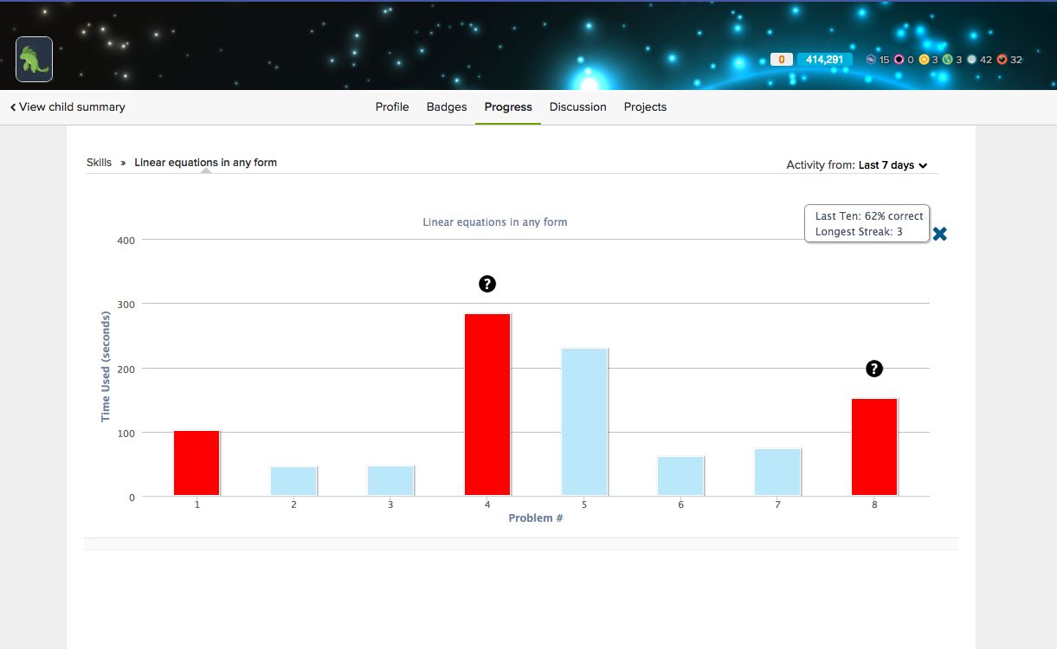

Slide 30
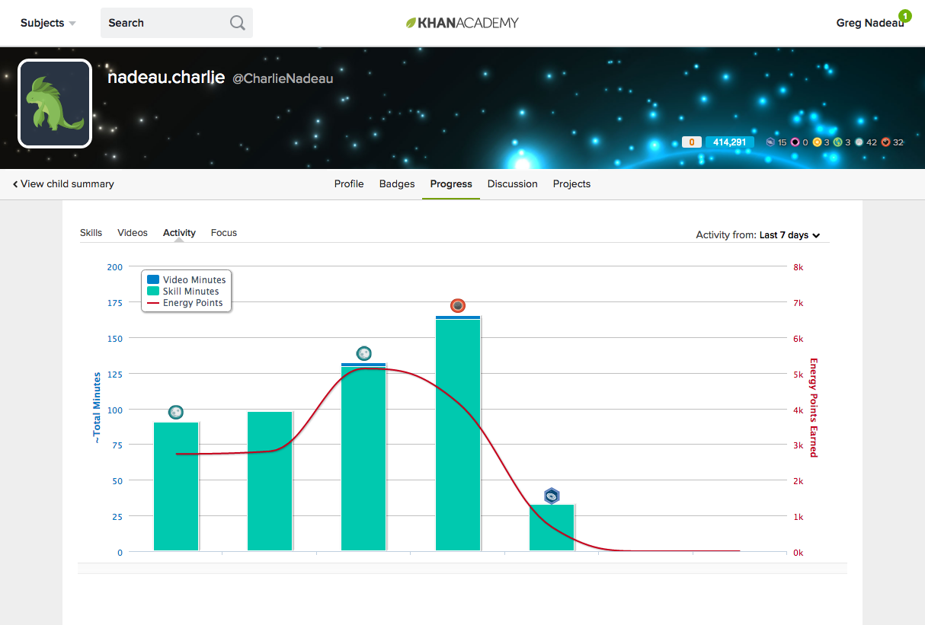

Slide 31
Personalized, Competency-Based Learning
ADL Competency and Skills System (CASS)

Slide 32
The Future of Higher Education
How can we radically expand the number of people who access higher education?
Lower costs
More efficient delivery
How can we make the higher education experience more relevant to the work world?
Project management, programming, AI
Service economy in the age of automation
Do we need to break up the accreditated program, course credit oligarchy to enable a more dynamic, lower cost, learning ecosystem

Slide 33
Resources and Links
Greg Nadeau
Public Consulting Group
gnadeau@pcgus.com
781-370-1017
Family Blogs
Max’s Blog - http://postcardsfromgeeklandia.blogspot.com/
Charlie’s Blog - http://scrollsfromsircharlie.blogspot.com/
My Blog - http://blogsandbadges.blogspot.com/
Trip Blog - https://rtw180.com/
Resources
EngageNY - https://www.engageny.org/
Learning Impact https://drive.google.com/file/d/0B5P0NQNzslzPWkpYNzB6NWZlSXM/view
IMS Global CASE - https://www.imsglobal.org/case
ADL CASS - https://www.adlnet.gov/cass

