Slide 1
Learning through Play
In order to make others understand how children learn while they play, we must first explain what play is.

Slide 2
“play” as defined by Webster's dictionary
the state of being active, operative, or relevant
recreational activity; especially : the spontaneous activity of children
absence of serious or harmful intent
Although you would find several more definitions these seemed most relevant in how we explain play in the sense of our intent.

Slide 3
Play is….
The natural activity of early childhood, play is what children do and their way of life. For young children, there is no distinction between play and learning; they are one and the same. Playing is a priority in early childhood ~ (Earlychildhood news, Learning through play, shelley butler)

Slide 4
Quote by: Jeanne bassis; founder of play reflections
“Play is not just about doing, it’s about being. Play is a state of grace, innocence, wonder and creativity... and happens when anyone is truly living in the present tense.”

Slide 5
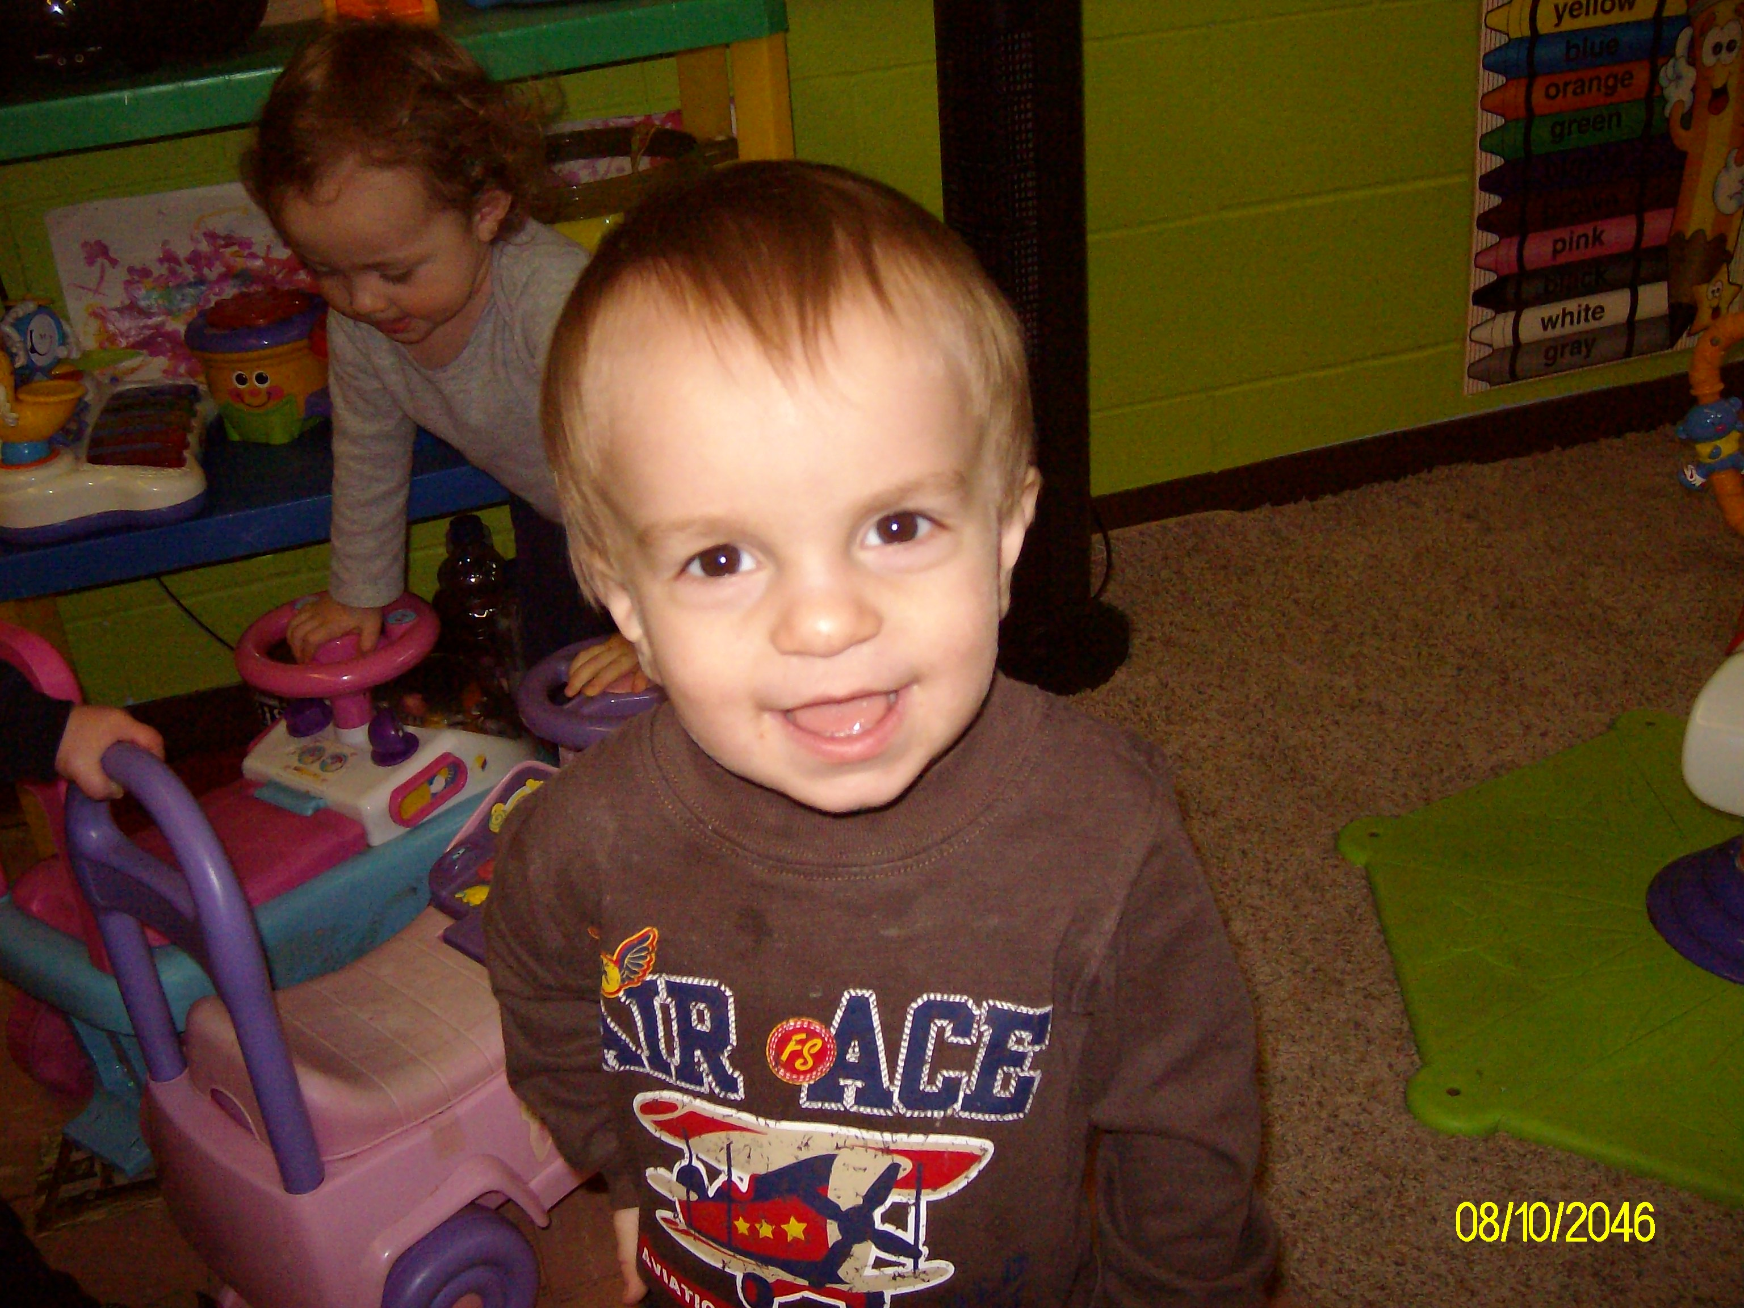
“You can discover more about a person in an hour of play than in a year of conversation.” ~Plato

Slide 6
Block Play
PHYSICAL
SOCIAL/EMOTIONAL
Creative
Competence
Success
Self Esteem
Autonomy
Initiative
Equality
Cooperation
Negotiation
Compromise
Responsibility
Leadership
Social Studies Concepts
Emotional Release
Coordination
Visual Perception
Motor Development
Spatial Orientation
Fine Motor Coordination
Associations
Relationships
Problem-solving
Finding New Solutions
Sensory Exploration
Notes:
All About Unit Block Play By Nancy P. Alexander

Slide 7
Block play
COGNITIVE
Math
science
Area
Size
Order
Space
Shapes
Numbers
Mapping
Patterns
Measuring
Fractions
Operations
Estimating
Negative Space
Adding
One to One Correspondence
Seriation
Weight
Height
Gravity
Balance
Symmetry
Textures
Action/Reaction
Cause and Effect
Spatial Visualization
Simple Machines
Symbolization and Representation
Comparisons
Classification
Concepts
Directionality
Sequence
Divergent Thinking
Logical Reasoning
Notes:
All About Unit Block Play By Nancy P. Alexander

Slide 8
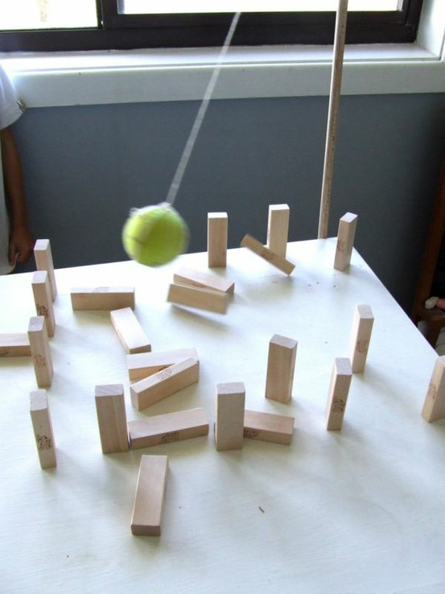
LITERACY
Labeling
Vocabulary
Recalling Stories
Creating/Dictating Stories
Sentence Structure
Making and Using Signs
Using Books as Resources
Using Writing
Notes:
All About Unit Block Play By Nancy P. Alexander

Slide 9
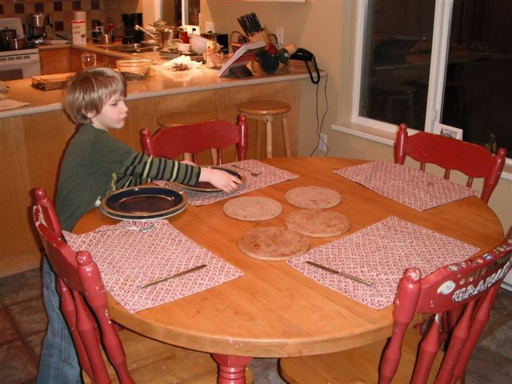
Setting the table
What can children learn from simple tasks such as setting the table?
Cognitive~ counting, following patterns
Social~cooperation and teaches younger children to help
Physical~ small motor coordination
Notes:
WMELS Page 106 2nd Edition

Slide 10
Finding toys and learning materials to work alone or with others
Cognitive: Makes decisions about interests and abilities
Self-help: find toys and set up environments
Social/Languages: learns to share, manage conflict, and ask for help.
Emotional: learns about acceptance and rejection and expresses needs.
Notes:
WMELS 2nd edition

Slide 11
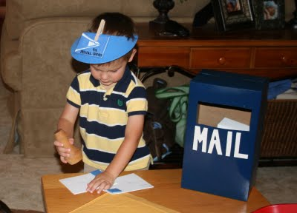
Dramatic play

Slide 12
What is dramatic play?
As the Center for Best Practices in Early Childhood states on its website, the essence of this type of play involves “the portrayal of life as seen from the actor’s view”.
Or to use the Center for best Practices in Early Childhood’s words, it “permits children to fit the reality of the world into their own interests and knowledge.”
Notes:
Center for Best Practices in Early Childhood. (2002, September). Dramatic play allows children to express themselves

Slide 13
Social/emotional
When children come together in a dramatic play experience, they have to agree on a topic, negotiate roles, and cooperate to bring it all together. And by recreating some of the life experiences they actually face, they learn how to cope with any fears and worries that may accompany these experiences. Children who participate in dramatic play experiences are better able to show empathy. They also develop the skills they need to cooperate, learn to control their impulses, and tend to be less aggressive than children who do not engage in this type of play.
Notes:
How Dramatic Play Can Enhance Learning By Marie E. Cecchini MS

Slide 14
Physical
Dramatic play helps children develop both gross and fine motor skills – fire fighters climb and parents dress their babies
when children put their materials away, they practice eye-hand coordination and visual discrimination.
Notes:
How Dramatic Play Can Enhance Learning By Marie E. Cecchini MS

Slide 15
Cognitive
When children are involved in make-believe play, they make use of pictures they have created in their minds to recreate past experiences, which is a form of abstract thinking. Setting a table for a meal, counting out change as a cashier, dialing a telephone, and setting the clock promote the use of math skills. By adding such things as magazines, road signs, food boxes and cans, paper and pencils to the materials included in the area, we help children develop literacy skills.
Notes:
How Dramatic Play Can Enhance Learning By Marie E. Cecchini MS

Slide 16
language
In order to work together in a dramatic play situation, children learn to use language to explain what they are doing. They learn to ask and answer questions and the words they use fit whatever role they are playing. Personal vocabularies grow as they begin to use new words appropriately, and the importance of reading and writing skills in everyday life becomes apparent by their use of literacy materials that fill the area.
Notes:
How Dramatic Play Can Enhance Learning By Marie E. Cecchini MS

Slide 17
A child loves his play, not because it’s easy, but because it’s hard.
Benjamin Spock
American pediatrician
1903–1998
The Value of Play
You say that you love your children,
And are concerned that they learn today,
As am I, that's why I'm providing
A variety of kinds of play.
You are asking what's the value
Of having your children play?
Your daughter's creating a tower,
She may be a builder someday.
You're asking me the value
Of blocks and sand and clay.
Your children are solving problems,
They will use that skill every day.
You're saying that you don't want your son
To play in that sissy way.
He's learning to cuddle a doll,
He may be a father someday.
You're questioning the interest centers,
They just look like useless play.
Your children are making choices,
They'll be on their own someday.
You're worried your children aren't learning
And later they'll have to pay.
They're learning a pattern for learning,
For they'll be learners always.
~NAEYC
Children need the freedom and time to play. Play is not a luxury. Play is a necessity.
Kay Redfield Jamison
Contemporary American professor of psychiatry
Notes:
stepbystepcc.com/poemsaboutplay.html

Slide 18
Resources
WMELS 2nd edition
Earlychildhood news: How Dramatic Play Can Enhance Learning By Marie E. Cecchini MS
Early childhood news: All About Unit Block Play By Nancy P. Alexander
Earlychildhood News: Learning through play, shelly butler

