Slide 1
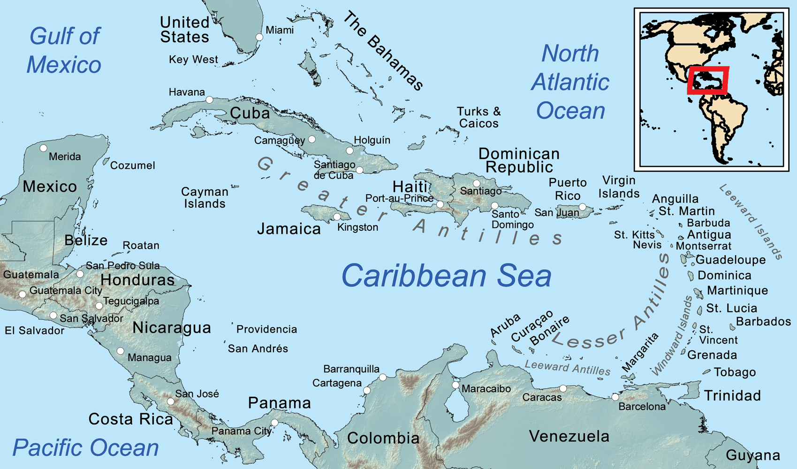
Photo Album
Southern Caribbean Cruise – September 9-16, 2017
Adventure of the Seas
by Paula L. Hook

Slide 2
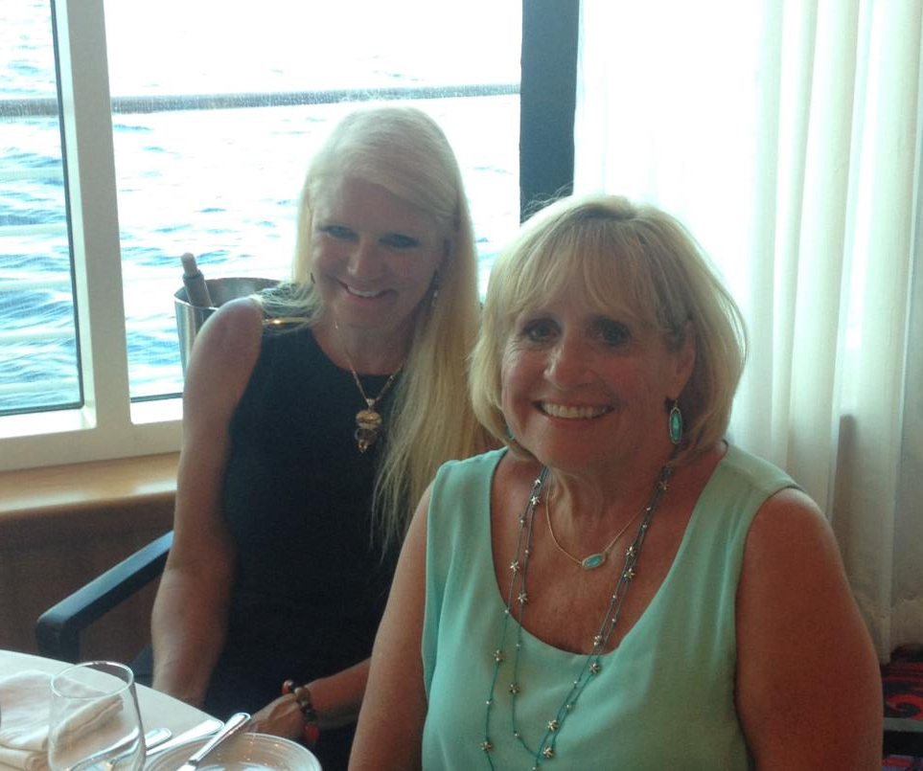
Photo Album
Paula Hook & Debby D’Artra
by Paula L. Hook

Slide 3
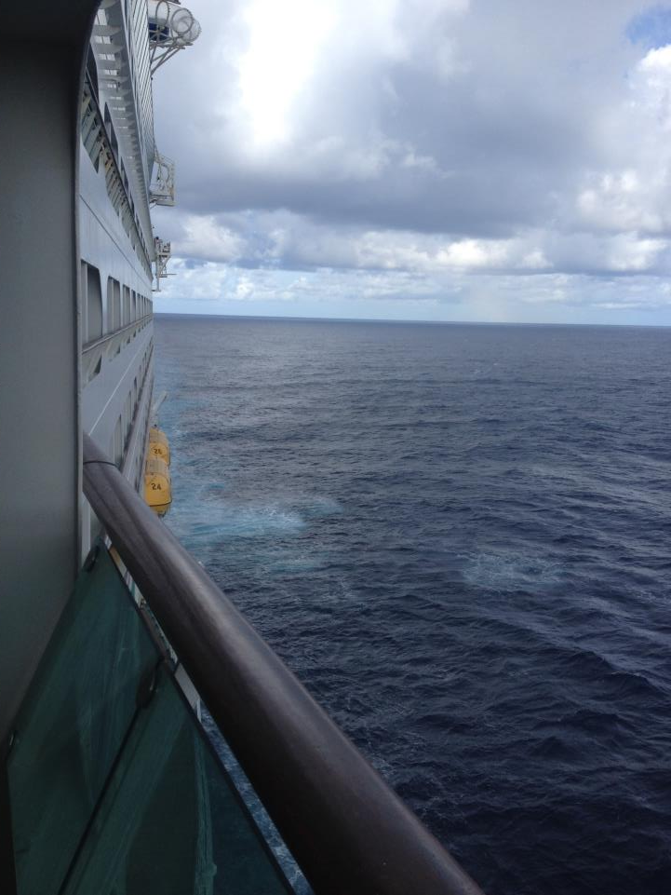
Day 1 – Crazy Travel Day
Day 2 – September 10, 2017
“We made it!”

Slide 4
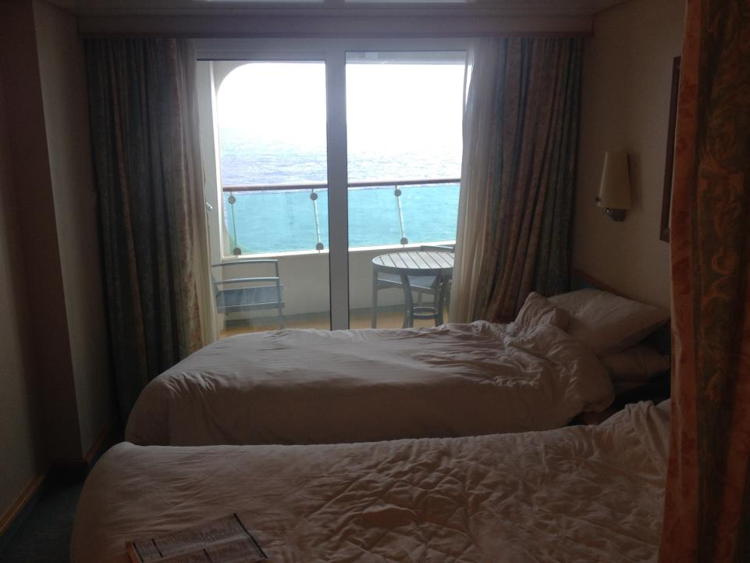
Balcony Cabin #8626

Slide 5
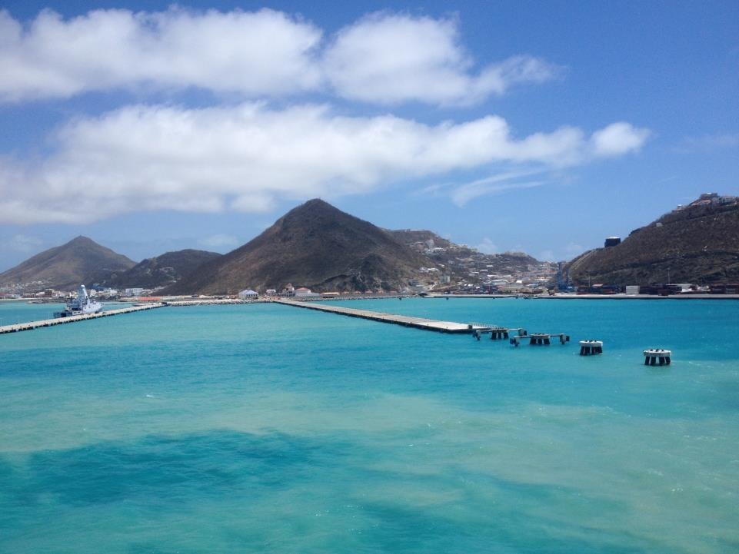
Re-routed to St. Maarten to provide humanitarian aid…
Dutch Navy escort to deliver supplies & take on 300 people

Slide 6
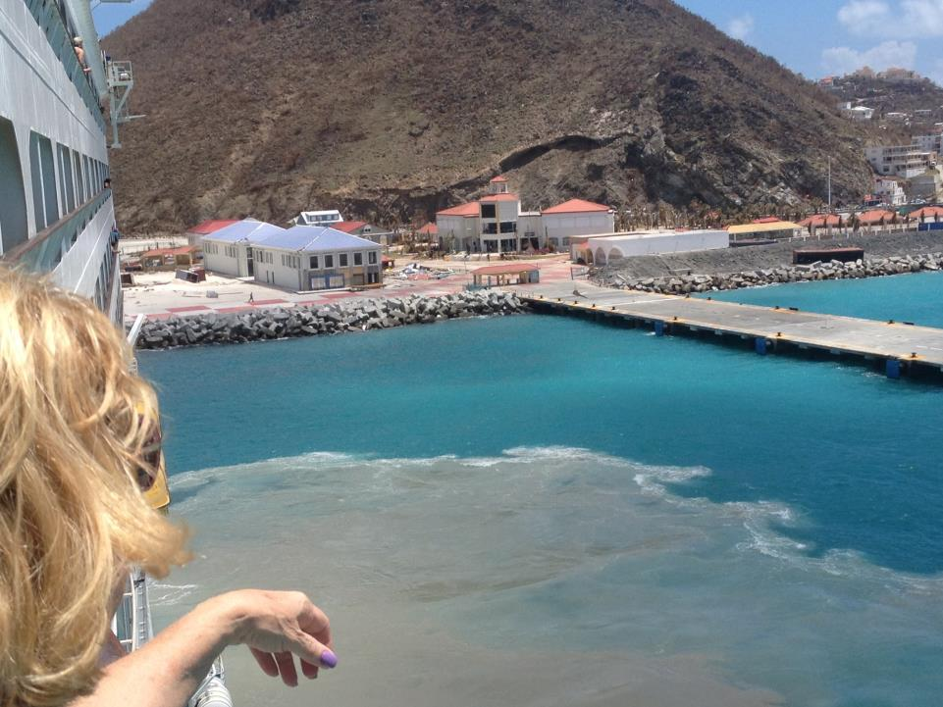
Hurricane Irma desruction

Slide 7
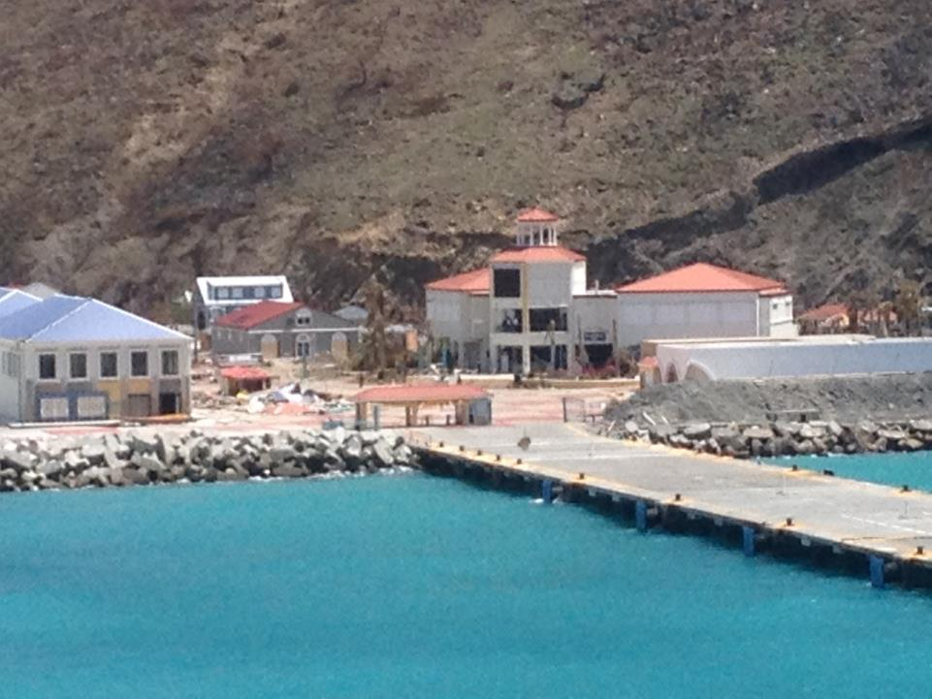

Slide 8
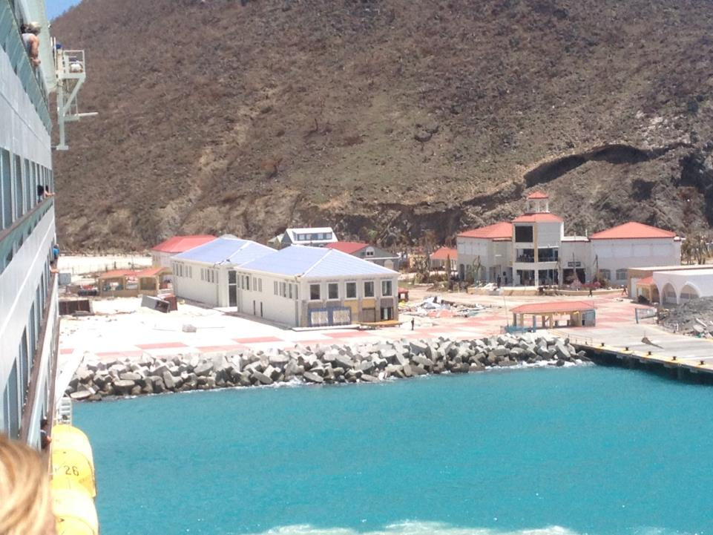

Slide 9
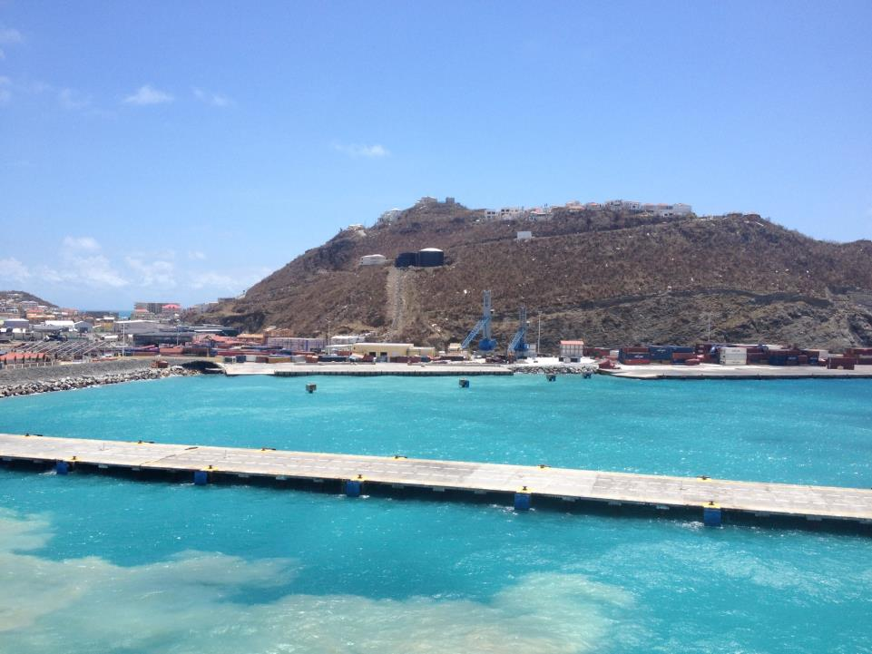

Slide 10
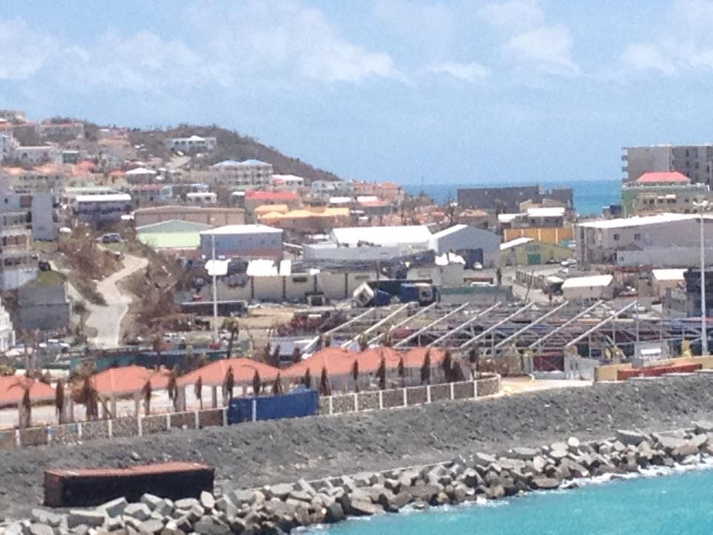

Slide 11
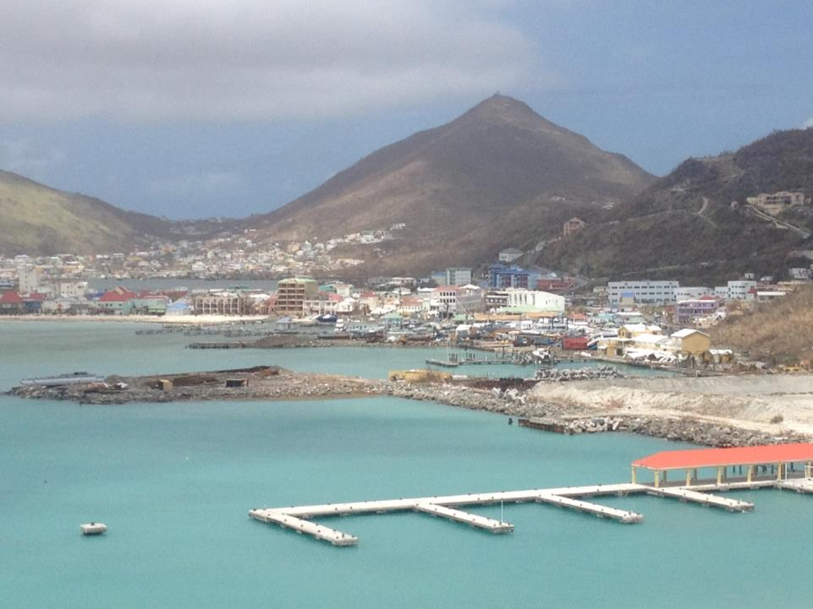

Slide 12
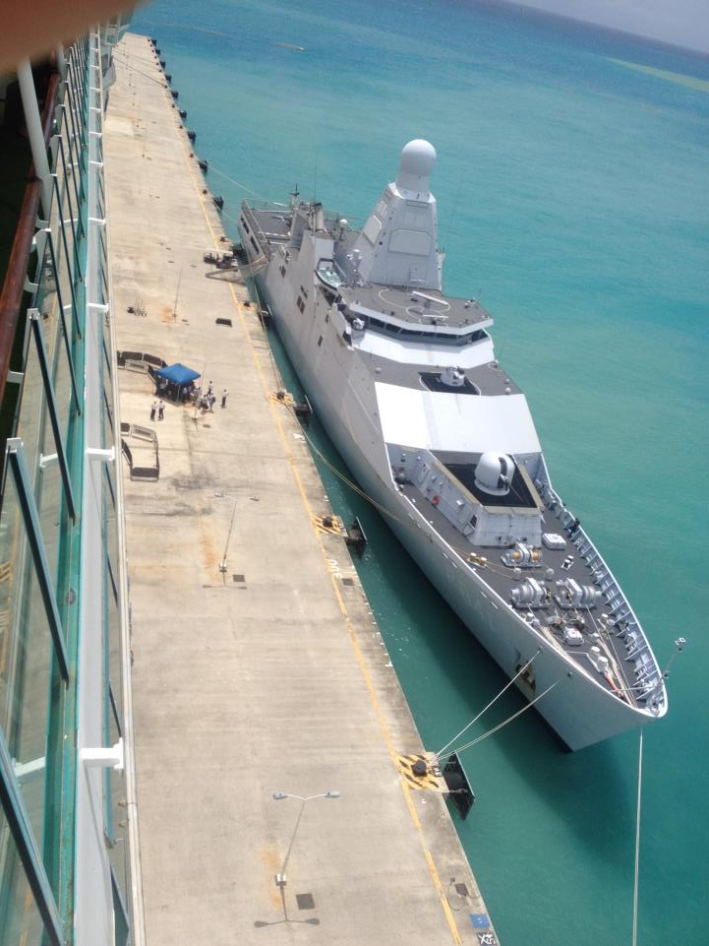
Dutch Navy Escort & Rescuing Victims

Slide 13
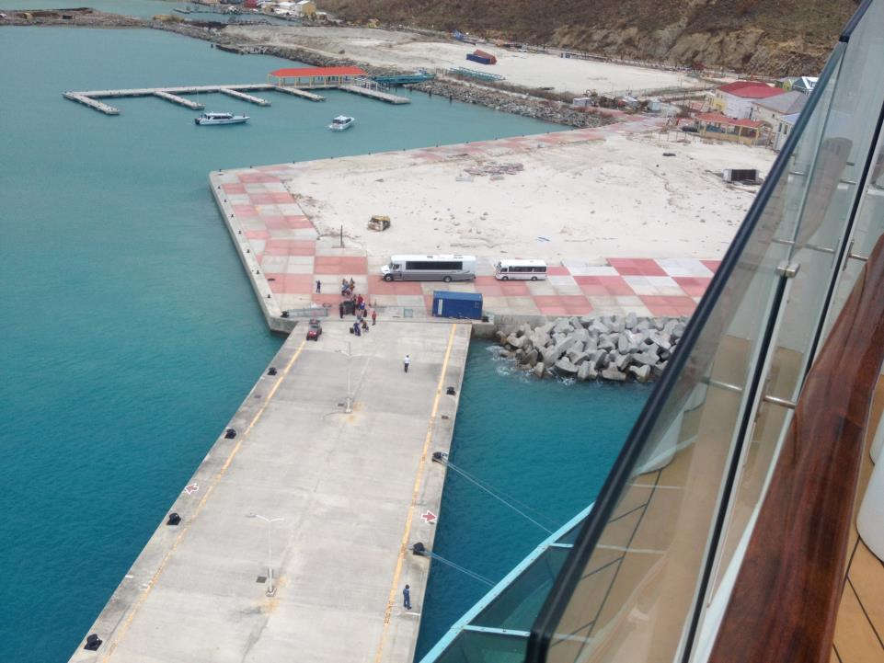

Slide 14
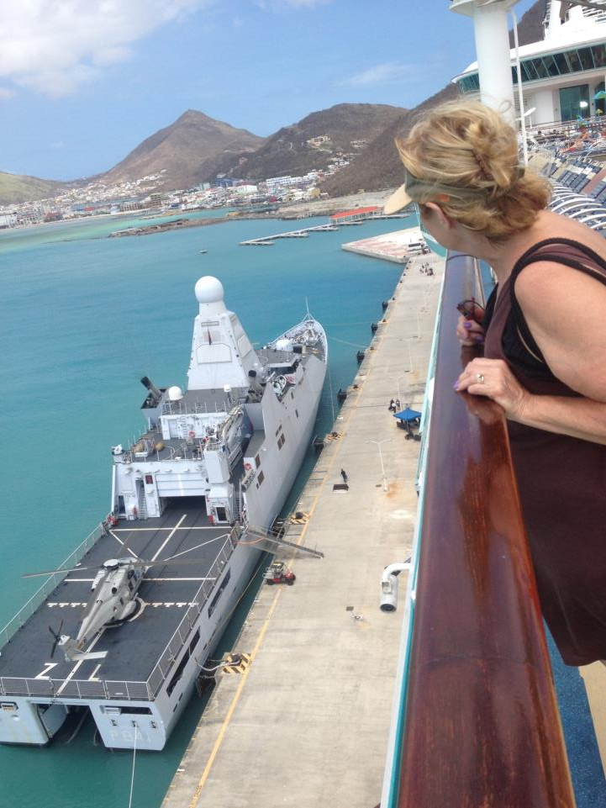

Slide 15
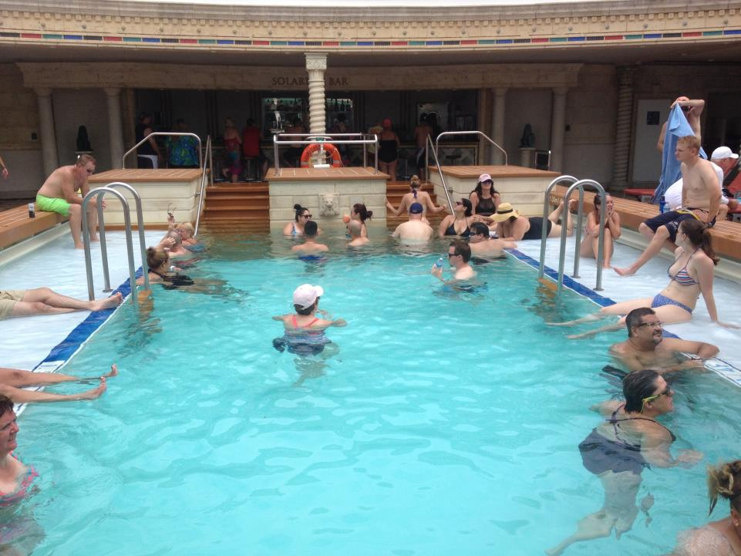
Adult Pool - Deck 11

Slide 16
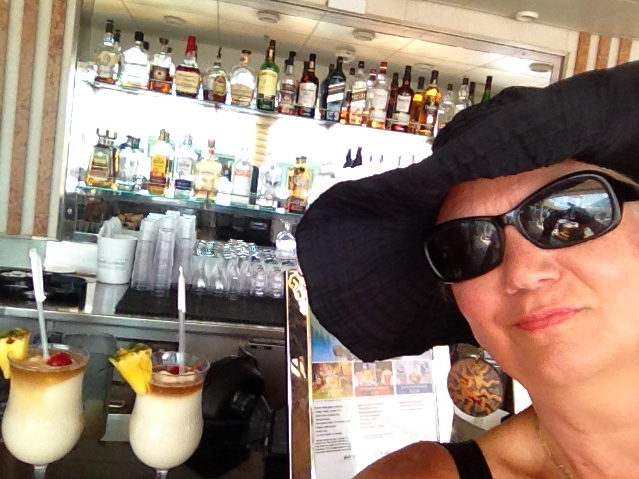

Slide 17
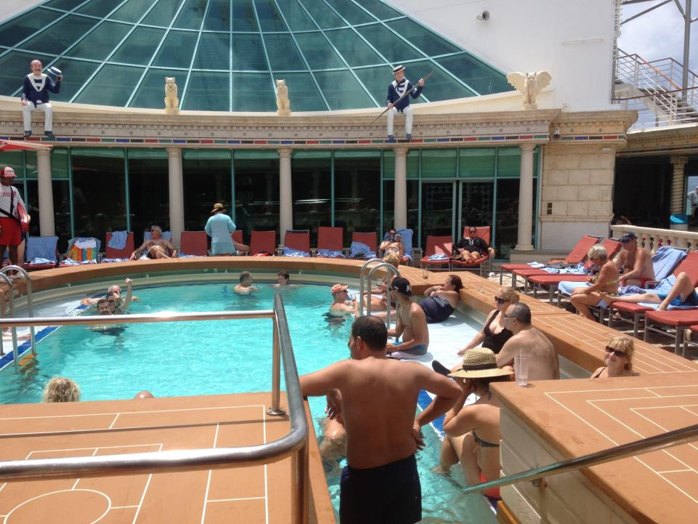

Slide 18
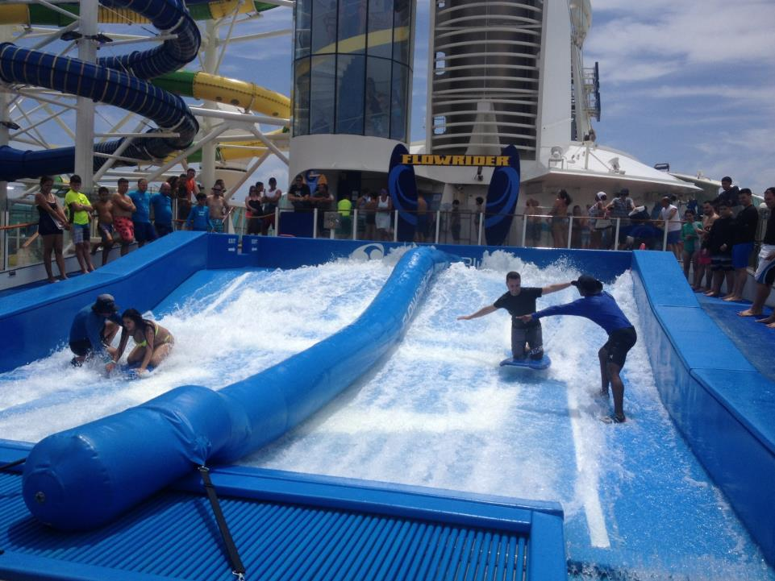

Slide 19
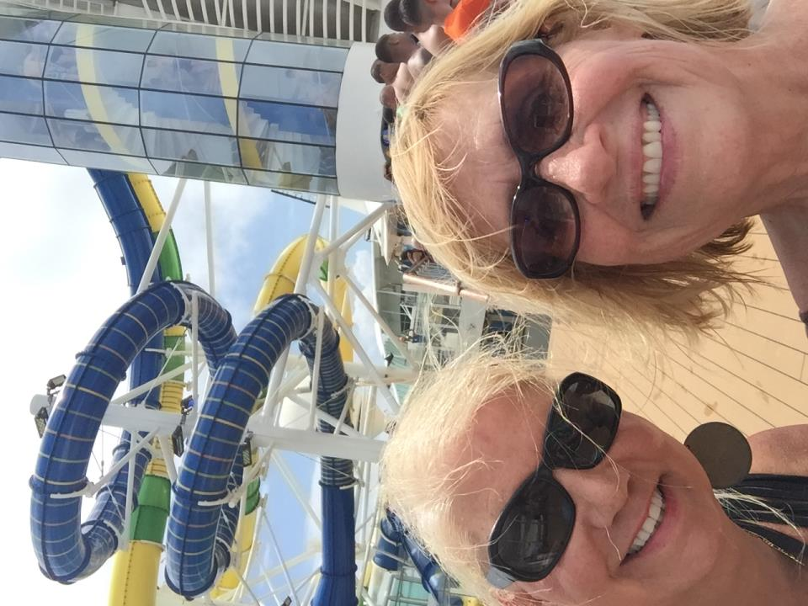

Slide 20
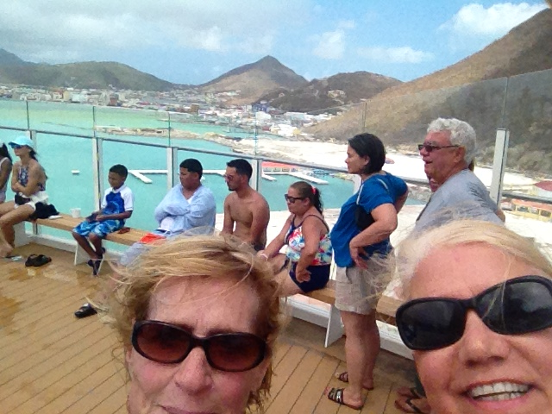

Slide 21
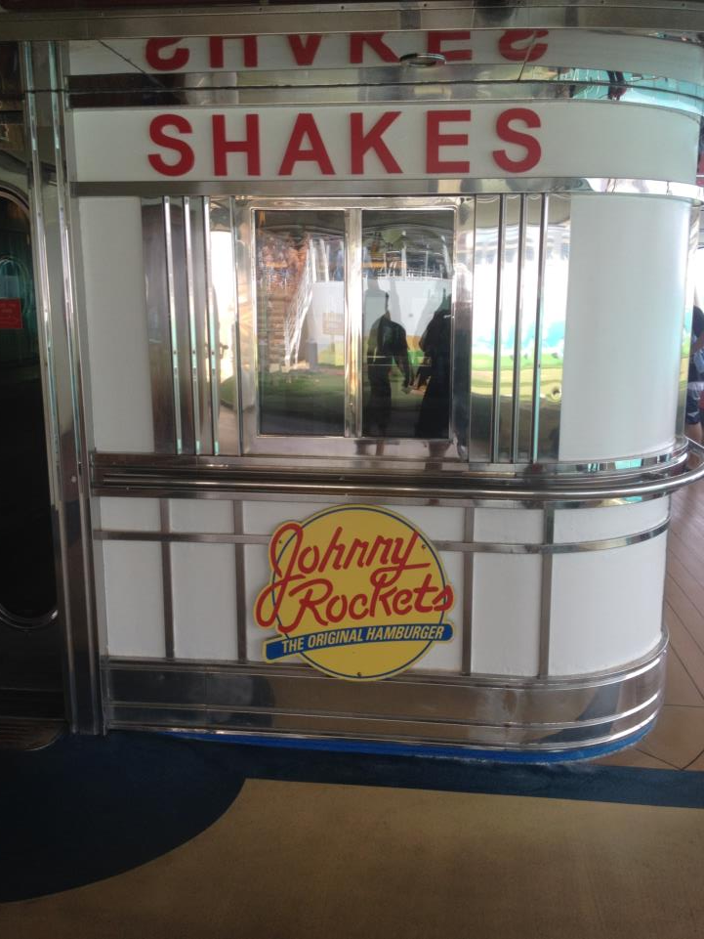

Slide 22
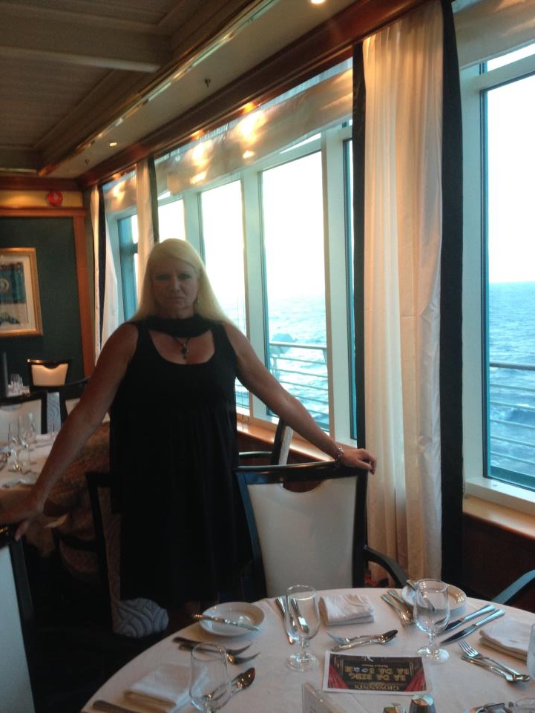
Formal Dining Night

Slide 23
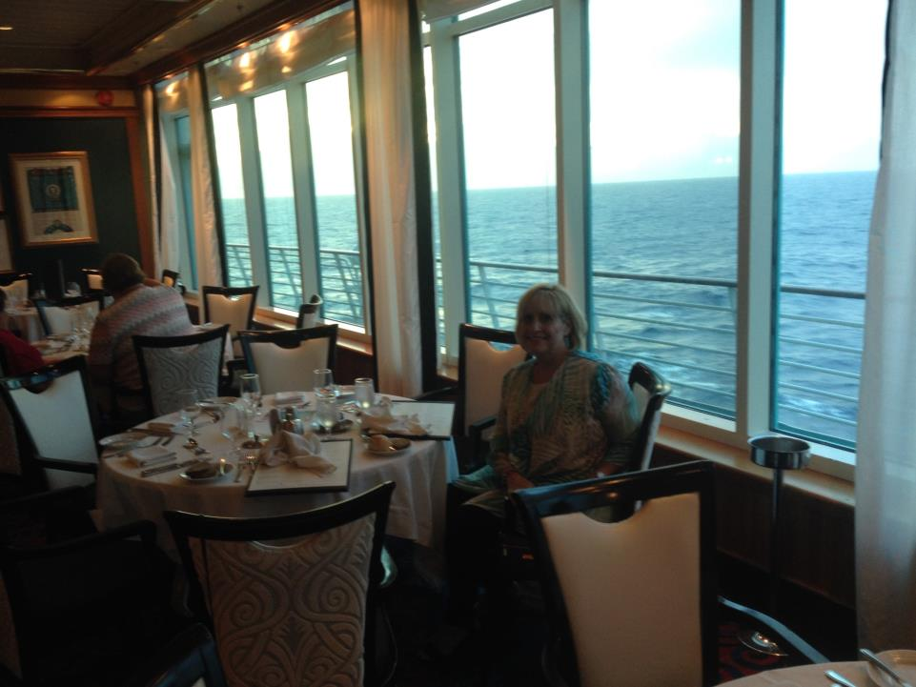
…and what about that view?!

Slide 24
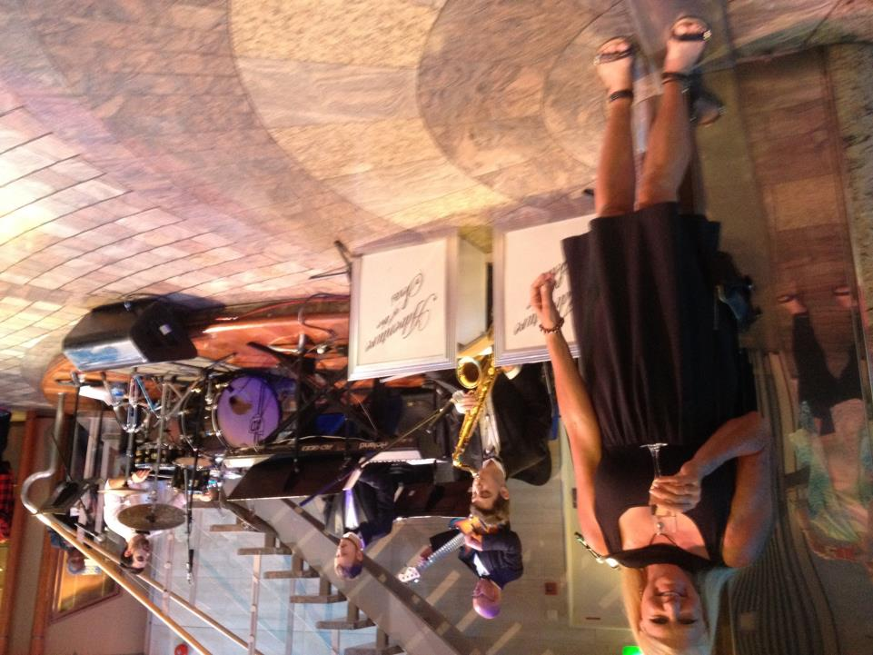
Captain Party in the Promenade – Deck 5

Slide 25
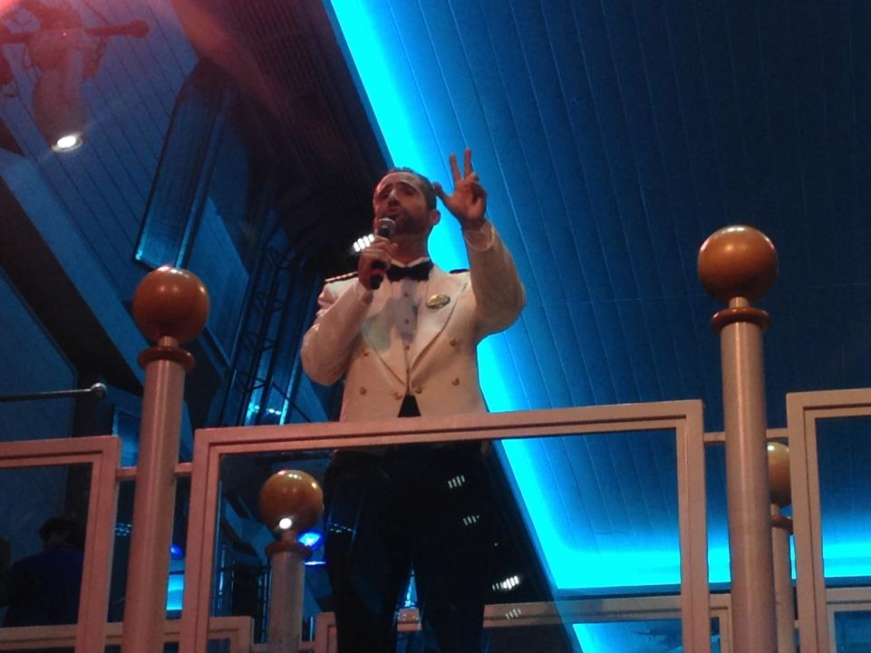
Captain Thomas

Slide 26
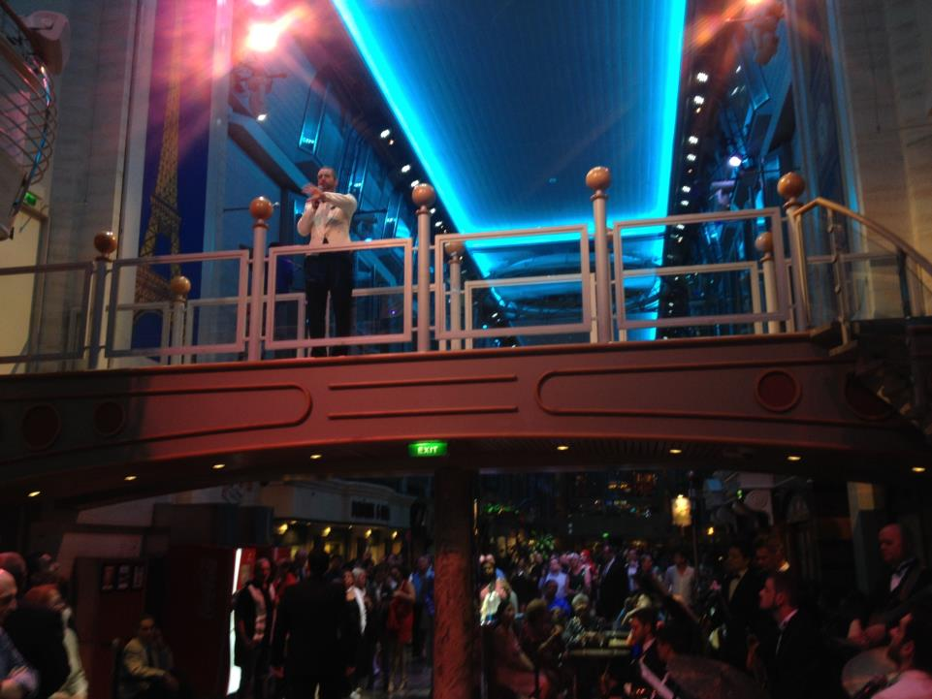

Slide 27
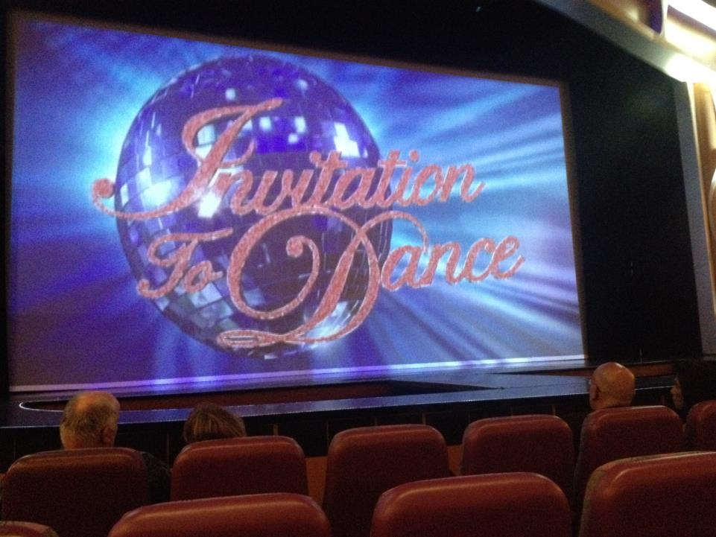
Great dancing & costumes!
Photos not allowed

Slide 28
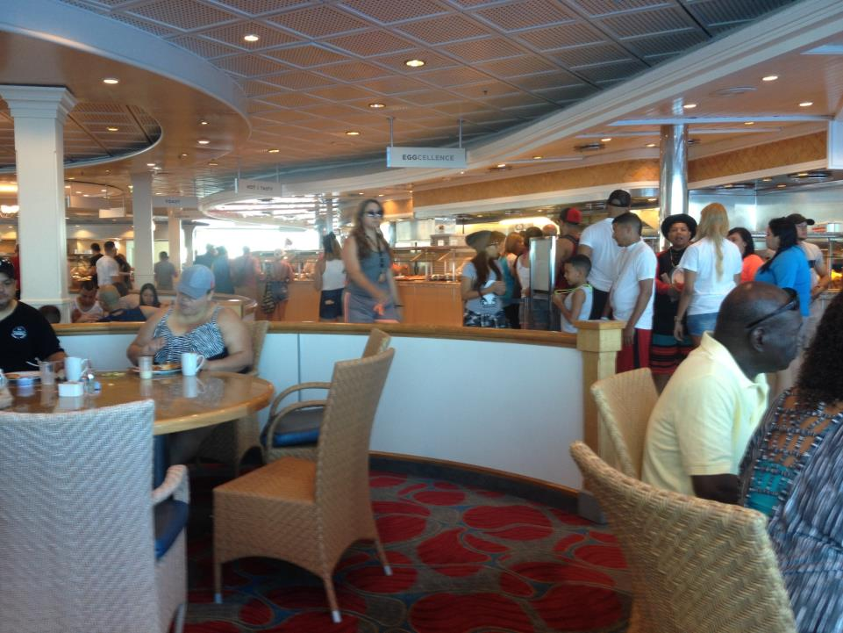
Day 3 – September 11, 2017 – Cruising Day
Breakfast in the Windjammer

Slide 29
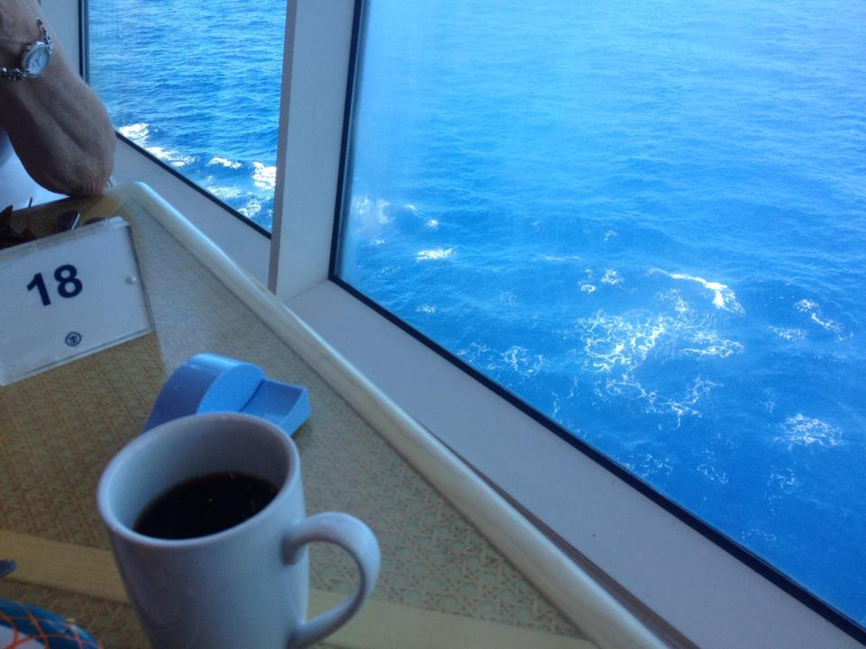
…and what about the color of that water!

Slide 30
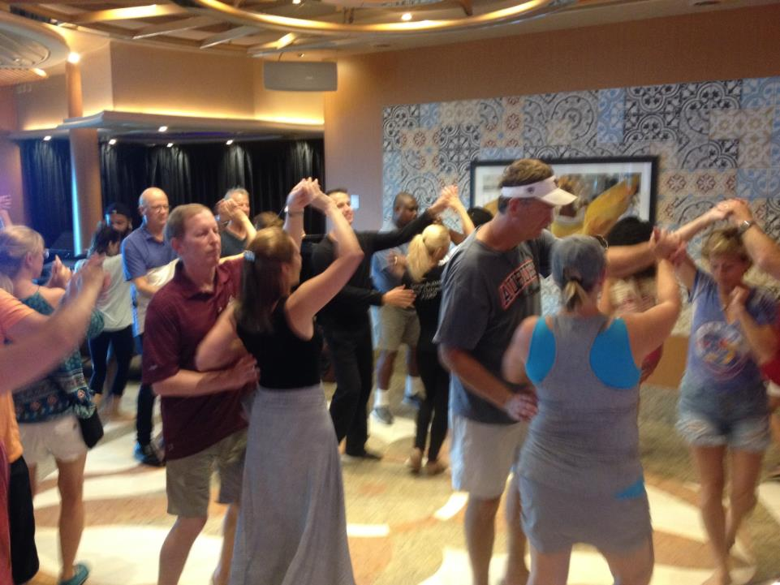
George & Petra teaching the Cha Cha!

Slide 31
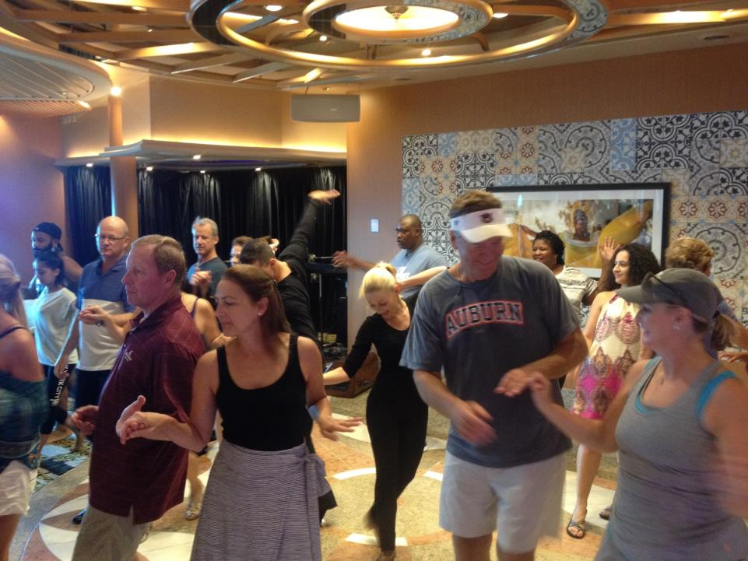

Slide 32
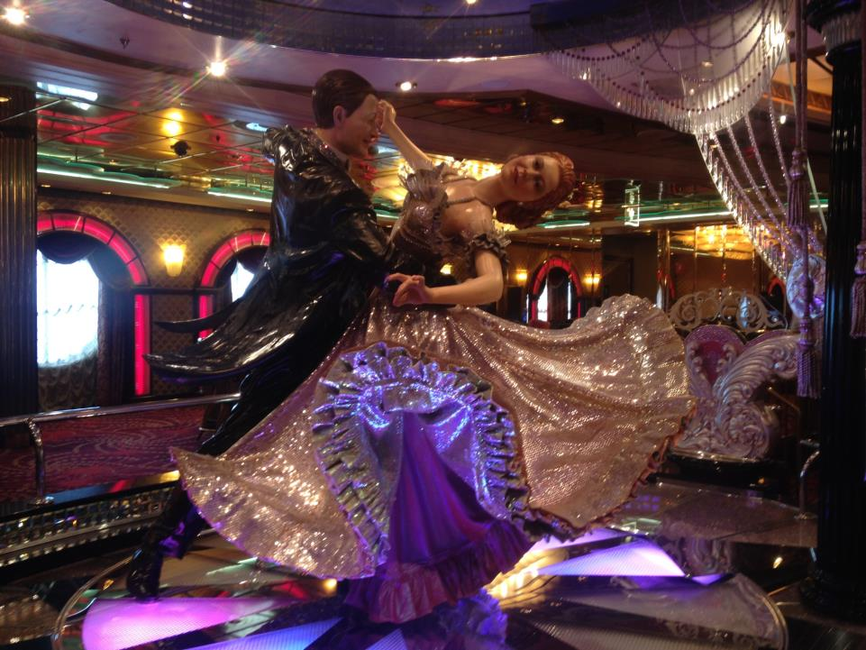

Slide 33
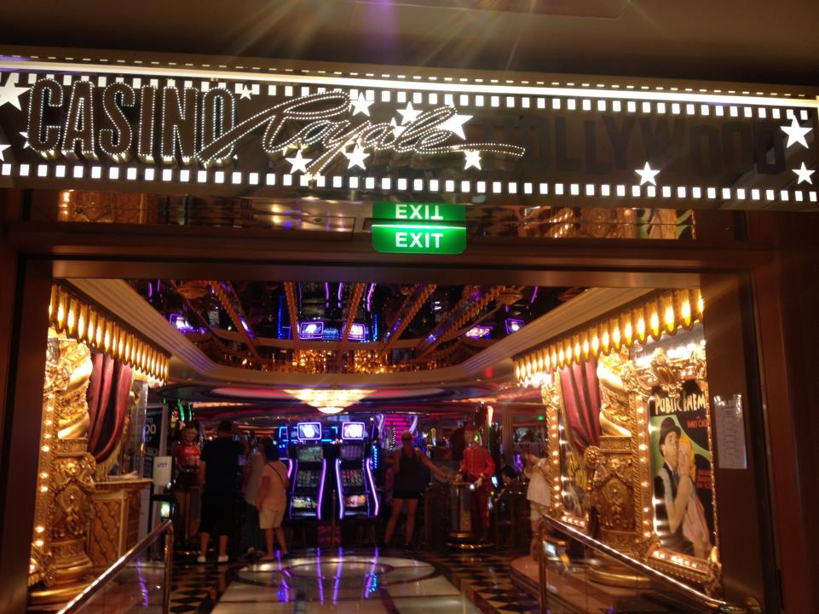

Slide 34
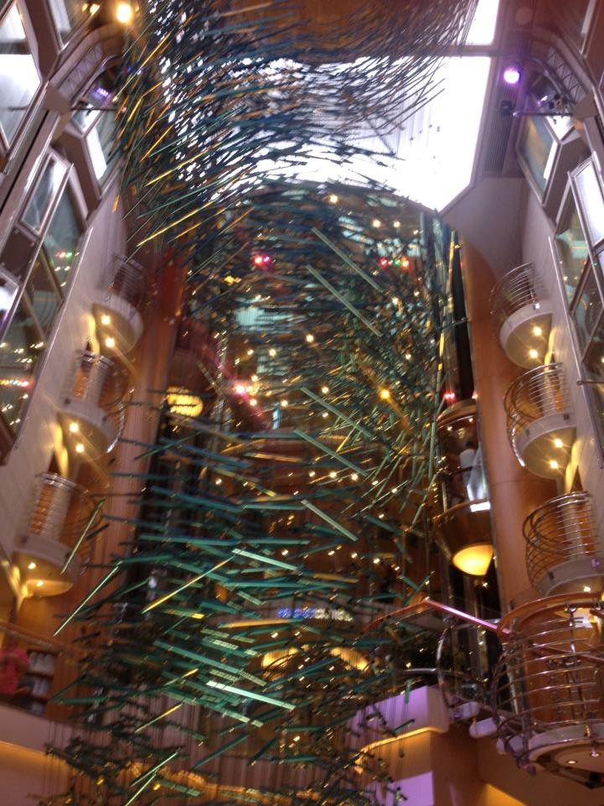

Slide 35
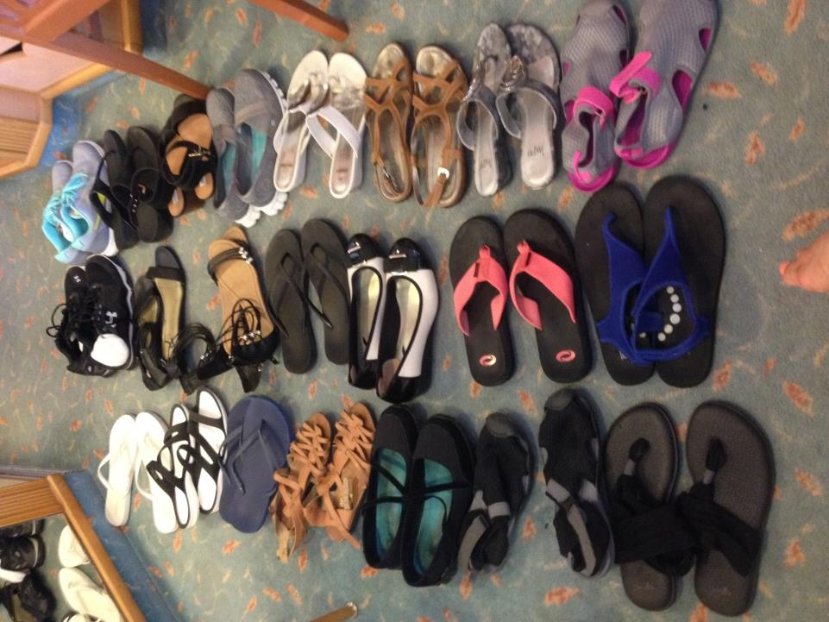

Slide 36
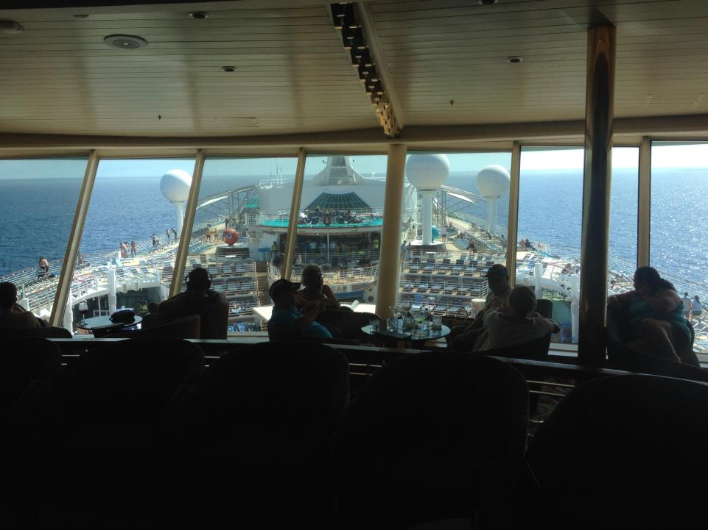
Party for Royal Caribbean Forum Group – Deck 14

Slide 37
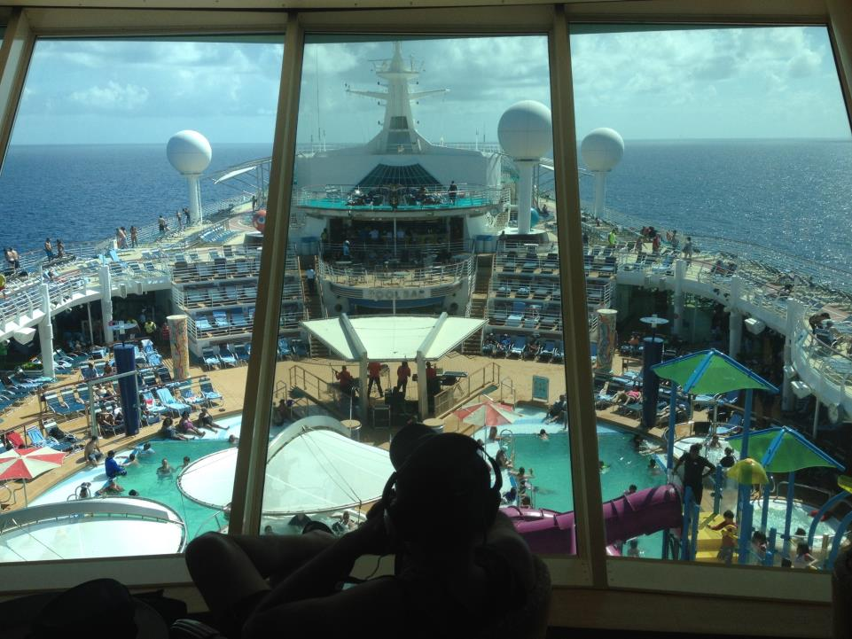

Slide 38
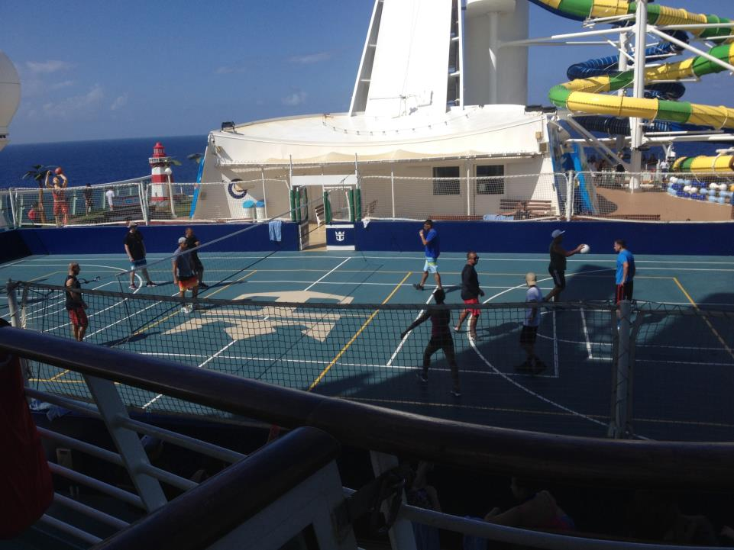

Slide 39
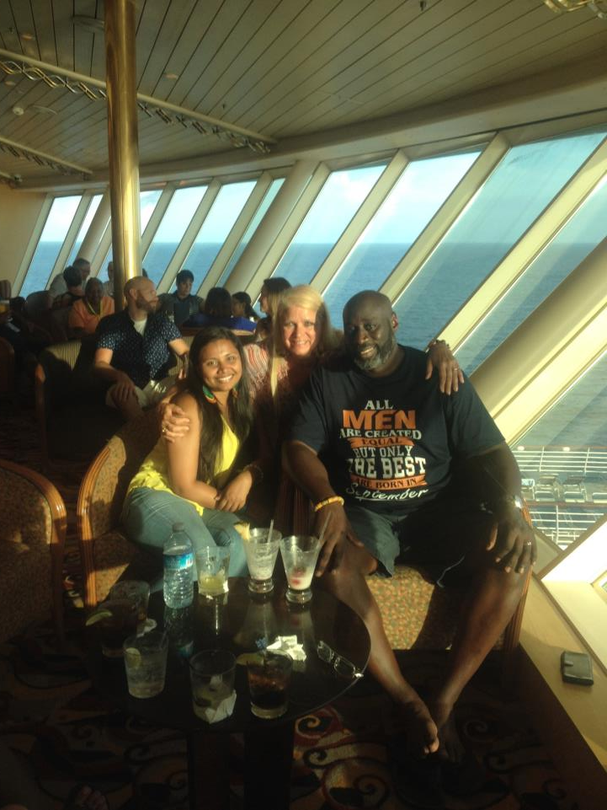
Welcome friends!

Slide 40
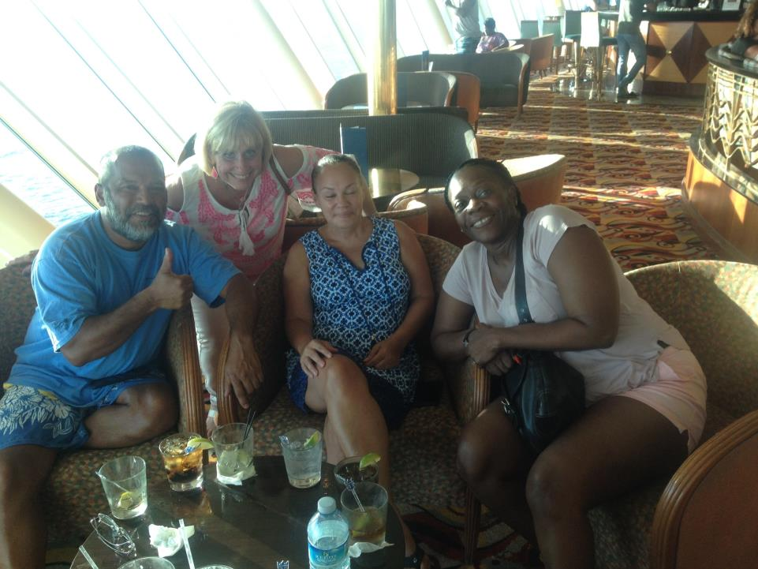
Shared tears with some of our St. Maarten guests

Slide 41
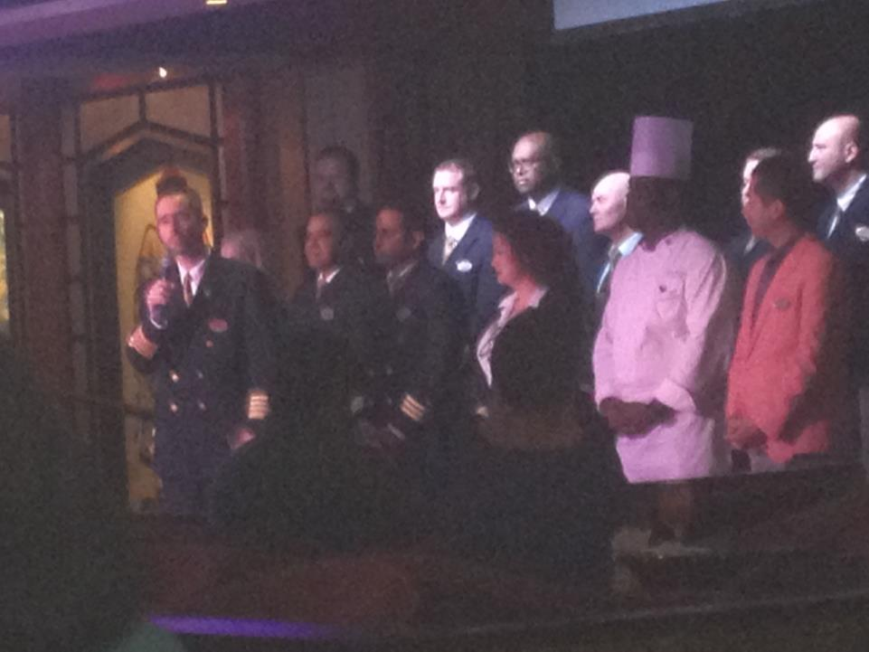
Party for “elite members” hosted by Captain Thomas

Slide 42
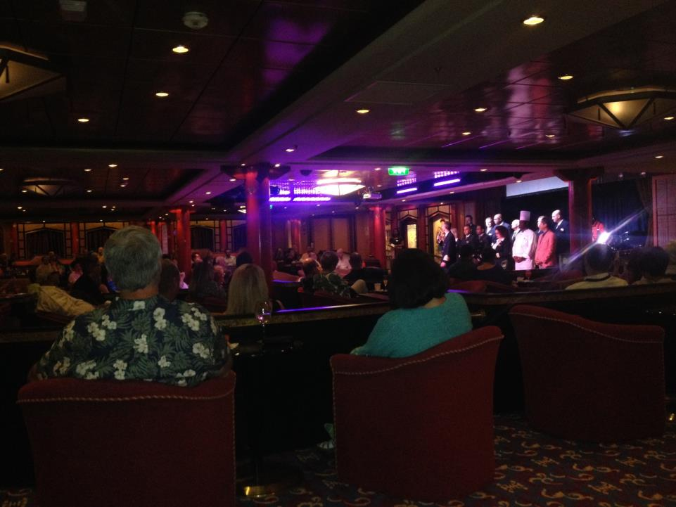

Slide 43
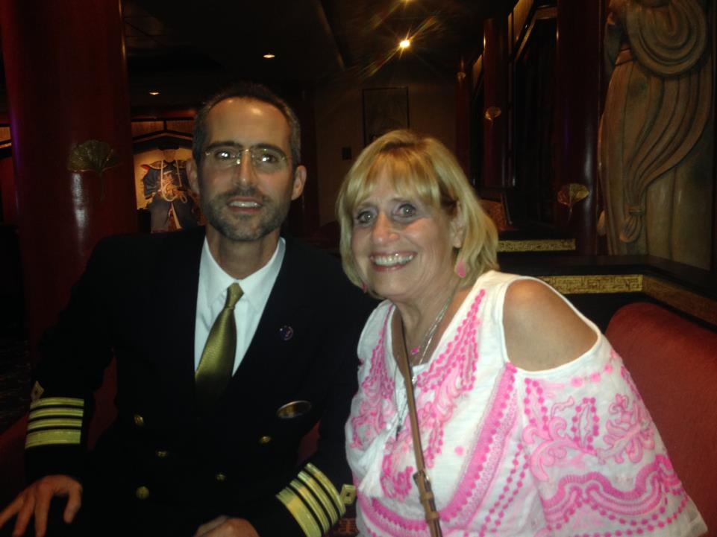
Yes, the Captain accepted our invite to join us!

Slide 44
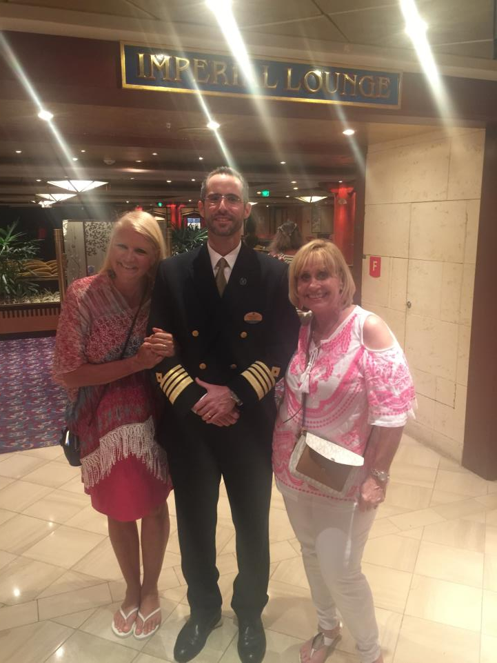

Slide 45
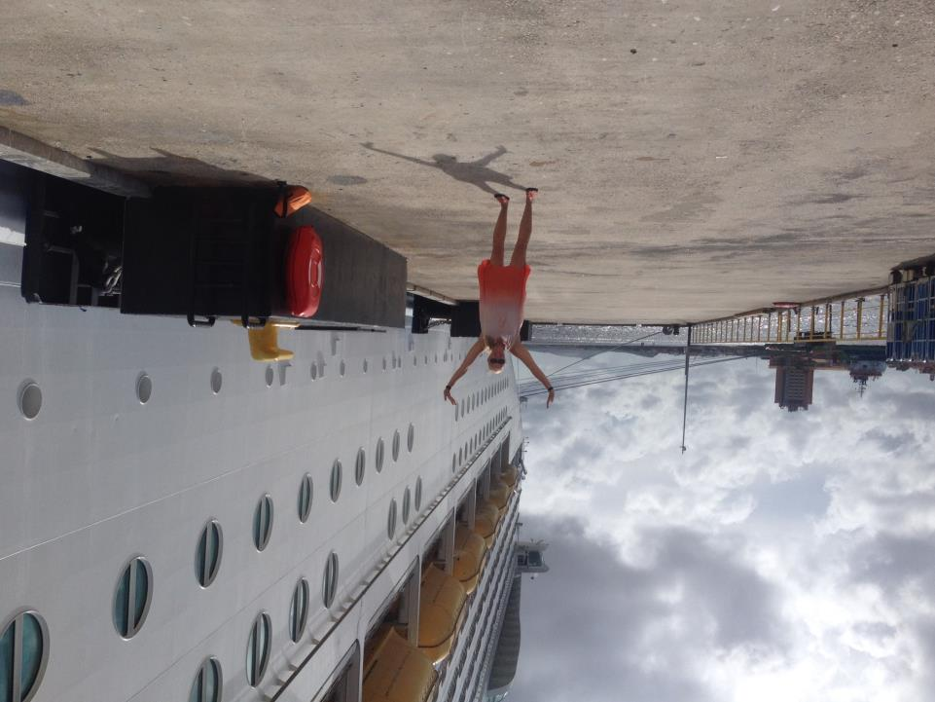
Day 4 – September 12, 2017
Willamstad, Curacau

Slide 46
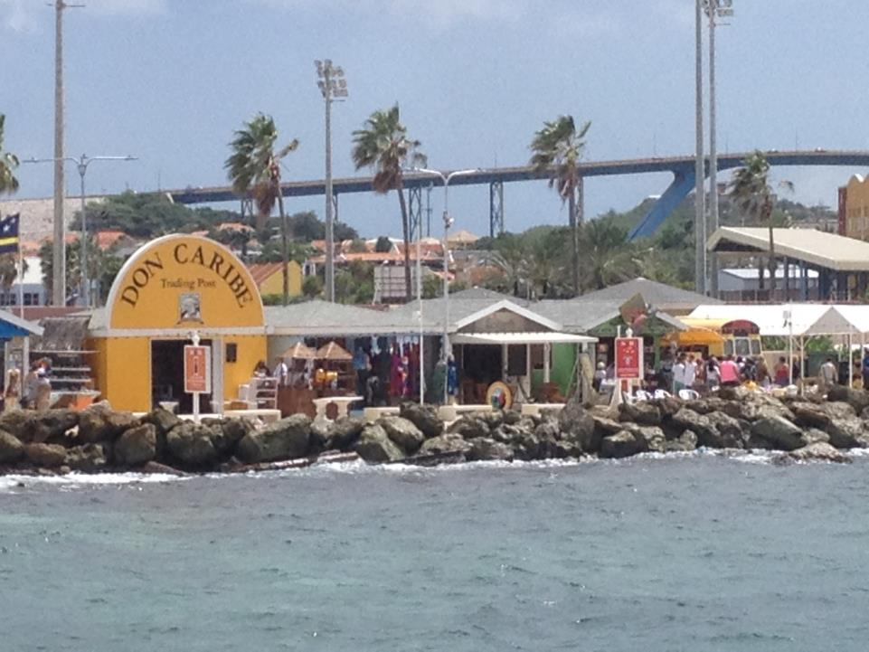

Slide 47
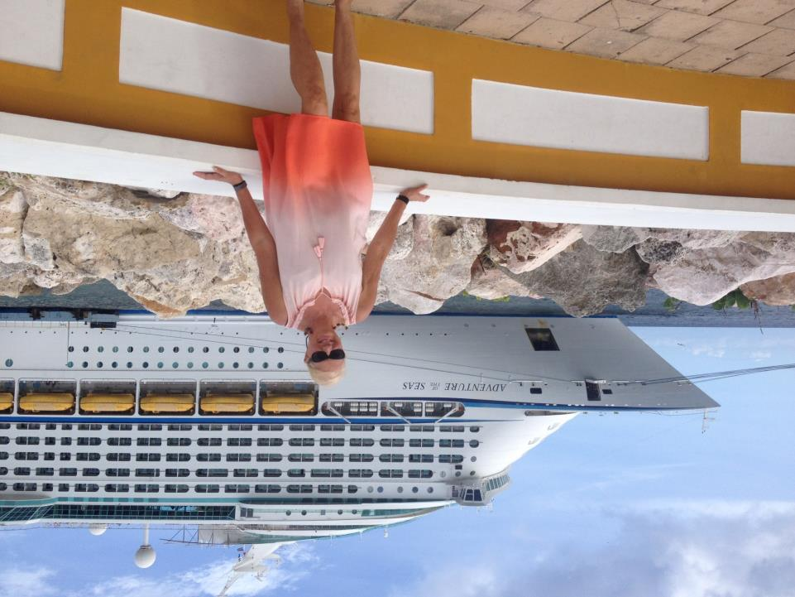

Slide 48
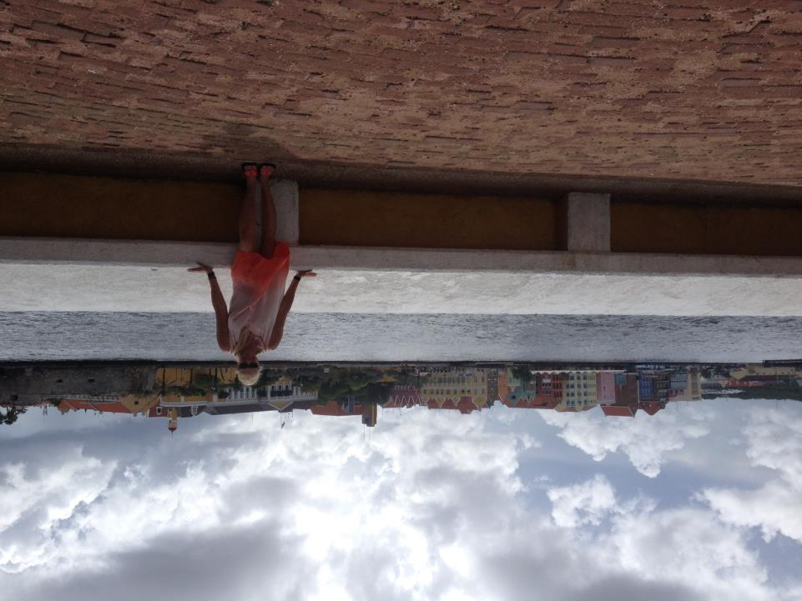

Slide 49
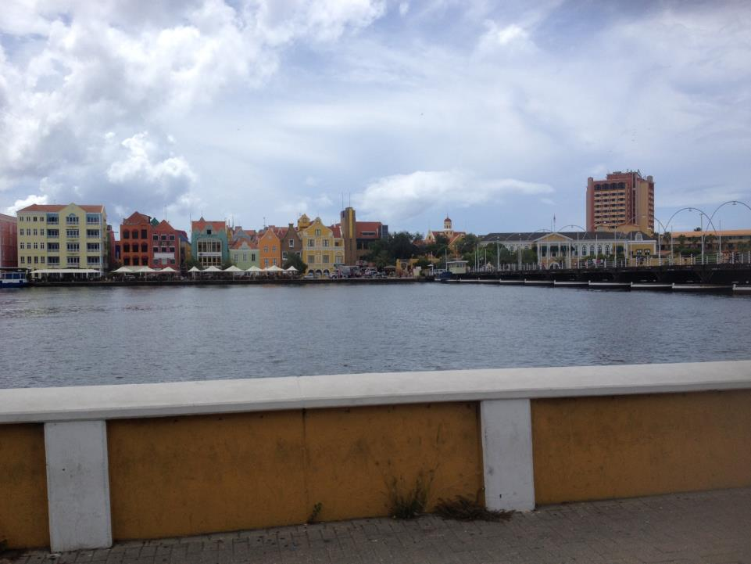

Slide 50
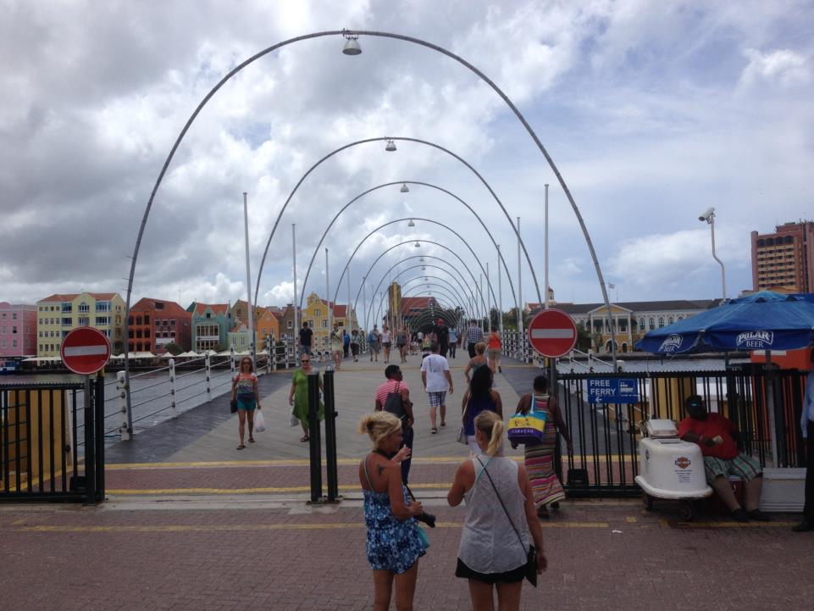

Slide 51
Curacao City & Beach Escape

Slide 63
Movie on the big screen – Beauty and the Beast

Slide 64
Another Dance Show…Awesome Tribute to Las Vegas!

Slide 65
Day 5 – September 13, 2017 (Rainbow!)

Slide 66
Oranjestad, Aruba (Dutch Capital)

Slide 67
…Double Rainbow!

Slide 71
Fun! Fun! Tour with Carlos!

Slide 72
Stations of the Cross on the way to the oldest Catholic Church

Slide 81
Divi Divi Tree

Slide 82
“California” Lighthouse

Slide 88
Palm Beach

Slide 93
Captain of our Sunset Cocktail Cruise Excursion

Slide 99
…new friends Wendy & Tony

Slide 106
Honeymooners…Matt & Bryan
Wendy/Tony’s 20th Anniversary

Slide 111
Day 6 – September 14, 2017
Sunrise before docking at Bonaire

Slide 117
SAMUR Sail, Beach and Snorkel

Slide 121
Captain Urs

Slide 126
Uninhabited , Klein Island
Deck hands…Chris & Roderick

Slide 127
A Ronnie Toast!

Slide 128
…and a Ronnie Cigar!

Slide 129
Departing Bonaire, “The Natural Choice”
Finest snorkeling & diving in the Caribbean

Slide 130
Final Formal Night

Slide 131
Such a great trip!
I conquered my fear and snorkeled today!

Slide 133
I conquered my fear
to lean over the balcony to truly enjoy the beauty!

Slide 135
Day 7 – September 15, 2017
Wine Tasting Around the World?

Slide 140
The Schooner Bar

Slide 143
Final Dinner and Farewell Parade
& Show by Crew

Slide 146
Day 8 – September 16, 2017
…back in San Juan, Puerto Rico

Slide 150
Old & New San Juan City Tour

Slide 165
Here’s to Royal Caribbean,
the people and the Islands!
The End

