Slide 1
Solving Word Problems Using Schemas and Equations

Slide 2
Contact Information
Sarah Powell, Ph.D
The University of Texas at Austin
srpowell@austin.utexas.edu
@sarahpowellphd
119

Slide 3
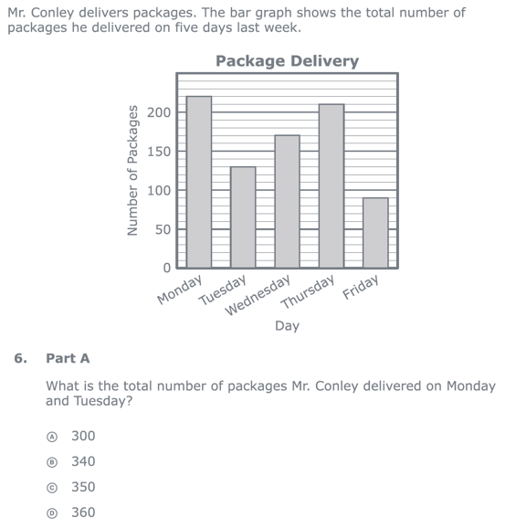
Reading problems
Understanding vocabulary
Identifying relevant information
Ignoring irrelevant information
Interpreting charts and graphs
PARCC third-grade release item (2015)
Identifying appropriate operation(s)
Performing the computation(s)

Slide 4
Don’t tie key words to operations
Do have an attack strategy
Do teach word-problem schemas

Slide 5
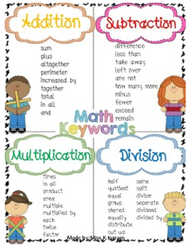
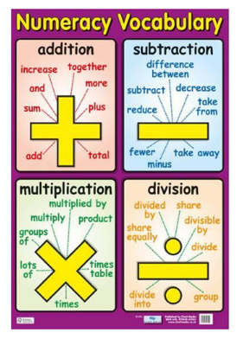
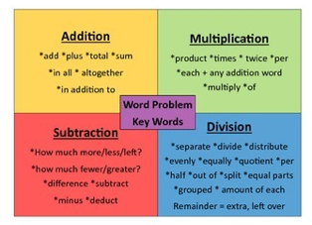
https://www.teacherspayteachers.com/Product/MATH-KEY-WORD-POSTERS-3762135
https://www.teacherspayteachers.com/Product/Math-Word-Problems-Key-Words-Poster-2077043
https://www.allposters.com/-sp/Numeracy-Vocabulary-Posters_i14273635_.htm?AID=96280778&gclid=Cj0KCQjwguDeBRDCARIsAGxuU8YzENihXfVnzDScNH9BmrMBwaCgSXveFnTsGXktnZr19bOcbYXUJhAaAurvEALw_wcB

Slide 6
Kasey made $42, and Mandy made $37. How much money did they make altogether?
Kasey and Mandy made $79 altogether. If Kasey made $42, how much money did Mandy make?
Becky has $70 more than Perla. If Becky has $120, how much money does Perla have?
Becky has $70 more than Perla. If Perla has $50, how much money does Becky have?

Slide 7
Matt baked 18 cookies. His brother baked twice as many. How many cookies did his brother bake?
Matt’s brother baked twice as many cookies as Matt. If Matt’s brother baked 36 cookies, how many did Matt bake?
Rachel wants to share 36 brownies with 6 friends. How many cookies will each friend receive?
Rachel shared brownies with 6 friends. Each friend ate 6 brownies. How many brownies did Rachel have to start with?

Slide 8
Key words NEVER work
for multi-step problems!

Slide 9
Students need to understand key words. But, key words should not be directly tied to operations.

Slide 10
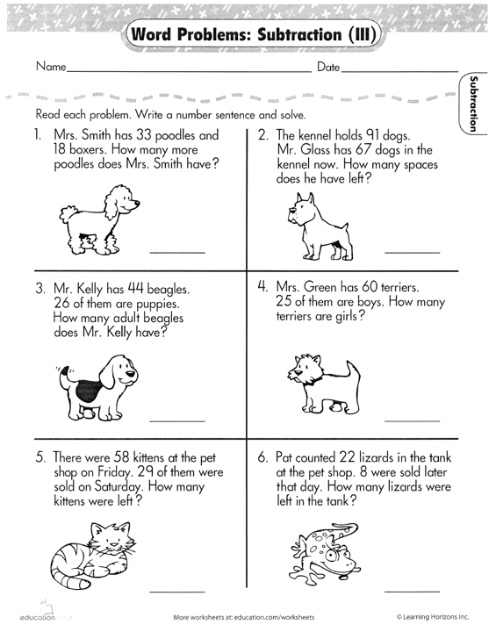

Slide 11
Don’t tie key words to operations
Do have an attack strategy
Do teach word-problem schemas

Slide 12
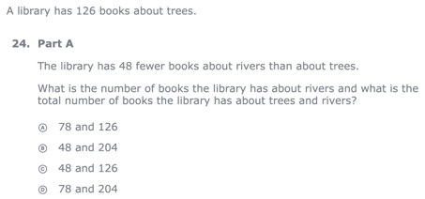
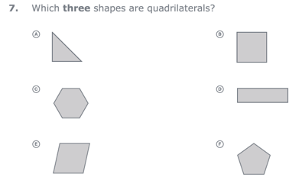
For every word problem
Regardless of problem type, students need an attack strategy for working through the problem
Routine Word Problems
Instructional Word Problems

Slide 13
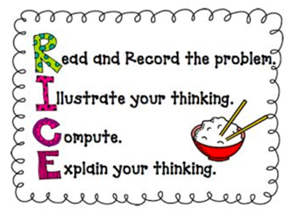
RIDGES
Read the problem.
I know statement.
Draw a picture.
Goal statement.
Equation development.
Solve the equation.
RIDE
Read the problem.
Identify the relevant information.
Determine the operation and unit for the answer.
Enter the correct numbers and calculate, then check the answer.

Slide 14
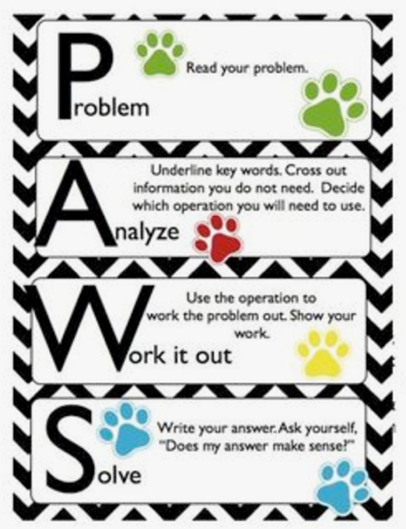
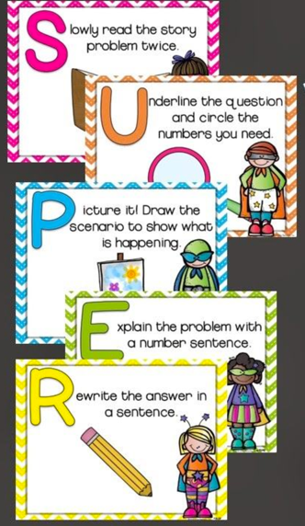

Slide 15
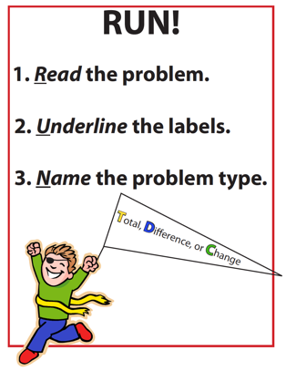
SIGNS
Survey questions
Identify key words
Graphically draw problem
Note operations
Solve and check
SOLVE
Study the problem.
Organize the facts.
Line up the plan.
Verify the plan with computation.
Examine the answer.

Slide 16
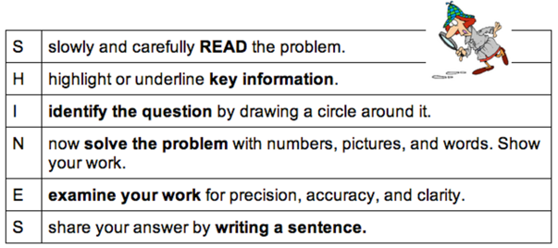
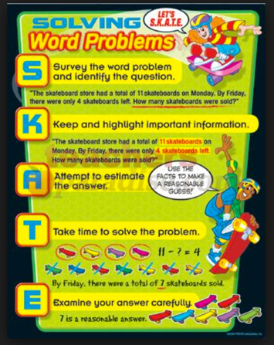
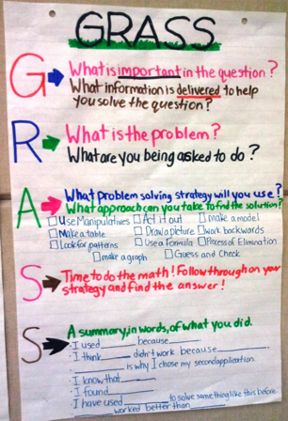

Slide 17
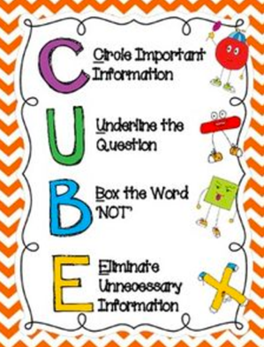
R-CUBES
Read the problem.
Circle key numbers.
Underline the question.
Box action words.
Evaluate steps.
Solve and check.

Slide 18
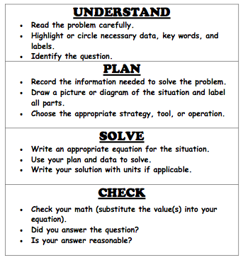

Slide 19
Don’t tie key words to operations
Do have an attack strategy
Do teach word-problem schemas

Slide 20
Schemas
Total
Difference
Change
Equal Groups
Comparison
Ratios/Proportions

Slide 21
Total
Parts put together into a total
Jennifer saw 4 cardinals and 5 blue jays. How many birds did Jennifer see?
4 + 5 = ?
Jennifer saw 9 birds. If 4 of the birds were cardinals, how many were blue jays?
4 + ? = 9
Jennifer saw 9 birds. 5 of the birds were blue jays, how many were cardinals?
5 + ? = 9

Slide 22
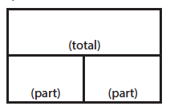
Total
P1 + P2 = T
Fuchs et al. (2008); Griffin & Jitendra (2009)

Slide 23
Total
✓
✓
✓
P1 + P2 = T
U
P
S
✓
✓
28
+
24
=
?
✓
✓
28 + 24 = 52
? = 52 cookies
Grade 3 Smarter Balanced

Slide 24
Total
“Are parts put together for a total?”

Slide 25
Difference
Greater and less amounts compared for a difference
Courtney has 9 apples. Silva has 4 apples. How many more apples does Courtney have? (How many fewer?)
9 – 4 = ?
Courtney has 5 more apples than Silva. If Silva has 4 apples, how many does Courtney have?
? – 4 = 5
Silva has 5 fewer apples than Courtney. Courtney has 9 apples. How many apples does Silva have?
9 – ? = 5

Slide 26
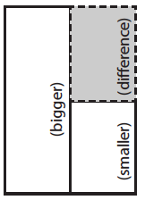
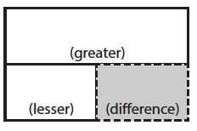
Difference
G – L = D
Fuchs et al. (2008); Griffin & Jitendra (2009)

Slide 27
Difference
✓
✓
G – L = D
✓
U
P
S
✓
✓
107
-
68
=
B
107
68
68
+ ?
107
✓
✓
107 – 68 = 39
Grade 3 Smarter Balanced
B = 39 more beads

Slide 28
Total
“Are parts put together for a total?”
Difference
“Are amounts compared for a difference?”

Slide 29
Change
An amount that increases or decreases
Sandra had $4. Then she earned $3 for cleaning her room. How much money does Sandra have now?
4 + 3 = ?
Sandra has $4. Then she earned money for cleaning her room. Now Sandra has $7. How much money did she earn?
4 + ? = 7
Sandra had some money. Then she made $3 for cleaning her room. Now she has $7. How much money did Sandra start with?
? + 3 = 7

Slide 30
Change
An amount that increases or decreases
Yolanda baked 9 cookies. Then, she ate 2 of the cookies. How many cookies does Yolanda have now?
9 – 2 = ?
Yolanda baked 9 cookies. Then, she ate some of the cookies. Now, she has 7 cookies. How many cookies did Yolanda eat?
9 – ? = 7
Yolanda baked some cookies. She ate 2 of the cookies and has 7 cookies left. How many cookies did Yolanda bake?
? – 2 = 7

Slide 31
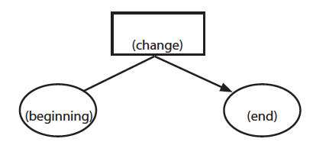
Change
ST +/– C = E
Fuchs et al. (2008); Griffin & Jitendra (2009)

Slide 32
Change
✓
A bus had 13 passengers. At the next stop, more passengers got on the bus. Now, there are 28 passengers. How many passengers got on the bus?
✓
✓
U
P
S
✓
ST + C = E
✓
13
+
?
=
28
✓
28
- 13
13
+ ?
28
✓
13 + 15 = 28
? = 15 passengers

Slide 33
Total
“Are parts put together for a total?”
Difference
“Are amounts compared for a difference?”
Change
“Does an amount increase or decrease?”

Slide 34
Total

Slide 35
Change

Slide 36
Difference

Slide 37
Total
P1 + P2 + P3 = T

Slide 38
Change
ST – C + C = E

Slide 39
Schema Quiz Time!

Slide 40
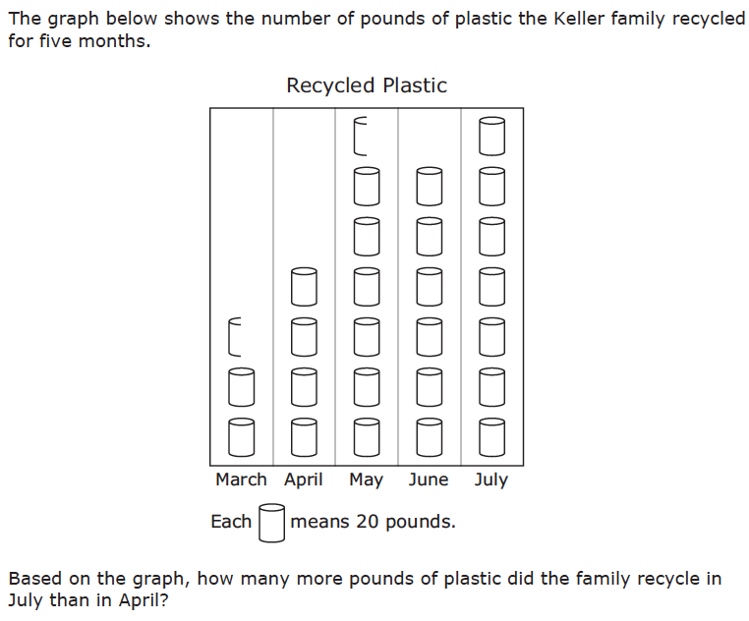
Difference
Grade 3 STAAR

Slide 41
Total
Grade 5 Smarter Balanced

Slide 42
Change
Grade 4 Smarted Balanced

Slide 43
Don’t tie key words to operations
Do have an attack strategy
Do teach word-problem schemas

Slide 44
Equal Groups
Groups multiplied by number in each group for a product
Kristina has 2 bags of apples. There are 6 apples in each bag. How many apples does Kristina have altogether?
2 × 6 = ?
Kristina has 12 apples. She wants to share them equally among her 2 friends. How many apples will each friend receive?
2 × ? = 12
Kristina has 12 apples. She put them into bags containing 6 apples each. How many bags did Kristina use?
? × 6 = 12

Slide 45
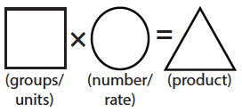
Equal Groups
G × N = P

Slide 46
✓
✓
✓
G x N = P
U
P
S
✓
✓
x
=
6
25
?
✓
✓
6 x 25 = 150
? = 150 cherries

Slide 47
Equal Groups
“Are there groups with an equal number in each group?”

Slide 48
Comparison
Set multiplied by a number of times for a product
Marcie picked 6 apples. Lisa picked 2 times as many apples as Marcie. How many apples did Lisa pick?
6 × 2 = ?

Slide 49
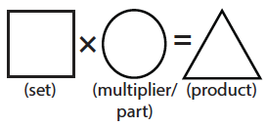
Comparison
S × T = P

Slide 50
Comparison
✓
U
P
S
✓
6
2
?
✓
✓
✓
Grade 4 Smarter Balanced
? = 12 DVDs

Slide 51
Equal Groups
“Are there groups with an equal number in each group?”
Comparison
“Is a set compared a number of times?”

Slide 52
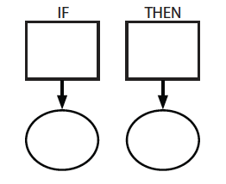
Ratios/Proportions
Description of relationships among quantities
Xin et al. (2005)

Slide 53
Ratios/Proportions
✓
✓
✓
✓
U
P
S
✓
✓
176
?
? = 110 slices
✓
✓
8
5

Slide 54
Equal Groups
“Are there groups with an equal number in each group?”
Comparison
“Is a set compared a number of times?”
Ratios/Proportions
“Are there relationships among quantities - if this, then this?”

Slide 55
Equal Groups

Slide 56
Ratios/Proportions

Slide 57
Comparison
Grade 4 Smarter Balanced

Slide 58
Schema Quiz Time!

Slide 59
Ratios/Proportions
Grade 6 Smarter Balanced

Slide 60
Equal Groups
Grade 4 PARCC

Slide 61
Comparison
Grade 4 Smarter Balanced

Slide 62
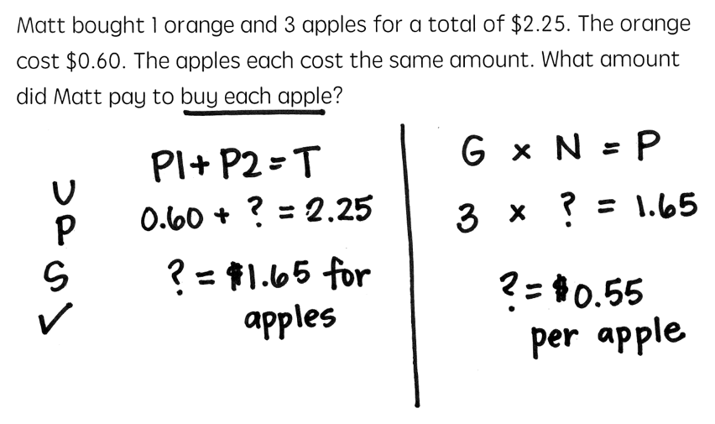

Slide 63
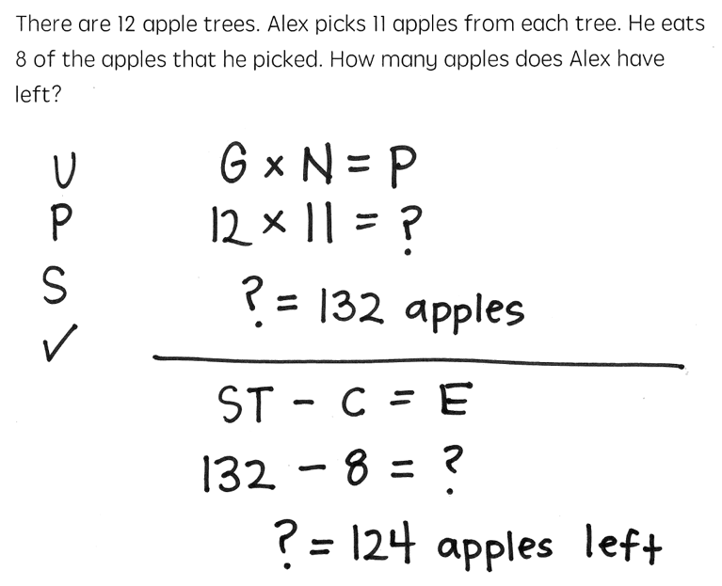

Slide 65
Schemas
Total
Difference
Change
Equal Groups
Comparison
Ratios/Proportions

Slide 66
Don’t tie key words to operations
Do have an attack strategy
Do teach word-problem schemas

Slide 67
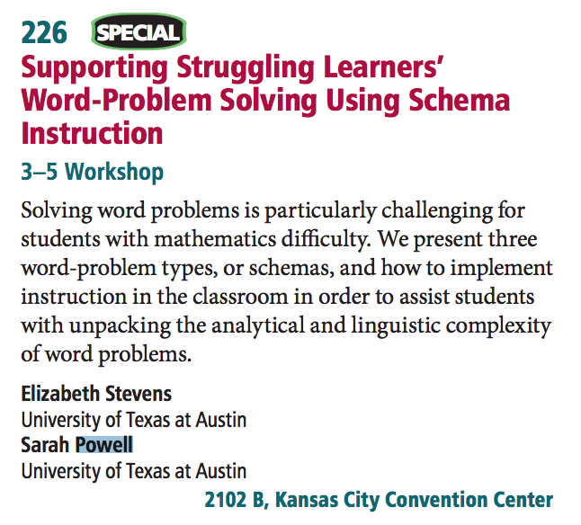
Saturday from 3:15-4:30

Slide 68
Contact Information
Sarah Powell, Ph.D.
The University of Texas at Austin
srpowell@austin.utexas.edu
@sarahpowellphd
119

