Slide 1
Process & System Management - Improving the User Experience to Increase Business Value Erich Kissel @PPMWarrior

Slide 2
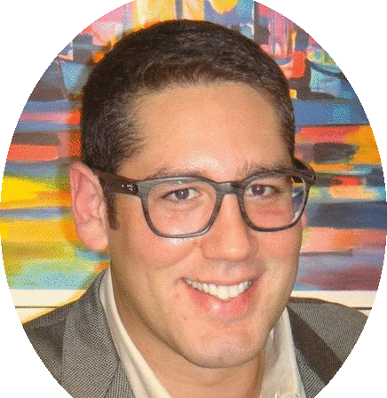
Abstract
Erich is a process/system functional specialist, blogger and thought leader in the PPM space. He has led PPM transformation through implementation, maturity and value enablement, including; Demand, Resource, Project, Financial Management and Portfolio Planning within his organization.
His latest interest is facilitating Design Sessions and Hackathons, with the intent to de/reconstruct Next Gen PPM.
Erich Kissel
Citrix
@PPMWarrior
LinkedIn: Erich Kissel
Erich.Kissel@Citrix.com

Slide 3
Agenda
We are Here to enable CA PPM ROI
1
Facilitating CA ppm value within our organizations
2
Unique Approaches
3
Value Enablement techniques
4

Slide 4
#ROI

Slide 5
The value of a process/system can be measured by the efficiency of input and value of output
Intuitive flow: “low clicks,” direct tie between process/system
Insight: right information, people, time with context

Slide 6
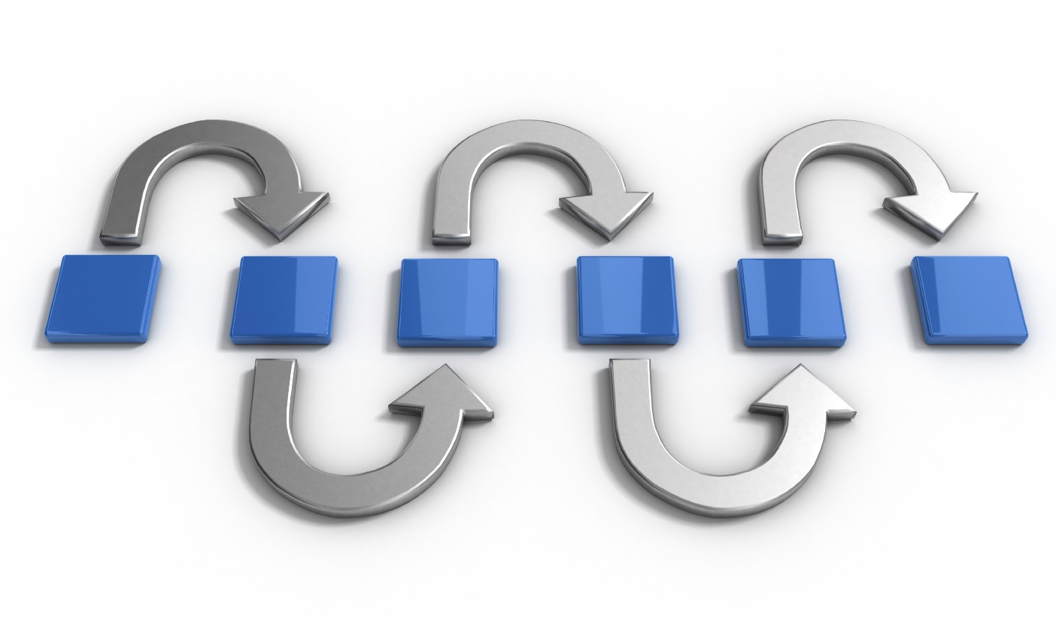
What is the value return?
Insight:
Capacity to gain an accurate and deep intuitive understanding
Right information, people, time and with context

Slide 7
Value Enablement Layer
Functional
Technical

Slide 8
Value Enablement
Usability
Quality attribute that assesses how easy user interfaces are to use; the word "usability" also refers to methods for improving ease-of-use during the design process
Defined by five quality components:
Learnability
Efficiency
Memorability
Errors
Satisfaction

Slide 9
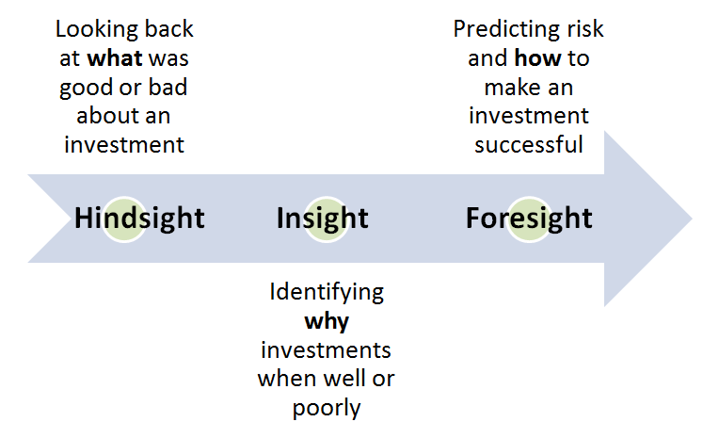
Can we track usability?
Metrics that matter
Data compliance and audit
KPIs
Click counts
Surveys
Beta and CRs
Availability and Speed
Show me tangible and real value!
Data quality enablement

Slide 10
#UNIQUE

Slide 11
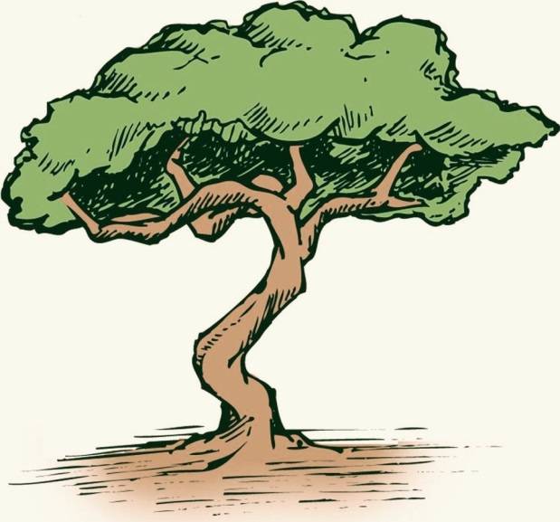
Concepts are easy
Process/system achieved value is difficult and unique to each organization

Slide 12
One size does not fit all
Coming from different environments
Have different stories
Unique limitations
Different needs and definitions of “value”
Singularly implementing functionality instead of solutions
Most do not have EPMOs, must be agile within own organization … Different adoption requirements from different groups

Slide 13
My story - from “ripping out,” to value enablement
“Way too complex”
“Find no value”
“Ignore it until it goes away”

Slide 14
Examples of how we showed improved User Experience
“I am satisfied with the updated process” 88 percent Agree or Strongly Agree (RM)
“Converted our business requirements into a robust and innovative PPM solution that provided simplified self-service project management capability” (Services)
“Enhanced functionality with minimal change management” (FM)
“I want to be on your team, you have the most fun.” (user)
22 clicks to 12 to 5 (“oob” AM)
“I love CA Clarity” (user)
Business value is difficult to track. Nine business units implemented Resource Allocation Management and/or Executive Status Reporting/ Top Down Gantt Views
Feedback from process training, 50 percent participation (average was 12 percent at the time)
Qualitative & Quantitative

Slide 15
#ENABLEMENT

Slide 16
Standard Steps to Success
Exec support
Trained and available team
Change management
Operationalized policies
But there is more …

Slide 17
An organization’s greatest asset is its people, not users

Slide 18
Embrace the hate
People having emotional reactions
Opportunity to identify the improvements

Slide 19
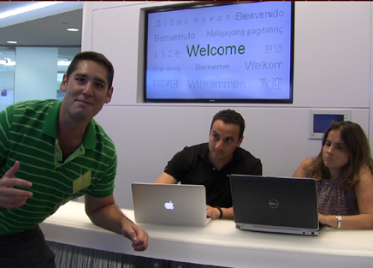
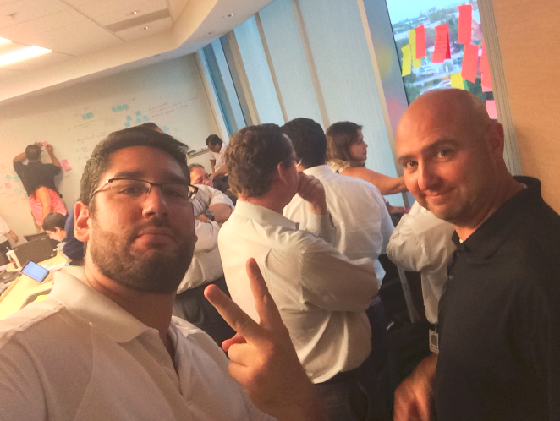
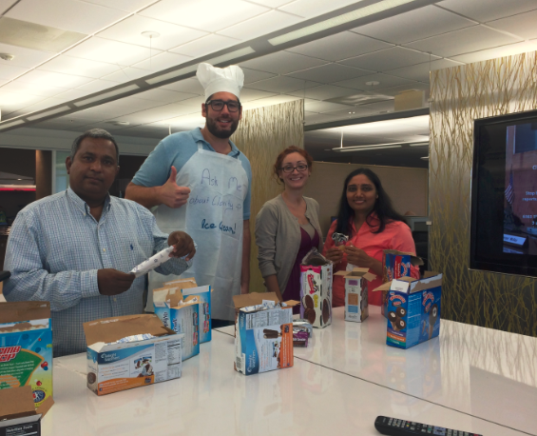
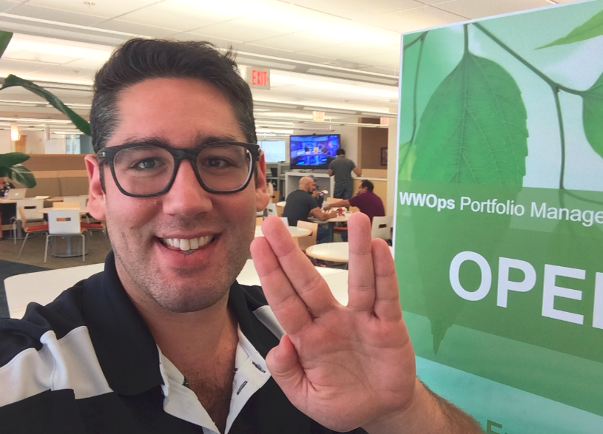
Engage and acknowledge, remove barriers of communication and issue propaganda

Slide 20
Creativity through Constraints
“Training on-demand”
“Performs like a pivot”
“Simple as a spreadsheet”
“Easier than a workaround”
“Quickly consumable communication”
…

Slide 21
“But all I need is a bucket of water”
“Out - In” v. “In - Out”
Only thing that an organization or group is capable of appreciating is a bucket of water
Beware of “shoulding” or speaking above the need

Slide 22
Is the “right thing,” right here and right now?
Best practices, or the “right thing,” are not wrong, they just never seem right enough for our specific situation—identify the pain
Not necessarily the “what,” but the “how” and the “why”

Slide 23
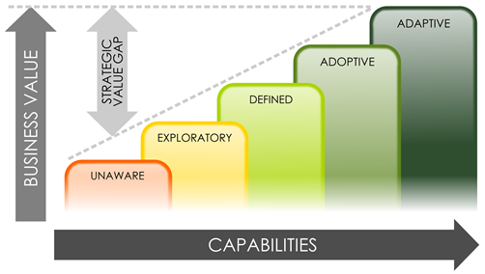
Maturity is Step-by-Step
Note: The rule is “Process 1st, then tool.” But some groups do want to leverage best practices and will adapt to a tool

Slide 24
Maturity is step-by-step
Project/Program
/Product
Management
Maturing towards portfolio processes
value is a the sum of the CA PPM processes
Project/ Program / Product Financial
Management
Demand Management
Resource
Management
Reporting

Slide 25
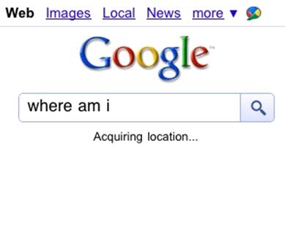
Enhancements | 50/50 | Simplification

Slide 26
Turn off the noise
Gain direct access
Set favorites
Set home
Publish “Action Boards”
Configure for pop-ups v. redirection

Slide 27
Needle in a haystack - must give a Metal Detector
Menu tied directly to processes
Scheduled and subscription reports
“Appify” functions
KPI dashboards
Make “smaller”

Slide 28
From Cog to Cognizance
Identifying the direct correlation between data entry and value output
KPIs drive activity and will change behavior
Organic audit

Slide 29
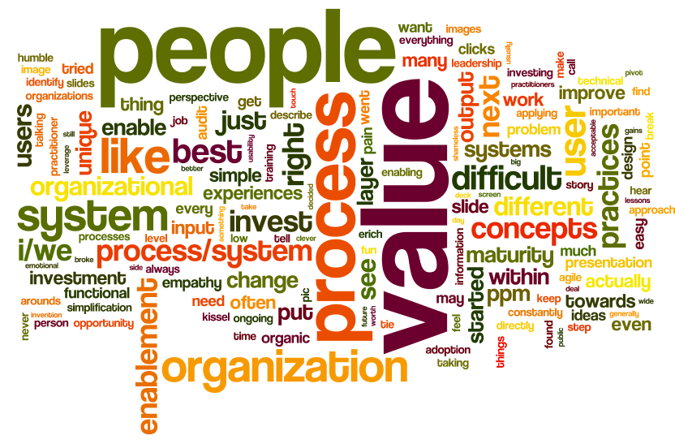
Play

Slide 30
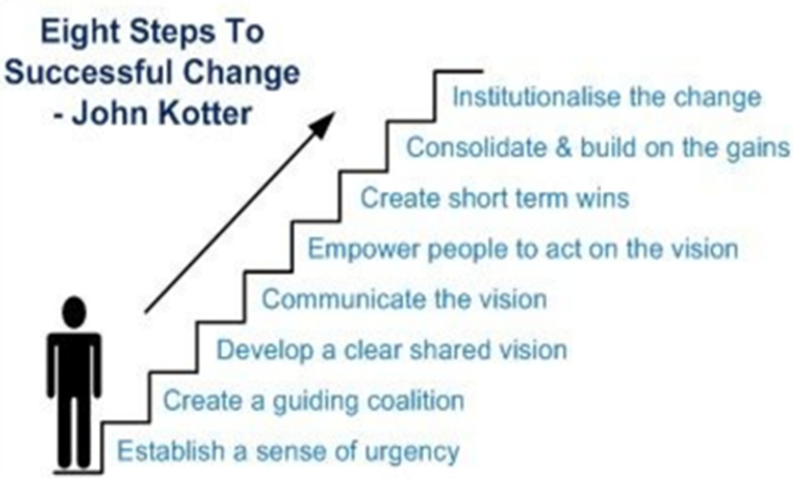
Play

Slide 31
Takeaways
No ROI without user acceptance
Value found with CA PPM insight
Value Enablement Layer— Each organization is unique

Slide 32
Takeaways
Value from process/ systems—easy-in and insight out
Treat process/ system users as people
Look for and embrace the hate/pain
Play and get a foot in the door to prove value
Get visible and create inclusion
Cog to cognizant when relating investments

Slide 33
Takeaways
Creativity through constraints
It’s the people out-to-in, not in-to-out when investing in further value
Maturity is PPM-holistic and step-by-step
Make the system “small”
Great transformation towards value is within our ability, low investment, high ROI!

Slide 34
Summary / Q&A
We can greatly improve the value that our supported processes/systems provide to our organizations by clever and custom enablement techniques when we treat our users as people.
@PPMWarrior
LinkedIn: Erich Kissel
Erich.Kissel@Citrix.com

