Slide 1
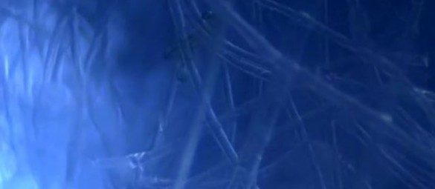
An Introduction to the Fascial System and Myofascial Release Techniques
By Lisa Satalino, PT

Slide 2
Definition of Fascia
Historical Definition
Definition Re-Created at First International Congress on Fascial Research in 2007
Fascia is the soft tissue component of the connective tissue system that permeates the human body forming a whole-body continuous three-dimensional matrix of structural support.
It interpenetrates and surrounds all organs, muscles, bones and nerve fibers, creating a unique environment for body systems functioning.
Fascia is described as all collagenous fibrous connective tissues that can be seen as elements of a body-wide tensional force transmission network.

Slide 3
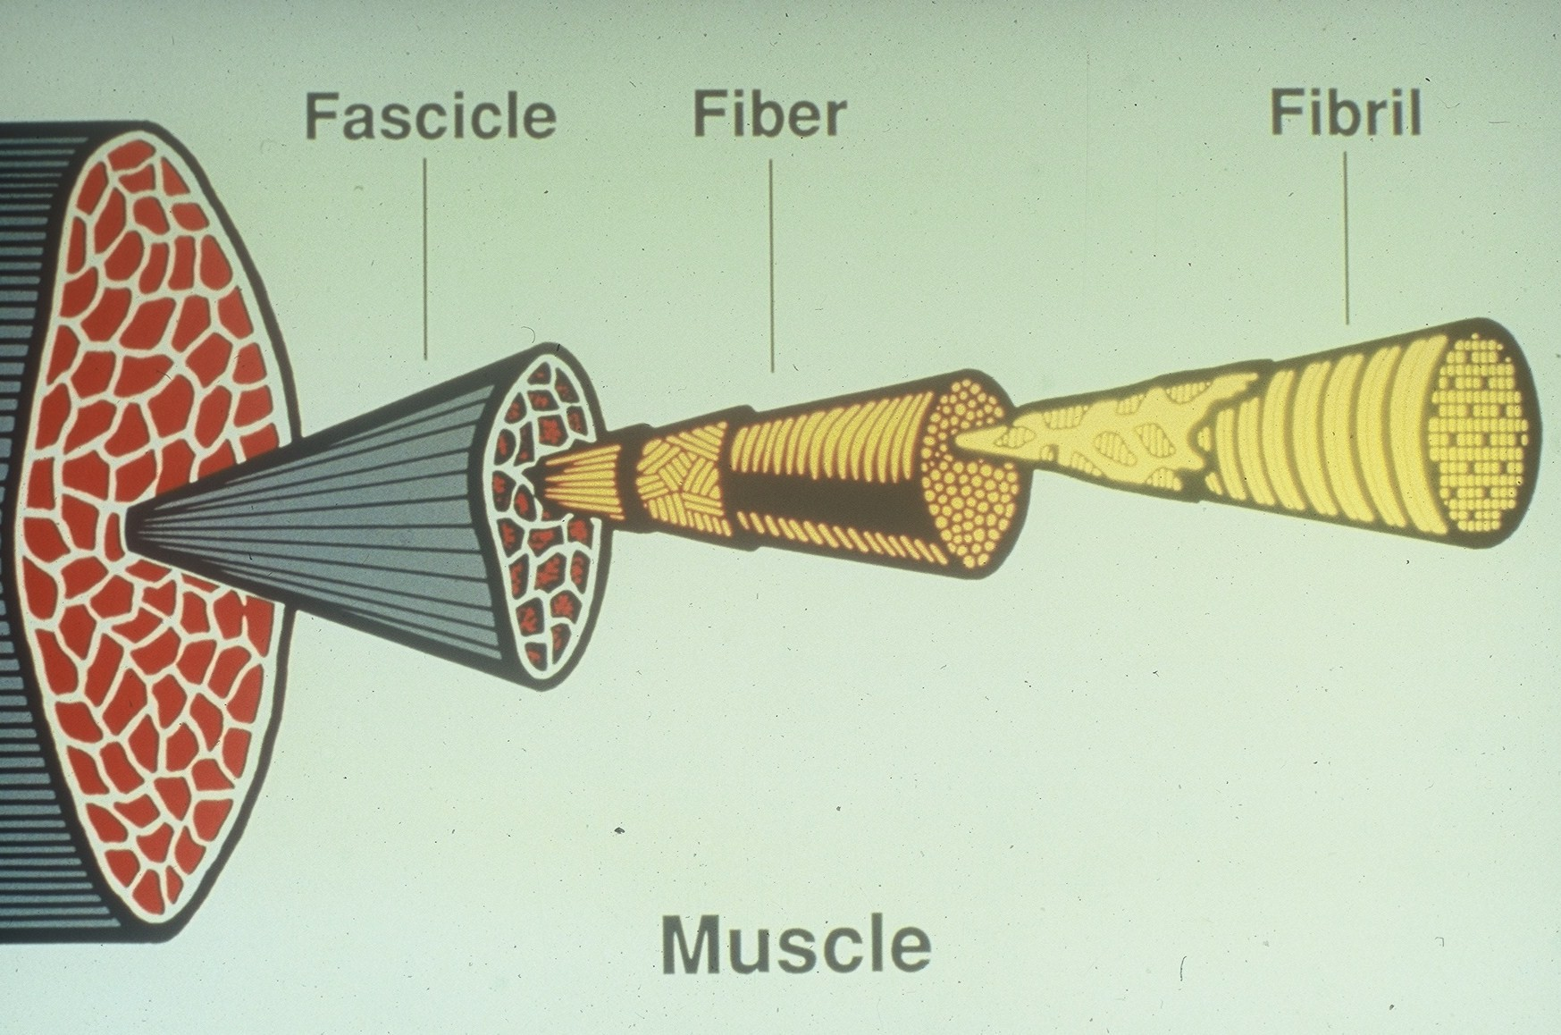
Anatomical Depiction of Fascia and Surrounding Architecture:
Traditional View
Fascia was removed from display to view underlying joint, bone, tendon, organ, etc.
A clear distinction between ligament, capsule, tendon, muscle, joint, etc. is portrayed.
Little attention was paid to the “continuity” of local architecture.
Movement of the body through space was believed to occur through the compressional forces of muscles on classic weight bearing structures such as bones and cartilage.

Slide 4
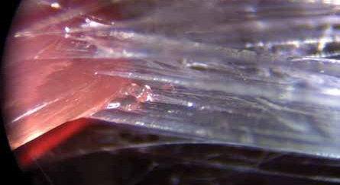
Anatomical Depiction of Fascia and Surrounding Architecture:
Current View
In vivo displays of fascia indicate little distinction in the transition between ligament, capsule, tendon, septum, and muscular envelopes.
Fascia is seen as a continuous web in which the morphology of tissue is dependent on the local history of tensional forces.
Movement of the body in space is seen to occur via tensegrity-type qualities.
It is believed that the “fascial web is the elastic portion of a tensegrity structure, in which bones and cartilage are suspended as spacers rather than as classical weight bearing structures.”

Slide 5
Types of Collagenous Fibrous Connective Tissue – aka Fascia
Superficial Fascia has relatively low density and high multidirectionality. Fibers tend to have an irregular pattern.
Tendons and ligaments are more unidirectional and dense.
Intramuscular fasciae such as septi, perimysium, and endomysium may be of varying degrees of directionality and density based on their function.
Visceral fascia is variable in directionality and density. Examples would be the very loose and lattice-like fascia of the abdominal cavity vs. the very dense tissue of the pericardium.

Slide 6
Morphology of Fascia as related to new definition
In contrast to bones or cartilage, the shape of fascia is dependent on the dominance of tensional loading rather than compressional loading.
The specific shape of the fascial tissue is dependent on the tensional forces of the given area.
For example, if the region’s torsional demands are unidirectional and involve high loads, the fascial net will be expressed as a tendon or ligament.
Where demands are more multidirectional or loads are more varied in nature, the fascial net may be expressed as a lattice-like membrane or spider web type tissue.
While “fascia” can be seen in lay terms as “connective tissue,” all tissue derived from the embryonic mesenchma layer including bones, cartilage, and blood are also considered “connective tissue.”
While we have conventionally made distinctions among different types of connective tissue, in reality there is no clear demarcation between them. They are just different densities and arrangements of the same tissue.

Slide 7
Fascial Architecture
In the past we considered the fibres (collagen and elastin) as separate entities from the matrix of the ground substance.
We now understand that the collagen fibres are a very important part of the matrix known as ground substance and play an important role in its architecture.
Fibres may be considered a sturdy cable/mesh system which combine with an amorphic material (ground substance) which produces an “optimal mechanical strength to multidirectional loading.”
Consider the analogy of re-bar in concrete..

Slide 8
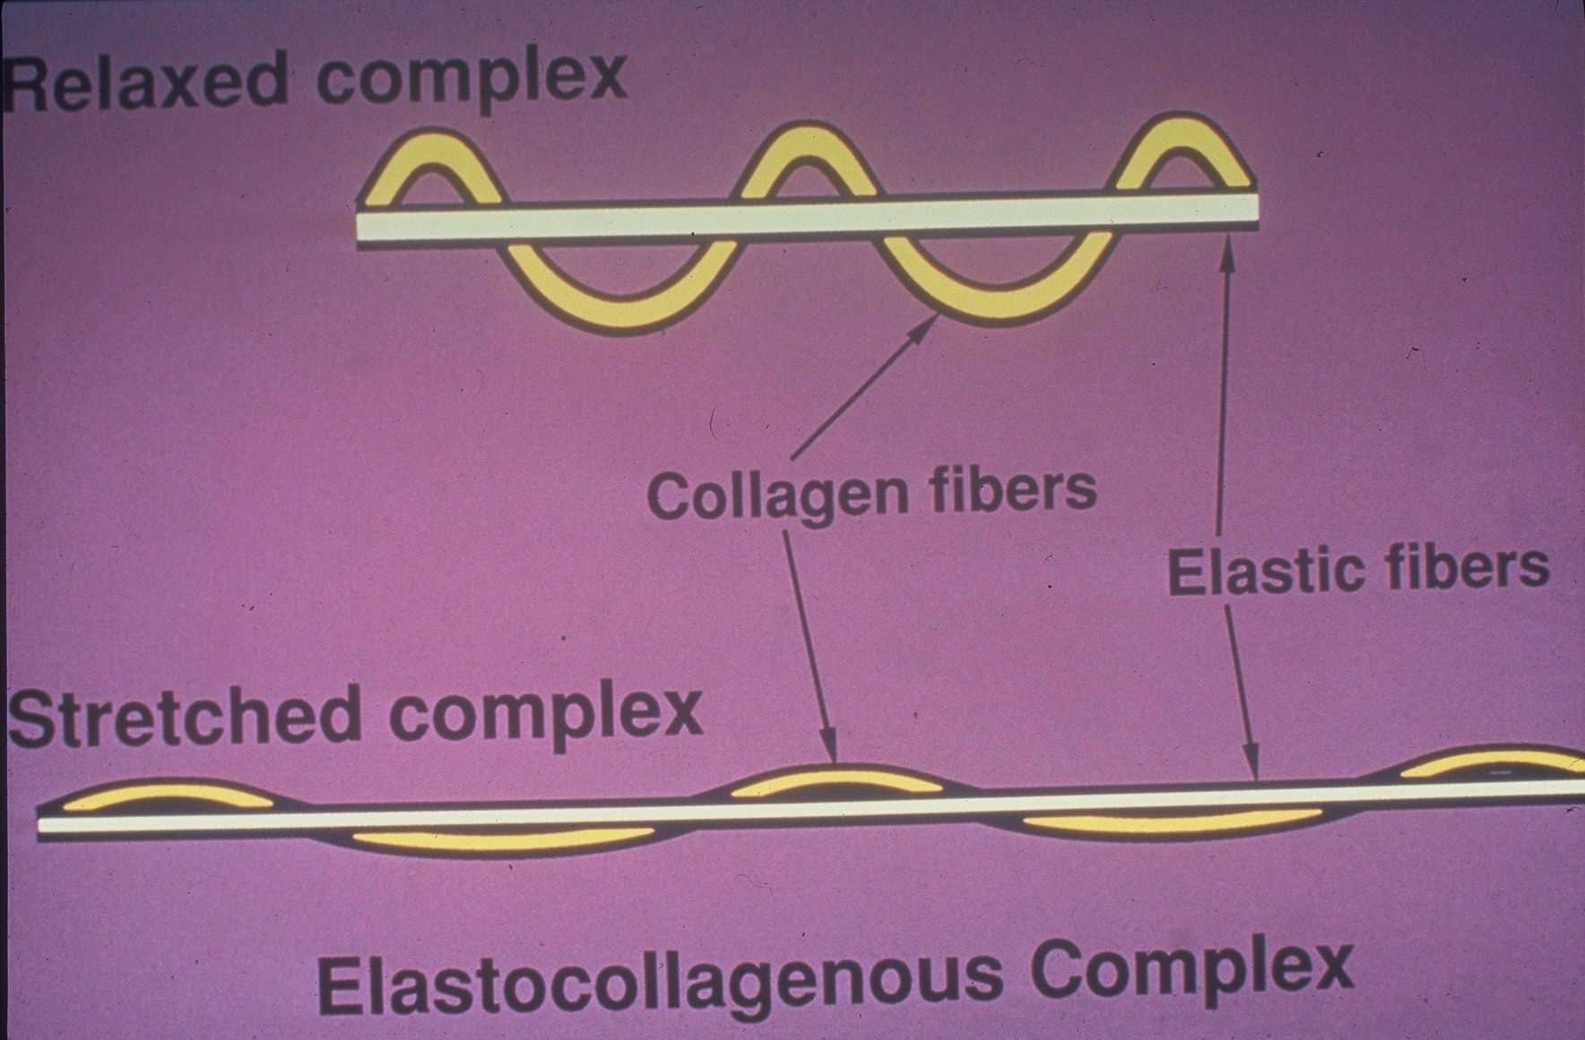

Slide 9
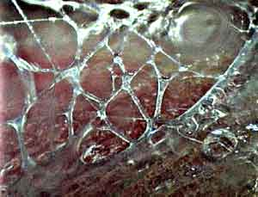

Slide 10
Components of Fascial Tissues: Contemporary View
Cells
Extracellular Matrix
Cells make up less than 5% of the total volume in fascial tissues.
Most of the cells are Fibroblasts and leukocytes.
Fibroblasts are the “construction and maintenance” workers of the matrix. They create collagen structure based on the forces imposed locally and “clean-up” debris from damaged cells.
ECM is made up of Ground substance and fibres.
Ground Substance – mostly made up of interstitial water which is bound by proteoglycans.
Fibres are comprised mostly of collagen with a few elastin fibres.

Slide 11
Fibroblasts and Fascial Health
Resident fibroblasts produce, remodel, and maintain most of what makes up fascia.
Water is the largest component of fascia and is extruded form small arterioles in the fascia.
Fibroblasts are responsive to mechanical stimulation and biochemical stimulation.
When fascia is loaded properly, fibroblasts can adapt the fascial matrix. Remodeling occurs, providing the tissue’s architecture the ability to respond better to ADL’s as well as athletic performance.

Slide 12
Why has the Fascial System not received much scientific attention in the past?
It is so pervasive and interconnected that it can not be easily divided into discreet subunits for study.
In anatomic displays the fascia is removed to study the underlying structures.
The properties of the fascial system drastically change post-mortem and the embalming process totally disrupts the fascial system.
We have not previously had a mechanism to study the fascial system in vivo.

Slide 13
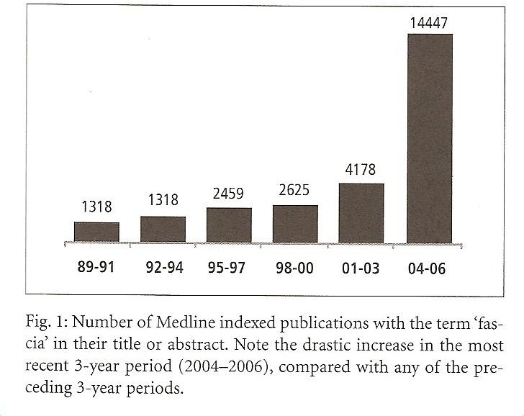
Recent Increase in Fascial Research
Understanding that fascia plays a role in musculoskeletal strain disorders, postural strain patterns, fibromyalgia, pelvic pain, respiratory dysfunction, chronic stress injuries, wound healing and scarring, and trauma recovery and repair.
Recent advances in microscopy and ultrasound are allowing us to view the fascial system in vivo.
The first International congress on Fascial Research was held in 2007 and was sold out at 700 participants representing every continent but Antarctica and was shown via delayed video to dozens of international viewing sites on 5 continents.
Since that time International Congresses on Fascial Research are held every two to three years and comprise the world’s leading scientists and researchers, physicians and surgeons, and manual therapists working directly with the fascial system.
Hundreds of fascia related scientific articles have been published since 2007 and millions of dollars have been spent in the research and development of research on the fascial system.

Slide 14
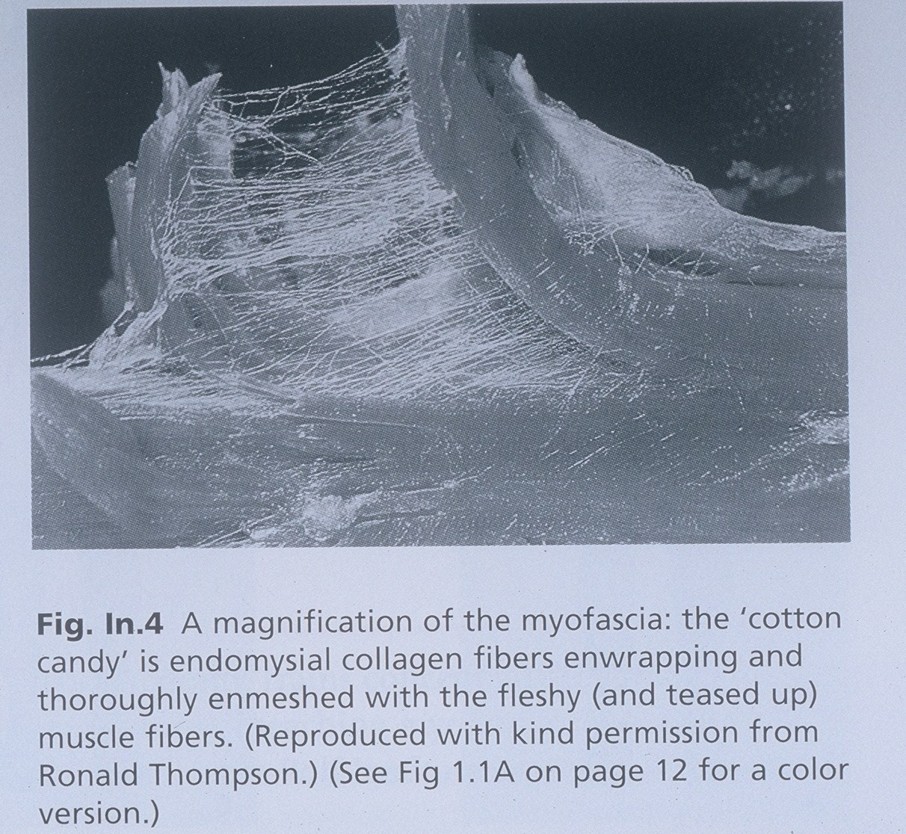
This is a picture of the fascial system in it’s non-hydrated form post mortem. The properties of the fascial system when it is non-hydrated act like that of an insulator.

Slide 15
This is a picture of the fascial system in vivo. The same collagen fibers that looked like
brittle spider webs now comprise hydrophilic jelly called proteoglycoaminoglycans.
The properties of the fascial system when hydrated allow the system to act as a
semi-conductor rather than an insulator.
In lay terms this equates to the difference between how the inside (semi-conductor) of an
electrical cord works vs. the outside (insulator) of an electrical cord works.

Slide 16
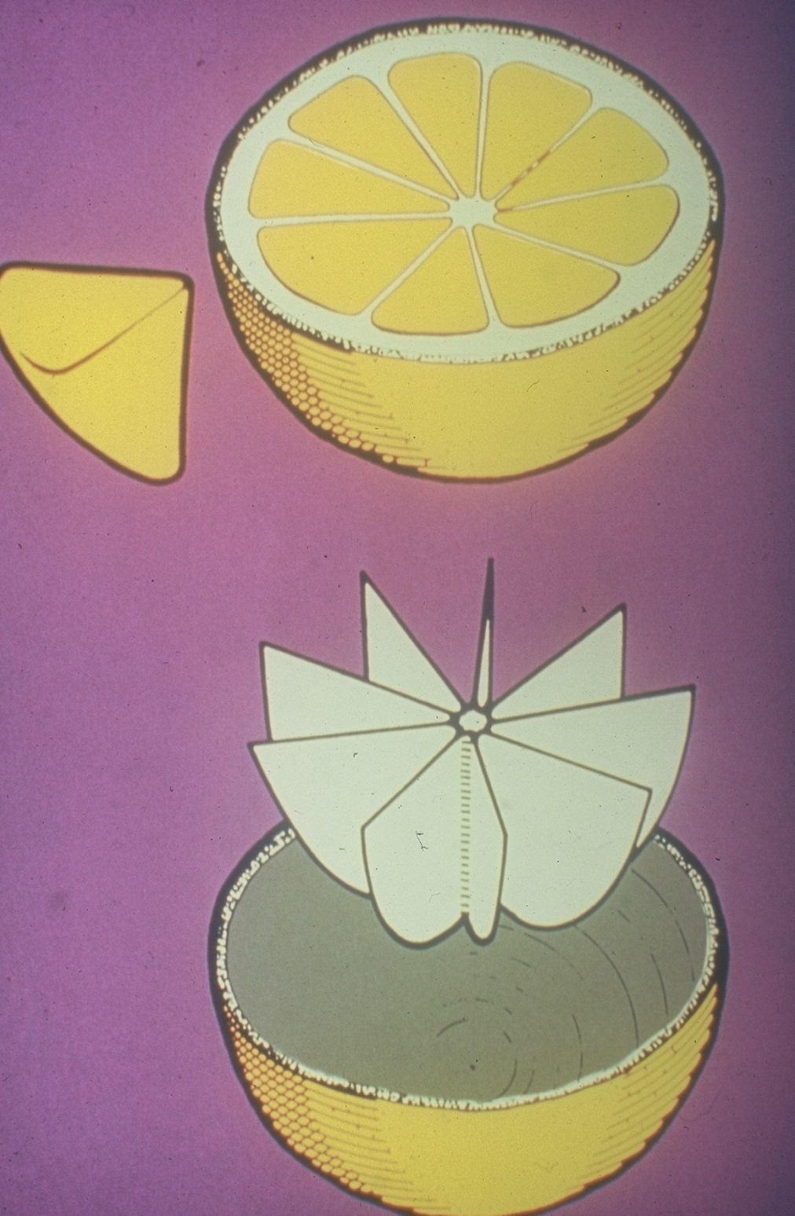

Slide 17
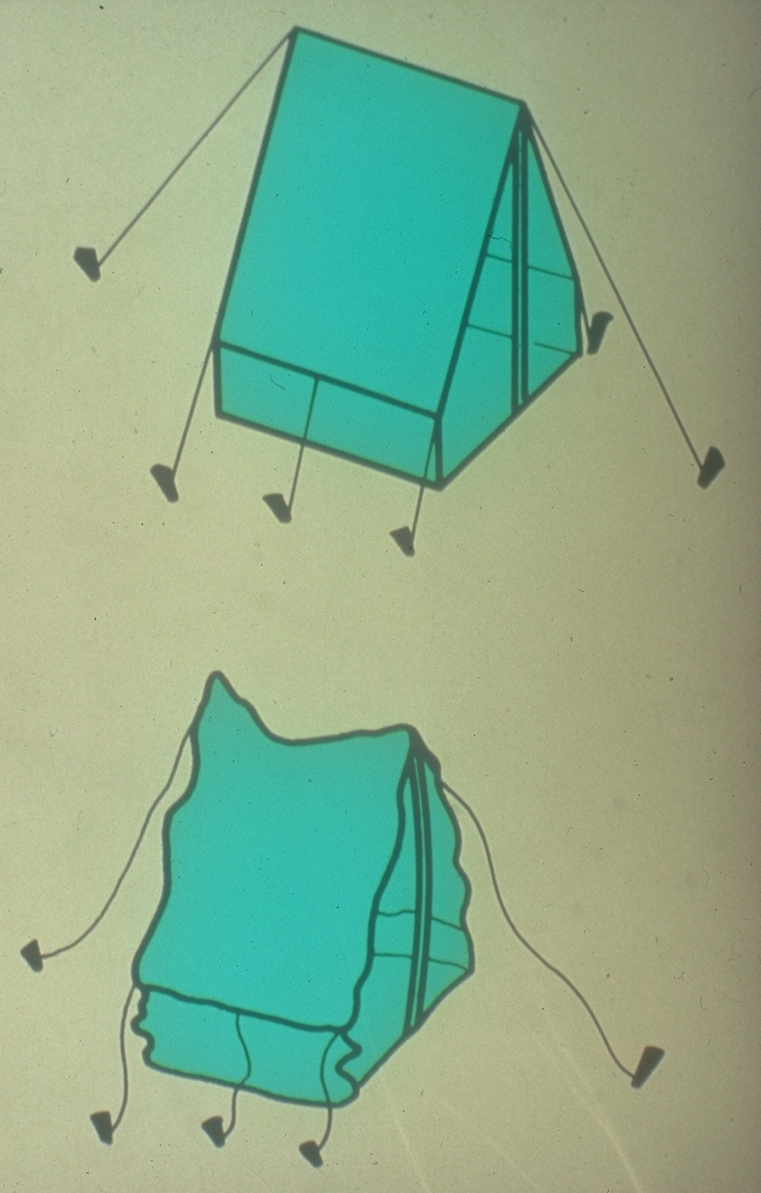

Slide 18
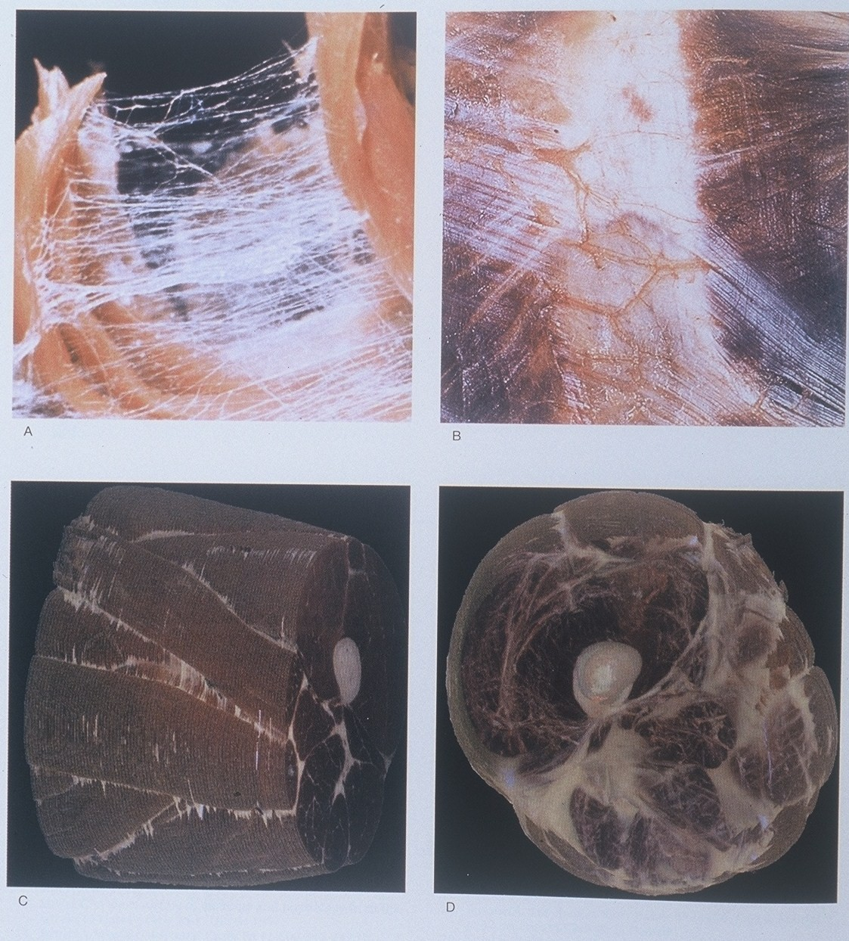

Slide 19
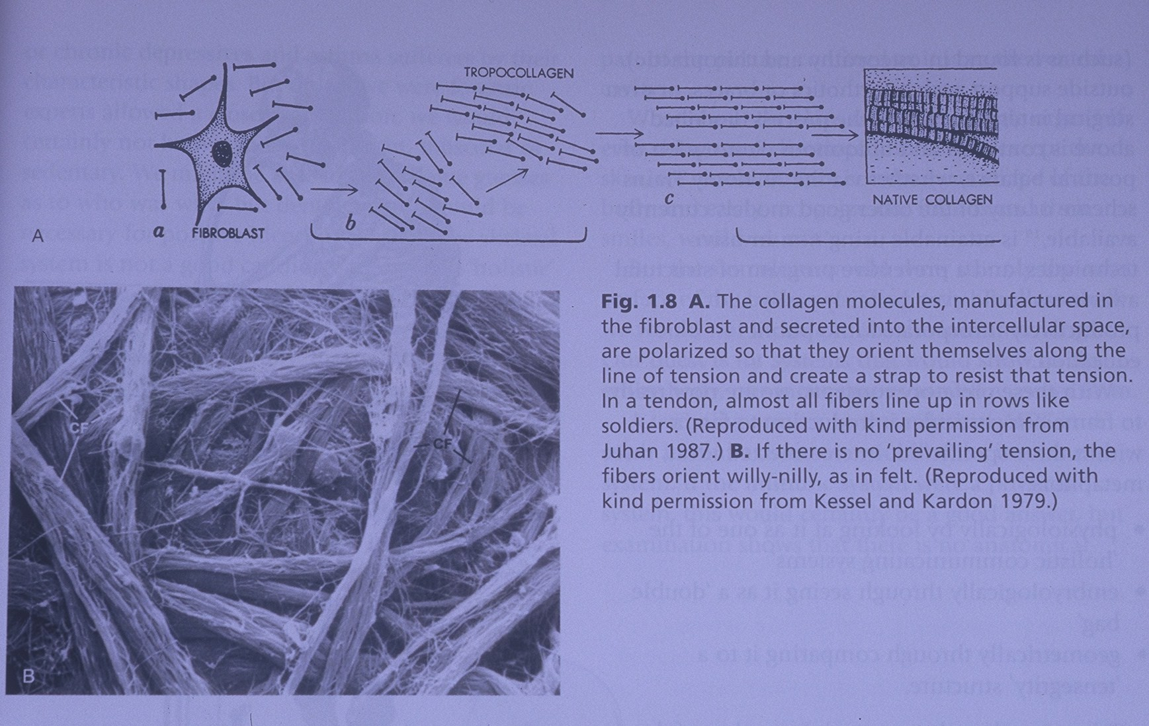

Slide 20
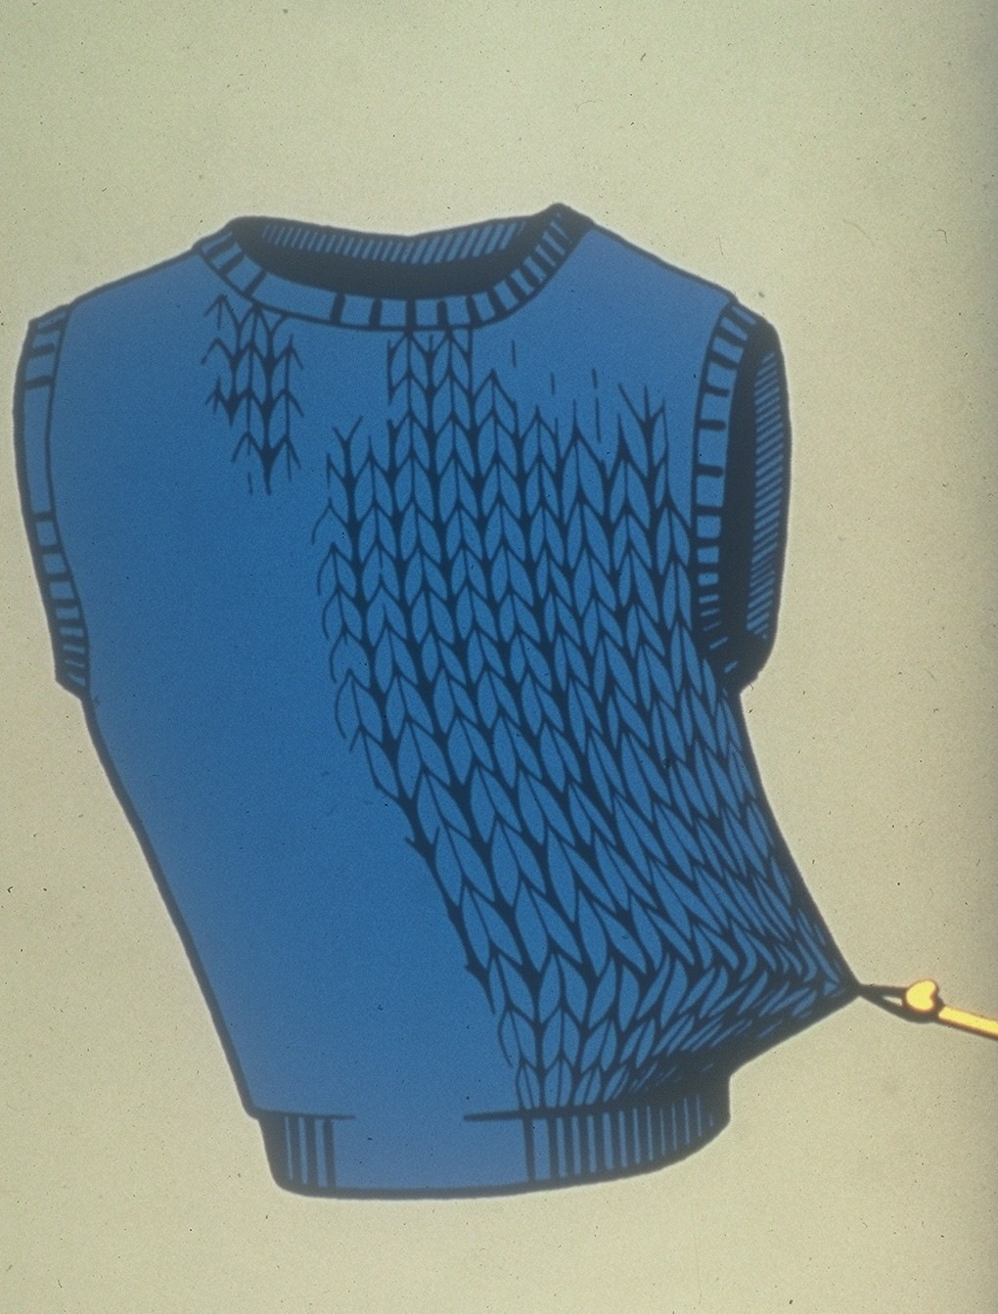

Slide 21
Fluid Composition in the Fascial System
Interstitial Fluid is made up of the same concentrations of salts as the water in our oceans.
There is interfascial or bound water and bulk or unbound water found in connective tissue
Healthy fascia contains more bound water than bulk water. Bound water behaves with the same characteristics of a liquid crystal.
Bound water has greater molecular stability, a negative electrical charge, a greater viscosity, the ability to absorb certain spectra of light, and the ability to string together molecules.
Many pathologies – such as inflammatory conditions, edema, accumulation of free radicals and waste products, etc. have a higher percentage of bulk water in the ground substance.
Bulk water does not contain the advantages of bound water.
When connective tissue is manipulated it can become rehydrated. It is like the effect of squeezing a sponge – bulk water zones are wrung out and “fresh” water from blood plasma is replenished allowing for bound “water zones.”

Slide 22
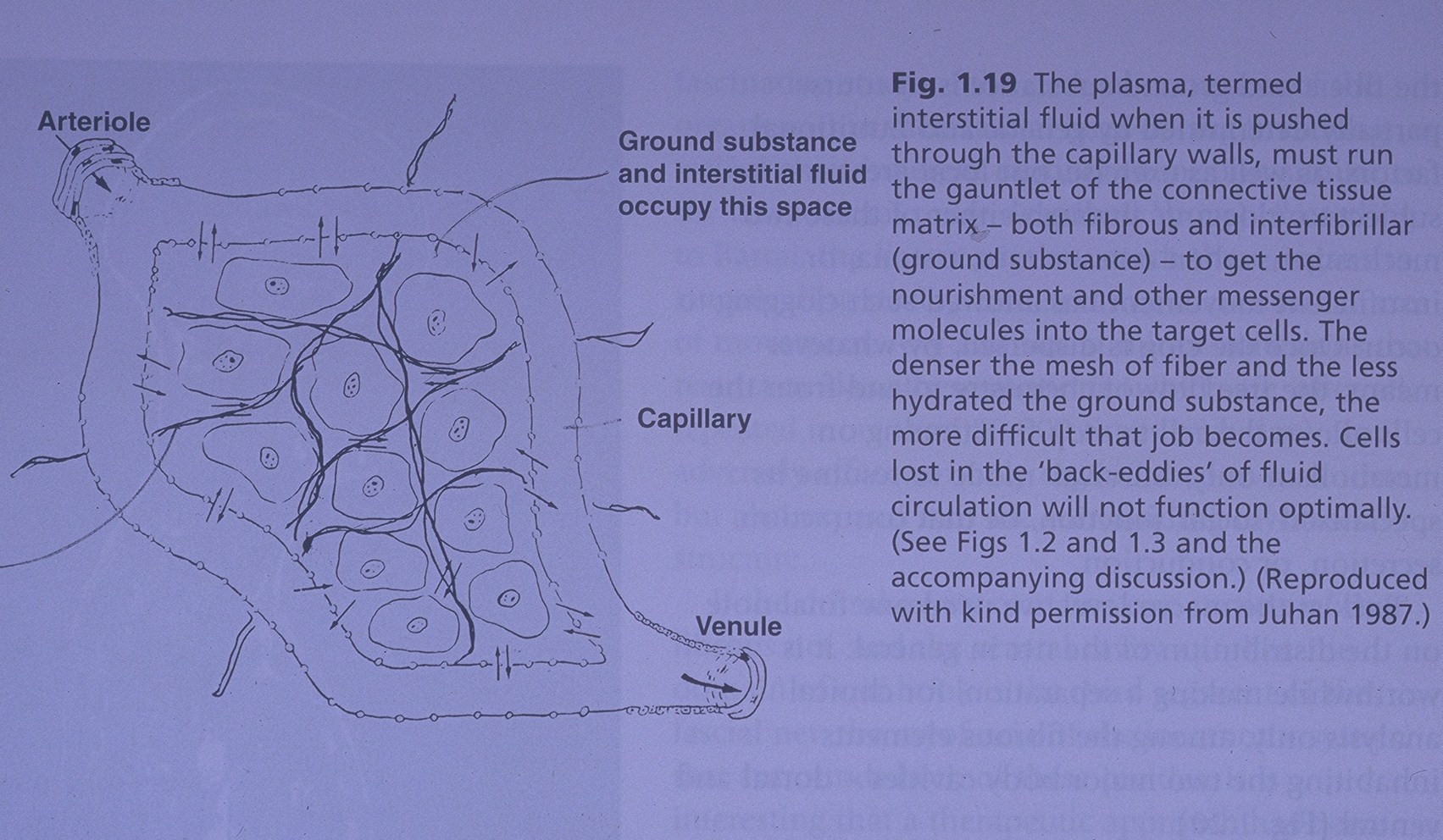

Slide 23
Functions of Fluids in the Fascial System
Interstitial fluids create a transport space for nutrients, waste materials, and messenger substances to facilitate homeostasis between the extracellular and intracellular milieu.
Fascia plays a major role in the fight against pathogens and infections prior to any kind of intervention from the immune system.
Interstitial fluid is a medium of communication between cells. Because both collagen and water molecules have polarization properties protons can “jump” along collagen fibers at a rate faster than electrical signals can conduct over a nerve fiber.
Fascia provides the pumping force for the return circulation of blood and lymph into the blood vessels.
The proteoglycans in fascia act as shock absorbers and lubricants. They actively participate in the mechanical cohesiveness of connective tissue.

Slide 24
The Fascial “Pump”
The fascial system is an intimate partner with the vascular and lymphatic system in regards to return circulation.
Unlike arteries, which have some rigidity, veins and the lymphatics are fairly flacid and collapse easily.
While the transport of lymph involves contraction of valves, these valves are made of fascia and they contract at the same rate as fascia.
Fascia continually contracts at the rate of 8-12 cycles per minute.
These contractions act as a pump, driving fluids through the vessels.
Fascia is not comprised of parallel bands but of layers arranged in circular, transverse, or oblique patterns.
Contraction of the fascia occurs in a spiral pattern similar to wringing out a dishtowel.
If fascia is in an abnormal state of tension this wringing can create a tourniquet type action resulting in stasis.
It is now believed that the “listening stations” associated with palpation of the cranialsacral rhythm are actually detecting the “fascial pulse.” Studies have shown that the cerebrospinal fluid, while creating the same rhythm of pulse, is actually contained within the dural tube and is distinct from the interstitial fluid flow of the periphery.

Slide 25
Cell Stimulation and Fascial Health
Biochemical Stimulation
Biomechanical Stimulation
Fibroblasts can be stimulated biochemically from the following: inflammatory cytokines, several other cytokines, hormones, changes in ground substance ph, and availability of HGH.
Human Growth Hormone is produced during sleep. It acts as an important “fertilizer” for collagen production and proper collagen synthesis. (ie sleep is very important for fascial health!!)
Nutritional care (and sleep) can improve the biochemical environment.
Fibroblasts change their metabolic function based on the tensional and mechanical shears imposed upon them.
Biomechanical stimulation is at least as important for tissue health as the biochemical environment.
Without proper mechanical stimulation, fascial fibroblasts will not create an adequate fibrous matrix, regardless of the status of the biochemical environment.
Sports, movement therapies, and manual therapies can foster optimal biomechanical stimulation for matrix remodeling from fibroblasts.

Slide 26
Collagen Fibre Loading and Fascial Health
Healthy fascia is able to store and release kinetic energy resulting in elastic recoil motion.
Elastic recoil motion is responsible for some of the “effortless” motion patterns seen in gymnastics, martial arts, and other dynamic movement sports. It is also what gives you the “spring in your step” associated with youth.
The collagen of “healthy fascia” has a two-directional lattice arrangement and undulations called “crimp” which appear like elastic springs.
Collagen that is aged or has been immobilized has a dysregular fibre arrangement, multidirectional growth of cross-links, and dense collagen fibres. The fibres lose their elasticity and stick together creating adhesions. The fibres flatten and lose their “crimp” and springiness.
Proper exercise with favorable loads to collagen fibers can result in regaining a more wavy fibre arrangement and improved elastic recoil.

Slide 27
Collagen Adaptation
Occurs slowly over time. The renewal speed of the fascial network is slow – the half life of which is months to years depending on the structure.
The load needed for restructuring is also dependent on the structure. Tendons require high load whereas low force is adequate for intramuscular fascia.
Timing for collagen synthesis vs degradation is important. Collagen synthesis is most prevalent in the first three hours after exercise. Within the next 48 hours the net degradation is greater than regeneration.

Slide 28
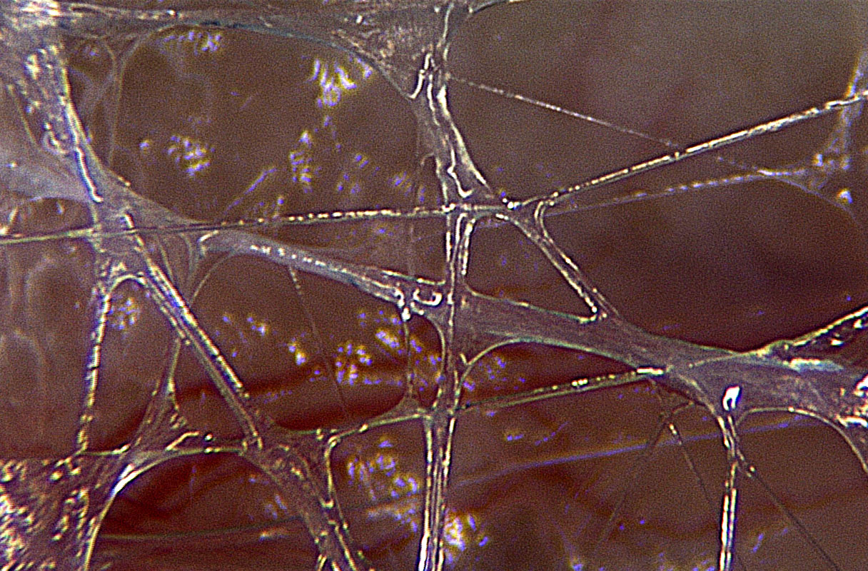
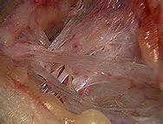
Guimberteau Pictures of Normal Fascia vs. Fascia with Restriction.
“Normal Fascia”
“Fascial Restriction”

Slide 29
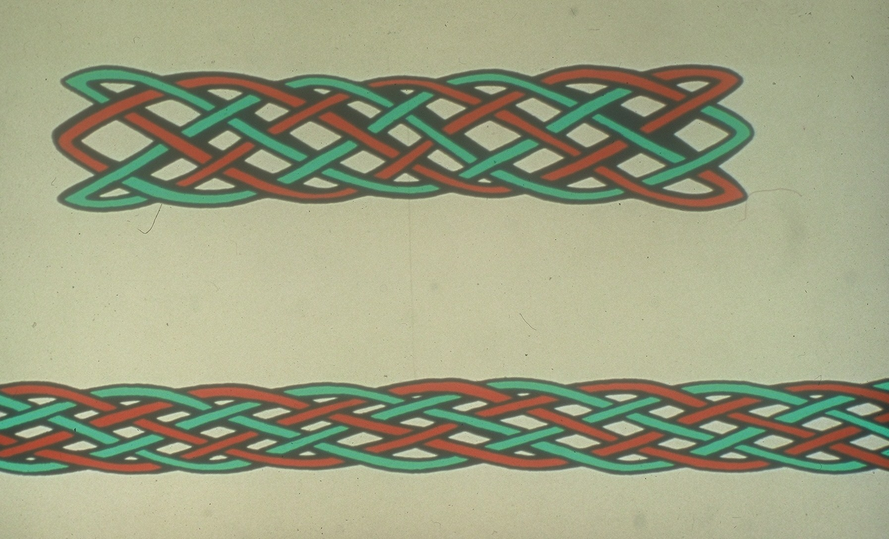

Slide 30
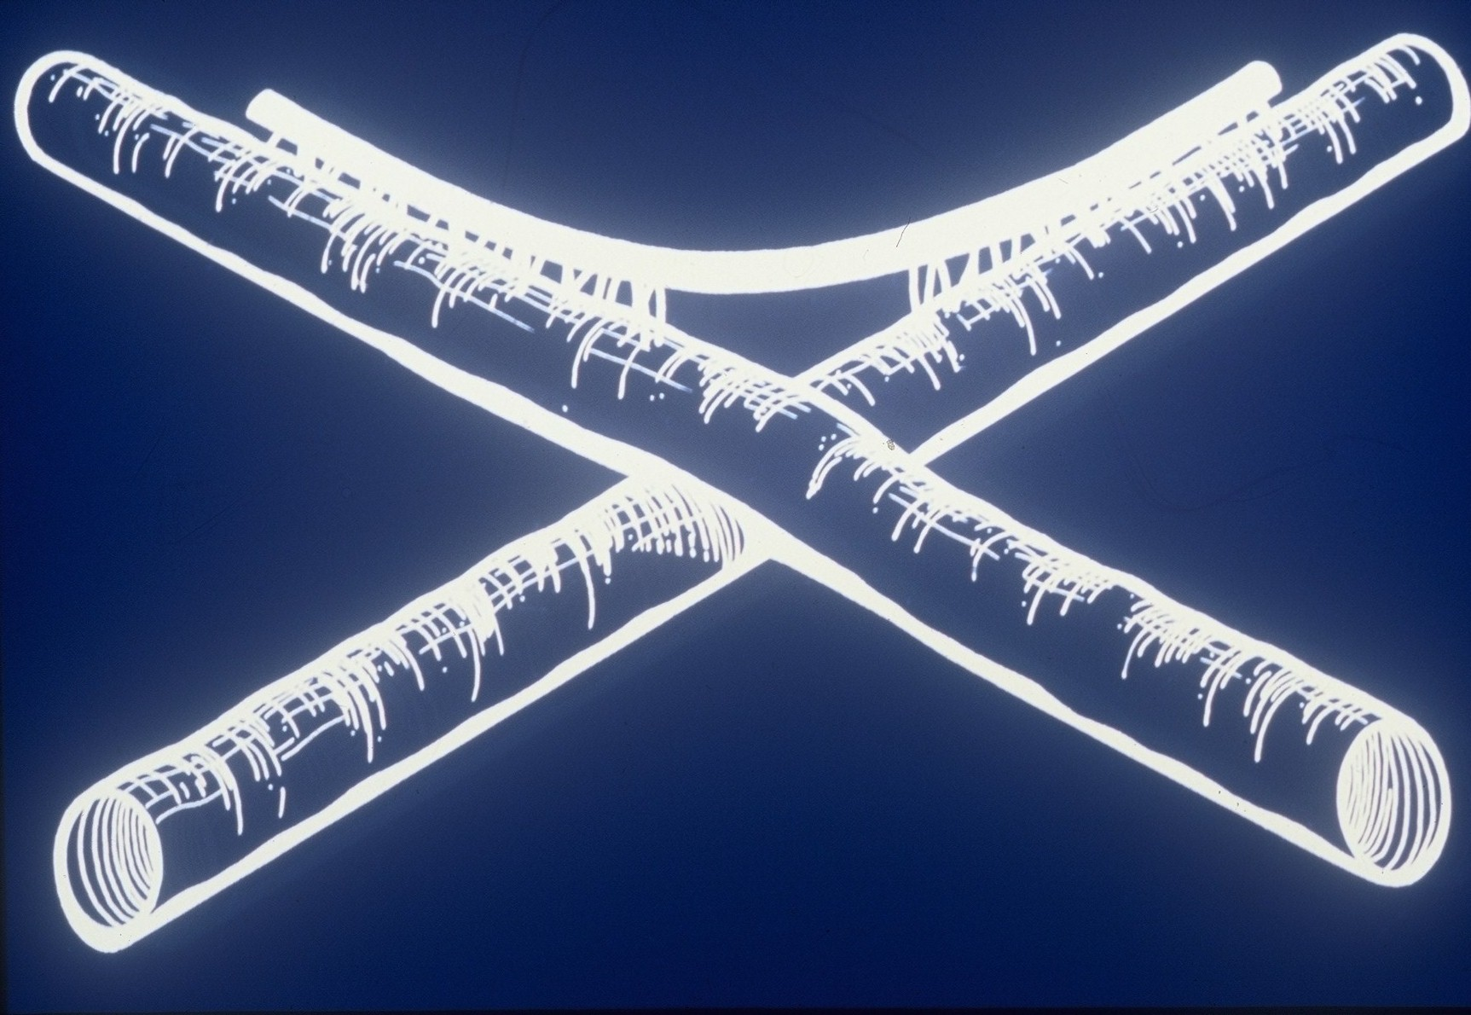

Slide 31
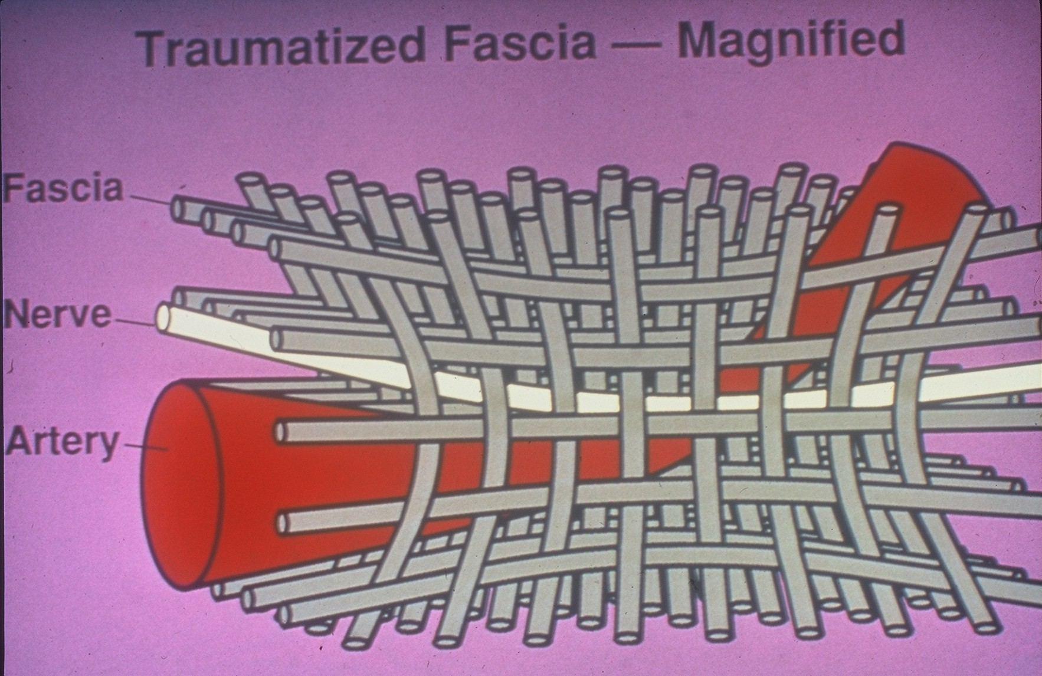

Slide 32
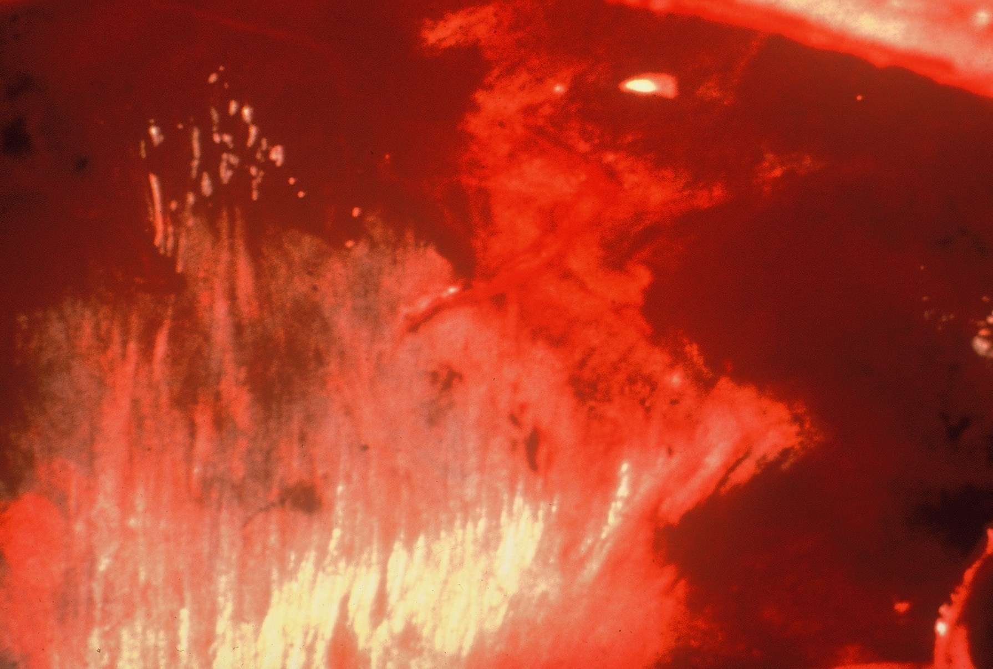

Slide 33
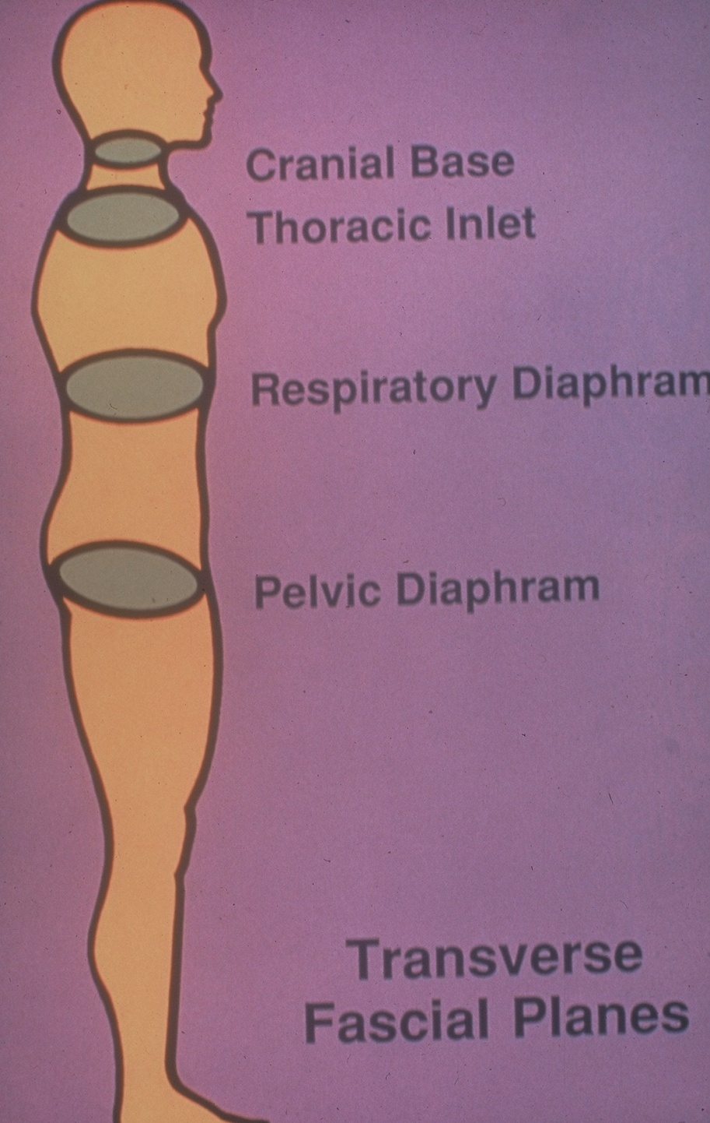

Slide 34
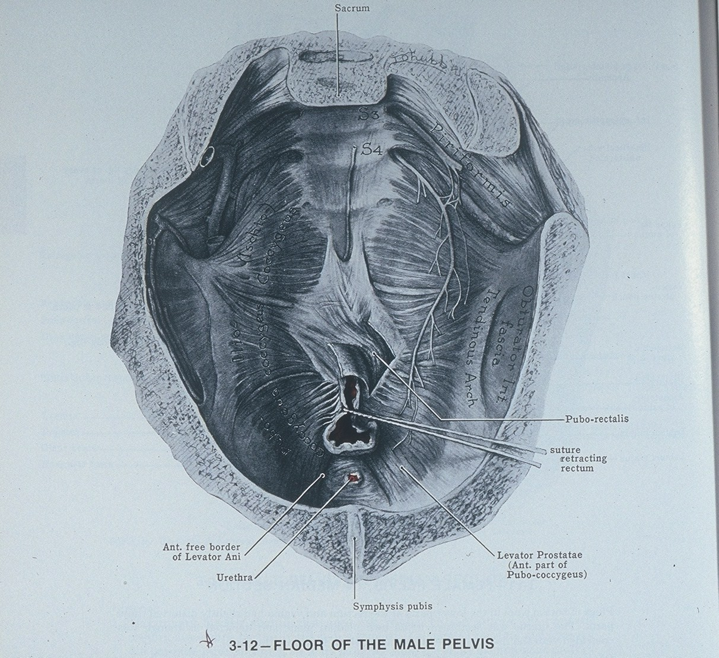

Slide 35
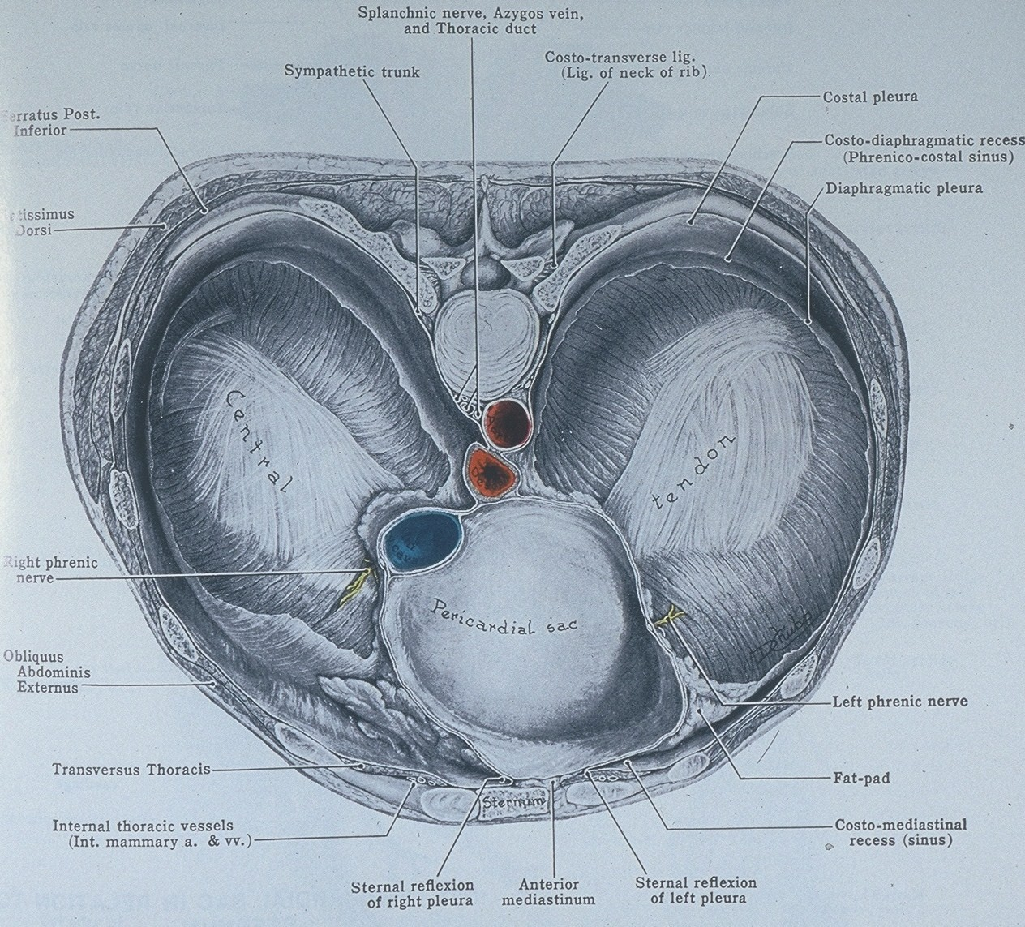

Slide 36
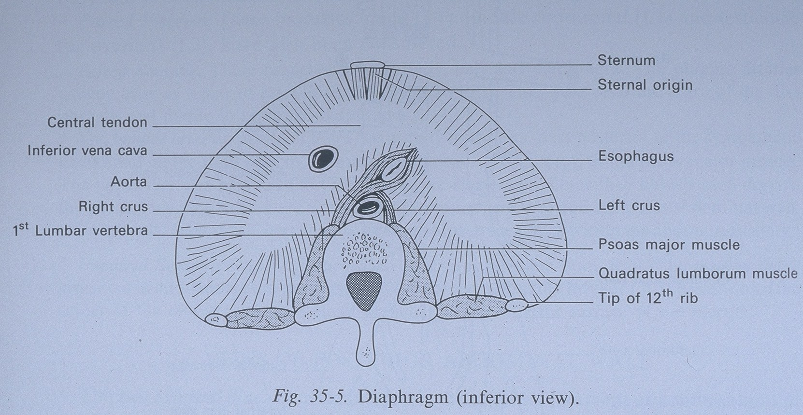

Slide 37
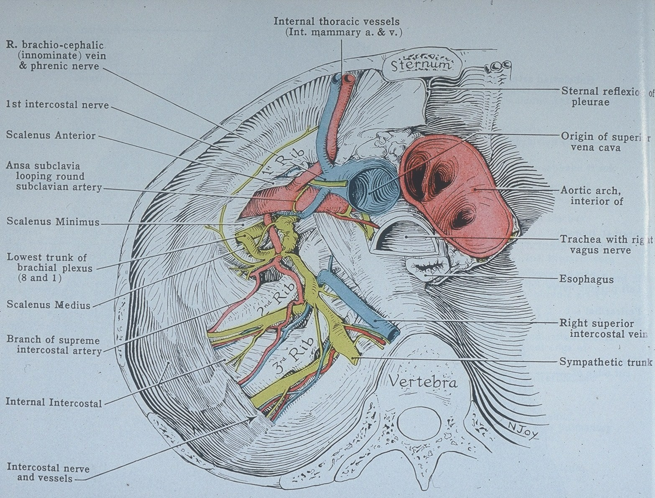

Slide 38
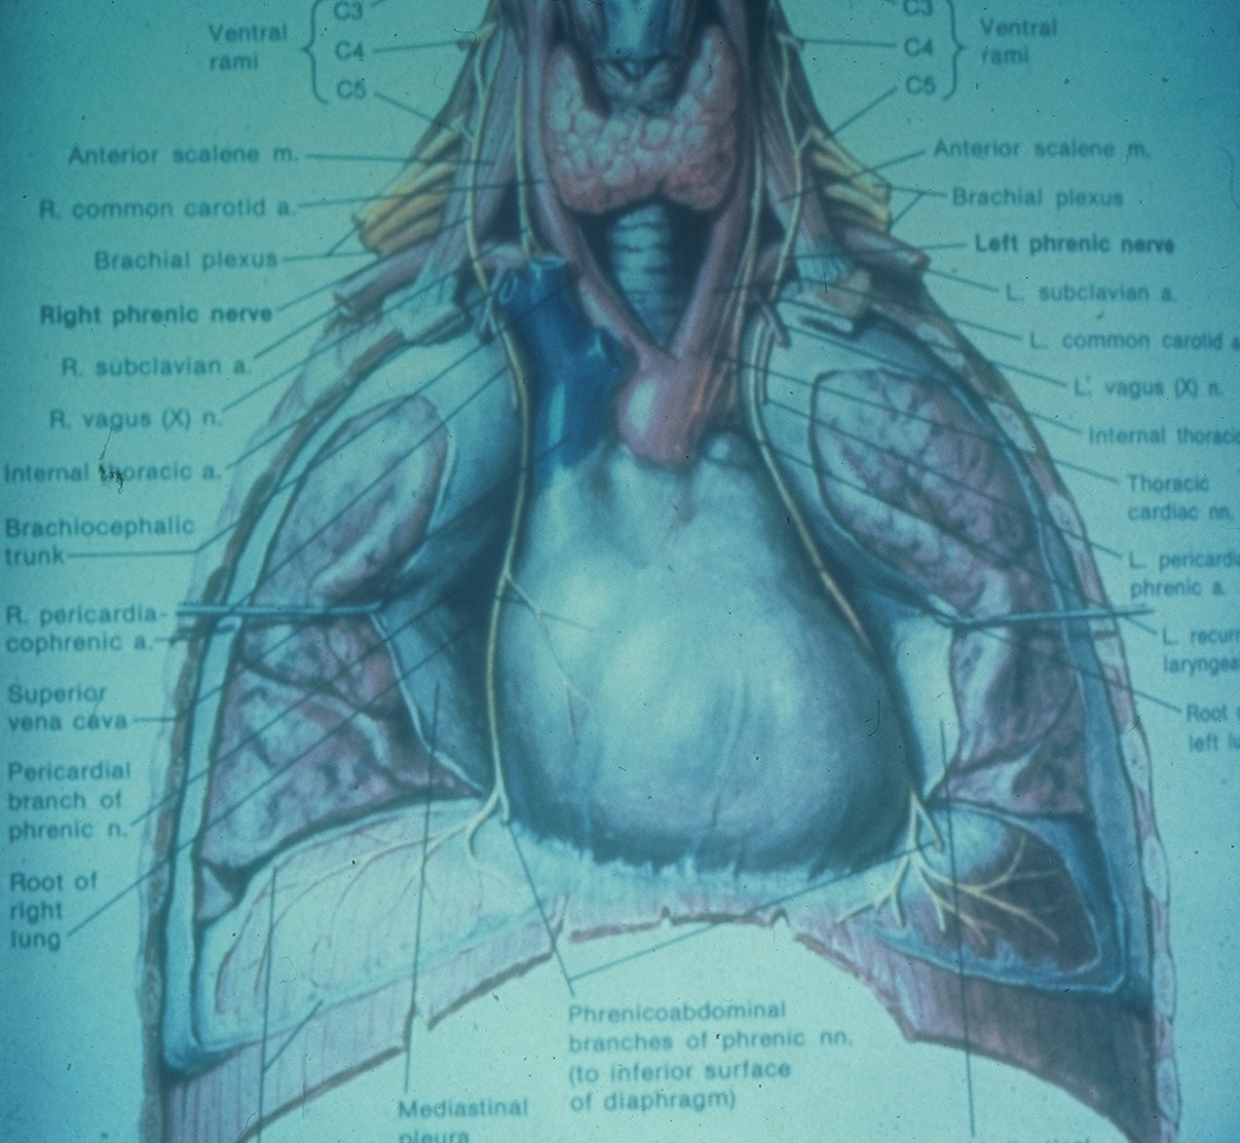

Slide 39
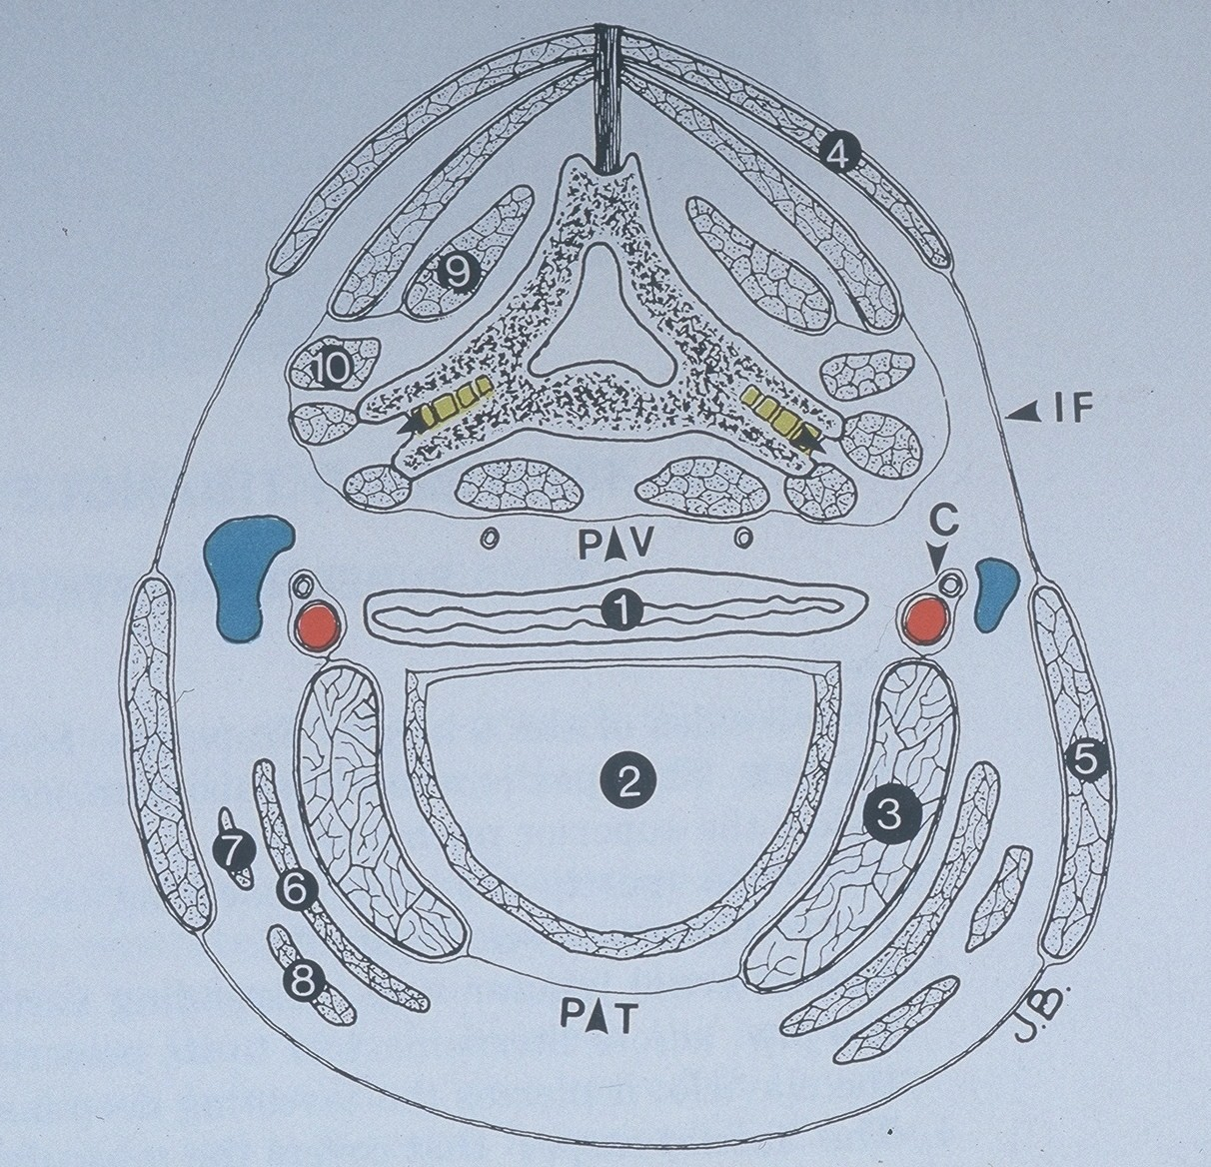

Slide 40
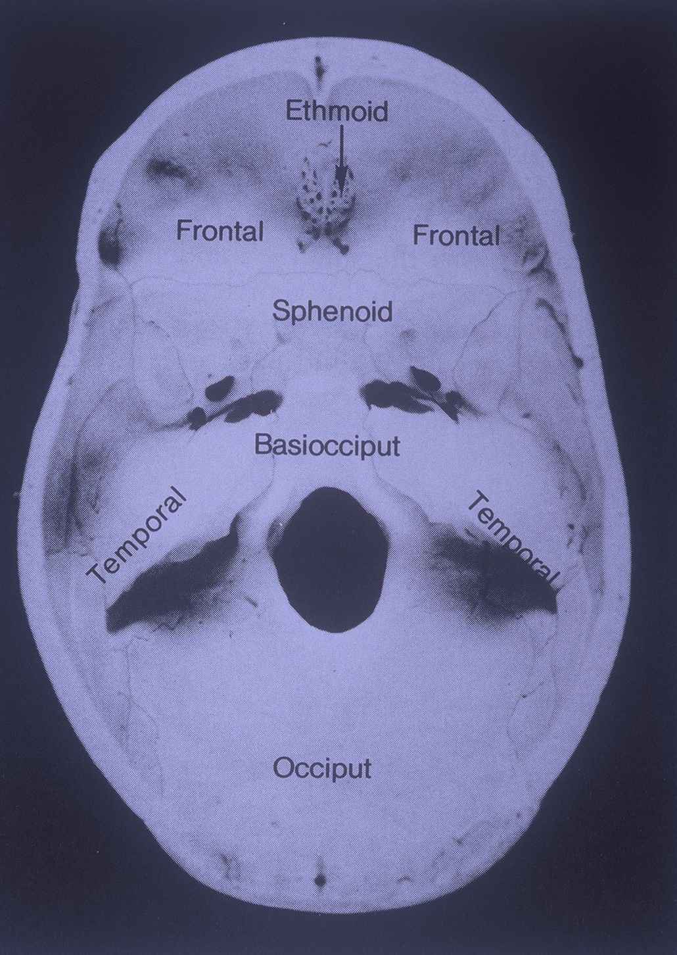

Slide 41
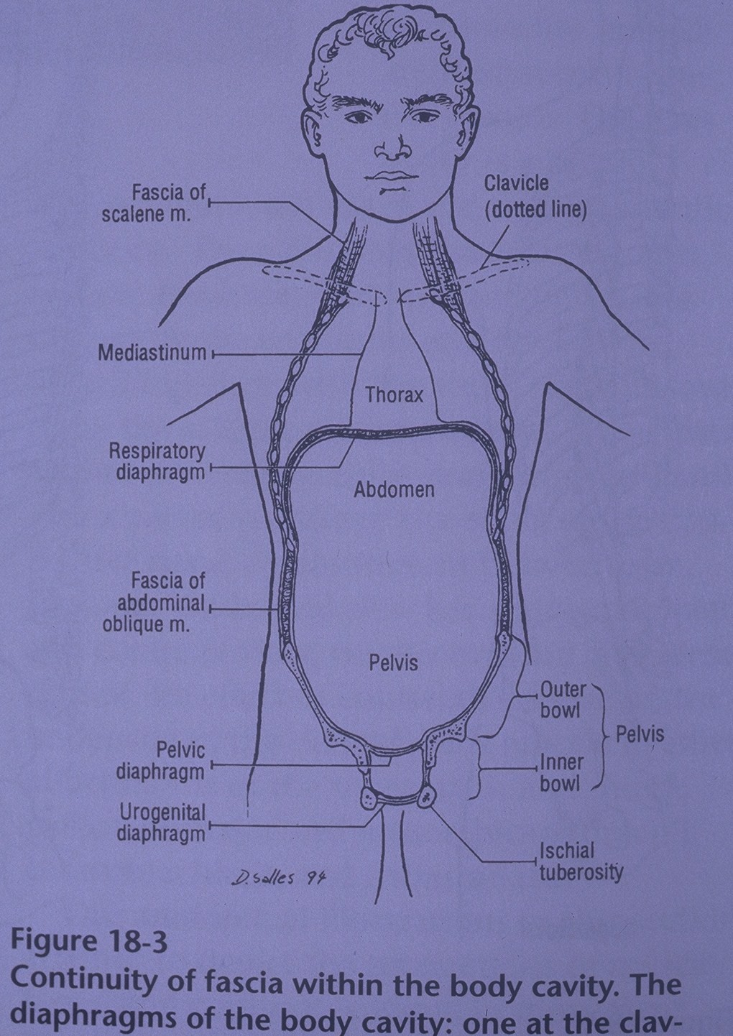

Slide 42
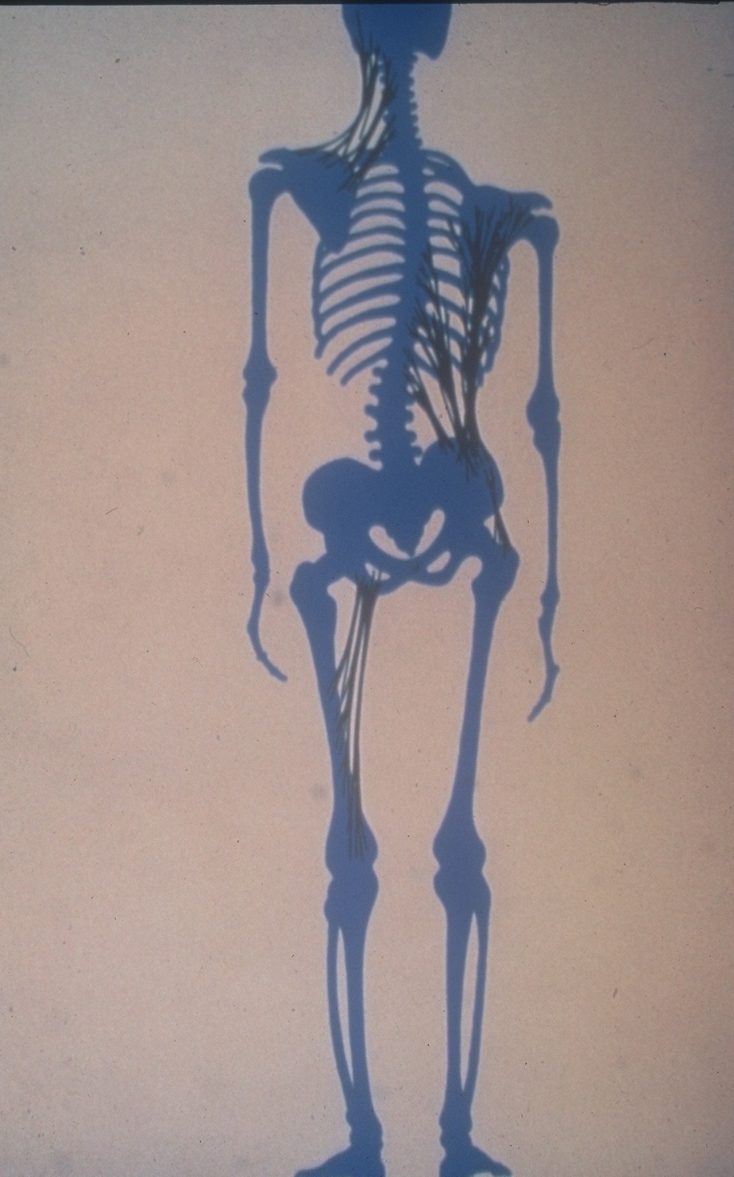

Slide 43
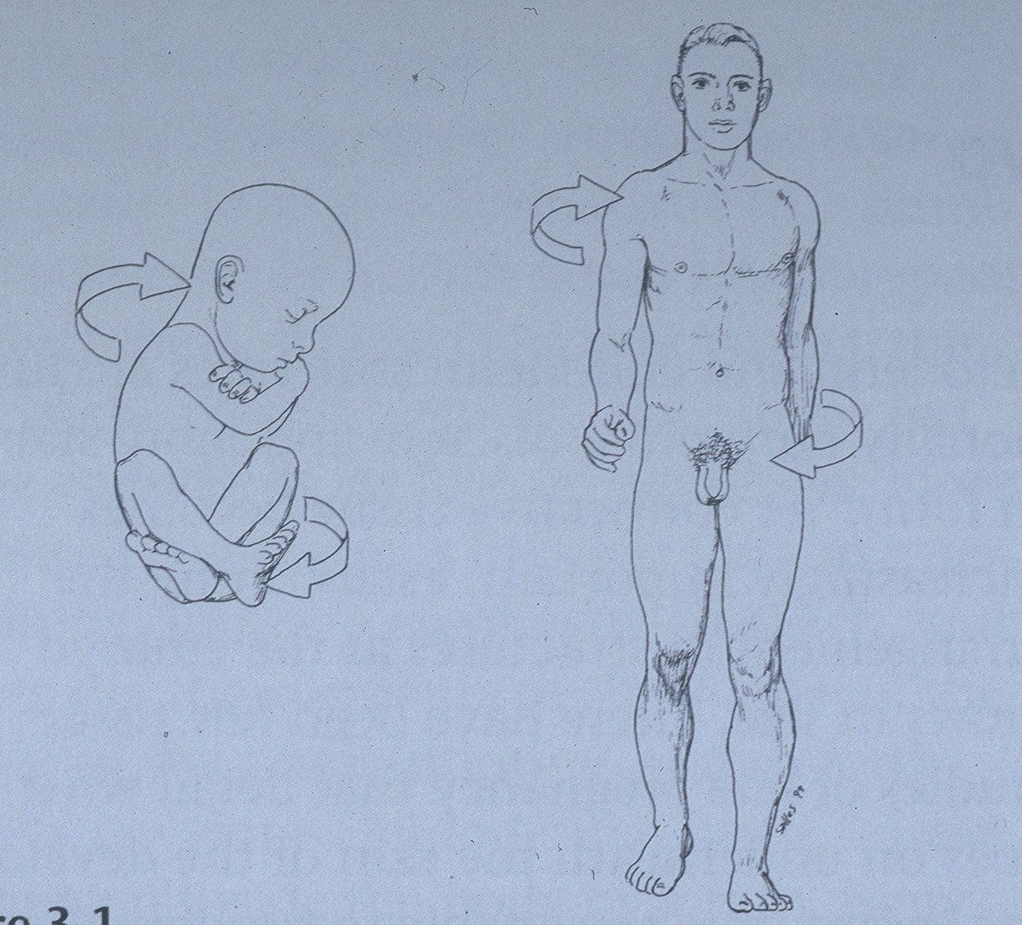

Slide 44
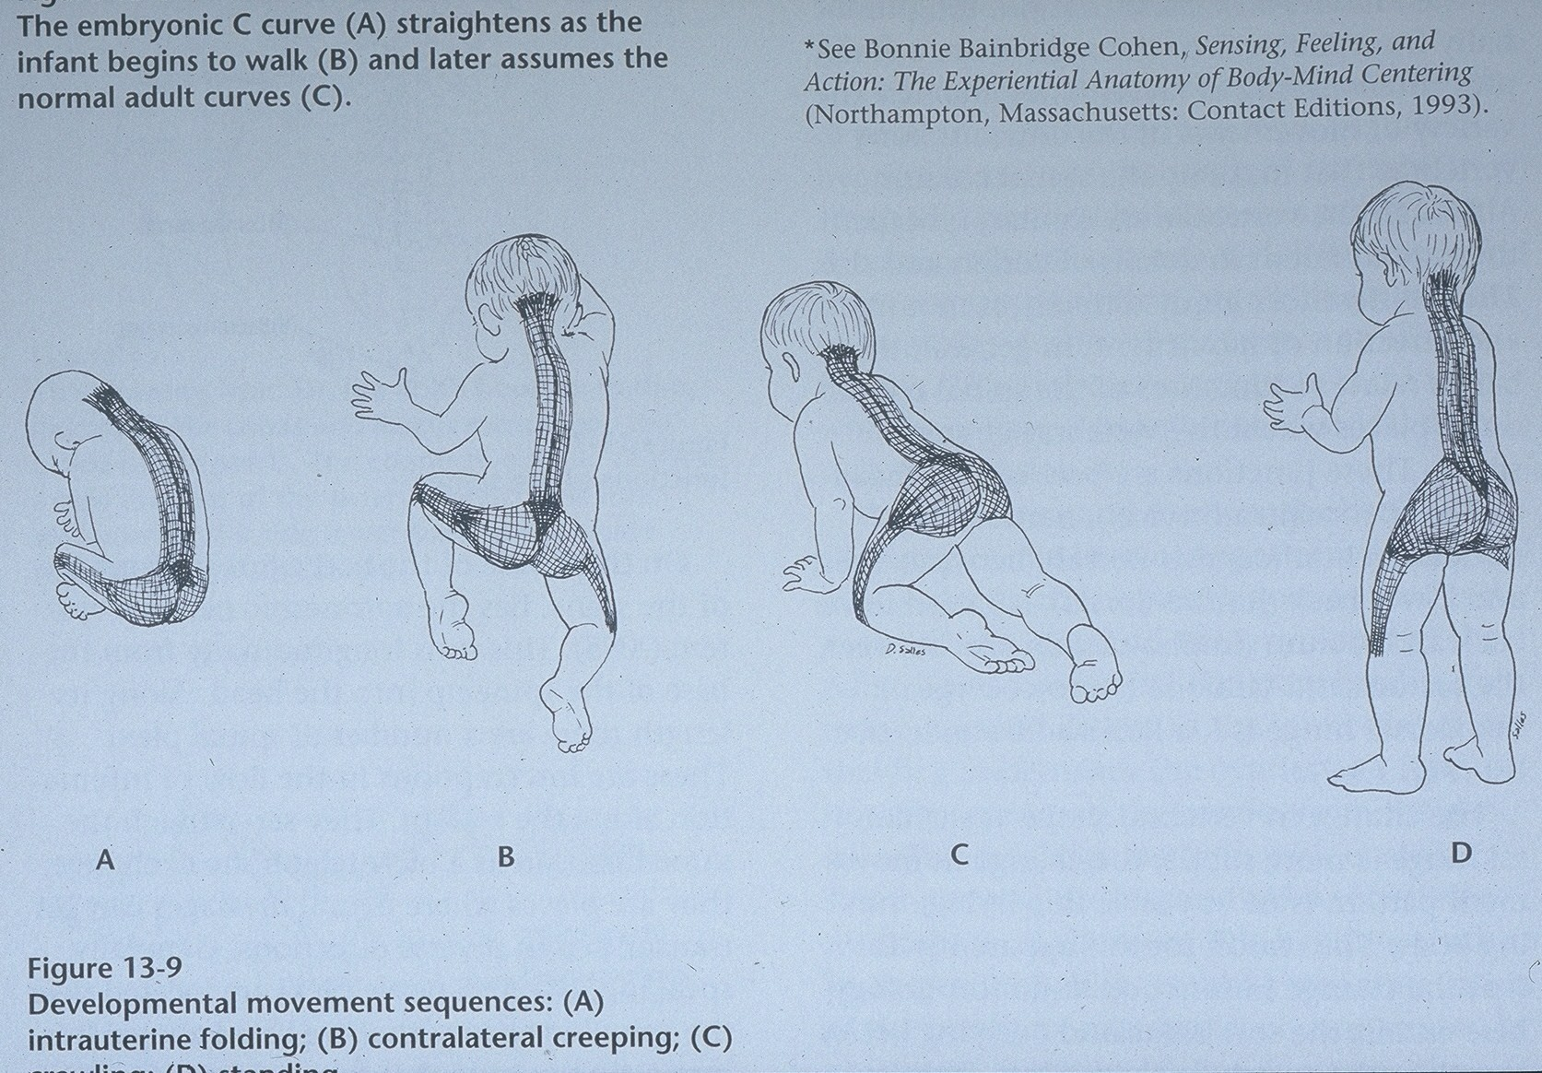

Slide 45
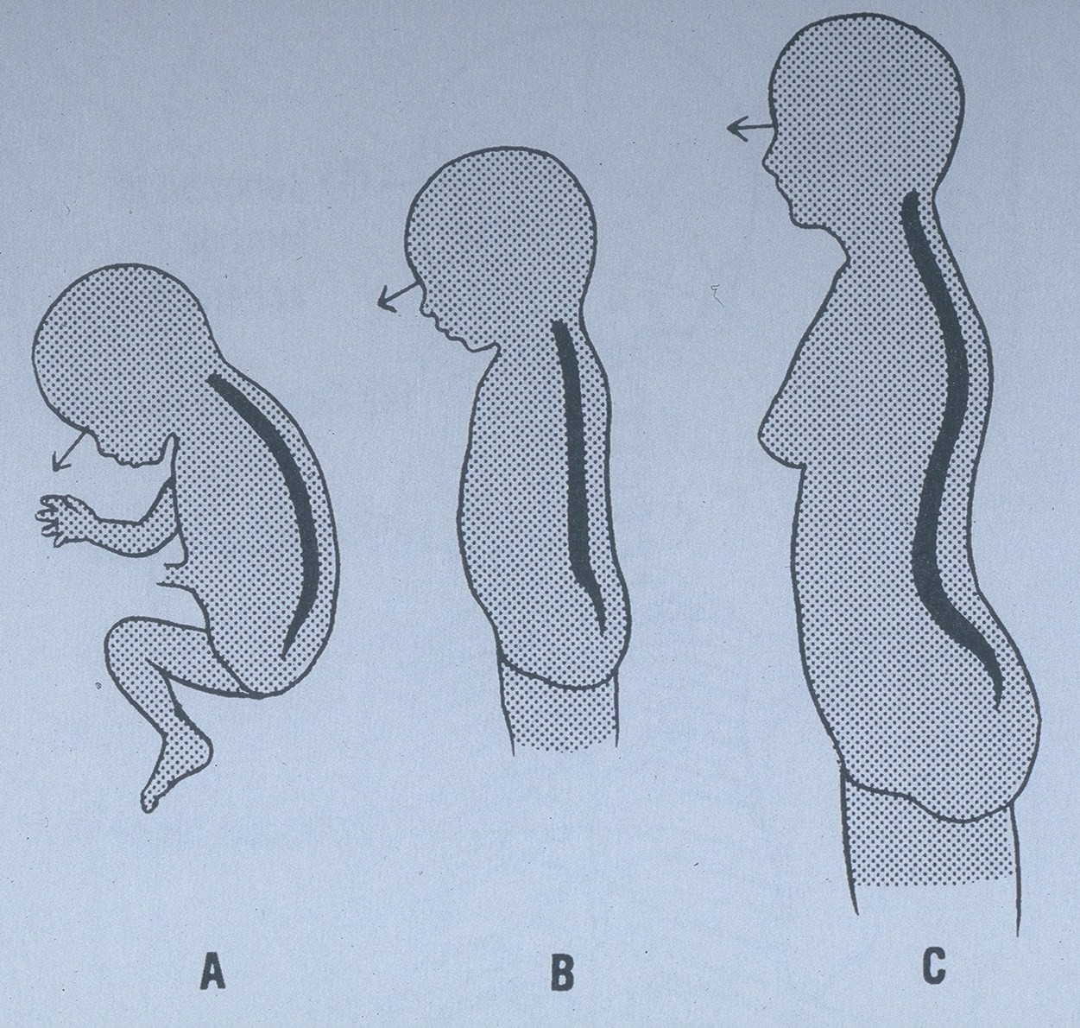

Slide 46
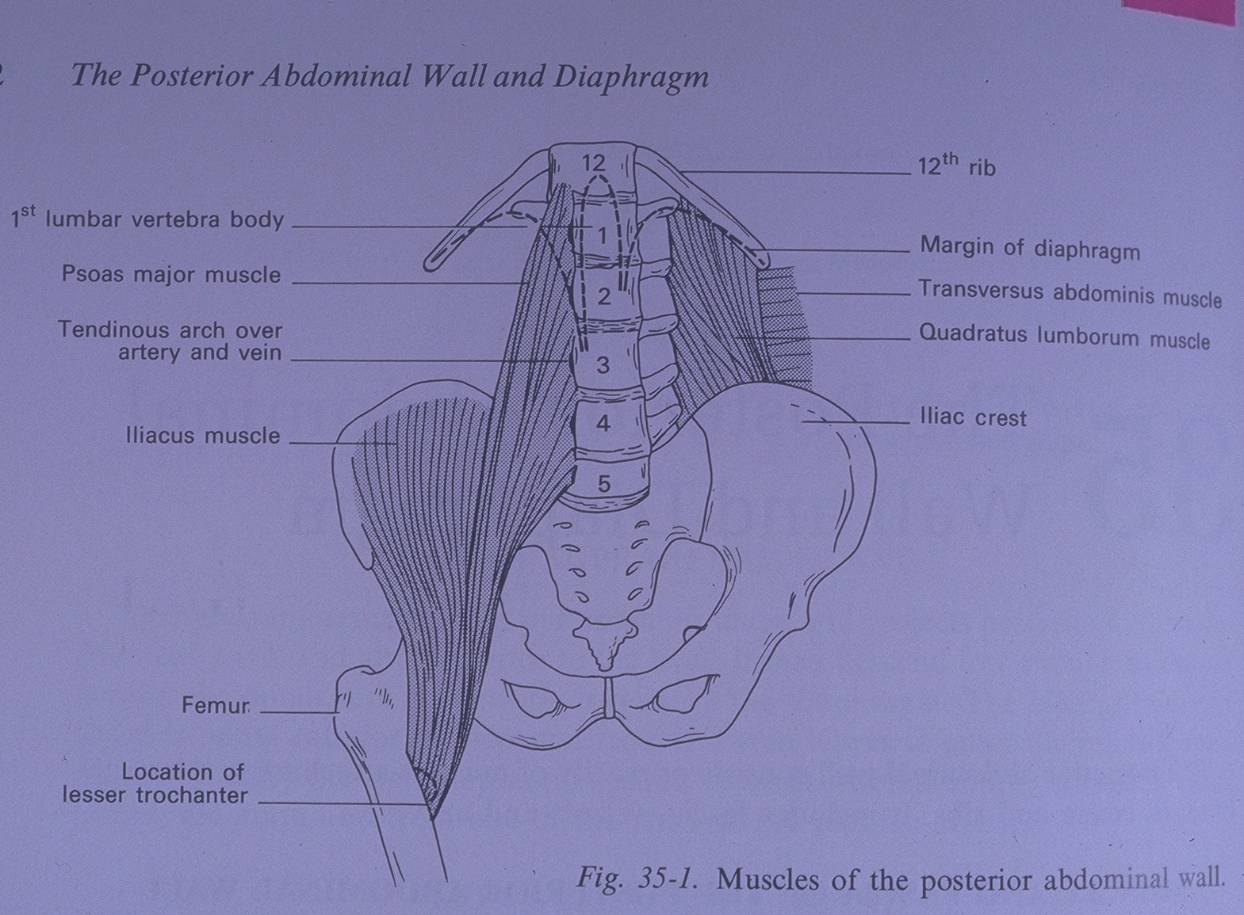

Slide 47
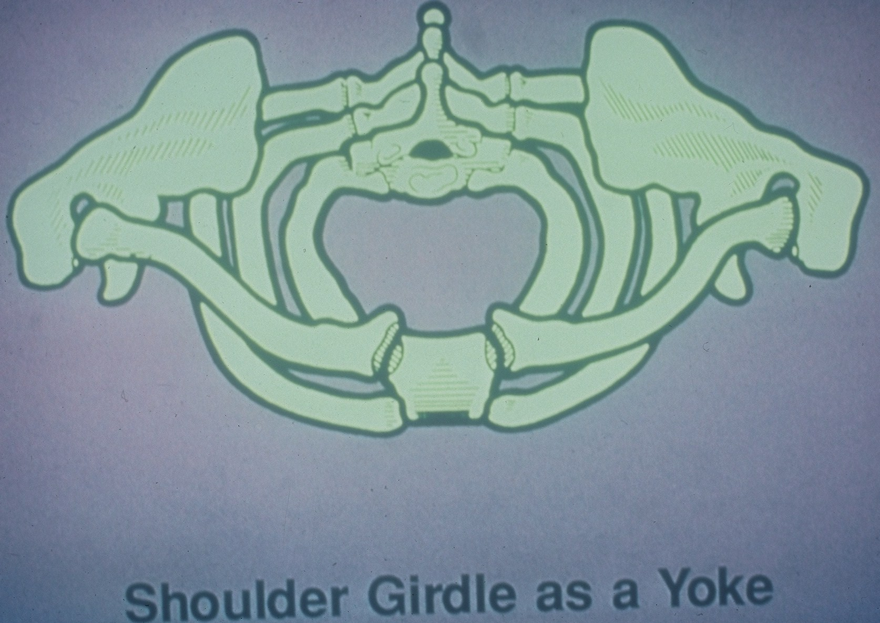

Slide 48
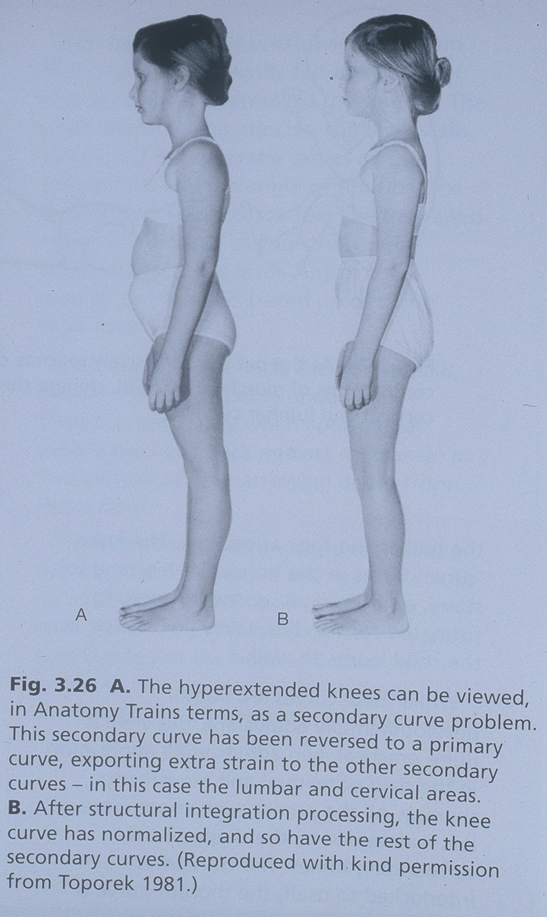

Slide 49
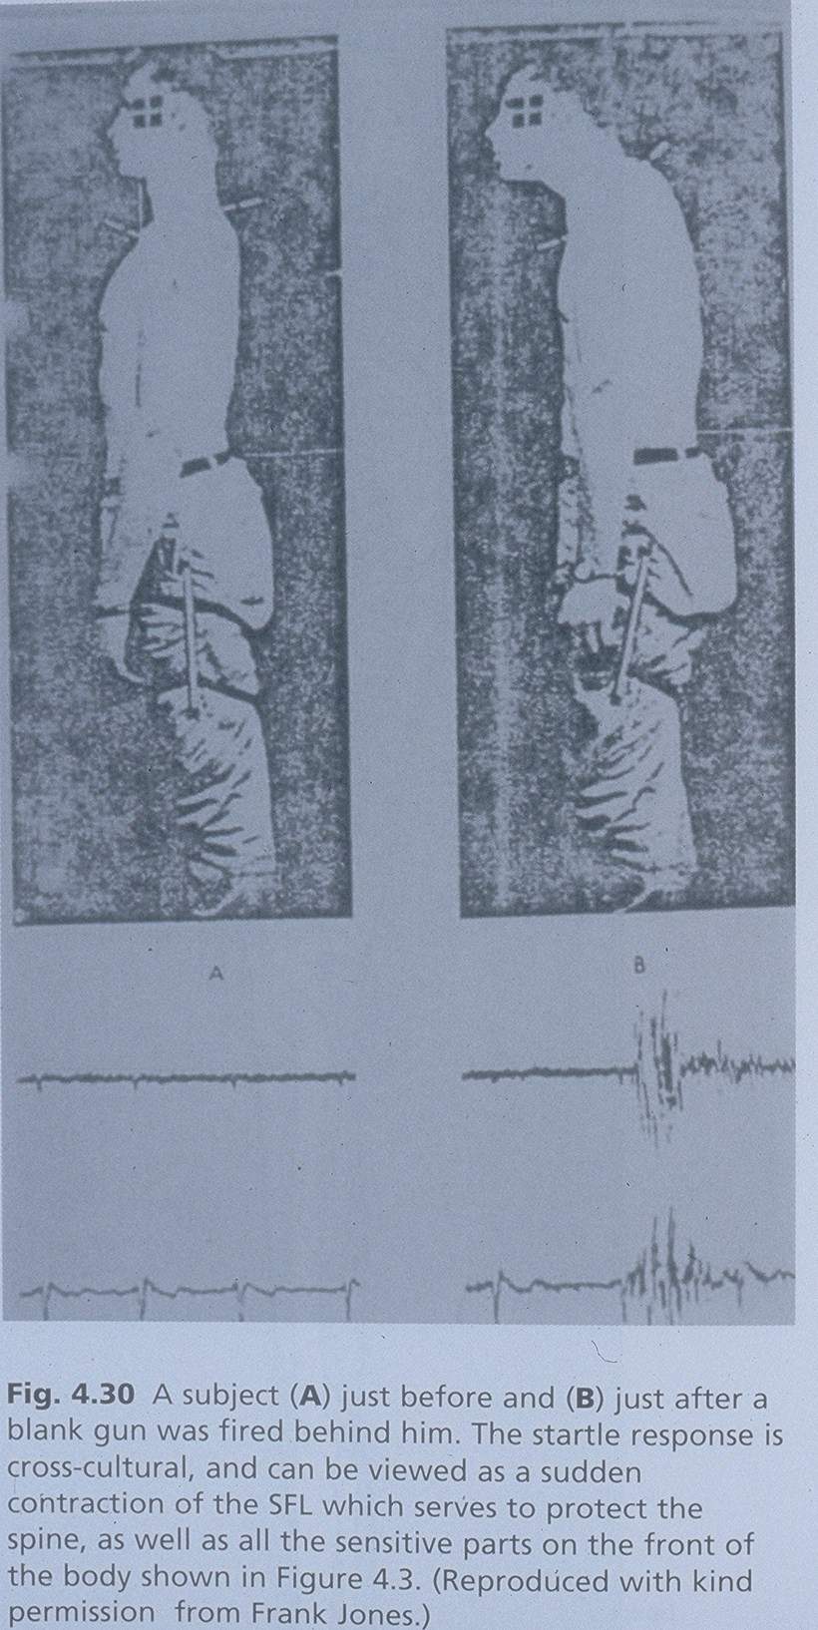

Slide 50
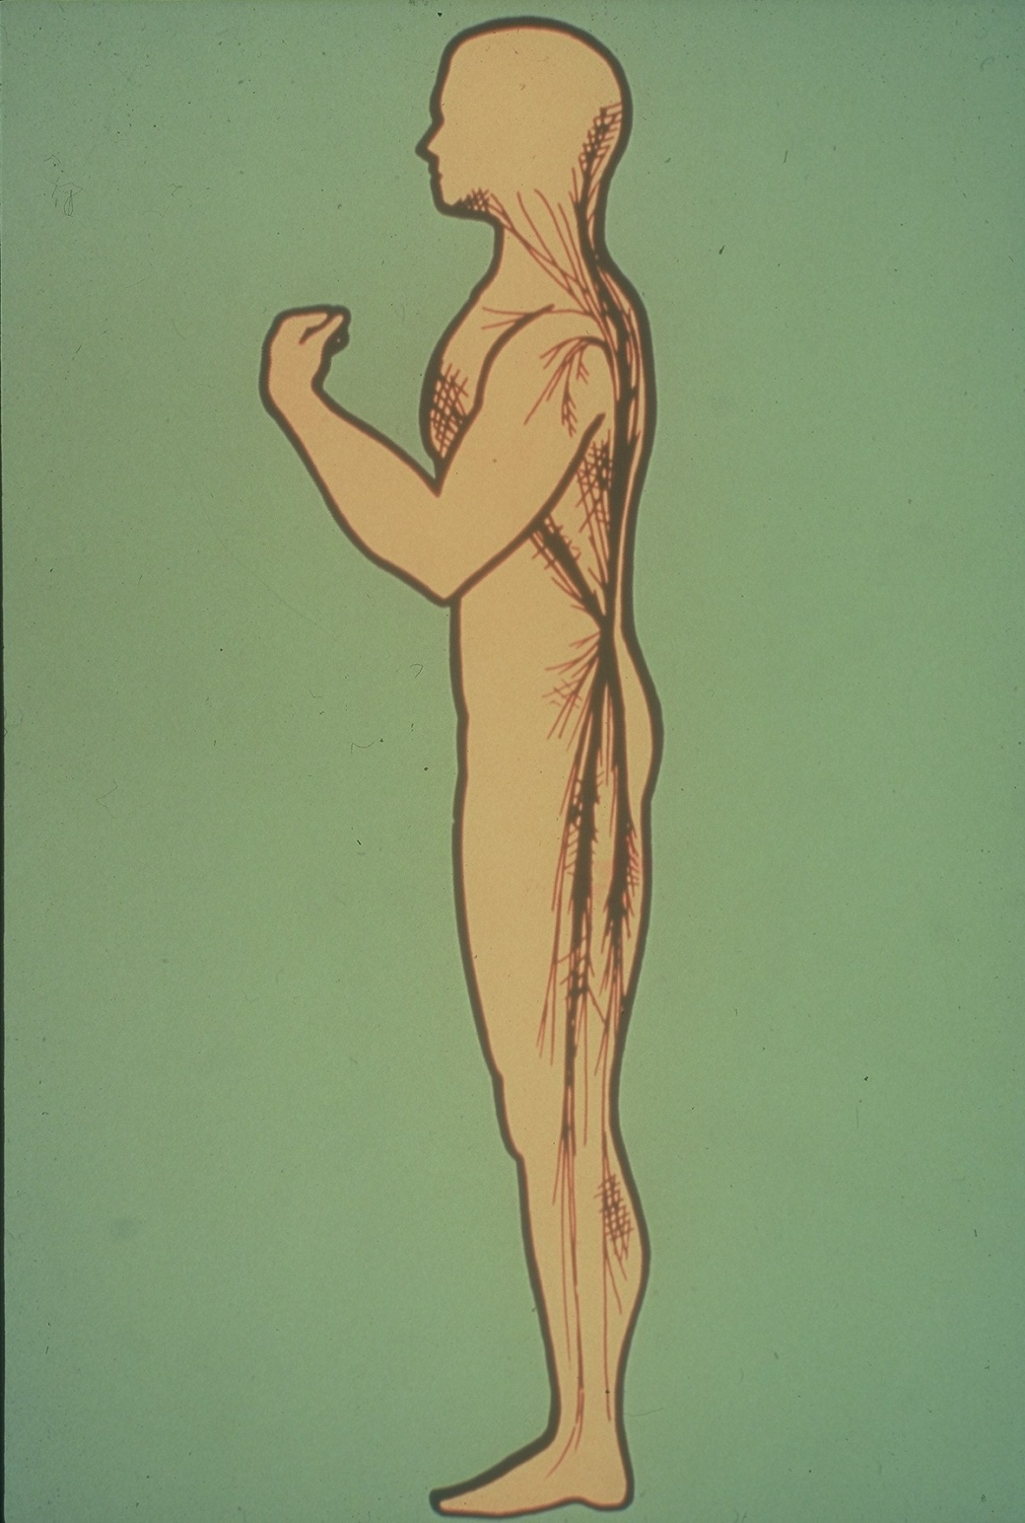

Slide 51
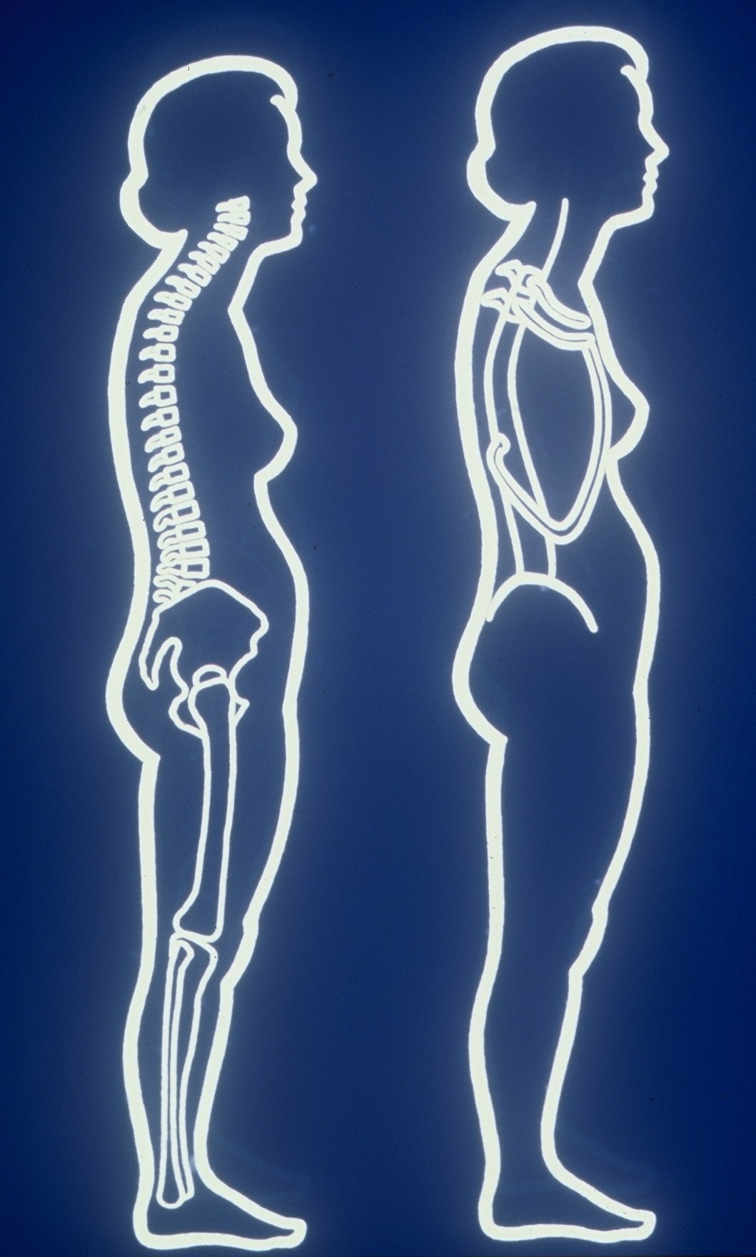

Slide 52
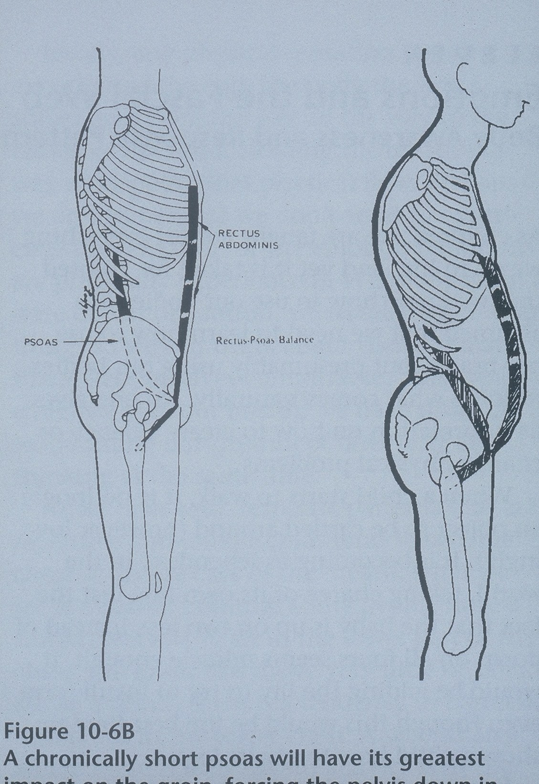

Slide 53
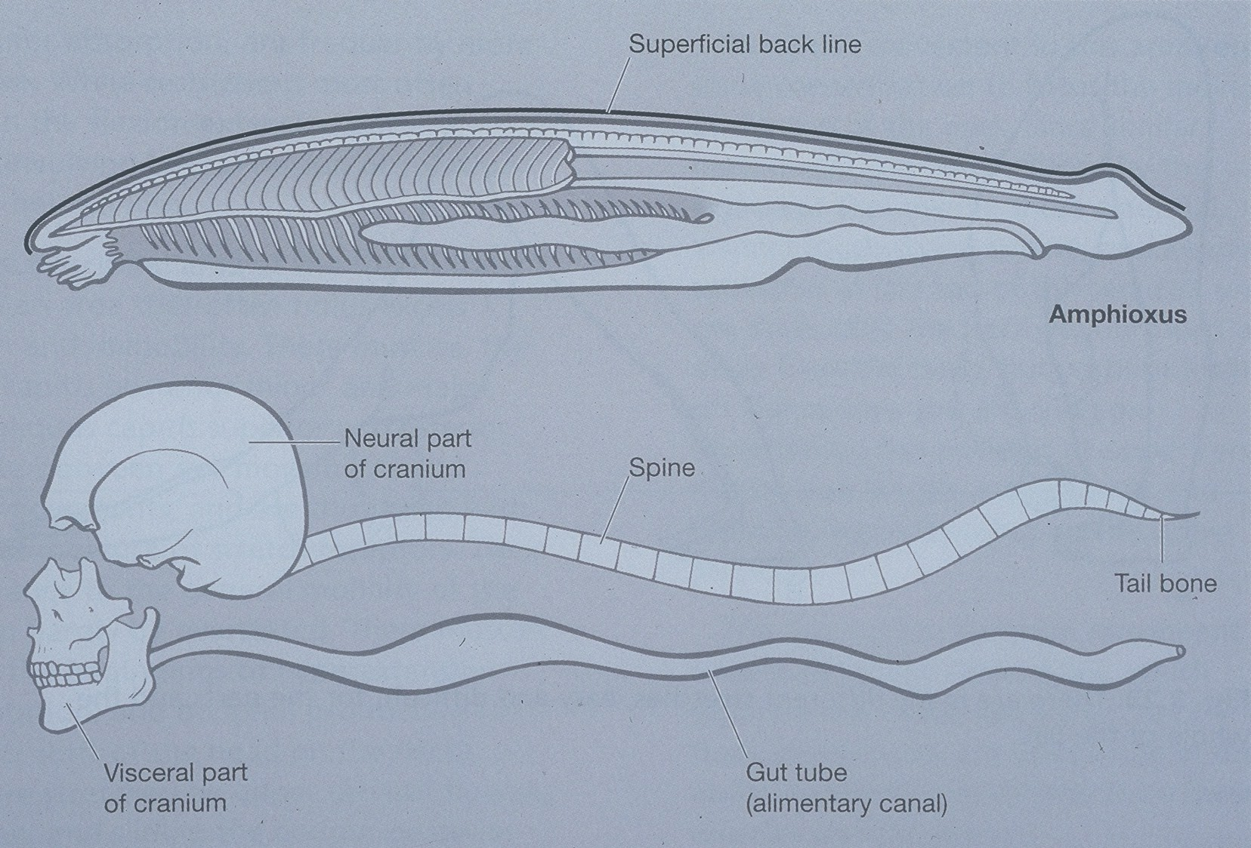

Slide 54
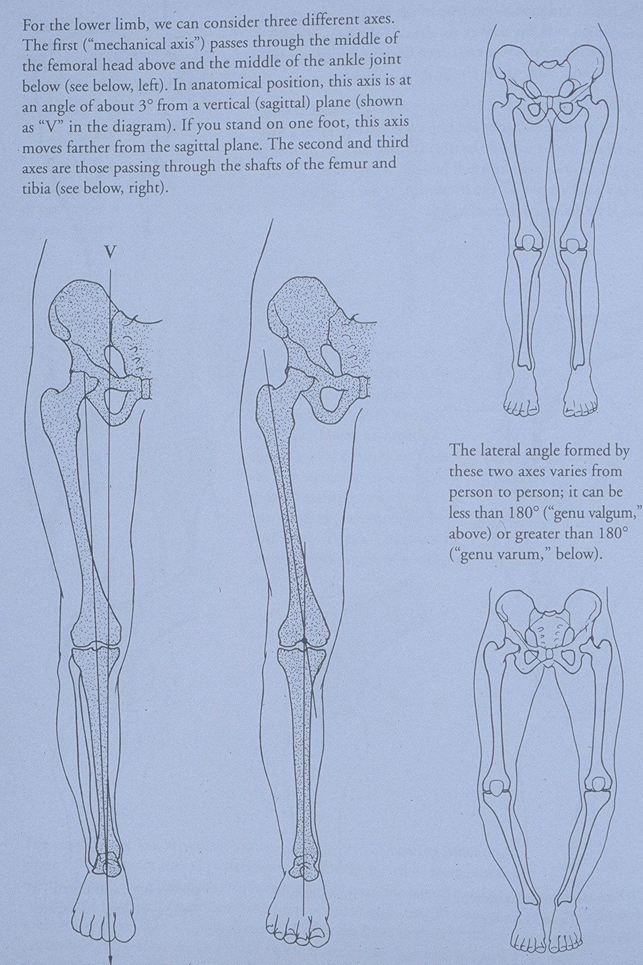

Slide 55
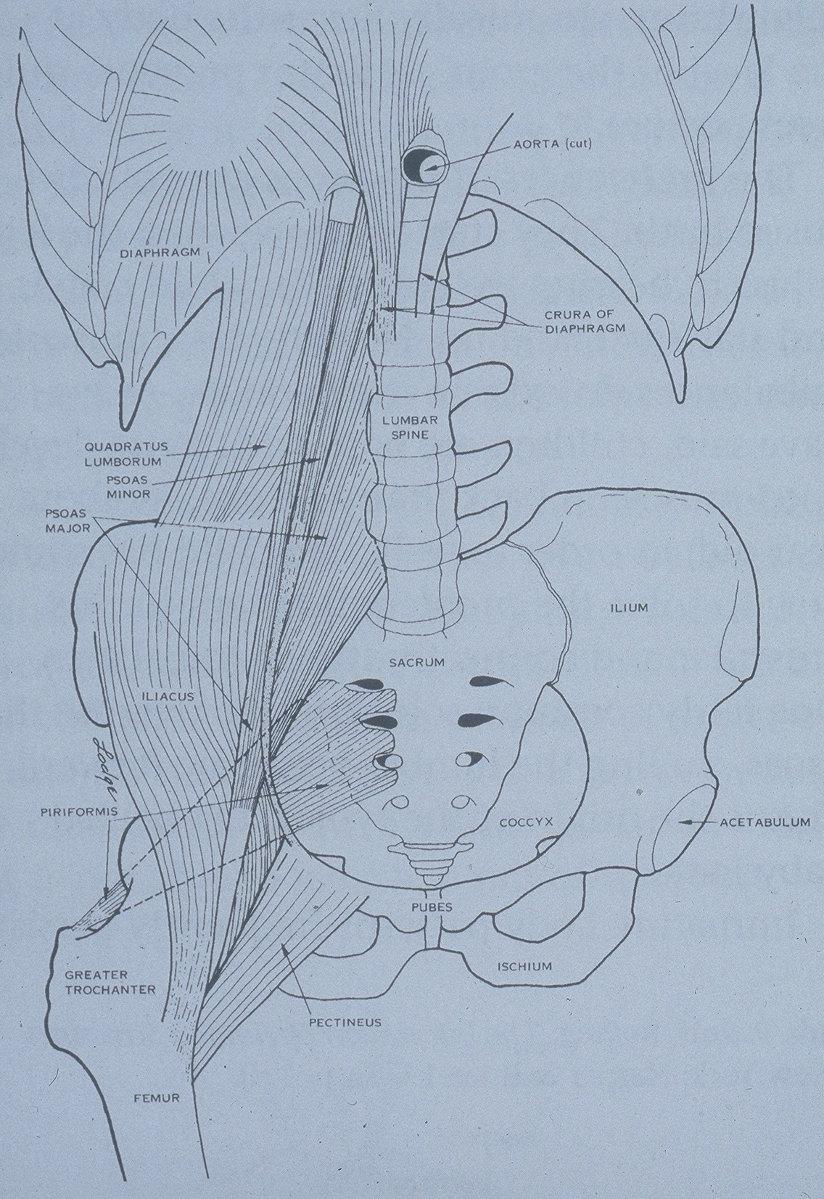

Slide 56
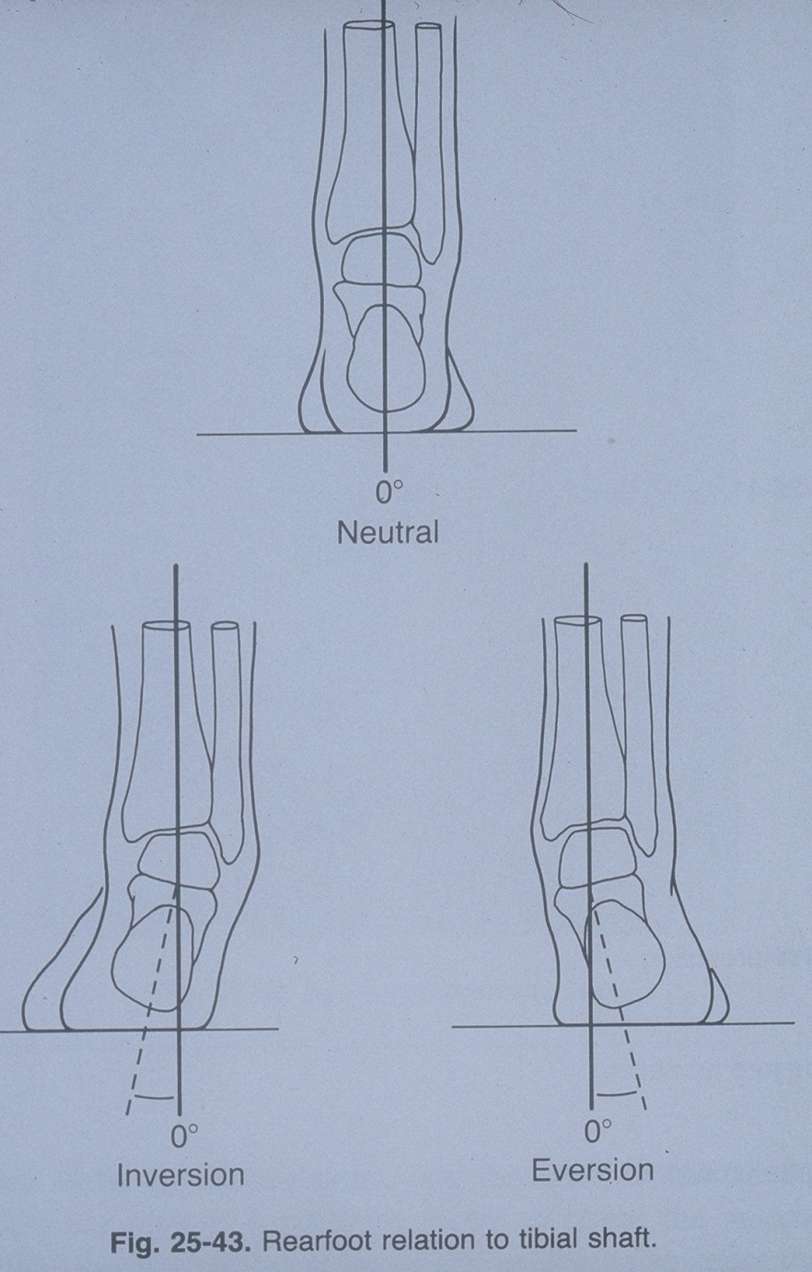

Slide 57
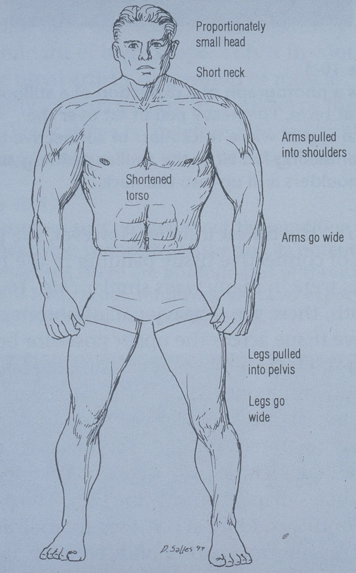

Slide 58
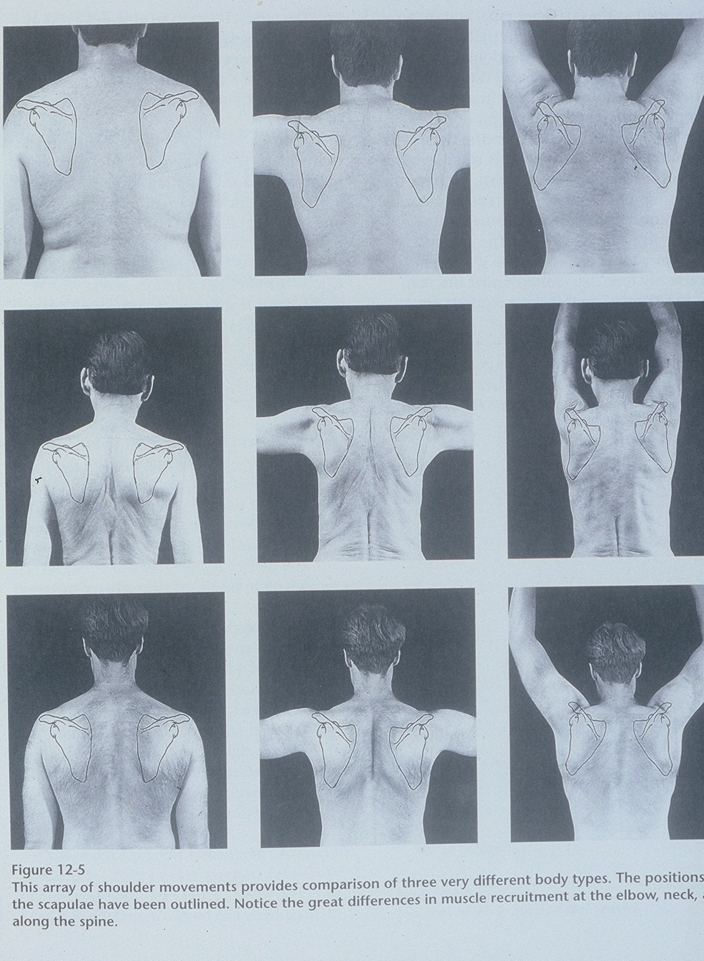

Slide 59
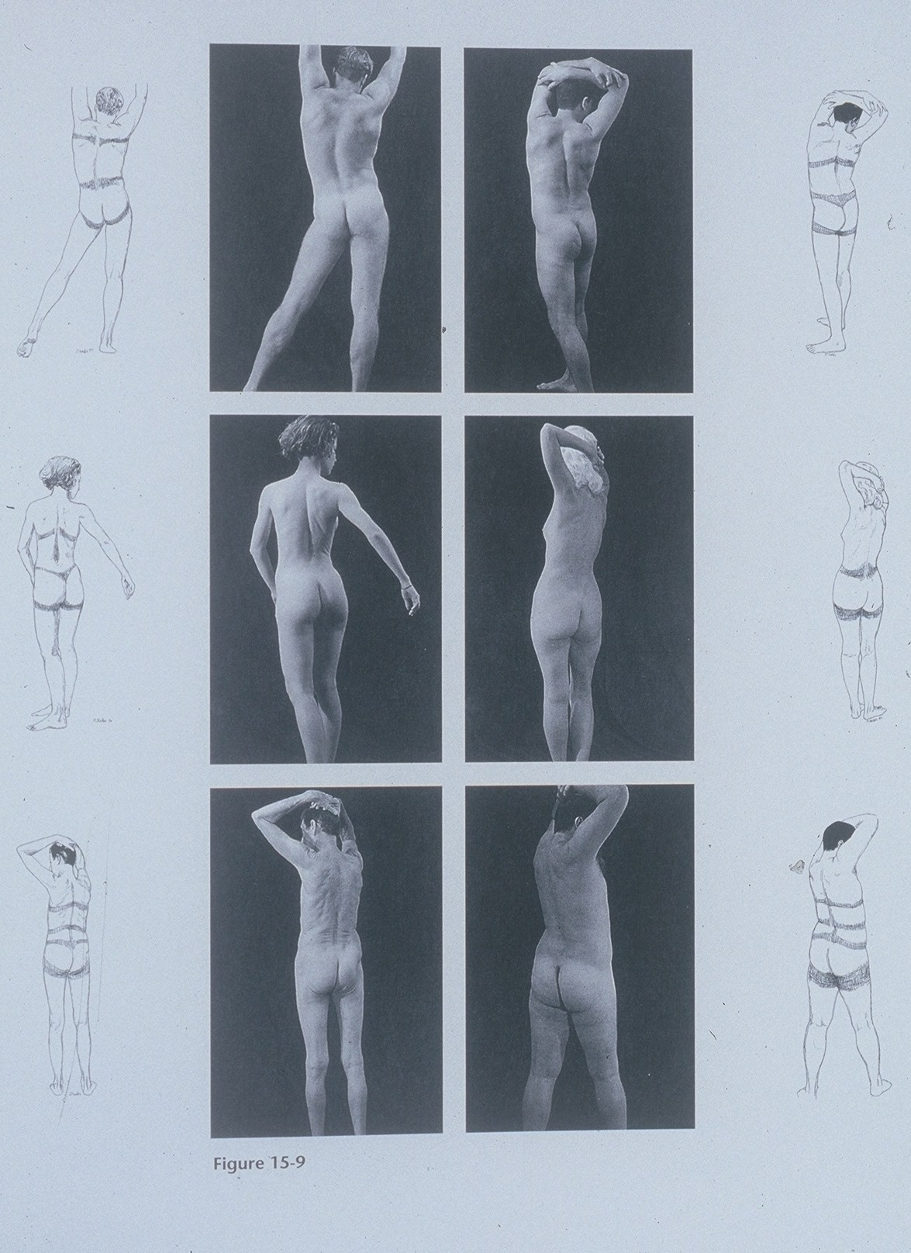

Slide 60
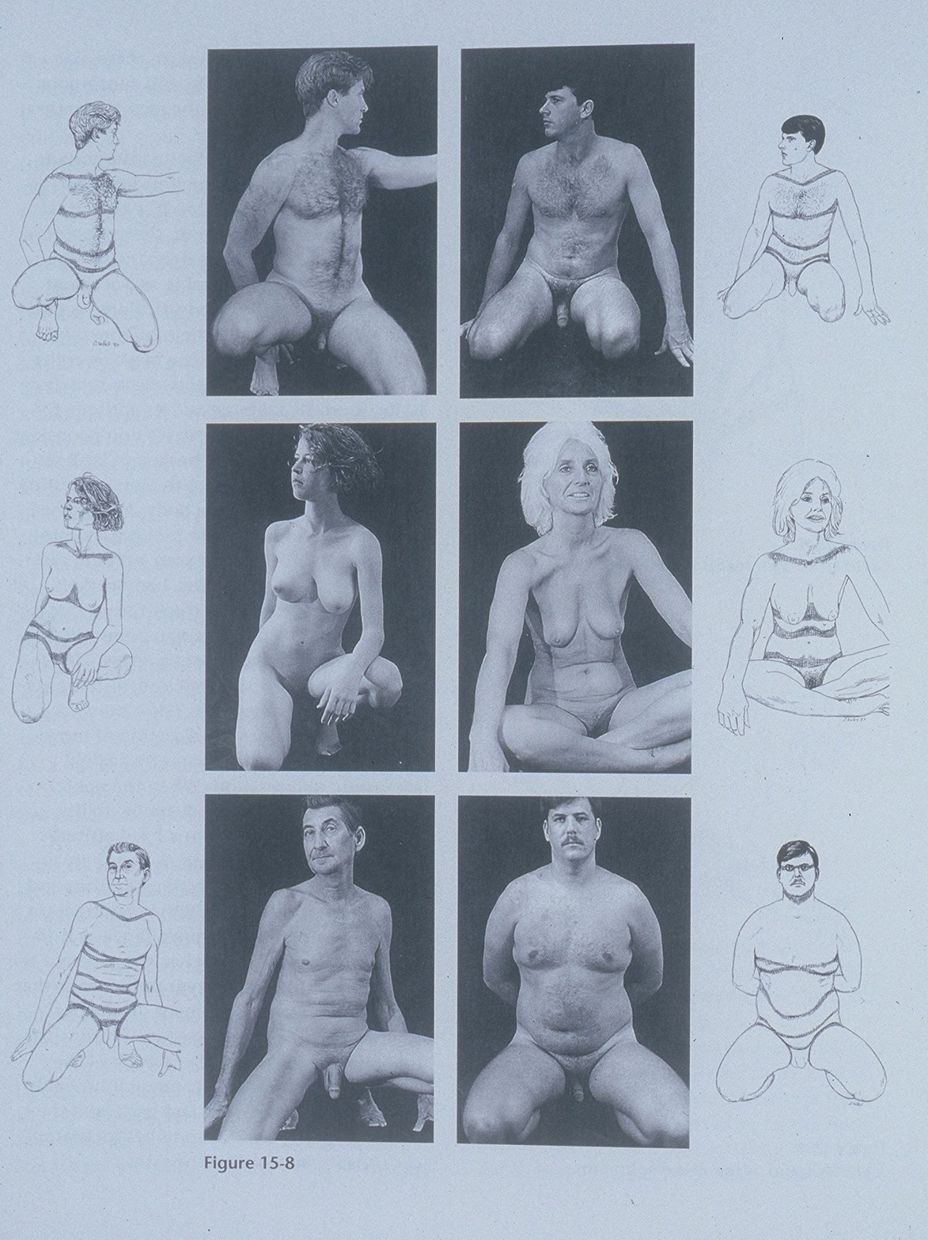

Slide 61
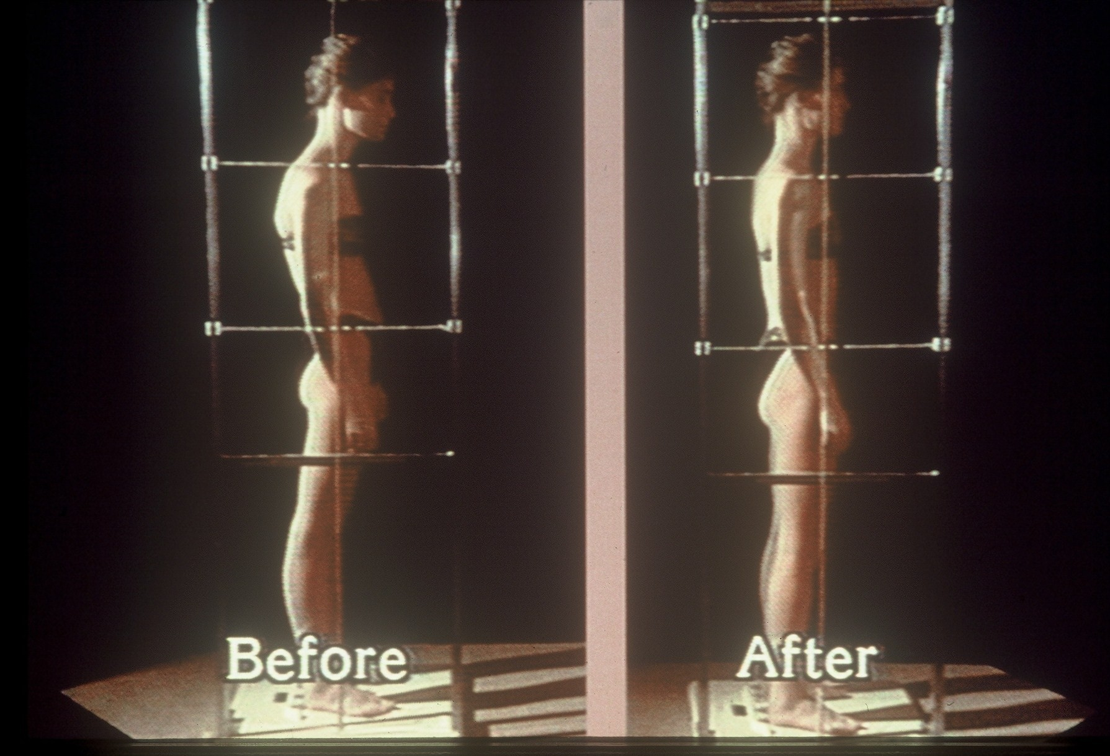

Slide 62
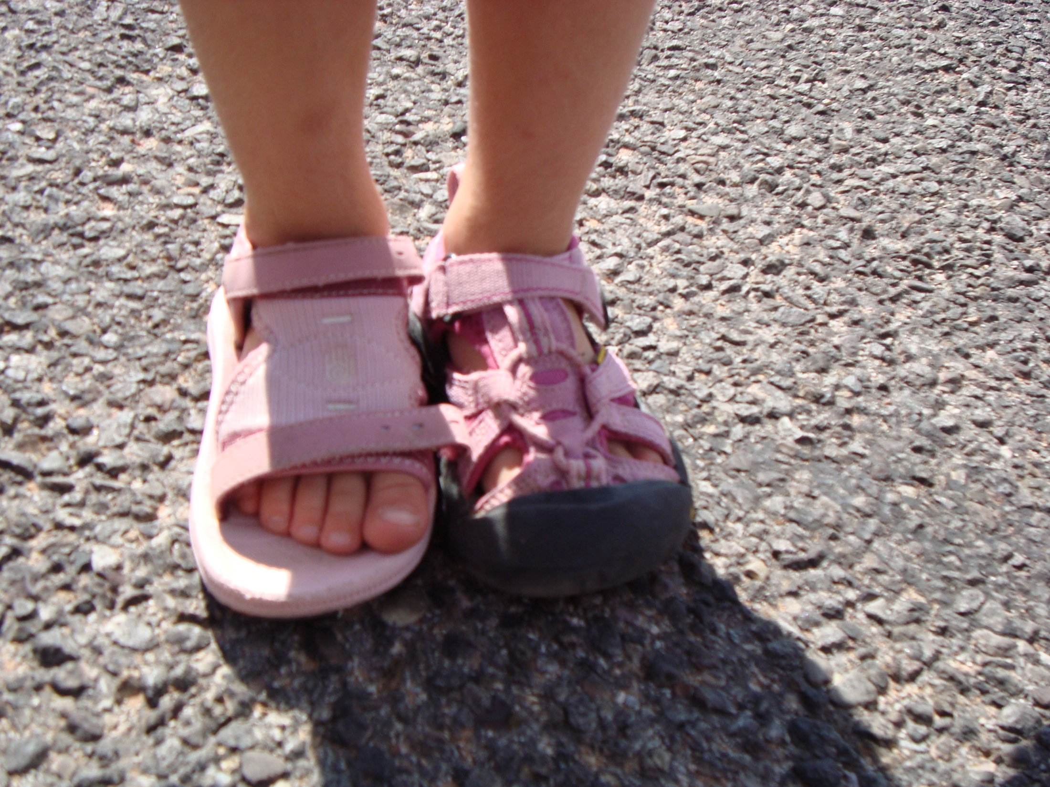

Slide 63
Women’s Health Issues
Pelvic Floor Dysfunction
Urinary Incontinence and Frequency
Painful menstruation and intercourse
Pelvic pain post surgery or child birth
Fibrocystic Breasts
Post Breast Cancer treatment

Slide 64
Chronic Pain
Fibromyalgia
Myofascial Pain syndromes
Chronic or recurrent headaches
Scleroderma
TMJ Syndrome
Polyalgia

Slide 65
Respiratory Dysfunction and Sclerotic Diseases
Pulmonary Fibrosis
Asthma
Arthrosclerosis

Slide 66
Pediatric Indications
Chronic Ear Infections
Suck/Swallow issues with infants
“Colicky” behavior in infants
Postural Dysfunctions
Developmental Delays
Autism

Slide 67
Scars and Wound Healing
A Fascial Restriction has a tensile strength of 2,000 psi.
An incised muscle loses 50 percent of its intercompartmental pressure during contraction.
New research on Fibroblast activity indicates Myofibroblasts can revert to fibroblasts when tension on the cell is decreased. This has huge implications for sclerotic diseases and wound healing.

