Slide 1
Lesson 8: Social Class and Stratification
Robert Wonser
Introduction to Sociology

Slide 2
There’s an old British joke that goes something like this:
Two Oxford professors, a physicist and a sociologist, were walking across a leafy college green. “I say old chap,” said the physicist, “What exactly do you teach in that sociology course of yours?”
“Well,” replied the sociologist, “This week we’re discussing the persistence of the class structure in America.”
“I didn’t even know they had a class structure in America,” said the physicist.
The sociologist smiled. “How do you think it persists?”

Slide 3
Understanding Inequality
Inequality is the unequal access to scarce goods or resources.
  It is the result of abundance.
  It is found in most, if not all, societies.
  It is a question of how unequal a society is.
  How unequal is the United States?

Slide 4
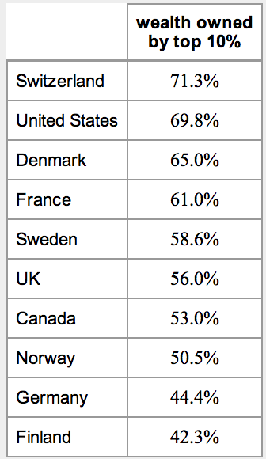
How does the US compare to other nations?
Percentage of wealth held in 2000 by the Top 10% of the adult population in various Western countries

Slide 5
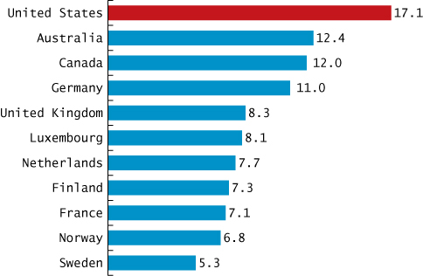
International Comparison of Poverty Rates among Wealthy Countries

Slide 6
Understanding Social Stratification
Social stratification is the division of society into groups arranged in a social hierarchy based on access to wealth, power and prestige.
Ex: slavery, caste and social class
Where people rank in stratification system influences every part of their lives in profound ways.
  What food they eat, where they shop, clothes they wear, schools they attend, income they earn, how long (and quality of life) they live, occupation.

Slide 7
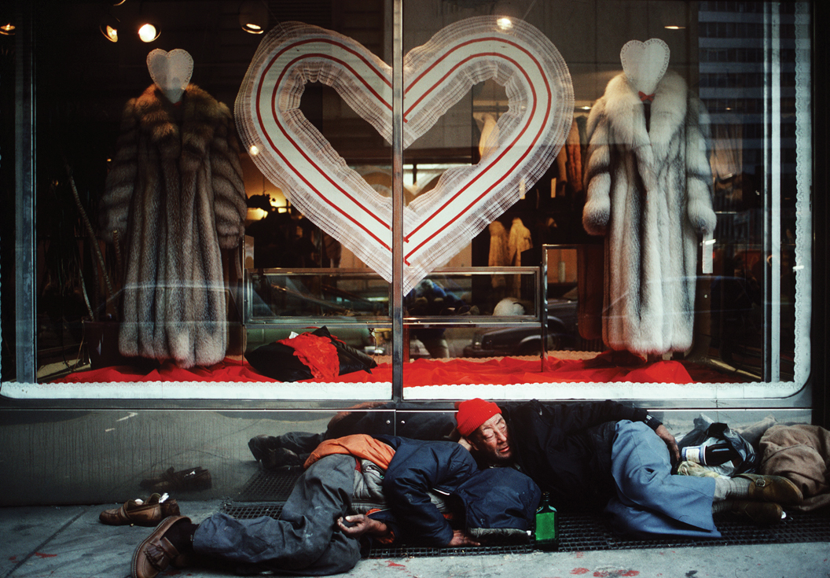
Social Stratification
Every society has some form of social stratification, but societies group people on different criteria (such as race, class, and gender).
Social stratification is a characteristic of society; it persists over generations, and it is maintained through beliefs (and ideologies) that are widely shared by members of society.
By definition inequality is unequal; this contradicts basic American values.
How are we ok with some having more than others?

Slide 8
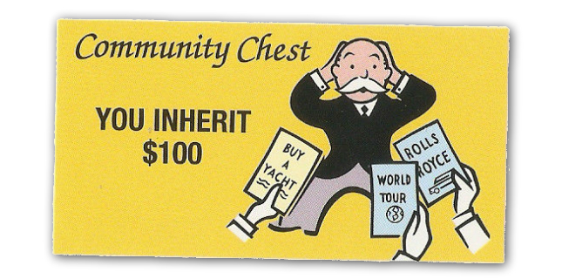
Systems of Stratification
Social class refers to a system of stratification based on access to resources such as wealth, property, power, education and prestige.
Sociologists often refer to it as socioeconomic status (or SES).
By the way, what’s the difference between income and wealth?

Slide 9
Social Classes in the United States
The upper class (capitalist class):
  Wealthiest people in a class system
  Make up about 1% of the U.S. population
  Possess most of the wealth of the country

Slide 10
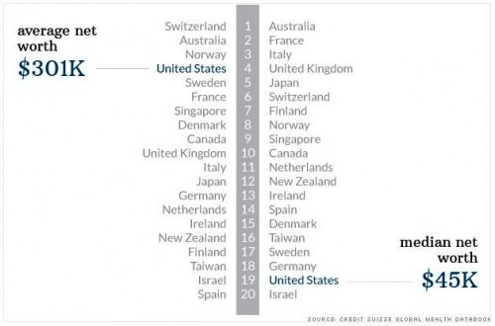
The United States is a Rich Society?
Only when you include those at the top. Exclude the top quintile and the picture is different.

Slide 11
Who are the 1%?
With 376,076 members, the largest single group in the 1 percent are those who listed their occupation as a manager.
Lawyers who work on Wall Street are twice as likely as those in general practice to make the top 1 percent.
Physicians who work primarily in doctor's offices are somewhat more likely to make the cutoff, though all doctors are well-represented in the group.

Slide 12
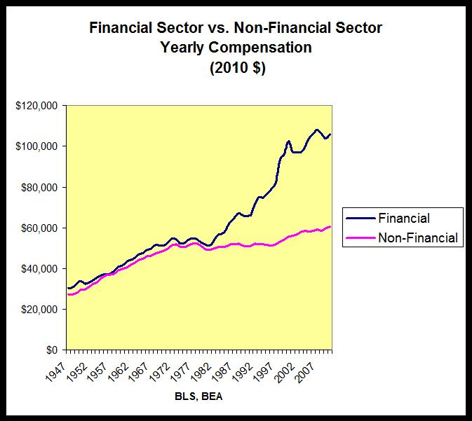
In 2010, the top hedge fund manager earned as much in one HOUR as the average (median) family earned in 47 YEARS.
The top 25 hedge fund managers in 2010 earned as much as 658,000 entry level teachers.
Notes:
http://www.huffingtonpost.com/les-leopold/inequality-is-much-worse-_b_2633191.html?utm_hp_ref=tw

Slide 13
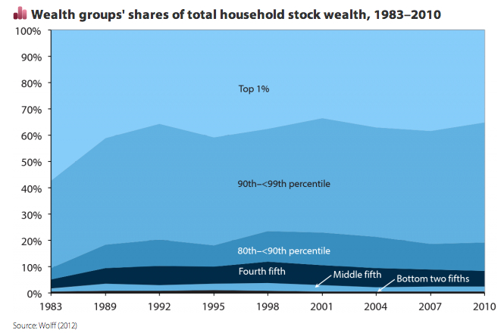
How are stocks distributed?
Dow closed 3/11/2013 over 14,400.
Whose wealth is this measuring?
Notes:
http://money.cnn.com/data/markets/ and http://www.washingtonpost.com/blogs/wonkblog/wp/2013/03/06/this-viral-video-is-right-we-need-to-worry-about-wealth-inequality/

Slide 14
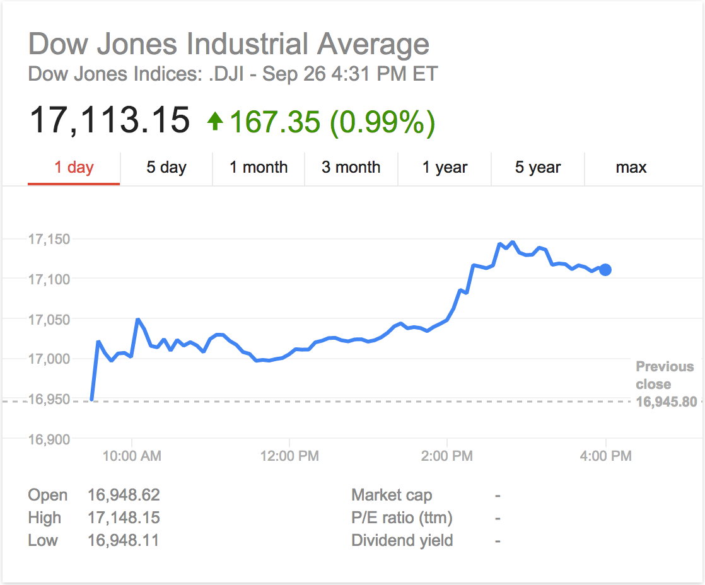
What’s the Dow at Recently?
The Dow closed on Sept 26, 2014

Slide 15
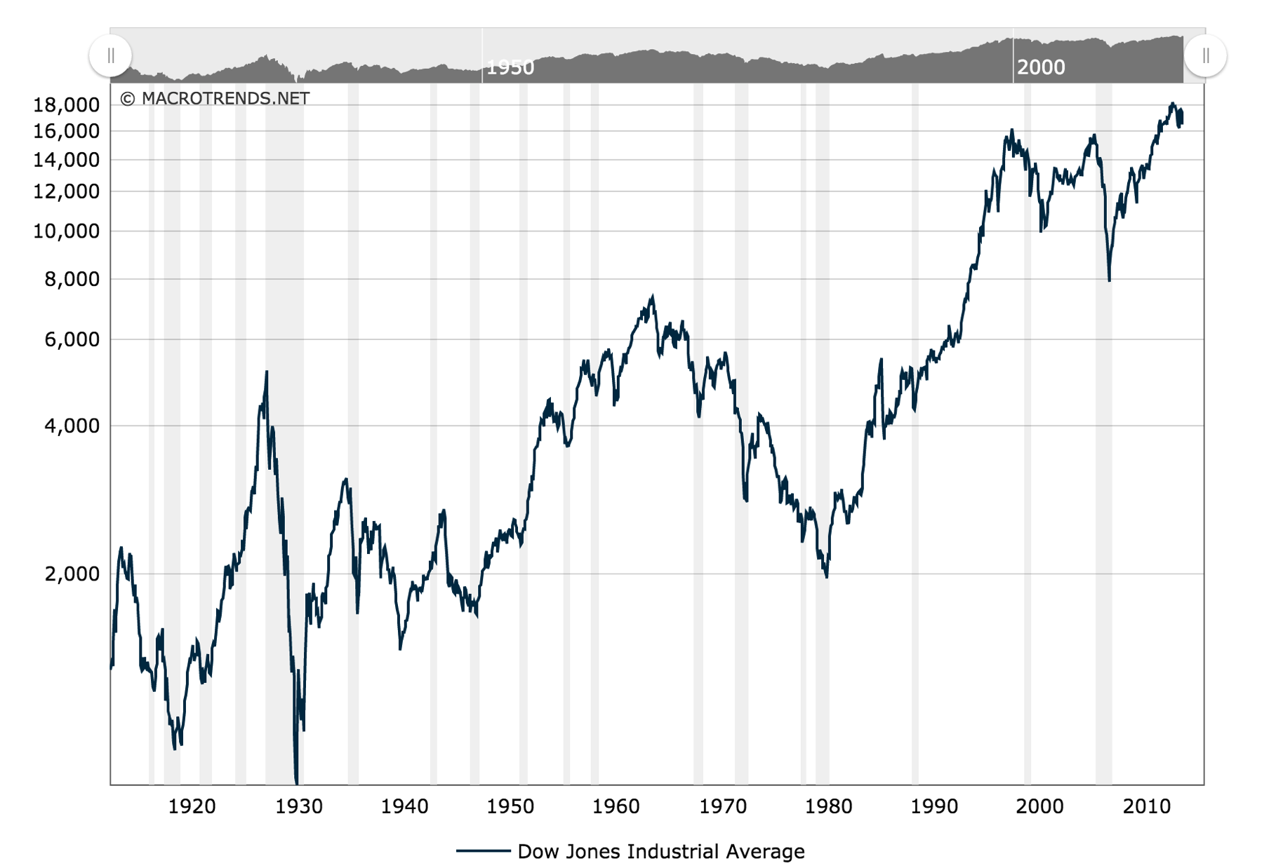
And the Dow over the last 40 Years?

Slide 16
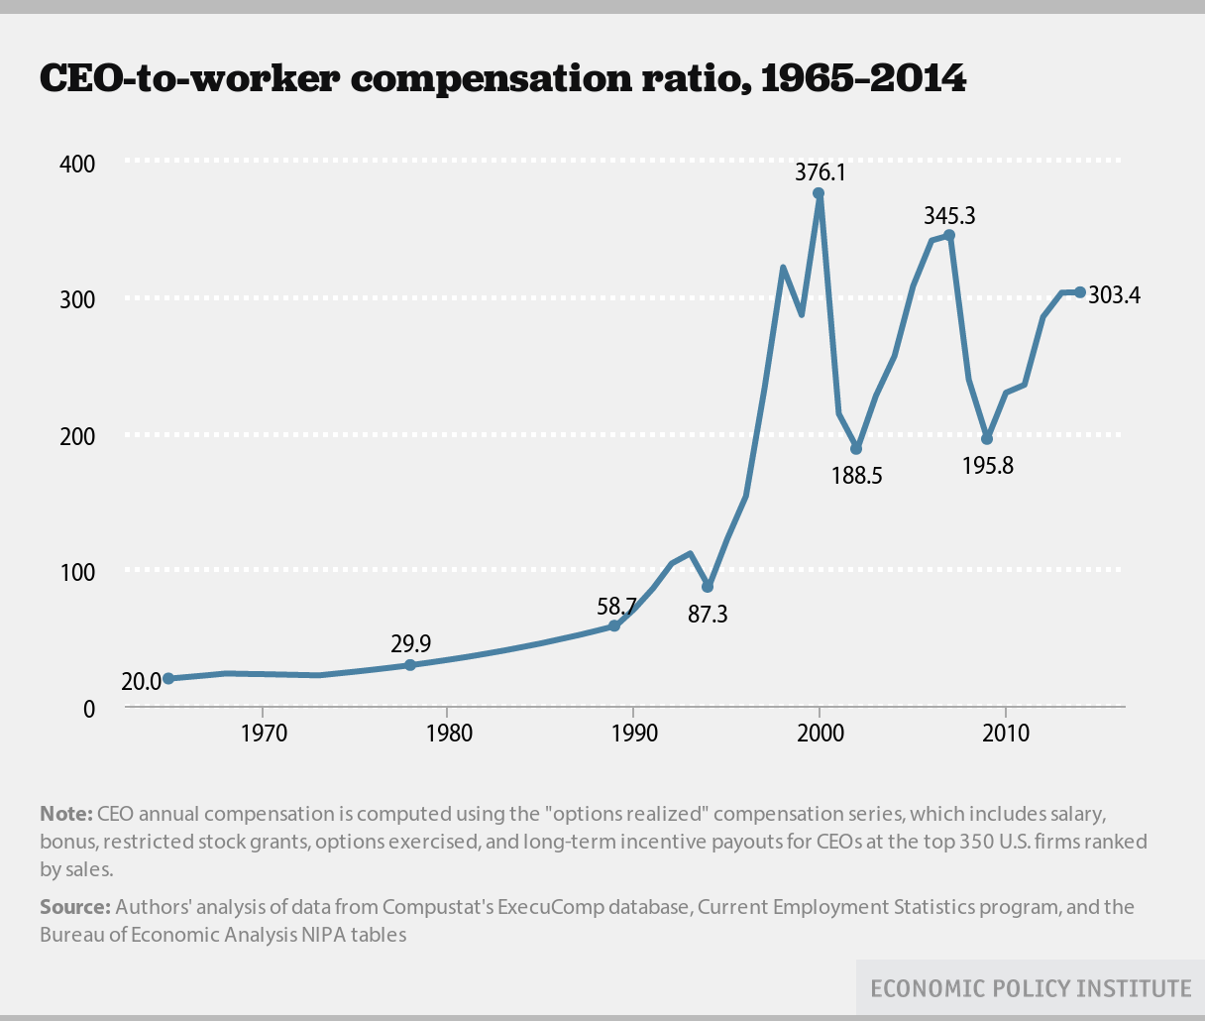
Ratio CEO pay to Workers’ Wages
Notes:
http://www.epi.org/publication/top-ceos-make-300-times-more-than-workers-pay-growth-surpasses-market-gains-and-the-rest-of-the-0-1-percent/?utm_source=Economic+Policy+Institute&utm_campaign=5757102b7a-EPI_News&utm_medium=email&utm_term=0_e7c5826c50-5757102b7a-55866341

Slide 17

Social Classes in the United States
The upper-middle class:
  Professionals and managers
  Make up about 14% of the U.S. population
  Benefited the most from college
The middle class consists primarily of
  “White collar” workers
  Have a broad range of incomes
  Make up about 30% of the U.S. population

Slide 18
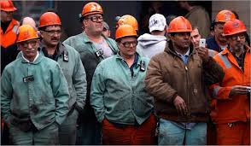
Social Classes in the United States
The working (lower-middle) class:
  “Blue-collar” or service industry workers
  Less likely to have college degrees
  Make up about 30% of the U.S. population

Slide 19

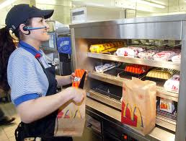
Social Classes in the United States
The lower class (the working poor):
  Many poor people who typically have lower levels of education than other classes
  Make up about 20% of the U.S. population

Slide 20
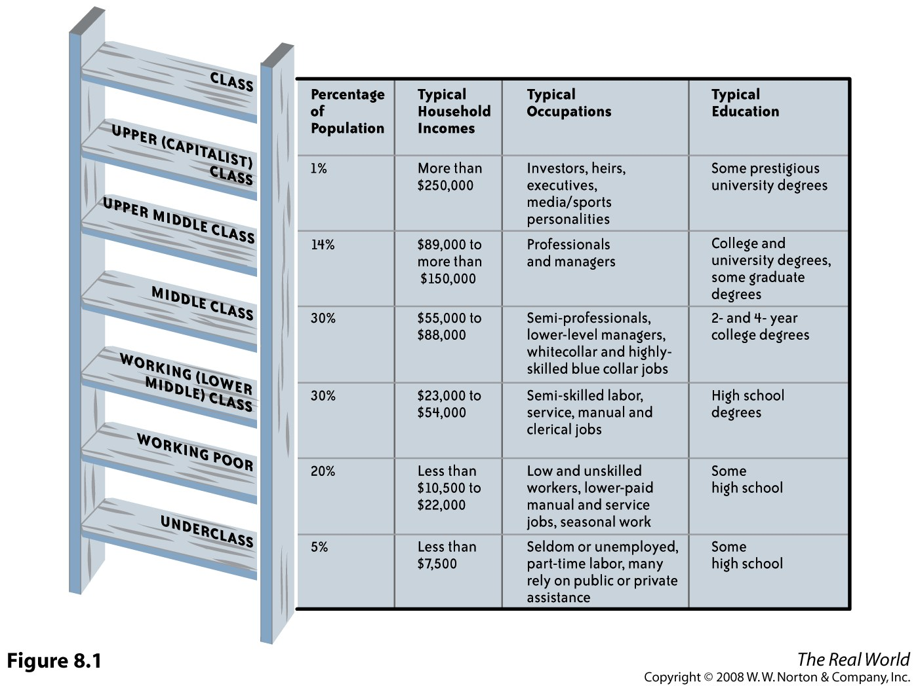

Slide 21
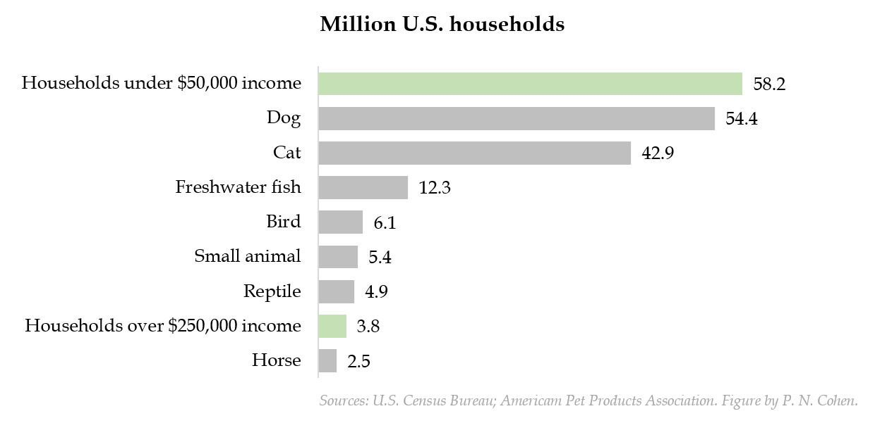
Household income above $250k is less common than owning a pet reptile. Under $50k is more common than a pet dog.

Slide 22
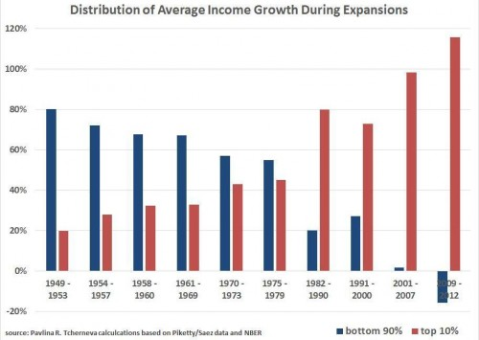
Social Class in the Era of Rising Inequality
Notes:
http://thesocietypages.org/socimages/2014/09/27/sat-stat-staggering-graph-reveals-the-cooptation-of-economic-recoveries-by-the-rich/

Slide 23
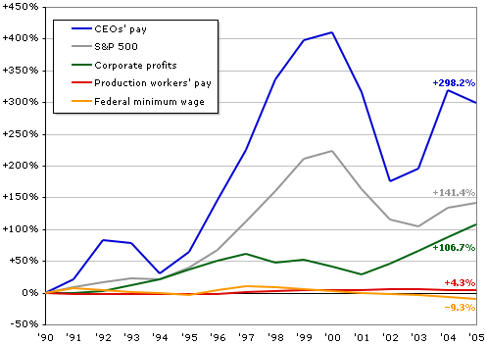
CEOs' average pay, production workers' average pay, the S&P 500 Index, corporate profits, and the federal minimum wage, 1990-2005 (all figures adjusted for inflation)

Slide 24
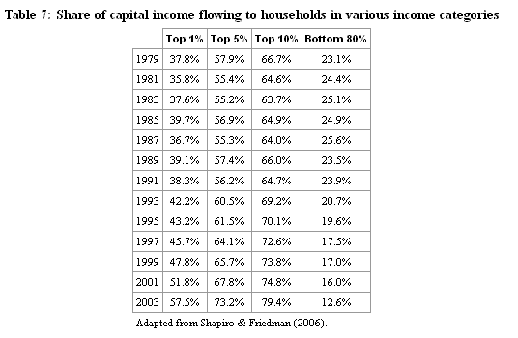
How unequal are we?

Slide 25
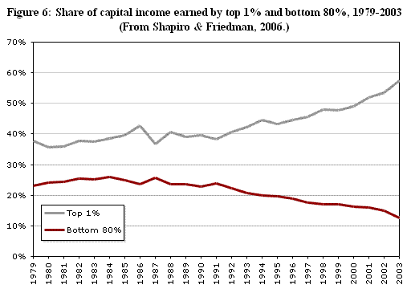
How unequal are we?

Slide 26
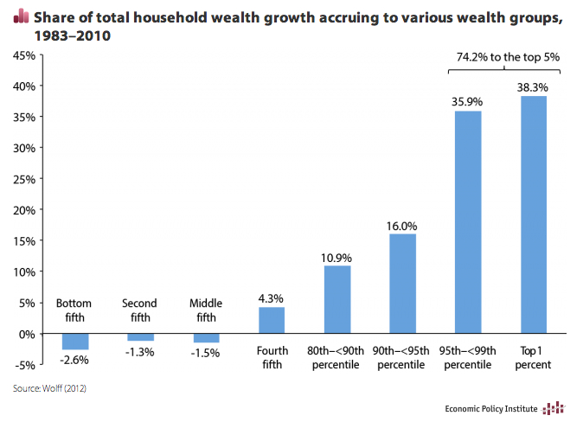
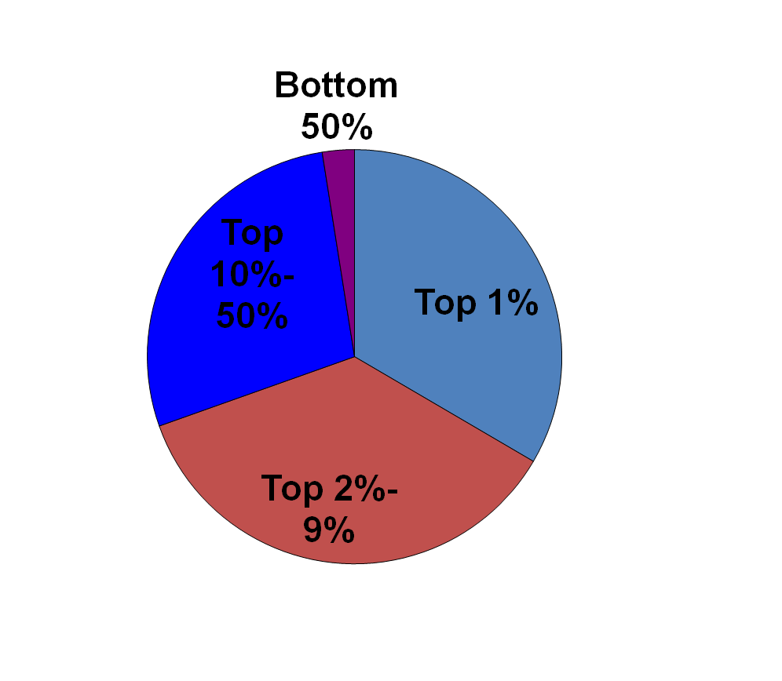
How is Wealth Distributed?
Distribution of Wealth in the United States, 2004
Notes:
Source: Kinnickell 2006

Slide 27
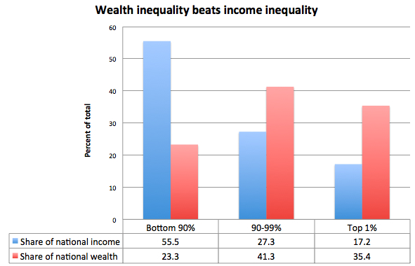
Wealth Inequality is Worse than Income Inequality
Notes:
http://www.washingtonpost.com/blogs/wonkblog/wp/2013/03/06/this-viral-video-is-right-we-need-to-worry-about-wealth-inequality/

Slide 28
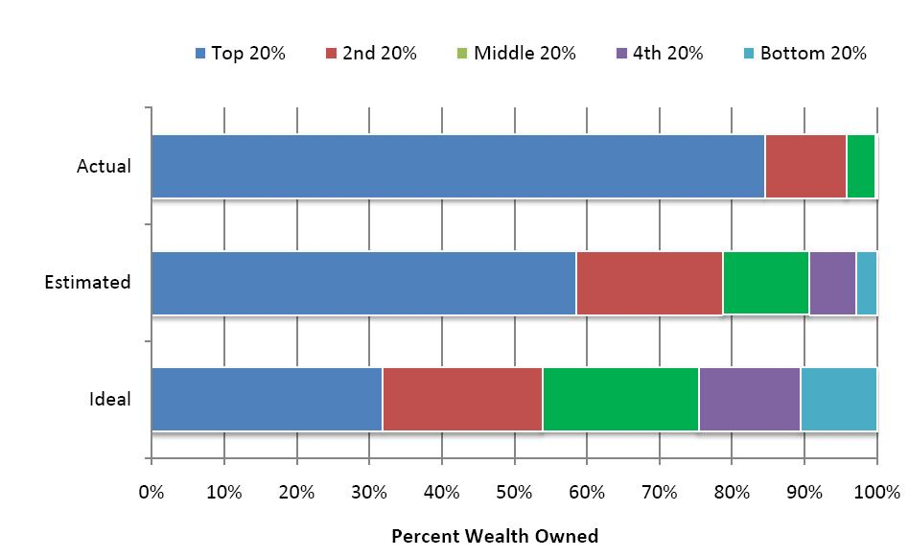
Americans Vastly Underestimate Wealth Inequality

Slide 29
Theories of Social Class
Karl Marx believed that there were two main social classes in capitalist societies:
  Capitalists (or bourgeoisie), who owned the means of production
  Workers (or proletariat), who sold their labor for wages
He believed that the classes would remain divided and social inequality would grow.
  Has social inequality grown?

Slide 30
Theories of Social Class
Max Weber offered a similar model that also included cultural factors.
He argued that class status was made of three components:
  Wealth (or Privilege, inherited assets)
  Power
  Prestige

Slide 31
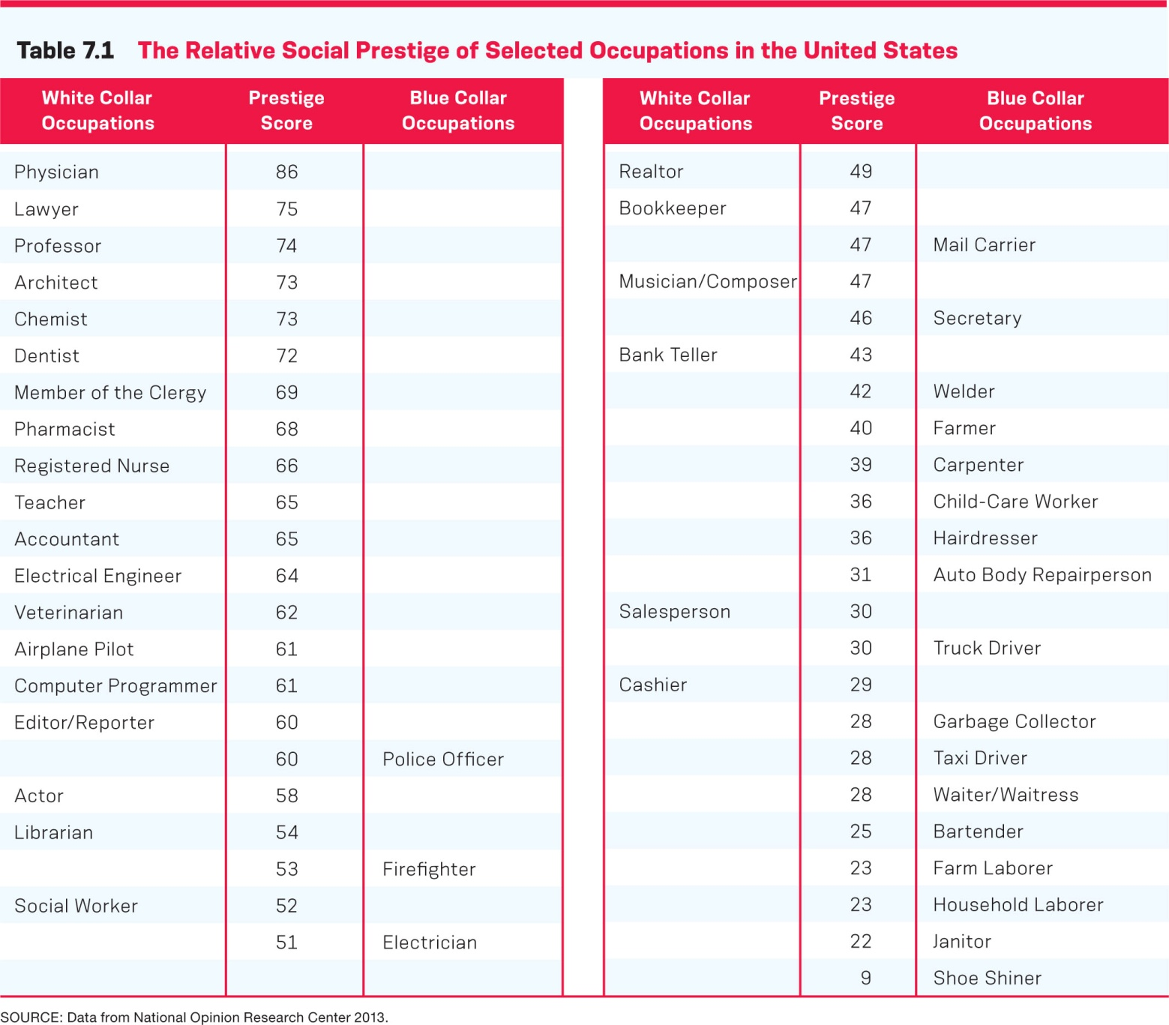

Slide 32



What does your living room/neighborhood say about you?

Slide 33

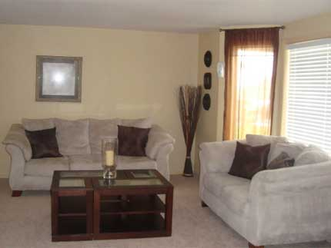

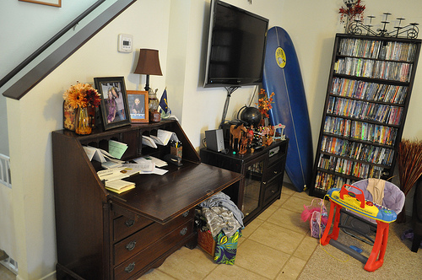

Slide 34
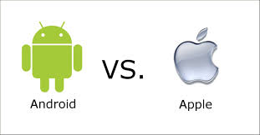
Theories of Social Class
More recently, Pierre Bourdieu has attempted to explain social reproduction, the tendency for social class status to be passed down from one generation to the next.
This happens because each generation acquires cultural capital (tastes, habits, expectations, skills, knowledge, etc.) that help us to gain advantages in society → comprising our habitus (a structure of the mind characterized by a set of acquired sensibilities, dispositions, preferences and tastes)
This cultural capital either helps or hinders us as we become adults.

Slide 35
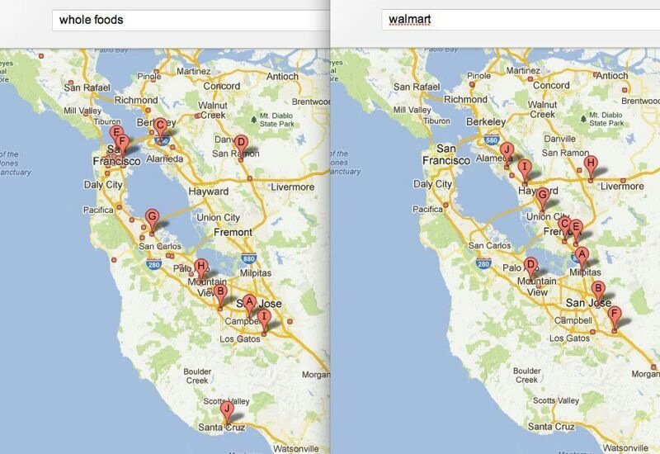
When ‘going to the store’ reveals your class position

Slide 36
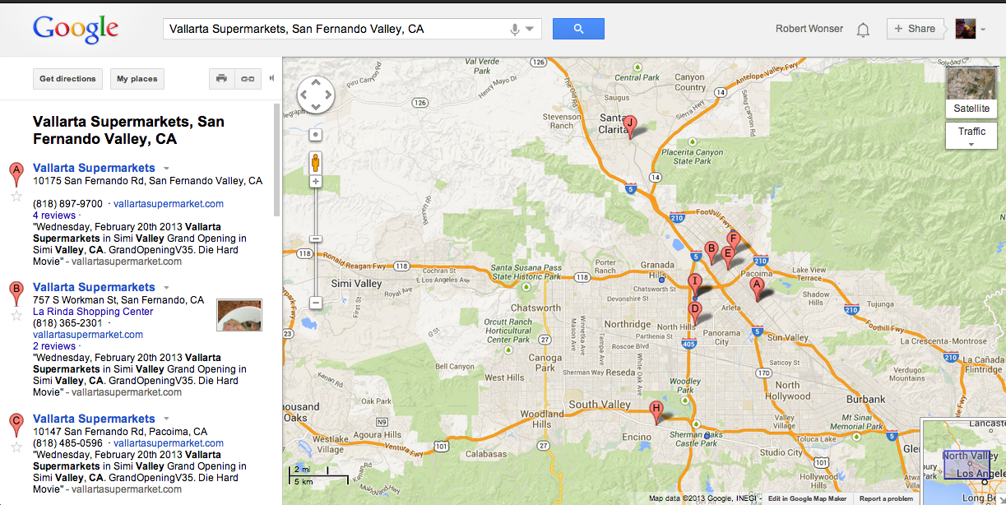
Vallarta Locations

Slide 37
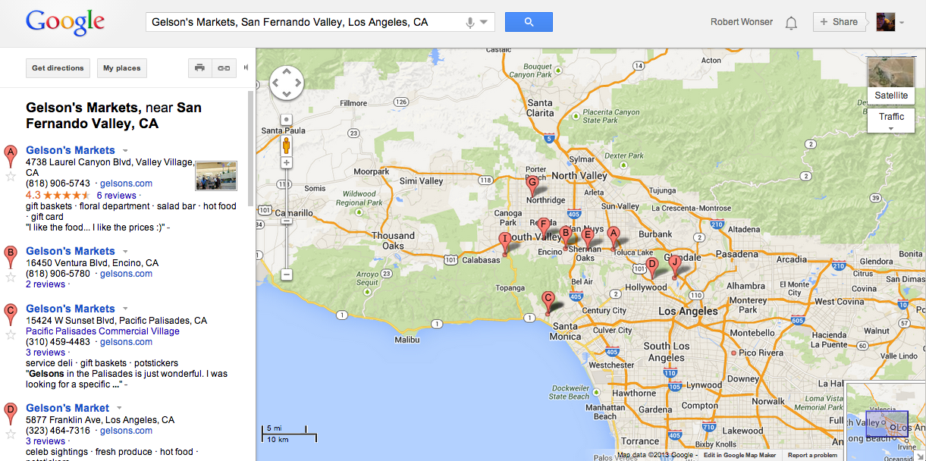
Gelson’s Locations

Slide 38
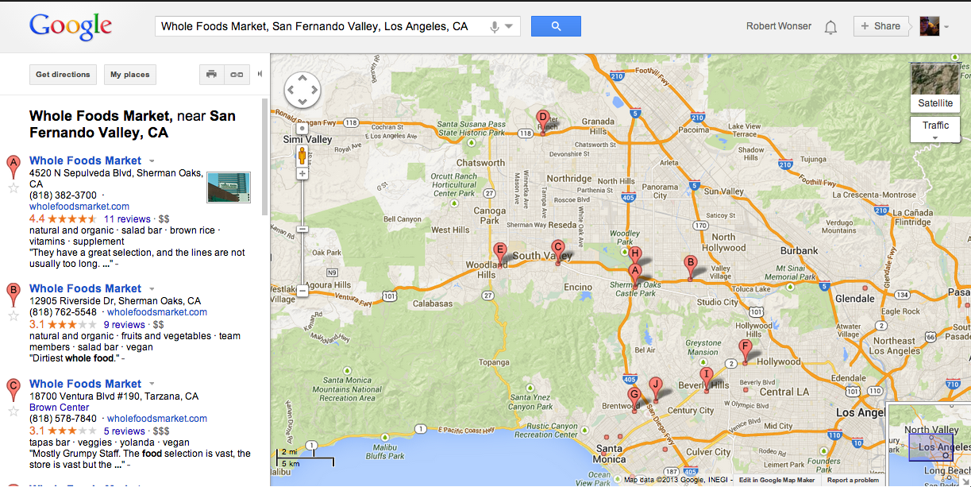
Whole Foods Locations

Slide 39
Theories of Social Class
Symbolic Interactionists examine the way we use status differences to categorize ourselves and others.
As Erving Goffman pointed out, our clothing, speech, gestures, possessions, friends, and activities provide information about our socioeconomic status.

Slide 40
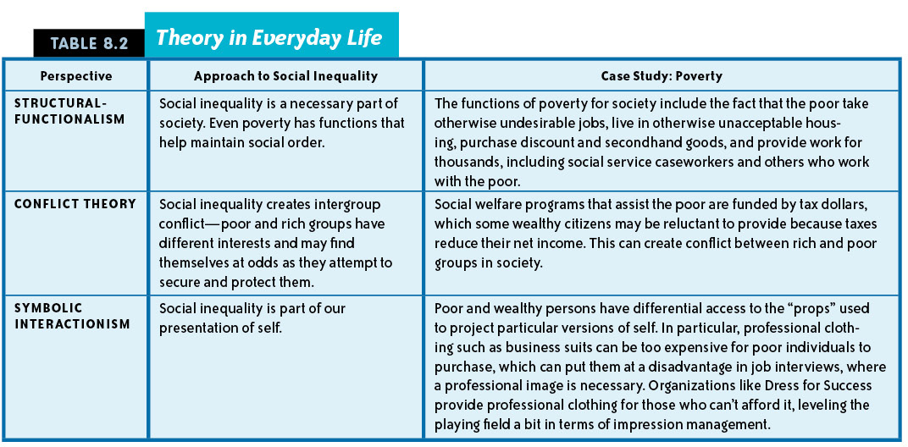

Slide 41
Socioeconomic Status and Life Chances
Belonging to a certain social class has profound consequences for individuals in all areas of life, including education, employment, and medical care.

Slide 42

Social Class and Health
The national average of annual household expenditures on fresh produce was $429 in 2009, while consumers in households earning $100,000 or more spent $712.
As Income ⬆
Fresh produce consumption ⬆
Notes:
Households whose members have not attended college spent on average $369 for fresh produce compared with $521 for households with members with bachelor’s degrees, and $651 for those with postgraduate degrees.
http://producenews.com/index.php/news-dep-menu/test-featured/9824-tracking-demographics-reveals-where-consumption-of-fruits-and-vegetables-is-highest-in-the-united-states?utm_source=13%2F03%2F08+Daily&utm_campaign=daily+march&utm_medium=email

Slide 43
Life Expectancy: Gap getting worse
"Men in the top 1 percent distribution level live about 15 years longer than men in the bottom 1 percent on the income distribution in the United States.
"To give you a sense of the magnitude, men in the bottom 1 percent have life expectancy comparable to the average life expectancy in Pakistan or Sudan.”
And where life spans are concerned, the rich are getting richer.
Since 2001, life expectancy has increased by 2.3 years for the wealthiest 5 percent of American men and by nearly 3 years for similarly situated women. Meanwhile, life expectancy has increased barely at all for the poorest 5 percent.
Among the study's findings was that poor people in affluent cities such as San Francisco and New York tend to live longer than people of similar income levels in rust belt cities such as Detroit.”
Notes:
http://www.npr.org/sections/thetwo-way/2016/04/11/473749157/its-not-just-what-you-make-its-where-you-live-says-study-on-life-expectancy

Slide 44
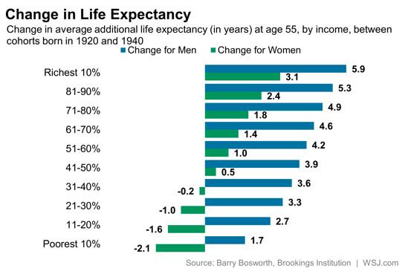
Life Expectancy
Changes in life expectancy, by income: An astonishing improvement for the wealthy; disappointment for the poor.
Notes:
See: http://jama.jamanetwork.com/article.aspx?articleid=2513561

Slide 45
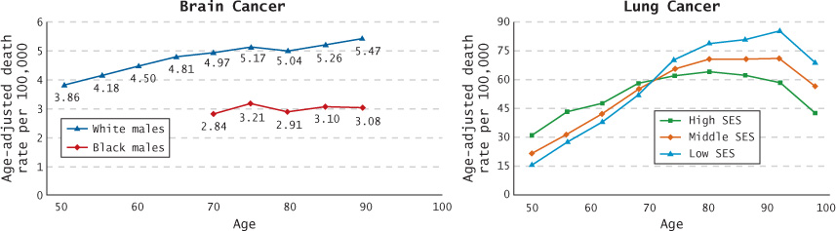
Brain and Lung Cancer Statistics
What’s different about how one gets which type of cancer?
Lung cancer is strongly impacted by health behaviors whereas brain cancer is generally viewed as less predictable or preventable

Slide 46
Social Mobility
Social mobility is the movement of individuals or groups within the hierarchal system of social classes.
America technically has an open system (it is legal and permissible for people to move between classes) but there are structural patterns where people tend to stay very close to the class they were raised in.
There is a less than 2% chance that someone whose parents are in the bottom 60% of all incomes will ever end up in the top 5%.
Born in the bottom 20%? You have a 40% chance of staying there.

Slide 47
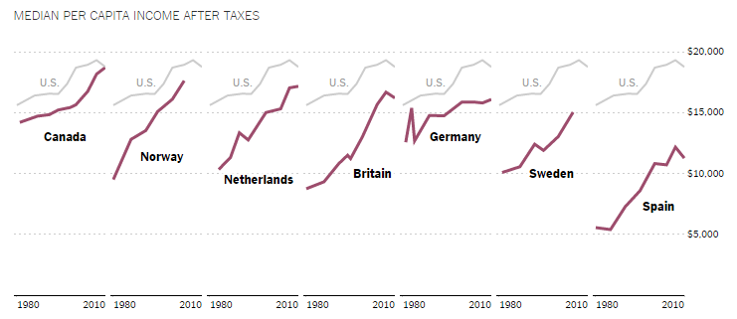
How Does the US Compare?

Slide 48
Poverty Threshold
Takes age, family size, and number of dependent children into account when determining amount of people living below the poverty line
Example:
In 2012, poverty threshold was $23,283 for a four person household with two children under 18
$18,498 for a three person household two children.
Can you get by on poverty wages?

Slide 49
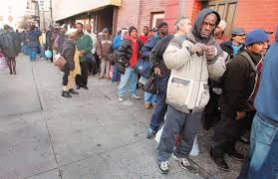
Poverty
The culture of poverty refers to learned attitudes that can develop among poor communities and lead the poor to accept their fate rather than attempt to improve their situation.
What is missing from this theory?

Slide 50

Inequality and the Ideology of the American Dream
The ideology of the American Dream (that anyone can achieve material success if they work hard enough) explains and justifies our social system, but it has been criticized for legitimizing stratification by telling us that everyone has the same opportunity to get ahead.
This Alger novel features a newsboy who rises to
Newspaper editor. Are most Americans today likely
to achieve upward mobility?

Slide 51
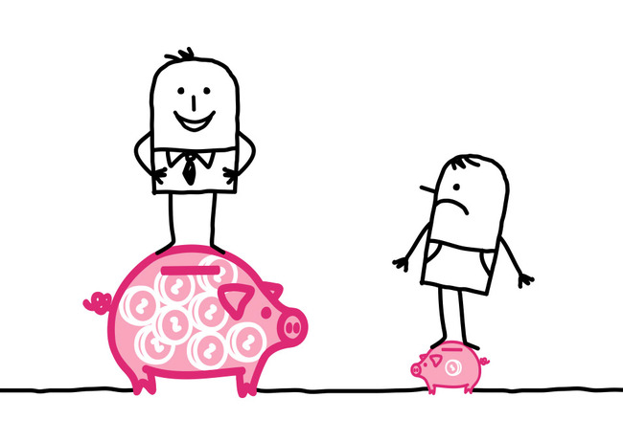
The Problem with the American Dream
It is predicated on a “meritocracy” (that hard work is justly rewarded).
This notion tells us that success or failure depends on the person, when in reality we know that there are structural advantages and disadvantages that also contribute to an individual’s success or failure.

Slide 52
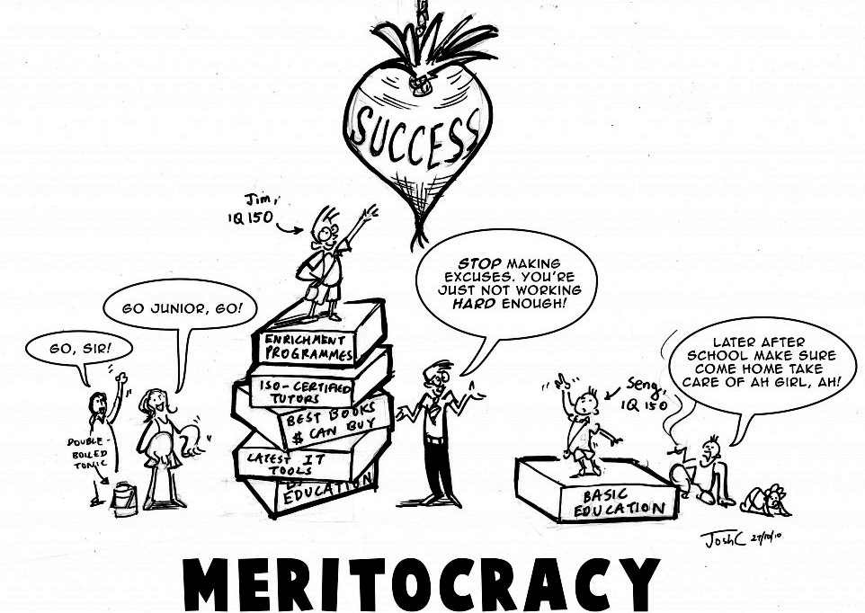
The Myth of Meritocracy

Slide 53
Lesson Quiz
True or False:
1. Every society has some form of stratification.
  a. True
  b. False

Slide 54
Lesson Quiz
2. The tendency of social classes to remain relatively stable as social class status is passed down from one generation to the next is called:
  a. cultural capital.
  b. social prestige.
  c. social reproduction.
  d. class consciousness.

Slide 55
Lesson Quiz
3. Entrenched attitudes that can develop among poor communities and lead the poor to accept their fate is called:
  a. the culture of poverty.
  b. the just-world hypothesis.
  c. disenfranchisement.
  d. social welfare.

Slide 56
Lesson Quiz
4. Max Weber argued that there were several important components of social class. Which of the following is NOT one of the components?
  a. Prestige
  b. Power
  c. Wealth
  d. Morals

Slide 57
Some Important Realizations
Inequality is intentional; moreover it is rising. The U.S. now has higher rates of inequality and poverty than other industrialized countries.
It is legitimated by the ideology of meritocracy and the American Dream.
Social class profoundly affects every facet of your life.

Slide 58
Which Class do you belong to?
PBS Quiz to accompany ‘People Like Us’
NY Times Class Locator
NY Times Analysis on Class

