Slide 1

Immunization Education Update
For Physicians and Staff
Immunizations for Adults
September 2017
Celebrating 16 years
Notes:
Educating Physicians In their Communities is:
A peer-to-peer immunization education program presented in the practice setting for practitioners and staff or in a classroom for students.
Presented by a team of 2 professionals: physician or other primary care provider (nurse practitioner, physician's assistant) and a nurse or office manager.
Our Beginnings…
EPIC is now in its 16th year of immunization education. The first EPIC Immunization Education program was developed and implemented in Pennsylvania (a joint venture between public health and the PA chapter of the American Academy of Pediatrics). The program has been replicated in several states - Georgia most closely resembling the Pennsylvania program. Georgia was first to add adult vaccines to the program. In 2009 the Georgia Chapter created a separate Women’s Health Immunization Education program for obstetricians and gynecologists. Presentations are also available for students in healthcare training. Presentation on Coding are available to members of the Georgia Chapter of AAP
In 2003 the National Vaccine Advisory Committee (NVAC) approved and published updated standards for adult and child/adolescent immunization practices.
EPIC programs are designed to meet Standard #10 of the Standards for Child and Adolescent Immunization Practices:
"Persons who administer vaccines and staff who manage or support vaccine administration are knowledgeable and receive on-going education"
And
Standard #8 of the Standards for Adult Immunization Practices: “Persons who administer vaccines are properly trained."

Slide 2
Presented By:
Georgia Chapter - American Academy of Pediatrics
Georgia Immunization Program
In Cooperation with:
Georgia Academy of Family Physicians
Georgia Chapter American College of Physicians
Georgia OB/Gyn Society
Notes:
The EPIC immunization education program is developed and updated annually, and more frequently when necessary, by the Georgia Chapter of the American Academy of Pediatrics in partnership with the Georgia Immunization Program and in cooperation with the Georgia Academy of Family Physicians, the Georgia Chapter of the American College of Physicians/American Society of Internal Medicine, and the Georgia OB/GYN Society.
EPIC education programs utilize information from the Centers for Disease Control and Prevention, ACIP Recommendations, The Immunization Action Coalition and other reliable resources. When there is more than one vaccine manufacturer for a specific type of vaccine the presenter utilizes the generic name (ie. Tdap, hepatitis b etc.)
Note: Vaccine manufacturers who provide funding for administrative support of the EPIC Program have no editorial control over the program materials or presentations.

Slide 3
Faculty Disclosure Information
In accordance with ACCME* Standards, all faculty members are required to disclose to the program audience any real or apparent conflict of interest to the content of their presentation.
This presentation will include the most current ACIP recommendations for frequently used vaccines but is not a comprehensive review of all available vaccines.
Some ACIP recommendations for the use of vaccines have not currently been approved by the FDA.
Detailed information regarding all ACIP Recommendations is available at www.cdc.gov/vaccines/acip/recs/index.html
*Accreditation Council for Continuing Medical Education
Notes:
Presenters for the EPIC program do not discuss vaccines that are not licensed by the FDA or any pending vaccines that are still undergoing clinical trials. Sometimes an ACIP recommendation may not be listed as an indication for a specific vaccine or a specific age group on the manufacturers package insert. Therefore, the recommendation is considered “off label” use of the vaccine. The presenters will discuss the most recent ACIP recommendations during this presentation. All new ACIP Recommendations discussed have been published in MMWR.

Slide 4
Objectives
Hello,
At the end of this presentation, you will be able to:
Recall the role vaccines have played in preventing diseases
Discuss the importance of vaccines for adolescents and adults
Explain the role of a vaccine champion
Review the most recent CDC recommendations for storage and handling of vaccines
List at least 2 reliable sources for immunization information
Notes:
These are the objectives for the 2016 EPIC presentation.

Slide 5
The Impact of Vaccines
Disease | Average Annual Reported Cases Pre-vaccine* | Cases in U.S. 2015** | Provisional Cases in U.S. 2016** | Provisional % Reduction In U.S. 2016
Smallpox | 48,164 | Eradicated worldwide in 1980
Diphtheria | 175,885 | 0 | 0 | 100%
Measles | 503,282 | 188 | 69 | >99.9%
Mumps | 152,209 | 1,329 | 5,311 | 96.5%
Pertussis | 147,271 | 20,762 | 15,737 | 89.3%
Polio (paralytic) | 16,316 | 0 | 0 | 100%
Rubella | 47,745 | 5 | 5 | >99.9%
Congenital Rubella Syndrome | 823 | 1 | 1 | >99.9%
Tetanus | 1,314 | 29 | 33 | 97.5%
H. Influenzae Type b Age<5 years | 20,000 | 29 | 22 | 99.9%
*MMWR 48(12);243-248 April 2, 1999
**MMWR 65(52), ND-924-ND-941, January 6, 2017
Notes:
This table shows the impact of vaccines on the annual reported cases of some vaccine preventable diseases in the United States.
Column 2 shows the average number of reported cases of a specific disease prior to the licensure of the vaccine.
Column 3 shows the number of reported cases in the United States in 2015.
Column 4 shows the provisional number of reported cases in the U.S in 2016.
Column 5 shows the percentage decrease in reported cases in the United States based on the provisional number of reported cases in 2016 compared with the pre-vaccine years.
Reference:
Achievements in Public Health, 1900-1999 Impact of Vaccines Universally Recommended for Children - United States, 1990-1998 MMWR April 02, 1999 / 48(12);243-248
MMWR 65(52);ND-924-ND-941, January 6, 2017

Slide 6

Advisory Committee on Immunization Practices (ACIP)
15 voting members with expertise in one or more of the following:
Vaccinology
Immunology
Infectious diseases
Pediatrics
Internal Medicine
Preventive medicine
Public health
Consumer perspectives and/or social and community aspects of
immunization programs
ACIP develops recommendations and schedules for the use of
licensed vaccines
Notes:
The dramatic reduction of vaccine preventable diseases in the United States can be attributed to the availability of vaccines, as well as recommendations and an organized vaccine schedule developed by the Advisory Committee on Immunization Practices (ACIP).
The overall goals of the ACIP are to provide advice which will assist the Department and the Nation in reducing the incidence of vaccine preventable diseases and to increase the safe usage of vaccines and related biological products.
For more information: http://www.cdc.gov/vaccines/acip/index.html
For more details about all the vaccine preventable diseases reviewed in this presentation, refer to: Epidemiology and Prevention of Vaccine-Preventable Diseases (The Pink Book), 13th edition. 2015. HHS, CDC.

Slide 7
Community Immunity
Formerly known as “Herd Immunity”
Transmitting case
Immune
Immune
Immune
Immune
Immune
Susceptible
(Indirectly
Protected)
Immune
Susceptible
(Indirectly
Protected)
Reference: Presentation from Immunize Georgia, September 9, 2016 by Walt A. Orenstein, MD
Professor of Medicine Global, Health, Epidemiology and Pediatrics
Emory Department of Medicine, Associate Director, Emory Vaccine Center Director
Vaccine Policy and Development, Emory University, Atlanta, GA
Notes:
EPIC 2017

Slide 8
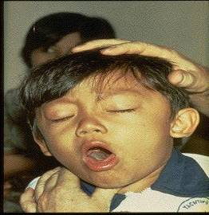
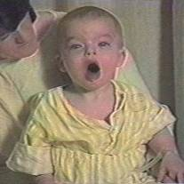

Diphtheria
©AAP
Tetanus
Pertussis
Notes:
Diphtheria, Tetanus and Pertussis (Whooping Cough) are all toxin mediated diseases. This means that the toxin or toxins produced by the bacteria are responsible for the symptoms of the disease.
DIPHTHERIA
Slide shows a child with diphtherial membrane in nasopharynx
Diphtheria is caused by a bacteria (Corynebacterium diphtheriae) that produces a toxin.
The bacterial growth and toxin cause local tissue destruction & membrane formation in nasopharynx & larynx & possible obstruction of respiratory tract.
Most common complications are myocarditis & neuritis (motor nerves).
TETANUS
Slide shows a child with muscle rigidity from tetanus.
Tetanus spores that are found everywhere in soil usually enter body through contaminated puncture wounds, lacerations or abrasions. Spores germinate and bacteria (Clostridium tetani) begin to multiply and produce an exotoxin. Toxin affects the neuromuscular junction and produces generalized rigidity and convulsive spasms of skeletal muscles, starting with the jaw and muscles of swallowing (lockjaw).
PERTUSSIS
Slide shows two children with pertussis (whooping cough) with paroxysmal coughing. (Sound is the typical pertussis cough and whoop. Pertussis, caused by a bacterium (Bordetella pertussis), produces multiple antigens and biologically active components that cause inflammation of the respiratory tract, paralysis of the cilia of the respiratory tract and lung damage resulting in pooling of secretions and characteristic cough lasting up to 12 weeks. Humans are the only reservoir. Transmission is by direct contact with respiratory droplets.
For more details about these 3 diseases refer to: Epidemiology and Prevention of Vaccine-Preventable Diseases, 13th edition. 2015 HHS, CDC.

Slide 9
Tetanus, Diphtheria, and Pertussis Vaccines
(Tdap)
ACIP Recommends:
One dose of Tdap:
  For all adolescents and adults
Boostrix is licensed for persons 10 years and older
Adacel is licensed for persons 10 through 64 years
For adults 65 years and older Boostrix should be used, when feasible; however, either vaccine product provides protection and is considered valid.
  There is no minimal interval between the last dose of Td and Tdap.
MMWR, September 23, 2011, Vol 60, #37 MMWR, January 14, 2011, Vol 60, #01 MMWR, June 29, 2012, Vol 61, #25
Notes:
Because of the epidemic of pertussis in California and other states during 2010 the ACIP revised the recommendations for the use of Tdap.
Ref: Updated Recommendations for Use of Tdap Vaccine from ACIP,
MMWR Weekly, September 23, 2011 / 60(37);1279-1280
(April 1, 2014)
The Food and Drug Administration has expanded the approved age range for Sanofi Pasteur's Adacel active booster immunization for tetanus, diphtheria and pertussis to ages 10 to 64 years. An open-label, multi-center Phase IV trial found that a single dose of the drug--which was approved for people ages 11 through 64 in 2005--had similar antibody responses and rates of adverse reactions in 10-year-olds as it does in 11-year-olds.

Slide 10
Pertussis
Natural infection and vaccines do not confer life long immunity.
Complications – apnea, pneumonia, weight loss, seizures, death.
    - Most deaths occur in infants younger than 6 months
    (1% die from pertussis)
    - Adolescents/adults usually have milder disease; disease is hard to distinguish from other cough illnesses.
Immunization is the best way to prevent pertussis.
Ref: Yeh, S and Mink, CM. Bordetella pertussis infection in infants and children: Clinical features and diagnosis. Post TW (Ed), UpToDate, Waltham, MA. (Accessed on March 6, 2014.)

Slide 11
Tdap for Pregnant Women
ACIP recommends:
One dose of Tdap during each pregnancy, irrespective of a prior history of receiving Tdap.
Optimal timing for Tdap administration is between 27 and 36 weeks gestation. ACIP guidance and current data suggest that vaccinating earlier in the 27 through 36 week window will maximize passive antibody transfer to the infant.
If Tdap is not given during pregnancy, and has not been given previously, administer Tdap immediately postpartum.
According to ACIP, Pregnant women and adolescents may receive additional doses of Tdap.
2017 Childhood Schedule: Children 7-10 years of age who receive Tdap as part of the catch-up series can be given Tdap again at ages 11-12 years
Ref: Advisory Committee on Immunization Practices. Updated ACIP statement for pertussis, tetanus and diphtheria vaccines presented by Jennifer L. Liang, October 19, 2016.
MMWR, February 7, 2017, Vol. 66
Notes:
Guidance on use of Tdap products for pregnant women:
All pregnant women should receive a dose of Tdap during each pregnancy, irrespective of prior history of receiving Tdap. Optimal timing for administration is between 27 and 36 weeks gestation. If a dose is given early in that same pregnancy, do NOT repeat it at 27-36 weeks. If not given during pregnancy, give Tdap immediately postpartum³.
References:
1. Advisory Committee on Immunization Practices. Updated ACIP statement for per
2. MMWR, February 22, 2013, Vol 62, #7
3. www.immunize.org, Ask the Experts, Tetanus section, IAC, Sept. 2013

Slide 12







Cocooning Strategy
Parents
Siblings
Child Care Provider
Healthcare Worker
Grandparents
Notes:
An infant who is infected with pertussis under 6 months of age can experience a devastating disease, frequently resulting in death, because the infant can not tolerate the severe inflammation of the respiratory tract. The primary series of DTaP is usually not completed until 6 months of age. Therefore, the best method to prevent the infant from infection with pertussis is to eliminate exposure to the disease. This is accomplished by immunizing ALL pregnant women, and all caregivers with Tdap vaccine. Ninety percent of pertussis deaths between 2000-2009 were in infants less than 3 months of age.

Slide 13
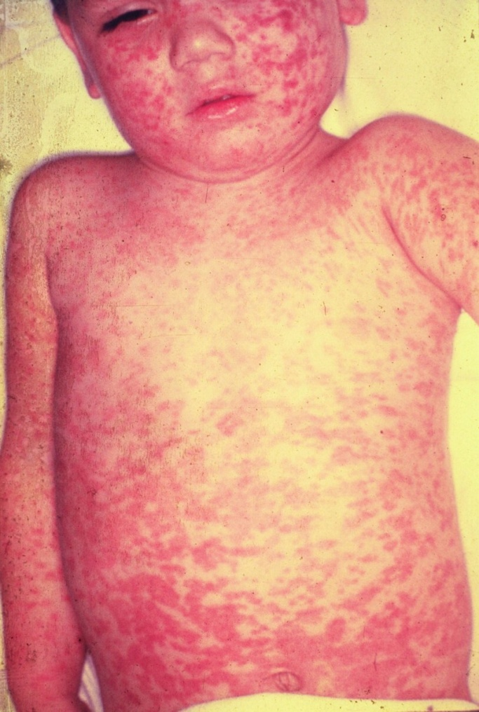
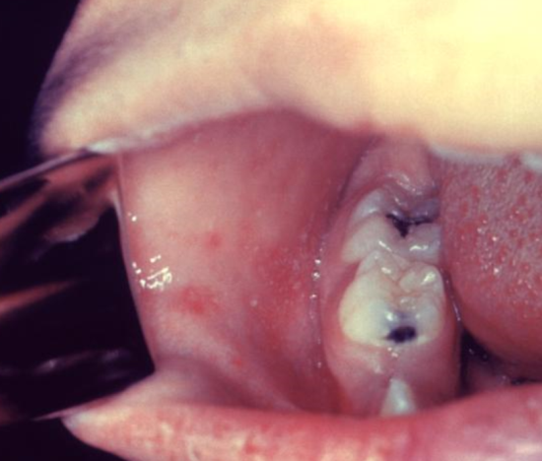
MEASLES
Incubation period generally 8 to 14 days from exposure to onset of symptoms.
Symptoms are fever, cough, coryza, conjunctivitis, maculopapular rash and Koplik spots.
Complications include otitis media, pneumonia, croup, & diarrhea.
Acute encephalitis occurs in 1 out of 1,000 cases.
Death occurs in 1 to 3 of every 1,000 cases.
Subacute sclerosing panencephalitis (SSPE) occurs in 1 to 609 infants
Koplik Spots
Measles Vaccine
95% of people develop serum
measles antibody after one dose.
99% after 2 doses.
5% or less may lose protection
after several years.
Source: American Academy of Pediatrics, Red Book Online Visual Library
Source: Centers for Disease Control and Prevention
AAP Red Book, 30th Edition 2015
Notes:
Subacute Sclerosing Panencephalitis (SSPE) is a neurological disorder that can appear years after a person is infected with measles and is always fatal. It is characterized by behavioral and intellectual deterioration and seizures that occur 7-11 years after measles infection. In rare cases the virus spreads to the brain, but then becomes dormant. Eventually it can lead to SSPE, resulting in deterioration and death. Researchers don’t know what causes the virus to reactivate.
There is no cure for SSPE and the only way to prevent it is to vaccinate everyone against measles.
Reference: Infection Diseases Society of America. Always Deadly Measles Complication more Common than Believed. October 29, 2016.

Slide 14
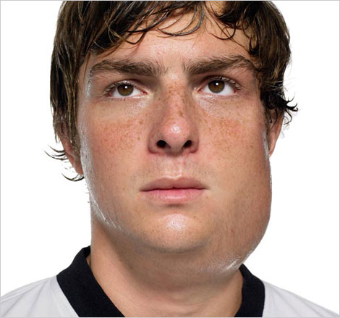
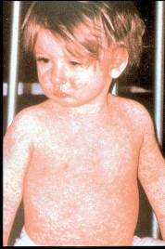
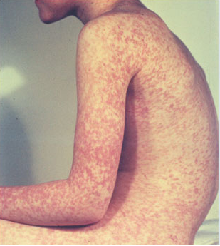
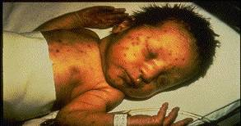
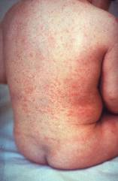
Measles, Mumps, Rubella
Measles (M)
Mumps (M)
Source: Creative Commons
Source: American Academy of Pediatrics
Red Book On Line Visual Library
Rubella (R)
Congenital Rubella (R)
Notes:
MEASLES (caused by paramyxovirus)
Slide shows two children with typical measles rash and conjunctivitis in younger child
Initial symptoms are runny nose, followed by increasing fever (103º-105º), cough, conjunctivitis, Koplik spots, and a maculopapular rash that lasts 5-6 days
Complications include otitis media (7%), pneumonia (6%), and acute encephalitis (0.1%) 1 in 1000 cases, death (0.2%) Although measles elimination was declared in the United States in 2000 , importation of measles cases continues to occur.
MUMPS (caused by paramyxovirus)
Slide shows an adolescent with parotitis due to mumps
Parotitis occurs in 30-40% of infected persons, 40-50% have only nonspecific or respiratory symptoms
Complications include aseptic meningitis, & deafness
Post pubertal individuals may have orchitis, ovarian inflammation, & pancreatitis
RUBELLA (Caused by togavirus)
In children, the rash may be the first manifestation of infection. Adults may have low-grade fever, malaise, URI, and lymphadenopathy prior to rash. Arthralgia and arthritis is common in adults, especially women. Complications include encephalitis and hemorrhagic manifestations
Rubella is no longer endemic in the U.S. However, it is still present in other countries and can be imported
CONGENITAL RUBELLA
Slide shows an adult and child with a typical rash from rubella and an infant with congenital rubella syndrome Infant was infected in utero and has “blueberry muffin spots” on skin due to petechial lesions, cataracts, hearing loss and congenital heart lesion and will most likely be developmentally delayed.
All woman of child bearing age should be certain they are immune to rubella.
For additional information refer to: Epidemiology and Prevention of Vaccine-Preventable Diseases, 13th edition 2015. HHS, CDC.

Slide 15
MMR Vaccine
  Anyone traveling to a foreign country should be appropriately immunized with MMR prior to leaving U.S.
Acceptable presumptive evidence of MMR immunity
Documentation of age appropriate vaccination with MMR vaccine
Laboratory evidence of immunity
Laboratory confirmation of disease
Birth before 1957
Birth date not acceptable evidence of rubella immunity for women who could become pregnant
MMWR, June 14, 2013, Vol 62, #RR-04
Notes:
MMR vaccine has been successful in reducing the cases of measles in the United States and many young physicians, physician’s assistants and nurse practitioners have never seen an acute case of measles. The symptoms of measles are more than a rash and include conjunctivitis, fever and white lesions (Koplik spots) on the buccal mucosa. Practitioners who have not seen a case of measles sometimes make a diagnosis solely on the basis of a rash. Serologic testing is now required to confirm a case of measles.

Slide 16
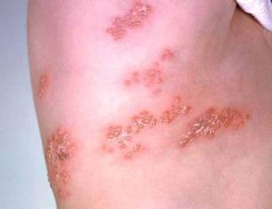
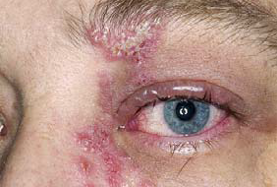
Herpes Zoster
Herpes zoster (HZ), or shingles, occurs through reactivation of latent varicella-zoster virus
Typically characterized by prodromal pain and an acute vesicular eruption (rash) accompanied by moderate to severe pain
One in three persons will develop zoster during their lifetime
Post-herpetic neuralgia (PHN) is a common consequence of zoster
Risk for zoster and PHN increases with age
Photo courtesy of www.webmd.com
Notes:
The picture on left shows zoster (shingles) on the upper chest and back.
The picture on right shows zoster on the face involving one of the cranial nerves.

Slide 17
Zostavax®
Zostavax is licensed for use in persons 50 years and older
Overall Efficacy
51% fewer episodes of zoster and less severe disease
66% less postherpetic neuralgia
Protection wanes within the first 5 years and duration of protection beyond 5 years is uncertain
ACIP recommends one dose for adults 60 years and older, including those who have experienced previous episodes of shingles.
It is not necessary to ask patient about a history of varicella or to do serologic testing for immunity.
MMWR, August 22, 2014, Vol 63, #33 MMWR (RR) June 6, 2008, Vol 57 #05; 1-30
Notes:
Herpes zoster vaccine (Zostavax [Merck & Co., Inc.]) was licensed in 2006 and recommended by the Advisory Committee on Immunization Practices (ACIP) in 2008 for prevention of herpes zoster (shingles) and its complications among adults aged ≥60 years. The Food and Drug Administration (FDA) approved the use of Zostavax in 2011 for adults aged 50 through 59 years based on a large study of safety and efficacy in this age group.
Because the protection offered by the herpes zoster vaccine wanes within the first 5 years after vaccination, and duration of protection beyond 5 years is uncertain, it is unknown to what extent persons vaccinated before age 60 years will be protected as they age and their risk for herpes zoster and its complications increases. Because duration of protection offered by the vaccine is uncertain, the need for revaccination is not clear. Assuming waning of vaccination protection according to currently available studies, the cost-effectiveness model projects a substantially greater reduction of disease burden, health care utilization, and costs with vaccination of older adults who have higher incidence of herpes zoster and related complications. Considering that the burden of herpes zoster and its complications increases with age and that the duration of vaccine protection in persons aged ≥60 years is uncertain, ACIP maintained its current recommendation that herpes zoster vaccine be routinely recommended for adults aged ≥60 years.
With FDA approval, Zostavax is available in the United States and indicated for use among adults aged ≥50 years. Vaccination providers considering the use of Zostavax among certain persons aged 50 through 59 years despite the absence of an ACIP recommendation should discuss the risks and benefits of vaccination with their patients. Although the vaccine has short-term efficacy, there have been no long-term studies of vaccine protection in this age group. In adults vaccinated at age ≥60 years, vaccine efficacy wanes within the first 5 years after vaccination, and protection beyond 5 years is uncertain; therefore, adults receiving the vaccine before age 60 years might not be protected when their risks for herpes zoster and its complications are highest. CDC is actively monitoring postmarketing data on duration of vaccine protection in adults vaccinated at age ≥60 years. As additional data become available, ACIP will reevaluate the optimal age for vaccination and the need for revaccination to maintain protection against herpes zoster and its complications.
Reference: Reference: Update on Recommendations for Use of Herpes Zoster Vaccine. MMWR/Vol. 63/No. 33 August 22, 2014
Insurance reimbursement for Zostavax will vary based on the patient’s insurance plan. Patients need to verify coverage with their insurance company. Zostavax is covered by Medicare under Part D, but there are many different plans available under Part D. Patients covered by Medicare should make sure the Part D plan they have selected covers Zostavax or they will be responsible for full payment. Many practices are not offering Zostavax to their patients because physicians can not bill Part D, unless their practice is approved to dispense prescription drugs. In Georgia, pharmacists who are trained in vaccine administration can give Zostavax and bill Medicare for the cost of the vaccine and an administrative charge, if the patient’s Part D plan covers the vaccine.

Slide 18
Pneumococcal Conjugate Vaccine for Adults (PCV13)
ACIP recommends 1 dose of PCV13 for:
Adults 19 years and older with the following (PCV13 should be given first followed by PPSV23 8 weeks later):
Immunocompromising conditions
Functional or anatomic asplenia
Sickle cell disease
CSF leaks
Cochlear implants
Adults 65 years and older (PCV13 should be given first, followed by PPSV23 1 year later).
MMWR 2014;Vol. 63 #37:822-5 MMWR, 2015 , Vol. 64, #34:944-7
Notes:
Two randomized, multicenter, immunogenicity studies conducted in the United States and Europe among older adults showed that PCV13 induced an immune response as good as or better than that induced by PPSV23. In two randomized studies, Immunocompetent adults aged 50 years and older received a single dose of PCV13 and PPSV23. In adults aged 60-64 years older, PCV13 had comparable antibody titers or higher than the antibody responses to PPSV23. In adults aged ≥70 years who previously had been immunized with a single dose of PPSV23 ≥5 years before enrollment, PCV13 elicited antibody responses that were comparable with those elicited by PPSV23 for two serotypes and higher for 10 serotypes.
Individuals who were given PCV13 1 year after receiving PPSV23 had lower antibody responses compared to the ones that received PCV13 as the initial dose.
Approximately, 20%–25% of IPD cases and 10% of community-acquired pneumonia cases in adults aged ≥65 years are caused by PCV13 serotypes and are potentially preventable with the use of PCV13 in this population (3,4).
Broader protection is expected to be provided through use of both PCV13 and PPSV23 in series
MMWR, September 19, 2014 / 63(37);822-825.
MMWR. September 4, 2015 / 64(34);944-947

Slide 19
Pneumococcal Polysaccharide Vaccine for Adults (PPSV23)
ACIP recommends 1 dose of PPSV23 for:
  Adults 65 years and older
  Persons aged 2 through 64 years with medical conditions that increase their risk for pneumococcal infection
  Persons 19 through 64 years with asthma
  Cigarette smokers 19 years of age and older
  Revaccination not recommended for most persons until they reach age 65
Persons at highest risk, such as those with immunocompromising conditions, and/or functional or anatomic asplenia, who received a dose before age 65, should receive a 2nd dose 5 years after dose 1, and a 3rd dose at age 65.
MMWR, September 3, 2010, Vol 59, #34 MMWR, October 12,2012, Vol 61 #40
Notes:
Updated recommendations for administration of 23-valent pneumococcal polysaccharide vaccine (PPSV23) among adults aged ≥19 years — Advisory Committee on Immunization Practices (ACIP), United States
• PPSV23 should be administered to adults aged 19–64 years with chronic or immunosuppressing medical conditions, including those who have asthma.
• Adults aged 19–64 years who smoke cigarettes should receive PPSV23 and smoking cessation guidance.
• All persons should be vaccinated with PPSV23 at age 65 years. Those who received PPSV23 before age 65 years for any indication should receive another dose of the vaccine at age 65 years or later if at least 5 years have passed since their previous dose. Those who receive PPSV23 at or after age 65 years should receive only a single dose.
• ACIP does not recommend routine revaccination for most persons for whom PPSV23 is indicated.
ACIP does recommend a third dose of PPSV23 in addition to PCV13 for some persons at increased risk for pneumococcal infection.
Ref: Updated Recommendations for Prevention of Invasive Pneumococcal Disease Among Adults Using the 23-Valent Pneumococcal Polysaccharide Vaccine (PPSV23) MMWR 2010; 59(34);1102-1106 September 3, 2010

Slide 20

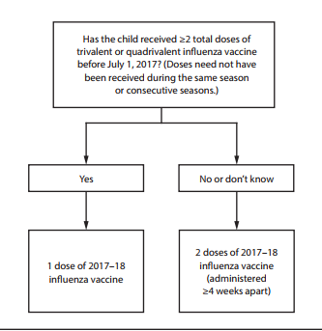
FDA Recommended Influenza Antigens
for 2017-2018 Season in the U.S.
Trivalent Vaccines (IIV3):
A/Michigan/45/2015 (H1N1) (NEW)
  A/Hong Kong/4801/2014 (H3N2)-like virus B/Brisbane/60/2008-like virus
Quadrivalent Vaccines (IIV4) also include:
B/Phuket/3073/2013-like virus
ACIP recommends annual influenza vaccine for all persons 6 months of age and older who do not have contraindications.
Recommendations and Reports Vol. 66 / No. 2
MMWR / August 25, 2017
Notes:
The Food and Drug Administration's Vaccines and Related Biologics Advisory Committee (VRBPAC) endorsed the WHO-recommended vaccine viruses for use in all U.S. seasonal flu vaccines for the 2017-2018 flu season.
Centers for Disease Control and Prevention, National Center for Immunization and Respiratory Diseases (NCIRD)

Slide 21
Influenza Vaccines for 2017-2018 Season
≥ 6 months | ≥ 3 years | ≥ 4 years | ≥ 5 years | ≥ 18 years | ≥ 65 years
Fluzone (IIV4) 6-35 mos—0.25 ml dose | Fluarix (IIV4) | Fluvirin (IIV3) | Afluria (IIV3) | FluBlok (RIV3 & RIV4) ** | Fluzone High-Dose (IIV3)
FluLaval (IIV4) 6 mos. and older--- 0.5 ml dose |  | Flucelvax (ccIIV4)* |  | Afluria (IIV4) | Fluad (aIIV3)
 |  |  |  | Fluzone Intradermal (IIV4) Ages 18-64 yrs.
*Cell-cultured **Recombinant
Ref: Centers for Disease Control and Prevention, National Center for Immunization and Respiratory Diseases (NCIRD). https://www.cdc.gov/mmwr/volumes/66/rr/rr6602a1.htm
Notes:
Flu vaccines for 2017-2018.
Changes in red on the table:
Afluria now licensed for persons 5 yrs. and older
FluBlok comes as trivalent and quadrivalent
Afluria has a vaccine licensed just for those 18 yrs. and older
Dosage note:
Fluzone for 6-35 mo. old children-----0.25 ml
FluLaval for 6 mo. and older children---0.5 ml

Slide 22
Live, Attenuated Influenza Vaccine (LAIV4)
  FluMist® MedImmune (Nasal Spray)
  licensed for healthy persons 2 through 49 years of age
ACIP recommendation
Due to poor effectiveness in past 3 seasons and concerns regarding the effectiveness against A(H1N1) viruses:
LAIV4 should not be used in the 2017-2018 season.
Currently only IIV provides protection against influenza and should be used for all persons
6 months and older who do not have contraindications.
MMWR 66(2); 1-24, August 25, 2017
Notes:
Studies demonstrated that LAIV did not work in the 2013-'14 influenza season when the primary strain was the 2009 pandemic influenza A(H1N1) strain, in 2014-'15 when the primary circulating strain was a drifted A(H3N2) virus, or the 2015-'16 season when the primary circulating strain was again the 2009 pandemic influenza A(H1N1) strain. With knowledge that LAIV had no protective benefit during the past three influenza seasons, ACIP does not recommend its use in the upcoming 2017-'18 influenza season.
The AAP Committee on Infectious Diseases and the Board of Directors all had reached the same conclusion about not using LAIV for the upcoming influenza season.

Slide 23
Influenza Vaccination of Persons with a History of Egg Allergy
Persons with a history of egg allergy who have had only hives after exposure to eggs should receive influenza vaccine.
Persons who report having had reactions to eggs such as angioedema, respiratory distress, lightheadedness, or recurrent emesis; or who required epinephrine or another emergency medical intervention may receive influenza vaccine. Vaccine should be administered in a medical setting supervised by a healthcare provider who is able to recognize and manage severe allergic conditions.
A previous severe allergic reaction to influenza vaccine is a contraindication to future receipt of the vaccine.
Recommendations and Reports Vol. 65 / No. 5 MMWR / August 26, 2016
Notes:
Recent studies with IIV and LAIV have indicated that a severe allergic reaction to egg-based influenza vaccine in a person with an egg allergy is very unlikely. Numerous studies have looked at egg-allergic patients receiving IIV3, LAIV in which mild allergic reactions occur and no anaphylactic reaction occurrences.
For the 2016-17 influenza season the ACIP has recommended If a person has a history of egg allergy and only experiences mild symptoms such as hives they can receive the flu vaccine. If they have experienced any other symptoms (angioedema, resp. distress) the flu vaccine should be administered in an appropriate medical setting and supervised by a health care provider who can manage emergent situation. If a patient has suffered a previous severe allergic reaction after receipt of the flu vaccine it is a contraindication and should not be administered.
Reference: MMWR. Prevention and Control of Seasonal Influenza with Vaccines Recommendations of the Advisory Committee on Immunization Practices-United, 2016-17 Influenza Season. August 26, 2016, Vol. 65; No. 5
EPIC 2017

Slide 24
Hepatitis A Vaccine for Adults
ACIP recommends hepatitis A vaccine for adults who are at high-risk of acquiring hepatitis A infection:
      Those traveling or working in countries with high or intermediate endemicity of infection
      Men who have sex with men
      Users of injecting and non-injecting drugs
      Persons working with HAV positive primates or with HAV in research laboratory settings
      Contact with adoptees from countries with high rates of hepatitis A if contact will be within 60 days of arrival in U.S. The first dose of the 2-dose series should be given as soon as adoption is planned.
.
MMWR, May 19, 2006, Vol 55, #RR-07 MMWR, September 18, 2009, Vol 58 #36
Notes:
The Advisory Committee on Immunization Practices of the Centers for Disease Control and Prevention has recommended hepatitis A vaccine for all previously unvaccinated persons who will have close contact with international adoptees from countries with high or intermediate hepatitis A endemicity. The vaccine should be given during the first 60 days following the adoptee’s arrival in the United States.³
For healthy persons 40 years of age or younger, 1 dose of single antigen vaccine administered at any time before departure can provide adequate protection.
Unvaccinated adults older than 40 years of age, immunocompromised persons, and persons with chronic liver disease planning to travel in 2 weeks or sooner should receive the first dose of vaccine and also can receive immune globulin at the same visit. Vaccine and IG should be administered with separate syringes at different anatomic sites.
Travelers who choose not to receive vaccine should receive a single dose of IG (0.02 mL/kg), which provides protection against HAV infection for up to 3 months. Persons whose travel period is more than 2 months should be administered IG at 0.06 mL/kg. IG should be repeated in 5 months for prolonged travel.
References:
1. Prevention of Hepatitis A Through Active or Passive Immunization - Recommendations of the Advisory Committee on Immunization Practices (ACIP) MMWR Vol. 55/No. RR-7 May 19, 2006
2. Notice to Readers: FDA Approval of an Alternate Dosing Schedule for a Combined Hepatitis A and B Vaccine (Twinrix®) MMWR 56(40);1057 October 12, 2007
3. Updated Recommendations from the Advisory Committee on Immunization Practices (ACIP) for Use of Hepatitis A Vaccine in Close Contacts of Newly Arriving International Adoptees MMWR 58(36);1006-1007 September 18, 2009
4. Epidemiology and Prevention of Vaccine-Preventable Diseases, 13th edition. 2015 HHS, CDC.

Slide 25
Hepatitis B
Transmission:
1. Percutaneous or mucosal exposure to blood or body fluids including contaminated surfaces, or exposure by sexual contact
2. Perinatal infection from HBsAg + mother
ACIP recommends hepatitis B vaccine for:
All newborns , to be administered “within 24 hours” of birth, using single antigen vaccine; Dose 2 at 1-2 mos. of age and Dose 3 at 6-18 mos. of age.
All children and adolescents less than 19 years of age who did not complete the series as an infant.
All adults at risk for hepatitis B infection, including those aged 19 through 59 years with diabetes mellitus, adults 60 years of age or older with diabetes may be vaccinated at the discretion of the healthcare provider.
Persons of any age at risk for infection by sexual exposure.
All other adults seeking protection from HBV infection.
MMWR, December 23, 2005, Vol 54, #RR16, MMWR, December 8, 2006, Vol 55, #RR16 , MMWR, December 22, 2011 Vol 60 , #50 Recommended Immunization Schedule for Persons Age 0 Through 18 Years, United States, 2017
Notes:
Incubation period from time of infection to onset of symptoms is 45 to 160 days (average, 90 days)
Approximately 10% of acute hepatitis B infections progress to chronic Hepatitis B infection.
90% of infants and 30-50% of children 1-5 years of age with acute hepatitis B infection become carriers
Many with chronic infection are asymptomatic. Chronic infection may progress to cirrhosis, liver failure & hepatocellular carcinoma
Timing for Doses 2 and 3 of infant series added to 1st bullet.
All pregnant women should be tested routinely for HBsAg
90% of healthy adults & 95% of infants, children & adolescents develop adequate antibody response after a complete series
If no antibody response after 6 doses, person is a non-responder and is susceptible to hepatitis B
Booster doses NOT recommended for any age group
References:
1. A Comprehensive Immunization Strategy to Eliminate Transmission of Hepatitis B Virus Infection in the United States. Recommendations of the Advisory Committee on Immunization Practices (ACIP) Part 1: Immunization of Infants, Children and Adolescents MMWR Vol. 54/ No. RR-16 December 23, 2005
2. A Comprehensive Immunization Strategy to Eliminate Transmission of Hepatitis B Virus Infection in the United States. Recommendations of the Advisory Committee on Immunization Practices (ACIP) Part 2: Immunization of Adults MMWR Vol. 55/ No. RR-16 December 8, 2006

Slide 26
Polio Vaccine Recommendations for Travel to
Countries Experiencing Polio Outbreaks
As of September, 2017 polio remains endemic in 3 countries: Nigeria, Pakistan, and Afghanistan.
If travel will be less than 4 weeks:
  Individuals <18 years – no additional dose if polio
  series has been completed
  Individuals ≥18 years – one dose prior to travel
  If travel will be for more than 4 weeks:
  Long-term travelers should receive the polio vaccine between 4 weeks and 12 months before departure.
Proof of polio vaccination is needed upon leaving infected countries.
MMWR, July 11, 2014, Vol 63/ # 27
Clinical Update: Interim CDC Guidance for Travel to and from Countries Affected by the New Polio Vaccine Requirements. August, 2016.
Notes:
Polio, also called poliomyelitis and infantile paralysis is caused by an Enterovirus (Serotypes 1,2,3)
Infection acquired through mouth, virus replicates in pharynx and GI tract, then spreads to lymphatics and other tissues.
Clinical response to infection is varied:
Up to 95% of polio infections are inapparent and asymptomatic;
4-8% non specific illness; 1-2% cause aseptic meningitis - full recovery;
<1% of infections result in flaccid paralysis
Attacks motor neurons in spinal cord & brain stem
Persons with impaired muscles of respiration or involvement of respiratory center require a ventilator
(“Iron lung” used in the 1940s and 1950s)
Most persons with paralytic polio recover completely
Muscle weakness or paralysis for more than 12 months after acute infection is usually permanent
25-40% of people who had paralytic polio in childhood develop “Post-polio Syndrome” (new muscle
pain, exacerbation of existing weakness or new weakness) 30-40 years after the acute infection
Last endemic polio case in the US in 1979; last indigenous case in Western Hemisphere in 1991
in 2015, Nigeria was removed from the list of polio-endemic countries The only 2 polio endemic countries now are Pakistan and Afghanistan.
In 2015, Africa marked an entire year without wild polio virus.
Type 2 polio virus declared eradicated.
80% of the world’s birth cohort will now start receiving IPV to boost their immunity.
Global Eradication Initiative: http://www.polioeradication.org/Portals/0/Document/Media/Newsletter/PN201512_EN.pdf
For additional information about polio refer to: Epidemiology and Prevention of Vaccine-Preventable Diseases, 13th edition 2015. HHS, CDC.

Slide 27
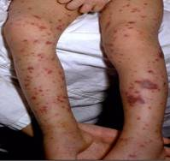
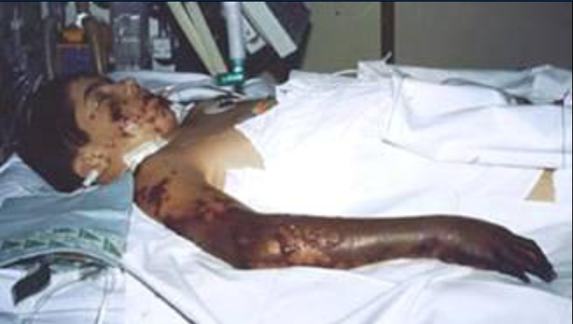
Meningococcal Disease
(caused by N. meningitidis)
Meningitis
~50% of cases 9-10% fatality rate
Meningococcemia
5%-20% of cases Up to 40% fatality rate
Rash
Vascular damage
Disseminated intravascular coagulation
Multi-organ failure
Shock
Death can occur in 24 hours
Photo courtesy CDC: Dr. Brodsky & Mr. Gust
11-19% of survivors have permanent sequelae
Ref: 1. Epidemiology and Prevention of Vaccine-Preventable Diseases. 13th Edition, 2015.
2. AAP Red Book 2015
Notes:
The most common clinical presentations of meningococcal disease are meningitis and meningococcemia.
Neisseria meningitides contains 13 serogroups, the most common being A, B, C, W, and Y.
About 5-10% of adults are asymptomatic nasopharyngeal carriers of this organism.
Individuals with meningococcemia may die within 24 hours of the onset of symptoms even with prompt treatment with appropriate antimicrobials and supportive care in an intensive care unit.
Reference: 1. Epidemiology and Prevention of Vaccine-Preventable Diseases, 13th edition. 2015 HHS, CDC.
2. AAP Redbook 2015
3. Meningococcal Disease. About the Disease. http://www.cdc.gov/meningococcal/about/index.html

Slide 28
Meningococcal Conjugate Vaccine (MCV4)
(Men A,C,Y, W-135)
Menactra™ licensed for 9 mos. through 55 years
Menveo® licensed for ages 2 mos. through 55 years
ACIP recommends:
  First dose at age 11 or 12 years and a booster dose at 16 years.
  If first dose is at 13-15 years, give booster dose 5 years after the first dose or sooner, but after age 16 if entering college or technical school.
  If first dose is received ≥ 16 years of age, a 2nd dose is not needed.
  Persons aged 21 years or younger attending school or college should have documentation of one dose of MVC4 not more than 5 years before enrollment.
MENOMUNE® production has been discontinued.
Persons aged ≥56 years who are recommended meningococcal vaccination because they are at increased risk for meningococcal disease should receive MenACWY conjugate vaccine.
MMWR, March 22, 2013, Vol 62, #RR02
Advisory Committee on Immunization Practices (ACIP) Summary Report February 22-23, 2017
Notes:
Recommendation for Routine Vaccination of Persons Aged 11 Through 18 Years
After a booster dose of meningococcal conjugate vaccine, antibody titers are higher than after the first dose and are expected to protect adolescents through the period of increased risk through age 21 years. Persons who receive their first dose of meningococcal conjugate vaccine at or after age 16 years do not need a booster dose. Routine vaccination of healthy persons who are not at increased risk for exposure to N. meningitidis is not recommended after age 21 years.
CDC Guidance for Transition to an Adolescent Booster Dose
Some schools, colleges, and universities have policies requiring vaccination against meningococcal disease as a condition of enrollment. For ease of program implementation, persons aged 21 years or younger should have documentation of receipt of a dose of meningococcal conjugate vaccine not more than 5 years before enrollment. If the primary dose was administered before the 16th birthday, a booster dose should be administered before enrollment in college. The booster dose can be administered anytime after the 16th birthday to ensure that the booster is provided. The minimum interval between doses of meningococcal conjugate vaccine is 8 weeks.
No data are available on the interchangeability of vaccine products. Whenever feasible, the same brand of vaccine should be used for all doses of the vaccination series. If vaccination providers do not know or have available the type of vaccine product previously administered, any product should be used to continue or complete the series.
Recommendations for Adults 56 years and older
MENOMUNE® production has been discontinued.
Persons aged ≥56 years who are recommended meningococcal vaccination because they are at increased risk for meningococcal disease should receive MenACWY conjugate vaccine.
Advisory Committee on Immunization Practices (ACIP) Summary Report February 22-23, 2017

Slide 29
Meningococcal Vaccine Updates
The following vaccines have been discontinued:
MENHIBRIX® (Men C&Y + Hib) licensed for ages 6 weeks through 18 months
MENOMUNE® (A/C/Y/W-135) licensed for use in persons 2 years of age and older.
Notes:
EPIC 2017

Slide 30
Meningococcal Vaccines for High Risk
Persons 6 weeks – 55 years
Menveo® (Men A,C,Y, W-135) licensed for ages 2 mos. through 55 years
Menactra^{™ (}(Men A,C,Y, W-135) licensed for 9 mos. through 55 years
Recommended for persons 6 weeks through 55 years:
human immunodeficiency virus (HIV)
complement component deficiency
functional or anatomic asplenia (sickle cell disease)
microbiologists exposed to isolates of N. meningitidis
part of a community outbreak due to vaccine serogroups
persons traveling internationally to regions with endemic meningococcal disease
For details on doses and schedule refer to the current Immunization Schedule
MMWR, June 20, 2014, Vol 63 #24 MMWR, March 22, 2013, Vol 62, #RR02 MMWR, November 4, 2016, Vol 65 #43
Notes:
June 2016, ACIP recommended routine use of meningococcal conjugate vaccine for persons ages >2 months with human immunodeficiency virus infection. The majority of meningococcal disease among HIV-infected persons is caused by these four serogroups.
The same vaccine product should be used for all doses. ACIP recommends HIC-infected infants 2 through 23 months should receive MenACWY-CRM (Menveo). HIV-infected children < 2 years should not receive MenACWY-D(Menactra) due to immune interference with PCV13.
Reference:
MMWR, November 4, 2016, Vol 65(43).

Slide 31
Serogroup B Meningococcal Vaccine
Bexsero® licensed for ages 10 through 25 years (2 dose)
Trumenba® licensed for ages 10 through 25 years (3 dose)
ACIP recommends serogroup B meningococcal vaccine for:
Persons with persistent complement component deficiencies
Persons with anatomic or functional asplenia
Microbiologists routinely exposed to isolates of Neisseria meningitidis
Persons identified to be at increased risk because of a serogroup B meningococcal disease outbreak
The 2 vaccine products are not interchangeable.
(Category B – Permissive recommendation)#
A Men B vaccine series may be administered to adolescents and young adults 16 through 23 years of age to provide short-term protection against most strains of Men B. Preferred age is 16-18 years.
MMWR; June 12, 2015 ,Vol. 64 #22; 608-611
# MMWR; October 23, 2015, Vol .64 #41; 1171-1176
Notes:
“MenB vaccine should be administered as either a 2-dose series of MenB-4C or a 3-dose series of MenB-FHbp. The same vaccine product should be used for all doses.“
On February 26, 2015 the ACIP approved for MenB vaccines be recommended for the use among persons aged >10 years at increased risk for serogroup B meningococcal disease. This recommendation was designated a Category A (recommended for all persons in the age-based risk factor group).
The ACIP determined that insufficient evidence existed to routinely recommend that all adolescents be vaccinated with MenB vaccines. ACIP agreed that the information provided would allow each individual health care professional to use clinical decision making when recommending the vaccine. A Category B recommendation was made. MenB vaccine series may be administered to yourg adults 16-23 years of age to provide short-term protection against most strains of MenB.
References: MMWR; October 23, 2015, Vol .64 #41; 1171-1176.
MMWR: June 12, 2015, Vol. 64 #22; 608-611.

Slide 32
Serogroup B Meningococcal
Vaccine Administration
Bexsero® licensed for ages 10 through 25 years (2 dose)
Trumenba® licensed for ages 10 through 25 years (2 dose or 3 dose)
MenB-FHbp (Trumenba®)
  2 dose schedule – administered at 0, 6 months
  Given to healthy adolescents who are not at increased risk for meningococcal disease
  3 dose schedule – administered at 0, 1-2, 6 months
  Given to persons at increased risk for meningococcal disease and for use during serogroup B outbreaks
MenB-4C (Bexsero®)
  2 dose schedule – 0, 1-2 months

Slide 33
Types of Human Papilloma Virus (HPV)
(More Than 150 Types Identified)
Mucosal/Genital
~40 types
Cutaneous
High risk types
16, 18, 31, 33, 45, 52, 58
(and others)
Low risk types
6, 11 and others
Cervical cancer
Anogenital cancer
Oropharyngeal Cancer
Cancer precursors
Low grade cervical disease
Genital Warts
Laryngeal Papillomas
Low grade cervical disease
Skin warts
Hands and Feet
Ref: 1.Epidemiology and Prevention of Vaccine Preventable Diseases 13th Edition, 2015
2. Red Book – AAP 2015 Report of the Committee on Infectious Diseases
3. MMWR, August 29, 2014, RR Vol. 63, No. 5

Slide 34
HPV Vaccines
Gardasil 9® (9vHPV) HPV types 6, 11, 16, 18, 31, 33, 45, 52, 58
(CERVARIX™ & GARDASIL 4® are no longer available
in the U.S. as of December, 2016)
ACIP recommends HPV vaccine starting at age 11 or 12 years for:
All females through 26 years of age
All males through 21 years of age
Men 22 through 26 years who have sex with men or have an immunocompromising condition.
All other males 22 through 26 years.
Series can be completed with 9vHPV if started with 2v or 4v.
MMWR, March 27, 2015, Vo1 64, No. 11
MMWR, December 16, 2016, Vol 65, No. 49
Notes:
Recommendations for Use of HPV Vaccines
ACIP recommends that routine HPV vaccination be initiated at age 11 or 12 years. The vaccination series can be started beginning at age 9 years.
† Vaccination is also recommended through age 26 years for men who have sex with men and for immunocompromised persons (including those with HIV infection) if not vaccinated previously.
As of December 2016, 2vHPV and 4vHPV are no longer available in the United States. No ACIP recommendation for routine additional vaccination with Gardasil 9 for persons who have completed a 3-dose vaccination series with other HPV vaccines.
References:
2017 Supplement to Epidemiology and Prevention of Vaccine-Preventable Diseases, 13th Edition (the Pink Book)
MMWR, December 16, 2016, Vol 65, No. 49

Slide 35
Top 5 reasons for not vaccinating daughter, among parents with no intention to vaccinate their child against HPV
** Did not know much about HPV or HPV vaccine.
CDC. Human papillomavirus vaccination coverage among adolescents, 2007-2013. Postlicensure vaccine safety monitoring, 2006-2014-U.S.
Notes:
This slide shows the responses that parents gave when asked why they would not be getting the HPV vaccine for their daughter in the next year.
Three reasons that parents provided—lack of knowledge, not needed, and not sexually active—all demonstrate a lack of understanding on the part of the parent, especially why it is important to vaccinate at ages 11 or 12. Parents need to be told that HPV vaccine is cancer prevention and that it must be given prior to exposure.
Safety concerns can be alleviated by sharing the tremendous amount of data before and after the vaccine was licensed that demonstrate that HPV vaccine is safe.
Some of the reasons that encouraged parents to accept HPV immunization included 1) family history of cervical cancer of HPV infection 2) family and community support 3) education on HPV vaccine 4) healthcare provider access to an immunization registry. Healthcare provider recommendation was the strongest predictor of HPV vaccine initiation.
Encourage Parents To Immunize a Pre-teen or Adolescent
Try saying:
Your child needs three shots today that will prevent tetanus, diphtheria, whooping cough, and one type of meningitis and protect him/her from many cancers caused by HPV.
HPV vaccine produces a better immune response in preteens than it does in older teens and young women. I strongly believe in the importance of this cancer-preventing vaccine.
Reference:
1. Bernstein, H. DO, Bocchini, J. MD. Pediatrics: The Need to Optimize Adolescent Immunization, March 2017; Vol 139, No. 3.

Slide 36

Critical Elements for
Immunization Services
Celebrating 16 years

Slide 37
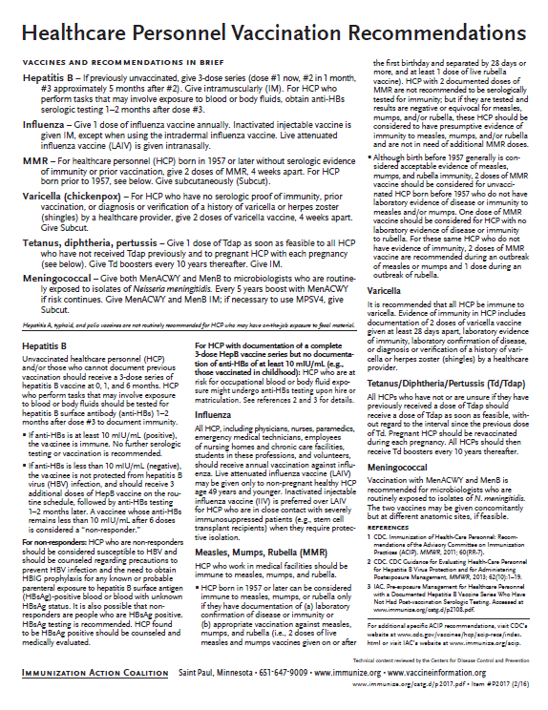
Recommended Healthcare Personnel Vaccinations
Hepatitis B
Influenza
Measles, Mumps, Rubella (MMR)
Varicella (Chickenpox)
Tetanus, Diphtheria, Pertussis (Tdap)
Meningococcal (recommended for microbiologists who are routinely exposed to isolates of N. meningitidis).
Are YOU up to date?
Available at www.immunize.org, P#2017
Notes:
Un-immunized HCP
Un-immunized healthcare workers are at risk of infecting patients, family members and community contacts
Immunized HCP
Protect patients from VPD’s
Help offices avoid potential liability cases. (The practice can be liable if an unimmunized HCP becomes infected with a vaccine preventable disease and infects a patient.)
Maintain productivity
Reduce illness and illness-related absenteeism
Evidence of Immunity to MMR
Documented administration of two doses of measles and mumps vaccine and one dose of rubella vaccine OR
Laboratory evidence of immunity or laboratory confirmation of disease (measles, mumps and rubella) OR
Born before 1957 (measles, mumps and rubella)
Because of their contact with patients or infective material from patients, many HCP are at risk for exposure to (and possible transmission of) vaccine-preventable diseases. Employers and HCP have a shared responsibility to prevent occupationally acquired infections and avoid causing harm to patients by taking reasonable precautions to prevent transmission of vaccine-preventable diseases.
Optimal use of recommended vaccines helps maintain immunity and safeguard HCP from infection, thereby helping protect patients from becoming infected. The recommendations for vaccination of HCP are presented in two categories: 1) th7se diseases for which routine vaccination or documentation of immunity is recommended for HCP because of risks to HCP in their work settings and, should HCP become infected, to the patients they serve and 2) those diseases for which vaccination of HCP might be indicated in certain circumstances. Vaccines recommended in the first category are hepatitis B, seasonal influenza, measles, mumps, and rubella, pertussis, and varicella vaccines. Vaccines in the second category are meningococcal, typhoid, and polio vaccines.
1. General Recommendations on Immunization, Recommendations of the Advisory Committee on Immunization Practices (ACIP). MMWR (RR-2); January 28, 2011
MMWR; November 25, 2011 / 60(RR07);1-45

Slide 38
PRE-EXPOSURE EVALUATION FOR HEALTH-CARE PERSONNEL
PREVIOUSLY VACCINATED WITH COMPLETE, ≥3-DOSES OF HEP B VACCINE
SERIES WHO HAVE NOT HAD POSTVACCINATION SEROLOGIC TESTING
Measure antibody to hepatitis B surface antigen (anti-HBs) anti-HBs ≥10 mIU/mL
Below adequate level
anti-HBs ≥10mIU/mL
1 dose of HepB vaccine,
4-6 wks.--- serologic testing
No Action for
Hepatitis B prophylaxis
(regardless of source patient hepatitis B surface antigen status)
Below adequate level
At or above adequate level
2 more doses of HepB vaccine,
4-6 wks.--- serologic testing
Below adequate level
At or above adequate level
Vaccinated HCP whose anti-HBs remains <10 mIU/mL after revaccination (i.e., after receiving a total of 6 doses) should be tested for HBsAg and anti-HBc to determine infection status.
HCP need to receive hepatitis B evaluation for all exposures
MMWR, December 20, 2013, Vol 62. RR # 10
Notes:
Postvaccination Serologic Testing
Testing unvaccinated HCP for HBV infection is not generally indicated for persons being evaluated for hepatitis B protection because of occupational risk.
Prevaccination serologic testing is indicated for:
all persons born in geographic regions with HBsAg prevalence of ≥2% (e.g., much of Eastern Europe, Asia, Africa, the Middle East, and the Pacific Islands)
certain indigenous populations from countries with overall low HBV endemicity (<2%)
persons with behavioral exposures to HBV (e.g., men who have sex with men and past or current injection drug users)
persons receiving cytotoxic or immunosuppressive therapy
persons with liver disease of unknown etiology.
Testing HCP at risk for HBV infection should consist of a serologic assay for HBsAg, in addition to either anti-HBc or anti-HBs. For unvaccinated HCP at risk for previous HBV infection, blood should be drawn for testing before the first dose of vaccine is administered.
HCP who have written documentation of a complete, ≥3-dose HepB vaccine series and subsequent postvaccination anti-HBs ≥10 mIU/mL are considered hepatitis B immune. Immunocompetent persons have long-term protection against HBV and do not need further periodic testing to assess anti-HBs levels.
All HCP recently vaccinated or recently completing HepB vaccination who are at risk for occupational blood or body fluid exposure should undergo anti-HBs testing. Anti-HBs testing should be performed 1–2 months after administration of the last dose of the vaccine series when possible. HCP with documentation of a complete ≥3-dose HepB vaccine series but no documentation of anti-HBs ≥10 mIU/mL who are at risk for occupational blood or body fluid exposure might undergo anti-HBs testing upon hire or matriculation. Testing should use a quantitative method that allows detection of the protective concentration of anti-HBs (≥10 mIU/mL) (e.g., enzyme-linked immunosorbent assay [ELISA]).
Completely vaccinated HCP with anti-HBs ≥10 mIU/mL are considered hepatitis B immune. Immunocompetent persons have long-term protection and do not need further periodic testing to assess anti-HBs levels.
Completely vaccinated HCP with anti-HBs <10 mIU/mL should receive an additional dose of HepB vaccine, followed by anti-HBs testing 1–2 months later. HCP whose anti-HBs remains <10 mIU/mL should receive 2 additional
vaccine doses (usually 6 doses total), followed by repeat anti-HBs testing 1–2 months after the last dose. Alternatively, it might be more practical for very recently vaccinated HCP with anti-HBs <10 mIU/mL to receive 3 consecutive additional doses of HepB vaccine (usually 6 doses total), followed by anti-HBs testing 1–2 months after the last dose.
References: 1. General Recommendations on Immunization, Recommendations of the Advisory Committee on Immunization Practices (ACIP). MMWR (RR-2); January 28, 2011
2. Immunization of Health-Care Personnel: Recommendations of ACIP MMWR; November 25, 2011 / 60(RR07);1-45
3. CDC Guidance for Evaluating Health-Care Personnel for Hepatitis B Virus Protection and for Administering Postexposure Management (Recommendations and Reports / Vol. 62 / No. 10 December 20, 2013)
Ref: CDC Guidance for Evaluating Health-Care Personnel for Hepatitis B Virus Protection and for Administering Post Exposure Management MMWR Recommendations and Reports /Vol. 62/No. 10 December 20, 2013

Slide 39
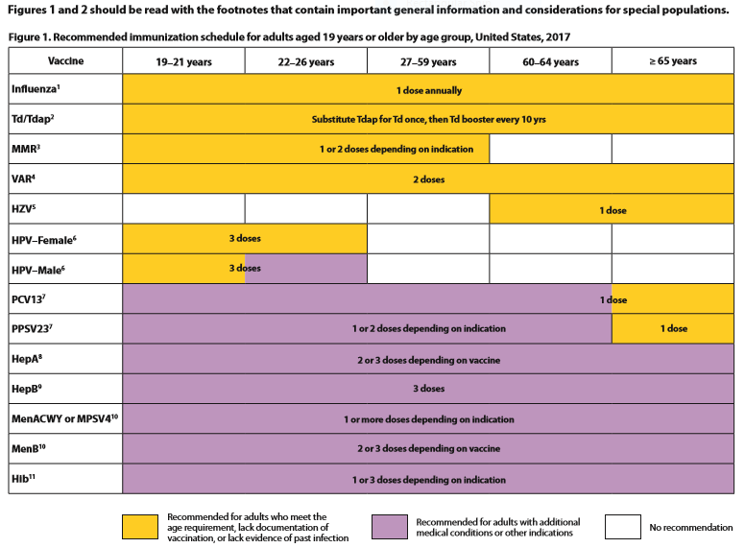
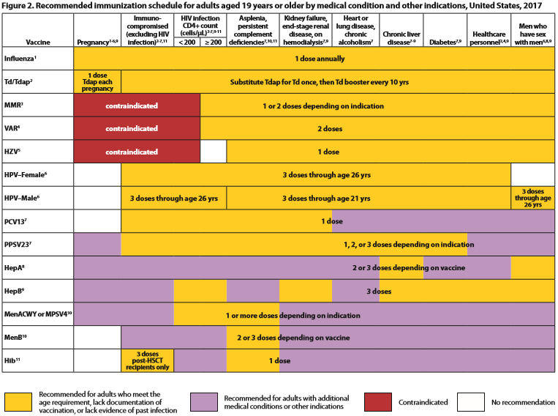
2017 Immunization Schedules
All staff must use the same immunization schedule
Five Schedules:
  Children & Adolescent
0 through 18 years
  Children & Adolescent
based on medical indications
  Catch-up schedule for
ages 4 months -18 years
  Adult 19 years and older
  Adult based on medical
  and other indications
READ THE FOOTNOTES
http://www.cdc.gov/vaccines/schedules/hcp/child-adolescent.html
http://www.cdc.gov/vaccines/schedules/hcp/adult.html
MMWR, February 7, 2017, Vol. 66
Notes:
2017 Adult Immunization Schedule changes
Influenza: LAIV should not be used during the 2016–2017 influenza season. Adults with a history of egg allergy info updatedHepatitis B: Adults with chronic liver disease, including, but not limited to, hepatitis C virus infection, cirrhosis, fatty liver disease, alcoholic liver disease, autoimmune hepatitis, and an alanine aminotransferase (ALT) or aspartate aminotransferase (AST) level greater than twice the upper limit of normal should receive a HepB series. HPV: Adult females through age 26 years and adult males through age 21 years who have not received any HPV vaccine should receive a 3-dose series of HPV vaccine at 0, 1–2, and 6 months. If an Adult received 1 dose prior to their 15th birthday they are eligible to complete the series with one additional dose. Meningococcal: Adults with asplenia receiving Men ACWY/Men B. HIV and Meningococcal for adults. HCP and Meningococcal administration. Men B for healthy young adults/2-dose admin.
Reference: MMWR, February 7, 2017, Vol. 6

Slide 40
Indications
Recommendations
Requirements
Indication
  Information about the appropriate use of the vaccine
Recommendation
  ACIP statement that broadens and further delineates the Indication found in the package insert
  Basis for standards for best practice
Requirement
  Mandate by a state that a particular vaccine must be administered and documented before entrance to child care and/or school
Notes:
EXAMPLES OF AN INDICATION
ADACEL vaccine is indicated for active booster immunization for the prevention of tetanus, diphtheria and pertussis as a single dose in persons 11 through 64 years of age.
EXAMPLE OF A RECOMMENDATION
Recommendations by ACIP for the routine administration of vaccines. May include other information and guidance on epidemiology of the disease, appropriate timing, dosage, contraindications to the vaccine and guidance for use in special populations.
EXAMPLE OF VACCINE REQUIREMENTS FOR ENTRY INTO CHILD CARE FACILITIES IN GEORGIA
Consistent with the Recommended Childhood and Adolescent Immunization Schedule
Children are required to be age appropriately immunized against each of these diseases: Hepatitis B, Diphtheria, Tetanus, Pertussis, Polio, Hib, Pneumococcus, Measles, Mumps, Rubella, Varicella, Hepatitis A, and meningococcal disease.

Slide 41
Maintaining Appropriate
Vaccine Storage & Handling
Assign a primary and alternate vaccine coordinator.
Store all vaccines as recommended by manufacturer and IN ORIGINAL PACKAGING.
Monitor and record temperatures of refrigerator and freezer twice daily.
Maintain temperature log records for 3 years.
Take immediate action for all out-of-range temps.
Implement a vaccine emergency system.
If it is necessary to transport vaccine, do NOT use dry ice.
Ref: Vaccine Storage and Handling Toolkit, June 2016
Notes:
Remember: if you find temperatures out of range, TAKE ACTION, DO SOMETHING ABOUT IT!
The June 2016 toolkit reflects an adjustment to the Fahrenheit temperature range for storing refrigerated vaccines. The new recommended range is between 36 and 46 degrees F (previously between 35 and 46 degrees F).

Slide 42
Check Expiration Date of Vaccines and Diluents
Vaccine Expiration Date is 12/10/17
Use through December 10, 2017
Do NOT use on or after December 11, 2017.
Vaccine Expiration Date is 12/17
Use through December 31, 2017
Do NOT use on or after January 1, 2018.
12/17
12/10/17
Note: Some multidose vials have a specified time frame for use once the vial is entered with a needle. This may vary from the expiration date printed on the vial.
Notes:
Ref: Vaccine Storage and Handling Toolkit, June, 2016.

Slide 43
General Best Practice Guidelines for Immunization
(formerly General Recommendations on Immunization)
Timing and Spacing
Contraindications and Precautions
Prevention and Management of Adverse Reactions
Vaccine Administration
Storage and Handling of Immunobiologics
Altered Immunocompetence
Special Situations
Vaccination Records
Vaccination Programs
Vaccine Information Sources
NEW
Kroger AT, Duchin J, Vázquez M. General Best Practice Guidelines for Immunization. Best Practices Guidance of the Advisory Committee on Immunization Practices (ACIP). [www.cdc.gov/vaccines/hcp/acip-recs/general-recs/downloads/general-recs.pdf].
Notes:
Specific administration guidelines have been established for each vaccine. Minimum age and intervals for vaccines are set by manufacturers during clinical trials; too young an age or too close together may alter effectiveness of a vaccine.
There is a 4-day grace period – vaccines given during the 4-day window before the recommended age/interval may be counted as valid. It is suggested that MMR and Varicella, not be given before one year of age. GRITS tables have been set up to calculate this correctly when a vaccine history is entered.
The updated version is entitled General Best Practice Guidelines for Immunization. It will not be available to order but can be accessed on the ACIP Recommendations pg. or downloaded. The bullets list the chapters in the document.
EPIC 2017

Slide 44
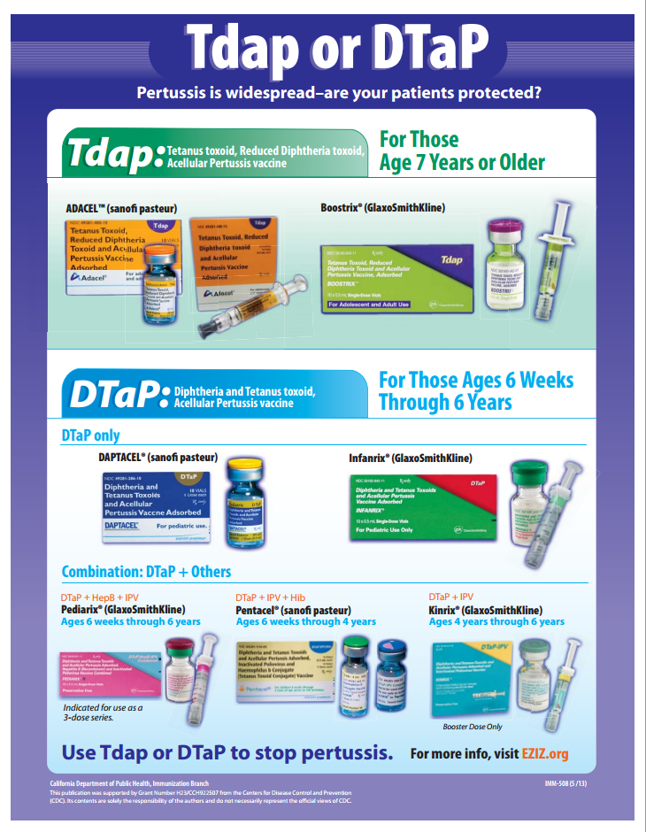
Check the vial 3 times!

Slide 45
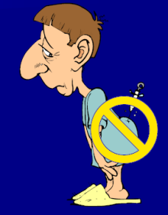
The 7 Rights of Vaccine Administration
Right Patient
Right Vaccine or Diluent
Right Time*
Right Dosage
Right Route, Needle Length, Technique
Right Site for route indicated
Right Documentation
* Correct age, appropriate interval, and administer before vaccine or diluent expires
Ref: Epidemiology and Prevention of Vaccine-Preventable Diseases. 13th Edition, 2015.
Notes:
Be sure to check package insert for correct route, correct sites for the route and correct needle length.
Much of this information is available in the ACIP General Recommendations document.
*Make a chart of this information for use in your office*. Or have a VACS FACS available in your office.
Ref: General Recommendations on Immunization MMWR 2011; 60 (No. RR-2) Jan 28, 2011
REMINDER:
Vaccines should never be given in the gluteus muscle
If it is discovered that Hepatitis B, rabies, or HPV vaccine has been given there, all such doses must be repeated at appropriate sites.

Slide 46
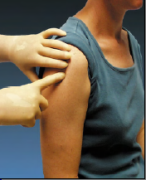
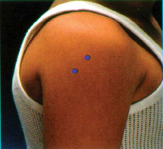
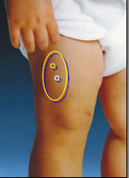
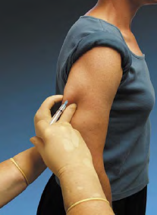
Sites for Vaccine Administration
Intramuscular (IM)
  DTaP, Tdap, Hib, Td, Hep A, Hep B, PCV13, IIV, MCV4, HPV
Subcutaneous (SQ, SC, or sub-Q)
  MMR, MMRV, Varicella, MPSV4, Herpes Zoster
Either intramuscular or subcutaneous
  IPV, PPSV23
Intranasal
LAIV
Intradermal
IIV3, IIV4 (Fluzone)
Notes:
Be sure to check package insert for correct route and then make a chart for use in your office.

Slide 47
Immunization Administration Practices
The CDC has identified improper use of syringes, needles and medication vials during procedures performed by healthcare personnel, such as administering injections. These improper practices have resulted in:
Transmission of bloodborne viruses (HCV, HBV, HIV)
Referral of providers to licensing boards for disciplinary action
Malpractice suits filed by patients
Never administer medications from the same syringe to more than one patient, even if the needle has been changed.
DO NOT ENTER a vial with a used syringe or needle.
Ref: 1.Epidemiology and Prevention of Vaccine Preventable Diseases 13th Edition, 2015
2. CDC, NCEZIZ, DHQP. Injection Safety Information for Providers: www.cdc.gov/injectionsafety/providers.html
Notes:
EPIC 2017

Slide 48
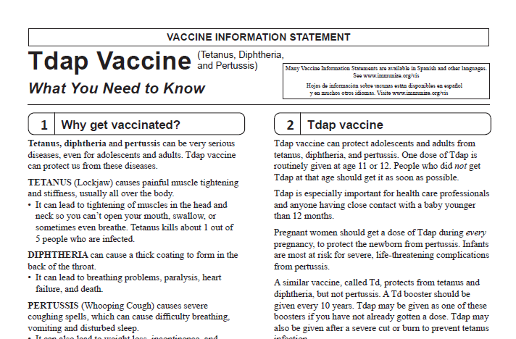
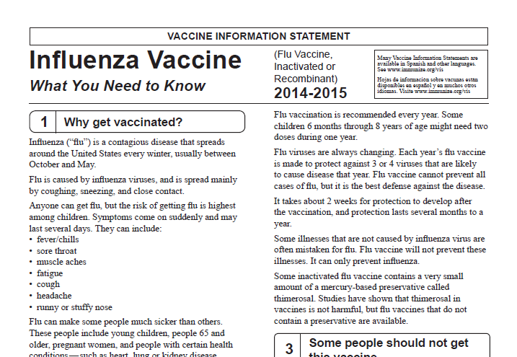
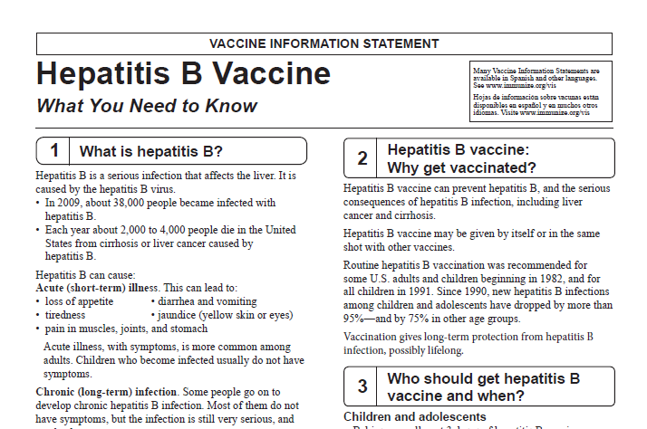
Always Document…
Accept only written documentation of prior immunizations
Provide VIS prior to administration of vaccine
After vaccine administration, document:
  Publication date of VIS & date VIS given
  Date, site, route, antigen(s), manufacturer, lot #
  Person administering vaccine, practice name and address
  Vaccine refusals with a signed “Refusal to Vaccinate Form”
  GA law does not require signed consent for immunizations
Notes:
Vaccine Information Sheets
VIS required by law for each vaccine given and each time that vaccine is given. The most current VIS must be used. For VIS statements in English and many other languages: www.immunize.org; www.cdc.gov/vaccines/ or call the National Immunization Program Information Hotline at
800-CDC-INFO (800-232-2522).
Document all information listed on slide. Information will also be helpful if a specific lot of vaccine is recalled in the future.
Refusal to consent for an immunization should be documented for liability purposes and chart completeness. There is no way to document this in GRITS.
Georgia recognizes only medical and religious exemptions. Medical exemptions must be re-evaluated every year.
Georgia law does not require signed consent for immunization. Patients, parents or legal guardians may verbally consent to immunization. However, some practices may require written consent for all medical care.

Slide 49

A ‘Birth to Death’ Immunization Registry
Providers administering vaccines in Georgia must provide appropriate information to GRITS.
GRITS personnel can work with your EHR/EMR vendor to create an interface between your system and GRITS that will drastically decrease data entry time for your practice.
Contact the GRITS Training Coordinator at (404) 463-0807 or e-mail : dph-immreg@dph.ga.gov
Notes:
In 2004, House Bill 1526 was passed making the Georgia Immunization Registry a birth to death registry mandating that providers of immunizations in Georgia report those immunizations into the registry database. Immunization data may now be shared by all providers of immunizations to Georgians of any age, and to schools, daycares, colleges and universities, and long term care facilities. The patient (age 18 or older) or parent or legal guardian may OPT-OUT of the registry.
Contact GRITS to enroll: 1-888-223-8644
Benefits of GRITS include: accurate immunization records, inventory tracking, reduction in missed opportunities or over-immunization, generation of school entrance forms/college immunization forms, reminder/recall notices for parents, assistance in generating reporting of immunizations to HEDIS/COCASA, and elimination of phone calls to providers for immunization records. The GRITS program is web-based. New users to the system will have to attend a training session and receive a password. UNIFIED FONT SIZES OF WHOLE PAGE
Advantages of a statewide registry are as follows:
Benefits to the Community
Enhance the overall health status by facilitating identification of inadequately immunized segments of the population
Decrease occurrence of over-immunization due to inability to locate past records
Assist in issuing reminders to patients for pending and overdue immunizations
Benefits to Healthcare Providers
Reduce staff time needed to obtain complete immunization history of patients
Provide printouts of school certificates
Provide vaccine information and simplify complex and dynamic immunization schedules
Streamline vaccine inventory process
Generate HEDIS and other reports
Reinforce the concept of a medical home
Benefits to Public Health Officials
Provide an accurate measure of immunization rates for districts, counties, and the state
Allow Georgia healthcare providers to update and exchange immunization information about their patients in a confidential manner
Facilitate community outreach programs
The Georgia Code 31-12-3.1, which took affect July 1, 1996 and House Bill 1526, which took affect July 1, 2004 states:
Any person who administers a vaccine or vaccines licensed for use by the United States Food and Drug Administration to a person shall, for each such vaccination, provide to the department such data as are deemed by the department to be necessary and appropriate for purposes of the vaccination registry established pursuant to subsection (a) of this Code section…
At the present time the mandatory use of GRITS is not being strictly enforced but will be sometime in the future.

Slide 50
Vaccine Adverse Events
Local
- pain, swelling, redness at injection site
- common with inactivated vaccines
- usually mild and self-limited
Systemic
- fever, malaise, headache
- nonspecific symptoms
- may be unrelated to vaccine
Allergic
- anaphylaxis
- serious but rare
Ref: Epidemiology and Prevention of Vaccine-Preventable Diseases. 13th Edition, 2015
Notes:
The most common type of adverse reactions are local reactions, such as pain, swelling, and redness at the site of injection, occurring within a few hours of the injection and are usually mild and self-limited. These may occur with up to 80% of vaccine doses, depending on the type of vaccine. They are most common with inactivated vaccines, particularly those that contain an adjuvant (DTaP). On rare occasions, local reactions may be very exaggerated or severe. These are often referred to as hypersensitivity reactions, although they are not allergic, as the term implies. These reactions are also known as Arthus reactions, and are most commonly seen with tetanus and diphtheria toxoids. Arthus reactions are believed to be due to very high titers of antibody, usually caused by too many doses of toxoid.
Systemic adverse reactions are more generalized events and include fever, malaise, myalgia (muscle pain), headache, loss of appetite, and others. These symptoms are common and nonspecific; they may occur because of the vaccine or may be caused by something unrelated to the vaccine, like a concurrent viral infection, stress, or excessive alcohol consumption. Systemic adverse reactions were relatively frequent with DTP vaccine, which contained a whole-cell pertussis component. However, comparison of the frequency of systemic adverse events among vaccine and placebo recipients shows they are less common with inactivated vaccines currently in use, including acellular pertussis vaccine. Systemic adverse reactions that follow live attenuated vaccines, such as fever or rash, represent symptoms produced from viral replication and are similar to a mild form of the natural disease. Systemic adverse reactions following live vaccines are usually mild, and occur 7–21 days after the vaccine was given (i.e., after an incubation period of the vaccine virus). LAIV replicates in the mucous membranes of the nose and throat, not in the lung. As a result, LAIV may cause upper respiratory symptoms (like a cold) but not influenza-like symptoms.
An anaphylactic (allergic) reaction may be caused by the vaccine antigen itself or some other component of the vaccine, such as cell culture material, stabilizer, preservative, or antibiotic used to inhibit bacterial growth. Severe allergic reactions may be life-threatening. Fortunately, they are rare, occurring at a rate of less than one in half a million doses. The risk of an allergic reaction can be minimized by good screening prior to vaccination. All providers who administer vaccines must have an emergency protocol and supplies to treat anaphylaxis.
Reference: Epidemiology and Prevention of Vaccine-Preventable Diseases, 13th edition. May 2015 HHS, CDC.

Slide 51
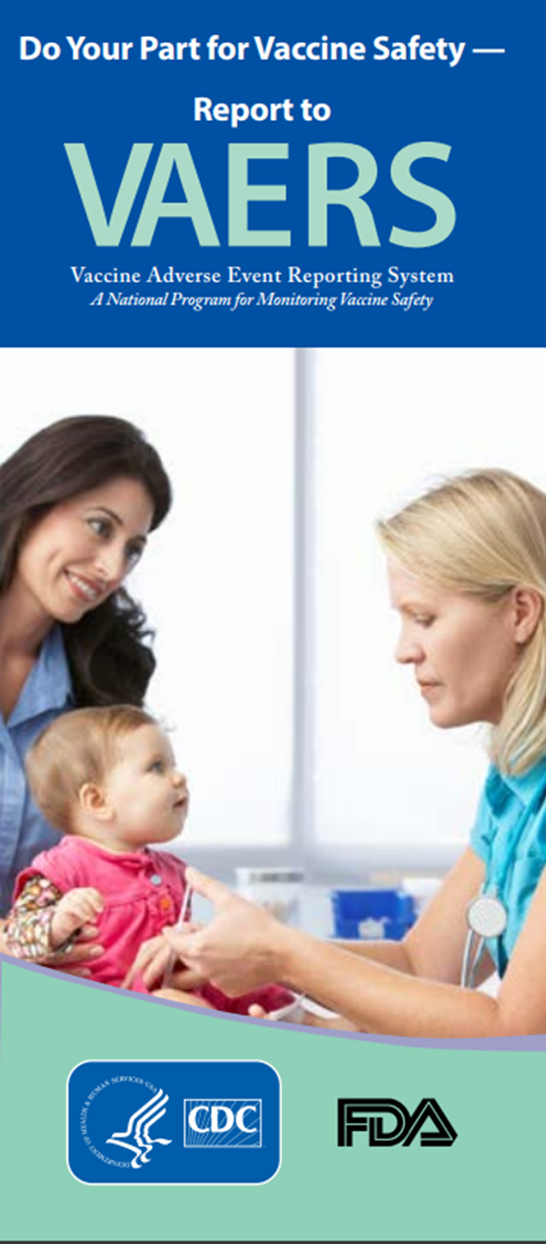
Monitoring Vaccine Safety
NEW
VAERS
Option 1 - Report Online to VAERS (Preferred)
Submit a VAERS report online. The report must be completed online and submitted in one sitting and cannot be saved and returned to at a later time. Your information will be erased if you are inactive for 20 minutes; you will receive a warning after 15 minutes.
Option 2 - Report using a Writable PDF Form
Download the Writable PDF Form to a computer. Complete the VAERS report offline if you do not have time to complete it all at once. Return to this page to upload the completed Writable PDF form by clicking here.
If you need further assistance with reporting to VAERS, please email info@VAERS.org or call 1-800-822-7967.
FDA and Vaccine Data Link Safety Project
VERP: VACCINE ERROR REPORTING SYSTEM
  On line reporting at http://verp.ismp.org/
  Report even if no adverse events associated with incident
  Will help identify sources of errors to help develop prevention strategies
Notes:
Nothing is 100% risk free. Most reactions to vaccines are mild with very small risk of severe allergic reactions (anaphylaxis).
Systems in place to monitor safety include the FDA (pre and post licensure monitoring) and the Vaccine Safety Datalink (VSD) Project. This large project links 4 HMO's at 10 sites with the CDC to monitor adverse events possibly caused by vaccines.
FDA monitors vaccines for safety before issuing licenses - very stringent licensing involving laboratory and human testing; vaccine safety is also monitored after licensure to ensure each vaccine lot is effective and pure. Vaccine manufacturers also do post-licensure monitoring.
The Institute of Medicine reviews research related to vaccine safety and publishes a report periodically.
VAERS
Updated system. Two options for reporting are outlined in the gray box.
Passive reporting system to monitor vaccine adverse events established by the National Childhood Vaccine Injury Act 1986
Mandates patients/ parents are educated about risk of vaccines and compensated for any injury caused by vaccine.
Emphasize there is no penalty for reporting an “adverse event”. The healthcare provider is only reporting that a specific event occurred after administration of a specific vaccine and is not claiming that the event was caused by the vaccine.
VERP – There is relatively little data available on why vaccine administration errors occur. The Institute for Safe Medication Practice (ISMP) has launched a national patient safety reporting program to capture the unique causes and consequences of vaccine –related errors. The ISMP National Vaccine Error Reporting Program (ISMP VERP) allows healthcare practitioners to report errors and near misses in confidence.
Sources of Vaccine Safety Information:
www.cdc.gov/vaccines/pubs/vis/default.htm www.cdc.gov/vaccinesafety/
www.idsociety.org www.vaccinesafety.edu
www.acponline.org www.aap.org
www.aafp.org www.immunize.org
www.vaccine.chop.edu www.vaers.hhs.gov
www.immunizationinfo.org
EPIC 2017

Slide 52

Why do we miss opportunities to immunize?
Physician or patient unaware of the need
Visits for mild illness, injury, or follow-up
Need for multiple vaccines
Invalid contraindications
Inappropriate clinic policies
Reimbursement deficiencies
Notes:
The CDC definition of a missed opportunity is, “A health care encounter in which a person is eligible to receive vaccination but is not vaccinated completely.” (Epidemiology and Prevention of Vaccine-Preventable Diseases, 13th edition. 2015 HHS, CDC. )
Missing an opportunity to immunize may leave you vulnerable to a lawsuit. Patients who developed vaccine-preventable disease after failing to be immunized (missed opportunities) have filed lawsuits. [see Needletips (1), 1,1994]
To avoid missed opportunities:
Vaccination records: Keep accurate immunization records in a prominent location in the chart so immunization status can be easily checked at each visit.
Mild illness/injury visits/follow-up visits: The CDC recommends immunization with all vaccines for patients even those with low-grade fever, mild diarrhea, mild ear infections, mild acute illness, or upper respiratory infections. There is no evidence of increased risk of adverse events associated with immunizations during the course of a minor illness. The decision to defer immunizations results in a missed opportunity. The procedure for assessing immunization status and giving immunizations at follow-up and sick/injury visits may require more time, necessitating change in your office practice.
Multiple vaccinations per visit: More than one vaccine can be administered at one time. There is no limit to the number of vaccines that can be given at one visit.
Know the schedules: Post the current schedule and keep staff updated on any changes.
Know Contraindications: Be aware of the true/valid contraindications, precautions and invalid contraindications. There are few truly valid contraindications to vaccine administration.
Adolescents: Adolescents are a large and healthy part of our population who seek medical care infrequently. Immunization status needs to be assessed at each visit.
Adults: Some adults who are healthy may be seen infrequently. Other adults may have multiple medical problems. Immunization status of all adults needs to be assessed at each visit.
Some barriers to be overcome regarding adolescents include:
Parents may be unaware that there are now more vaccines recommended for adolescents
Infrequent medical encounters for adolescent preventive medical services leaves fewer opportunities to immunize
Lack of awareness by both physicians and parents that VFC provides recommended vaccines free for the uninsured and underinsured (in Georgia) through age 18. SPACING ADJUSTED
Obtaining parental consent for vaccines is a challenge
Failure to vaccinate during sports physicals
Lack of reminder/recall systems for adolescents
Studies have shown that eliminating missed opportunities can help to increase vaccination coverage by 20 percent.

Slide 53
Invalid Contraindications to Vaccine
Mild illness or injury
Antibiotic therapy
Disease exposure or convalescence
Pregnancy or immunosuppression in household
Family history of an adverse event to a vaccine
Breastfeeding
Prematurity
Allergies to products not in vaccine
Need for TB skin testing
Need for multiple vaccines
Ref: General Recommendations on Immunization - MMWR January 28, 2011, Vol 60 # RR02)
Notes:
ANTIBIOTIC THERAPY
Antibiotics do not have an effect on the immune response to a vaccine. [Exception: The growth of the live Ty21, a strain of typhoid vaccine, is inhibited in vitro by various antibacterial agents. Some antibacterial agents may interfere with efficacy of Ty21 vaccine. CDC Yellow Book (Health Information for Travelers) recommends delaying vaccine >72 hours after any antibacterial agent. The Typhoid VIS recommends a delay of >24 hours.]
DISEASE EXPOSURE OR CONVALESCENCE
There is no evidence that either disease exposure or convalescence will affect the response to a vaccine or increase the likelihood of an adverse event.
PREGNANCY OR IMMUNOSUPPRESSION IN THE HOUSEHOLD OR BREASTFEEDING
Most vaccines, including live vaccines (MMR, varicella, and yellow fever) can be given to infants or children with pregnant or immunosuppressed household contacts, as well as to breast-feeding infants. Breastfeeding does not decrease the response to routine childhood vaccines and does not extend or improve passive immunity to vaccine-preventable disease provided by maternal antibody.
PREMATURE BIRTH
Vaccines should be started on schedule based on the child's chronological age. Studies demonstrate that decreased seroconversion rates might occur among certain premature infants with low birth weights (i.e., <2,000 grams) after administration of hepatitis B vaccine at birth. However, by one month chronological age, all premature infants, regardless of initial birthweight or gestational age are as likely to respond as adequately as older and larger infants.
NEED OR REQUIREMENT FOR TUBERCULOSIS SKIN TEST (PPD)
All vaccines, including MMR, can be given on the same day as a TB skin test, or any time after a TB skin test is applied. MMR vaccine may decrease the response to a TB skin test, potentially causing a false negative response in someone who actually has an infection with tuberculosis. If MMR has been given and one or more days have elapsed, in most situations it is recommended to wait 4-6 weeks before giving a routine TB skin test. No information on the effect of varicella vaccine on a TB skin test is available. It is prudent to apply rules for spacing measles vaccine and TB skin testing to varicella vaccine."
ADMINISTERING VACCINES TO HOUSEHOLD MEMBERS OF IMMUNOCOMPROMISED PATIENTS
Immunocompetent individuals who live in a household with immunocompromised patients can safely receive inactivated vaccines. They may also receive live virus vaccines such as MMR, varicella, rotavirus, zoster, yellow fever, and oral typhoid vaccines if indicated. LAIV should be avoided in some instances. (See Footnote 3).
1. General Recommendations on Immunization, Recommendations of the Advisory Committee on Immunization Practices (ACIP). MMWR 2011; 60 (No. RR-2) January 28, 2011
2. Epidemiology and Prevention of Vaccine-Preventable Diseases, 13th edition 2015. HHS, CDC. (Pink Book).
3. IDSA Guidelines, “2013 IDSA Clinical Practice Guideline for Vaccination of the Immunocompromised Host,” Clinical Infectious Diseases Advance Access published December 4, 2013

Slide 54
Vaccine Risk Perception
Many patients are not familiar with vaccine-preventable diseases and perceive the risks of vaccines outweigh the benefits.
Concerns
  Immune system overload
  Vaccines have side effects (adverse reactions)
  Immunity from the disease is better than immunity from a vaccine (ie. chicken pox)
  Vaccines cause autism
Notes:
Vaccine Concerns
-One quarter of parents mistakenly believe that vaccines weaken the immune system.
-One quarter of parents believe that children get more immunizations than are good for them.
-On the plus side, the child's health care provider is seen as the most important source for immunization information. (Gellin, B., et.al. "Do parents understand immunizations? A national telephone survey." Pediatrics, 106(5); 1097-1102).
Answers to common concerns about vaccines
Vaccines do not weaken the immune system (we give a small antigen load even at peak times/ages in the vaccine schedule)
Natural immunity is not better than vaccines (ex: shingles in those who have had chicken pox natural illness)
Vaccine-preventable diseases are serious illnesses with the possibility of complications and even death
Well controlled studies during the past 10 years have failed to show any association between MMR vaccine or thimerosal and autism. However, many anti-vaccine groups continue to promote the association of autism and MMR vaccine and the dangers of thimerosal.
For more information about these topics (and others of concern to parents/patients) visit http://www.cdc.gov/vaccinesafety/

Slide 55
Response to Vaccine Safety Concerns
Vaccines are among the most thoroughly tested and safest things we put into our bodies
Refusing a vaccine means taking the risks of the disease and of spreading the disease to others
“Natural immunity” (from disease) may come with complications, permanent damage, or death
In Georgia, an unimmunized student may be prohibited from attending school during an epidemic*
Consistent reproducible research has shown that autism is NOT caused by:
— Thimerosal
— Multiple vaccines at one time
— MMR vaccine
* State of Georgia -Rules of Department of Human Services: Public Health 290-5-4-.07
Notes:
Studies have found no link between autism and MMR vaccine.
The Story of Dr. Andrew Wakefield and MMR – Autism Link
Original “study”, published in UK medical journal, Lancet, in 1998, proposing MMR - autism link was based on 12 children.
This resulted in decreased use of MMR vaccine and outbreaks of measles in the United Kingdom.
A press investigation revealed that Dr. Wakefield had falsified patient data and relied on laboratory reports that he had been warned were incorrect.
Larger studies, done later by other researchers, failed to establish any link between MMR and autism.
In 2010 Dr. Wakefield was found guilty of “serious professional misconduct” and his medical license was revoked.
The editors of Lancet took the unusual step of retracting his article from the scientific literature on the grounds that it was the product of dishonest and irresponsible research.

Slide 56




Anti-Vaccine Movement
Promotes the idea that there is less evidence of disease today and immunizations are no longer needed
Sends confusing & conflicting information
Uses stories, personal statements, and books to play on the emotional side of concerned parents
Encourage patients to:
  Get the facts
  Consider the source
  Discuss their concerns with you
Notes:
Anti-vaccine issues have been around since the early 1800's.
Most patients/parents haven't seen the diseases so are more concerned about vaccine risk
Media portrays tragedies with emotional appeal
Web sites with anti-immunization information are plentiful with little scientifically-based vaccine information
Address any concerns and questions your patients may have
We are living in a “world of information”, however, more information does not always mean a better informed consumer. The “anti” groups often report on personal stories of “tragedy”, with pain and suffering instead of using available information based on sound research. As health care providers we must be aware of the anti-immunization information in order to answer the questions presented by parents/patients. We need to provide information about immunizations in terms understandable by a non-medical person in order to educate the public about the reduction of vaccine preventable diseases due to the currently available vaccines.
Anti-Vaccine web sites:
This is just a small list of the many sites available on the internet for anti-vaccine promotion. Please be sure to check some of these locations so that you are aware of the type on information that can be obtained from these sites.
http://www.thinktwice.com/global.htm
http://www.gval.com/
http://www.nvic.org
For “Evaluating Information on the Web”
go to http://www.immunizationinfo.org/parents/evaluating-information-web

Slide 57










Resources for Factual & Responsible Vaccine Information
Notes:
These are sources for scientific and credible information
See information sheet in participant packet
http://www.cdc.gov/vaccines/vac-gen/safety/default.htm
www.idsociety.org/Immunization/
www.who.int
www.gaaap.org
www.aap.org
www.cispimmunize.org
www.aafp.org
www.acponline.org
www.immunize.org/resources This site is a good resource for healthcare providers and for information written specifically for patient and parents.
www.immunizationinfo.org
www.nfid.org Great resources for immunization for healthcare professionals; Webinars
www.pkids.org (support and counseling for children with infectious diseases)
www.vaccine.org

Slide 58


Improve Access to Immunizations in Your Practice
Immunization only visits
Walk-ins for immunizations
Implement standing orders
Early, extended, or weekend hours
Mass vaccination clinics
NEW
High Immunization rates begin with a team designed plan!

Slide 59
Important Office Practices
Use reminders on medical records and notify patients when vaccines are needed
Recall patients when vaccine is available after a shortage
Assess your immunization rates using CoCASA¹ to improve patient care, HEDIS² scores, and identify problem areas
Use current codes for vaccines and vaccine administration
1. Comprehensive Clinic Assessment Software Application
2. Health Plan Employer Data and Information Set®)
Notes:
Reminders and Recall
For providers: A reminder communicating to the health care provider that a patient needs an immunization can be as simple as a chart clip, “sticky note” on the immunization record/ patient record, or a flag on the electronic medical record
For patients: A reminder is a message notifying a patient/parent of an upcoming appointment and/or a need for an immunization
A recall is a message notifying a patient that they are past due for an appointment and/or immunization
These can be automated or manual, computerized, telephonic, or written
If one member of a family is scheduled for an appointment, be sure and check all family member records for up to date immunizations and send reminder home at that time!
Reference: General Recommendations on Immunization, Recommendations of the Advisory Committee on Immunization Practices (ACIP). MMWR 60(RR-2); January 28, 2011
Dentists and veterinarians do a much better job with reminders and recalls than physicians

Slide 60

Stay Current!
Sign up for listserv sites which provide timely information pertinent to your practice www.immunize.org/resources/emailnews.asp
  AAP Newsletter
  CDC immunization websites (32 in all)
  CHOP Parents Pack Newsletter
  IAC Express, Needle Tips and Vaccinate Adults
  Websites specific to particular vaccines

Slide 61
Questions?
Check out these links for more immunization information and resources!
National Immunization Program
E-mail ► NIPInfo@cdc.gov
Hotline 800.CDC.INFO
Website http://www.cdc.gov/vaccines
Georgia Immunization Program
E-mail DPH-Immunization@dph.ga.gov
Hotline 404-657-3158
Website http://dph.georgia.gov/immunization-section
Immunization Action Coalition
E-mail admin@immunize.org
Phone 651.647.9009
Website www.immunize.org
Notes:
With a second click of the mouse presenters can highlight NIPInfo@cdc.gov, an Email site that can provide answers to specific questions about immunizations. Experts from the CDC will respond to questions Monday through Fridays in 24 to 48 hours or sooner. It is not a practical source of information if the practitioner has a patient in an exam room waiting for an immunization. However, it a great source for information you can not find in the Pink Book or on the CDC web site.

Slide 62
Test Your Knowledge!
EPIC 2017

Slide 63
Simon received MPSV4 at 5 years of age for international travel and a dose of MCV4 at age 11.
Does he need a booster dose of MCV4 vaccine at age 16?
Test Your Knowledge!

Slide 64
Simon received MPSV4 at 5 years of age for international travel and a dose of MCV4 at age 11.
Does he need a booster dose of MCV4 vaccine at age 16?
Test Your Knowledge!
Yes. Any meningococcal vaccination given prior to the tenth birthday (either with MCV4 or MPSV4) does NOT count toward routinely recommended doses.
IAC Ask the Experts - Reviewed September 2013

Slide 65
Test Your Knowledge!
Ethan is 17 years old. After his second DTP vaccine at 4 months of age he cried persistently for 4 hours, had a fever of 104°F, and developed a severe local reaction at the injection site.
His pediatrician subsequently administered DT at 6 months, 18 months and 5 years of age. He received Td when he was 12 years old.
With this history of a severe reaction to pertussis vaccine, should he receive Tdap?

Slide 66
Test Your Knowledge!
Ethan is 17 years old. After his second DTP vaccine at 4 months of age he cried persistently for 4 hours, had a fever of 104°F, and developed a severe local reaction at the injection site.
His pediatrician subsequently administered DT at 6 months, 18 months and 5 years of age. He received Td when he was 12 years old.
With this history of a severe reaction to pertussis vaccine, should he receive Tdap?
Yes, administer Tdap. These adverse reactions in infancy are not contraindications or precautions for Tdap vaccination in adolescents.
Ref: Preventing Tetanus, Diphtheria, and Pertussis Among Adolescents: Use of Tetanus Toxoid, Reduced Diphtheria Toxoid and Acellular Pertussis Vaccines MMWR Recommendations and Reports March 24, 2006 / Vol. 55 / No. RR-3

Slide 67
Test Your Knowledge!
Dakota is an 18 year girl who will be starting her first year of college in August. She had her first dose of HPV vaccine on April 5 and her second dose on May 8. She will not be coming home again until late November.
Should you give her the third dose of HPV vaccine before she leaves home in mid August?

Slide 68
Test Your Knowledge!
Dakota is an 18 year girl who will be starting her first year of college in August. She had her first dose of HPV vaccine on April 5 and her second dose on May 8. She will not be coming home again until late November.
Should you give her the third dose of HPV vaccine before she leaves home in mid August?
No! The minimum interval between the second and third doses of vaccine is 12 weeks. The minimum interval between the first and third doses is 24 weeks.
Ref: Immunization Action Coalition – Ask the Experts April 2012

Slide 69
Test Your Knowledge!
Ben is a 25 year old plumber. Three months ago he had a motorcycle wreck causing multiple fractures, lacerations, and a ruptured spleen. His spleen was removed. He received Td in the ER.
He had chicken pox when he was 6 years old but has no idea if he ever had MMR.
What vaccines do you recommend?

Slide 70
Test Your Knowledge!
Ben is a 25 year old plumber. Three months ago he had a motorcycle wreck causing multiple fractures, lacerations, and a ruptured spleen. His spleen was removed. He received Td in the ER.
He had chicken pox when he was 6 years old but has no idea if he ever had MMR.
What vaccines do you recommend?
Tdap, MCV4, MenB, PCV13, PPSV23, MMR, consider Hib
Influenza vaccine (in fall)
HPV?
Ref: Adult Immunization Schedule
Notes:
Answer: Tdap. MCV4, MenB, PCV13, and PPSV23 because he is asplenic. He can be offered HPV (this is an ACIP permissive recommendation)
Excerpt from Ask the Experts
What vaccines are indicated for someone who has had a splenectomy, and is there concern that they may have a less than optimum response to vaccines?²
Regarding which vaccines are indicated: People who do not have a functioning spleen or who have had a splenectomy do not handle encapsulated bacteria well and, therefore, are at increased risk for infection with encapsulated bacteria, especially Neisseria meningitidis, Streptococcus pneumoniae, and Haemophilus influenzae type b. They should be vaccinated with age-appropriate pneumococcal, meningococcal, and possibly Hib vaccines. Regarding immune response to vaccines: Immunosuppression is not an issue unless the patient has other health issues or treatments that are suppressing the immune system. Their response to vaccination should not be affected by the lack of a functioning spleen. In addition to receiving their routine vaccinations, children and adults without a functioning spleen who are age 2 years and older should receive 1 dose of pneumococcal polysaccharide vaccine (PPSV) and 1 dose of meningococcal conjugate vaccine (MCV4). MPSV4 should be used for adults age 56 and older who have not previously received meningococcal vaccine and anticipate requiring a single dose, such as international travelers and persons at risk as a result of a community outbreak of meningococcal disease. ACIP recommends off-label use of MCV4 for persons age 56 years and older who were previously vaccinated with MCV4 and require revaccination or for whom multiple doses are anticipated, such as persons with asplenia and microbiologists. Men B is also recommended because he is asplenic. Although Haemophilus influenzae type b (Hib) vaccine generally is not recommended for people age 5 years and older, studies suggest good immunogenicity in patients who have had a splenectomy. Giving 1 pediatric dose of Hib vaccine to these patients who have not previously received Hib vaccine is not contraindicated. Ideally, PPSV, meningococcal, and Hib vaccines should be administered at least 2 weeks before a scheduled splenectomy, if possible. If vaccines are not administered before surgery, they should be administered as soon as the person’s condition stabilizes post-operatively.
Reference: 1. General Recommendations on Immunization, Recommendations of the Advisory Committee on Immunization Practices (ACIP). MMWR 60(RR-2); January 28, 2011
2. Ask the Experts- Needle Tips; September 2009 www.immunize.org

Slide 71
Test Your Knowledge!
Paige is 24 years old. She has well controlled diabetes. She will be getting married in 3 months. Paige has received 2 doses of MMR and her last Td was 4 years ago. She denies ever having chicken pox but her 2 younger siblings had chicken pox.
What vaccines are recommended now?

Slide 72
Test Your Knowledge!
Paige is 24 years old. She has well controlled diabetes. She will be getting married in 3 months. Paige has received 2 doses of MMR and her last Td was 4 years ago. She denies ever having chicken pox but her 2 younger siblings had chicken pox.
What vaccines are recommended now?
Tdap, PPSV23, hepatitis B, HPV, varicella
Influenza vaccine (in fall)
Ref: Adult Immunization Schedule
Notes:
Tdap
Pneumococcal (PPSV23) and hepatitis B vaccine because of her diabetes.
HPV
Seasonal Influenza
Varicella
MMR? No.
Hepatitis A? No
Meningococcal? No
One point for discussion:
Before administering a two dose series of varicella vaccine the health-care provider should suggest that Paige ask her parent(s)/other relative if she had chicken pox as a child. If her two younger siblings had chicken pox and she did not develop chicken pox at the same time it is likely she had chicken pox previously. If her parents do not remember her having the disease or the history of chicken pox is not reliable or questionable she should be immunized with varicella vaccine.
The ACIP recommends Hepatitis B vaccine for unvaccinated adults with diabetes mellitus ages 19 through 59 years. Hepatitis B vaccine may be administered to those age 60 years and older at the discretion of the treating clinician. (MMWR/December 23, 2011/Vol.60/No. 50)

Slide 73
Test Your Knowledge!
Sam is a 32 year old carpenter. He punctured the palm of his hand with one of his tools at 6pm Friday. The injury caused minimal bleeding and he says it doesn’t need stitches.
Does he need tetanus toxoid tonight or can he wait until Monday when your office is open?

Slide 74
Test Your Knowledge!
Sam is a 32 year old carpenter. He punctured the palm of his hand with one of his tools at 6pm Friday. The injury caused minimal bleeding and he says it doesn’t need stitches.
Does he need tetanus toxoid tonight or can he wait until Monday when your office is open?
The decision to delay a booster dose of tetanus toxoid following an injury should be based on the nature of the injury and likelihood that the injured person is susceptible to tetanus. If a tetanus toxoid booster is recommended he should receive Tdap if he has not received Tdap previously.
Ref:Updated Recommendations for Use of Tetanus Toxoid, Reduced Diphtheria Toxoid and Acellular Pertussis (Tdap) Vaccine from the Advisory Committee on Immunization Practices, 2010 MMWR / January 14, 2011 / Vol. 60 / No. 1
Notes:
Answer:
ACIP has not addressed this issue specifically. Puncture wounds, however, should be attended to as soon as possible. The decision to delay a booster dose of tetanus toxoid-containing vaccine following an injury should be based on the nature of the injury and likelihood that the injured person is susceptible to tetanus. The more likely the person is to be susceptible, the more quickly that tetanus prophylaxis should be administered. A person with a tetanus-prone wound (e.g., punctures, wounds contaminated with soil or fecal material) and who has no history of tetanus immunization must be vaccinated with an age-appropriate dose of DTaP, Td, or Tdap and given tetanus immune globulin (TIG) as soon as possible. He should then complete the other doses of the vaccine series per schedule. A person with a documented series of at least three tetanus toxoid-containing products, with a booster dose within the previous 10 years ago is less likely to be susceptible to tetanus, and the need for a booster dose is not as urgent, particularly if the wound can be thoroughly cleaned. The more likely a person is to be completely susceptible to tetanus (i.e., unvaccinated or incompletely vaccinated), the sooner that TIG and Td/Tdap should be administered, even if it means a trip to the emergency department.
Ref: Immunization Action Coalition Ask the Experts (As of January 18, 2012)

Slide 75
Test Your Knowledge!
A 45-year-old patient will be traveling to Haiti for a mission trip. She doesn't recall ever getting an MMR booster. She was immune to rubella when pregnant 20 years ago. Her measles titer is negative.
Would you recommend an MMR booster?

Slide 76
Test Your Knowledge!
A 45-year-old patient will be traveling to Haiti for a mission trip. She doesn't recall ever getting an MMR booster. She was immune to rubella when pregnant 20 years ago. Her measles titer is negative.
Would you recommend an MMR booster?
ACIP recommends 2 doses of MMR given at least 4 weeks apart for any adult born in 1957 or later who plans to travel internationally. There is no harm in giving MMR vaccine to a person who may already be immune to one or more of the vaccine viruses.
IAC Ask the Experts - Reviewed July 2014

Slide 77
Test Your Knowledge!
Lillian, a 50 year old grandmother, was given DTaP instead of Tdap.
Does she need to receive one dose of Tdap?

Slide 78
Test Your Knowledge!
Lillian, a 50 year old grandmother, was given DTaP instead of Tdap.
Does she need to receive one dose of Tdap?
Lillian received the appropriate amount of tetanus toxoid and MORE diphtheria toxoid and pertussis antigen than is recommended. Count the dose as Tdap. The patient does not need a repeat dose of Tdap.
Take measures to prevent this error in the future.
IAC Ask the Experts - Reviewed July 2014

Slide 79
Test Your Knowledge!
Morris is a 59 year old accountant. He is an alcoholic with chronic liver disease and smokes 1 pack of cigarettes per day. No other significant medical problems. His last tetanus booster was 12 years ago. He states he has never had measles or chicken pox.
What vaccines does he need?
Ref: Adult Immunization Schedule

Slide 80
Test Your Knowledge!
Morris is a 59 year old accountant. He is an alcoholic with chronic liver disease and smokes 1 pack of cigarettes per day. No other significant medical problems. His last tetanus booster was 12 years ago. He states he has never had measles or chicken pox.
What vaccines does he need?
Tdap, hepatitis A, hepatitis B, PPSV23(alcoholic, liver disease and smoker), varicella
MMR (if he has no documentation of MMR)
Influenza vaccine (in fall)
Ref: Adult Immunization Schedule

Slide 81
Test Your Knowledge!
Hazel is 61 years old. She had major surgery one month ago requiring a blood transfusion. During her visit to your office today she tells you she would like to get the shingles vaccine.
How would you respond to her request?

Slide 82
Test Your Knowledge!
Hazel is 61 years old. She had major surgery one month ago requiring a blood transfusion. During her visit to your office today she tells you she would like to get the shingles vaccine.
How would you respond to her request?
Zoster vaccine can be given to persons who have recently received blood products. The amount of antigen in zoster vaccine is so substantial that it overpowers any antibody to herpes zoster that may be in the blood product.
Ref: Immunization Action Coalition - Ask the Experts – September 2011

Slide 83
Dr. Brown treats many patients for shingles and post-herpetic neuralgia. He is encouraging all his patients 60 years and older to get zoster vaccine.
Should he ask his patients if they had chickenpox or shingles before administering zoster vaccine?
Test Your Knowledge!

Slide 84
Dr. Brown treats many patients for shingles and post-herpetic neuralgia. He is encouraging all his patients 60 years and older to get zoster vaccine.
Should he ask his patients if they had chickenpox or shingles before administering zoster vaccine?
Test Your Knowledge!
No. All persons age 60 years or older-whether they have a history of chickenpox or shingles or not-should be given zoster vaccine unless they have a medical contraindication to the vaccine. It is also not necessary to test for varicella antibody prior to giving the vaccine.
IAC Ask the Experts - Reviewed July 2014

Slide 85
Test Your Knowledge!
Sixty five year old Nadine requests the shingles vaccine. In addition, she needs pneumococcal and influenza vaccine.
Should she receive all 3 vaccines on the same day?

Slide 86
Test Your Knowledge!
Sixty five year old Nadine requests the shingles vaccine. In addition, she needs pneumococcal and influenza vaccine.
Should she receive all 3 vaccines on the same day?
Yes.
Although Merck reports one study showing a reduced immune response to Zostavax when administered at the same time as Pneumovax compared to administration 4 weeks apart, ACIP has not made this recommendation.
Ref: 1. Zostavax Prescribing Information – Section 7.1, 14.3 (September 2013)
2. Immunization Action Coalition - Ask the Experts – September 2011

