Slide 1


RV Brazil
UNC Global Marketing, March ’18

Slide 2
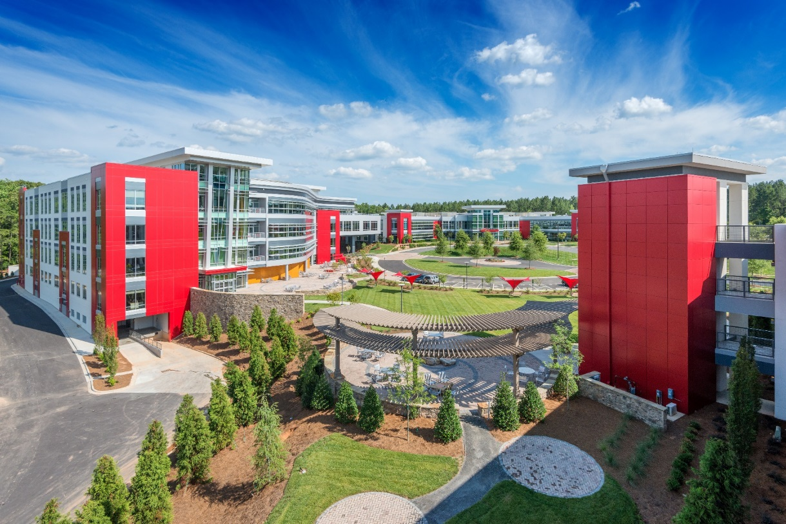






Overview
of Red Ventures.
HISTORY
Founded as Red F in 2000
Red Ventures launched in 2004
General Atlantic & SilverLake minority strategic investors.
BY THE NUMBERS
3,500+ Employees
Locations
  USA - 13 Locations
  Brazil - Sao Paulo
  United Kingdom - London
1 Culture

Slide 3


















Our Evolution as a Business.
Throughout our history, we’ve continually challenged ourselves to be pioneers in the digital age. Evolving from a performance based dealer model in the early years, we have continued the principal mentality in every business partnership we’ve forged regardless of business model. From helping driving growth through digital media funnels for large brand partners to building complete digital platforms for others, our mindset remains the same. Be the pioneer that helps our partners dominate their industry with a model founded in outcome orientation and aligned objectives.

Slide 4





















Red Ventures
General Capabilities Overview.
Consumer Destinations
Strategic Brand Partners
Journey
Optimization
Data
Sciences
Tech
Integrations
Programmatic
Media
Digital
Transactions
Customer
Messaging
Digital
Strategy

Slide 5















Red Ventures
Corporate Structure Explained.

Slide 6


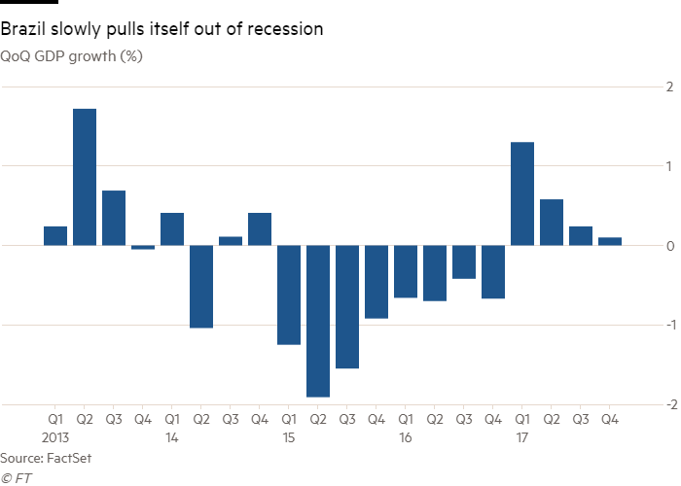




WHY
WHERE
HOW
did we go?
did we start?
did we structure?
CULTURAL
DIFFERENCES

Slide 7





Finding Our Lane
EARLY PARTNERS

Slide 8
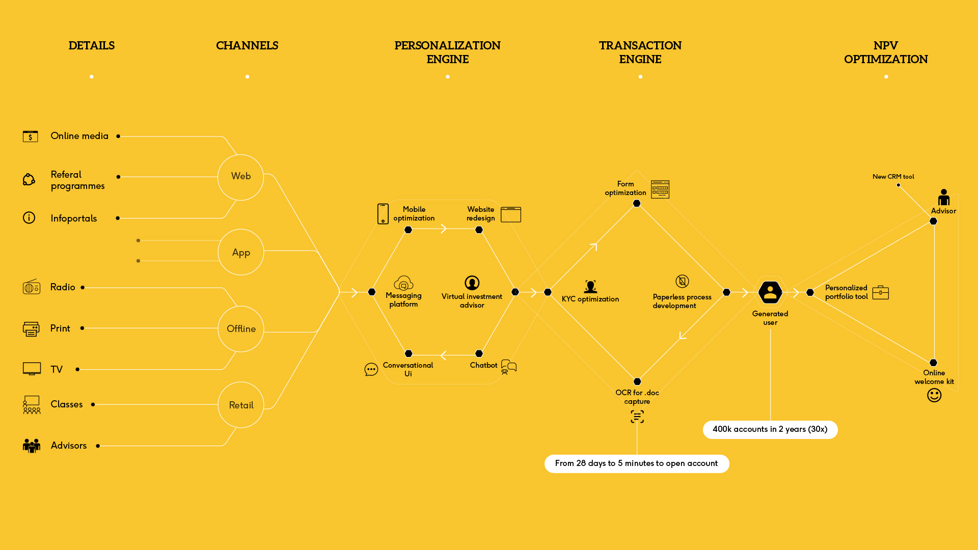

+

Slide 9






Brazil’s Strategic Priorities
Wealth
management
Credit
cards
Insurance
Proprietary marketplaces
2015
2016
2017
2018 E
2018
Telecom & Loans
Notes:
Business Summary
Two new verticals launched in 2017: credit cards (Itau) and life insurance (Icatu), with full ownership of brand acquisition
Investment business 2x that of 2016 (250k new accounts in ’17 vs 120k in ‘16)
Team grew 2x from 26 to 51. New CFO, CTO and VP to join until Feb ’18.
Proprietary marketplace (IQ360) launched.
Growth Corridors:
Expand partnerships to other industries (telecom, health, travel, loans)
Scale IQ360 into a top-of-mind consumer brand
Build multi-product insurance agency
Explore new partnership models for digital transformation (beyond acquisition)

Slide 10

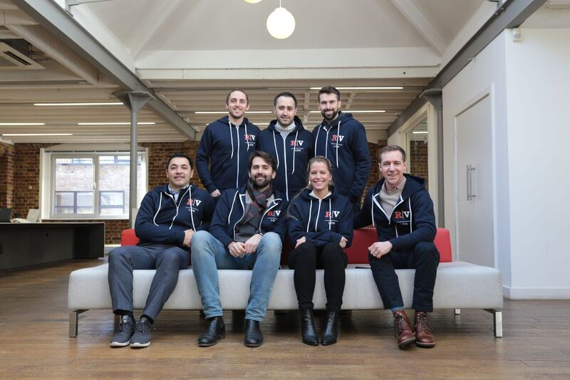


Notes:
Our strategy is two-fold:
Build partnerships with leading consumer brands, focusing on the UK and Germany as the biggest economies in Europe. Our partnership focus will be in financial services and home services
Bring our biggest US owned and operated brands to the UK such as Bankrate where we see a great fit with the European regulatory regime which is encouraging more flexibility in switching personal finance providers and giving more control to consumers
We’re very reliant on the US as we build our business. A few areas include:
Technology – we are relying on our US tech, rather than reinventing the wheel although we are adapting certain elements to comply with European data protection laws
People – as we grow our team locally, we have a number of people who spend a good proportion of their time working on European projects with us, often spending time here with the team
Partnerships – Many partnerships are being developed directly in Europe however the problems the partners here face are very similar to those in the US and so we have directly applicable experience that we can show our partners. We also have a number of global partners in the US such as Amex and Apple and are in discussion with those companies to work together

