Slide 1
Advanced Breastfeeding Support 2018
Breastfeeding
Breastfeeding Education
Copyright © 2007 Georgia Chapter, American Academy of Pediatrics. All rights reserved.
Notes:
Explain EPIC; Educating Physicians in their Community. The EPIC Breastfeeding Program is a peer-to-peer, physician led, education program designed to assist practices in promoting and supporting breastfeeding as the optimal source of infant nutrition.

Slide 2
Faculty Disclosure Information
In accordance with ACCME* standards of commercial support, all faculty members are required to disclose to the program audience any real or apparent conflict(s) of interest to the content of their presentation. I would like to disclose the following:
* Accreditation Council for Continuing Medical Education
Notes:
If you have anything to disclose please do it now. If not, go to the next slide.

Slide 3
Program Objectives
Describe effective ways to manage acute breastfeeding issues
Discuss when and how to supplement the breastfeeding baby
Describe methods to resolve common breastfeeding issues to improve outcomes
Notes:
EPIC is geared toward the physician but will include information for other healthcare professionals.

Slide 4
EPIC Program Funding
This presentation is made possible by the Georgia Department of Public Health (DPH) through a contract managed and in partnership with Georgia Chapter - American Academy of Pediatrics (GA AAP). Neither DPH nor Contractor is responsible for any misuse or copyright infringement with respect to the material.
Notes:
The EPIC program is funded by The Georgia Department of Public Health – Maternal Child Health Program.

Slide 5
EPIC Breastfeeding Program Partners
Georgia Chapter - American Academy of Pediatrics
Georgia OB/GYN Society
Georgia Academy of Family Physicians
Centers for Disease Control and Prevention
The Department of Public Health –Maternal Child Health
Notes:
Read the slide
These are our partners.
Our EPIC office is housed at the AAP office.

Slide 6
Breastfeeding Questions
How will I know if a mother is producing enough milk?
How can a mother increase her milk supply?
What can a mother do to prevent or treat sore nipples?
Are supplements ever necessary? If so, how can a mother supplement without interfering with breastfeeding?
How do pre-term babies differ in their ability to breastfeed?
Notes:
These will be the 5 questions that we will cover today. Read each question to the audience.

Slide 7
How will I know if a mother is producing enough milk?
Notes:
How will I know if a mother is producing enough milk?

Slide 8
Key Questions
How did your breasts change during pregnancy?
Have you had any breast surgery?
Are you on any medications?
Did you have difficulty getting pregnant?
When did you notice your breasts getting full?
Notes:
A good history is always important.
Breast changes during pregnancy: increased size, more tenderness, areola darkening
You want to ask about any breast surgery. Breast surgery can effect the milk supply; especially surgeries like breast reduction
Remember to ask about medications. Some mothers who start back on certain birth controls methods may notice a decrease in milk supply.
Ask the mother if she had any problems with getting pregnant.. Some literature is suggesting that moms that have trouble with infertility may be more at risk of having a low milk supply because of hormonal issues.
By day 3-5 moms breast should feel very full.

Slide 9
Key Questions (cont)
Tell me about your baby’s feeding pattern
How do your breasts feel after breastfeeding?
How many urine and stool diapers are you changing in 24 hours?
Notes:
Ask about the baby's feeding pattern. Many mothers think that the baby that eats frequently is not getting enough. Explain that babies need small frequent feedings in the first few weeks.. It’s not uncommon for newborns to eat every 1-3 hours in the first few weeks,
Breasts are usually softer after a feeding
Baby feeds 8-12 times in 24 hours
Baby has 3 or more wet diapers and stools after day 3
Regains birth weight by 2 weeks

Slide 10
Separate “real” and “perceived” Low Milk Supply
What are normal feeding patterns?
What are growth spurts and when do they happen?
How does the breast change?
Why do babies take the bottle with ease?
What is a let down?
Does a fussy baby mean a hungry baby?
Notes:
Breast fed infants may eat more frequently than formula fed infants especially in the first few weeks of life. Remind mothers that the stomach of a newborn is small and is not made to hold large volumes of milk. Breastfed infants do eat more frequently than formula fed infants.
More frequent feedings or cluster feedings are common in the evenings. As the baby get older he may feed more frequently for a few days and then return to his regular feeding frequency. This usually happens at about 6 weeks and again at 6 months. Moms need to know that this is NORMAL. Babies god through these growth spurts at different times.
Some mothers are worried as their breast soften after the first week or two. This is normal. They should feel fuller before a feeding and softer after.
Remind mothers that to bottle feed is different from breast feeding. With breastfeeding a baby can refuse more milk when she is full but with a bottle feeding the baby may continue to suck even after she is full.
Some mothers do not feel a let down. Other mothers feel one at most feedings.
Babies fuss for many different reasons. Discuss ways to calm a fussy baby. You can suggest swaddling the baby. Offer the less full or empty breast for the baby to suckle. Some mothers choose a pacifier to calm the baby. The AAP suggests waiting till breastfeeding is well established before offering the pacifier.

Slide 11
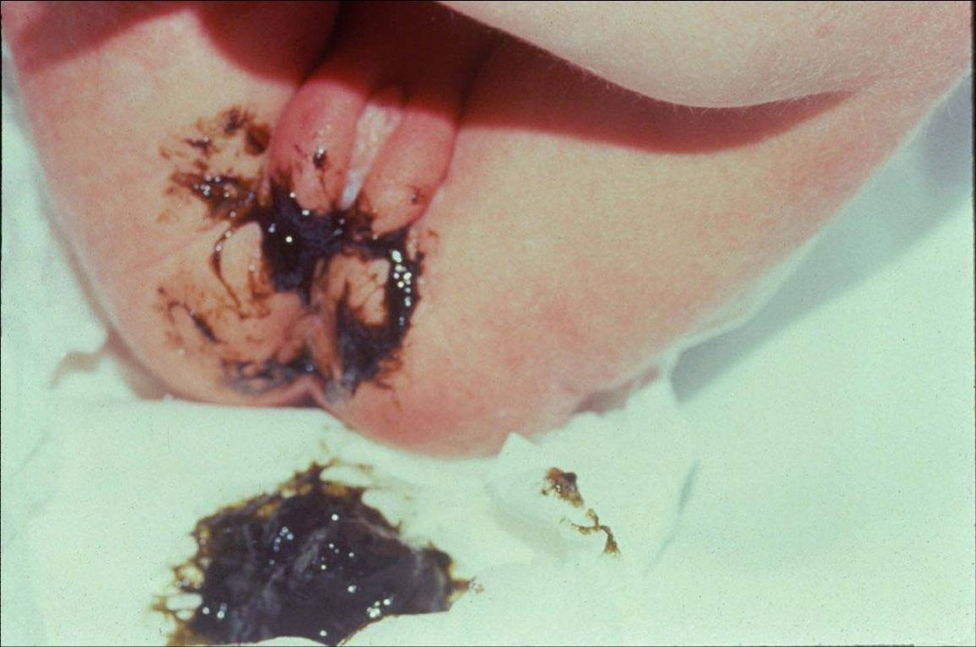
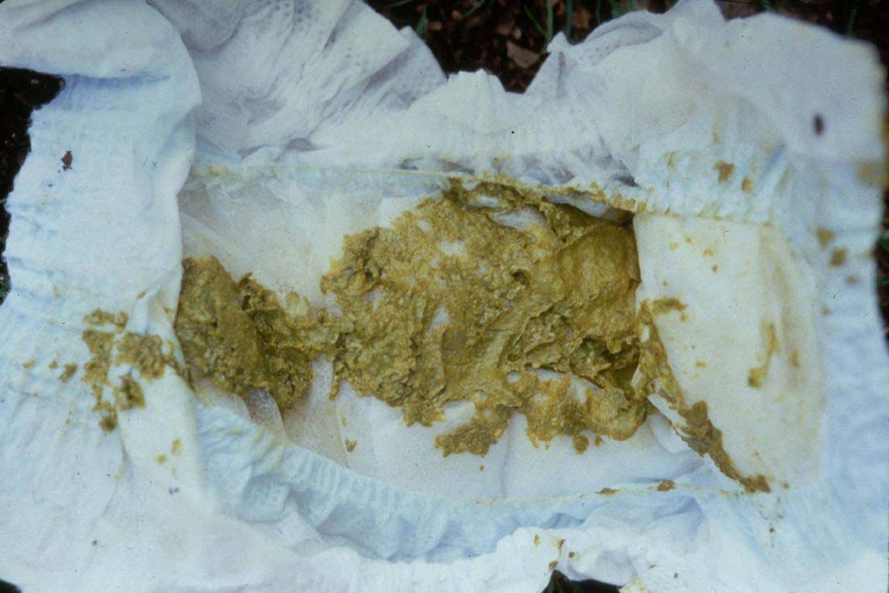
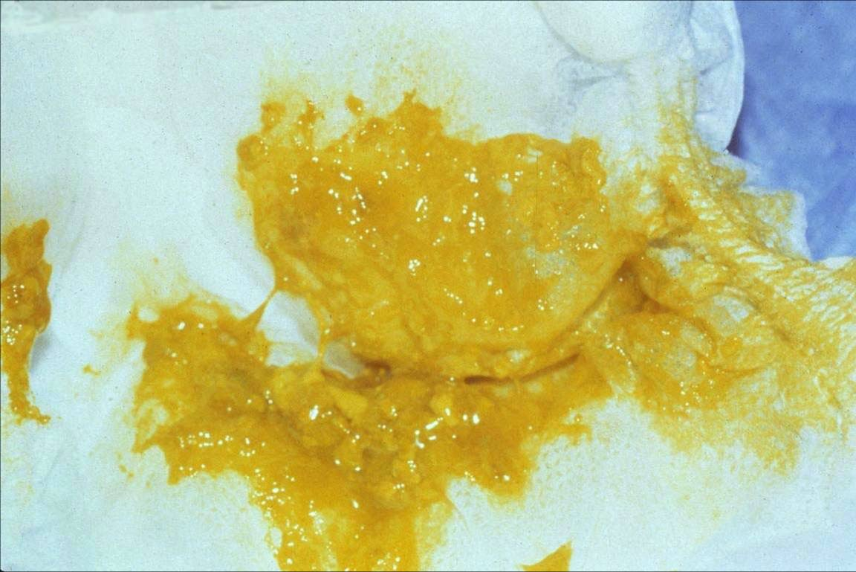
Breastfed Infant’s Stool
Meconium
Transitional stool
Breastfed stool
Notes:
Meconium – usually at least one stool the first day and increases in number each day. It looks black like tar.
Transitional stool usually seen by day 3 or 4.
A mature breast milk fed stool is seen at 5-7 days. It is usually soft, yellow and seedy. Breastfed babies have many stools a day and may have a stool after every feeding. After 6 weeks this may slow. It is common for older exclusively breastfed babies to go days without a stool.
A lack of stools are a warning sign in the early few days and weeks that the infant may mot be receiving sufficient milk. After 4-6 weeks, stools may decrease even though breastfeeding is going well. This is normal. After approximately 6 weeks some infant may go days between stools.

Slide 12
Weight Gain
May loose up to 10% of weight in the first 3 days
Expect a weight gain of ½ to 1 oz. per day after day 4
If birth weight is not regained by two weeks a feeding plan should be initiated
Monitor stool/urine output
Notes:
Some infants may loose up to 10% of their body weight in the first few days especially if they have been given other fluids at birth.
The infant should not continue to loose weight after the fourth day of life. The latch on and milk transfer should be evaluated at this time. Breastfed infants should regain birth weight by two weeks and if not, the pediatrician should work with the mother to come up with a feeding plan that may include pumping and/or supplementing with her own milk or formula for a few days. Follow-up is important.

Slide 13
Case Study
3 day old female infant born via cesarean section has a weight loss of 10%
Should she be supplemented?
Notes:
ASK FOR SHOW OF HANDS—WHO WANTS TO SUPPLEMENT? In training most of us were taught that 10% was the threshold that we should worry about crossing, and some studies did support that. But, is a strict 10% rule always appropriate? Or is there another way to look at weight loss more precisely? When we look at jaundice, for instance, we don’t necessarily just worry about whether it’s an 8 or a 14—those numbers might be fine, or might be a problem, depending on baby’s DOL or gestational age. We use the nomogram in the AAP guidelines or bilitool.org (which is based on this nomogram) to chart how jaundiced our patient is compared to other babies their age—kids over the 90th percentile usually we at least think about some intervention, kids over the 75th we think about monitoring them maybe a bit more closely. We now have a nomogram just like this for infant weight loss which is very exciting! Using a cohort of 161,471 healthy, singleton newborns born at ≥36 weeks gestation at 14 Northern California Kaiser Permanente hospitals between 2009 and 2013 were included in the research that generated the Newt nomograms. Data were extracted from the birth hospitalization regarding delivery type, feeding type, and weights from electronic records. So now, just like with jaundice, you can look and see what weight loss really means based on mode of delivery—which makes a BIG difference, as you will see. PLAY VIDEO. POINT TO WEB ADDRESS, THEN NARRATE THE INPUTS. WHEN THE GRAPH APPEARS UNDERSCORE THAT WEIGHT LOSS IS <75th PERCENTILE FOR A C-SECTION DELIVERY.
Although no tool can replace clinician judgement, this might be a situation where watchful waiting, optimizing breastfeeding practices, and weighing again in a few days is appropriate.

Slide 15
Case Study
12 DOL term female infant was born cesarean has just returned to birth weight
Should you intervene?
Notes:
It’s tempting here to say that weight gain is poor, because infant didn’t regain weight by day 7 to 10 (depending on where you trained, 7 dol or 10 dol may be correct answer). but as we saw in the last example, c section babies are different! so, what does NEWT say about this?
PLAY VIDEO. POINT TO WEB ADDRESS AND THEN NARRATE INPUTS, THEN WHEN GRAPH APPEARS SAY “This baby’s weight recovery is between the 50th and 75th percentile—reasonable for her age and mode of delivery.” THEN SAY “Even if she took to 13 days her weight recovery would be still pretty reasonable—still below the 75th percentile.”

Slide 17
Wake a Sleeping Baby? Yes or No?
Wake the baby when:
Sleeping longer than 4 hours (at night) and the baby is < 4 weeks old
Moms breasts are full and painful
Feed the baby when you see signs of hunger
Sucking sounds
Hand to mouth movements
Restlessness
(the late preterm infant should eat more frequently until good weight gain is established)
Notes:
In the first few weeks of life it is important that the baby nurses around the clock. Usually 8-12 times in 24 hours. If a baby sleeps more than 4-6 hours at night they may not get enough milk to have sufficient weight gain. On the flip side there are exceptions to that rule. The important thing is to make sure that the infant is gaining weight. If the weight gain is less than ideal it is important to be waking the infant to feed.
If you have a mom that has a sleepy baby and has difficulty getting the baby to take a full feed, mom should either hand express her milk or be instructed to pump after feedings She can supplement with her own milk. Some moms choose to pump and have the dad give a bottle of breastmilk in the evening.
Remember breastfeeding is a joint venture. If the mother feels full she can also wake the baby to feed and relieve her fullness.
Once a steady weight gain is established it is not as important to wake the infant for feedings.

Slide 18
How can a mother increase her milk supply?
Notes:
How can a mother increase her milk supply?
Removing Milk from the breasts increases milk supply!

Slide 19
Milk removal
is the key to milk production
Notes:
The frequency and effectiveness of colostrum removal in the first 3 days influences later milk production potential. (Morton J, et al, J Perinatol, 2009 Nov; 29(11):757-64. Epub 2009 July 2.)
When milk is removed from the breast a message is sent to the brain that it needs to be refilled. The brain then tells the body to make more milk.
So, …when milk leaves the breast, more milk is replaced. If milk stays in the breast it signals to the brain to slow down milk production.

Slide 20
Strategies to Determine Milk Production
Observe the breastfeeding
Evaluate position and latch
Check positioning
Confirm a letdown
Listen for swallowing
Notes:
Always observe the breastfeeding when possible to check for milk transfer.
Check position and latch.
Check the positioning.
You should be able to hear swallowing after DOL # 4. Watch for changes in the baby’s sucking rhythm.
A feeding should be observed once every 8 hours during the hospital stay.

Slide 21
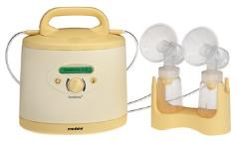
Strategies to Increase Milk Supply
Hand express or pump
Hand express or pump after feedings
Pump between feedings
Increase the frequency and/or duration of feedings
Suggest galactogogues or
medications
Refer to Jane Morton’s website
http://newborns.stanford.edu/Breastfeeding/MaxProduction.html
Notes:
We know that pump suction alone may not remove milk (especially colostrum) as well as the baby or hand expression. Tactile stimulation of hand expression may increase stimulation of the let down reflex. New studies by Jane Morton report that hand expression increases milk production.
Her website: http://newborns.stanford.edu/Breastfeeding/HandExpression.html.
Some mothers may ask about drugs or medications to increase her milk supply. These are called Galactogoues.

Slide 22
Galactogogues
Herbs/Home remedies
Fenugreek
Brewers yeast
Mother milk tea
Blessed thistle
Pharmacologic
Metoclopromide (Reglan)
Domperidone (Motilium)
Notes:
Galactogogues are medications or herbs used to assist initiation, maintenance or augmentation of maternal milk production. Common reasons to use are adoptive nursing, relactation, increasing a low milk supply or helping the mother that is dependent on a breast pump due to mother-child separation.
Studies differ as to the success of using herbs and home remedies to increase milk production.
Pharmacologic drugs for increasing milk production:
Reglan – is probably the most used drug for increasing a mothers milk supply. Usually used for gastrointestinal problems. It works by increasing prolactin levels in breastfeeding mothers. A rare, but serious side effect is tardive dyskinesia.
Domperidone is a great galactogogue but is not approved for use in the US. Some compounding pharmacies may dispense this medication. Some suggest that it may be better than Reglan because it does not have the negative CNS effects
You can get more information about Reglan and Domperidone in Dr. Hale’s book.

Slide 23
Maternal Medications
Short list of contraindicated medications
Amiodarone
Chemotherapy agents
Chloramphenicol
Drugs of Abuse
Ergotamine
Gold salts
Lithium
Phenindione
Radioactive Compounds
Retinoids
Tetracyclines (chronic use >3weeks)
Notes:
May need to consider information on medication half-life, absorption, and clearance in order to prescribe the timing of the medication so that it has the best efficacy and the least risk of negative effects on the nursing child. Or maybe another medication could be used instead.
Balance the risks of stopping breastfeeding against the need for the medication. Maybe another medication may be used instead.
Emphasis: It is rarely necessary to interrupt breastfeeding for any medication.

Slide 24
Medication Resources
Hale’s Medication and Mother’s Milk
Poison Control 404.616.9000 or 1.800.222.1222
Lactmed @ http://toxnet.nlm.nih.gov/cgibin/sis/htmlgen?LACT
Notes:
Avoid such references as the PDR and drug inserts.

Slide 25
LactMed App
Notes:
You can actually download the Lactmed app on your smartphone. The LactMed® database contains information on drugs and other chemicals to which breastfeeding mothers may be exposed. It includes information on the levels of such substances in breast milk and infant blood, and the possible adverse effects in the nursing infant. Suggested therapeutic alternatives to those drugs are provided, where appropriate. All data are derived from the scientific literature and fully referenced. A peer review panel reviews the data to assure scientific validity and currency.

Slide 26
Contraception
LAM – Lactational Amenorrhea Method
Mom exclusively breastfeeding (day and night)
Baby is under 6 months old
No return of menses
98% effective
Barrier Methods
Condom
Diaphragm
Spermicides
Sterilization
Notes:
It is important to ask the mother if she is taking any birth control because many times mothers do not equate birth control with medications.
The LAM method is used to spaces children approximately 2 years apart. If using this method it is important for the mother to remember that she needs to exclusively breastfeed and some research suggests that if a mother is pumping in lieu of some breastfeeding this increases her chance of ovulating early and becoming pregnant. A mother must be breastfeeding at least every 4 hours to this be effective. Pumping at feedings does not provide the same effectiveness.
Barrier Methods provide good protection with out interfering with breastfeeding.
Sterilization – Most common form of birth control
These three forms of contraception are not going to interfere with breastfeeding.

Slide 27
Contraception
IUD’s
No effect on breastfeeding
Some may contain progestin
Hormones
Progestin Only
Mini pill, Implanon, Mirena IUD, or Depo-provera.
May decrease milk supply if given before lactation is established
Combination Pill
Estrogen and Progestin
Avoid until baby is weaned
Notes:
The Cochran review indicated that the evidence from randomized controlled trials of Progestin is limited and of poor quality. The two most sited articles contradict each other. Koetsawang¹ reported an increase in milk production and Tankeyoon² noted a 12% decrease in milk production. The consensus is to have the mother wait until her milk is well established before using the Progestin Only method.
Koetsawang S: The effects of contraceptive methods on the quality and quantity of breast milk, Int J Gynaecol Obstet (Suppl 25): 115-127, 1987.
Tankeyoon M, Dusitsin N, Chalapati S, et al: Effects of hormonal contraceptives on milk volumes and infant growth. WHO Special Programme of Research, Development and Research Training in Human Reproduction Task force on oral contraceptives, Contraception 30(6): 505-522, Dec 1984.
Since there is conflicting research on these birth control methods it would be best to wait until breastfeeding is well established before giving the hormone forms of contraception.

Slide 28
What can a mother do to prevent sore nipples?
Notes:
What can a mother do to prevent sore nipples?
Observe the Latch!

Slide 29
Nipples
Do Not need to be
“toughened up”
Notes:
There is still a misconception that nipples need to be toughened.
Research does not show that having a mother toughen up her nipples by either rubbing them with a towel or sandpaper (just being funny) help prevent sore nipples.
In most cases a correct latch will prevent sore nipples

Slide 30
Causes of Nipple Soreness
Nipple problems
Poor Latch
Poor fit
Inverted or flat nipples
Early use of artificial nipples
Engorgement
Short frenulum, lip tie or high palate
Thrush
Notes:
The most common reason for sore nipples is a poor latch. When a latch problem is resolved the feeding is more comfortable to the mom. Once the mother is already sore some discomfort may be normal when the baby first latches but should dissipate in a few seconds.
When a mom becomes engorged the baby has difficulty latching well. The mom can hand express or pump for a few minutes before the baby latches.
A baby with a short frenulum may cause the mother nipple soreness because the tongue is not able to latch well and usually ends up rubbing the nipple raw. Most moms find a great improvement if the frenulum is clipped. Many ENT’s do this. (These babies can bottle feed well.)
Thrush is usually seen after several weeks of breastfeeding. Mother and baby need to be treated. Sometimes thrush is resilient and mom must be treated with Diflucan for best results.
Sometime the nipples are too large, flat or inverted. For the mothers with flat or inverted nipples, nipple shields work well for some. If a mother has very large nipples she may prefer to pump for a few days or weeks until the baby’s mouth finally grows big enough to feed well.

Slide 31
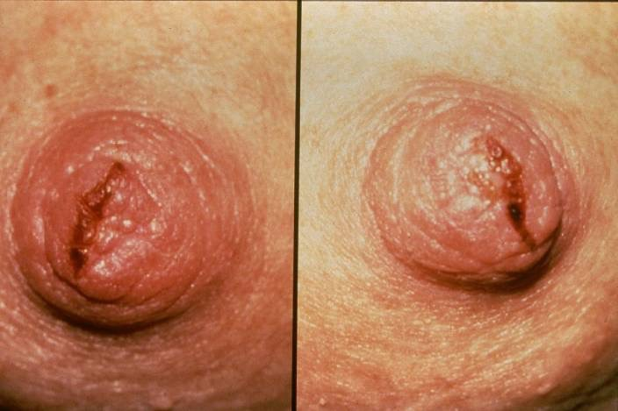
Poor Latch
Observe the feeding
Correct latch if necessary
Treatment
Colostrum or lanolin applied to nipples after feedings
Gel pads
Acetaminophen or ibuprofen
for pain
Notes:
Poor latch is the number one cause of sore nipples.
Pediatricians and OB’s need to become comfortable and knowledgeable on what a good latch on looks like. Correcting a bad latch usually improves the pain level of the mother immediately.
Once a good latch is established tell the mother to start feedings on the side that is less sore or pump for a few feedings while they heal.
Mothers can take pain medications like Tylenol to get some relief.
Gel pads can be bought in most baby stores. Several companies make them.

Slide 32
Engorgement
Express milk to soften areola
Use reverse pressure softening
Pump breast if necessary
Apply cold compresses between feedings and warm compresses before feedings
Prescribe pain reliever
Frequent feedings or manual removal of
milk is the best treatment
Notes:
Almost all women experience full breasts a few days after delivery.
However engorgement is worse causing swollen hard breasts usually accompanied by an elevated temperature in the mother.
Express milk to soften the areola before feeding.
Reverse pressure softening is a techniques where moms put gentle pressure around the nipple to decrease the swelling and help evert the nipple.
Frequent feedings usually help keep the breasts from becoming engorged. It is important in avoiding engorgement to have the mom feed frequently. If the baby is not latching on well have the mother pump to help soften the breasts.
Mom can use Acetaminophen for pain relief.

Slide 33
Infant Issues
Short frenulum
Tongue is not allowed
to grasp the breast
Clipping usually helps the latch
High palate
- More common among preterm infants
Notes:
Babies with a short frenulum do not have problems taking milk from a bottle but many have difficulty breastfeeding.
Clipping the frenulum usually facilitates the latch and the baby can breastfeed immediately after the clipping.
Some pediatricians and many ENTs will clip the frenulum and the results are usually a better latch immediately.
A high palate can also interfere with a good latch. These are more common in premature infants that have been on a vent for a long time.

Slide 34
Candidiasis (Thrush)
Usually appears several weeks after delivery
Mother experiences red shiny nipples
Sharp burning feeling during and after breastfeeding
More common after antibiotic treatment
Treatment
Both baby and mother need treatment
Clotrimazole, nystatin, or miconazole
Gentian violet (diluted to .25% to 1%)
Fluconazole
Notes:
Most mothers do not get thrush but when they do they experience nipple pain and tenderness.
The mother and infant need to be treated simultaneously for two 2 weeks.
If a baby has diaper rash his mouth should always be checked for thrush as well.
Clotrimazole, nystatin and miconazol are usually the treatments of choice.
Gentian violet can be used 3 times a day for 3 days only. Tell mom her nipples, baby’s mouth, and clothing will be stained purple.
You should recommend that the mother boil any pacifiers, bras, and nipples.

Slide 35
Nipple Problems
Poor Fit
Baby’s mouth may be too small for the mothers nipples
Areola is thick
Edema
Reverse pressure softening technique
Flat or inverted nipples
Nipple shield (temporary)
Breast pump
Use of artificial nipples
Notes:
There are a few babies that have small mouths while the mom has large nipples. Latch on my be difficult as well as impossible in the beginning. The mother should begin to pump (using a large pump flange) and continue to try and latch infant ever few days or so. Most babies will eventually be able to latch.
Some mothers have a thick, dense areola tissue which makes latching on difficult. For most of these moms the areola is only dense due to edema caused by IV’s during delivery. It may take a few days to resolve. Some moms have success with a techniques called reverse pressure technique. You can go to www.kellymom.com. for more information. Flat nipples are not always a problem especially if the mom’s breast tissue is soft. The baby makes his own nipple. So looks are deceiving. If a baby is unable to latch due to flat nipples some moms have success with a nipple shield or using a breast pump a few minutes before latching the infant to her breast. In the case of the nipple shield it is important that the mother continue to work on getting the baby onto the breast with it. Some research suggests that the continued use of the nipple shield can cut down on milk supply.
When a nipple shield is used for flat or inverted nipples is should be used for a short period of time. Moms should continue to try and latch the baby without the shield. Before using a shield you should check the mothers nipples. If you are able to grasp the outside of the mother’s areola, compress and the nipple is formed, she does not have true inverted nipples. Some mothers nipples appear flat but are easily drawn into the baby’s mouth.
Side note: Nipples shields have also been used for sore nipples or with moms that have a strong let down and the baby tend to choke on the milk. The shield slows the flow of the milk somewhat. There is much controversy about whether or not babies get “nipple confused”. What we do know is that “some” babies have difficulty learning to do both in the beginning. Other babies can go back and forth from the bottle to breast without difficulty. To avoid any unforeseen problems it is best to avoid artificial nipples in the beginning for at least for 4-6 weeks until breastfeeding is established.

Slide 36
Latch and Milk Transfer
Belly to belly, Chest to chest,
Chin and nose, Touch the breast
Notes:
Mention this little rhyme to the mother to help with positioning.
Belly to belly, chest to chest, chin to nose and touch the breast.

Slide 37
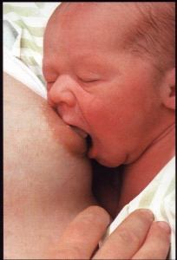
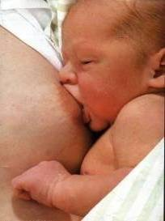
A Good Latch
Flange lips round the breast—“fish lips.”
Have wide angle at corner of mouth.
Take sufficient areola into mouth.
Notes:
Putting a baby skin-to-skin will many times facilitate the infant to wake, start rooting and begin to open wide for a latch. It is important for the mother to take her time and wait for the baby to open wide for the baby to latch effectively.

Slide 38
Signs of Effective Breastfeeding
Audible swallowing
Appropriate output (i.e. urine/stool)
Appropriate weight gain
Notes:
Listen for swallowing.
Ask about the urine and stool output. A rule of thumb is one urine and one stool on the first day of life. Two urines and two stools on DOL 2. Three urines and three stools on DOL 3 etc.
Monitor the weight gain.
Emphasize that normal infant weight gain is ½-1 oz. per day on average. Weight loss should stop after day 3 of life.

Slide 39
When a supplement is needed, how can you provide a supplement and protect breastfeeding?
Notes:
When supplementing is indicated how does a mom supplement without interfering with breastfeeding?
If a baby is not gaining weight we all agree that it may be necessary to supplement. It is always most important to “Feed the Baby”. We can work on breastfeeding while the baby is being supplemented.
A supplement of formula should be treated like a medication. It should be given in doses and the goal should be to eliminate it as soon as breastfeeding is going better.

Slide 40
Maternal Risk Factors
Previous breastfeeding difficulty
Birth interventions
Separation from infant
Absence of prenatal breast changes
Mother’s perception of insufficient milk supply
Breast surgery or trauma
Breast or nipple abnormality
Unrelieved fullness or engorgement
Notes:
Encourage women with previous breastfeeding problems, or potential problems as detailed in this slide, to meet with a Lactation Consultant prior to delivery if possible.
Stress to mothers that every baby is different and this baby may be a great breastfeeder.
Research shows that birth interventions and separation of mother and infant at birth puts the mother at risk for premature weaning and low milk supply.
If a mother states that her breasts did not change during pregnancy, this is a red flag.
The mother may be unrealistic when it comes to feeding frequency of the newborn. Frequent feedings are normal and babies do feed at night.
Breast surgery or breast trauma can sometimes effect breastfeeding success.
Breast augmentation is usually not a problem however many mothers that have reduction surgery are at risk for a compromised milk supply.
Some mothers may have inverted nipples, flat nipples and/or have had nipple trauma.
Engorgement that is not resolved may lead to a low milk supply.

Slide 41
Infant Risk Factors
Prematurity, SGA, LGA or IUGR
Hyperbilirubinemia or hypoglycemia
Oral anomalies
Birth interventions and/or trauma
Inability to maintain an effective latch
Acute or chronic disease
Persistent sleepiness or irritability
Notes:
Read slide

Slide 42
Reasons to Supplement?
Weight loss because of low milk supply
Hyperbilirubinemia
Hypoglycemia
Failure to latch
Mother is ill
Medications
Premature infant
Adoption
Notes:
Why should we supplement? Weight loss or lack of weigh gain
There are a few babies that have such a high bilirubin count that breastfeeding may be interrupted for a short time. If this happened it is important to have the mother continue to pump until the baby is back on the breast. There are two types of jaundice; the most common is physiologic jaundice or as many call it… lack of breastfeeding jaundice which means the infant is not getting enough breast milk. The second type of jaundice, and less common is breastmilk jaundice which shows up after a week or so in the infant. The Academy of Breastfeeding Medicine has a great protocol on jaundice is you have more questions.
Hypoglycemia that has been unresponsive to appropriate frequent breastfeeding's.
Infant is not able to latch.
Mother and baby are separated due to the mothers illness or need surgery.
A few medication can interfere with a mom breastfeeding.
The premature infants that is not able to remove milk well from the breasts
Adoptive babies can breastfeed. A few mothers have been able to breastfeed exclusively. Most mothers will breastfeed partially and use formula to supplement their adopted baby. Most mothers that choose to try breastfeeding when adopting an infant do so because of the bonding they feel they get from the breastfeeding experience.

Slide 43
Weight Gain Issues
Weight loss >75th percentile
Slow weight recovery (>75th percentile)
Baby has meconium stools after the 5th day
of life
Use the WHO growth
charts and NEWT app
Notes:
When weight loss is greater than 8% make sure you observe feedings. Listen for swallowing, count urine and stool output.
After an intervention have the mother come back the next day for a follow-up weight check.
The CDC recommends that pediatricians use the World Health Organization growth charts which are developed using breastfed children. These charts show that breastfed infants weigh patterns are different than formula fed children.
If weight gain needs to be monitored closely the mother may be able to rent a baby weigh scale if she is not able to come to the MD’s office or clinic for regular weight checks.
There can be weight scale problems. If possible the baby should be weighed on the same scale at each visit to avoid any inaccurate readings.

Slide 44
Not Latching
Start pumping and using hand expression
Supplement with pumped breast milk when possible
Encourage skin-to-skin
Make an appointment with a lactation specialist for help
Notes:
When a baby is not latching onto the breast the milk supply has to be preserved.
Start pumping and/or hand expressing every 2-3 hours.
Supplement with breast milk whenever possible.
Work on getting the infant to the breast.
Encourage mom to seek assistance as soon as possible. Having a lactation consultant can help mothers with breastfeeding problems.. Many LC’s will come to the mothers house for assistance and some insurance companies will pay for these services. WIC mothers should seek out their local WIC department for help.

Slide 45
Supplementing
Colostrum
Amounts are appropriate for baby’s stomach size
Prevents hypoglycemia in the healthy, term infant
Average in first 24 hours is 2-10ml per feeding
Small amounts give the baby a chance to coordinate their suck, swallow and breathing
Notes:
All newborns lose weight because of a physiologic diuresis of extra fluid following birth. Average weight loss is about 6% and it occurs aver a period of 2-3 days after birth. Breastfed infants should regain birth weight around 9-14 days of life days of life.
Colostrum is the yellow liquid full of antibodies that provides nutrition for the first days of an infants life.
The amount of colostrum is measure is teaspoons and tablespoons. This is the perfect amount for the newborn infants gut.
Colostrum usually changes to transitional milk at about 3-5 days.

Slide 46
Milk Intake for the Healthy Term Infant
2.5 ounces per pound per day
Average newborn:
1.5 – 2 ounces per feeding
Notes:
Usually infants will take in about 1 ½ to 2 ounces of milk per feeding after approximately 5-7 days. Remember that colostrum is measured in teaspoons and infants need more short frequent feeds in the first few days to stimulate more milk producation.

Slide 47
Methods of Supplementation
Supplemental nursing system
Bottle feeding
Cup feeding
Finger feeding
Dropper feeding
Spoon feeding
Syringe feeding
Notes:
No perfect feeding device has been found. No method is without benefits or risks
The bottle is most common but the rapid flow and the mouth position is different and may confuse the baby when she goes back to the breast.
Not all babies will be “Nipple confused” but we just don’t know which ones will so we try and avoid the introduction of a bottle nipple until after breastfeeding is well established; usually around 4-6 weeks.
The SNS or supplemental nursing system may be the best because helps to stimulate a milk supply while receiving the supplement. The downside is that is more trouble and moms have to clean it well after every use.
Each parent must decide which method is best for their family but they do need to know the benefits and risks of all supplementing methods.
The goal with using any supplement is to eventually get the baby back to the breast and exclusively breastfeeding if possible.

Slide 48
What Supplement to Use?
Mother’s own milk is always the first choice
Pasteurized donor human milk
Protein hydrolysate formula*
Cow’s milk formula
* this formula is expensive and should only be used as a short term supplement if possible
Notes:
Mother may be able to hand express or pump between breastfeedings and supplement with her own milk. This should be the first choice.
If she is not able to pump or hand express banked milk may be a good second choice. Be aware that mothers can and do buy breastmilk over the internet. This should be discouraged because the safety of milk not pasteurized may harm her baby. Donor human milk is also very expensive. It costs about $3.00 per ounce.
The hydrolysate formula is the third choice because it avoids the exposure of cows milk protein, reduced bilirubin levels more rapidly and may convey the message to the mother that this supplementing is a temporary therapy for her baby.
The 4th choice is cows milk formula.
Soy formula should be a last choice.
Supplementing with glucose water is not appropriate. (Lawrence)

Slide 49
When to Supplement
Maternal illness
Inborn error of metabolism
Contraindicated maternal medication
Dehydration (clinical or lab)
Delayed bowel movements on day 5
Jaundice or hypoglycemia that does not resolve after frequent breastfeeding
Delayed lactogenesis
Notes:
Mom is very sick or is separated from her infant for some reason.
Baby has PKU, for example.
Maternal medication that is contraindicated. Make sure if this is a medication that will be used temporarily that you have the mother pump and dump her milk until it is OK for her to go back to breastfeeding and receiving human milk.
Baby is very sick or has a congenital malformation and breast milk is not available.
Dehydration – supplement
Monitor stools and urine output. Supplements should be used with excessive weight loss.
In some cases with jaundice when the infant is not feeding well and breast milk is delayed.
* Refer to the ABM hypoglycemia and jaundice protocols for more information

Slide 50
Increasing Milk Production
Hand express after each feeding for 5 minutes (http://newborns.stanford.edu/Breastfeeding/HandExpression.html)
Use a breast pump if mom prefers
Give infant expressed breastmilk
Supplement with 1 oz. hydrolyzed formula if breast milk is not available
Slowly decrease, then discontinue supplementing when infant is gaining adequately (daily weight checks)
Notes:
Remember that new research is showing that hand expression in the first few days yields more milk than pumping. This is especially true in the first few days and for mothers that are pumping for weeks at a time.
Jane Morton has a great website that has a video on hand expression. This is very helpful for the mother that is trying to increase her milk supply.
Hand expression along with pumping increases milk production
Offer infant expressed breast milk.
Monitor weight.
The hydrolyzed formula may be a good choice when needing to supplement for a few feedings because the infants rarely like the taste and may return back to the breast easier. Although this formula is more expensive.
Decrease amount of formula used while increasing breastfeedings. Still monitor weight gain.
Mothers can rent a scale for their home use from Medela the breast pump company.

Slide 51
How does the pre-term baby differ in their ability to breastfeed?
Notes:
How does the pre-term differ in their ability to breastfeed?

Slide 52
Who is the Late Pre-term Infant?
Born to mothers between 34-36.6 weeks of gestation
More immature
Difficulty maintaining body temperature
They are more often :
Born to C-section mothers or diabetic mothers
Multiples
Notes:
Even thought these babies look like small “term” babies or their weight may be good, they are very different.
They are more immature.
They may even look like a term baby with a good weight.
They have difficulty maintaining body temperature.
They are more common in mothers that are delivered by C section, diabetic, or are carrying multiples.

Slide 53
Late Pre-term Infant
Increased risk of
RDS
Hospitalization
Hypoglycemia
Jaundice and phototherapy
Breastfeeding difficulties
Slow weight gain
Notes:
This baby is no longer called the Near Term infant because it implies that they are almost term but they may act more like a premature baby in many respects.
They are at an increased risk of Respiratory distress syndrome, hospitalization, hypoglycemia, jaundice that requires phototherapy, not gaining well and have breastfeeding problems.
Many have slow weight gains or failure to thrive.
Most hospitals treat these babies as full term infants especially if they are not small or have a low birth weight. \
In 2011, Research at Utah’s Intermountain Healthcare found that a baby born at 38 weeks gestation is 3 times as likely to be in the ICU for respiratory problems and he is 5 times more likely to be in the ICU for respiratory problems if he was born at just 37 weeks.

Slide 54
Late Pre-term Breastfeeding Issues
Increased risk of
Separation after delivery
Supplementation
Weak suck
Not latching well
Sleepy baby
Compromised milk supply
Mom needs to pump or hand express
Infant supplemented with mom’s milk
Notes:
Pre-term infants are more likely to be separated from their mother at delivery.
They are more likely to be supplemented.
They may need to be supplemented because of their weak suck, not able to maintain a latch and they usually more sleepy than term infants.
The late preterm infant may have more difficulty with weight gain. The problem may be insufficient breast milk, inability of the infant to latch well or a combination of both. Increasing the number of feeds per day may help or have mother hand express or pump after feedings and supplement with that milk.
Mothers that have a baby that does latch well but falls asleep at the breast may have success with hand expressing while the infant is feeding to facilitate emptying of the breast.

Slide 55
Late Pre-term Follow up
Weekly weight checks
If not gaining well
Make feeding plan
Office visit in 2- 4 days
Lots of skin to skin
Weight gain should average more than 20g/day after the first week
Head circumference should increase an average of .5cm/week (ABM protocols)
Notes:
Weight checks until 40 weeks postconceptual age or until it is demonstrated that the baby is thriving without supplements. Some of these babies may need to be supplemented for a short period of time but the goal should be to get to exclusive breastfeeding as the baby matures and feeds improve.
When weight gain is an issue the mother will need a feeding plan and close follow-up.
Weight gain should average more than 20g/day after the first week.
Head circumference should increase an average of .5cm/week.

Slide 56
Referrals
Hospital lactation consultants
WIC
Lactation specialist
Peer counselor
La Leche League
Mother Support groups
www.GeorgiaBreastfeedingCoalition.org
Private Lactation Consultants
www.ZIPMilk.org
Notes:
Many hospital have support groups and some have clinics that will help the mother after discharge.
If the mother is eligible for WIC she can get breastfeeding help and in many cases she can receive a breast pump from WIC. The WIC program also employs peer counselors that can assist and even make house calls.
La Leche League is a mother to mother support group.
There are other local support groups.
Moms may be able to locate these groups through the Georgia Breastfeeding Coalition website.
Private lactation consultants are available.

