Slide 1
Attendance Supervisors Conference
EIS, TEDS and SIS Contracts
Cliff Lloyd | CIO | April 2019, Franklin, TN

Slide 2
EIS and TEDS

Slide 3
EIS, TEDS and Ed-Fi
Last September we announced the TN Education Data System (TEDS) project and the eventual end-of-life of EIS.
Top Level Notes:
We are on track to release a limited feature “V1” of TEDS on July 1st 2019.
TEDS will run in parallel to EIS for at least the 19/20 school year with EIS as primary.
If all goes according to plan we will sunset EIS for the 20/21 school year.

Slide 4
Why do we need to replace EIS?
EIS is an 18 year-old technology that is no longer consistent with 2019-era user expectations of data availability and functionality.
The level of EIS processing on many nights has outgrown the State’s shared Oracle platform and impacts systems in other agencies (and vice versa)
EIS data has become fragmented and is spread over multiple (often redundant) data “islands” introducing ambiguous “sources of the truth”
The business rules that govern data transformations and reporting have become contradictory over time and are increasingly difficult to reconcile
Maintenance of the EIS code is difficult and the cost of support is growing higher
EIS

Slide 5
Ultimate Objective of TEDS
Creation of a single, agency data warehouse
Introduce a centralized business rules engine and single point of truth for all validation
Automatic, real time data integration with every district SIS
Dramatically simplified error reporting and data correction protocols for districts
Enhanced district visibility into received data, particularly data used for key processes
New support for advanced data analytics and on-demand data enquiries, including mobile
Enhanced security, performance and scalability
Reduced operational cost to the state

Slide 6
Five (Modest) Goals for TEDS V1 in 19/20
Perfect our migration to Ed-Fi 3.X
Build trust in TEDS at the district level that data sent equals data received
Perfect our new identity management system (State ID’s)
Perfect our new user authentication system (SSO / Orion)
Perfect the new error management portal
PLEASE NOTE: It is not a goal in 19/20 to attain equivalency with EIS. EIS data reports will not be part of this release, however a new data visibility portal intended for data verification purposes will be in scope.

Slide 7
Frequently Asked Questions
Q: What system is considered the primary system for
state reporting purposes in the 19/20 school year?
A: EIS
Q: In the event of data discrepancies between EIS and
TEDS, which system will prevail?
A: EIS
Q: Will districts have to continue with EIS batch reporting
in 19/20 in conjunction with Ed-Fi transmissions?
A: Yes
Q: What version of Ed-Fi have we standardized on?
A: 3.1 – 3.1 includes a schema for formative
assessment data and grades

Slide 8
Frequently Asked Questions
Q: Is SSO needed as part of TEDS?
A: Yes – SSO will be the only method of accessing
TEDS
Q: What system is going to be used to provision SSO
accounts in 19/20?
A: EIS and TEDS (whichever has the best data)
Q: Will TEDS have all the same data reports and enquiries
as EIS does now
A: No. Duplicating all of the existing EIS reports and
enquiries is not in scope for July 1
Q: How will we see our data in TEDS V1?
A: Through a new data visibility dashboard and through visibility tools specific to BEP and Assessment

Slide 9
Frequently Asked Questions
Q: Are we expected to fix errors in TEDS in timely
manner?
A: No – EIS is the main system in 19/20 so the
business impact of errors in TEDs is low –
however, the point of the July release is to
iron out the kinks. This means we do need to care
about errors so that we can understand why they
are occurring and either explain them or fix them
Q: Should we expect discrepancies between EIS and
TEDS?
A: Yes – EIS does a lot of data transformation and
applies contradicting rules – TEDS does not

Slide 10
Frequently Asked Questions
Q: How will we work with our state reporting data errors
in TEDS?
A: I’m glad you asked!

Slide 11
Error Management Portal - Demo
Demo Link

Slide 12
Other Topics

Slide 13
Other Topics of Interest
SIS Contracts
SSO 2.0 and Legacy Login
TNReady
What else?

Slide 14
Questions?
cliff.lloyd@tn.gov

Slide 15
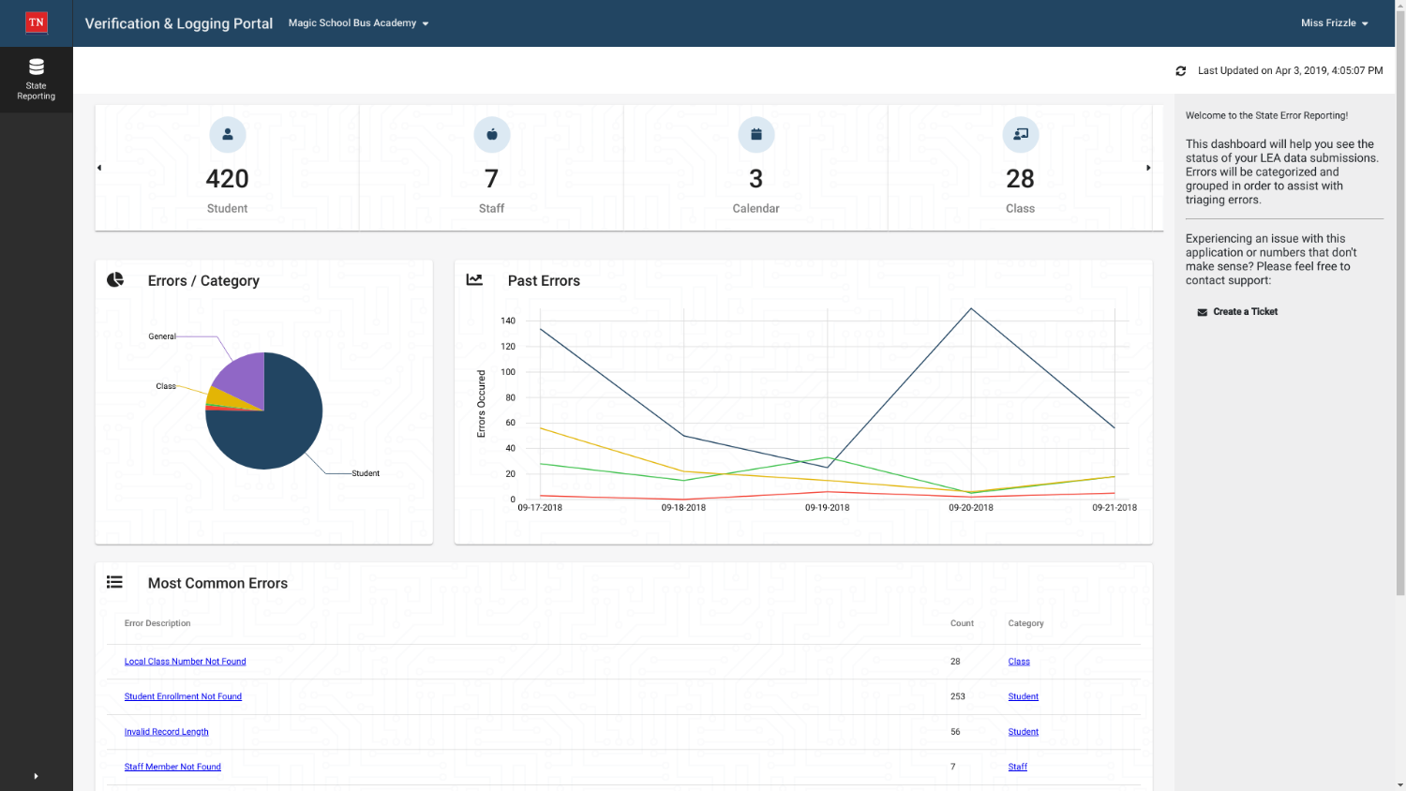

Slide 16
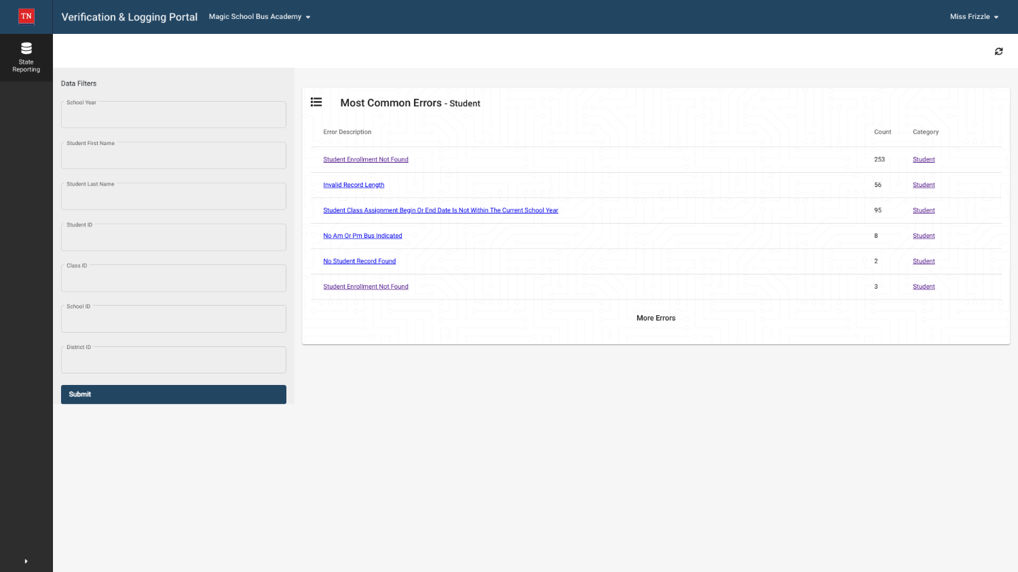

Slide 17
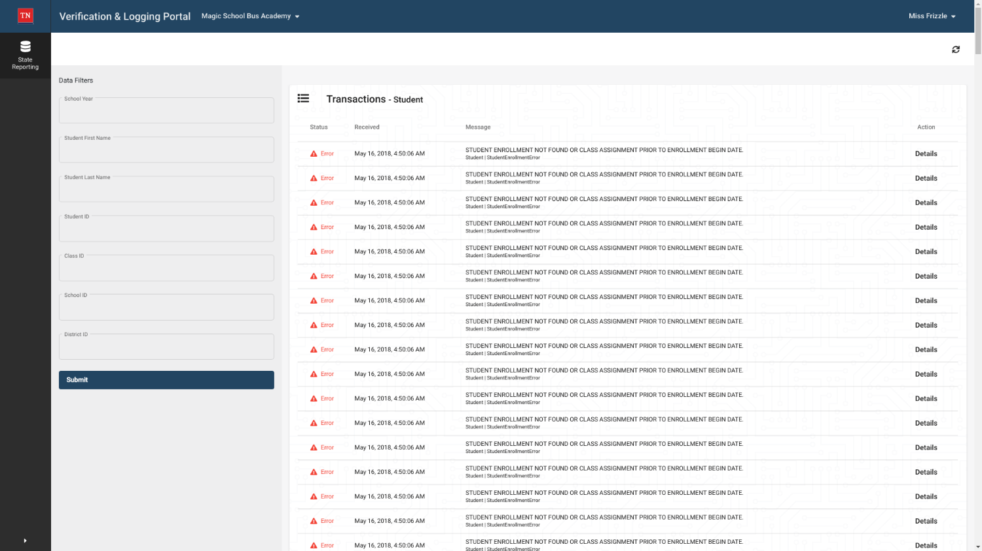

Slide 18
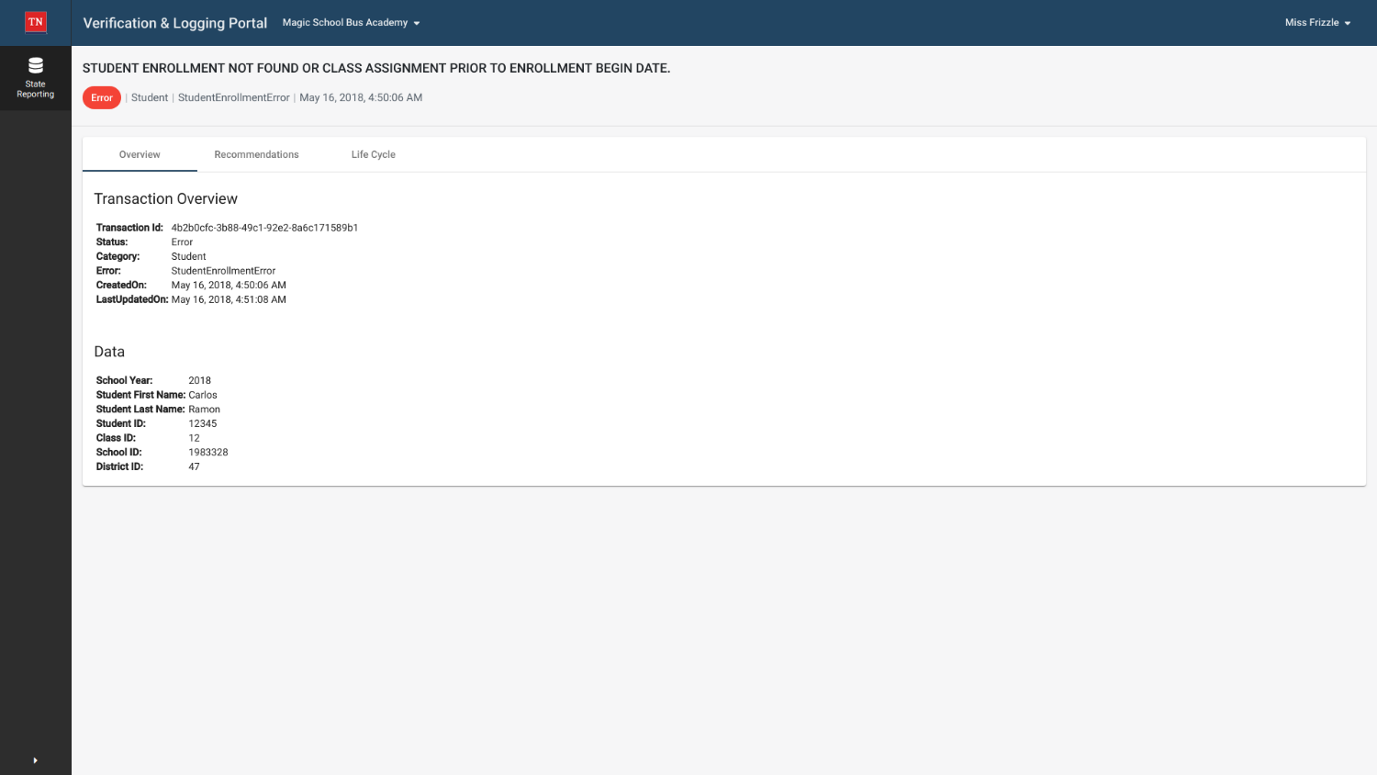

Slide 19
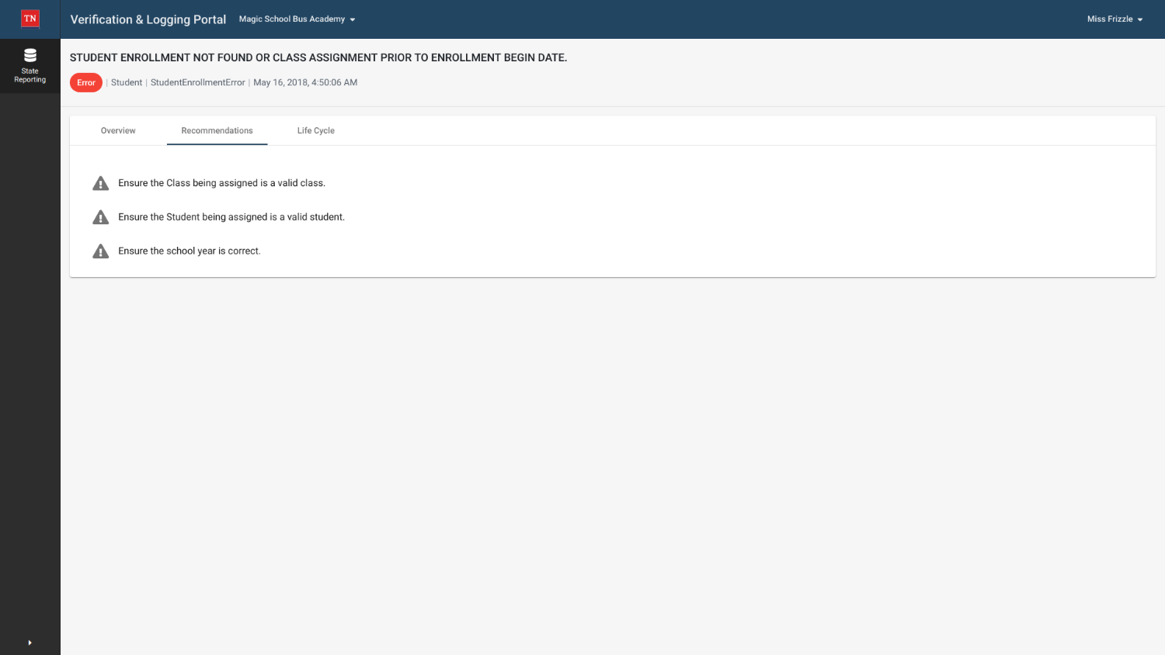

Slide 20
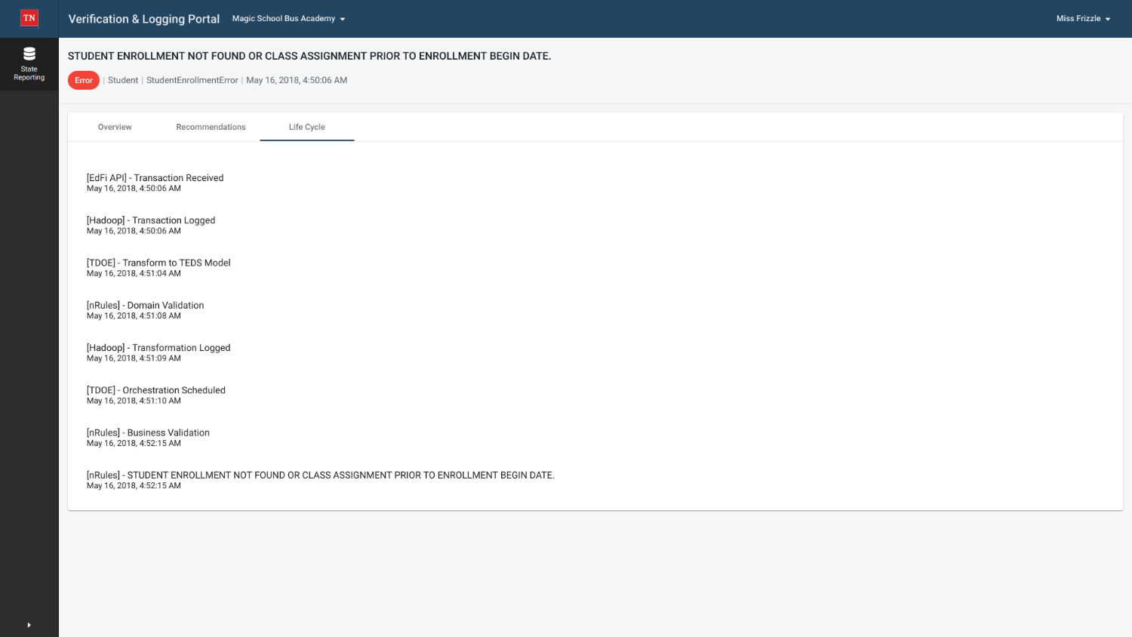

Slide 21
