Slide 1
The Language of Mathematics: Grades 7-12
Marburn Academy
New Albany, OH
September 15, 2018

Slide 2
Presenter
Sarah R. Powell
srpowell@austin.utexas.edu
@sarahpowellphd
www.sarahpowellphd.com

Slide 3
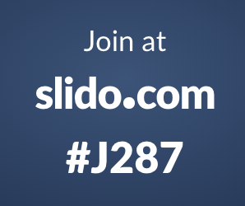
Today

Slide 5
The Language of Mathematics
Listening
Speaking
Reading
Writing
Vocabulary

Slide 6
Vocabulary Across Grades

Slide 7
degree

Slide 8
base

Slide 9
mean

Slide 10
Mathematical Vocabulary is Tricky
1. Some math terms are shared with English but have different meanings
right
base
degree
Rubenstein & Thompson (2002)

Slide 11
Mathematical Vocabulary is Tricky
1. Some math terms are shared with English but have different meanings
2. Some math words are shared with English with similar meanings (but a more precise math meaning)
difference
even
Rubenstein & Thompson (2002)

Slide 12
Mathematical Vocabulary is Tricky
1. Some math terms are shared with English but have different meanings
2. Some math words are shared with English with similar meanings (but a more precise math meaning)
3. Some math terms are only used in math
numerator
trapezoid
parallelogram
Rubenstein & Thompson (2002)

Slide 13
Mathematical Vocabulary is Tricky
1. Some math terms are shared with English but have different meanings
2. Some math words are shared with English with similar meanings (but a more precise math meaning)
3. Some math terms are only used in math
4. Some math terms have more than one meaning
square
round
base
second
Rubenstein & Thompson (2002)

Slide 14
Mathematical Vocabulary is Tricky
1. Some math terms are shared with English but have different meanings
2. Some math words are shared with English with similar meanings (but a more precise math meaning)
3. Some math terms are only used in math
4. Some math terms have more than one meaning
5. Some math terms are similar to other content-area terms with different meanings
divide vs. Continental Divide
variable vs. variably cloudy
Rubenstein & Thompson (2002)

Slide 15
Mathematical Vocabulary is Tricky
1. Some math terms are shared with English but have different meanings
2. Some math words are shared with English with similar meanings (but a more precise math meaning)
3. Some math terms are only used in math
4. Some math terms have more than one meaning
5. Some math terms are similar to other content-area terms with different meanings
6. Some math terms are homographs
sum vs. some
eight vs. ate
base vs. bass
rows vs. rose
Rubenstein & Thompson (2002)

Slide 16
Mathematical Vocabulary is Tricky
1. Some math terms are shared with English but have different meanings
2. Some math words are shared with English with similar meanings (but a more precise math meaning)
3. Some math terms are only used in math
4. Some math terms have more than one meaning
5. Some math terms are similar to other content-area terms with different meanings
6. Some math terms are homographs
7. Some math terms are related but have distinct meanings
hundreds vs. hundredths
factor vs. multiple
numerators vs. denominator
Rubenstein & Thompson (2002)

Slide 17
Mathematical Vocabulary is Tricky
1. Some math terms are shared with English but have different meanings
2. Some math words are shared with English with similar meanings (but a more precise math meaning)
3. Some math terms are only used in math
4. Some math terms have more than one meaning
5. Some math terms are similar to other content-area terms with different meanings
6. Some math terms are homographs
7. Some math terms are related but have distinct meanings
8. An English math term may translate into another language with different meanings
mesa vs. tabla
Rubenstein & Thompson (2002)

Slide 18
Mathematical Vocabulary is Tricky
1. Some math terms are shared with English but have different meanings
2. Some math words are shared with English with similar meanings (but a more precise math meaning)
3. Some math terms are only used in math
4. Some math terms have more than one meaning
5. Some math terms are similar to other content-area terms with different meanings
6. Some math terms are homographs
7. Some math terms are related but have distinct meanings
8. An English math term may translate into another language with different meanings
9. English spelling and usage may have irregularities
four vs. forty
Rubenstein & Thompson (2002)

Slide 19
Mathematical Vocabulary is Tricky
1. Some math terms are shared with English but have different meanings
2. Some math words are shared with English with similar meanings (but a more precise math meaning)
3. Some math terms are only used in math
4. Some math terms have more than one meaning
5. Some math terms are similar to other content-area terms with different meanings
6. Some math terms are homographs
7. Some math terms are related but have distinct meanings
8. An English math term may translate into another language with different meanings
9. English spelling and usage may have irregularities
10. Some math concepts are verbalized in more than one way
skip count vs. multiples
one-fourth vs. one quarter
Rubenstein & Thompson (2002)

Slide 20
Mathematical Vocabulary is Tricky
1. Some math terms are shared with English but have different meanings
2. Some math words are shared with English with similar meanings (but a more precise math meaning)
3. Some math terms are only used in math
4. Some math terms have more than one meaning
5. Some math terms are similar to other content-area terms with different meanings
6. Some math terms are homographs
7. Some math terms are related but have distinct meanings
8. An English math term may translate into another language with different meanings
9. English spelling and usage may have irregularities
10. Some math concepts are verbalized in more than one way
11. Informal terms may be used for formal math terms
rhombus vs. diamond
vertex vs. corner
Rubenstein & Thompson (2002)

Slide 21
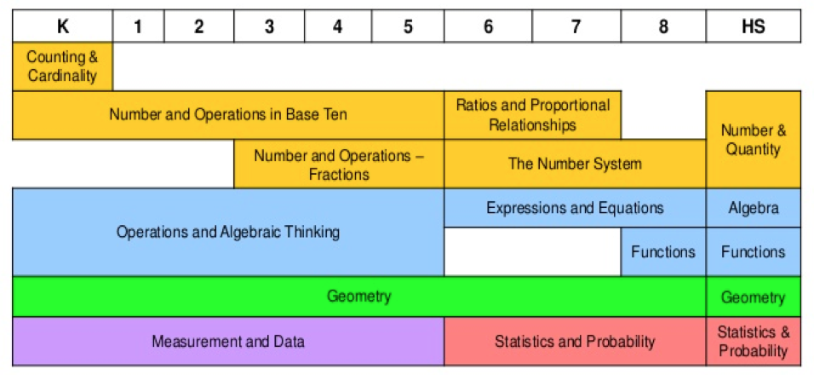
Language Across Grades

Slide 22
Language Across Grades
add
decimals
add
addends
add
fractions
add
equations
add
integers
add
perimeter
add
mean

Slide 23
Use formal math language
Use terms precisely

Slide 24
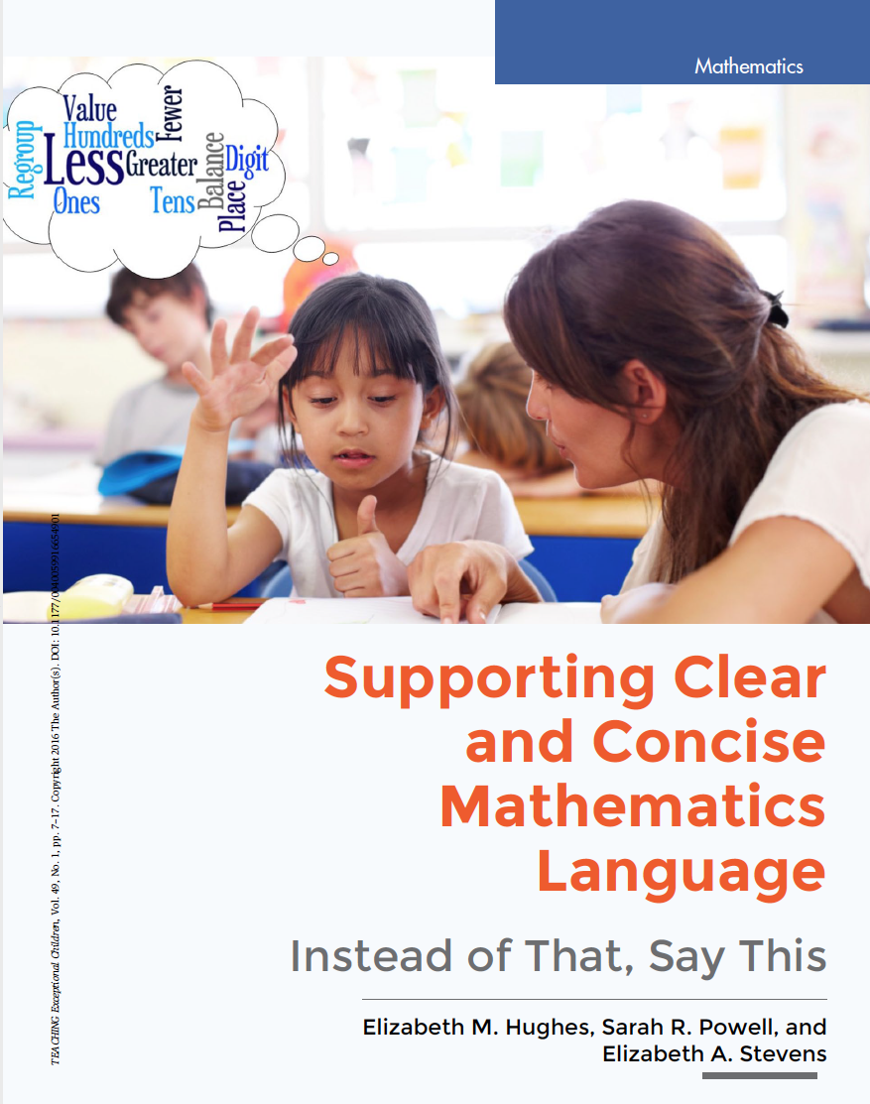
http://journals.sagepub.com/doi/full/10.1177/0040059916654901

Slide 25
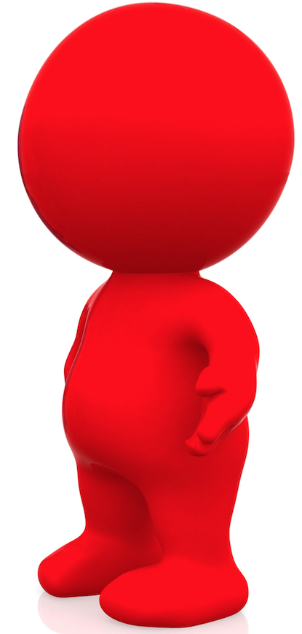
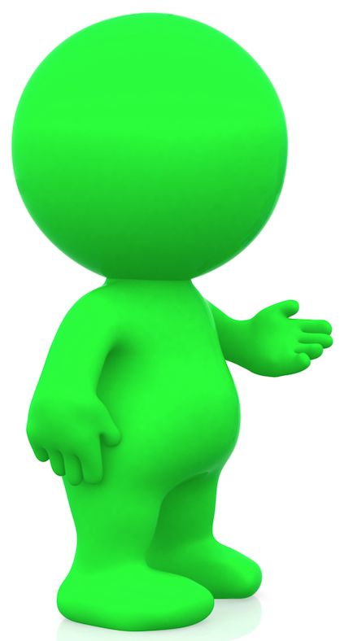
Counting and Cardinality
Instead of this... say that...

Slide 26
1 is the first number
Let’s start counting
with 1 (or 0)
Why this is important...
1 is not the first number.
The number line extends infinitely in both directions.
May cause confusion with understanding 0 and negative integers.
Numbers do not start at a particular place; we choose to start counting with 0, 1, or any other integer.
Notes:
Teachers can also use a number line that extends in both directions (even though you will not teach/count using negative integers)

Slide 27
...and the last one is 10
...8, 9, 10. We’ll stop counting there, but we could count more.
Why this is important...
Suggests that 10 is the final or highest number.
Provide opportunities to count beyond 10.
Use language that indicates there are numbers beyond 10, but 10 is the stopping point.

Slide 28
...7, 8, 9, and 10
...7, 8, 9, 10
Why this is important...
“And” suggests 10 is the highest or final number.
Only use “and” when referring to the decimal point:
132.8 is read as
“one hundred thirty-two and eight tenths.”
Notes:
These suggestions --- allow students to incorporate new, more complex understanding later on when it is developmentally appropriate

Slide 29
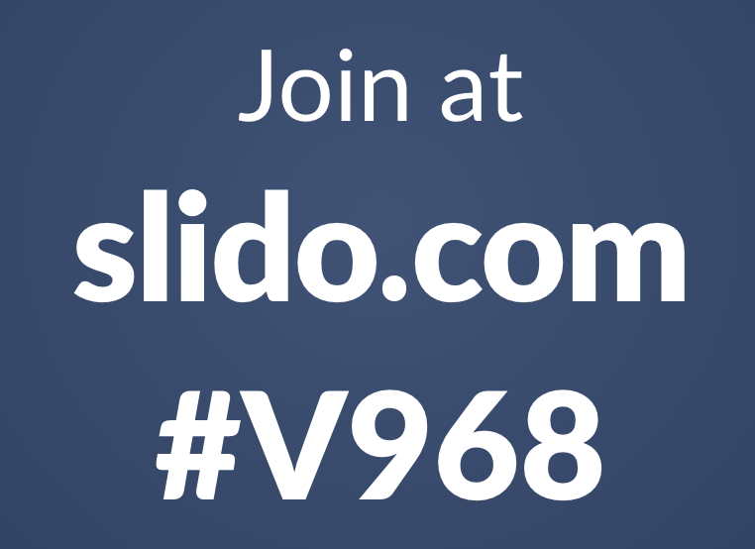
Notes:
These suggestions --- allow students to incorporate new, more complex understanding later on when it is developmentally appropriate

Slide 30
Whole Numbers
Instead of this... say that...

Slide 31
What number is in the tens place?
What digit is in the tens place?
What is the value of the
digit in the tens place?
135
Why this is important...
A number refers to the entire amount.
The 3 in the tens place value is not a number, but rather a digit in the number 135.
Reinforces conceptual understanding of place value.
Emphasizes that 3 is part of the number 135 with a value of 30.
Notes:
When teaching this domain, use language that supports place value understanding AND develops flexibility in mathematical thinking

Slide 32
The numbers you add
addends
Why this is important...
Students should also know:
Minuend, subtrahend, factors, dividend, and divisor.
Notes:
When teaching this domain, use language that supports place value understanding AND develops flexibility in mathematical thinking

Slide 33
answer
Sum, difference,
product, or quotient
Why this is important...
Students are regularly asked to use these formal terms.
This is especially important to be able to interpret word problems.
Notes:
When teaching this domain, use language that supports place value understanding AND develops flexibility in mathematical thinking

Slide 34
When adding, your answer is always bigger.
When subtracting, your answer is always smaller.
(Ask students to predict and reason.)
Why this is important...
These are rules that expire in later grade levels.
Leads to erroneous understanding of addition and subtraction.
-7 + 8 = 1
Notes:
When teaching this domain, use language that supports place value understanding AND develops flexibility in mathematical thinking

Slide 35
The equal sign means to write the answer.
The equal sign means the same as.
5 + 3 = 8
Why this is important...
Students may develop a habit (or a misunderstanding) that the equal sign means they should write an answer or compute.
Using ”the same as” reinforces the understanding that the quantities on both sides of the equal sign need to be the same.
Notes:
When teaching this domain, use language that supports place value understanding AND develops flexibility in mathematical thinking

Slide 36
carry OR borrow
regroup OR
trade OR
exchange
167
+ 294
Why this is important...
“Carry” or “borrow” is procedural.
The other terms reinforce the conceptual understanding or regrouping ones into tens, tens into hundreds, and so on (i.e., the total amount does not change) or ungrouping hundreds into tens, tens into ones, and so on.
Notes:
When teaching this domain, use language that supports place value understanding AND develops flexibility in mathematical thinking

Slide 37
Notes:
These suggestions --- allow students to incorporate new, more complex understanding later on when it is developmentally appropriate

Slide 38
Rational Numbers
Instead of this... say that...

Slide 39
top number and bottom number
numerator and denominator
Why this is important...
Identifying that there are two separate (whole) numbers suggests that whole number properties can be applied to fractions.
Emphasizing that a fraction is ONE number with ONE magnitude on a number line that is communicated with a numerator and denominator is important.

Slide 40
A fraction is always part of a whole.
part of a whole OR set OR group OR volume
2
5
Why this is important...
Fractions are more than just “part of a whole.”
It is important to include more than just pizza fractions and fraction rectangles.

Slide 41
reduce the fraction
rename OR
find equivalent OR
simplify
Why this is important...
Reducing suggests that the quantity or magnitude of the new number will be less than the original number.

Slide 42
Four point seven
Four point oh seven
Four and seven tenths
Four and seven hundredths
4.7
4.07
Why this is important...
Accurately shares the magnitude of the decimal.
Emphasizes place value.

Slide 43
Notes:
These suggestions --- allow students to incorporate new, more complex understanding later on when it is developmentally appropriate

Slide 44
Geometry
Instead of this... say that...

Slide 45
box OR ball
square OR
circle
Why this is important...
Use the formal language of shapes to confirm informal language.

Slide 46
corner
angle
Why this is important...
Reinforce that an angle is the space between two intersecting lines.

Slide 47
point
vertex
Why this is important...
This is the endpoint where two or more line segments or rays meet.

Slide 48
These are the same shape.
These shapes are congruent.
Why this is important...
“Same” is too vague.
”Congruent” should be used to describe similar shapes that are the same size.

Slide 49
flips, slides, turns
reflections, translations, rotations
Why this is important...
The informal language helps children remember the actions, but this vocabulary is not used on assessments.
Use the formal mathematical terms.

Slide 50
Notes:
These suggestions --- allow students to incorporate new, more complex understanding later on when it is developmentally appropriate

Slide 51
Measurement
Instead of this... say that...

Slide 52
long
length

Slide 53
tall
height

Slide 54
outside
surface area

Slide 55
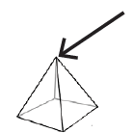
top
apex

Slide 56
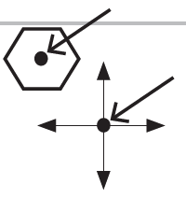
middle
apothem
origin

Slide 57
Notes:
These suggestions --- allow students to incorporate new, more complex understanding later on when it is developmentally appropriate

Slide 59
http://journals.sagepub.com/doi/full/10.1177/0040059916654901

Slide 60
Use formal math language
Use terms precisely

Slide 62
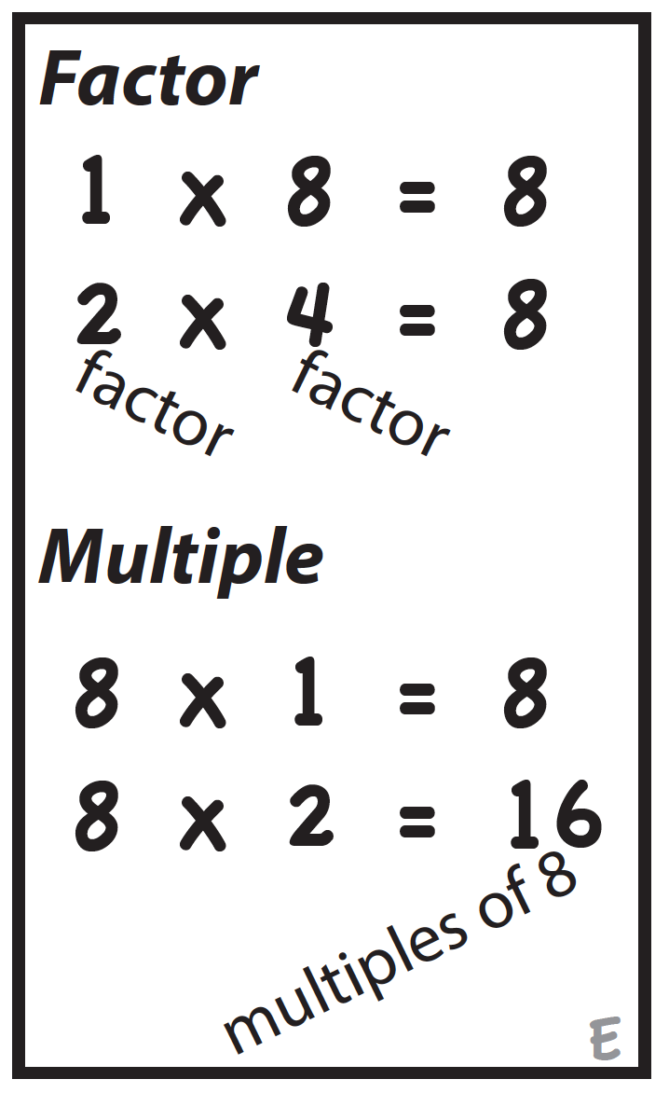
Terms Require Specificity
Rubenstein & Thompson (2002)

Slide 63
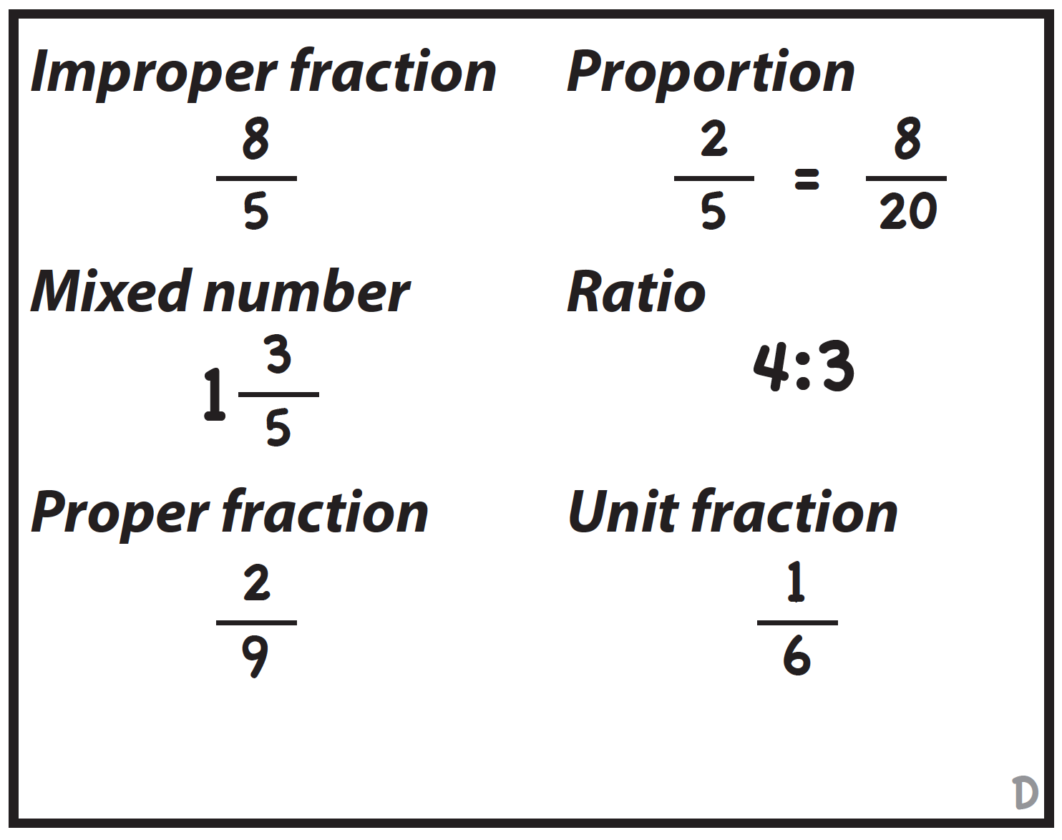
Terms Require Specificity
Rubenstein & Thompson (2002)

Slide 64
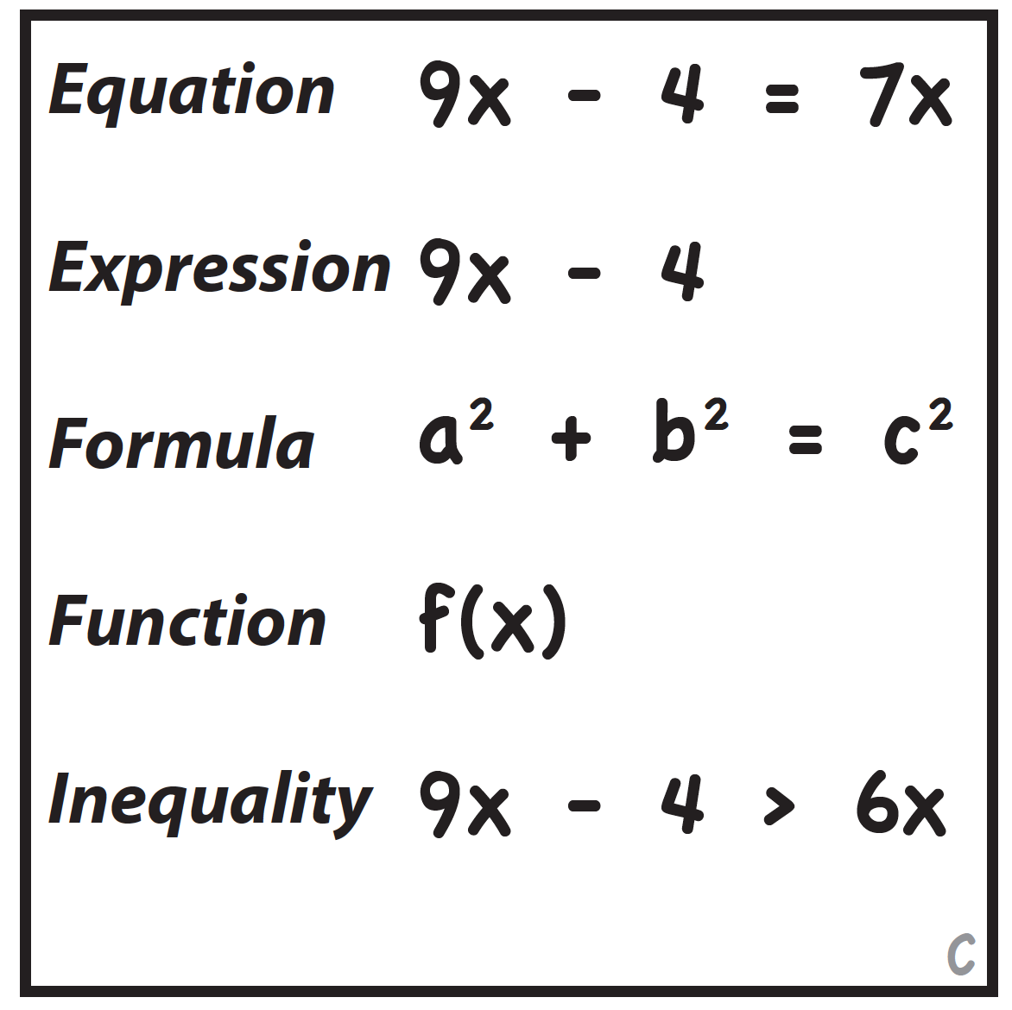
Terms Require Specificity
Rubenstein & Thompson (2002)

Slide 65
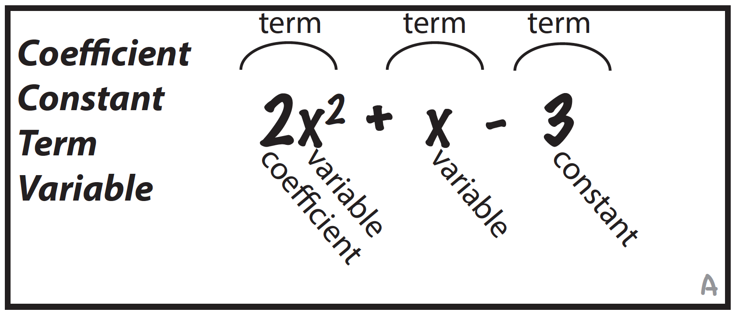
Terms Require Specificity
Rubenstein & Thompson (2002)

Slide 66
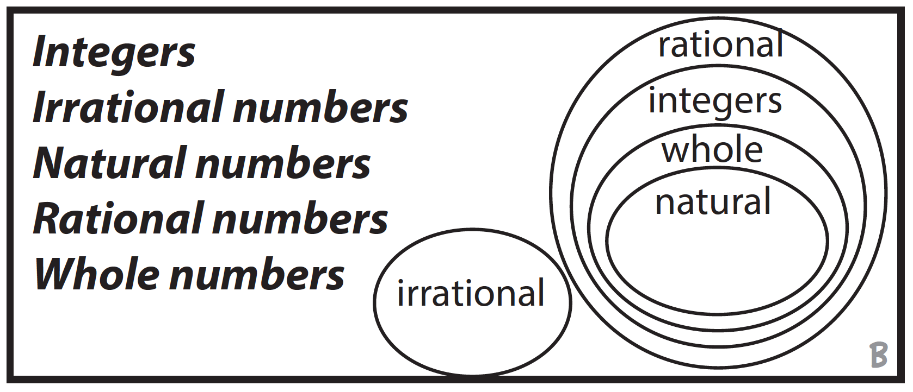
Terms Require Specificity
Rubenstein & Thompson (2002)

Slide 67
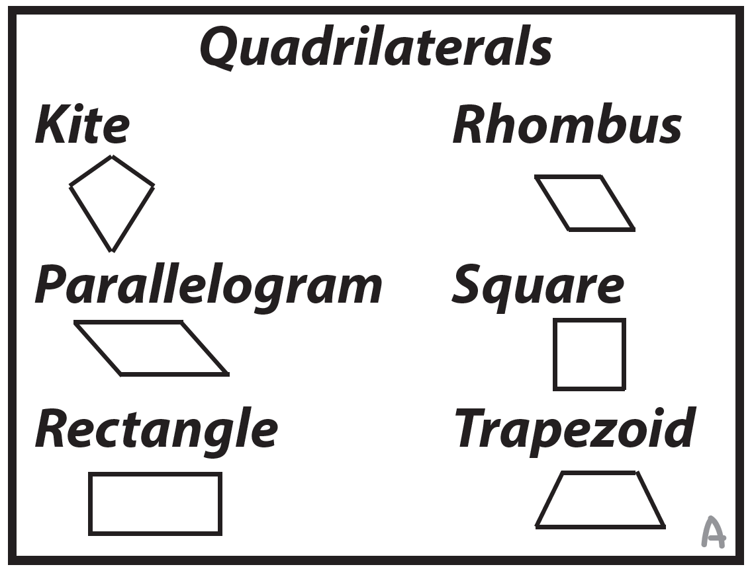
Terms Require Specificity
Rubenstein & Thompson (2002)

Slide 68
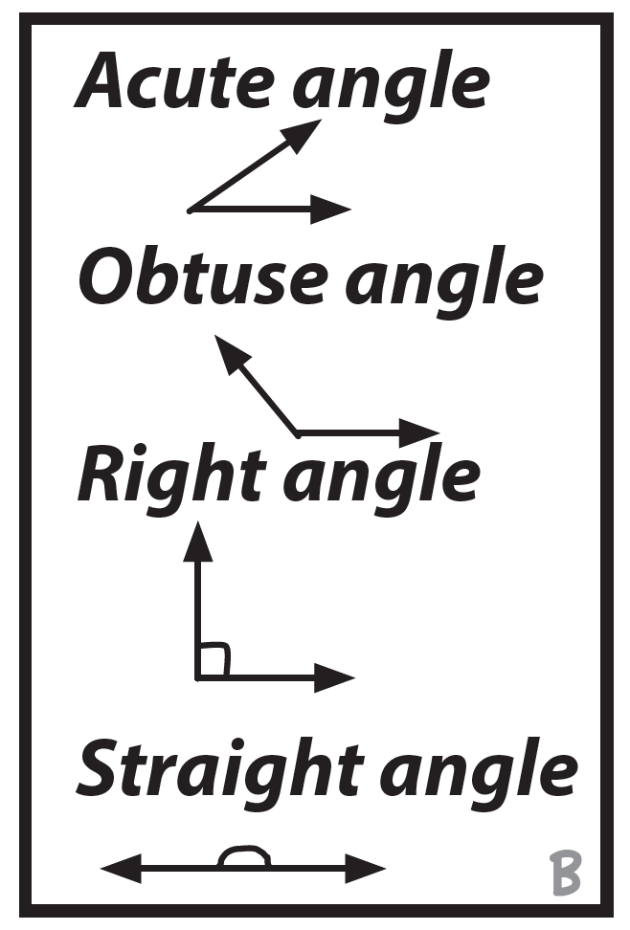
Terms Require Specificity
Rubenstein & Thompson (2002)

Slide 69
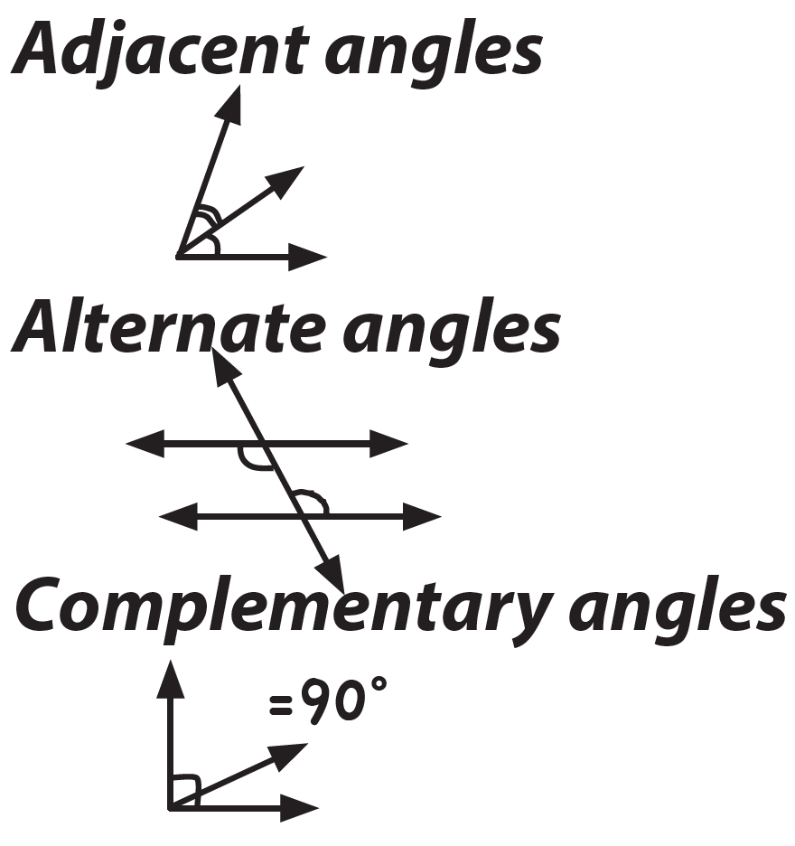
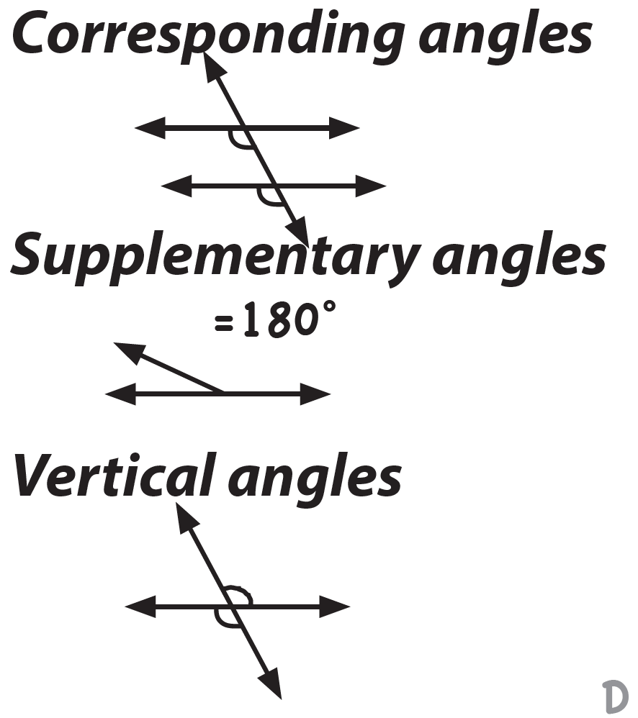
Terms Require Specificity
Rubenstein & Thompson (2002)

Slide 70
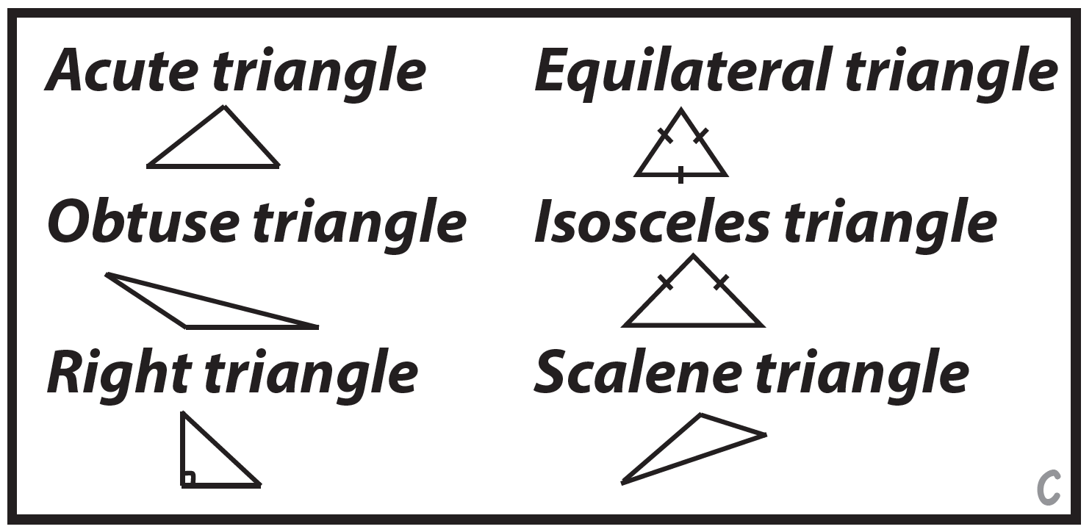
Terms Require Specificity
Rubenstein & Thompson (2002)

Slide 71
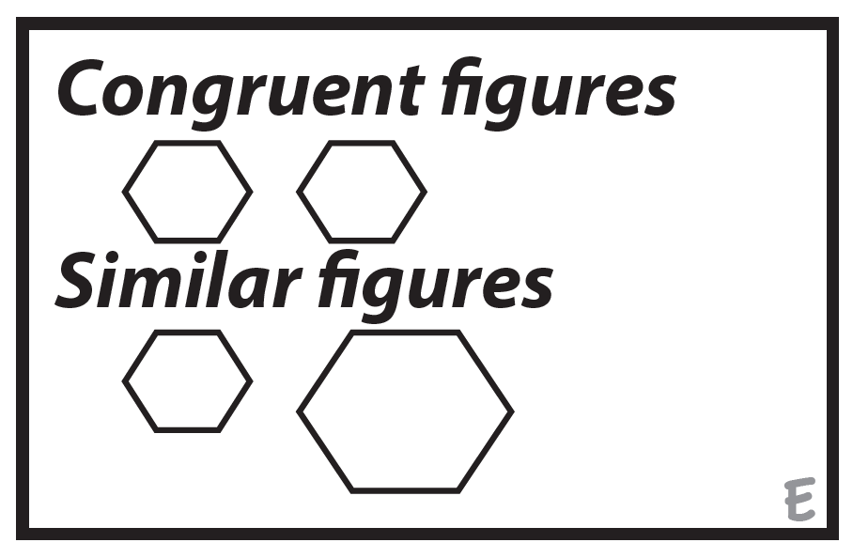
Terms Require Specificity
Rubenstein & Thompson (2002)

Slide 72
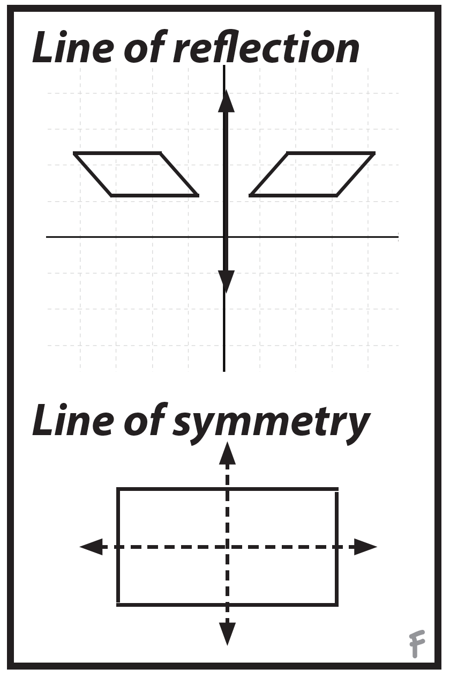
Terms Require Specificity
Rubenstein & Thompson (2002)

Slide 73
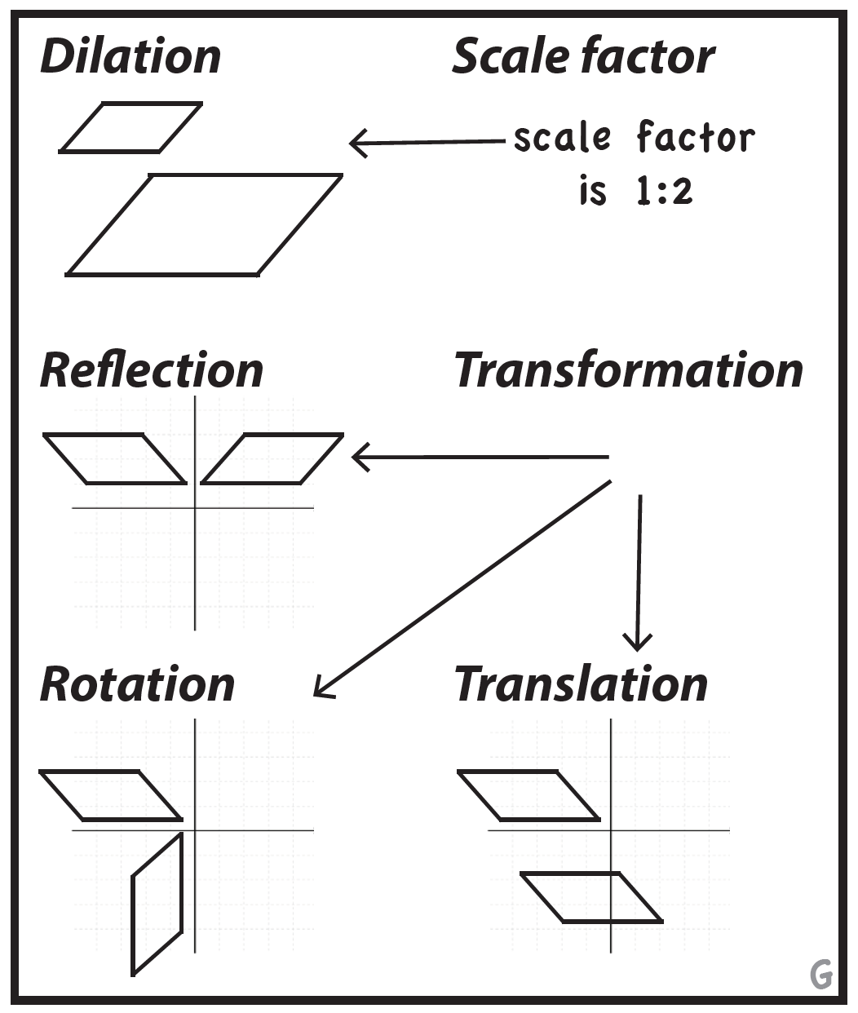
Terms Require Specificity
Rubenstein & Thompson (2002)

Slide 74
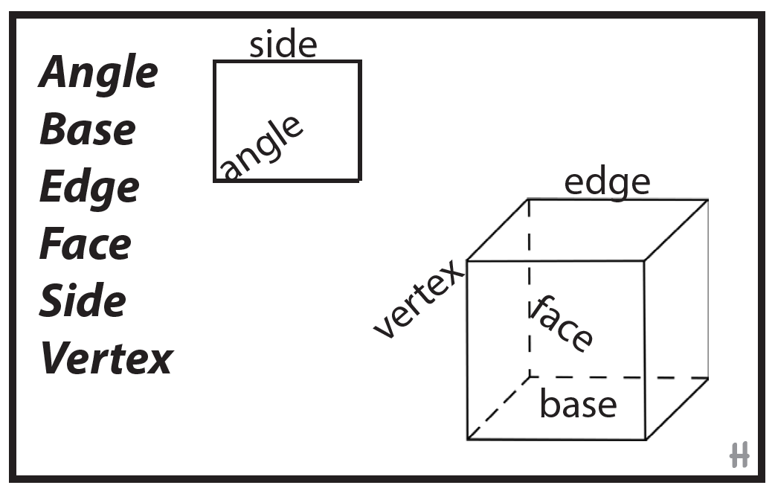
Terms Require Specificity
Rubenstein & Thompson (2002)

Slide 75
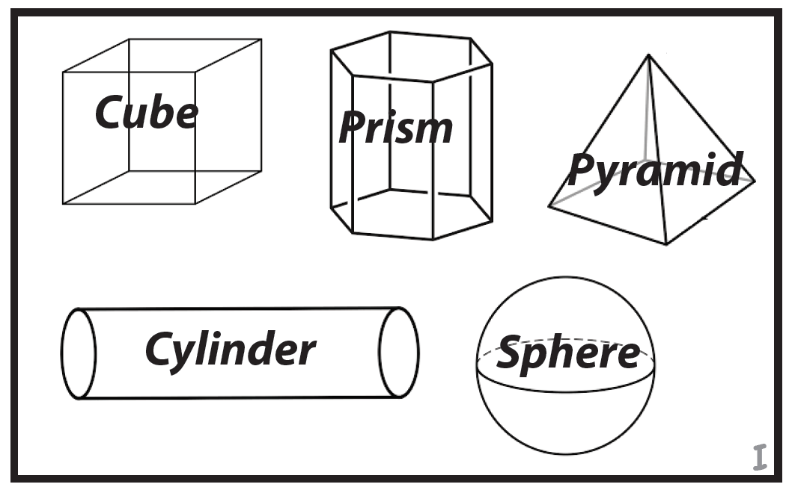
Terms Require Specificity
Rubenstein & Thompson (2002)

Slide 76
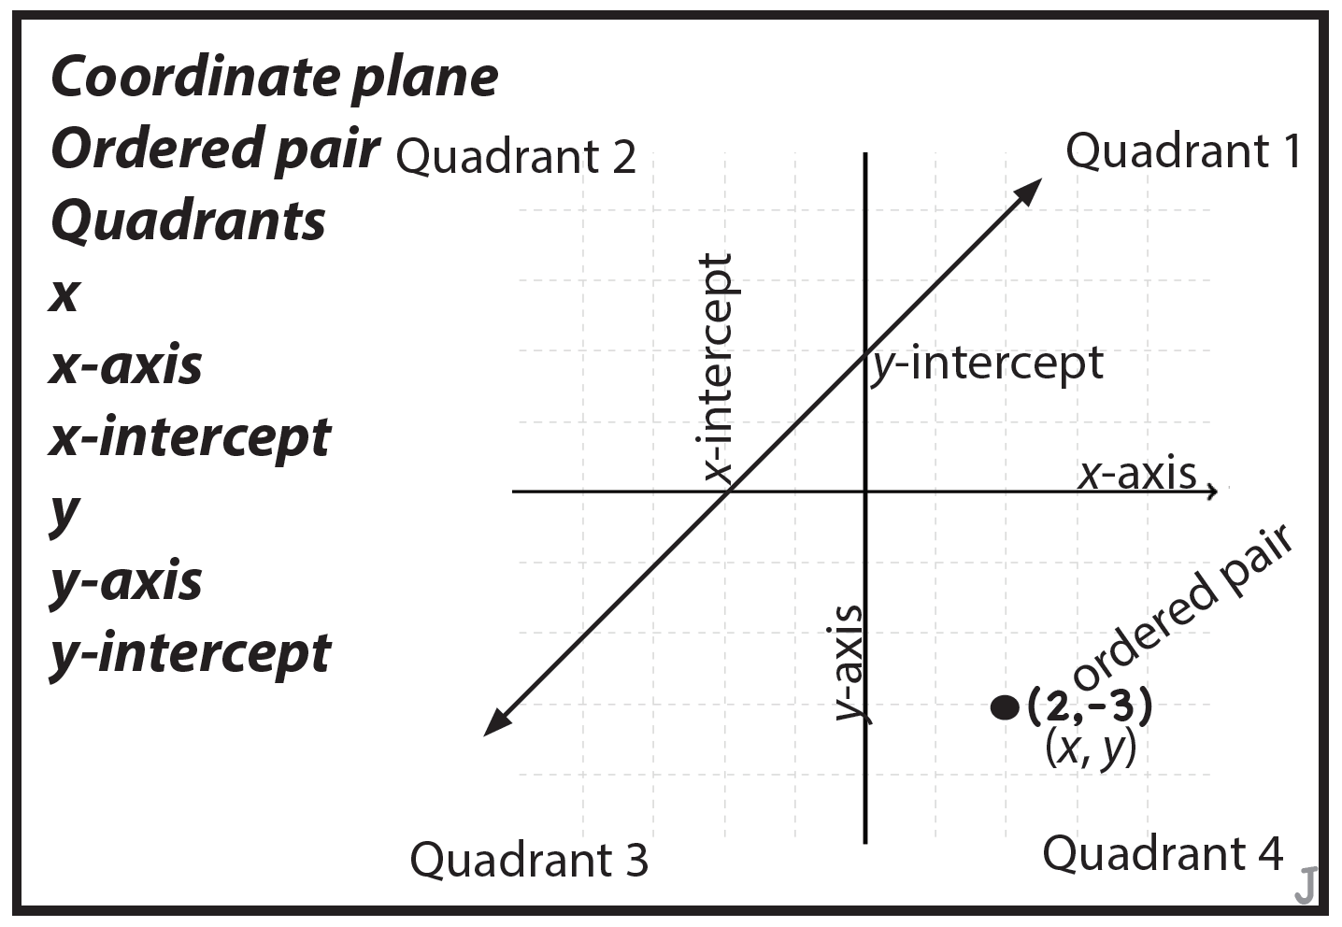
Terms Require Specificity
Rubenstein & Thompson (2002)

Slide 77
Use formal math language
Use terms precisely

Slide 79
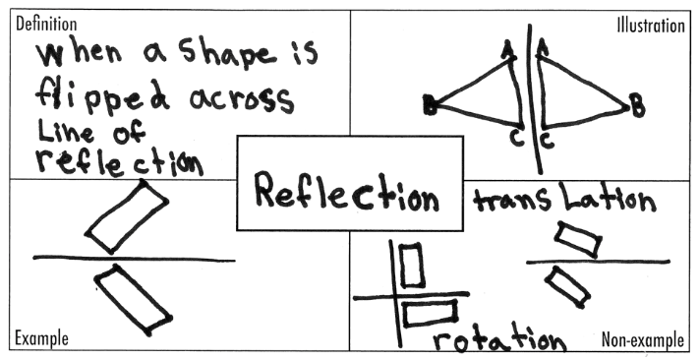
Suggestions for Instruction
MATH JOURNAL

Slide 80
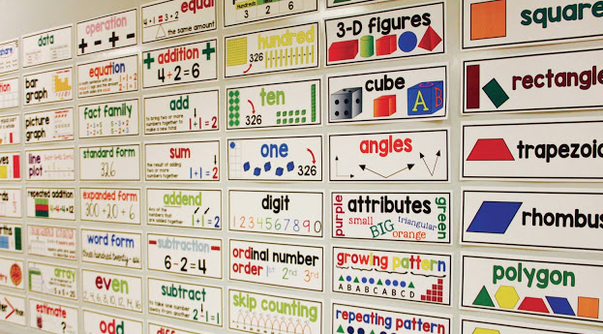
Suggestions for Instruction
http://www.starrspangledplanner.com/math-word-walls/

Slide 81
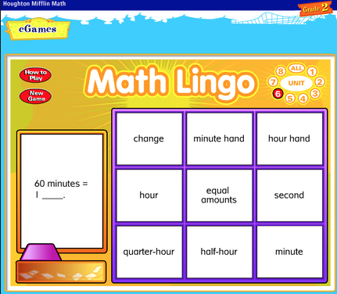
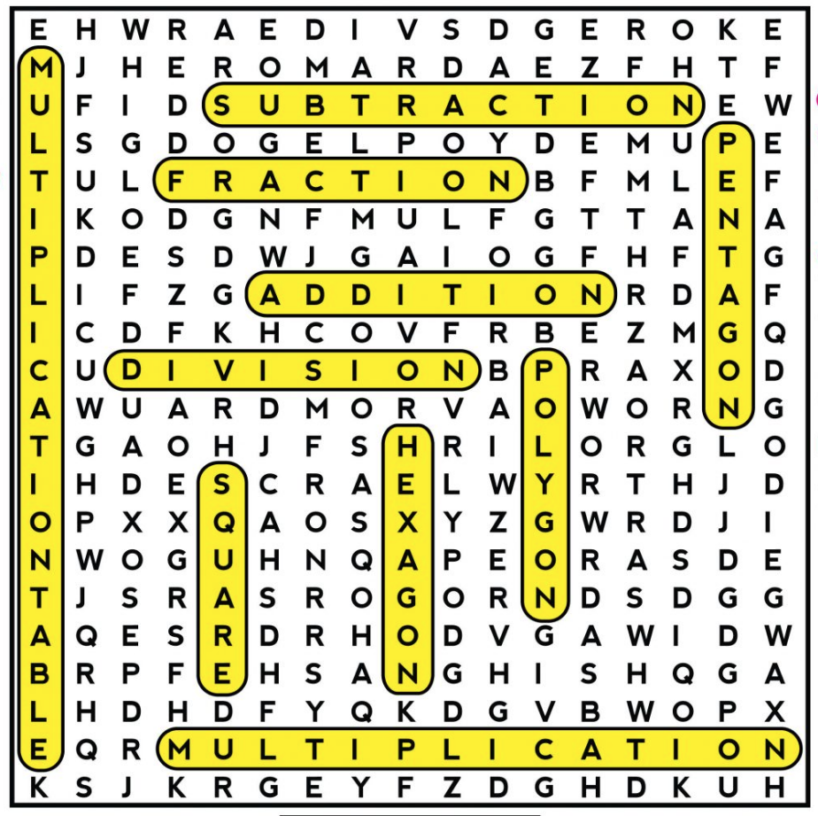
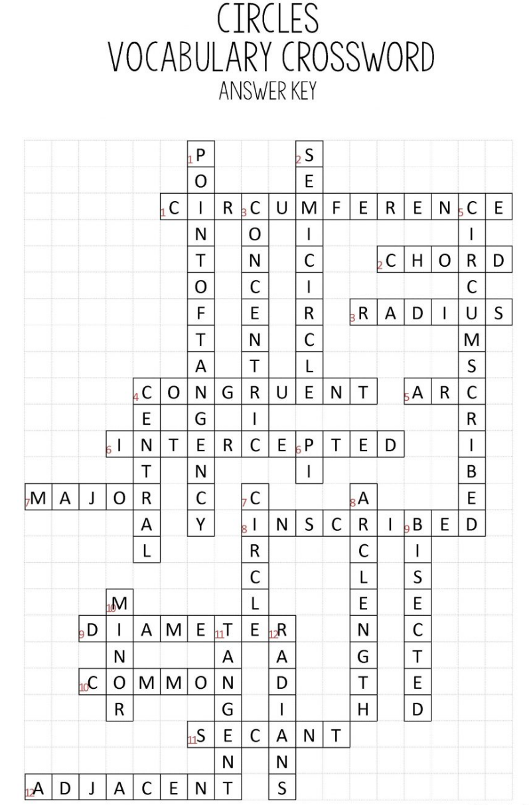
Suggestions for Instruction
www.catherinecrabill.com

Slide 82
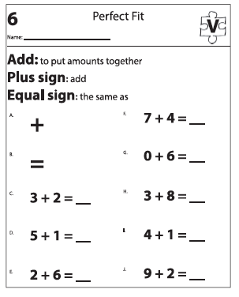
Suggestions for Instruction
Powell & Driver (2015)

Slide 83
Suggestions for Instruction
Listening
Speaking
Reading
Writing

Slide 84
Use formal math language
Use terms precisely

Slide 85
Thank you!
Sarah R. Powell
srpowell@austin.utexas.edu
@sarahpowellphd
www.sarahpowellphd.com

