Slide 1
Emergency Medical Responder
Chapin Area Rescue Squad

Slide 2
Chapter 5: Human Body

Slide 3
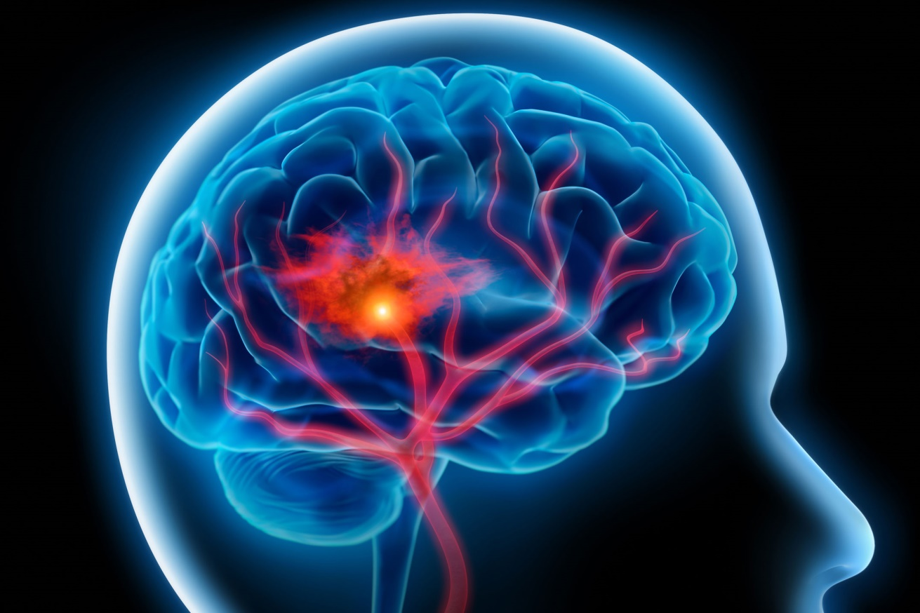
Objectives
Gain an understanding of the following:
Upper Airway
Heart
Vessels
Blood
Lungs
Skin
Muscles
Bones

Slide 4
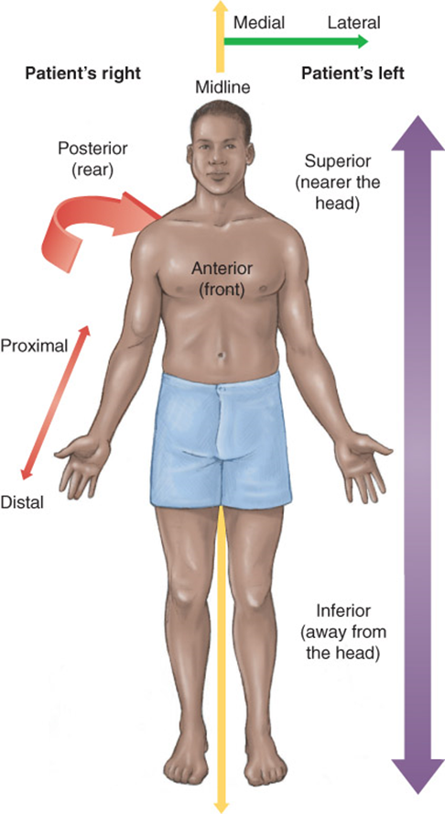
Introduction
The standard anatomic position is a person standing and facing you, with arms at the sides and thumbs pointing outward.
Anterior is the front surface of the body.
Posterior is the back surface of the body.
The midline refers to an imaginary vertical line drawn from head to toe that separates the body into a left half and a right half.

Slide 5
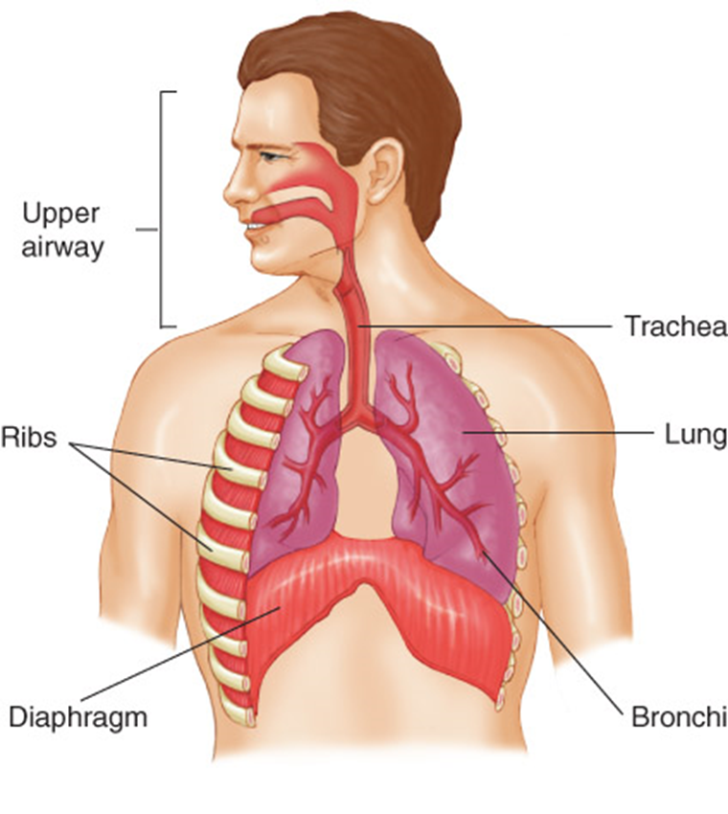
Respiratory System
Brings oxygen into the body and removes the waste gas, carbon dioxide
Structures include:
Upper airway
Trachea
Lungs
Ribs
Bronchi
Diaphragm

Slide 6
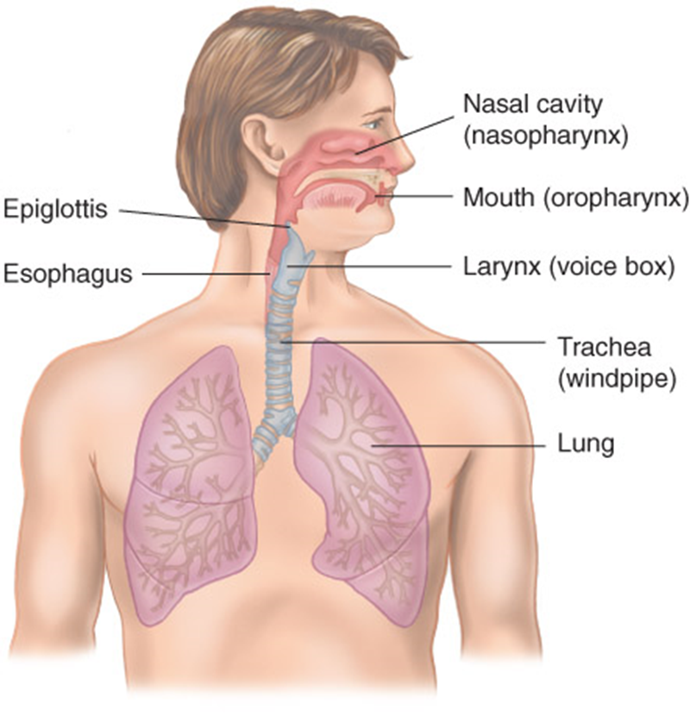
Respiratory System
The airway consists of the:
Nose (nasopharnyx)
Mouth (oropharynx)
Throat
Larynx (voicebox)
Trachea (windpipe)
Passages within the lungs

Slide 7
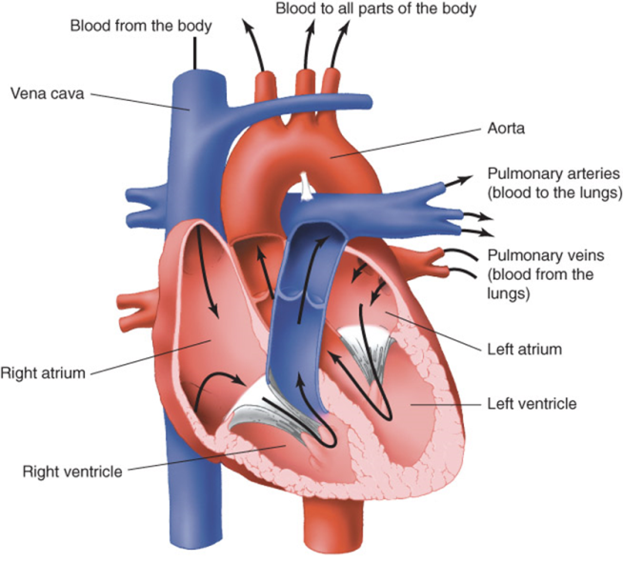
Circulatory System
Includes Heart, Blood, and Vessels
Flow of blood
Blood picks up oxygen in the lungs and goes to the heart.
The heart pumps it to the rest of the body.
The cells absorb oxygen and nutrients from the blood and release waste products.
Blood carries the waste back to the lungs and kidneys.
In the lungs, the blood exchanges the carbon dioxide for more oxygen.

Slide 8
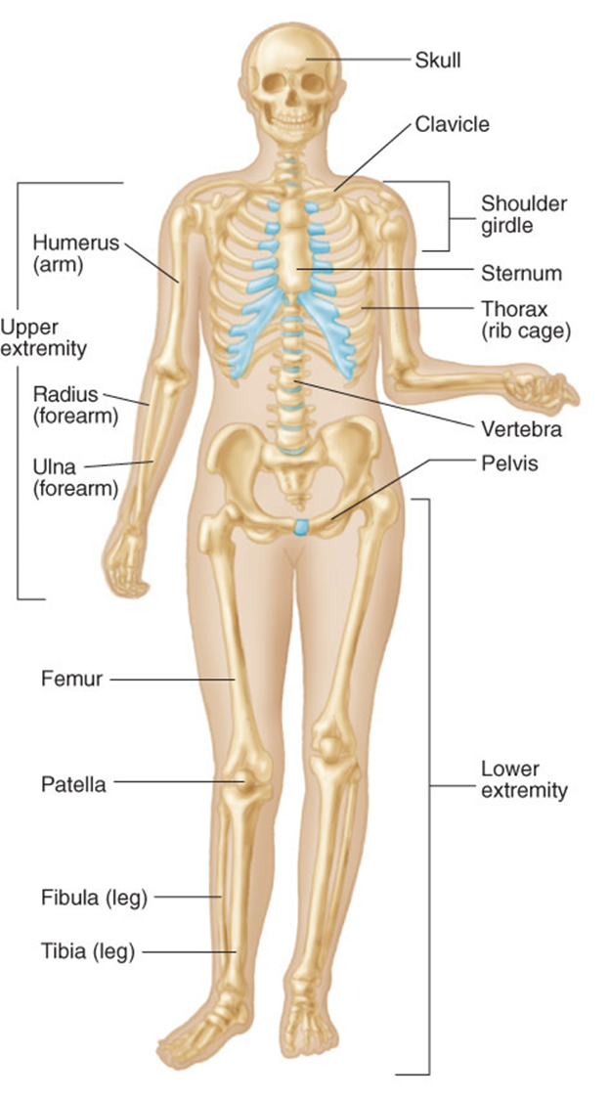
Skeletal System
The skeletal system consists of bones and is the supporting framework for the body.
It has three major functions:
To support the body
To protect vital structures
To manufacture red blood cells

Slide 9
Muscular System
Voluntary muscles move our bodies
Smooth muscles carry out automatic functions.
Also called involuntary muscles
Cardiac muscle is found only in the heart.

Slide 10
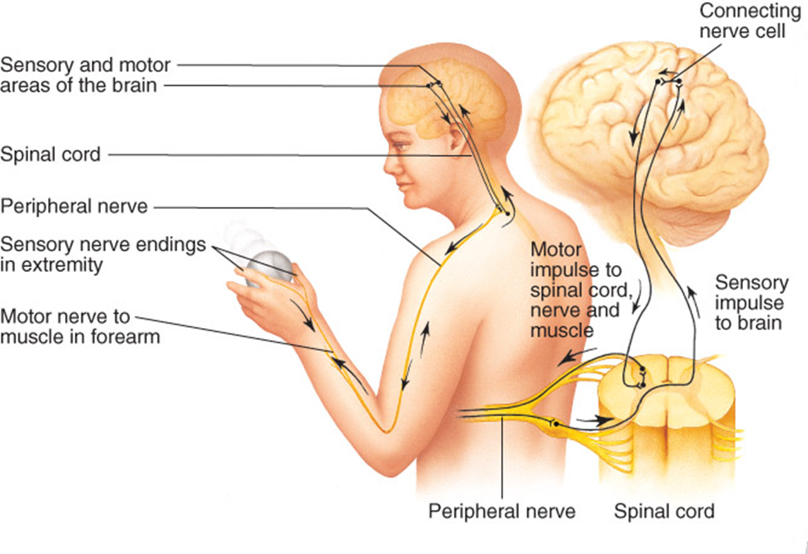
Nervous System
Governs the body’s functioning
Consists of the brain, the spinal cord, and the individual nerves that extend throughout the body

Slide 11
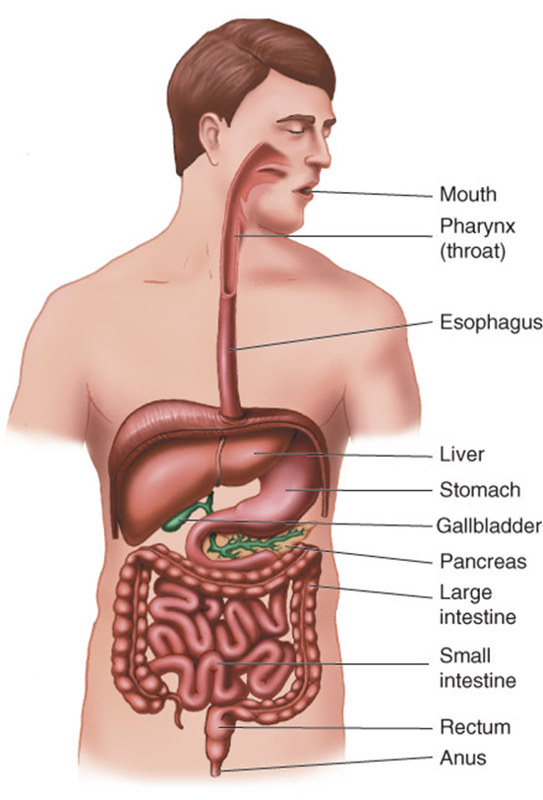
Digestive System
Breaks down food into a form that can be carried by the circulatory system to the cells of the body
Food that is not used is eliminated as solid waste.
Major organs of the digestive system are located in the abdomen.

Slide 12
Genitourinary System
The removal of waste products begins in the kidneys, which filter the blood to form urine.
The urine flows down from the kidneys through tubes (ureters) into the bladder.
The bladder collects and stores the urine before it passes out of the body through the urethra
Reproduction organs

Slide 13
Vital Signs and Development
Most commonly measured vital signs:
Pulse (heart rate)
Respiration rate
Blood pressure
Normal vital signs change with age.
Normal pulse and respiratory rates decrease.
Systolic blood pressure increases.

Slide 14
Review
Throughout a person’s life, the body changes constantly.
In an infant, the airway is very small and is easily obstructed by swelling or objects.
Because toddlers have poor coordination and balance, they are at high risk for falls.
School-aged children are physically active and prone to injuries from bicycle riding and other athletic mishaps.
Adolescents do not fully understand the consequences of dangerous actions.
Early adulthood is the period when most body systems are fully developed.
Middle adulthood is generally the time when body systems start to decline.
During late adulthood, these declines become more pronounced.

