Slide 1

PAULOWNIA PRIMED WOOD TRIM & PATTERN
SANTIAM LUMBER SALES

Slide 2
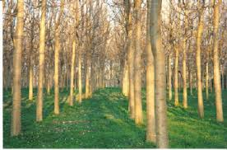
PLANTATION GROWN

Slide 3

Paulownia-A Soft Hardwood
Paulownia - A Soft Hardwood
General Characteristics | Product Offered
Wood Structure | Boards & Dimension
Wood Properties | Pattern Stock
Wood Utilization/Uses | Bevel Sidings
Summary of Benefit | Plant Processing

Slide 4
General Characteristic
Paulownia is a soft hardwood native to China. The heartwood is light in color and the sapwood even lighter. Color differential between the two is not distinct. The wood is without odor or taste and is mostly free from knots. Planed or sanded, it has the feel of spun silk.
Wood Structure
The demarcation between heartwood and sapwood is not clear and the wood is straight grained and lustrous.
Wood Properties
Paulownia is comparatively soft and light in weight for a hardwood. Physical weight is slightly less than kiln dried western red cedar. It is low in overall strength, but has a high strength to weight ratio. The shrinkage coefficient is smaller than most commercially harvested coniferous and broad leaf woods. The wood dries rapidly and does not easily warp, cup, end check,

Slide 5
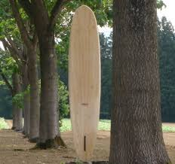
PAULOWINA
splinter or split. Movement in service is rated as small.
Paulownia has one of the lowest thermal conductivity values of any wood; therefore the wood has very high insulation properties. Low thermal conductivity contributes to the low shrinkage in use.
Compared to most woods, Paulownia has a high resistance to fire and flames and a higher ignition/flash point.
Paulownia is naturally decay resistant and any rot is generally superficial. The wood is also naturally resistant to insect attack.
Paulownia has no measurable pitch, resin or tannins so it is not subject to extractive bleeding.

Slide 6
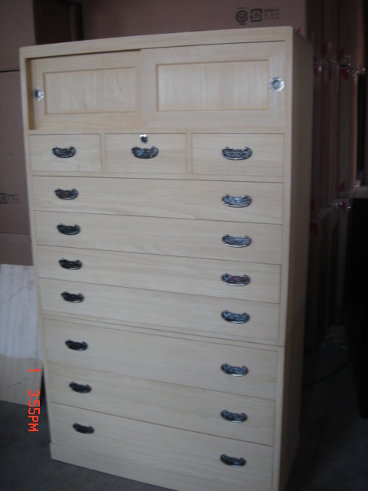
All types of usage
Working Properties
Paulownia is easy to work using hand or machine tools. It is easy to plane, sand, saw, rip, route, and carve, and even during quick processing there is no danger of splitting or chipping. It easily absorbs glue, paint and stains.

Slide 7
Wood Utilization/Uses - Exterior/Interior Trim Boards - Exterior/Interior Pattern Stock - Paneling/Siding - Box Columns - Extension Jambs/Flat Jambs - Millwork | Summary of Benefits - Mostly Plantation Grown - Dimensionally Stable - Low Shrinkage Coefficient - Light Physical Weight - High Strength to Weight Ratio - High Insulation Properties - High Fire and Ignition Resistance - Low Thermal Conductivity - Contains No Measurable Tannins, Resin or Pitch - Easy to Nail, Screw or Staple - Light Color - Straight Grain - Easy to Work with All Tools - Easy to Handle - Easy to Glue, Stain and Paint - Naturally Rot, Decay and Insect Resistant - Glossy, Lustrous Finish

Slide 8
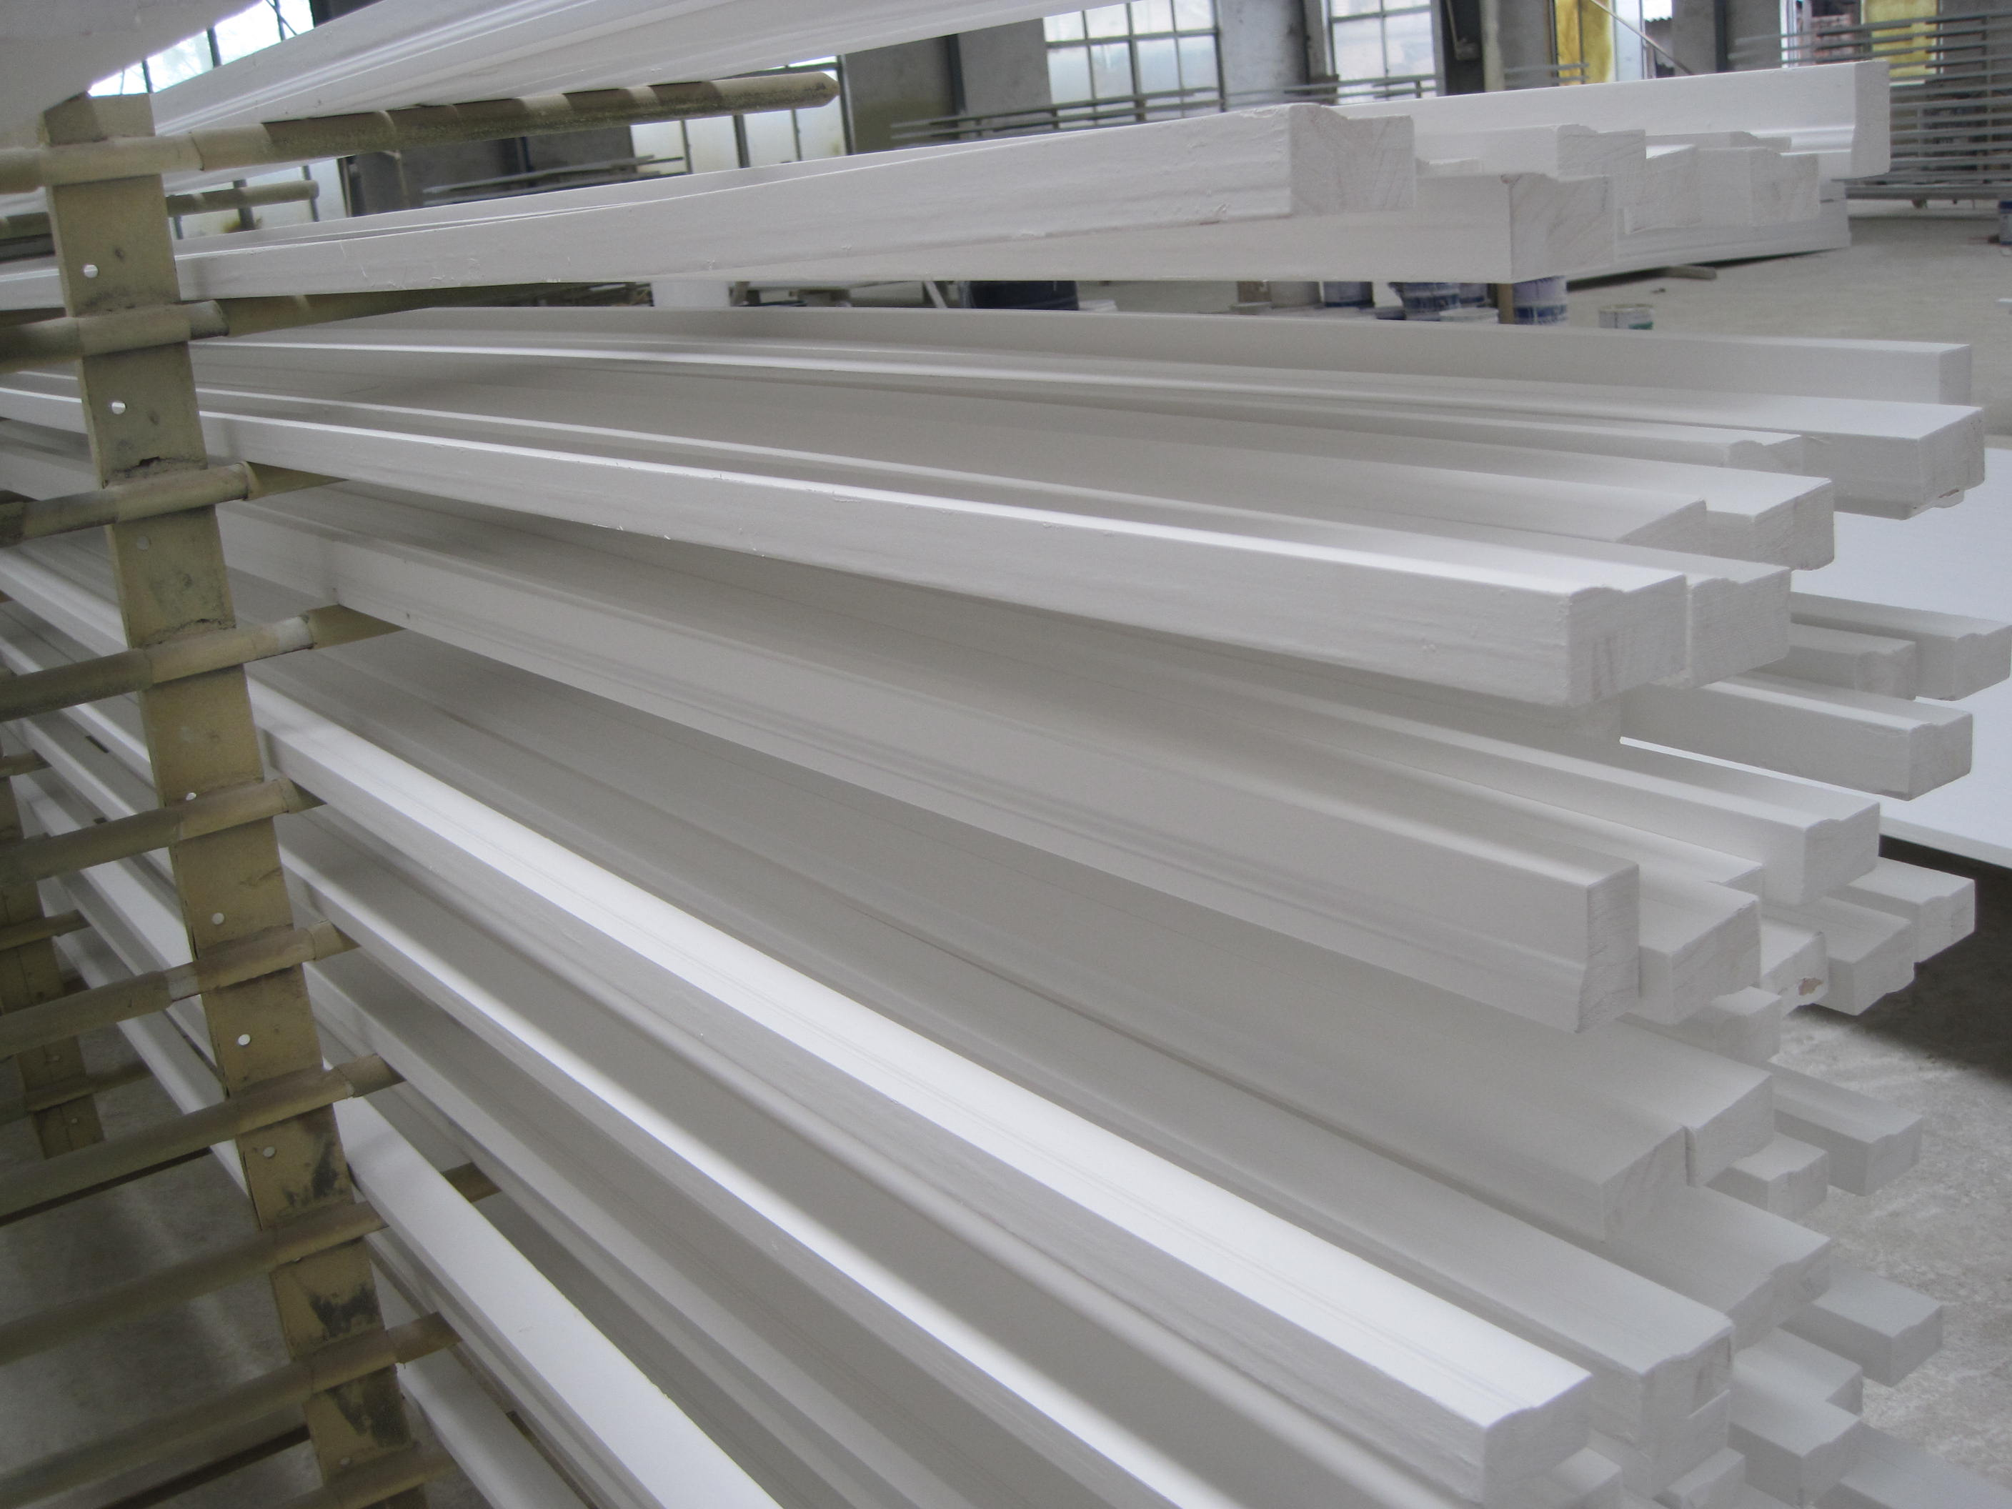
Products Offered
offers a wide range of primed products made of Paulownia Sherwin-Williams Primer Optional.
All Paulownia products are standard 16' Lengths. 18' & 20' & custom lengths available.

Slide 9
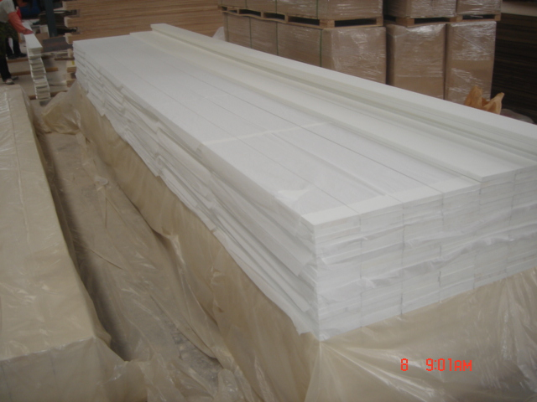
Boards & Dimension
Kiln Dried S4S or S1S2E Square or Eased Edge FJ and or FJ/EG Exterior Waterproof Glue Exterior Oil Base Spray Primed 4 Sides & Both Ends 180 Grit Sanded 4 Sides After Priming One or Two Coat Primed Standard ALS Widths-Custom Thickness & Widths Available Fully Reversible

Slide 10
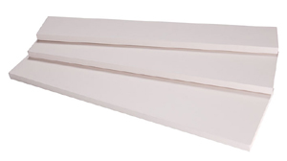
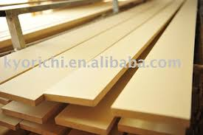
Primed boards
Standard Product Line:
4/4 (11/16") - 1 x 2, 1 x 3, 1 x 4, 1 x 5, 1 x 6, 1 x 8, 1 x 10 & 1 x 12 4/4 (3/4") - 1 x 2, 1 x 3, 1 x 4, 1 x 5, 1 x 6, 1 x 8, 1 x 10 & 1 x 12 5/4 (1 1/8") -5/4 x 3, 5/4 x 4, 5/4 x 5, 5/4 x 6, 5/4 x 8, 5/4 x 10 & 5/4 x 12 8/4 (1 1/2") - 2 x 2, 2 x 4, 2 x 6, 2 x 8, 2 x 10 & 2 x 12

Slide 11
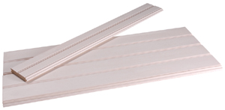
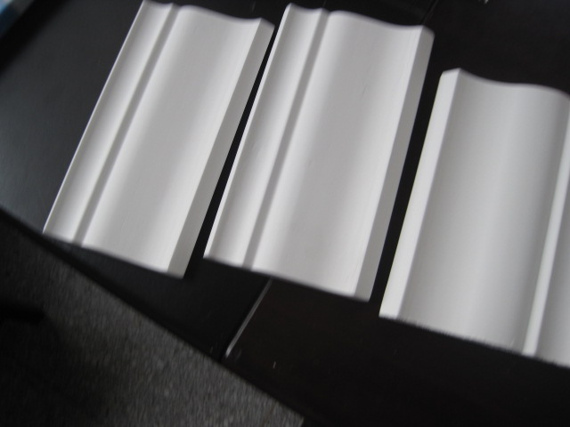
Pattern stock
Pattern Stock
Kiln Dried S4S - Square Edge S2S - tongue and groove FJ and or FJ/EG Exterior Waterproof Glue Exterior Oil Base Spray Primed 4 Sides & Both Ends 180 Grit Sanded 4 Sides After Priming One or Two Coat Primed Fully Reversible

Slide 12
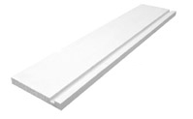
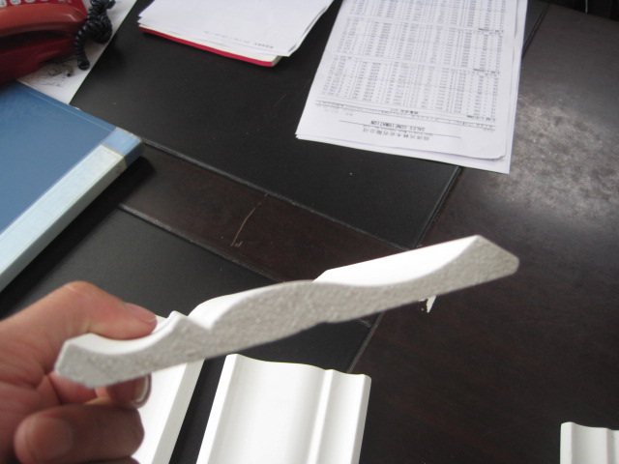
Stocking patterns
Standard Product Line:
1 x 4 & 1 x 6 T & G Beaded Ceiling - EB & CB/V2E 1 x 6 & 1 x 8 Plowed for Soffit Custom Patterns Available

Slide 13
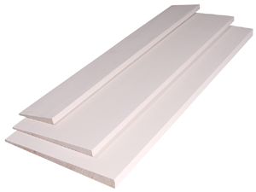
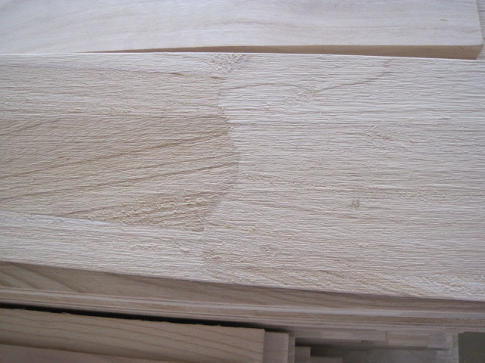
Bevel stock
Bevel Sidings
Kiln Dried Smooth Face/Re-Sawn Face Eased Edges & Tip FJ and or FJ/EG Exterior Waterproof Glue Exterior Oil Base Spray Primed 4 Sides & Both Ends 180 Grit Sanded 3 Sides After Priming One or Two Coat Primed Fully Reversible
Standard Product Line:
 | 1/2 x 4, 1/2 x 6 & 1/2 x 8 11/16x 6, 11/16x 8 & 11/16 x 10 3/4 x 8 & 3/4 x 10 5/8 x 6, 5/8 x 8 & 5/8 x 10 Custom Sidings Available

Slide 14
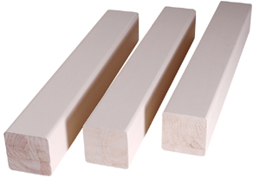
Timbers
Timbers
Kiln Dried S4S Square or Eased Edge FJ and or FJ/EG Exterior Waterproof Glue Exterior Oil Base Spray Primed 4 Sides & Both Ends 180 Grit Sanded 4 Sides After Priming One or Two Coat Primed
Standard Product Line:
 | 4 x 4 Custom Sizes Available

Slide 15
PAULOWNIA lightweight-stable decay&insect resistance

Slide 16
Protect your best investment

Slide 17
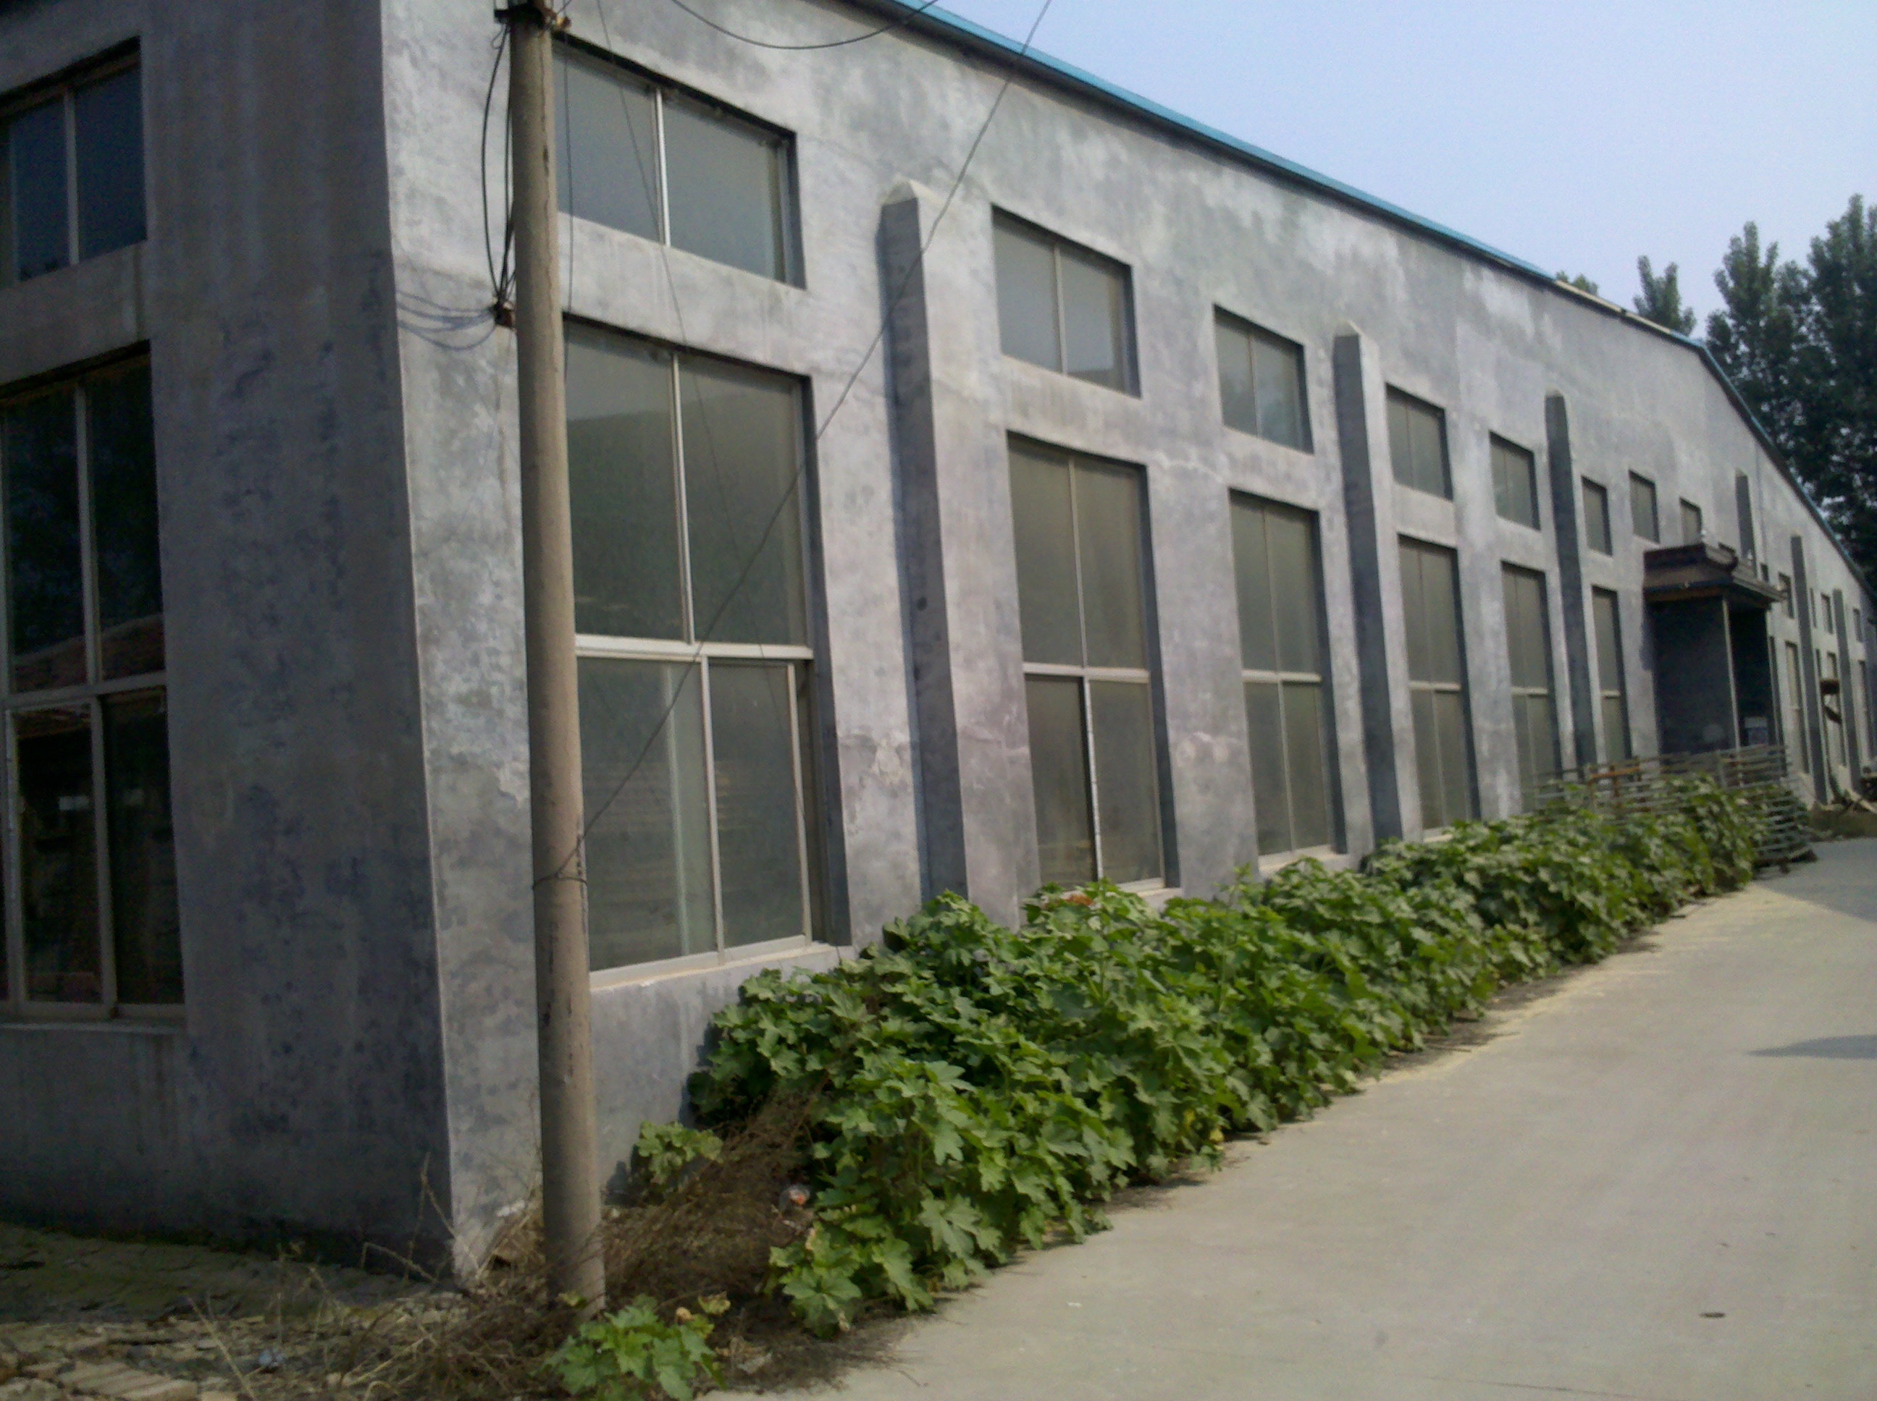
TRIP THOUGH THE PLANT

Slide 18
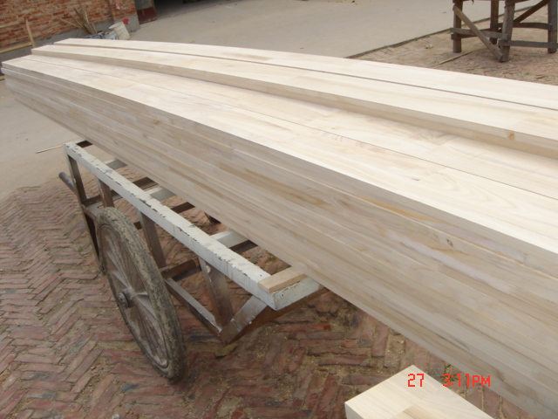
Paulownia blanks

Slide 19
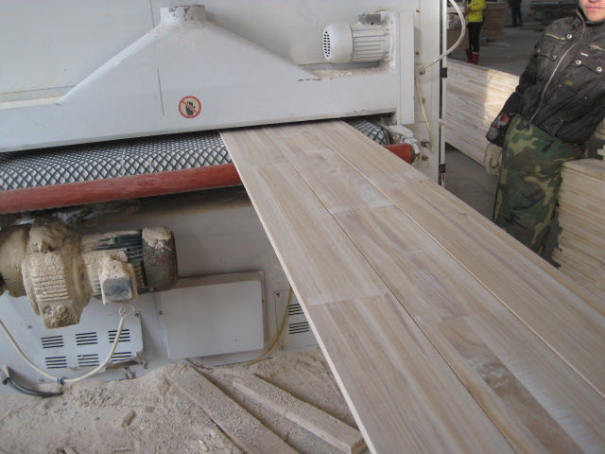
Paulownia being planned

Slide 20
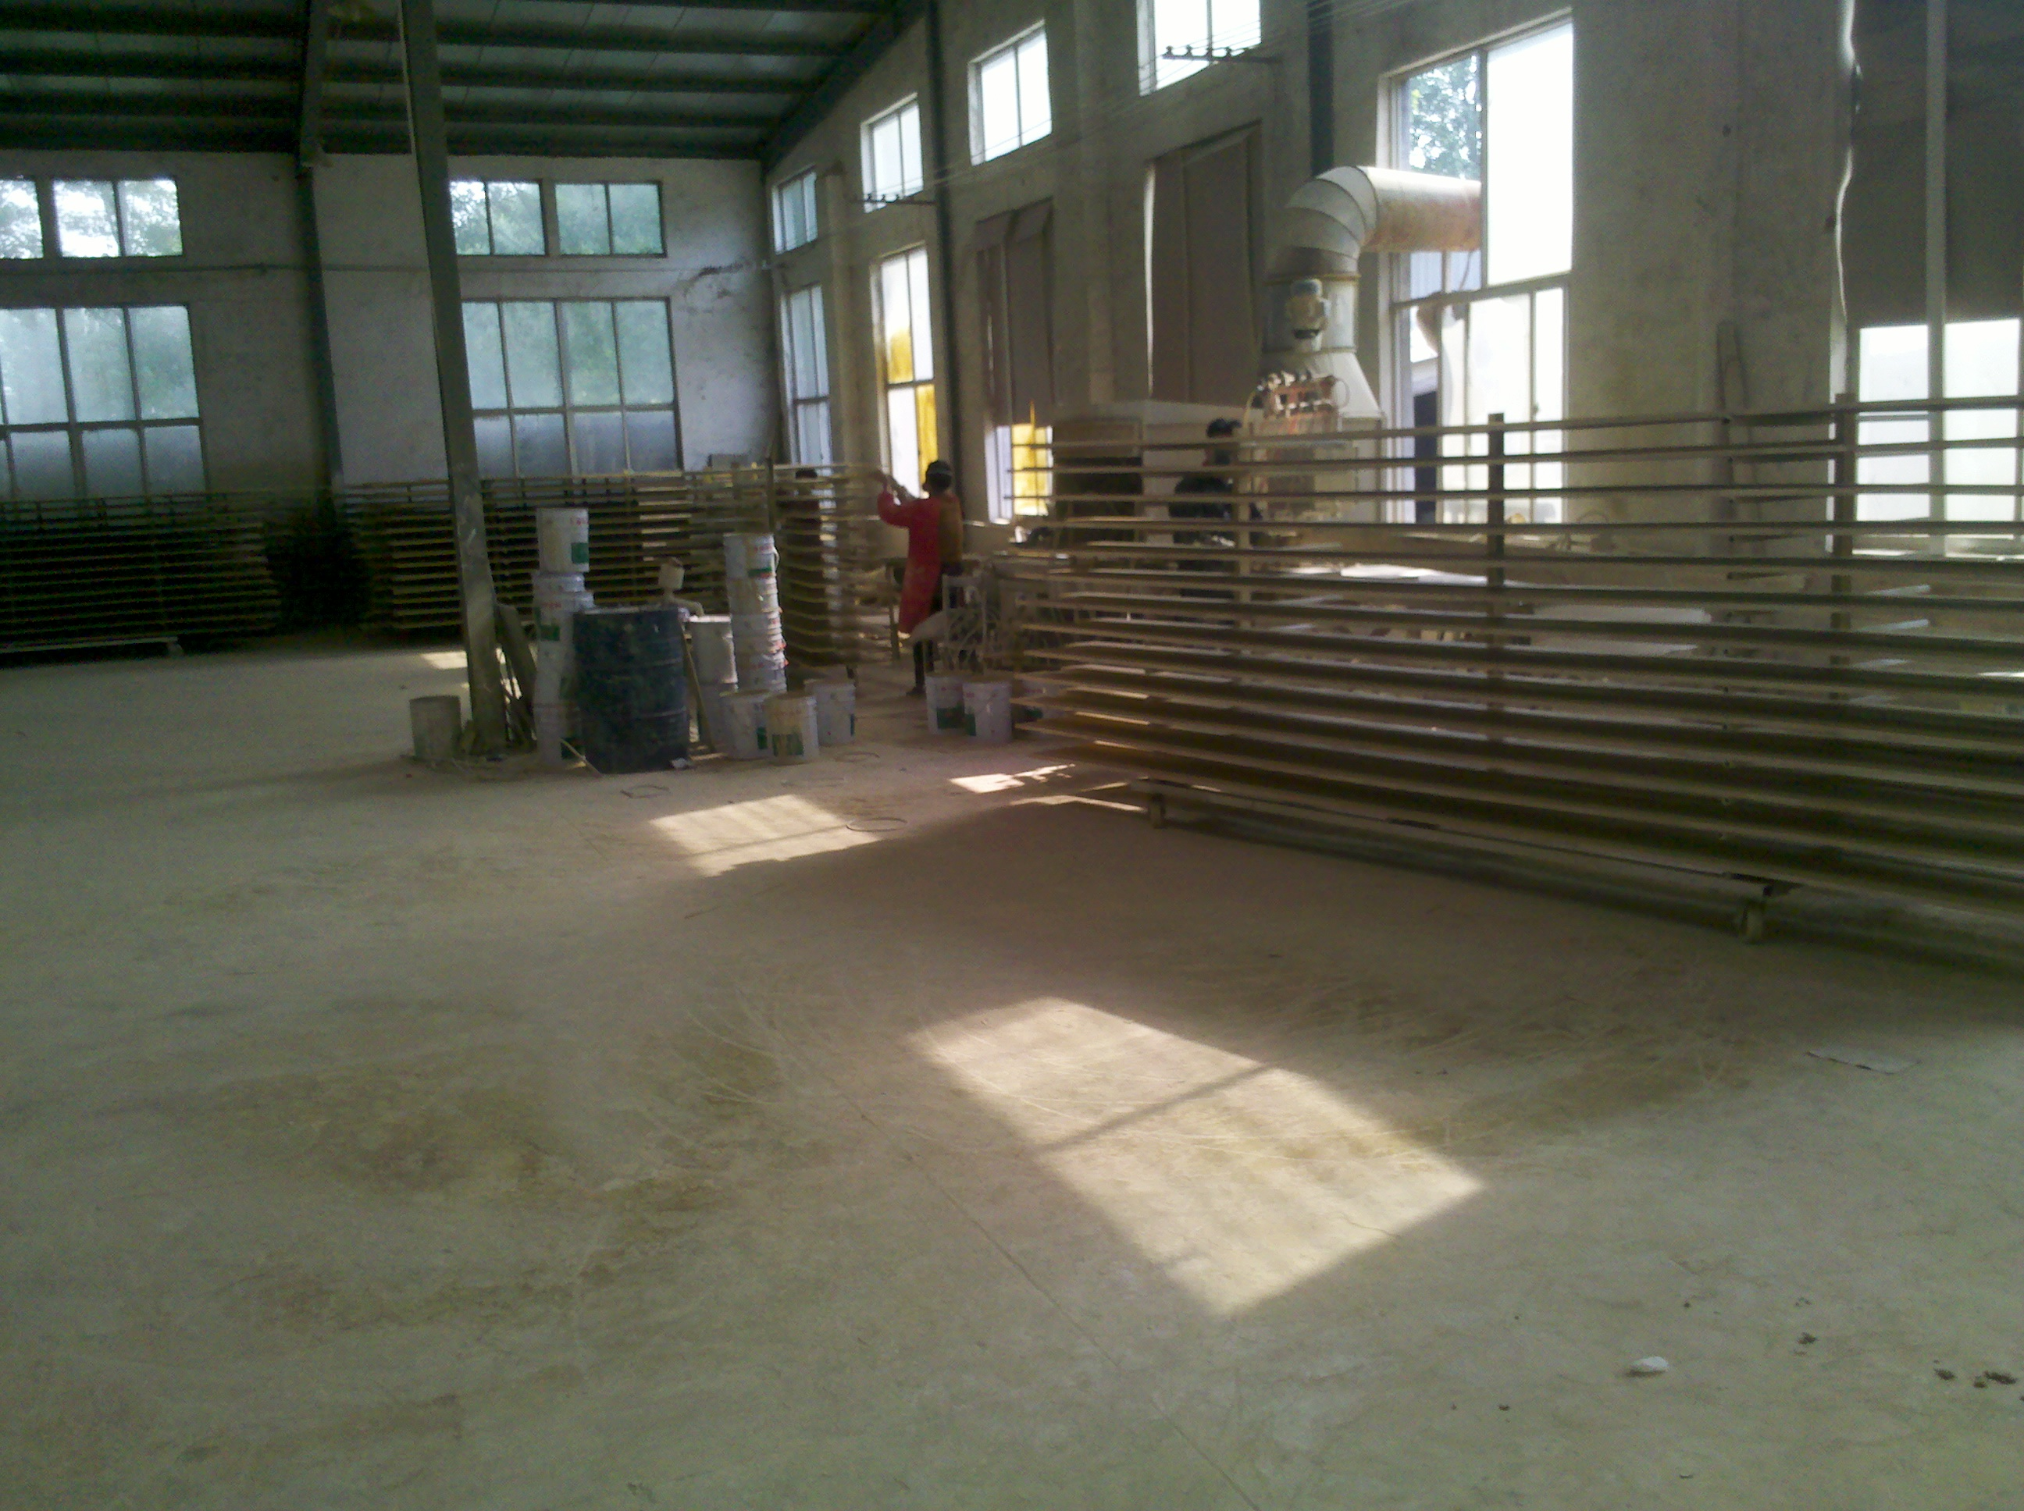
Product being primed

Slide 21
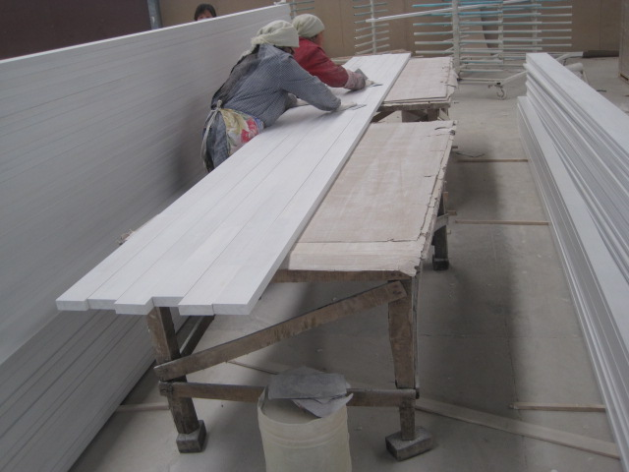
Hand sanding & patching defects

Slide 22
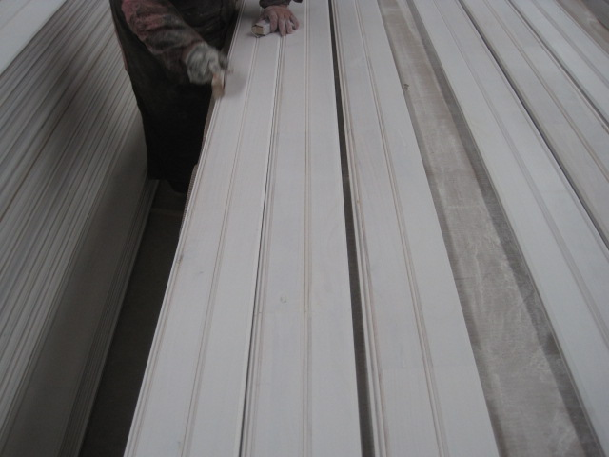
Quality check on beaded pattern

Slide 23
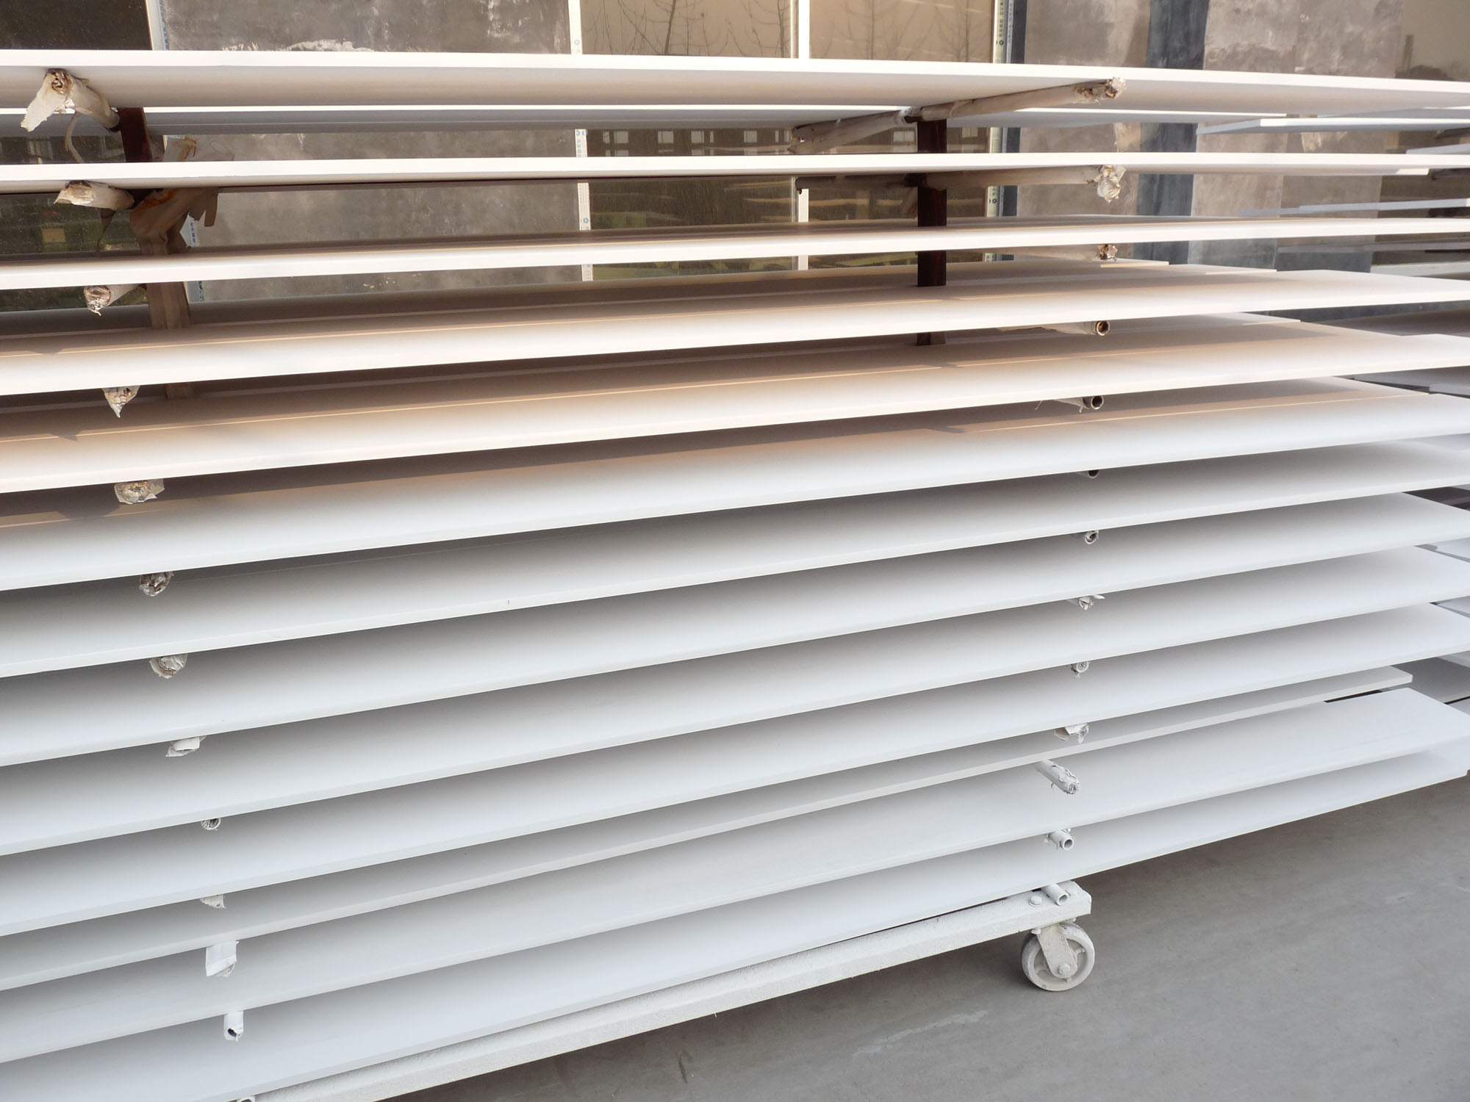
Drying racks

Slide 24
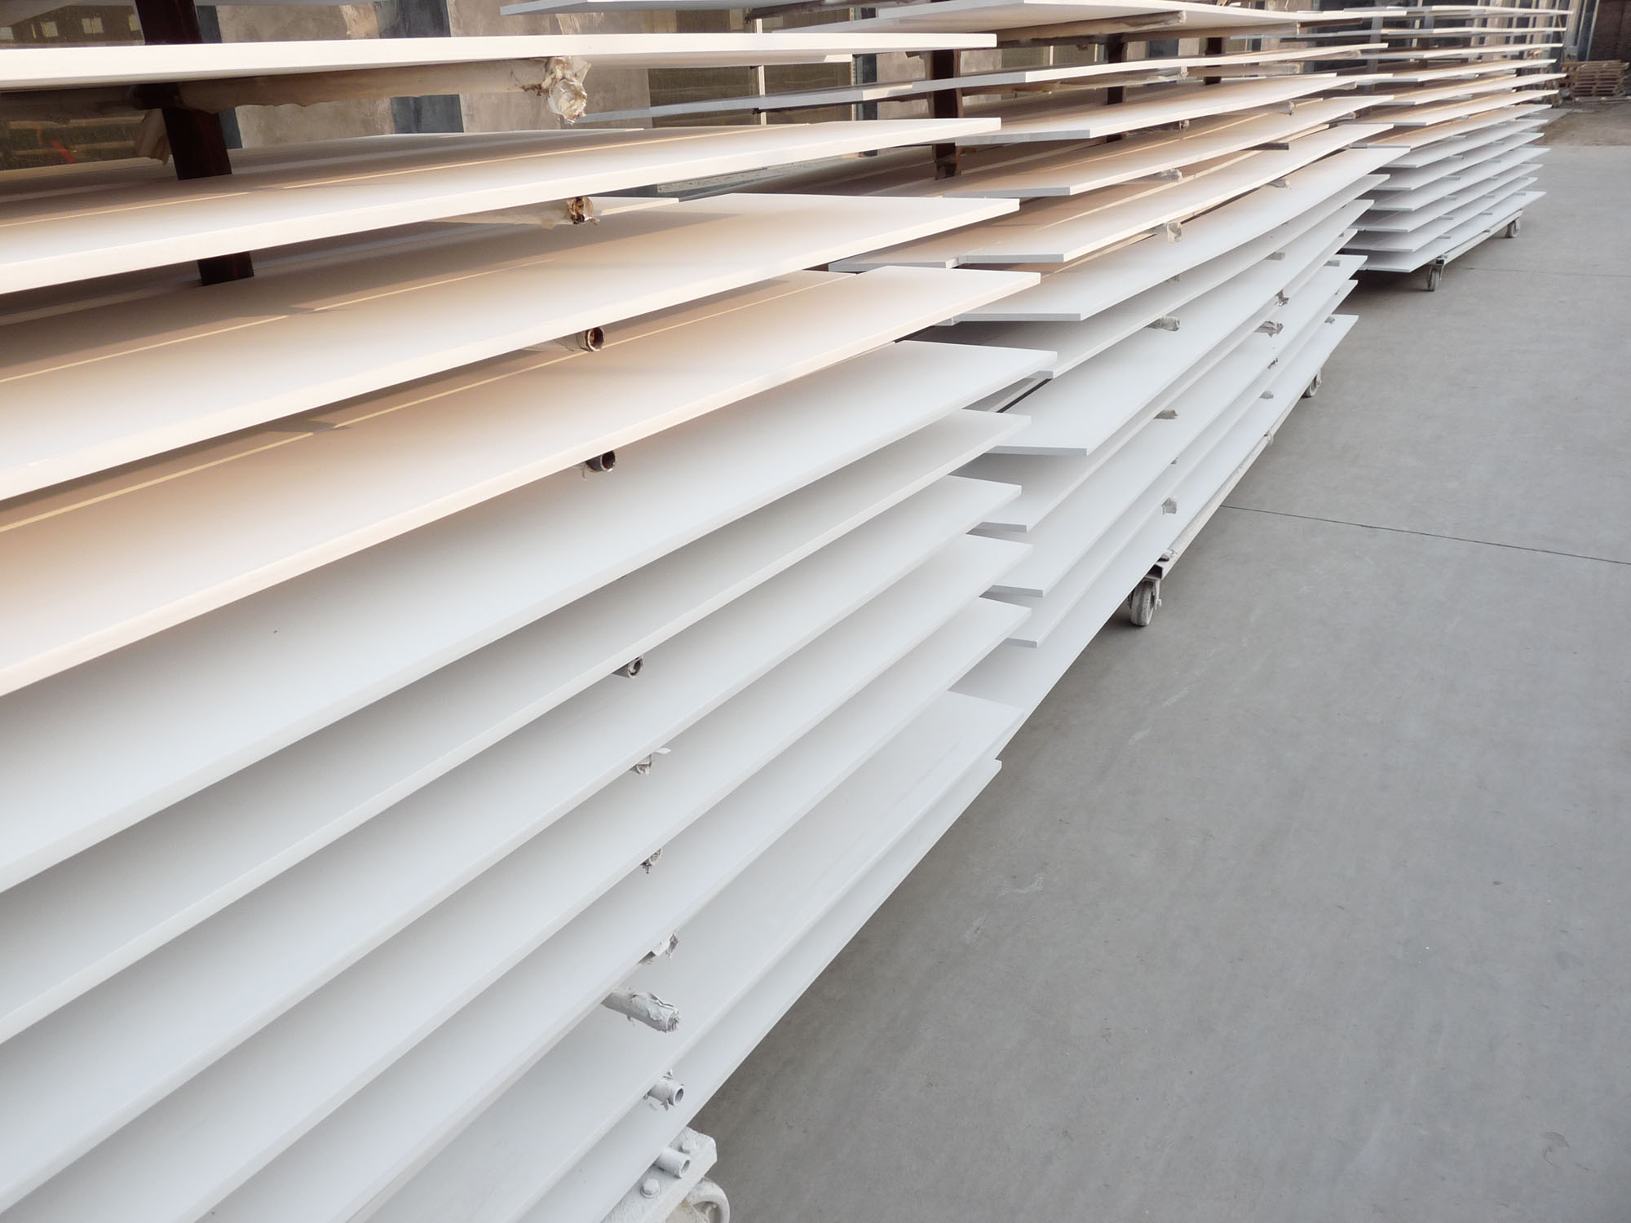
Drying room

Slide 25
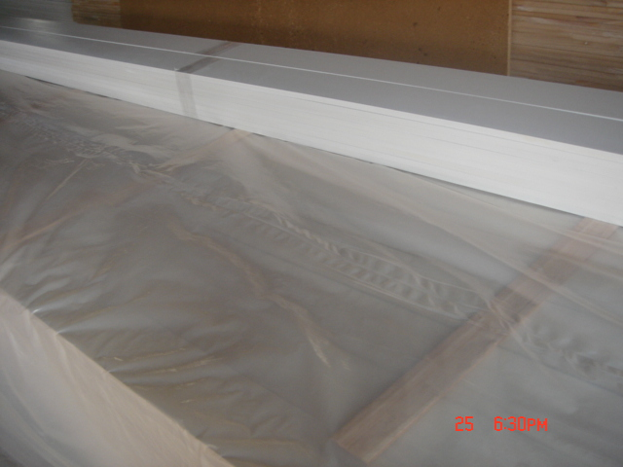
Packaging paulownia

Slide 26
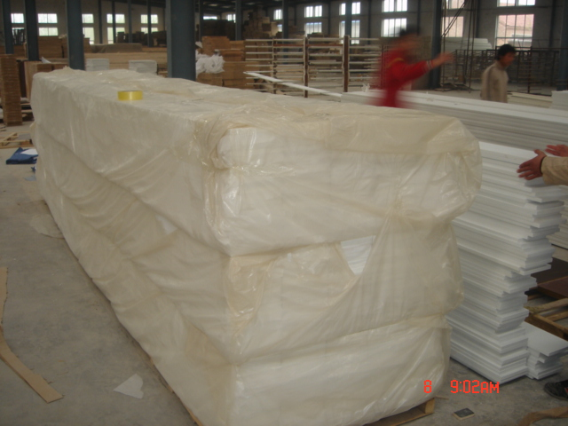
Packaging product

Slide 27
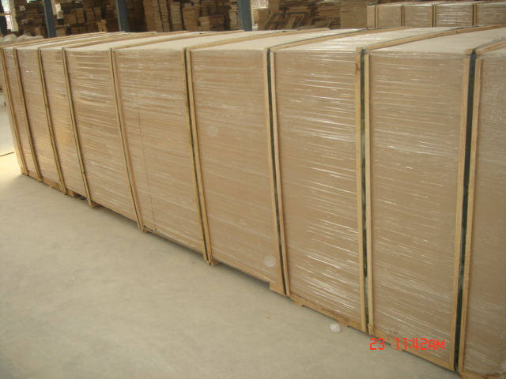
Packaging units

Slide 28
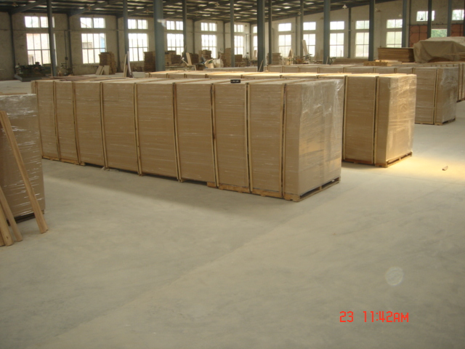
Staging package units

Slide 29
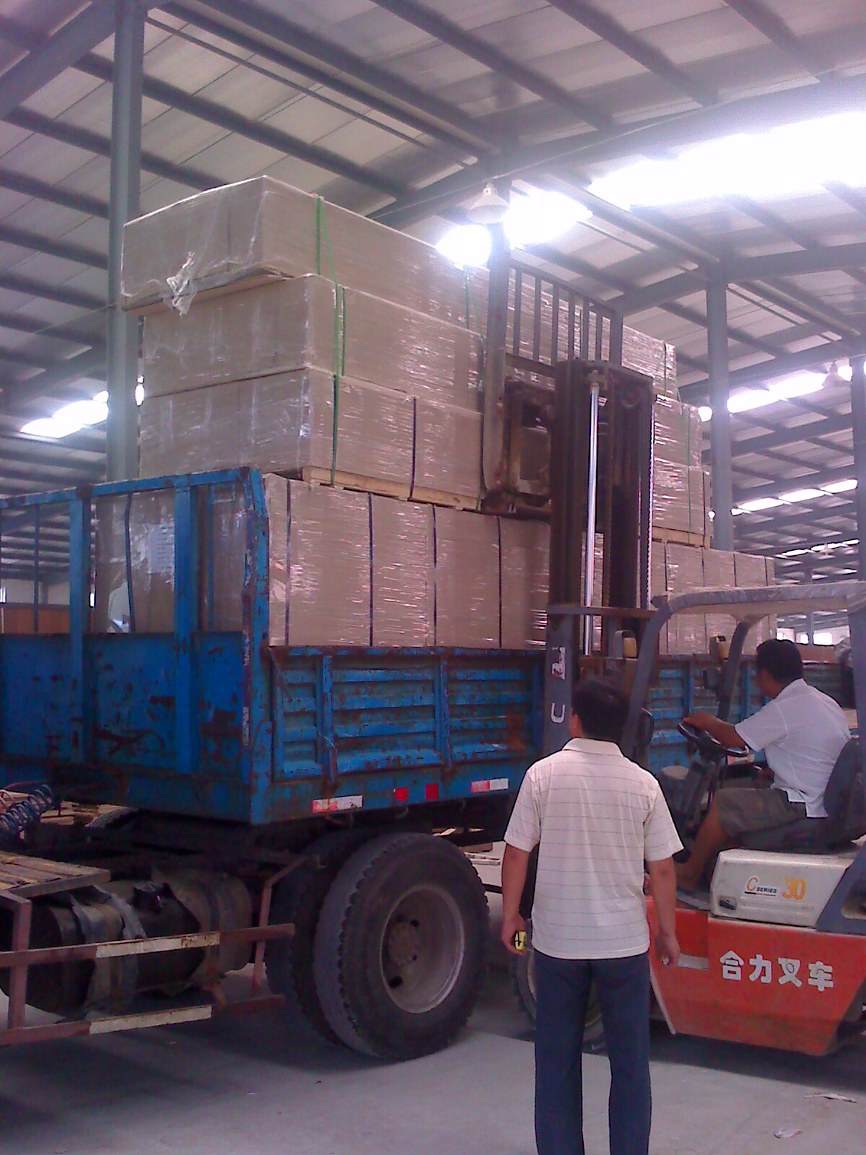
Loading trucks

Slide 30
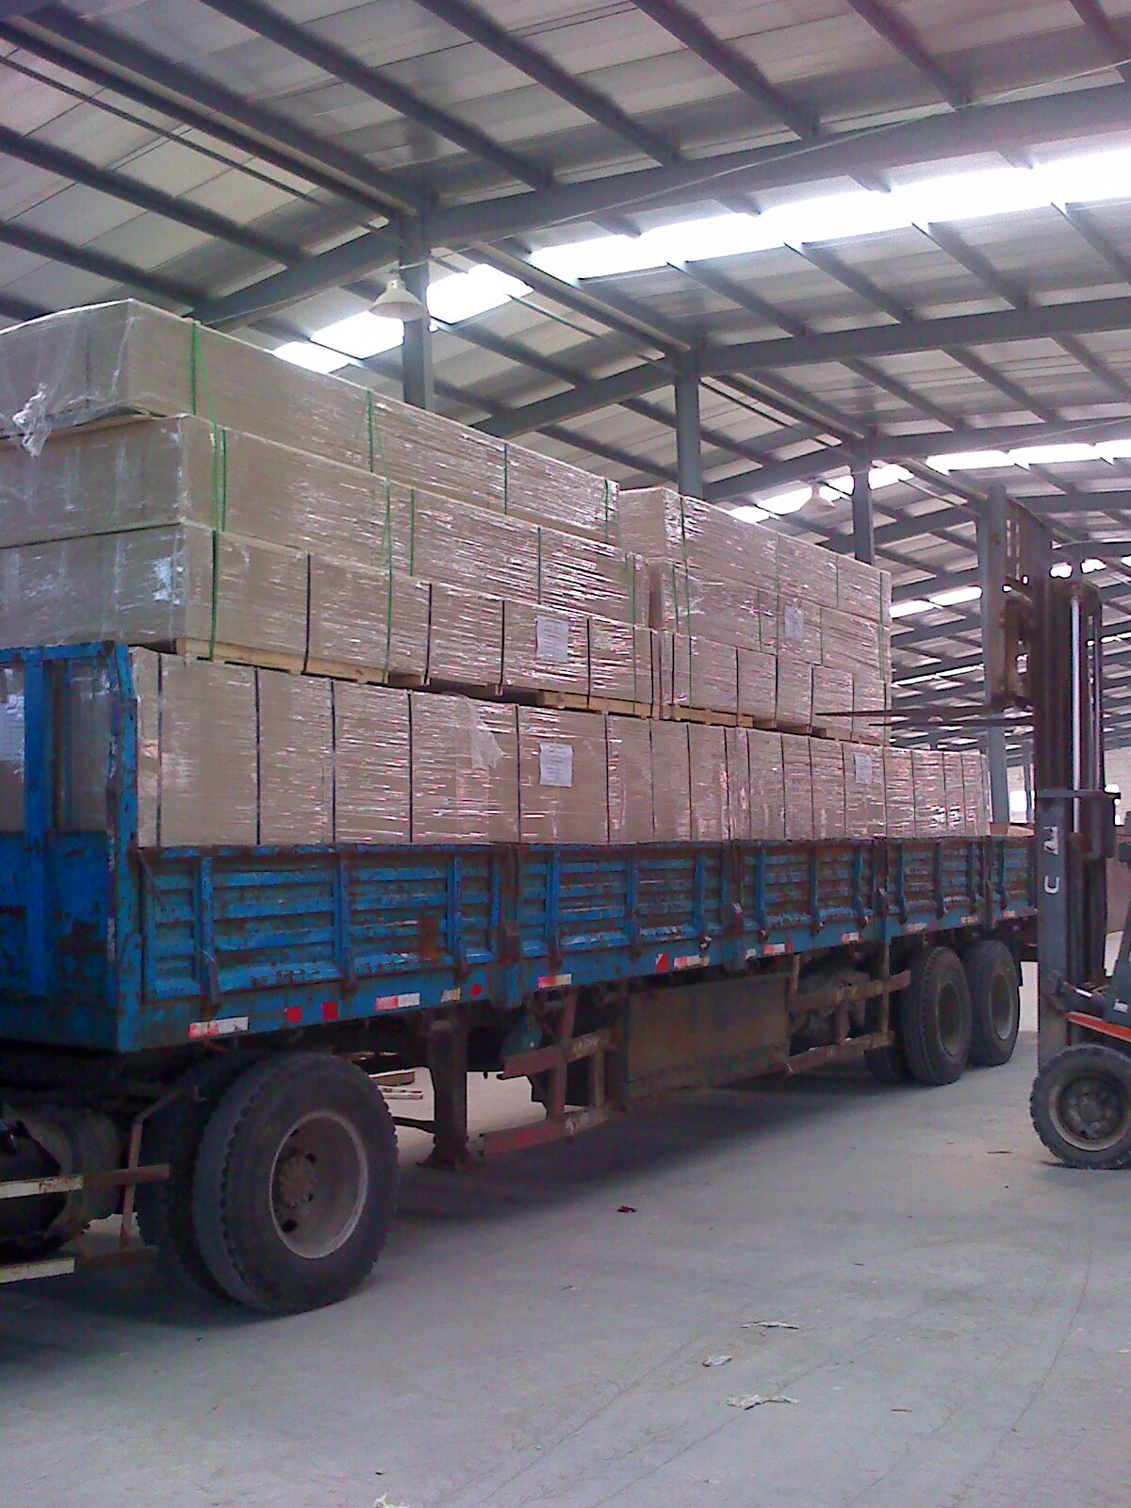
TRUCK GOING TO DOCK TO LOAD IN VANS

Slide 31
ADDITIONAL INFORMATION SHEETS
MSDS SHEETS * ON GLUE IN PRODUCT * ON PAULOWNIA WOOD * ON PAINT/PRIMER WARRANTY ON PRODUCT * 10 YEAR WARRANTY * AGAIN FJ FAILURE * AGAIN ROT OR DECAY * INSECT RESISTANT ADDITIONAL INFORMATION *WWW.SANTIAMLUMBERSALES.COM

