Slide 1
Mashing Content, Information Literacy, and 21st Century Skills
FAPSC annual administrator conference 2015

Slide 2
“… positive correlation between multimedia and student achievement.” Jonassen, 1995

Slide 3

21st Century Skills

Slide 4
21st Century Skills
Use technology and digital media strategically and capably
Integrate and evaluate information from diverse media and formats
Integrate and evaluate information presented visually, orally, and quantitatively
Make strategic use of digital media to express ideas and information

Slide 5
Kids Speak Out on Student Engagement
Edutopia
"Students are most interested when the curriculum applies to more than just the textbook. The book is there -- we can read a book. If we're given projects that expand into other subjects and make us think, it'll help us understand the information.”
"I like to explore beyond the range of what normal textbooks allow us to do through hands-on techniques such as project-based learning. Whenever I do a project, I always seem to remember the material better than if I just read the information straight out of a textbook."

Slide 6


Slide 7
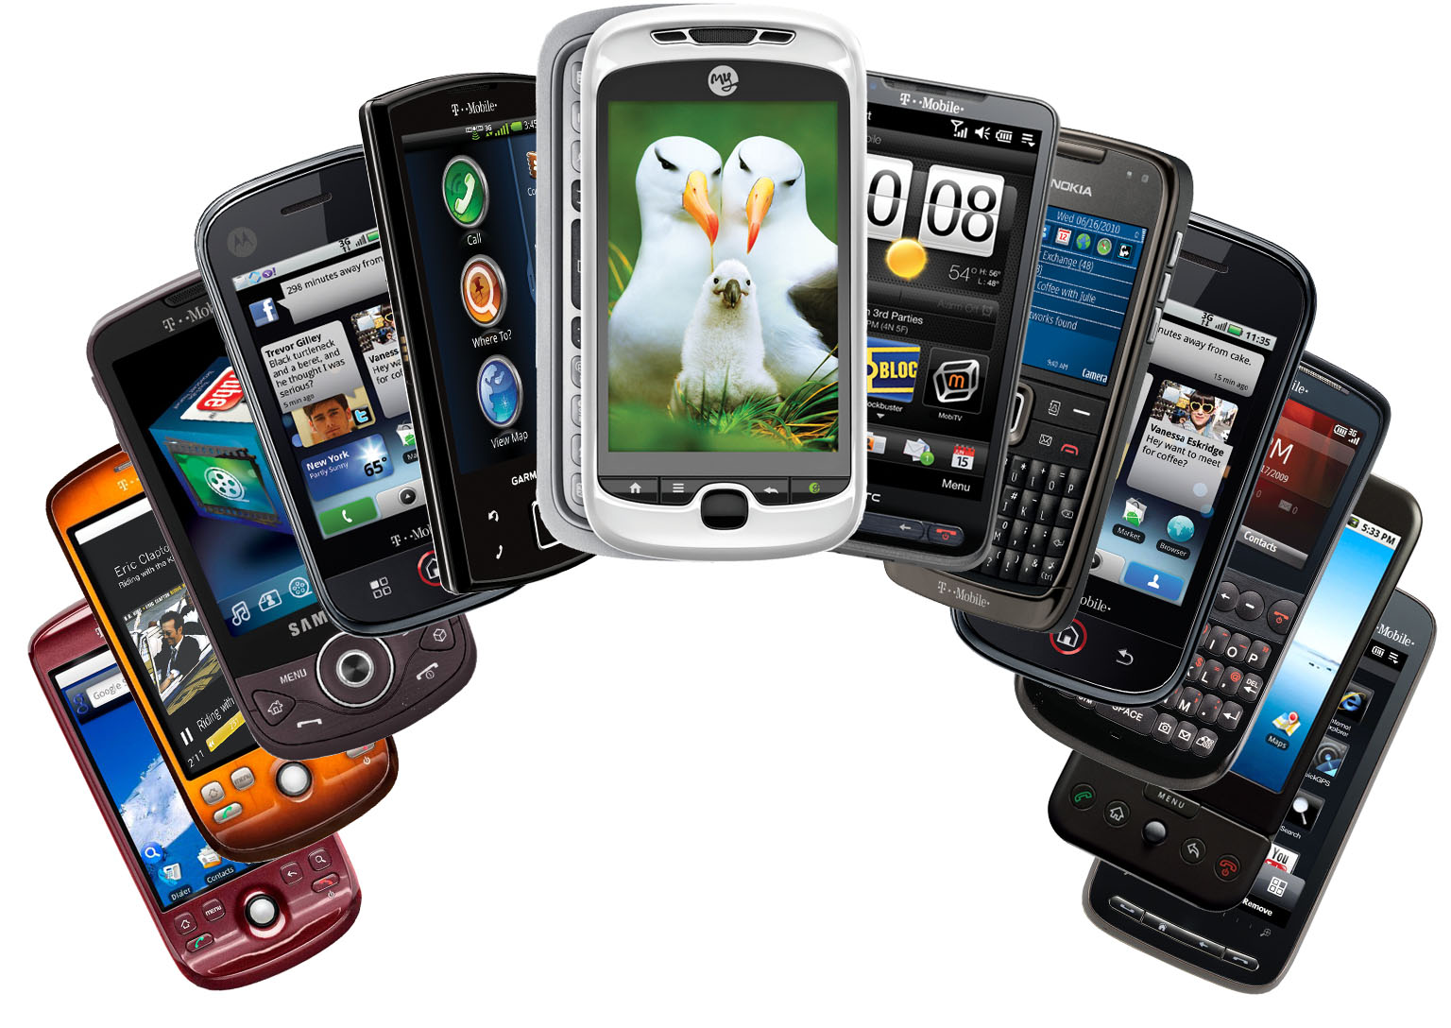
Smart Phones & Tablets
Interview
Oral Speaking
Picture Prompt
Apps

Slide 8
Twitter
Create a class or lesson hashtag (#)
#ABTUMKTG
#SmithScience
#iwishmyteacherknew

Slide 9
TodaysMeet --- https://todaysmeet.com/FAPSC-Administrator-Conference

Slide 10
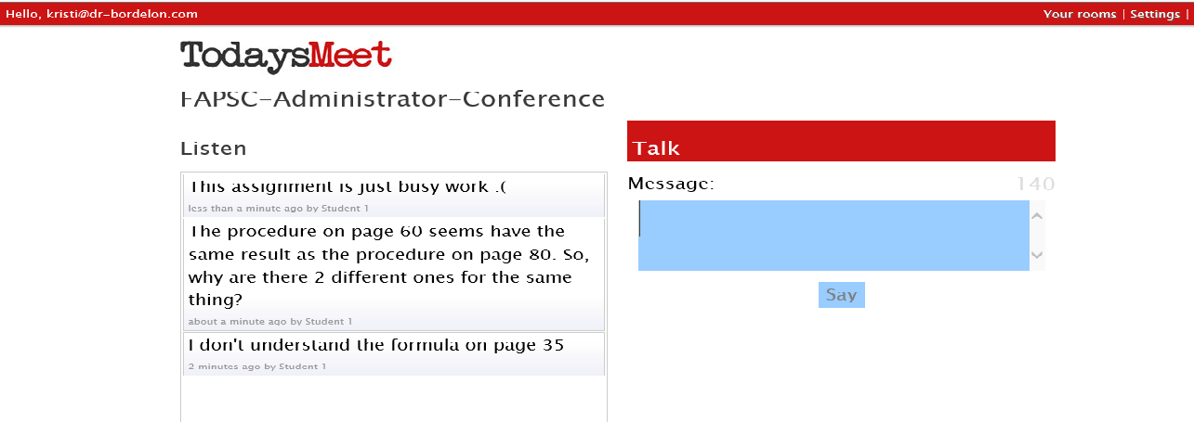

Slide 11
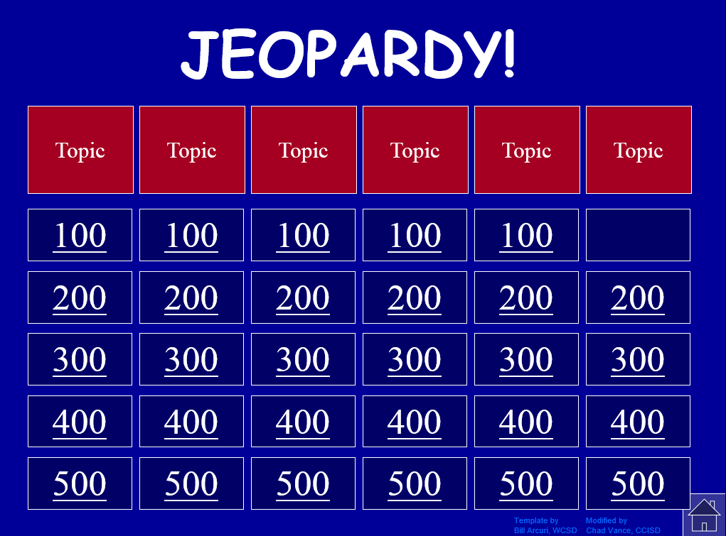
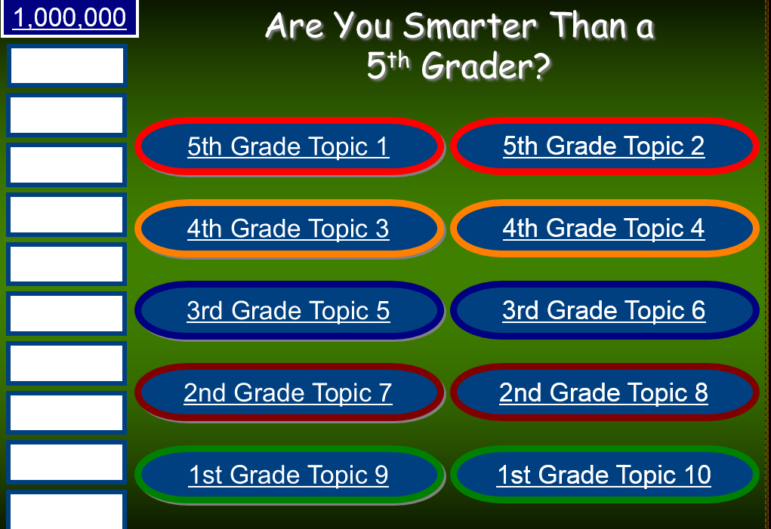
Games
http://powerpointgames.wikispaces.com/PowerPoint+Game+Templates
http://www.ircsd.org/webpages/dyoung/game_templates.cfm

Slide 12
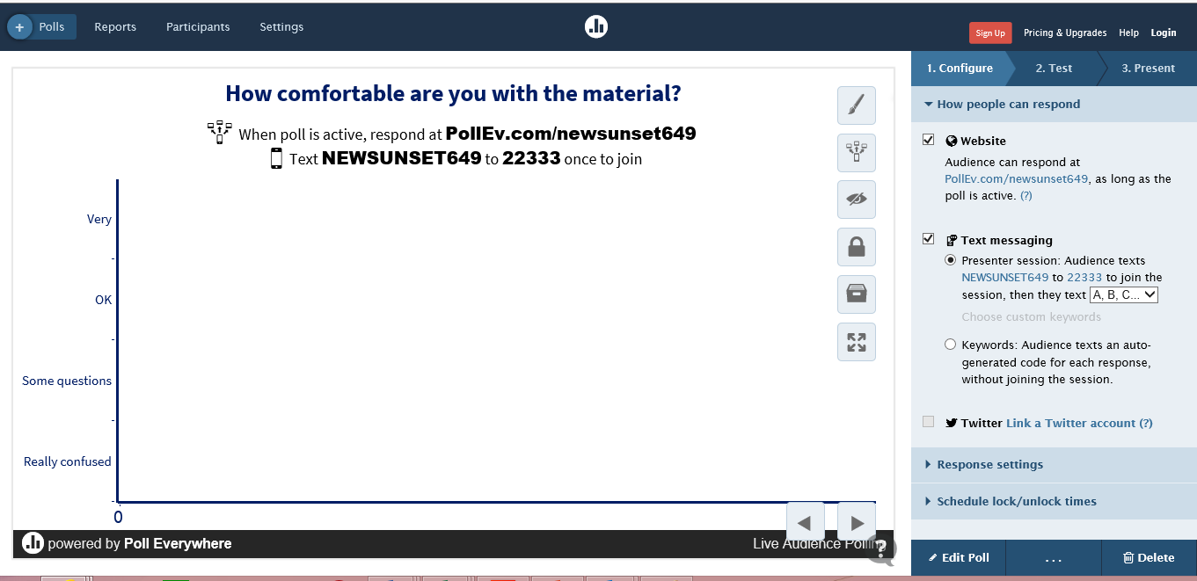
Poll Everywhere http://www.polleverywhere.com/

Slide 13
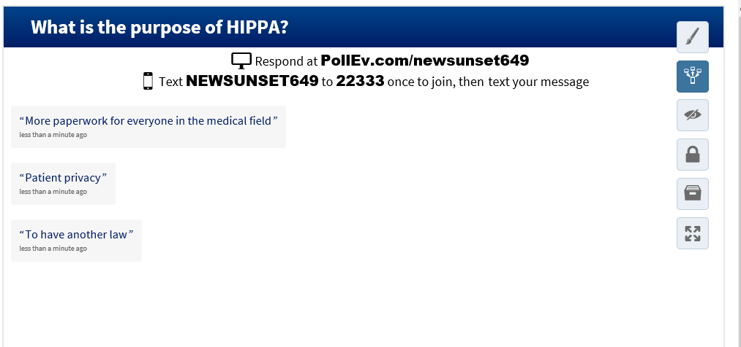

Slide 14
Trello https://trello.com/

Slide 15
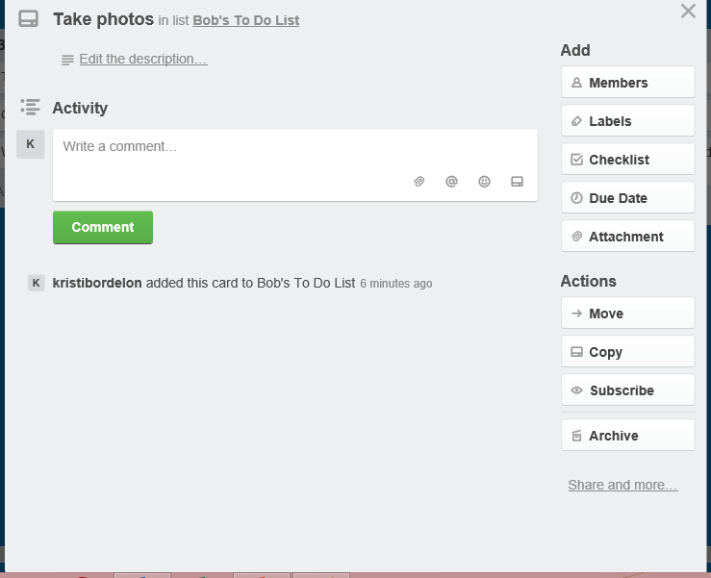

Slide 16
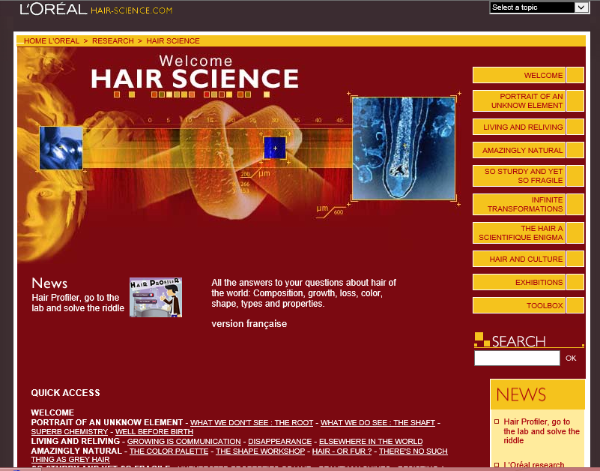
L'Oreal Hair Science http://www.hair-science.com/_int/_en/index.aspx

Slide 17
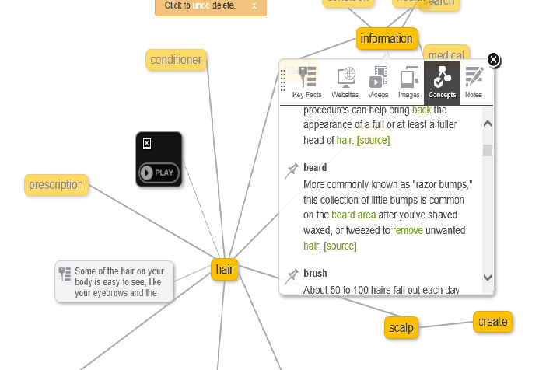
Instagrok http://www.instagrok.com/

Slide 18
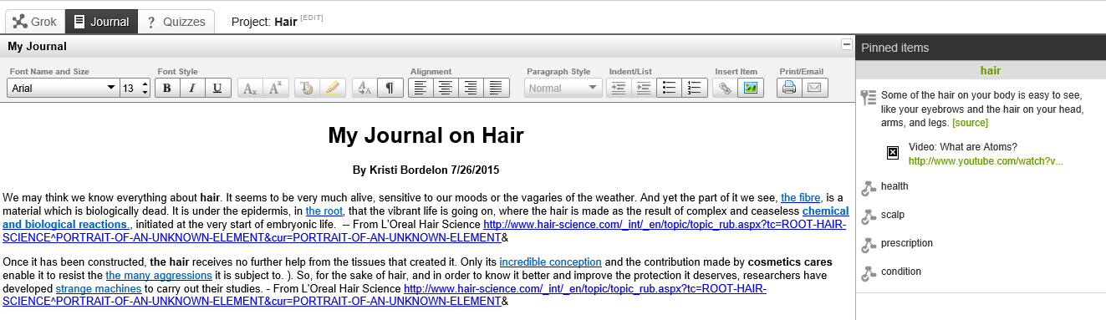
Instagrok http://www.instagrok.com

Slide 19
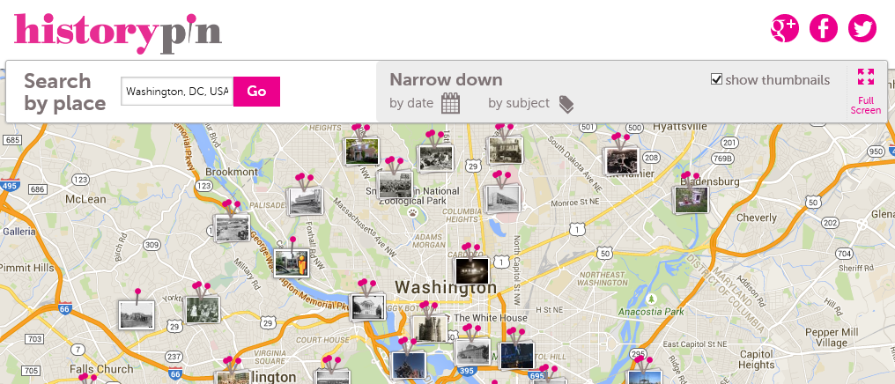
Historypin http://www.historypin.org

Slide 20
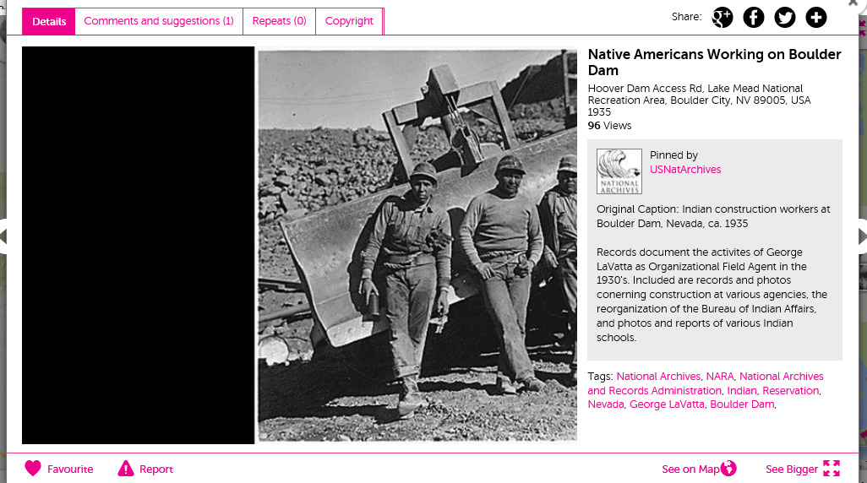
Historypin http://www.historypin.org

Slide 21

  Smore https://www.smore.com/

Slide 22

Coggle https://coggle.it/

Slide 23
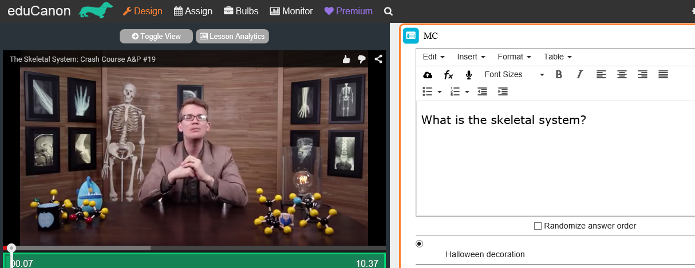
  eduCanon http://www.educanon.com/
Notes:
Educanon - Create a video, add questions, flipped classroom or have students create lectures / quizzes

Slide 24
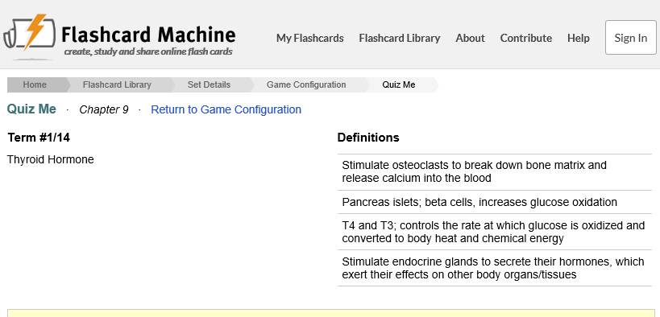
  Flashcard Machine http://www.flashcardmachine.com/

Slide 25
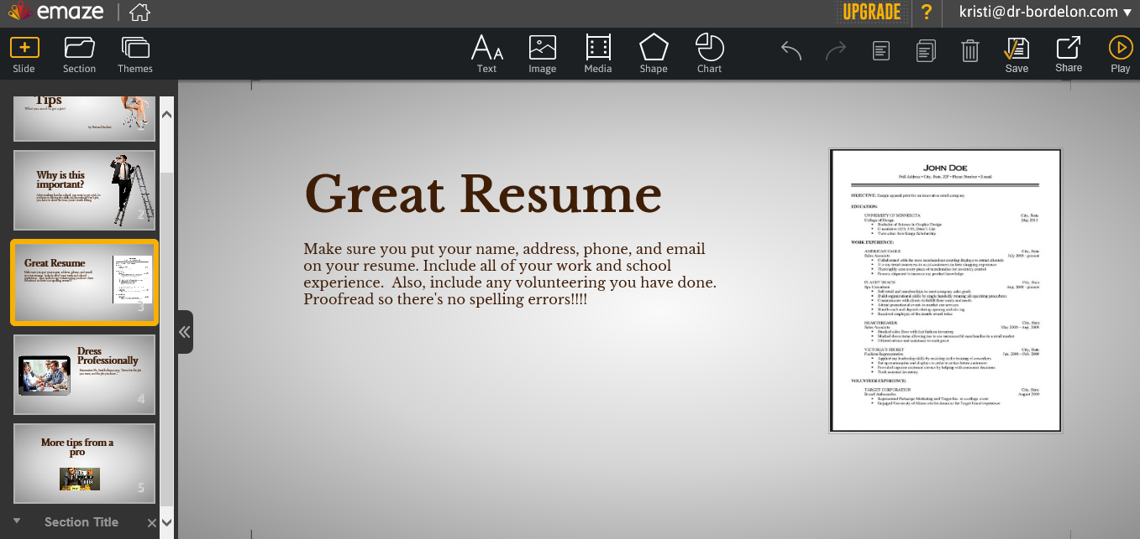
  EMaze https://www.emaze.com

Slide 26
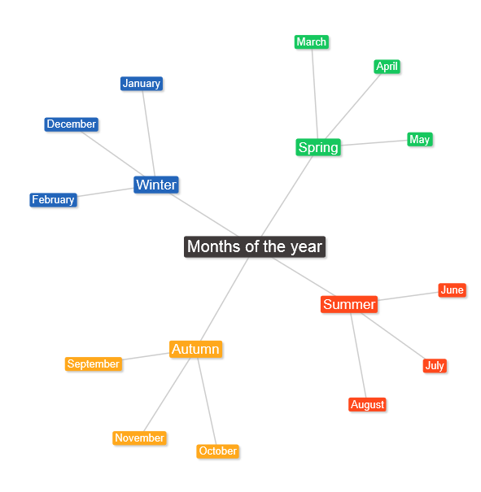
  Text 2 Mind Map https://www.text2mindmap.com/

Slide 27
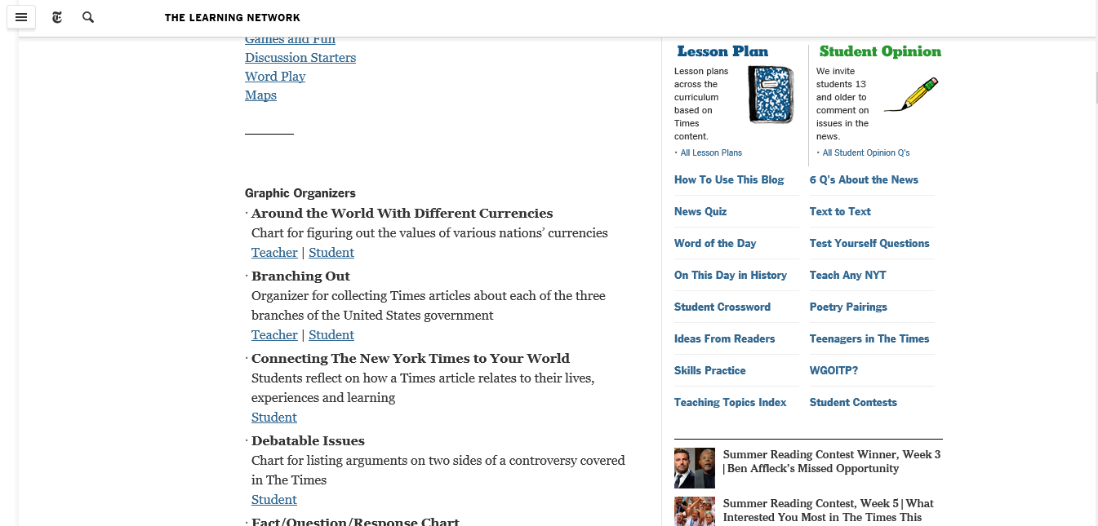
New York Times Teaching Today’s News http://learning.blogs.nytimes.com/teaching-topics/teaching-topics-great-ways-to-teach-any-days-times/

Slide 28
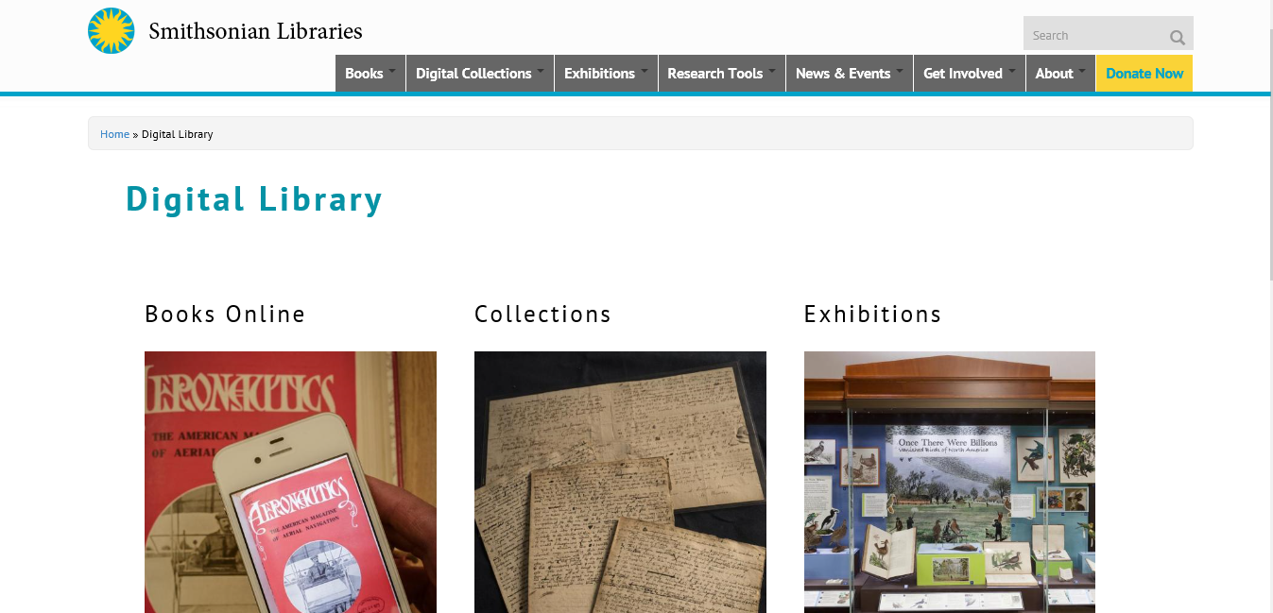
Smithsonian Digital Collection http://library.si.edu/digital-library

Slide 29
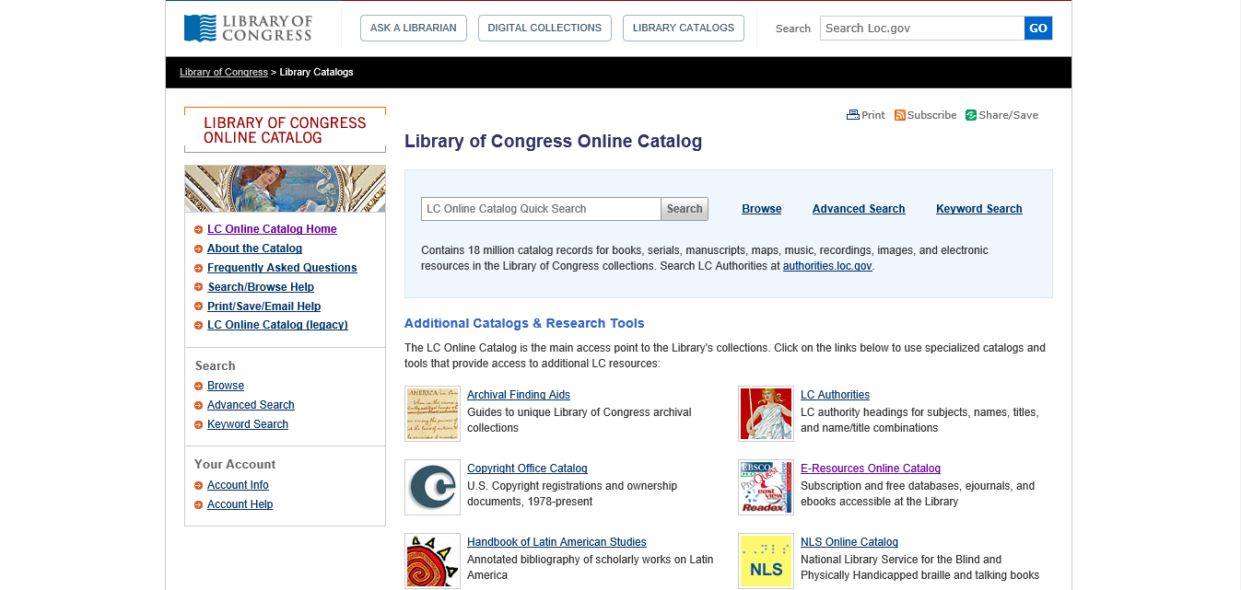
Library of Congress Digital Collection http://loc.gov/library/libarch-digital.html

Slide 30
Content Sites……
BBC Learning Zone http://www.bbc.co.uk/programmes/p01b8f09
Languages Online http://www.education.vic.gov.au/languagesonline/default.htm
Penn State Food Science - http://foodscience.psu.edu/youth
Science Behind Cosmetology - http://www.thesciencebehindcosmetology.com/
Cosmetic Science Technology - http://www.cosmeticsciencetechnology.com/index.php?flash=no

Slide 31
Content Sites……
Google Art Project https://www.google.com/culturalinstitute/project/art-project
Exploratorium http://www.exploratorium.edu/explore
The Big History Project https://www.bighistoryproject.com/home
Facing History and Ourselves https://www.facinghistory.org
History’s Heros http://historysheroes.e2bn.org/
Steve Spangler Science
http://www.stevespanglerscience.com/lab/experiments

Slide 32
Other Tools……
MIT App Inventor http://appinventor.mit.edu/explore/front.html
YouTube www.youtube.com/
TeacherTube www.teachertube.com/
Khan Academy https://www.khanacademy.org/
TED Talks https://www.ted.com/talks
Google Docs https://www.google.com/docs/about/
Google Scholar http://scholar.google.com/
Victorian Crime and Punishment http://vcp.e2bn.org/

Slide 33
Other Tools……
Masher http://masher.com/
Timetoast http://www.timetoast.com/
Paper https://www.fiftythree.com/paper
Storybird http://storybird.com/
Creaza http://www.creazaeducation.com/
  Timemapper http://timemapper.okfnlabs.org/

Slide 34
Other Tools……
Screencast O Matic http://www.screencast-o-matic.com/
CamStudio http://camstudio.org/
EZVid http://www.ezvid.com/
Netiquette Primer
http://www.bucks.edu/old_docs/online/dlresources/Netiquette-quiz-results.html
Netiquette Quiz http://www.nku.edu/~rkdrury/experiment/netiquette_quiz.htm
Comic Book http://www.makebeliefscomix.com/Apple/index.php

Slide 35
Thank you!
Kristi@dr-bordelon.com http://www.dr-bordelon.com/research.html

