Slide 1
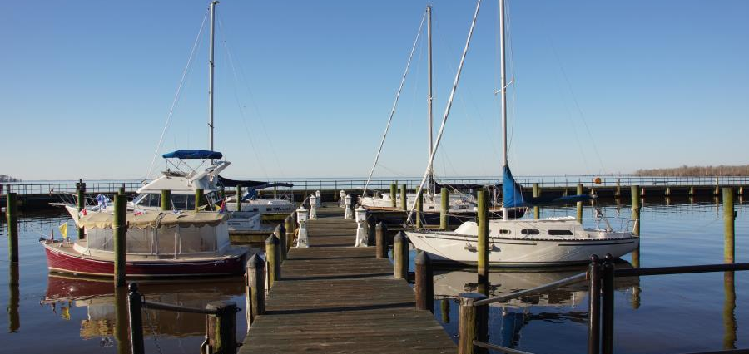
Water Transportation in the Albemarle Sound
Katie Bradshaw, Heather Brutz, Kiara Burroughs, Elisa Elkind, Cindy Frantz, Maria Grimshaw, Taylor Mallard, Susan Sullivan, Brandon Stephenson, Elise Wagner
May 1, 2015

Slide 2
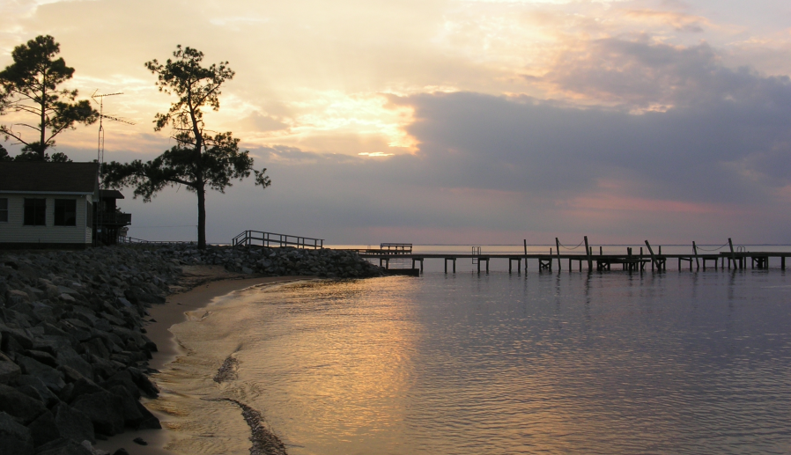
The Albemarle Sound region is an area poised for investment and economic growth
“Vacationers may be drawn to the coastal area by the ocean, but they will wind up enchanted by the Albemarle Sound.”
--OuterBanks.com

Slide 3
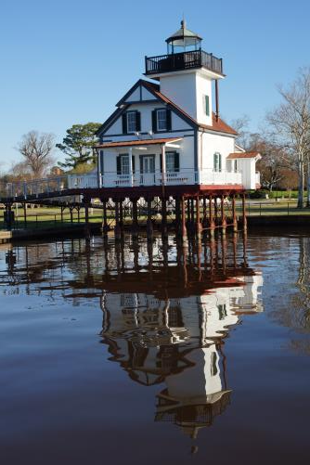
Agenda
Introduction and Proposal
Operational Aspects
Financial Model
Risks
Summary and Recommendation

Slide 4
This presentation is a pitch deck that introduces the Albemarle Sound ferry investment opportunity
Our Approach
Feasibility study
Pitch deck
Intended audience
Private Investors
State/local government officials
Community Members

Slide 5
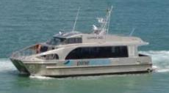
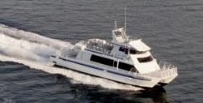
Recommendation: A ferry serving five towns in the Albemarle Sound would attract tourists and reach profitability in Year 1
Boat
49 seat catamaran
149 seat catamaran
Towns
In phase 1, ferries stop in five towns:
Elizabeth City
Edenton
Hertford
Plymouth
Columbia
Financial Impact
Cos
t
$6.8M in capital expenditures is required to launch the ferry. Annual operating expenses in year 1 would be $2M.
Return
The ferry is immediately profitable in year 1. Year 1 profitability is projected to be $679K and annual ridership would be 159,000.
See appendix for more detail on calculations

Slide 6
Introduction
An introduction to the region, its attractions, and the tourist population

Slide 7
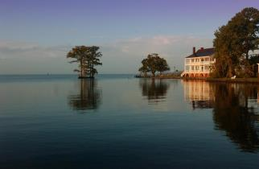
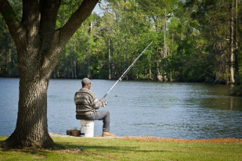
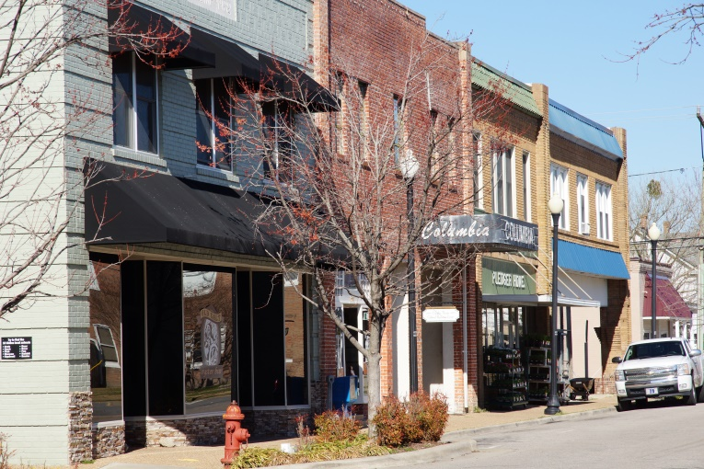
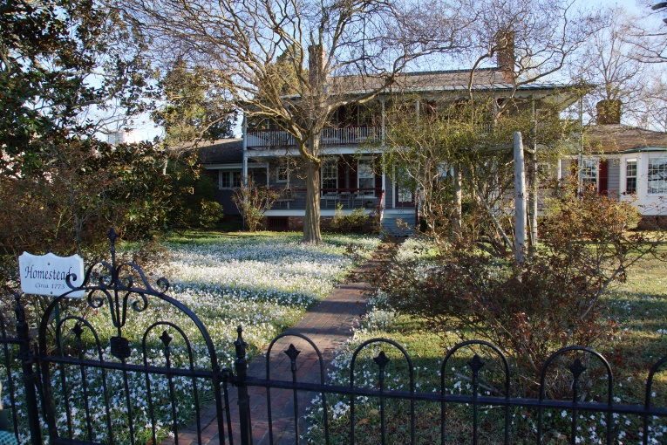
Exploration of the Inner Banks is a perfect way for visitors to experience rural North Carolina
Idyllic Atmosphere
Outdoor Fun
Charming Villages
Historic Architecture

Slide 8
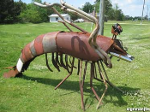
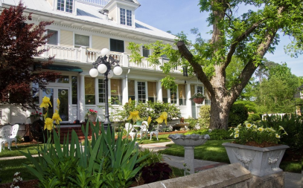
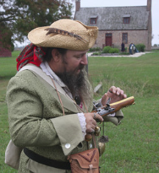
Friendly small-town culture and southern hospitality make for an authentic tourist experience
Local Arts
Welcoming Hosts
Colonial History

Slide 9
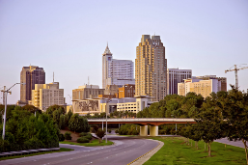
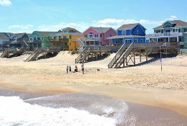
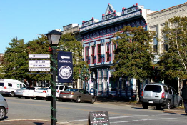
The estimated market in Year 1 is 160,000 visitors from three different consumer groups
Projected Visitors:
Weekenders
Coastal Tourists
Inner Banks Residents
To Area:
8,000,000
5,000,000
200,000
13,200,000
To Ferry:
20,000
110,000
30,000
160,000
A projected 160,000 visitors will use the Albemarle Sound Ferry System per year
See appendix slides for more detail on calculations
Notes:
http://goodnightraleigh.com/2011/07/the-raleigh-skyline-ca-1960/
http://www.outerbanks.com/oceanfront-vacation-rentals.html

Slide 10
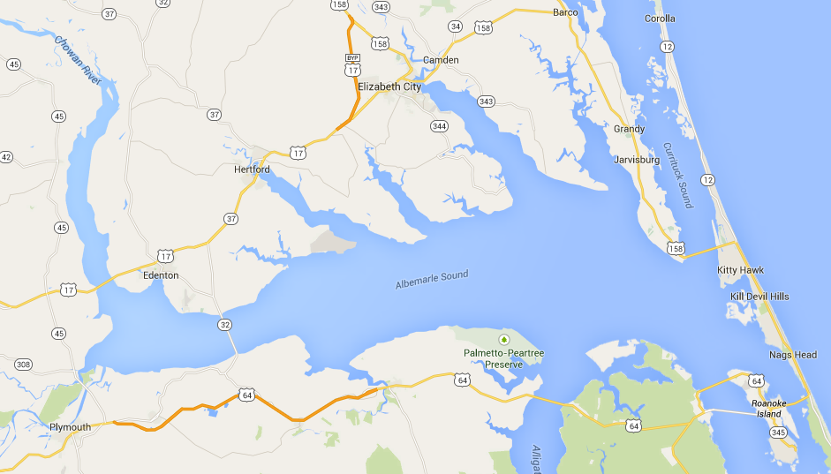
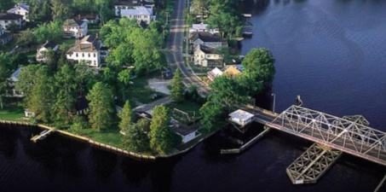
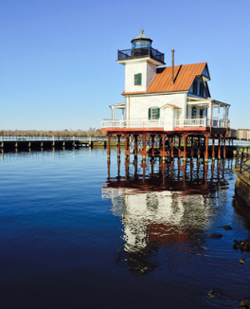
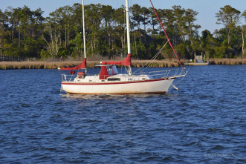
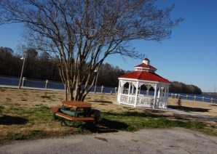
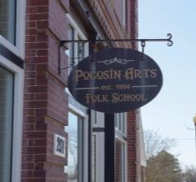
Weekend visitors currently visit historic sites and enjoy seeing nature in the region

Slide 11
Tourists in the Coastal Region of North Carolina want to do more than just visit the beach
Popular activities for overnight visitors in the coastal region of North Carolina:
Shopping
28%
Visiting the Beach
70%
Rural Sightseeing
17%
Wildlife Viewing & Bird Watching
Visiting Historic Sites
15%
10%
Source: 2013 North Carolina Regional Travel Summary, North Carolina Department of Commerce

Slide 12
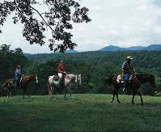

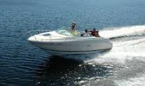
The average Inner Banks consumer is older in age, but interested in a wide variety of outdoor activities
Over 40% of the total Inner Banks population makes over $50,000 annually
Average age: ~ 40 years
Outdoor Activities:
  Fishing
  Hunting
  Horseback Riding
  Baseball
  Basketball
  Volleyball
  Golf
  Tennis
  Swimming
  Skiing
  Boating
  Biking
  Camping
  Gardening
Source: http://accessnc.commerce.state.nc.us/docs/

Slide 13
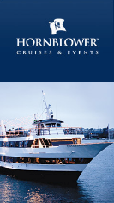
The water transport industry has experienced strong growth in the past ten years
The water transport industry…
Is projected to have revenues of
$454M in 2015
Grew an average of 12% YOY
between 2004-2010
A case study: Hornblower
Hornblower is a privately owned water transport business founded in 1980. Hornblower has grown significantly in the years since and now operates 60 vessels in California, New York and New Jersey. The company’s 2010 annual revenue was $130M.
Source: Inc. Magazine’s article, “Ferry Industry Gaining Speed”; Hornblower.com

Slide 14
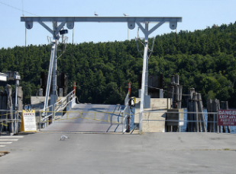
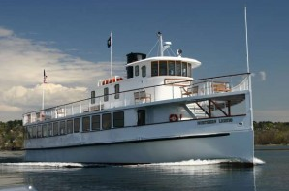
High-speed ferries are successful tourist attractions in the U.S.
Port Clinton, OH
Lake Champlain, VT
Location: Town 1 hour from Toledo
Median Income: $44,000
Purpose: Tourist (Hop-on, Hop-off)
Calendar: Seasonal
Annual riders: 300,000
Boats: 4 ferries
Price: $23-39
Location: Burlington is on this lake
Median Income: $55,000
Purpose: Tourism/Commuting
Calendar: Reduced in winter
Annual riders: 1,000,000
Boats: 4 ferries
Price: $8-10
Source: Ferries.com; LakeChamplainCruises.com; JetExpress.com

Slide 15
Operations
An overview of vessel type, cities and routes, industry best practices, and expansion ideas

Slide 16
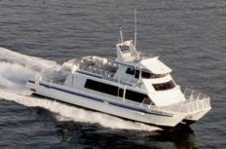

Catamarans are the most popular type of operating ferry
With four 49 seat Catamarans:
Min Ticket Sales= 392
Max Ticket Sales= 1,568
49 seat Catamaran
Example: Clipper 3
Knots: 28; MPH: 32; Size: 47.2 ft; Price: $1.7M
149 seat Catamaran
Example: Condor Express
Knots: 28; MPH: 32; Size: 71.7 ft; Price: $3.9M
Pros: Choice of most ferry operators; greater maneuverability; value; spacious; low draft requirements
Cons: Compared to monohulls of similar size capital costs are higher; dock space
Transit Capacity and Quality of Service Manual – 2nd Edition

Slide 17
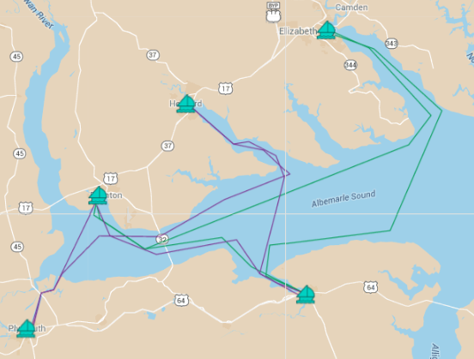
Routes 1 and 2 of the Ferry System should include Elizabeth City, Columbia, Edenton, Plymouth, and Hertford
Routes 1 and 2
Why These Cities:
Elizabeth City
Location (accessibility and inter-distance)
Infrastructure and amenities
Vitality, attraction, and potential
Hertford
Edenton
Edenton
Quick ramp up time & flexible hop on hop off trips
Plymouth
Plymouth
Columbia

Slide 18
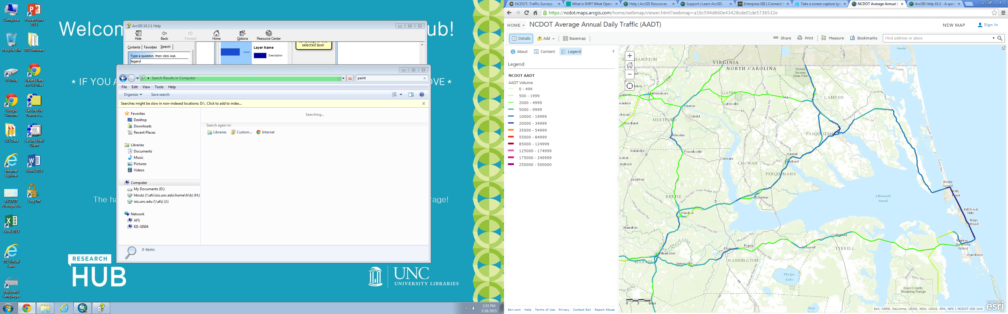
All cities are easily accessible by car and Elizabeth City, Edenton, and Hertford especially lie on frequented roads
10,000-19,000 cars/day
2,000-4,999 cars/day
Source: NCDOT GIS Unit

Slide 19
Ferry trips are < 2 hrs and average trip is 66 minutes, offering flexibility for hop-on-hop off travel (assuming 32 mph)
Route 1 (operates in both directions):
Route 2 (operates in both directions):
From | To | Distance (miles) | Time
Elizabeth City | Columbia | 50 | 1 hr 33 mins
Columbia | Edenton | 24 | 45 mins
Edenton | Elizabeth City | 57 | 1 hr 46 mins
From | To | Distance (miles) | Time
Plymouth | Edenton | 13 | 24 mins
Edenton | Columbia | 24 | 45 mins
Columbia | Hertford | 34 | 1 hr 3 mins
Hertford | Plymouth | 46 | 1 hr 26 minutes
Assuming average loaded fast ferry speed of 32 mph (28 knots)

Slide 20
In a sample time table, each route is assigned 1 vessel to operate clockwise, and 1 to operate counterclockwise
Route 1 (32 mph, 27 knots):
Total operating hours/day per vessel: 10.5 hours
Total miles/day per vessel: 131 miles
Lunch and nature walk in Columbia!
Wine and Stargazing

Slide 21
Ramp up time is minimal because most amenities already exist at these locations
Port City | Power | Water | Pump Out | Fuel | Wifi | Restaurant | Restroom/Shower | Groceries/Shopping
Columbia | Yes | Yes | Yes | No | Yes | Yes | Yes | Yes
Edenton | Yes | Yes | Yes | No | No | Yes | Yes | Yes
Elizabeth City | No | Yes | No | No | Yes | Yes | Yes | Yes
Hertford | Yes | Yes | Yes | No | No | Yes | No | Yes
Plymouth | Yes | Yes | Yes | No | Yes | Yes | Yes | Yes
Note: Fuel dock will need to be added (perhaps in hubs Edenton or Columbia), or current mobile fuel solution will be used; Also consider Plymouth or Hertfod for Dry Dock/Maintenance (secluded areas; Hertford may already have a facility)
“The Albemarle Loop Marinas” brochure, 2015

Slide 22
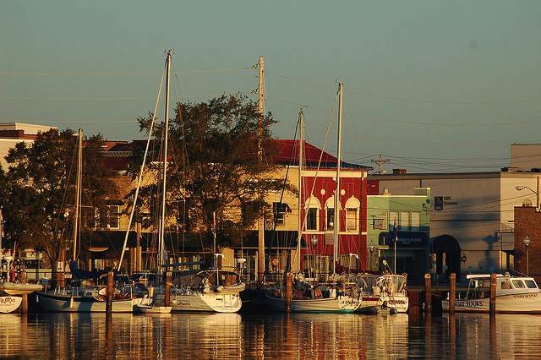
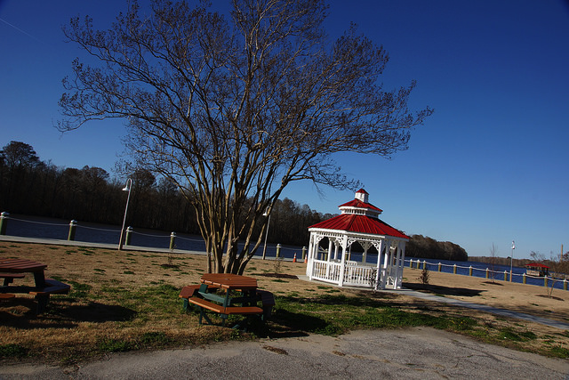
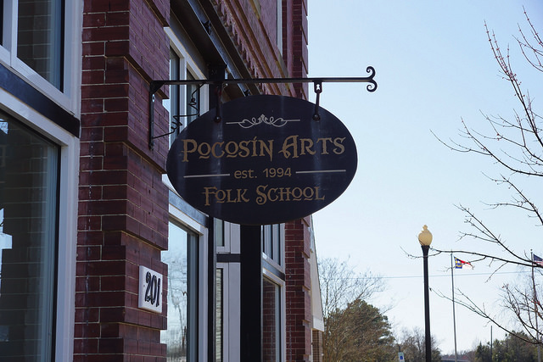
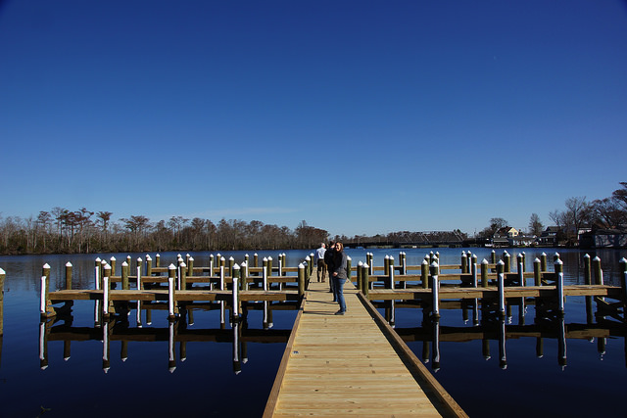
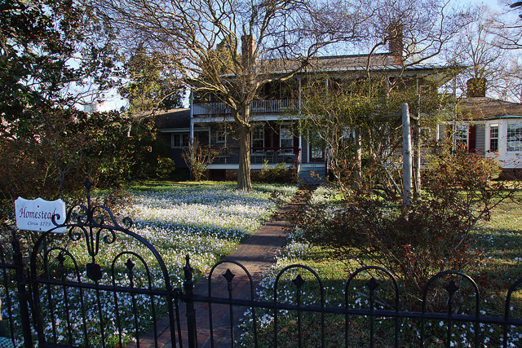
All of these cities are either already quite developed or feature great potential
Elizabeth City
Large population vs. IBX
Lively downtown with numerous activities and boating culture
Plymouth
Beautiful waterfront with gazebo
Quaint but lengthy main street, with several storefronts ready for entrepreneurs
    Businesses beginning to turn toward the waterfront
Columbia
Downtown Charm
Antique Shopping
Art school and gallery complete with accommodations for groups and scholarship for artists in residence
Developing downtown with hip cafes
Shiny new docks ready for visitors
    Beautiful and historical downtown runs to waterfront
    Single boat for tourists already established
Nice open spaces, well cared for homes and yards to enjoy
Hertford
Edenton
Based on Team visits/firsthand experiences

Slide 23
All of these cities are either already quite developed or feature great potential
Elizabeth City
Plymouth
Columbia
Hertford
Edenton
Elizabeth City photo from https://www.flickr.com/photos/33896652@N00/243758227/in/photostream/; all others from Team

Slide 24
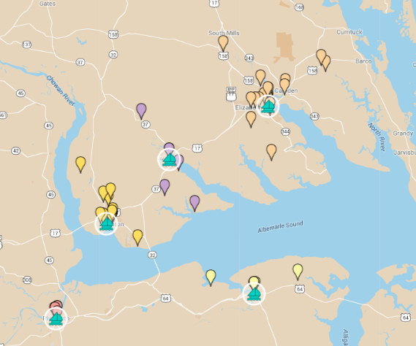
Elizabeth City, Edenton, and Columbia especially can serve as initial anchors with several attractive “Things to do”
Port City | “Things to do” (not including restaurants)
Columbia | 15
Edenton | 30
Elizabeth City | 26
Hertford | 6
Plymouth | 5
Elizabeth City
Hertford
Edenton
Plymouth
Columbia
Link to Live Map (Categories)
Link to Live Map (Cities)
Attractions based on “Things to do” search at www.VisitNC.com; More details in the Appendix

Slide 25
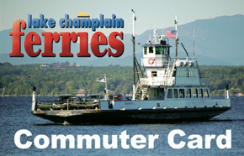
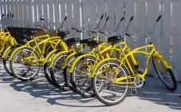
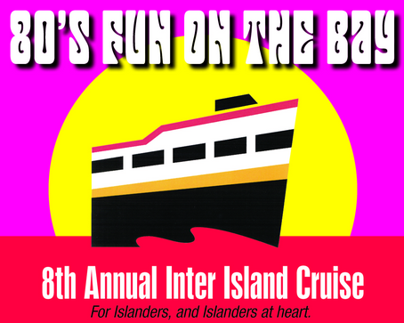
Apply best practices from other water transportation systems
PRICING
PARTNERSHIP
POSITIONING
Local resident discounts
Commuter/education bulk pass
Hop on/hop off pricing
Family/seasonal passes
Ticket prices vary greatly*
Public transportation at docks (bikes rentals, etc.)
Onshore nature walks
Discounts at local businesses
Onboard entertainment
Seasonal schedule
Onboard concessions
Special event charters
See Appendix for more information on benchmark studies in price/schedules

Slide 26
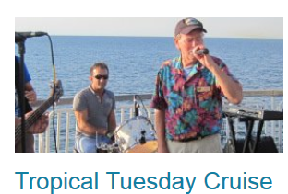
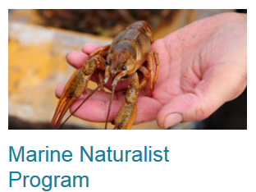
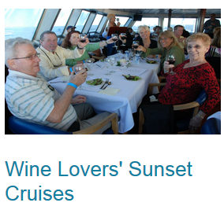
Offer on board entertainment to capitalize on the natural beauty of the Albemarle Sound and help build consumer interest
Nature Talk
Wine and Cheese Evening
Star Gazing
Sunset Dinner and Drinks
Weddings
Family Night
Fishing
Photo Source: http://www.capemaylewesferry.com/

Slide 27
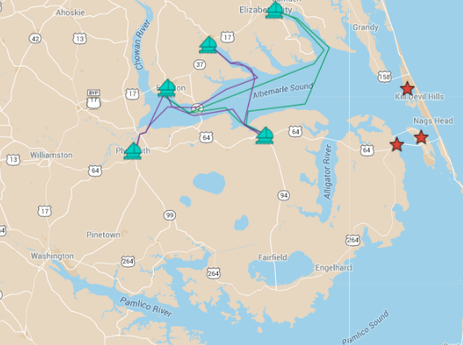
Routes can be added over time to include other cities on the Albemarle Sound, Outer Banks, and Pamlico Sounds
Connect to the Outer Banks
Kitty Hawk
Manteo
Manns Harbor
Link to Live Map

Slide 28
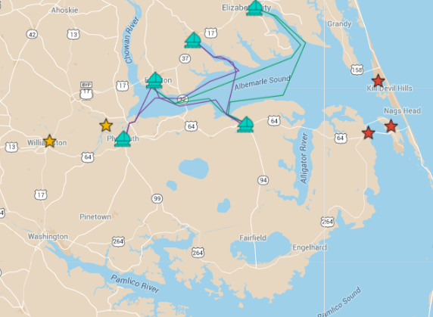
Routes can be added over time to include other cities on the Albemarle Sound, Outer Banks, and Pamlico Sounds
Add one-off trips to more cities near the Albemarle Sound
Windsor
Williamston
Link to Live Map

Slide 29
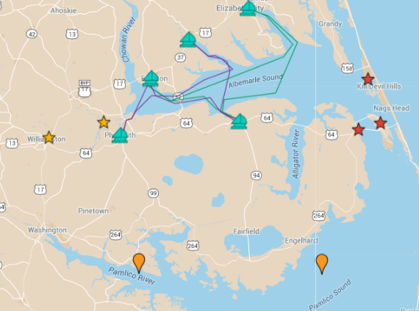
Routes can be added over time to include other cities on the Albemarle Sound, Outer Banks, and Pamlico Sounds
Reach cities along the Pamlico Sound and River
Link to Live Map

Slide 30
Finances
The investment opportunity, a conservative model, ticket price and passengers, and growth potential

Slide 31

Our most conservative models show that the water transport system is an excellent financial opportunity
Investment Opportunity:
Four 49-passenger catamaran ferries traveling Route 1 and Route 2
Operates 7 days a week from April 1st through October 31st annually
Sells food and drinks, but not alcohol
Financial Metrics (10 year model)
Internal Rate of Return (IRR) | 16%
Return on Investment (ROI) | 1.60
Net Present Value (NPV) | $ 4,113,876
Payback Period | 5.83 Years

Slide 32
Financial models show that the water transport system will be profitable in Year 1
Assumptions
No public funds used
Investor uses debt to pay for the boats
Towns pay for all terminal expenses
Ticket prices escalate 5% annually
Initial passengers per day is 750 and escalates 5% annually
Marketing and advertising expense is 10% of ticket sales
Start-Up Costs | Year 0
Administration and Due diligence | $ 204,000.00
Boats | $ 6,800,000.00
Terminal Expenses | $ -
Contingency (3%) | $ 210,120.00
Total Start-Up | $ 7,214,120.00
 | Year 1 | Year 2 | Year 3 | Year 4 | … | Year 10
Total Operating Revenue | $ 3,514,500.00 | $ 3,857,962.50 | $ 4,235,791.22 | $ 4,651,466.76 |  | $ 8,184,797.82
Total Operating Expenses | $ 1,996,963.84 | $ 2,037,700.09 | $ 2,082,192.46 | $ 2,130,804.99 |  | $ 2,534,453.37
Net Income | $ 679,068.23 | $ 880,503.00 | $ 1,102,072.88 | $ 1,345,815.85 |  | $ 3,417,053.91

Slide 33
Conservative assumptions were made for ticket prices and number of passengers
The model is most sensitive to ticket prices and ridership. Ticket prices and Passengers per day escalate at a conservative 5% annually
Ticket Prices
Year 1 | $ 20.00
Year 2 | $ 21.00
Year 3 | $ 22.05
Year 4 | $ 23.15
Year 5 | $ 24.31
Year 6 | $ 25.53
Year 7 | $ 26.80
Year 8 | $ 28.14
Year 9 | $ 29.55
Year 10 | $ 31.03
Passengers per day
Year 1 | 750
Year 2 | 788
Year 3 | 827
Year 4 | 868
Year 5 | 912
Year 6 | 957
Year 7 | 1005
Year 8 | 1055
Year 9 | 1108
Year 10 | 1163

Slide 34
The water transport system has high growth potential

Slide 35
Risks
An overview of the political, operational, environmental, and financial risks

Slide 36



Project risks emerge within four primary categories
POLITICAL
OPERATIONAL
ENVIRONMENTAL
FINANCIAL
$$$

Slide 37



Key risks and challenges should be addressed in the short term with next steps or mitigation tactics
Key Risks & Challenges
Mitigation
Local political leader support
Host leadership meetings to build support; establish monetary expectations early
Are local leaders excited about this opportunity?
Are local leaders willing to work across county lines to ensure success of this ferry system?
Additional Infrastructure Needs
Determine exact needs in robust feasibility study
Do the docks need to be updated?
Do water, fuel or sewage facilities need to be installed?
Are additional parking lots needed?
Impact on Wildlife & Vegetation
Select low wake vessels and plan navigation routes in existing channels
Will wakes from ferries damage low lying marsh areas around regional harbors?
Will the ferries product noise that will disturb waterfowl?
$$$
Ridership Estimate
Conduct market research into existing OBX and IBX tourists as well as other potential sources
Will enough interest be generated to attract sufficient passengers?
Note: Full list of risks and potential mitigation tactics can be found in the appendix

Slide 38
Recommendation
Suggested next steps and a review of the recommendation

Slide 39
In addition to the risk mitigation next steps identified, four large project next steps are necessary to complete before launch
Feasibility Study:
Complete feasibility study with additional market research
Investment Source:
Solidify investment source and execute due diligence
Community Buy-in:
Garner community buy-in for increased tourism through ferry system
Tourist Attractions:
Develop tourist attractions in harbor towns

Slide 40
In addition to the risk mitigation next steps identified, four large project next steps are necessary to complete before launch
Investigate depth needs for ferry routes
Conduct market research by surveying current residents and coastal NC tourists
Finalize routes and prices based on market research
Confirm local government willingness and ability to pay
Confirm financial model assumptions
Investigate legal and regulatory obstacles
Map economic development potential
Feasibility Study:
Complete feasibility study with additional market research
Map community assets
Identify themes/brands for each town
Host town halls for community member input and feedback
Attract and engage potential entrepreneurs for commercial endeavors
Identify grants to cover local town expenses
Community Buy-in:
Garner community buy-in for increased tourism through ferry system
Notes:
Example feasibility studies
Willamette River Ferry Feasibility Study: http://www.portlandoregon.gov/bps/article/292730
Feasibility for Passenger Ferry Service in Alabama: http://www.mobilempo.org/Publications/ferry.pdf

Slide 41
In addition to the risk mitigation next steps identified, four large project next steps are necessary to complete before launch
Identify and approach individual, corporate, and/or partner investors
Forecast investment amount expected from local communities
Build due diligence planning into overall timeline
Investment Source:
Solidify investment source and execute due diligence
Foster economic development within harbor towns
Encourage local entrepreneurs or corporate partners to consider new endeavors
Emphasize all future development be focused on waterfront
Tourist Attractions:
Develop tourist attractions in harbor towns

Slide 42
Recommendation: A ferry serving five towns in the Albemarle Sound would attract tourists and reach profitability in Year 1
Boat
49 seat catamaran
149 seat catamaran
Towns
In phase 1, ferries stop in five towns:
Elizabeth City
Edenton
Hertford
Plymouth
Columbia
Financial Impact
Cos
t
$6.8M in capital expenditures is required to launch the ferry. Annual operating expenses in year 1 would be $2M.
Return
The ferry is immediately profitable in year 1. Year 1 profitability is projected to be $679K and annual ridership would be 159,000.
See appendix for more detail on calculations

Slide 43
APPENDIX

Slide 44
We estimate that between 100,000 and 140,000 tourists from the Outer Banks could be drawn to the ferry each year
8 million
Tourists who visit the Outer Banks annually
17%
Interested in rural sightseeing or historical tours
1.36 million
Outer Banks tourists interested in rural sightseeing
10%
Assumption about how many would take the ferry
Sources: 2013 North Carolina Regional Travel Summary, NC Department of Commerce
2013 Economic Impact of Travel on Counties, NC Department of Commerce
North Carolina’s Northeast Alliance
Notes:
Note from Heather: I updated these numbers with the number specific to the Coastal Region of North Carolina

Slide 45
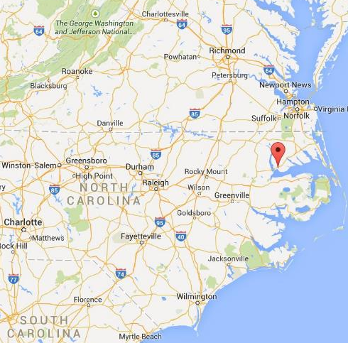
More than 5 million people live within a 3 hour drive of the Inner Banks
Richmond metropolitan area: 1.2 million
Raleigh-Durham-Chapel Hill metropolitan region: 2.0 million
Hampton Roads metropolitan area: 1.7 million
Fayetteville metropolitan area: 377 thousand
Source: US Census data
Notes:
https://www.outerbanks.org/media/879102/2015_attractions.pdf

Slide 46
Currently, about 100,000 tourists visit the Inner Banks annually
$144 million spent by tourists each year in the counties surrounding the Albemarle Sound*
$899 spent in average trip in the Coastal Region
101,000 visitors annually
*Excluding Dare County, which includes the Outer Banks
Approximately 80% of those visitors visit between April and October.
If we assume that 20% of the existing Inner Banks tourists would ride the ferry, that is 20,000 people per year, or a little over 90 people per day.
Sources: 2013 North Carolina Regional Travel Summary, NC Department of Commerce
2013 Economic Impact of Travel on Counties, NC Department of Commerce
Notes:
Note from Heather: I updated these numbers with the number specific to the Coastal Region of North Carolina

Slide 47
Market Size for Inner Banks consumers
Source: http://quickfacts.census.gov/qfd/maps/north_carolina_map.html

Slide 48
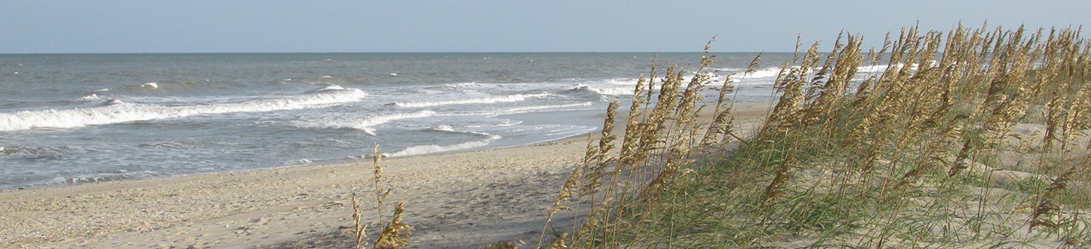
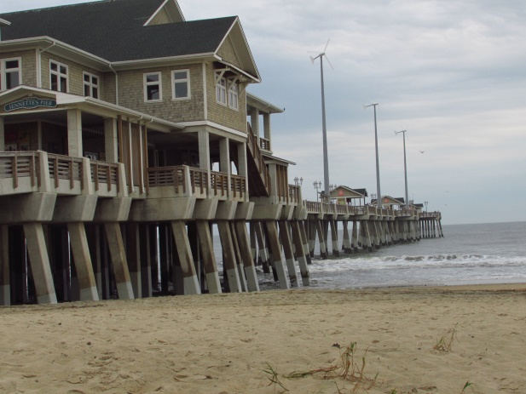
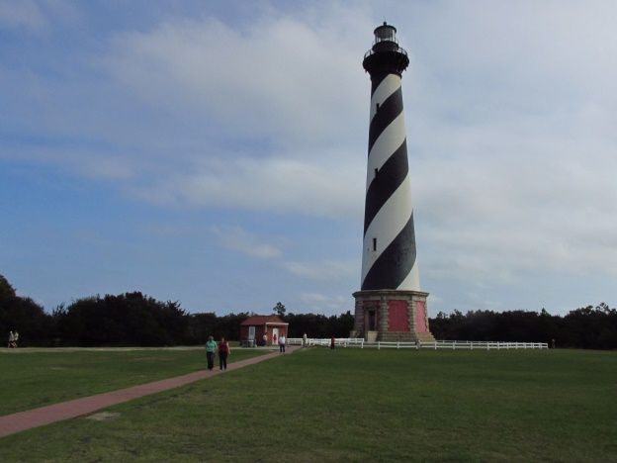
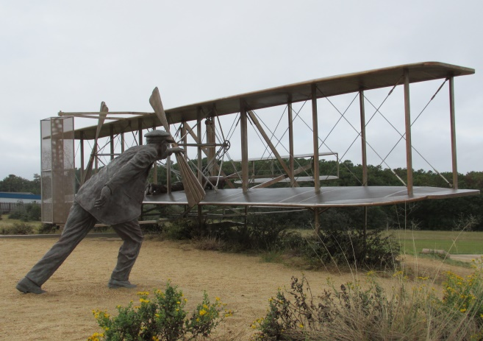
The Outer Banks are a dramatic and attractive tourist destination drawing millions of visitors annually to the region
Cape Hatteras National Seashore – 2.25 million visitors in 2014
Jennette’s Pier – 860,000 visitors in 2014
Cape Hatteras Light– 420,000 visitors in 2014
Wright Bros. memorial – 432,000 visitors in 2014
Notes:
https://www.outerbanks.org/media/879102/2015_attractions.pdf
Add slide of who is coming aside from OBX visitors after. Who is visiting?

Slide 49
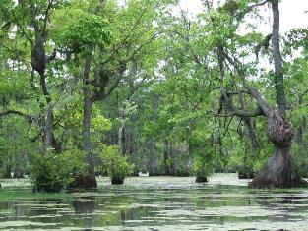



Attractions in the Inner Banks receive fewer tourists than the Outer Banks
Merchants Millpond State Park – 283,000 visitors in 2014
Museum of the Albemarle – 71,000 visitors in 2011
Historic Edenton Visitor Center – 22,000 visitors in 2011
Dismal Swamp State Park – 125,000 visitors in 2014
Notes:
https://www.outerbanks.org/media/879102/2015_attractions.pdf
Add slide of who is coming aside from OBX visitors after. Who is visiting?

Slide 50
Operations

Slide 51
There are 5 other main types of vessels
Other Ferry Options
Monohulls: Commonly used in the United States, especially where speeds greater than 30 knots in high sea conditions are not required.
Hydrofoils: Feature low-wake profiles, high speed, and low fuel usage.
Small Waterplane Area Twin Hull: Designed to reduce vessel motions during rough head seas, while sustaining normal cruising speeds.
Surface Effect Ships: Operate with low fuel usage and high speeds but have a high capital cost per seat, high maintenance requirements and costs, susceptibility to speed loss in heavy sea conditions, and a less comfortable ride.
Hovercraft: Travel above water and are propelled through the air. This hull form is attractive for shallow areas and is faster than other vessels. Negative considerations include high capital and maintenance costs, bumpy rides, and high levels of exterior noise.
Source: Transit Capacity and Quality of Service Manual – 2nd Edition
Notes:
VESSELS

Slide 52

Routes 1 and 2 of the Ferry System should include Elizabeth City, Columbia, Edenton, Plymouth, and Hertford
Route 1) Elizabeth City, Columbia, Edenton , Elizabeth City
Elizabeth City
Edenton
Columbia
Link to Live Map
Notes:
ROUTES

Slide 53

Routes 1 and 2 of the Ferry System should include Elizabeth City, Columbia, Edenton, Plymouth, and Hertford
Route 2) Plymouth, Edenton, Columbia, Hertford, Plymouth
Hertford
Edenton
Plymouth
Columbia
Link to Live Map
Notes:
ROUTES

Slide 54

Elizabeth City, Edenton, and Columbia can serve as initial anchors with several attractive “Things to do”
Columbia
Attractions
Attractions based on “Things to do” search at www.VisitNC.com for each city
Notes:
VITALITY

Slide 55

Elizabeth City, Edenton, and Columbia can serve as initial anchors with several attractive “Things to do”
Edenton
Attractions
Attractions based on “Things to do” search at www.VisitNC.com for each city
Notes:
VITALITY

Slide 56

Elizabeth City, Edenton, and Columbia can serve as initial anchors with several attractive “Things to do”
Edenton
Attractions
Attractions based on “Things to do” search at www.VisitNC.com for each city
Notes:
VITALITY

Slide 57

Elizabeth City, Edenton, and Columbia can serve as initial anchors with several attractive “Things to do”
Elizabeth
City
Attractions
Attractions based on “Things to do” search at www.VisitNC.com for each city
Notes:
VITALITY

Slide 58

Elizabeth City, Edenton, and Columbia can serve as initial anchors with several attractive “Things to do”
Elizabeth
City
Attractions
Attractions based on “Things to do” search at www.VisitNC.com for each city
Notes:
VITALITY

Slide 59

Elizabeth City, Edenton, and Columbia can serve as initial anchors with several attractive “Things to do”
Hertford
Attractions
Attractions based on “Things to do” search at www.VisitNC.com for each city
Notes:
VITALITY

Slide 60

Elizabeth City, Edenton, and Columbia can serve as initial anchors with several attractive “Things to do”
Plymouth
Attractions
Attractions based on “Things to do” search at www.VisitNC.com for each city
Notes:
VITALITY

Slide 61
Pricing and scheduling of other benchmarked ferry options
 | Beaufort | Port Clinton | Bahamas | Ft. Lauderdale | Wilmington | Lake Champlain, VT | Cape May Lewes, DE
Seasonal Usage | Reduced service off season | Seasonal May-Sept | Reduced service off season | More frequent stops in peak season | Daily in summers, weekends in the fall | Reduced in winter | Extended hours in summer
Ticket price | $10-$30 | $23-$39 | $27 | $26 | $5-7 | $8-10 | $4-$8
Source | Island Ferry Adventures | Jet Express | Albury’s Ferry Service | Water Taxi | River Taxi | Lake Champlain Ferries | Cape May Lewes Ferry

Slide 62
Finances

Slide 63
Worst case scenario models show that the water transport is not a viable investment
Investment Opportunity:
Two 149-passenger and two 49-passenger catamaran ferries traveling Route 1 and Route 2
Operates 7 days a week from April 1st through September 30st annually
Sells food and drinks, but not alcohol
Ticket prices stay flat at $20
Year 1 ridership starts at 600 passengers per day
Financial Metrics (10 year model)
Internal Rate of Return (IRR) | -28%
Return on Investment (ROI) | -1.13
Net Present Value (NPV) | $-13,393,164
Payback Period | More than 10 Years

Slide 64
Financial Model: Scenario 1
Scenario 1: Two 149-passenger ferries and two 49-passenger ferries, no alcohol sales
ENC Ferry Financial Model - Two ferries of each type, No alcohol sales
 | YEAR 0
Start-Up Costs
Administration and Due diligence | 336,000.00 | Assume 3% of boat expense
Boats | 11,200,000.00 | Assume loan out for boat only
Terminal Expenses | 0 | Assume that the towns will pay for this
Contingency (3%) | 346,080.00 | Assume 3% of boat expense plus admin and due diligence
Total Start-Up | 11,882,080.00
IRR | 1%
ROI | 0.05
NPV | ($4,761,226.84)
Payback period | 9.78

Slide 65
Financial Model: Scenario 1
Assumptions
Boat Passenger capacity | 396 | Assume two 49-passenger and two 149-passenger
Number of trips per day | 8 | 4 loops of each
Number of potential passengers per day | 3168
Operating days | 213
Average ticket price | $ 20.00
Number of boats | 4
Boat Acquisition cost 149 | $ 3,900,000.00
Boat Acquisition cost 49 | $ 1,700,000.00
Tax rate | 35%
Food and Drink | 40% | $ 5.00
Alcohol | 25% | $ 7.00
Number of captains | 4
Number of Crew | 10
Salary of captains | $ 52,000.00
Salary of Crew | $ 383,400.00
Crew Hourly Rate | $ 15.00
Operating hours per day | 12
Marketing/Advertising | 10% | Annual sales
Insurance Percentage per boat | 1.6%
Damages and Pollution Insurance per boat | $ 13,200.00
Other Staff - Manager | $ 35,000.00
Other Staff - COO | $ 65,000.00
Other Staff - Ticket Sales | $ 140,000.00
Number of locations | 5
Maintenance per boat 149 | $ 50,000.00
Maintenance per boat 49 | $ 30,000.00
Boat Length 149 | 72.00
Slip price per foot per month | $ 8.00
Boat Length 49 | 43.00
Off season months | 5.00
Food Margin (Supplies) | 50%
Operating cost per hour (fuel and lube) 149 | $ 146.08
Operating cost per hour (fuel and lube) 49 | $ 50.29
Ticket price escalation annual | 5%
Ticket Prices
Year 1 | $ 20.00
Year 2 | $ 21.00
Year 3 | $ 22.05
Year 4 | $ 23.15
Year 5 | $ 24.31
Year 6 | $ 25.53
Year 7 | $ 26.80
Year 8 | $ 28.14
Year 9 | $ 29.55
Year 10 | $ 31.03
Passengers per day
Year 1 | 750 | 5%
Year 2 | 788 | 5%
Year 3 | 827 | 5%
Year 4 | 868 | 5%
Year 5 | 912 | 5%
Year 6 | 957 | 5%
Year 7 | 1005 | 5%
Year 8 | 1055 | 5%
Year 9 | 1108 | 5%
Year 10 | 1163

Slide 66
Financial Model Scenario 1
 | YEAR 0 | YEAR 1 | YEAR 2 | YEAR 3 | YEAR 4 | YEAR 5 | YEAR 6 | YEAR 7 | YEAR 8 | YEAR 9 | YEAR 10
Revenue
Passenger Fares | - | 3,195,000.00 | 3,522,487.50 | 3,883,542.47 | 4,281,605.57 | 4,720,470.14 | 5,204,318.33 | 5,737,760.96 | 6,325,881.46 | 6,974,284.31 | 7,689,148.45
Food and Drink | - | 319,500.00 | 335,475.00 | 352,248.75 | 369,861.19 | 388,354.25 | 407,771.96 | 428,160.56 | 449,568.59 | 472,047.01 | 495,649.37
Total Operating Revenue | - | 3,514,500.00 | 3,857,962.50 | 4,235,791.22 | 4,651,466.76 | 5,108,824.39 | 5,612,090.29 | 6,165,921.52 | 6,775,450.05 | 7,446,331.32 | 8,184,797.82
Operating Expenses
Captain | - | 208,000.00 | 208,000.00 | 208,000.00 | 208,000.00 | 208,000.00 | 208,000.00 | 208,000.00 | 208,000.00 | 208,000.00 | 208,000.00
Crew | - | 383,400.00 | 383,400.00 | 383,400.00 | 383,400.00 | 383,400.00 | 383,400.00 | 383,400.00 | 383,400.00 | 383,400.00 | 383,400.00
Other Staff | - | 240,000.00 | 240,000.00 | 240,000.00 | 240,000.00 | 240,000.00 | 240,000.00 | 240,000.00 | 240,000.00 | 240,000.00 | 240,000.00
Fuel | - | 1,003,817.88 | 1,003,817.88 | 1,003,817.88 | 1,003,817.88 | 1,003,817.88 | 1,003,817.88 | 1,003,817.88 | 1,003,817.88 | 1,003,817.88 | 1,003,817.88
Maintenance | - | 160,000.00 | 160,000.00 | 160,000.00 | 160,000.00 | 160,000.00 | 160,000.00 | 160,000.00 | 160,000.00 | 160,000.00 | 160,000.00
Insurance | - | 192,400.00 | 192,400.00 | 192,400.00 | 192,400.00 | 192,400.00 | 192,400.00 | 192,400.00 | 192,400.00 | 192,400.00 | 192,400.00
Supplies | - | 159,750.00 | 167,737.50 | 176,124.38 | 184,930.59 | 194,177.12 | 203,885.98 | 214,080.28 | 224,784.29 | 236,023.51 | 247,824.68
Docking Fees | - | 9,200.00 | 9,200.00 | 9,200.00 | 9,200.00 | 9,200.00 | 9,200.00 | 9,200.00 | 9,200.00 | 9,200.00 | 9,200.00
Marketing and Advertising | - | 319,500.00 | 352,248.75 | 388,354.25 | 428,160.56 | 472,047.01 | 520,431.83 | 573,776.10 | 632,588.15 | 697,428.43 | 768,914.85
Total Operating Expenses | - | 2,676,067.88 | 2,716,804.13 | 2,761,296.50 | 2,809,909.03 | 2,863,042.02 | 2,921,135.69 | 2,984,674.25 | 3,054,190.32 | 3,130,269.82 | 3,213,557.41
EBITDA | - | 838,432.12 | 1,141,158.37 | 1,474,494.72 | 1,841,557.73 | 2,245,782.37 | 2,690,954.60 | 3,181,247.26 | 3,721,259.73 | 4,316,061.51 | 4,971,240.41
Depreciation and Amoritization | - | 224,000.00 | 224,000.00 | 224,000.00 | 224,000.00 | 224,000.00 | 224,000.00 | 224,000.00 | 224,000.00 | 224,000.00 | 224,000.00
EBIT | - | 614,432.12 | 917,158.37 | 1,250,494.72 | 1,617,557.73 | 2,021,782.37 | 2,466,954.60 | 2,957,247.26 | 3,497,259.73 | 4,092,061.51 | 4,747,240.41
Interest expense (debt) | - | 554,755.45 | 542,940.45 | 530,520.97 | 517,466.09 | 503,743.30 | 489,318.42 | 474,155.54 | 458,216.89 | 441,462.80 | 423,851.53
EBT | - | 59,676.67 | 374,217.92 | 719,973.75 | 1,100,091.64 | 1,518,039.08 | 1,977,636.18 | 2,483,091.73 | 3,039,042.84 | 3,650,598.71 | 4,323,388.88
Taxes |  | 20,886.84 | 130,976.27 | 251,990.81 | 385,032.07 | 531,313.68 | 692,172.66 | 869,082.11 | 1,063,664.99 | 1,277,709.55 | 1,513,186.11
Net Income | - | 38,789.84 | 243,241.65 | 467,982.93 | 715,059.57 | 986,725.40 | 1,285,463.52 | 1,614,009.62 | 1,975,377.84 | 2,372,889.16 | 2,810,202.77
Cash Flows | (11,882,080.00) | 38,789.84 | 243,241.65 | 467,982.93 | 715,059.57 | 986,725.40 | 1,285,463.52 | 1,614,009.62 | 1,975,377.84 | 2,372,889.16 | 2,810,202.77

Slide 67
Financial Model: Scenario 2
Scenario 2: Two 149-passenger ferries and two 49-passenger ferries, includes alcohol sales
ENC Ferry Financial Model - Two ferries of each type, Alcohol sales
 | YEAR 0
Start-Up Costs
Administration and Due diligence | 336,000.00 | Assume 3% of boat expense
Boats | 11,200,000.00 | Assume loan out for boat only
Terminal Expenses | 0 | Assume that the towns will pay for this
Contingency (3%) | 346,080.00 | Assume 3% of boat expense plus admin and due diligence
Total Start-Up | 11,882,080.00
IRR | 2%
ROI | 0.15
NPV | ($4,017,687.04)
Payback period | 9.4

Slide 68
Financial Model: Scenario 2
Assumptions
Boat Passenger capacity | 396 | Assume two 49-passenger and two 149-passenger
Number of trips per day | 8 | 4 loops of each
Number of potential passengers per day | 3168
Operating days | 213
Average ticket price | $ 20.00
Number of boats | 4
Boat Acquisition cost 149 | $ 3,900,000.00
Boat Acquisition cost 49 | $ 1,700,000.00
Tax rate | 35%
Food and Drink | 40% | $ 5.00
Alcohol | 25% | $ 7.00
Number of captains | 4
Number of Crew | 10
Salary of captains | $ 52,000.00
Salary of Crew | $ 383,400.00
Crew Hourly Rate | $ 15.00
Operating hours per day | 12
Marketing/Advertising | 10% | Annual sales
Insurance Percentage per boat | 1.6%
Damages and Pollution Insurance per boat | $ 13,200.00
Other Staff - Manager | $ 35,000.00
Other Staff - COO | $ 65,000.00
Other Staff - Ticket Sales | $ 140,000.00
Number of locations | 5
Maintenance per boat 149 | $ 50,000.00
Maintenance per boat 49 | $ 30,000.00
Boat Length 149 | 72.00
Slip price per foot per month | $ 8.00
Boat Length 49 | 43.00
Off season months | 5.00
Food Margin (Supplies) | 50%
Operating cost per hour (fuel and lube) 149 | $ 146.08
Operating cost per hour (fuel and lube) 49 | $ 50.29
Ticket price escalation annual | 5%
Ticket Prices
Year 1 | $ 20.00
Year 2 | $ 21.00
Year 3 | $ 22.05
Year 4 | $ 23.15
Year 5 | $ 24.31
Year 6 | $ 25.53
Year 7 | $ 26.80
Year 8 | $ 28.14
Year 9 | $ 29.55
Year 10 | $ 31.03
Passengers per day
Year 1 | 750 | 5%
Year 2 | 788 | 5%
Year 3 | 827 | 5%
Year 4 | 868 | 5%
Year 5 | 912 | 5%
Year 6 | 957 | 5%
Year 7 | 1005 | 5%
Year 8 | 1055 | 5%
Year 9 | 1108 | 5%
Year 10 | 1163

Slide 69
Financial Model: Scenario 2
 | YEAR 0 | YEAR 1 | YEAR 2 | YEAR 3 | YEAR 4 | YEAR 5 | YEAR 6 | YEAR 7 | YEAR 8 | YEAR 9 | YEAR 10
Revenue
Passenger Fares | - | 3,195,000.00 | 3,522,487.50 | 3,883,542.47 | 4,281,605.57 | 4,720,470.14 | 5,204,318.33 | 5,737,760.96 | 6,325,881.46 | 6,974,284.31 | 7,689,148.45
Food and Drink | - | 319,500.00 | 335,475.00 | 352,248.75 | 369,861.19 | 388,354.25 | 407,771.96 | 428,160.56 | 449,568.59 | 472,047.01 | 495,649.37
Alcohol | - | 279,562.50 | 293,540.63 | 308,217.66 | 323,628.54 | 339,809.97 | 356,800.46 | 374,640.49 | 393,372.51 | 413,041.14 | 433,693.19
Total Operating Revenue | - | 3,794,062.50 | 4,151,503.13 | 4,544,008.88 | 4,975,095.30 | 5,448,634.36 | 5,968,890.76 | 6,540,562.01 | 7,168,822.56 | 7,859,372.46 | 8,618,491.01
Operating Expenses
Captain | - | 208,000.00 | 208,000.00 | 208,000.00 | 208,000.00 | 208,000.00 | 208,000.00 | 208,000.00 | 208,000.00 | 208,000.00 | 208,000.00
Crew | - | 383,400.00 | 383,400.00 | 383,400.00 | 383,400.00 | 383,400.00 | 383,400.00 | 383,400.00 | 383,400.00 | 383,400.00 | 383,400.00
Other Staff | - | 240,000.00 | 240,000.00 | 240,000.00 | 240,000.00 | 240,000.00 | 240,000.00 | 240,000.00 | 240,000.00 | 240,000.00 | 240,000.00
Fuel | - | 1,003,817.88 | 1,003,817.88 | 1,003,817.88 | 1,003,817.88 | 1,003,817.88 | 1,003,817.88 | 1,003,817.88 | 1,003,817.88 | 1,003,817.88 | 1,003,817.88
Maintenance | - | 160,000.00 | 160,000.00 | 160,000.00 | 160,000.00 | 160,000.00 | 160,000.00 | 160,000.00 | 160,000.00 | 160,000.00 | 160,000.00
Insurance | - | 192,400.00 | 192,400.00 | 192,400.00 | 192,400.00 | 192,400.00 | 192,400.00 | 192,400.00 | 192,400.00 | 192,400.00 | 192,400.00
Supplies | - | 299,531.25 | 314,507.81 | 330,233.20 | 346,744.86 | 364,082.11 | 382,286.21 | 401,400.52 | 421,470.55 | 442,544.08 | 464,671.28
Docking Fees | - | 9,200.00 | 9,200.00 | 9,200.00 | 9,200.00 | 9,200.00 | 9,200.00 | 9,200.00 | 9,200.00 | 9,200.00 | 9,200.00
Marketing and Advertising | - | 319,500.00 | 352,248.75 | 388,354.25 | 428,160.56 | 472,047.01 | 520,431.83 | 573,776.10 | 632,588.15 | 697,428.43 | 768,914.85
Total Operating Expenses | - | 2,815,849.13 | 2,863,574.44 | 2,915,405.33 | 2,971,723.30 | 3,032,947.00 | 3,099,535.93 | 3,171,994.50 | 3,250,876.57 | 3,336,790.39 | 3,430,404.00
EBITDA | - | 978,213.37 | 1,287,928.68 | 1,628,603.55 | 2,003,372.00 | 2,415,687.36 | 2,869,354.83 | 3,368,567.51 | 3,917,945.98 | 4,522,582.07 | 5,188,087.01
Depreciation and Amoritization | - | 224,000.00 | 224,000.00 | 224,000.00 | 224,000.00 | 224,000.00 | 224,000.00 | 224,000.00 | 224,000.00 | 224,000.00 | 224,000.00
EBIT | - | 754,213.37 | 1,063,928.68 | 1,404,603.55 | 1,779,372.00 | 2,191,687.36 | 2,645,354.83 | 3,144,567.51 | 3,693,945.98 | 4,298,582.07 | 4,964,087.01
Interest expense (debt) | - | 554,755.45 | 542,940.45 | 530,520.97 | 517,466.09 | 503,743.30 | 489,318.42 | 474,155.54 | 458,216.89 | 441,462.80 | 423,851.53
EBT | - | 199,457.92 | 520,988.23 | 874,082.57 | 1,261,905.91 | 1,687,944.06 | 2,156,036.41 | 2,670,411.97 | 3,235,729.09 | 3,857,119.28 | 4,540,235.48
Taxes |  | 69,810.27 | 182,345.88 | 305,928.90 | 441,667.07 | 590,780.42 | 754,612.74 | 934,644.19 | 1,132,505.18 | 1,349,991.75 | 1,589,082.42
Net Income | - | 129,647.65 | 338,642.35 | 568,153.67 | 820,238.84 | 1,097,163.64 | 1,401,423.67 | 1,735,767.78 | 2,103,223.91 | 2,507,127.53 | 2,951,153.06
Cash Flows | (11,882,080.00) | 129,647.65 | 338,642.35 | 568,153.67 | 820,238.84 | 1,097,163.64 | 1,401,423.67 | 1,735,767.78 | 2,103,223.91 | 2,507,127.53 | 2,951,153.06

Slide 70
Financial Model: Scenario 3
Scenario 3: Four 49-passenger ferries, no alcohol sales
ENC Ferry Financial Model - Four small ferries, No alcohol sales
 | YEAR 0
Start-Up Costs
Administration and Due dilligence | 204,000.00 | Assume 3% of boat expense
Boats | 6,800,000.00 | Assume loan out for boat only
Terminal Expenses | 0 | Assume that the towns will pay for this
Contingency (3%) | 210,120.00 | Assume 3% of boat expense plus admin and due dilligence
Total Start-Up | 7,214,120.00
IRR | 16%
ROI | 1.60
NPV | $4,113,876.13
Payback period | 5.83

Slide 71
Financial Model: Scenario 3
Assumptions
Boat Passenger capacity | 196 | Assume four 49-passenger
Number of trips per day | 8 | 4 loops of each
Number of potential passengers per day | 1568
Operating days | 213
Average ticket price | $ 20.00
Number of boats | 4
Boat Acquisition cost 149 | $ 3,900,000.00
Boat Acquisition cost 49 | $ 1,700,000.00
Tax rate | 35%
Food and Drink | 40% | $ 5.00
Alcohol | 25% | $ 7.00
Number of captains | 4
Number of Crew | 8
Salary of captains | $ 52,000.00
Salary of Crew | $ 306,720.00
Crew Hourly Rate | $ 15.00
Operating hours per day | 12
Marketing/Advertising | 10% | Annual sales
Insurance Percentage per boat | 1.6%
Damages and Pollution Insurance per boat | $ 13,200.00
Other Staff - Manager | $ 35,000.00
Other Staff - COO | $ 65,000.00
Other Staff - Ticket Sales | $ 140,000.00
Number of locations | 5
Maintenance per boat 149 | $ 50,000.00
Maintenance per boat 49 | $ 30,000.00
Boat Length 149 | 72.00
Slip price per foot per month | $ 8.00
Boat Length 49 | 43.00
Off season months | 5.00
Food Margin (Supplies) | 50%
Operating cost per hour (fuel and lube) 149 | $ 146.08
Operating cost per hour (fuel and lube) 49 | $ 50.29
Ticket price escalation annual | 5%
Ticket Prices
Year 1 | $ 20.00
Year 2 | $ 21.00
Year 3 | $ 22.05
Year 4 | $ 23.15
Year 5 | $ 24.31
Year 6 | $ 25.53
Year 7 | $ 26.80
Year 8 | $ 28.14
Year 9 | $ 29.55
Year 10 | $ 31.03
Passengers per day
Year 1 | 750 | 5%
Year 2 | 788 | 5%
Year 3 | 827 | 5%
Year 4 | 868 | 5%
Year 5 | 912 | 5%
Year 6 | 957 | 5%
Year 7 | 1005 | 5%
Year 8 | 1055 | 5%
Year 9 | 1108 | 5%
Year 10 | 1163 | 5%

Slide 72
Financial Model: Scenario 3
 | YEAR 0 | YEAR 1 | YEAR 2 | YEAR 3 | YEAR 4 | YEAR 5 | YEAR 6 | YEAR 7 | YEAR 8 | YEAR 9 | YEAR 10
Revenue
Passenger Fares | - | 3,195,000.00 | 3,522,487.50 | 3,883,542.47 | 4,281,605.57 | 4,720,470.14 | 5,204,318.33 | 5,737,760.96 | 6,325,881.46 | 6,974,284.31 | 7,689,148.45
Food and Drink | - | 319,500.00 | 335,475.00 | 352,248.75 | 369,861.19 | 388,354.25 | 407,771.96 | 428,160.56 | 449,568.59 | 472,047.01 | 495,649.37
Total Operating Revenue | - | 3,514,500.00 | 3,857,962.50 | 4,235,791.22 | 4,651,466.76 | 5,108,824.39 | 5,612,090.29 | 6,165,921.52 | 6,775,450.05 | 7,446,331.32 | 8,184,797.82
Operating Expenses
Captain | - | 208,000.00 | 208,000.00 | 208,000.00 | 208,000.00 | 208,000.00 | 208,000.00 | 208,000.00 | 208,000.00 | 208,000.00 | 208,000.00
Crew | - | 306,720.00 | 306,720.00 | 306,720.00 | 306,720.00 | 306,720.00 | 306,720.00 | 306,720.00 | 306,720.00 | 306,720.00 | 306,720.00
Other Staff | - | 240,000.00 | 240,000.00 | 240,000.00 | 240,000.00 | 240,000.00 | 240,000.00 | 240,000.00 | 240,000.00 | 240,000.00 | 240,000.00
Fuel | - | 514,113.84 | 514,113.84 | 514,113.84 | 514,113.84 | 514,113.84 | 514,113.84 | 514,113.84 | 514,113.84 | 514,113.84 | 514,113.84
Maintenance | - | 120,000.00 | 120,000.00 | 120,000.00 | 120,000.00 | 120,000.00 | 120,000.00 | 120,000.00 | 120,000.00 | 120,000.00 | 120,000.00
Insurance | - | 122,000.00 | 122,000.00 | 122,000.00 | 122,000.00 | 122,000.00 | 122,000.00 | 122,000.00 | 122,000.00 | 122,000.00 | 122,000.00
Supplies | - | 159,750.00 | 167,737.50 | 176,124.38 | 184,930.59 | 194,177.12 | 203,885.98 | 214,080.28 | 224,784.29 | 236,023.51 | 247,824.68
Docking Fees | - | 6,880.00 | 6,880.00 | 6,880.00 | 6,880.00 | 6,880.00 | 6,880.00 | 6,880.00 | 6,880.00 | 6,880.00 | 6,880.00
Marketing and Advertising | - | 319,500.00 | 352,248.75 | 388,354.25 | 428,160.56 | 472,047.01 | 520,431.83 | 573,776.10 | 632,588.15 | 697,428.43 | 768,914.85
Total Operating Expenses | - | 1,996,963.84 | 2,037,700.09 | 2,082,192.46 | 2,130,804.99 | 2,183,937.98 | 2,242,031.65 | 2,305,570.21 | 2,375,086.28 | 2,451,165.78 | 2,534,453.37
EBITDA | - | 1,517,536.16 | 1,820,262.41 | 2,153,598.76 | 2,520,661.77 | 2,924,886.41 | 3,370,058.64 | 3,860,351.30 | 4,400,363.77 | 4,995,165.55 | 5,650,344.45
Depreciation and Amoritization | - | 136,000.00 | 136,000.00 | 136,000.00 | 136,000.00 | 136,000.00 | 136,000.00 | 136,000.00 | 136,000.00 | 136,000.00 | 136,000.00
EBIT | - | 1,381,536.16 | 1,684,262.41 | 2,017,598.76 | 2,384,661.77 | 2,788,886.41 | 3,234,058.64 | 3,724,351.30 | 4,264,363.77 | 4,859,165.55 | 5,514,344.45
Interest expense (debt) | - | 336,815.81 | 329,642.42 | 322,102.02 | 314,175.84 | 305,844.14 | 297,086.18 | 287,880.15 | 278,203.11 | 268,030.98 | 257,338.43
EBT | - | 1,044,720.35 | 1,354,619.99 | 1,695,496.74 | 2,070,485.93 | 2,483,042.27 | 2,936,972.46 | 3,436,471.16 | 3,986,160.65 | 4,591,134.56 | 5,257,006.02
Taxes |  | 365,652.12 | 474,117.00 | 593,423.86 | 724,670.07 | 869,064.79 | 1,027,940.36 | 1,202,764.91 | 1,395,156.23 | 1,606,897.10 | 1,839,952.11
Net Income | - | 679,068.23 | 880,503.00 | 1,102,072.88 | 1,345,815.85 | 1,613,977.47 | 1,909,032.10 | 2,233,706.25 | 2,591,004.43 | 2,984,237.47 | 3,417,053.91
Cash Flows | (7,214,120.00) | 679,068.23 | 880,503.00 | 1,102,072.88 | 1,345,815.85 | 1,613,977.47 | 1,909,032.10 | 2,233,706.25 | 2,591,004.43 | 2,984,237.47 | 3,417,053.91

Slide 73
Financial Model: Scenario 4
Scenario 4: Four 49-passenger ferries, includes alcohol sales
ENC Ferry Financial Model - Four small ferries, Alcohol sales
 | YEAR 0
Start-Up Costs
Administration and Due diligence | 204,000.00 | Assume 3% of boat expense
Boats | 6,800,000.00 | Assume loan out for boat only
Terminal Expenses | 0 | Assume that the towns will pay for this
Contingency (3%) | 210,120.00 | Assume 3% of boat expense plus admin and due diligence
Total Start-Up | 7,214,120.00
IRR | 18%
ROI | 1.76
NPV | $4,857,415.93
Payback period | 5.54

Slide 74
Financial Model: Scenario 4
Assumptions
Boat Passenger capacity | 196 | Assume four 49-passenger
Number of trips per day | 8 | 4 loops of each
Number of potential passengers per day | 1568
Operating days | 213
Average ticket price | $ 20.00
Number of boats | 4
Boat Acquisition cost 149 | $ 3,900,000.00
Boat Acquisition cost 49 | $ 1,700,000.00
Tax rate | 35%
Food and Drink | 40% | $ 5.00
Alcohol | 25% | $ 7.00
Number of captains | 4
Number of Crew | 8
Salary of captains | $ 52,000.00
Salary of Crew | $ 306,720.00
Crew Hourly Rate | $ 15.00
Operating hours per day | 12
Marketing/Advertising | 10% | Annual sales
Insurance Percentage per boat | 1.6%
Damages and Pollution Insurance per boat | $ 13,200.00
Other Staff - Manager | $ 35,000.00
Other Staff - COO | $ 65,000.00
Other Staff - Ticket Sales | $ 140,000.00
Number of locations | 5
Maintenance per boat 149 | $ 50,000.00
Maintenance per boat 49 | $ 30,000.00
Boat Length 149 | 72.00
Slip price per foot per month | $ 8.00
Boat Length 49 | 43.00
Off season months | 5.00
Food Margin (Supplies) | 50%
Operating cost per hour (fuel and lube) 149 | $ 146.08
Operating cost per hour (fuel and lube) 49 | $ 50.29
Ticket price escalation annual | 5%
Ticket Prices
Year 1 | $ 20.00
Year 2 | $ 21.00
Year 3 | $ 22.05
Year 4 | $ 23.15
Year 5 | $ 24.31
Year 6 | $ 25.53
Year 7 | $ 26.80
Year 8 | $ 28.14
Year 9 | $ 29.55
Year 10 | $ 31.03
Passengers per day
Year 1 | 750 | 5%
Year 2 | 788 | 5%
Year 3 | 827 | 5%
Year 4 | 868 | 5%
Year 5 | 912 | 5%
Year 6 | 957 | 5%
Year 7 | 1005 | 5%
Year 8 | 1055 | 5%
Year 9 | 1108 | 5%
Year 10 | 1163 | 5%

Slide 75
Financial Model: Scenario 4
 | YEAR 0 | YEAR 1 | YEAR 2 | YEAR 3 | YEAR 4 | YEAR 5 | YEAR 6 | YEAR 7 | YEAR 8 | YEAR 9 | YEAR 10
Revenue
Passenger Fares | - | 3,195,000.00 | 3,522,487.50 | 3,883,542.47 | 4,281,605.57 | 4,720,470.14 | 5,204,318.33 | 5,737,760.96 | 6,325,881.46 | 6,974,284.31 | 7,689,148.45
Food and Drink | - | 319,500.00 | 335,475.00 | 352,248.75 | 369,861.19 | 388,354.25 | 407,771.96 | 428,160.56 | 449,568.59 | 472,047.01 | 495,649.37
Alcohol | - | 279,562.50 | 293,540.63 | 308,217.66 | 323,628.54 | 339,809.97 | 356,800.46 | 374,640.49 | 393,372.51 | 413,041.14 | 433,693.19
Total Operating Revenue | - | 3,794,062.50 | 4,151,503.13 | 4,544,008.88 | 4,975,095.30 | 5,448,634.36 | 5,968,890.76 | 6,540,562.01 | 7,168,822.56 | 7,859,372.46 | 8,618,491.01
Operating Expenses
Captain | - | 208,000.00 | 208,000.00 | 208,000.00 | 208,000.00 | 208,000.00 | 208,000.00 | 208,000.00 | 208,000.00 | 208,000.00 | 208,000.00
Crew | - | 306,720.00 | 306,720.00 | 306,720.00 | 306,720.00 | 306,720.00 | 306,720.00 | 306,720.00 | 306,720.00 | 306,720.00 | 306,720.00
Other Staff | - | 240,000.00 | 240,000.00 | 240,000.00 | 240,000.00 | 240,000.00 | 240,000.00 | 240,000.00 | 240,000.00 | 240,000.00 | 240,000.00
Fuel | - | 514,113.84 | 514,113.84 | 514,113.84 | 514,113.84 | 514,113.84 | 514,113.84 | 514,113.84 | 514,113.84 | 514,113.84 | 514,113.84
Maintenance | - | 120,000.00 | 120,000.00 | 120,000.00 | 120,000.00 | 120,000.00 | 120,000.00 | 120,000.00 | 120,000.00 | 120,000.00 | 120,000.00
Insurance | - | 122,000.00 | 122,000.00 | 122,000.00 | 122,000.00 | 122,000.00 | 122,000.00 | 122,000.00 | 122,000.00 | 122,000.00 | 122,000.00
Supplies | - | 299,531.25 | 314,507.81 | 330,233.20 | 346,744.86 | 364,082.11 | 382,286.21 | 401,400.52 | 421,470.55 | 442,544.08 | 464,671.28
Docking Fees | - | 6,880.00 | 6,880.00 | 6,880.00 | 6,880.00 | 6,880.00 | 6,880.00 | 6,880.00 | 6,880.00 | 6,880.00 | 6,880.00
Marketing and Advertising | - | 319,500.00 | 352,248.75 | 388,354.25 | 428,160.56 | 472,047.01 | 520,431.83 | 573,776.10 | 632,588.15 | 697,428.43 | 768,914.85
Total Operating Expenses | - | 2,136,745.09 | 2,184,470.40 | 2,236,301.29 | 2,292,619.26 | 2,353,842.96 | 2,420,431.89 | 2,492,890.46 | 2,571,772.53 | 2,657,686.35 | 2,751,299.96
EBITDA | - | 1,657,317.41 | 1,967,032.72 | 2,307,707.59 | 2,682,476.04 | 3,094,791.40 | 3,548,458.87 | 4,047,671.55 | 4,597,050.02 | 5,201,686.11 | 5,867,191.05
Depreciation and Amoritization | - | 136,000.00 | 136,000.00 | 136,000.00 | 136,000.00 | 136,000.00 | 136,000.00 | 136,000.00 | 136,000.00 | 136,000.00 | 136,000.00
EBIT | - | 1,521,317.41 | 1,831,032.72 | 2,171,707.59 | 2,546,476.04 | 2,958,791.40 | 3,412,458.87 | 3,911,671.55 | 4,461,050.02 | 5,065,686.11 | 5,731,191.05
Interest expense (debt) | - | 336,815.81 | 329,642.42 | 322,102.02 | 314,175.84 | 305,844.14 | 297,086.18 | 287,880.15 | 278,203.11 | 268,030.98 | 257,338.43
EBT | - | 1,184,501.60 | 1,501,390.31 | 1,849,605.57 | 2,232,300.20 | 2,652,947.25 | 3,115,372.69 | 3,623,791.40 | 4,182,846.91 | 4,797,655.13 | 5,473,852.62
Taxes |  | 414,575.56 | 525,486.61 | 647,361.95 | 781,305.07 | 928,531.54 | 1,090,380.44 | 1,268,326.99 | 1,463,996.42 | 1,679,179.30 | 1,915,848.42
Net Income | - | 769,926.04 | 975,903.70 | 1,202,243.62 | 1,450,995.13 | 1,724,415.71 | 2,024,992.25 | 2,355,464.41 | 2,718,850.49 | 3,118,475.84 | 3,558,004.20
Cash Flows | (7,214,120.00) | 769,926.04 | 975,903.70 | 1,202,243.62 | 1,450,995.13 | 1,724,415.71 | 2,024,992.25 | 2,355,464.41 | 2,718,850.49 | 3,118,475.84 | 3,558,004.20

Slide 76
Risks

Slide 77
Political Risks: Local community support is critical for this cross-county initiative; focus should be on community leader buy-in in the near term
Ranked Risks & Challenges
Mitigation
1
Local political leader support
Host leadership meetings to build support; establish monetary support early
Are local mayors and other elected/appointed community leaders excited about this opportunity?
Are local leaders willing to work across county lines to ensure success of this ferry system?
2
Community Buy-In
Facilitate a series of community meetings to share plan, gauge interest, and develop buy-in
Will community members support tourism in their home?
Will local communities be willing to contribute financially?
Are communities ready and willing to establish a town identity and brand?
3
Outer Banks involvement
Prove viability and success without OBX initially; consider future expansion
Will the Outer Banks support this initiative?

Slide 78
Operational Risks: Prepare for operational challenges with additional research and measured actions
Ranked Risks & Challenges
Mitigation
1
Additional Infrastructure Needs
Determine exact needs in robust feasibility study
Do the docks need to be updated?
Do water or sewage facilities need to be installed?
Are additional parking lots needed?
2
Tourist Attractions
Develop the initial route with a focus on towns with the densest tourist attractions to prove profitability
Are there enough existing tourist attractions to draw tourists and give them something to do on shore?
3
Weather & Seasonality
1) Purchase natural disaster insurance
2) Make decisions based on projected revenue from April 1- October 31
How can you protect against natural disasters such as hurricanes?
Is seasonality a concern?

Slide 79

Environmental Risks: Sufficient planning for route, navigation equipment, and boat selection will alleviate environmental impacts
Ranked Risks & Challenges
Mitigation
1
Impact on Wildlife & Vegetation
Select low wake vessels and plan navigation routes in existing channels
Will wakes from ferries damage low lying marsh areas?
Will the ferries product noise that will disturb waterfowl?
Will the pollution from the ferries damage marine life, oyster beds, and sea grasses?
2
Impact on Physical Space
Select ferries with minimal draft and waterjet propulsion
Is dredging required?
Will existing channels be used?
3
Impact on People
Use existing channels for routes, include state-of-the-art navigation equipment on boats, and thoroughly train crews
Will the ferries damage the commercial and recreational fishing industries?
Will existing channels be used?
Will the ferries maintain a safe water experience for others?

Slide 80
Financial Risks: The tenuousness of few key assumptions can be mitigated through additional research and planned agreements
Ranked Risks & Challenges
$$$
Mitigation
1
Ridership Estimate
Conduct market research into existing OBX and IBX tourists as well as other potential sources
Will the ferry system attract sufficient passengers?
2
Supplementary Investments Required
Rely on harbor communities to fund additional public facility projects
What costs will need to be incurred to ready harbors for increased traffic?
3
Exposure to Volatile Oil Market
Hedge risk by purchasing futures in oil
Will fluctuations in fuel prices make running ferries cost prohibitive?

Slide 81
Demographics

Slide 82


Albemarle Sound Population
Residents primarily reside in rural areas.
Back Country Folks
Golden Ponds
Crossroads Villagers
Bedrock America
Old Milltowns
Young & Rustic
Blue Highways
Simple Pleasures
Heartlanders
Shotguns & Pickups
Red, White & Blues
Kid Country, USA
Traditional Times
Big Sky Families
Greenbelt Sports
Mayberry-ville
New Homesteaders
Big Fish, Small Pond
God's Country
Country Squires
Fast-Track Families
$
Income
$$$$
Source: Nielsen

Slide 83

Albemarle Sound Population
Segments vary in age and skew towards lower income.
Older
Old Milltowns
Heartlanders
Traditional Times
Big Fish, Small Pond
Back Country Folks
Simple Pleasures
Bedrock America
Kid Country, USA
New Homesteaders
Shotguns & Pickups
Age
Country Squires
Blue Highways
Red, White & Blues
Young & Rustic
God's Country
Mayberry-ville
Crossroads Villagers
Greenbelt Sports
Younger
Blue Highways
$
Income
$$$$
Source: Nielsen

Slide 84






Top 6 Segments
Traditional Times is the kind of lifestyle where small-town couples nearing retirement are beginning to enjoy their first empty-nest years. Typically in their fifties and older, these upper-middle-class Americans pursue a kind of granola-and-grits lifestyle. On their coffee tables are magazines with titles like Country Living and Country Home. But they're big travelers, especially in recreational vehicles and campers.
With many of its residents over 65 years old, Simple Pleasures is mostly a retirement lifestyle: a neighborhood of lower-middle-class singles and couples living in modestly priced homes. Many are high school-educated seniors who held blue-collar jobs before their retirement. And a disproportionate number served in the military, so many residents are members of veterans clubs.
Strewn among remote farm communities across the nation, Back Country Folks are a long way away from economic paradise. The residents tend to be poor, over 65 years old, and living in older, modest-sized homes and manufactured housing. Typically, life in this segment is a throwback to an earlier era when farming dominated the American landscape.
With a population of white-collar couples and families, Crossroads Villagers is a classic rural lifestyle. Residents are high school-educated, with downscale incomes and modest housing; one-fifth live in mobile homes. And there's an air of self-reliance in these households as Crossroads Villagers help put food on the table through fishing, gardening, and hunting.
Older, upper-class, college-educated professionals, the members of Big Fish, Small Pond are often among the leading citizens of their small-town communities. These upscale, empty-nesting couples enjoy the trappings of success, including belonging to country clubs, maintaining large investment portfolios, and spending freely on computer technology.
On maps, Blue Highways are often two-lane roads that wind through remote stretches of the American landscape. Among lifestyles, Blue Highways is the standout for midscale residents who live in isolated towns and farmsteads. Here, Boomer men like to hunt and fish, the women enjoy sewing and crafts, and everyone looks forward to going out to a country music concert.
Source: Nielsen

Slide 85

Population Changes in North Carolina
Source: http://www.osbm.state.nc.us/ncosbm/facts_and_figures/socioeconomic_data/population_estimates/demog/2013provgrowthmig.pdf
Notes:
http://www.osbm.state.nc.us/ncosbm/facts_and_figures/socioeconomic_data/population_estimates/demog/2013provgrowthmig.pdf

Slide 86
Unemployment rates are declining across inner and outer banks counties, but they still remain higher than the overall state.
 | 2013 | 2014
North Carolina | 6.7% | 5.4%
Beaufort County | 9.70% | 6.30%
Bertie County | 10.90% | 7.80%
Camden County | 7.60% | 5.80%
Carteret County | 7.40% | 5.40%
Chowan County | 9.50% | 6.70%
Craven County | 9.00% | 6.00%
Currituck County | 6.40% | 5.50%
Dare County | 9.80% | 8.80%
Hertford County | 9.40% | 6.40%
Hyde County | 9.50% | 9.70%
Pamlico County | 8.90% | 6.00%
Pasquotank County | 10.10% | 7.70%
Perquimans County | 9.20% | 6.90%
Pitt County | 8.10% | 5.20%
Tyrrell County | 8.90% | 7.00%
Washington County | 9.80% | 6.60%
Source: http://http://accessnc.commerce.state.nc.us/EDIS/demographics.html
Notes:
http://http://accessnc.commerce.state.nc.us/EDIS/demographics.html

Slide 87


Blue Collar Workers
Albemarle Sound
Source: http://sm2.simplymap.com.libproxy.lib.unc.edu/index.html
Notes:
http://sm2.simplymap.com.libproxy.lib.unc.edu/index.html

Slide 88


White Collar Workers
Source: http://sm2.simplymap.com.libproxy.lib.unc.edu/index.html

Slide 89

Manteo, NC
Population: 6,708 – Median Age: 42.6 – Median Income: $51,000
A segment of upscale exurban couples, Greenbelt Sports is known for its active lifestyle. Most of these older residents are married, college-educated, and own new homes. And few segments have higher rates for pursuing outdoor activities such as skiing, canoeing, backpacking, boating, and mountain biking.
Widely scattered throughout the nation's heartland, Kid Country, USA is a segment dominated by large families living in small towns. Ethnically diverse, these young, working-class households include homeowners, renters, and military personnel living in base housing; a little over a tenth of residents own mobile homes.
Young, upper-middle-class families seeking to escape suburban sprawl find refuge in New Homesteaders, a collection of small rustic townships filled with new ranches and Cape Cods. With decent-paying jobs in white and blue-collar industries, these dual-income couples have fashioned comfortable, child-centered lifestyles; their driveways are filled with campers and powerboats, their family rooms with PlayStations.
The residents of Red, White & Blues typically live in exurban towns rapidly morphing into bedroom suburbs. Their streets feature new fast-food restaurants, and locals have recently celebrated the arrival of chains like Walmart, Radio Shack, and Payless Shoes. Middle-aged or older, with high school educations and midscale incomes, these folks are transitioning from blue-collar jobs to the service industry.
Traditional Times is the kind of lifestyle where small-town couples nearing retirement are beginning to enjoy their first empty-nest years. Typically in their fifties and older, these upper-middle-class Americans pursue a kind of granola-and-grits lifestyle. On their coffee tables are magazines with titles like Country Living and Country Home. But they're big travelers, especially in recreational vehicles and campers.
Source: Nielsen

Slide 90

Columbia, NC
Population: 4,034 – Median Age: 40.7 – Median Income: $33,700
Strewn among remote farm communities across the nation, Back Country Folks are a long way away from economic paradise. The residents tend to be poor, over 65 years old, and living in older, modest-sized homes and manufactured housing. Typically, life in this segment is a throwback to an earlier era when farming dominated the American landscape.
Bedrock America consists of economically challenged families in small, isolated towns located throughout the nation's heartland. With modest educations, sprawling families, and service jobs, many of these residents struggle to make ends meet. One in five live in mobile homes. One in four haven't finished high school. Rich in scenery, Bedrock America is a haven for fishing, hunting, hiking, and camping.
On maps, Blue Highways are often two-lane roads that wind through remote stretches of the American landscape. Among lifestyles, Blue Highways is the standout for midscale residents who live in isolated towns and farmsteads. Here, Boomer men like to hunt and fish, the women enjoy sewing and crafts, and everyone looks forward to going out to a country music concert.
With a population of white-collar couples and families, Crossroads Villagers is a classic rural lifestyle. Residents are high school-educated, with downscale incomes and modest housing; one-fifth live in mobile homes. And there's an air of self-reliance in these households as Crossroads Villagers help put food on the table through fishing, gardening, and hunting.
Golden Ponds is mostly a retirement lifestyle, dominated by downscale singles and couples over 65 years old. Found in small bucolic towns around the country, these high school-educated seniors live in small apartments on less than $35,000 a year; more than one in five reside in a nursing home. For these elderly residents, daily life is often a succession of sedentary activities such as reading, watching TV, playing bingo, and doing craft projects.
Source: Nielsen

Slide 91

Hertford, NC
Population: 12,366 – Median Age: 47.3 – Median Income: $37,800
Strewn among remote farm communities across the nation, Back Country Folks are a long way away from economic paradise. The residents tend to be poor, over 65 years old, and living in older, modest-sized homes and manufactured housing. Typically, life in this segment is a throwback to an earlier era when farming dominated the American landscape.
On maps, Blue Highways are often two-lane roads that wind through remote stretches of the American landscape. Among lifestyles, Blue Highways is the standout for midscale residents who live in isolated towns and farmsteads. Here, Boomer men like to hunt and fish, the women enjoy sewing and crafts, and everyone looks forward to going out to a country music concert.
America was once a land of small middle-class towns, which can still be found today among Heartlanders. This widespread segment consists of older couples with white-collar jobs living in sturdy, unpretentious homes. In these communities of small families and empty-nesting couples, Heartlanders residents pursue a rustic lifestyle where hunting and fishing remain prime leisure activities along with cooking, sewing, camping, and boating.
With many of its residents over 65 years old, Simple Pleasures is mostly a retirement lifestyle: a neighborhood of lower-middle-class singles and couples living in modestly priced homes. Many are high school-educated seniors who held blue-collar jobs before their retirement. And a disproportionate number served in the military, so many residents are members of veterans clubs.
Traditional Times is the kind of lifestyle where small-town couples nearing retirement are beginning to enjoy their first empty-nest years. Typically in their fifties and older, these upper-middle-class Americans pursue a kind of granola-and-grits lifestyle. On their coffee tables are magazines with titles like Country Living and Country Home. But they're big travelers, especially in recreational vehicles and campers.
Source: Nielsen

Slide 92

Edenton, NC
Population: 12,714 – Median Age: 45 – Median Income: $31,800
Strewn among remote farm communities across the nation, Back Country Folks are a long way away from economic paradise. The residents tend to be poor, over 65 years old, and living in older, modest-sized homes and manufactured housing. Typically, life in this segment is a throwback to an earlier era when farming dominated the American landscape.
With a population of white-collar couples and families, Crossroads Villagers is a classic rural lifestyle. Residents are high school-educated, with downscale incomes and modest housing; one-fifth live in mobile homes. And there's an air of self-reliance in these households as Crossroads Villagers help put food on the table through fishing, gardening, and hunting.
America was once a land of small middle-class towns, which can still be found today among Heartlanders. This widespread segment consists of older couples with white-collar jobs living in sturdy, unpretentious homes. In these communities of small families and empty-nesting couples, Heartlanders residents pursue a rustic lifestyle where hunting and fishing remain prime leisure activities along with cooking, sewing, camping, and boating.
America's once-thriving mining and manufacturing towns have aged--as have the residents in Old Milltowns communities. Today, the majority of residents are retired singles and couples, living on downscale incomes in pre-1960 homes and apartments. For leisure, they enjoy gardening, sewing, socializing at veterans clubs, or eating out at casual restaurants.
With many of its residents over 65 years old, Simple Pleasures is mostly a retirement lifestyle: a neighborhood of lower-middle-class singles and couples living in modestly priced homes. Many are high school-educated seniors who held blue-collar jobs before their retirement. And a disproportionate number served in the military, so many residents are members of veterans clubs.
Source: Nielsen

Slide 93

Plymouth, NC
Population: 7,288 – Median Age: 43.4 – Median Income: $33,000
Strewn among remote farm communities across the nation, Back Country Folks are a long way away from economic paradise. The residents tend to be poor, over 65 years old, and living in older, modest-sized homes and manufactured housing. Typically, life in this segment is a throwback to an earlier era when farming dominated the American landscape.
Bedrock America consists of economically challenged families in small, isolated towns located throughout the nation's heartland. With modest educations, sprawling families, and service jobs, many of these residents struggle to make ends meet. One in five live in mobile homes. One in four haven't finished high school. Rich in scenery, Bedrock America is a haven for fishing, hunting, hiking, and camping.
Golden Ponds is mostly a retirement lifestyle, dominated by downscale singles and couples over 65 years old. Found in small bucolic towns around the country, these high school-educated seniors live in small apartments on less than $35,000 a year; more than one in five reside in a nursing home. For these elderly residents, daily life is often a succession of sedentary activities such as reading, watching TV, playing bingo, and doing craft projects.
With many of its residents over 65 years old, Simple Pleasures is mostly a retirement lifestyle: a neighborhood of lower-middle-class singles and couples living in modestly priced homes. Many are high school-educated seniors who held blue-collar jobs before their retirement. And a disproportionate number served in the military, so many residents are members of veterans clubs.
Young & Rustic is composed of middle-aged, restless singles. These folks tend to be lower-middle-income, high school-educated, and live in tiny apartments in the nation's exurban towns. With their service industry jobs and modest incomes, these folks still try to fashion fast-paced lifestyles centered on sports, cars, and dating.
Source: Nielsen

Slide 94

Washington, NC
Population: 27,404 – Median Age: 41 – Median Income: $38,700
Bedrock America consists of economically challenged families in small, isolated towns located throughout the nation's heartland. With modest educations, sprawling families, and service jobs, many of these residents struggle to make ends meet. One in five live in mobile homes. One in four haven't finished high school. Rich in scenery, Bedrock America is a haven for fishing, hunting, hiking, and camping.
With a population of white-collar couples and families, Crossroads Villagers is a classic rural lifestyle. Residents are high school-educated, with downscale incomes and modest housing; one-fifth live in mobile homes. And there's an air of self-reliance in these households as Crossroads Villagers help put food on the table through fishing, gardening, and hunting.
America's once-thriving mining and manufacturing towns have aged--as have the residents in Old Milltowns communities. Today, the majority of residents are retired singles and couples, living on downscale incomes in pre-1960 homes and apartments. For leisure, they enjoy gardening, sewing, socializing at veterans clubs, or eating out at casual restaurants.
With many of its residents over 65 years old, Simple Pleasures is mostly a retirement lifestyle: a neighborhood of lower-middle-class singles and couples living in modestly priced homes. Many are high school-educated seniors who held blue-collar jobs before their retirement. And a disproportionate number served in the military, so many residents are members of veterans clubs.
Young & Rustic is composed of middle-aged, restless singles. These folks tend to be lower-middle-income, high school-educated, and live in tiny apartments in the nation's exurban towns. With their service industry jobs and modest incomes, these folks still try to fashion fast-paced lifestyles centered on sports, cars, and dating.
Source: Nielsen

Slide 95

Belhaven, NC
Population: 4,038 – Median Age: 46.9 – Median Income: $30,800
Strewn among remote farm communities across the nation, Back Country Folks are a long way away from economic paradise. The residents tend to be poor, over 65 years old, and living in older, modest-sized homes and manufactured housing. Typically, life in this segment is a throwback to an earlier era when farming dominated the American landscape.
On maps, Blue Highways are often two-lane roads that wind through remote stretches of the American landscape. Among lifestyles, Blue Highways is the standout for midscale residents who live in isolated towns and farmsteads. Here, Boomer men like to hunt and fish, the women enjoy sewing and crafts, and everyone looks forward to going out to a country music concert.
With a population of white-collar couples and families, Crossroads Villagers is a classic rural lifestyle. Residents are high school-educated, with downscale incomes and modest housing; one-fifth live in mobile homes. And there's an air of self-reliance in these households as Crossroads Villagers help put food on the table through fishing, gardening, and hunting.
Golden Ponds is mostly a retirement lifestyle, dominated by downscale singles and couples over 65 years old. Found in small bucolic towns around the country, these high school-educated seniors live in small apartments on less than $35,000 a year; more than one in five reside in a nursing home. For these elderly residents, daily life is often a succession of sedentary activities such as reading, watching TV, playing bingo, and doing craft projects.
With many of its residents over 65 years old, Simple Pleasures is mostly a retirement lifestyle: a neighborhood of lower-middle-class singles and couples living in modestly priced homes. Many are high school-educated seniors who held blue-collar jobs before their retirement. And a disproportionate number served in the military, so many residents are members of veterans clubs.
Source: Nielsen

