Slide 1

Swindon & North Wiltshire Deaf Children’s Society
ANNUAL GENERAL MEETING 2023

Slide 2


AGM AGENDA 2023
13th JULY 2023
Committee Welcome & Apologies for Absence
Annual Report – Chair’s update reporting on the past year
Financial Report – Accounts update reporting on group’s income and spending throughout the year
The Funding Support Model
The DCS in the last decade
Election of Trustees & Committee Members for coming year:
          Election of Trustees (including co-chairs)
          Election of Committee Members
            Secretary
            Treasurer
            Safeguarding Officer
            Committee – Non-specified
Looking forward to 2023/2024
NEXT STEPS
AOB

Slide 3
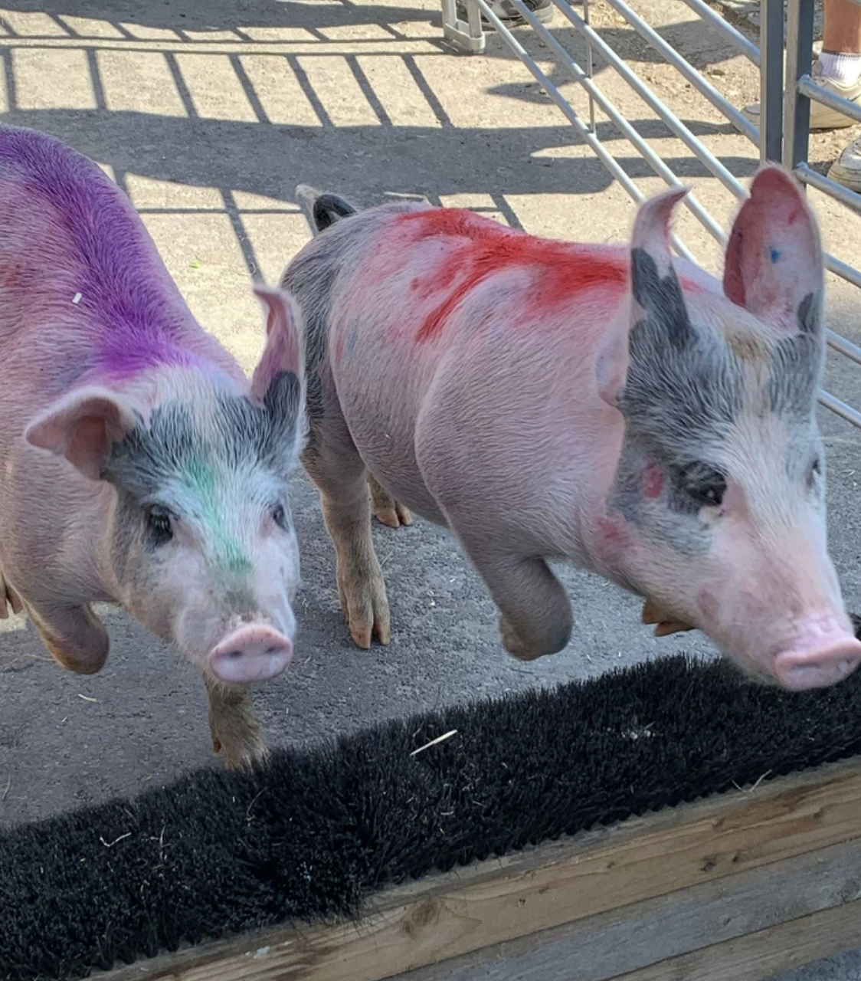
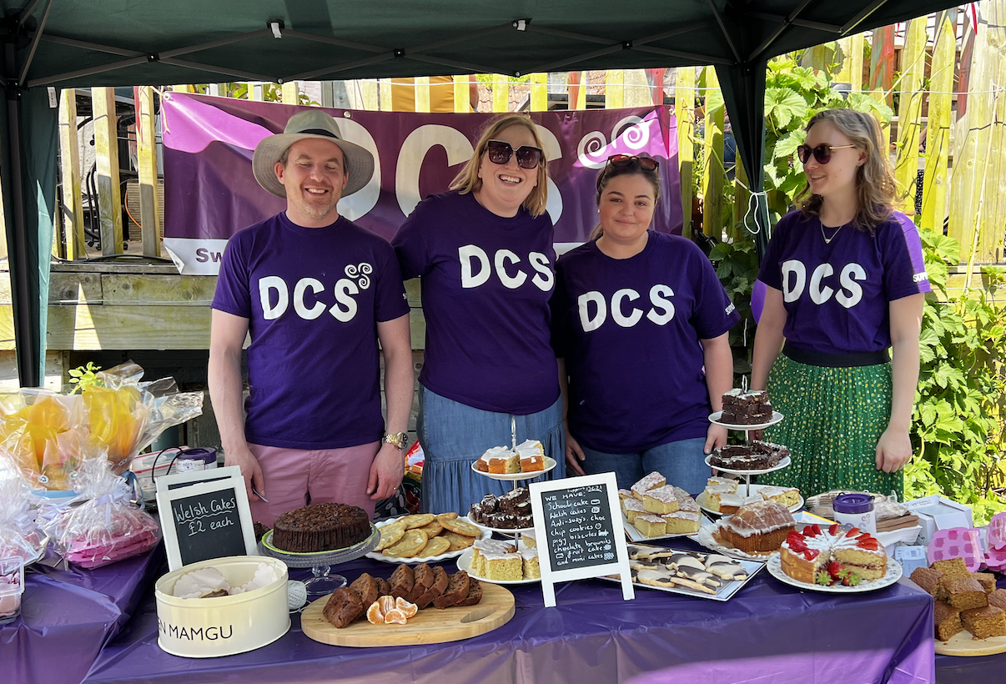
The DCS in 2022/2023
Since our last AGM we have:
Held 5 events:
        Ice Skating (Aug 22) - 24 attendees (8 families)
        Pantomime (Dec 22) - 35 attendees (9 families)
        Soft Play (March 23) – 24 children with 4 new families attending
        Pre-School Farmer Gows – 30 attendees (8 families)
        Secondary School Pizza and Bowling – 7 children
Promoted NDCS online events
Continued our new funding support offering which funded a transition event for the TOD team for year 6 children
Rolled out resources bags for pre-school children in Swindon with the TOD team
Raised £1,225 selling cakes and racing pigs in Bishopstone
Ended mobile phone contract – contactable by email
Established a strong committee to protect the future of the charity

Slide 4
MEMBERSHIP
July 2023
The current membership (as of 03.07.2023): are:
142 registered memberships, with a total of 160 adult members (increase of 31 memberships).
This includes:
17 volunteers members
  21 Professional members
Total of 213 children (118 deaf, 95 hearing siblings) – (increase of 54 child members)
Audit shows we have 7 “children” registered who are now over 18 – These members will need to be contacted to ask if these young people would like to become adult members.

Slide 5
DCS Donations since the last AGM
A HUGE THANK YOU to:
Mr John Elliot who donated £80.00 on his 80th birthday
Wiltshire Trauma Informed Counselling who donated £100.00
Swindon Lottery - £32.50
Helen Brownings Royal Oak for supporting us with pig racing in Bishopstone - £1,225.00 raised
Our members who supported us by contributing £370.00 towards pantomime tickets

Slide 6
FINANCIAL REPORT
Account Balances 2021/22
OPENING ACCOUNT BALANCE AS AT 31.08.2021 | £
Santander Current Account | 948.75
Santander Savings Account | 40,000.99
Petty Cash | 0.00
TOTAL BALANCE | 40,949.74
CLOSING ACCOUNT BALANCE AS AT 31.08.2022 | £
Santander Current Account | 1,553.73
Santander Savings Account | 38,622.64
Petty Cash | 0.00
TOTAL BALANCE | 40,176.37

Slide 7
FINANCIAL REPORT
Account Balances – 2022/23
OPENING ACCOUNT BALANCE AS AT 31.08.2022 | £
Santander Current Account | 1,553.73
Santander Savings Account | 38,622.64
Petty Cash | 0.00
TOTAL BALANCE | 40,176.37
ACCOUNT BALANCE AS AT 09.07.2023 | £
Santander Current Account | 4,257.38
Santander Savings Account | 32,672.86
Petty Cash | 0.00
TOTAL BALANCE | 36,930.24

Slide 8
FINANCIAL REPORT
Profit & Loss 2021/22
01/09/2021 – 31/08/2022
INCOME | £
DONATIONS | 2,270.00
GIFT AID | 0.00
BANK INTEREST | 15.24
SWINDON LOTTERY | 125.00
JUST GIVING – GENERAL CAMPAIGN | 296.39
TOTAL INCOME | 3,006.63
OUTGOINGS | £
WEBSITE & DOMAIN NAME | 166.82
ZOOM SUBSCRIPTION | 143.88
JUST GIVING | 216.00
PHONE | 90.00
PRINTING, POSTAGE, ONEDRIVE | 49.84
GIFTS | 22.50
EVENTS | 1,758.74
BSL INTERPRETERS | 1,149.45
SUPPORT TO OTHERS | 148.77
TOTAL OUTGOINGS | 3,780.00
NET PROFIT | -£773.37
END OF YEAR ANNUAL RETURN for 2021-22 SUBMITTED TO HMRC 7th November 2022

Slide 9
FINANCIAL REPORT
Profit & Loss 2022/23
01/09/22 – 09/07/23
INCOME | £
DONATIONS | 80.00
CONTRIBUTIONS FOR EVENTS | 370.00
BANK INTEREST | 150.22
SWINDON LOTTERY | 32.50
FUNDRAISING | 1,225.00
TOTAL INCOME | £1,857.72
OUTGOINGS | £
WEBSITE & DOMAIN NAME | 143.86
FUNDRAISING | 51.54
ZOOM SUBSCRIPTION | 143.88
JUST GIVING | 180.00
PHONE | 68.58
ROOM HIRE | 68.00
INVESTMENT (gazebo & trustee training) | 149.00
EVENTS | 3,090.01
BSL INTERPRETERS | 800.00
SUPPORT TO OTHERS | 408.98
TOTAL OUTGOINGS | 5,103.85
NET PROFIT | -£3,246.13
END OF YEAR ANNUAL RETURN for 2022-23 TO BE SUBMITTED TO HMRC FOLLOWING YEAR END 31/08/2023

Slide 10
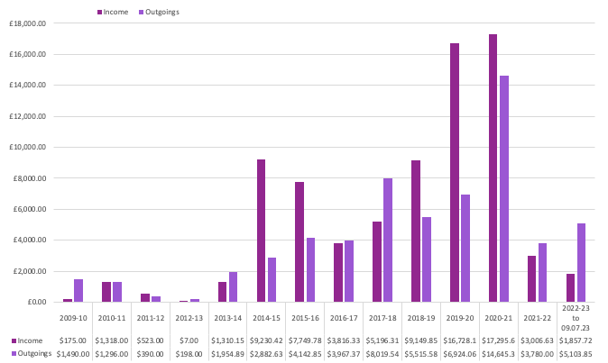
FINANCIAL REPORT
Past 14 Years
COMMITTEE CHANGE

Slide 11

The Funding Support Model
FUNDING APPLICATIONS
The Funding Scheme has been available to support deaf children in the Swindon & North Wiltshire area for many years and we continued this in 2023. It is available to support the aims of the DCS and further promote opportunities for deaf children and young people to socialise and have fun together to improve the children’s confidence and encourage friendships.
Individuals & organisations can apply for up to £500 to be able to benefit deaf children, young people and their families. This includes applying for funding to hold an event, run group sessions or any other opportunities that meet the charities aims and objectives.
Funding for more than £500 is considered by the committee if presented to the committee showing full details and the benefits that will be delivered.
Funding Application Forms can be downloaded from: www.swindonandnorthwiltsdcs.org/member-support

Slide 12
The Funding Support Model
INDIVIDUAL MEMBER GRANTS
The Grant is designed to support two of the charity’ objectives:
To advance the education of children and young people with a hearing impairment.
To promote deaf awareness and support the needs of deaf children.
Who is eligible to apply for this grant?
Current family & child/young people members who are signed up to Swindon & North Wiltshire Deaf Children’s Society may apply
What type requests will the charity consider?
Assistance with the purchase of specialist hearing equipment which will benefit an individual member
The provision of funding for specialist courses that will support the advancement of the child’s education
Support for professional assessments
Funding Application Forms can be downloaded from: www.swindonandnorthwiltsdcs.org/member-support

Slide 13
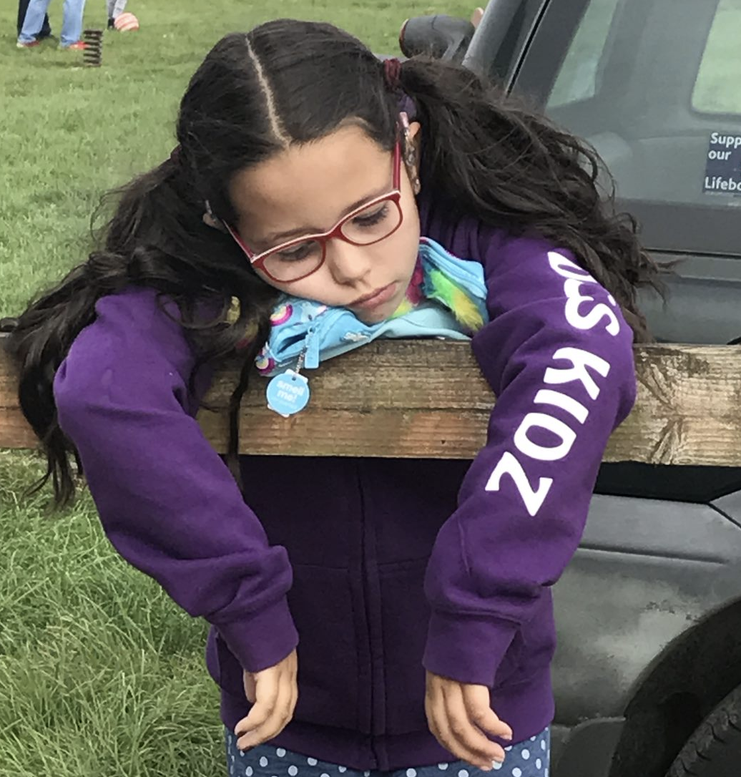
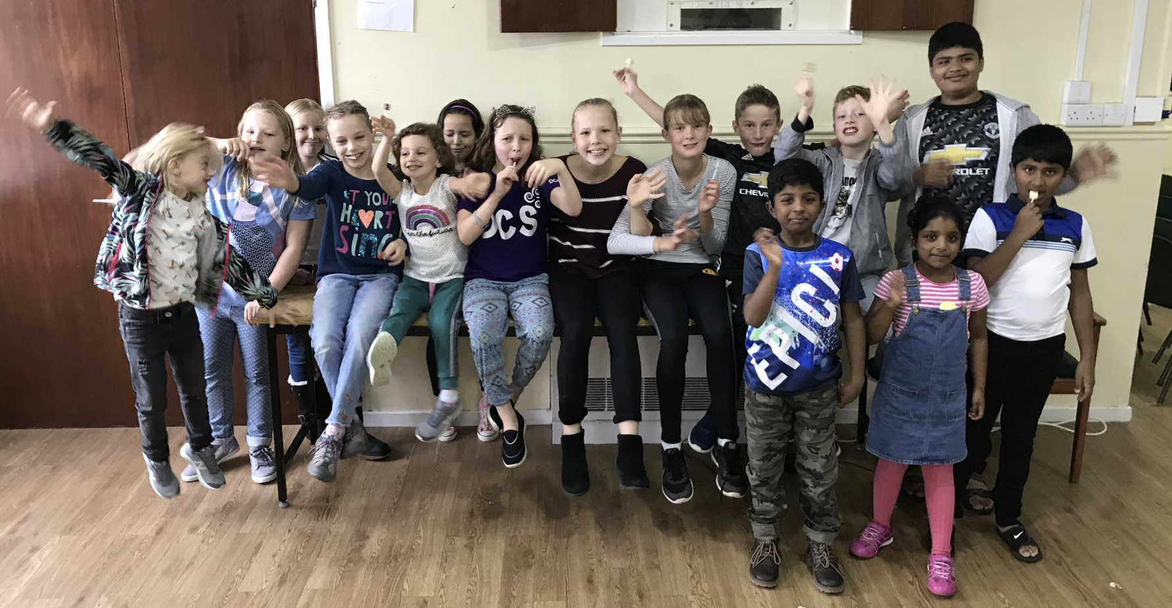
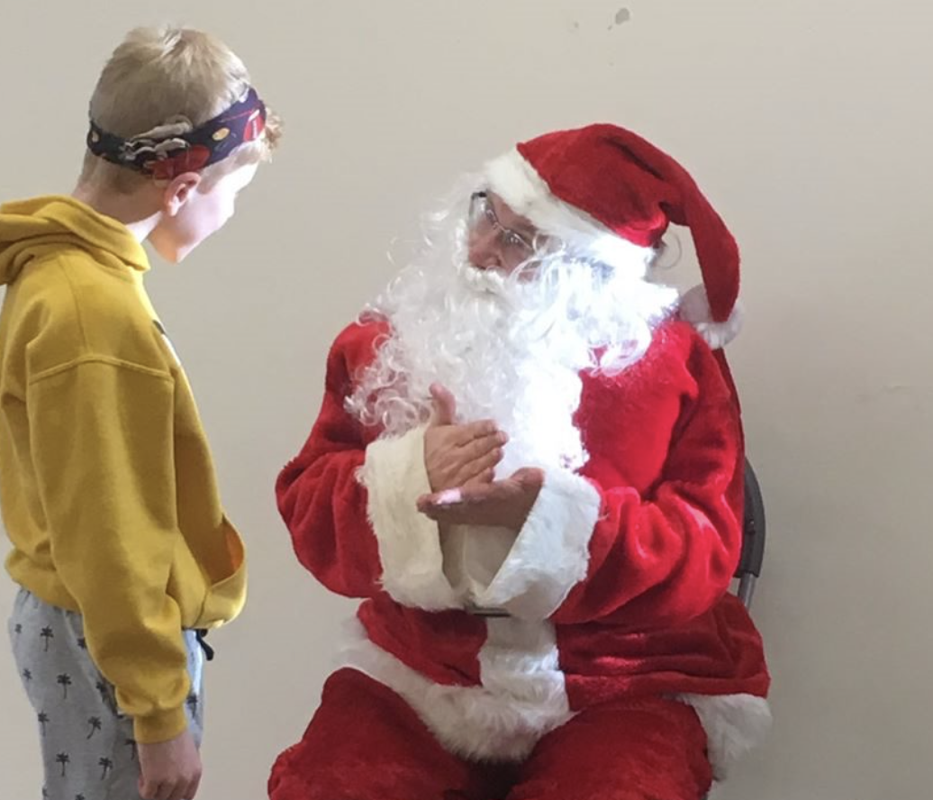
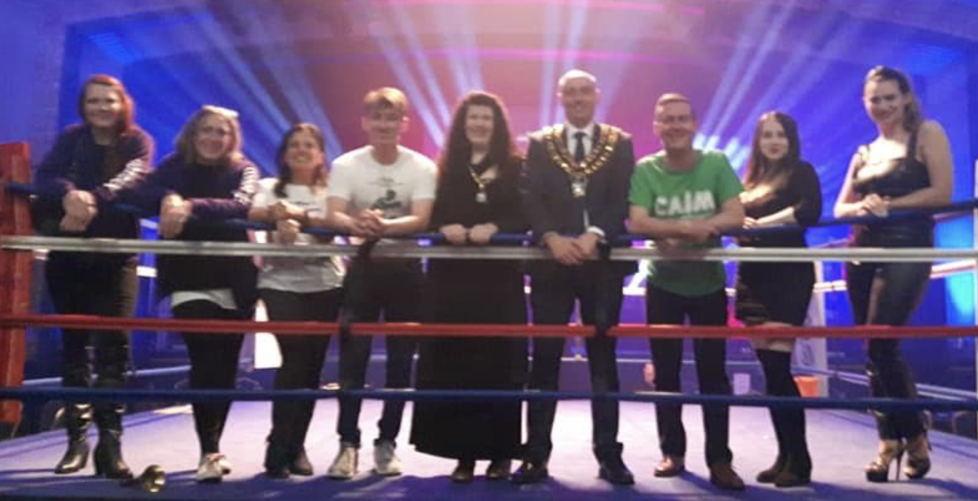
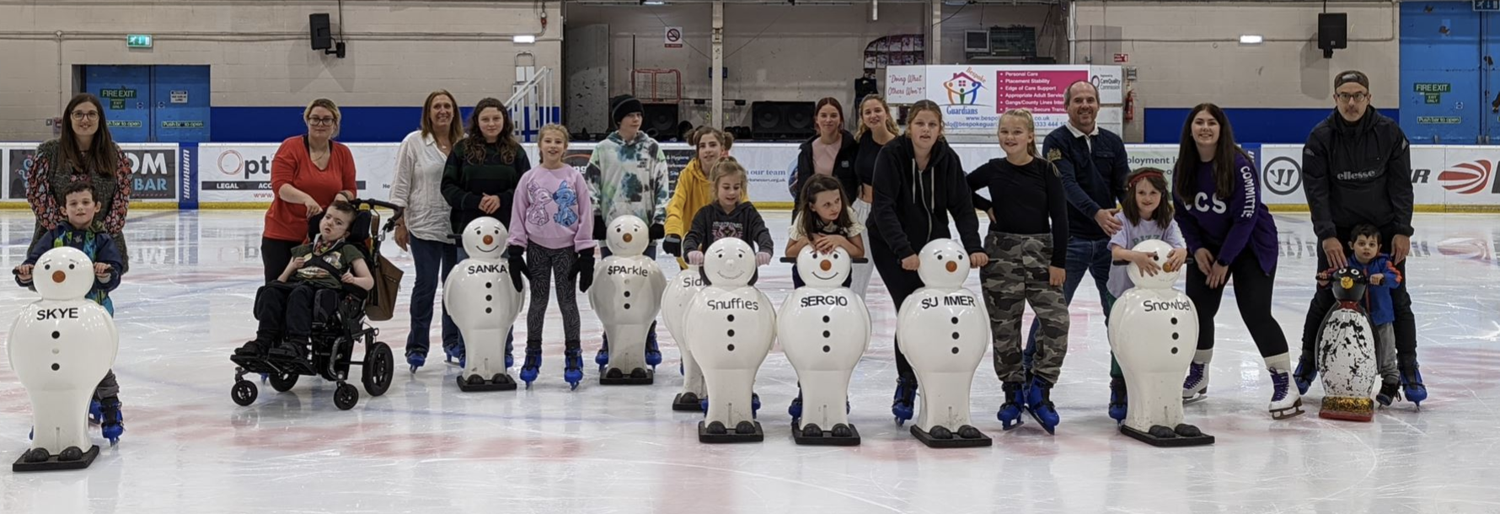
The DCS in the last decade
Increased membership from 38 to 160 adult members
Updated the charity's constitution
Re-branded with a new logo
Created t-shirts, hoodies, leaflets, posters and events banners
Launched the DCS website, Facebook Group and Page
Attended multiple NDCS National Councils
Automated membership sign up to meet GDPR
Launched Mailchimp for email campaigns to reach our members
Held approx. 40 events for our children and family members
Survived Covid and multiple lockdowns!
Raised a total of £75,341 from just £7 income in 2012/13
Held loads of skydives raising £18,559
Had 1 Oscar winner with The Silent Child short film
Supported 30 events with the Mayor's Year of fundraising as one of the two nominated charities raising £11,990
Funded online BSL courses & launched the funding support model
Switched on the Old Town Christmas Lights
Supported Audiology and Advisory Teachers of the Deaf with iPads, Soundfields, Puppets, Men in the boat, Book projects, radio aids …
Created the DCS handbook to support running the charity
Built a strong and sustainable committee

Slide 14
COMMITTEE
ELECTIONS
  A HUGE THANK YOU TO OUR CURRENT COMMITTEE MEMBERS WHO ARE ALL STANDING DOWN TODAY:
  Millie Green, Natasha Gallagher, Tim Swinyard, Emily Beardshall, Salim Suleman, Les Cavilla, Victoria Jones, Hayley Cozens, Josie Singleton and Victoria Batterton
  ELECTION OF TRUSTEES & CHAIR/S
  ELECTION OF SECRETARY
  ELECTION OF TREASURER
  ELECTION OF SAFEGUARDING OFFICER
  ELECTION OF COMMITTEE MEMBERS
  Note: Quorum is 10% of the voting membership.
  We have 160 registered adult members, so 16 votes is quorum.

Slide 15

Looking Forward 2023/24
  Upcoming Events:
  Summer Family Event – 2nd or 3rd September – TBC
  Pottery Event – 30th September – Eastcott Studios
  Technology Evening – 12th October – Dorcan Academy
  Snow White - BSL interpreted pantomime – 10th December – The Wyvern Theatre
  30th September 2023 – Charity is 30 years old!
The outgoing trustees wish the new trustees and committee members all the best for a successful 2023/2024 and we look forward to seeing where you take the charity next...

Slide 16
NEXT STEPS
  Advice: All event cut offs recommended to be more than 14 days in advance to allow for cancellation of BSL interpreters without incurring a charge.
  DCS HANDBOOK FOR HANDOVER
  AGREE BANKING CHANGES AND NEXT STEPS
  AGREE WHO WILL COMPLETE CHARITIES COMMISSION UPDATE OF TRUSTEES
  AGREE WHO WILL NOTIFY NDCS LOCAL GROUPS OF NEW COMMITTEE
  AGREE WHO WILL CHANGE THE REGISTERED ADDRESS OF THE CHARITY
  AGREE ADMINS FOR FACEBOOK PAGE, PRIVATE GROUP & COMMITTEE & MAKE CHANGES
  BOOK WEBSITE & MAILCHIMP TRAINING WITH TASHA
  BOOK CHAIR HANDOVER WITH MILLIE (This session will check all accounts and change details together)
  BOOK DATE FOR NEXT COMMITTEE MEETING
  TO NOTE: GDA (50% cancellation) and Coleview Centre invoices to be received and paid – Gift & AGM pizzas paid, not yet reported by Treasurer

Slide 17
AOB

Slide 18
Swindon & North Wiltshire Deaf Children’s Society
THANK YOU FOR ATTENDING

