Slide 1
Mashing Content, Information Literacy, and 21st Century Skills
SITE 2015 Las Vegas, Nevada

Slide 2
“… positive correlation between multimedia and student achievement.” Jonassen, 1995
Let’s help our pre-service teachers………..

Slide 3
TodaysMeet --- https://todaysmeet.com/SITE-2015

Slide 4
21st Century Skills

Slide 5
21st Century Skills
Use technology and digital media strategically and capably
Integrate and evaluate information from diverse media and formats
Integrate and evaluate information presented visually, orally, and quantitatively
Make strategic use of digital media to express ideas and information

Slide 6
Before Getting Started……
Screen Capture Tools
Screencast O Matic http://www.screencast-o-matic.com/
CamStudio http://camstudio.org/
EZVid http://www.ezvid.com/
Group Behavior
Netiquette Primer http://www.bucks.edu/old_docs/online/dlresources/Netiquette-quiz-results.html
Netiquette Quiz
http://www.nku.edu/~rkdrury/experiment/netiquette_quiz.htm

Slide 7
Victorian Crime and Punishment http://vcp.e2bn.org/

Slide 8
History’s Heros http://historysheroes.e2bn.org/

Slide 9
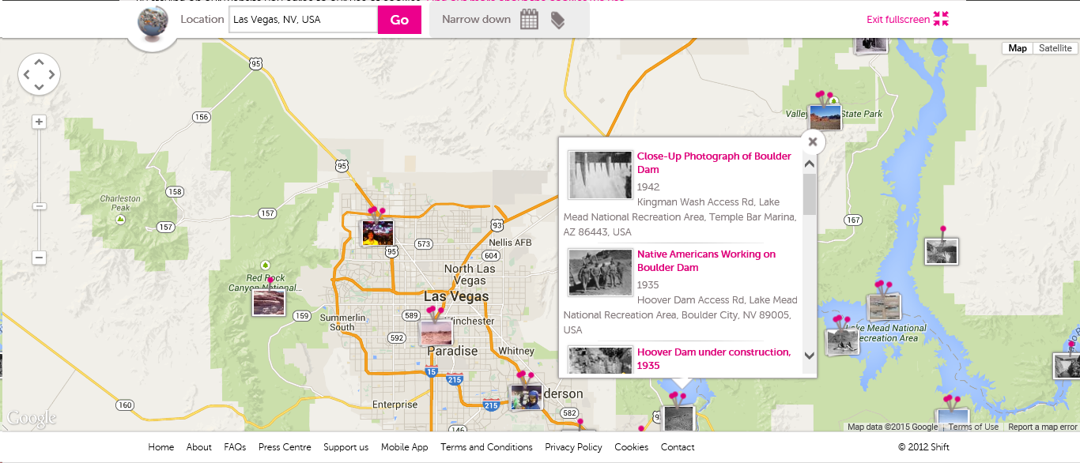
Historypin http://www.historypin.org
Like pintrest
Notes:
Like Pinterest but with historical photos
Searched for Las Vegas… Boulder and Hoover Dam --close up photos, native americans, working on the dam, under construction etc

Slide 10
Historypin http://www.historypin.org
Multimedia Brochure
Glogster
http://edu.glogster.com/
Collage
FX Photo
Top 10 List
Use phone to create video
Comic Book http://www.makebeliefscomix.com/Apple/index.php
Notes:
Like Pinterest but with historical photos
Searched for Las Vegas… Boulder and Hoover Dam --close up photos, native americans, working on the dam, under construction etc

Slide 11
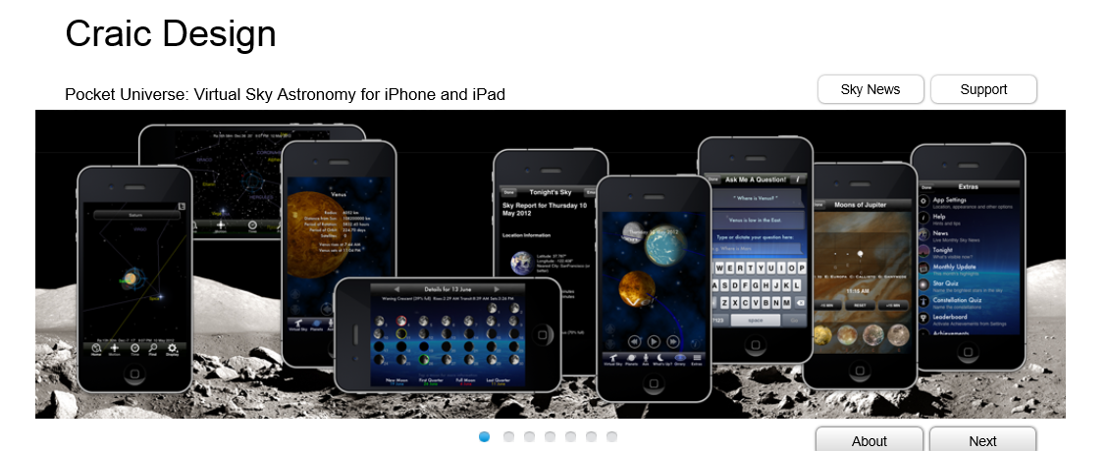
Pocket Universe http://pocketuniverse.info/
Notes:
App available for apple and android.
augmented reality view of the night sky, to a virtual visit to the surface of Mars, Pocket Universe is the ultimate in astronomy apps. Moon phases, Orrery, ISS sightings, Jupiter’s moons, Quiz games, Leaderboard achievements, pop-up notifications of important events, monthly and nightly highlights..

Slide 12
Pocket Universe http://pocketuniverse.info/
Learn / Interesting / Questions
audioBoom https://audioboom.com/
Group Presentation
Coggle https://coggle.it/
Interact https://www.tryinteract.com/
©Craic Design
Notes:
audioBoom also has prerecorded libraries of topics – can combine student audio with library audio
Interact – online quiz creator

Slide 13
Poll Everywhere http://www.polleverywhere.com/

Slide 14
Poll Everywhere http://www.polleverywhere.com/
Lecture
To create KWL

Slide 15
Biodigital Human https://www.biodigital.com/

Slide 16
Biodigital Human https://www.biodigital.com/
Presentation / Quiz
eduCanon http://www.educanon.com/
InterAct https://www.tryinteract.com/
Flashcards
Flashcard Machine http://www.flashcardmachine.com/
Tutorial
Book Creator https://edshelf.com/tool/book-creator
Notes:
Educanon - Create a video, add questions, flipped classroom or have students create lectures / quizzes

Slide 17
Smithsonian Digital Collection http://library.si.edu/digital-library

Slide 18
Smithsonian Digital Collection http://library.si.edu/digital-library
Museum Box http://museumbox.e2bn.org/
Concept Map
Instagrok Instagrok Instagrok http://www.instagrok.com/
Cacoo https://cacoo.com/

Slide 19
Instagrok http://www.instagrok.com/
Notes:
Creates interactive concept map links to content searched las vegas

Slide 20
Library of Congress Digital Collection http://loc.gov/library/libarch-digital.html

Slide 21
Library of Congress Digital Collection http://loc.gov/library/libarch-digital.html
Notate With Original Ideas
Explain Everything https://itunes.apple.com/us/app/explain-everything/id431493086?mt=8
Make a Timeline
Timemapper http://timemapper.okfnlabs.org/
Group Presentation
Wiggio https://wiggio.com
Mash Audio Files http://soundcloud.com/apps/myna
Teaching With Primary Sources at UCF http://loc-ucf-site-2015.weebly.com/
Notes:
Wiggio – conf calls, shared calendar, to do lists, assign tasks, poll in real time, email, tesxr, shared online folder

Slide 22
Google Art Project https://www.google.com/culturalinstitute/project/art-project

Slide 23
Google Art Project https://www.google.com/culturalinstitute/project/art-project
Masher http://masher.com/
Timetoast http://www.timetoast.com/
Paper https://www.fiftythree.com/paper
Storybird http://storybird.com/
Creaza http://www.creazaeducation.com/
Notes:
Paper – iPad app for drawing etc
Storybirt - read, write, share books

Slide 24
The Big History Project https://www.bighistoryproject.com/home

Slide 25
The Big History Project https://www.bighistoryproject.com/home
Use with Facing History and Ourselves https://www.facinghistory.org/ to design a concept web.
Gliffy https://www.gliffy.com
Using graphics, create a video
Loopster https://www.loopster.com/
Graph Statistics
Create A Graph http://nces.ed.gov/nceskids/createagraph/
Quiz Quizlet http://quizlet.com/
Notes:
Facing History - Resource collections has links to sites, videos, print materials, lessons
Loopster is a video editor and an app

Slide 26
Other Content Sites……
Exploratorium - http://www.exploratorium.edu/explore
Online Tangrams - http://www.abcya.com/tangrams.htm
BBC Learning Zone - http://www.bbc.co.uk/programmes/p01b8f09
Languages Online - http://www.education.vic.gov.au/languagesonline/default.htm
New York Times Teaching Today’s News - http://learning.blogs.nytimes.com/teaching-topics/teaching-topics-great-ways-to-teach-any-days-times/

Slide 27
MIT App Inventor http://appinventor.mit.edu/explore/front.html
Notes:
Open source code for creating apps.

Slide 28
Thank you! Kristi@dr-bordelon.com

