Slide 1
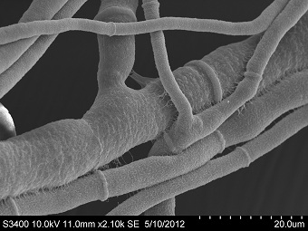
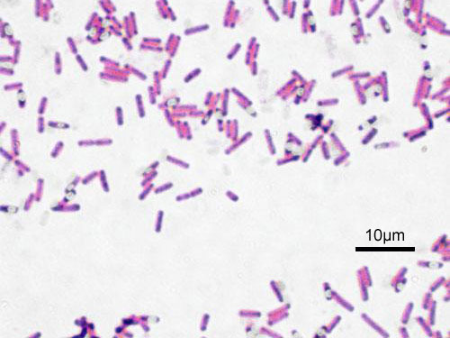
Microbiome sampling
What are you made of?
www.tridiybio.org
Experiment:
Inoculate plate for bacterial sampling
Do two of the following:
1) Streak finger on one side of plate
2) Swab nose and streak
3) Swab tongue and streak
4) Streak finger, wipe, streak other
side of plate
Incubate at 37º Celsius
Take picture and send via email
Microbiome is the collection of
small microorganisms that cover
and inhabit a body
Human body has around
1 trillion cells
Human microbiome has around
1-10 trillion organisms
Primarily bacteria, fungi

