Slide 1
Is this rock any good?
Some things to consider for cabachoning

Slide 2
Good for what?
Hardness (Why 7 is the magic number)
Structural Integrity
Color
Pattern
Value
Setting
Customer issues

Slide 3
hardness
A quick review of the Moh’s hardness scale.
Measure of relative hardness (which rocks scratch other rocks)
Common minerals given whole number hardness numbers
1-Talc, 2-Gypsum, 3-Calcite, 4-Flourite, 5-Apatite, 6-Orthoclase, 7-Quartz, 8-Topaz, 9-Corundum, 10-diamond.
Why is 7 the magic number in the jewelry industry?

Slide 4
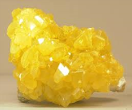
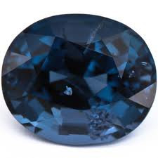
Hardness of other common materials
Ice, lead – 1.5
Sulfur – 2
Gold, silver, aluminum, copper, fingernails – 2.5 to 3
Tooth enamel, obsidian, glass – 5 to 5.5
Opal, peridot, tanzanite 6 to 7
Emerald, steel, spinel 7.5 to 8
Silicon carbide (carborundum) 9 to 9.5

Slide 5
hardness
7 is the hardness of quartz (silica) which is the major component of dust.
Stones with a hardness of less than 7 over time will develop scratches from rubbing against dust.

Slide 6
Structural integrity (holding it all together)
Cracks
Inclusions
Soft spots
Two minerals coming together
Cleavage planes
Outside weathered or oxidized layer
Color changes in the rock

Slide 7
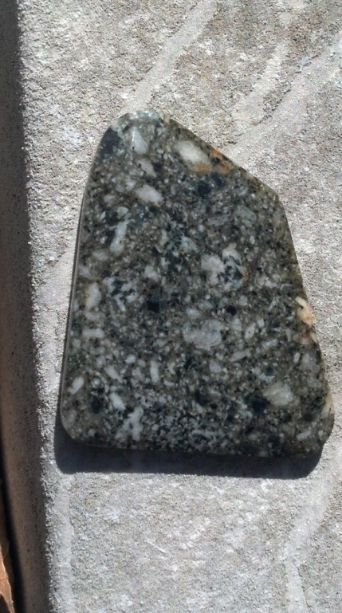
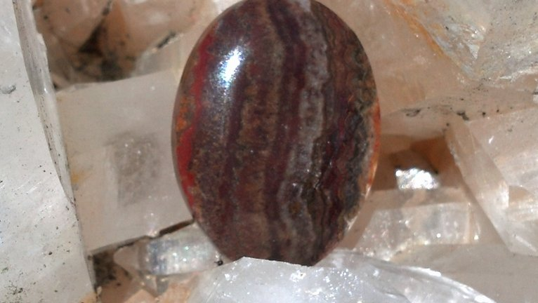
color
Is it a pretty color (e.g. spinel)?
Is it rich? Is it “pastel” or just washed out?
Is it consistent throughout the piece you want to use?

Slide 8
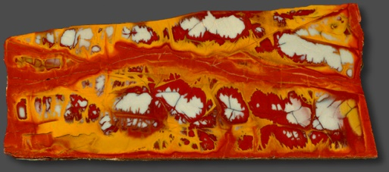
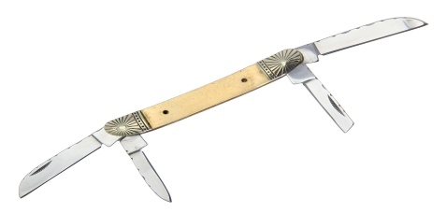
pattern
Is it recognizable (waves, lines, dots, dendrites)?
Does the stone you want to craft capture the pattern?
Bad pairing of stone and setting
Big pattern
Itty bitty space

Slide 9
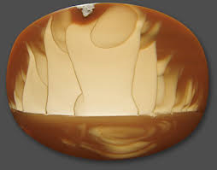
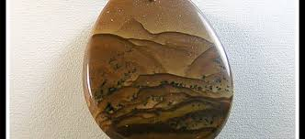
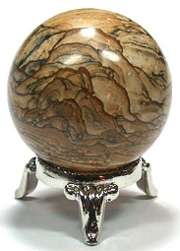
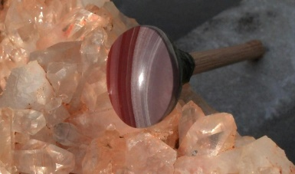
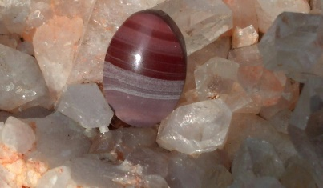
pattern
Good examples

Slide 10
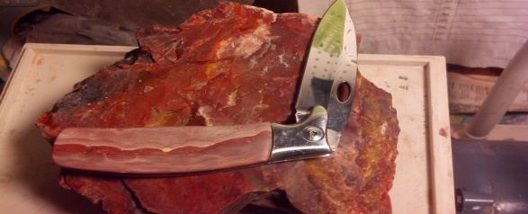
Setting
How big of a hole are you trying to fill?
Setting size may limit your options on which stones you can find or afford to put in there.
Kind of related to pattern.
Does the setting protect or expose the stone? Softer stones need protection.

Slide 11
value
Do the individual components of the project have intrinsic (recognizable) value?
Precious metals and “name brand” stones usually let you charge more.
There are many beautiful stones and minerals that no one has ever heard of.
It is very hard to charge top dollar for a piece if you don’t know the name of the stone.

Slide 12
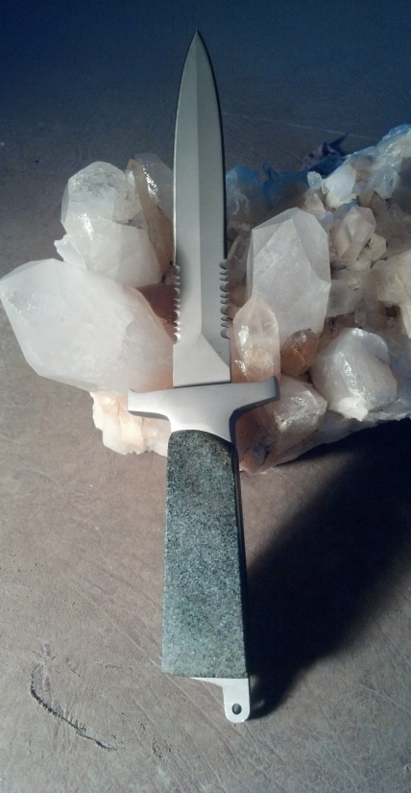
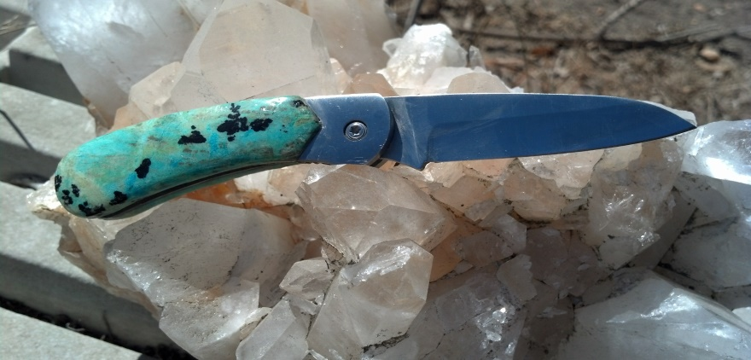
Customer issues
What does the customer want to do with the stone?
Every day use versus special occasion

