Slide 2
“I am looking for
Creation Care Crews.”
Join me.
Join Climate Church that brings Good Kingdom!

Slide 3
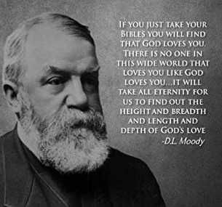

Slide 4
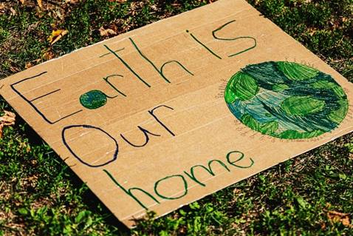
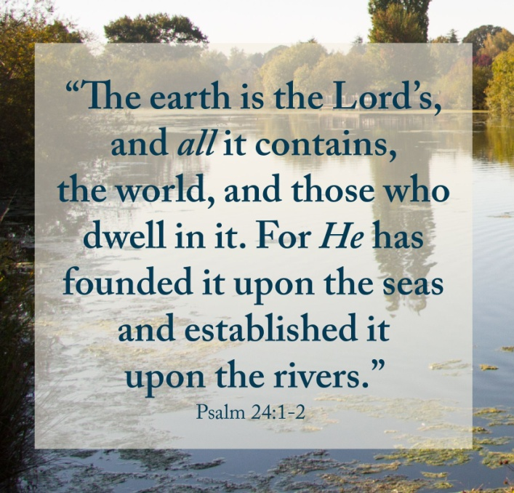
Psalm 96:1-13
Praise the Lord with a New Song.

Slide 5
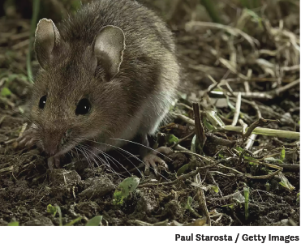
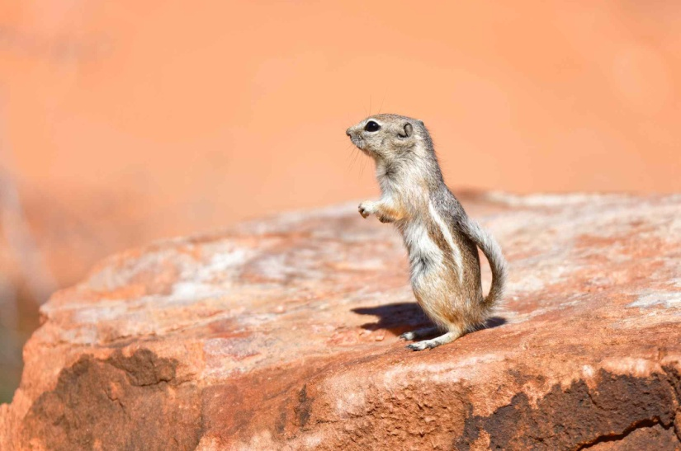
Psalm 96:1-13
Sing to the Lord, All the Earth.
Birds and insects sing with abandon, human enjoy singing; mice sing at supersonic levels…

Slide 6
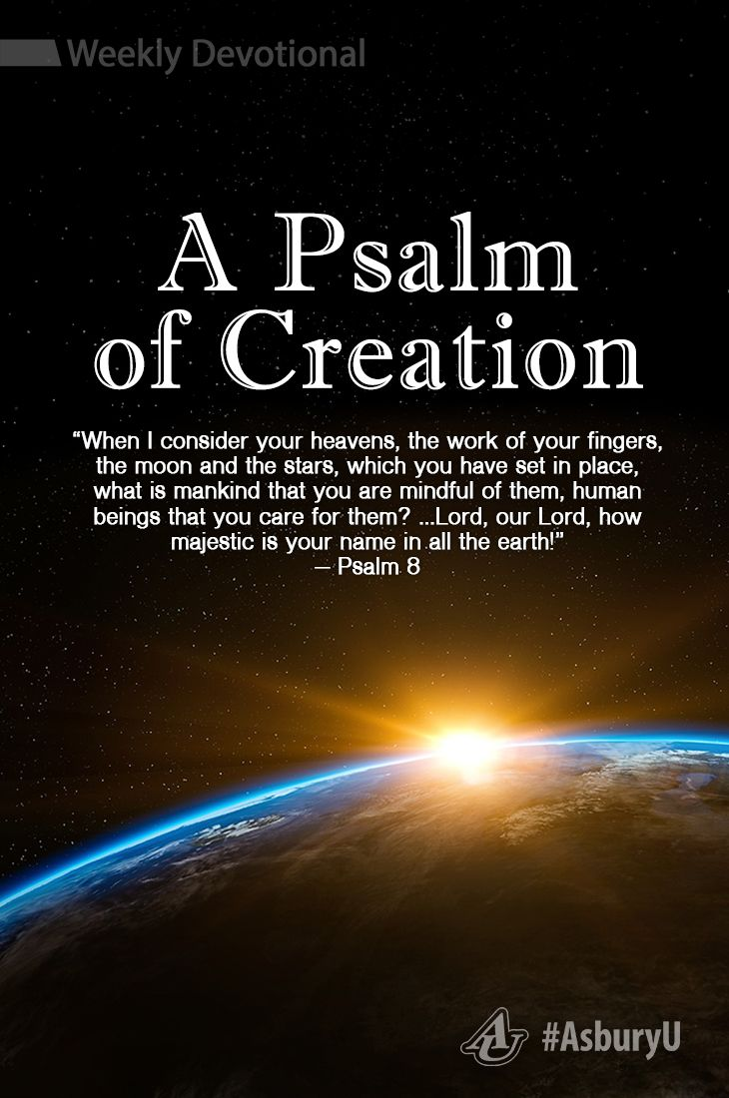
Psalm 96:1-13
Sing for the Salvation of the World.

Slide 7
1. Proclaim his salvation day after day.
Climate Church, Good Kingdom
Part 2. Sing to the Lord, All the Earth!

Slide 8
1. Proclaim his salvation day after day.
Save Souls
Find the lost!
Climate Church, Good Kingdom
Part 2. Sing to the Lord, All the Earth!

Slide 9
1. Proclaim his salvation day after day.
Climate Church, Good Kingdom
Part 2. Sing to the Lord, All the Earth!

Slide 10
1. Proclaim his salvation day after day.
2. Let the heavens rejoice, let the earth be glad;
Climate Church, Good Kingdom
Part 2. Sing to the Lord, All the Earth!

Slide 11
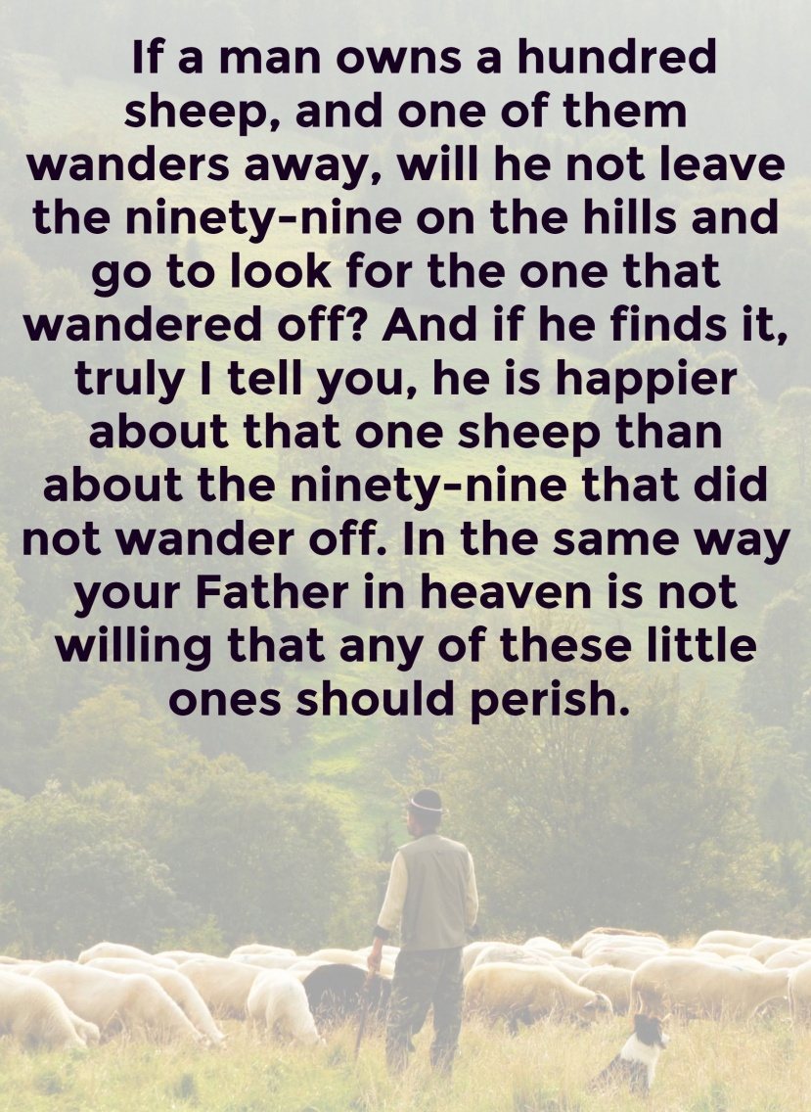
2. Let the heavens rejoice, let the earth be glad;
Matthew 18:12-14
Climate Church, Good Kingdom
Part 2. Sing to the Lord, All the Earth!

Slide 12
2. Let the heavens rejoice, let the earth be glad;
Climate Church, Good Kingdom
Part 2. Sing to the Lord, All the Earth!

Slide 13
1. Proclaim his salvation day after day.
2. Let the heavens rejoice, let the earth be glad;
3. Let the sea resound, and all that is in it;
Climate Church, Good Kingdom
Part 2. Sing to the Lord, All the Earth!

Slide 14
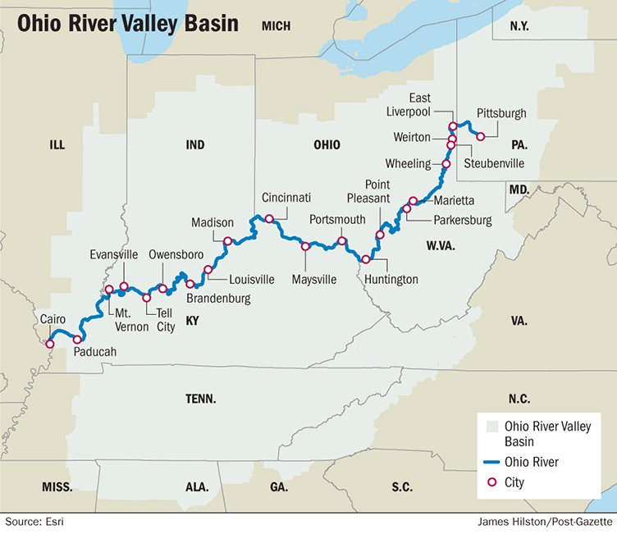
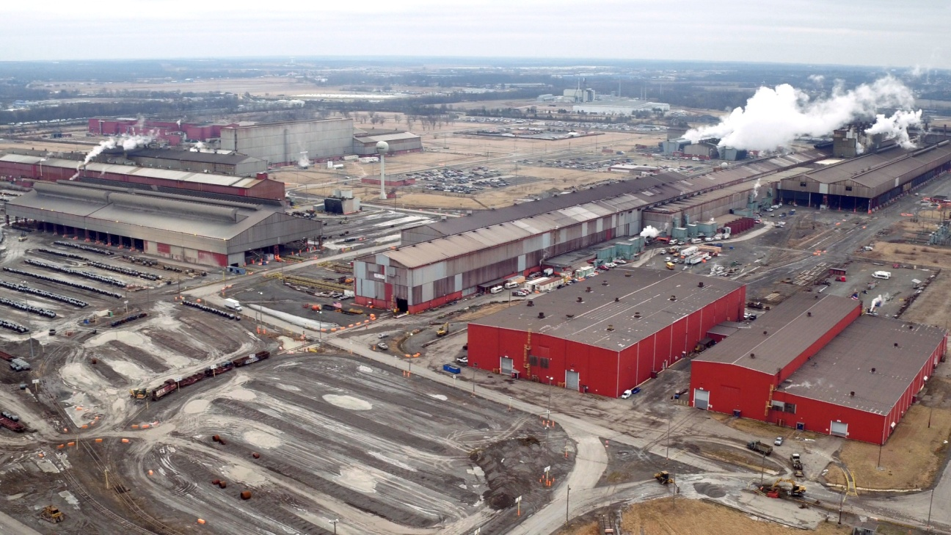
3. Let the sea resound, and all that is in it;
Climate Church, Good Kingdom
Part 2. Sing to the Lord, All the Earth!

Slide 15
3. Let the sea resound, and all that is in it;
Climate Church, Good Kingdom
Part 2. Sing to the Lord, All the Earth!

Slide 16
3. Let the sea resound, and all that is in it;
Revelation 22:2-3
Climate Church, Good Kingdom
Part 2. Sing to the Lord, All the Earth!

Slide 17
1. Proclaim his salvation day after day.
2. Let the heavens rejoice, let the earth be glad;
3. Let the sea resound, and all that is in it
4. Let the fields be jubilant, and everything in them, for he comes.
Climate Church, Good Kingdom
Part 2. Sing to the Lord, All the Earth!

Slide 18
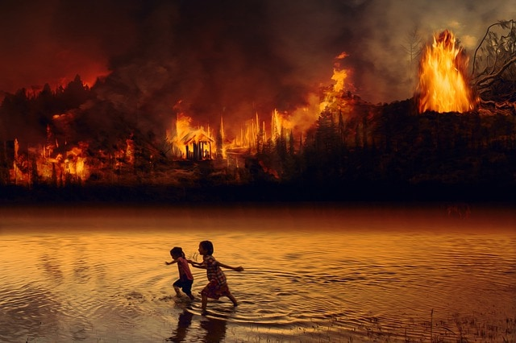
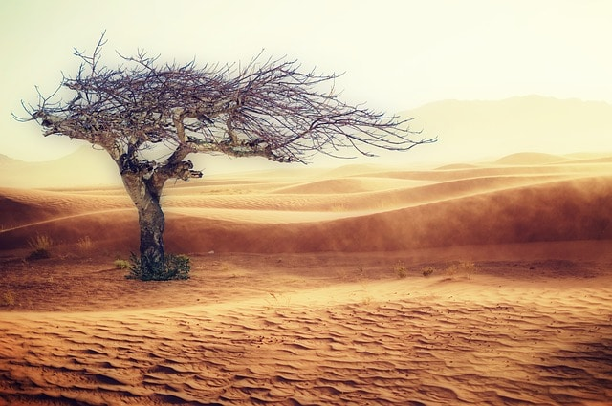
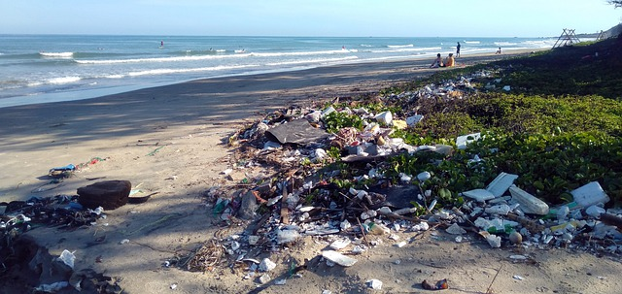
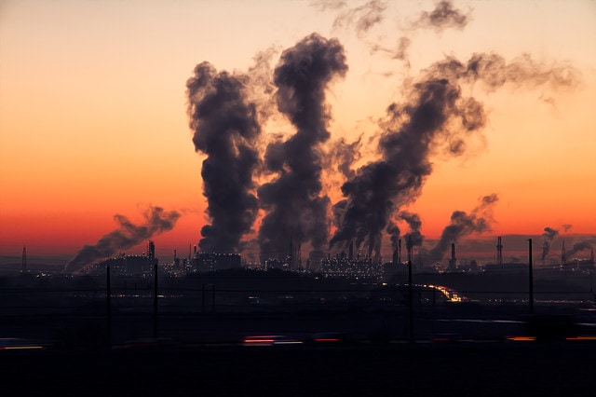
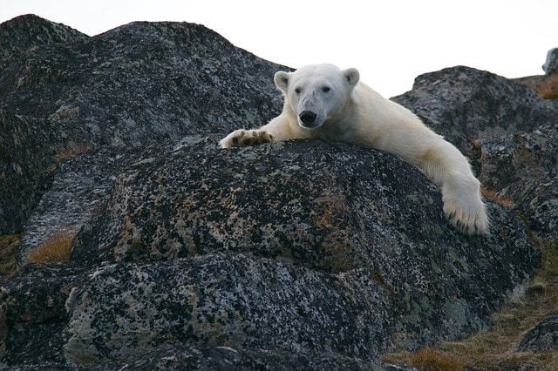
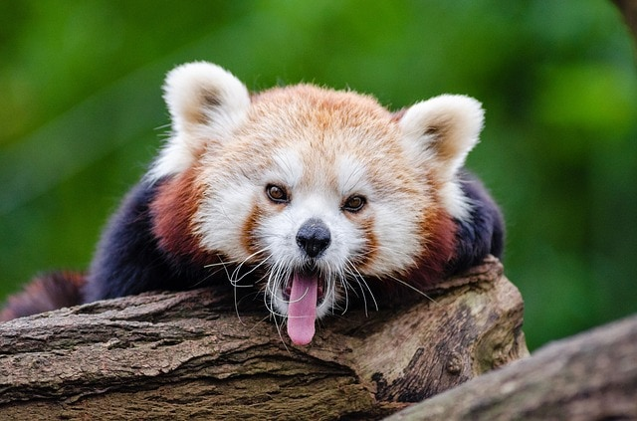
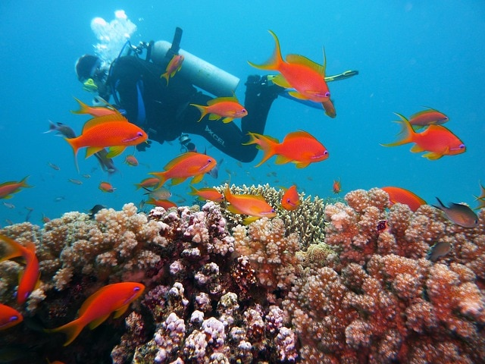
4. Let the fields be jubilant, and everything in them, for he comes.
Climate Church, Good Kingdom
Part 2. Sing to the Lord, All the Earth!

Slide 19
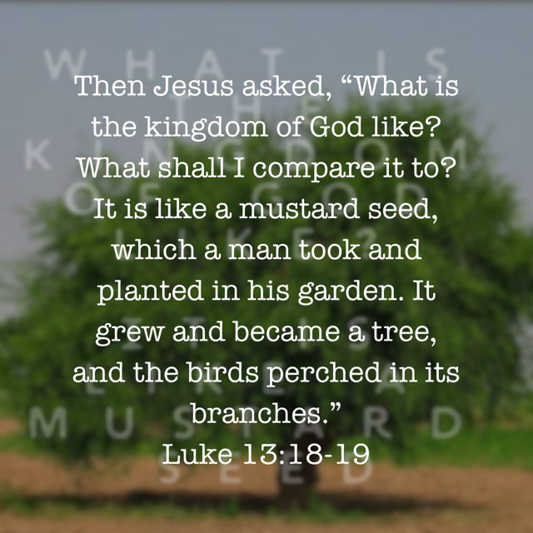
4. Let the fields be jubilant, and everything in them, for he comes.
Climate Church, Good Kingdom
Part 2. Sing to the Lord, All the Earth!

