Slide 1
Basic Radio 101
An Emergency Responder’s Guide to Effective Radio Communication
Notes:
Welcome to Basic Radio 101. The goal of this training is to increase the overall effectiveness of emergency radio communication among North Dakota’s first responders.

Slide 2
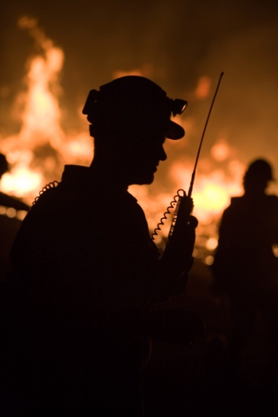
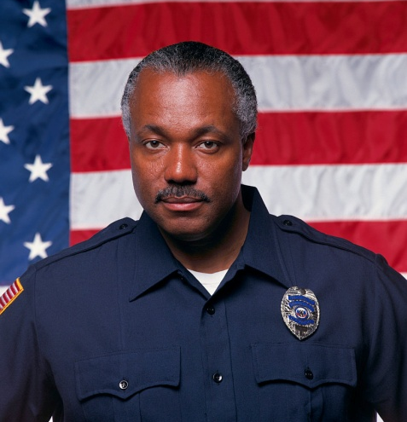
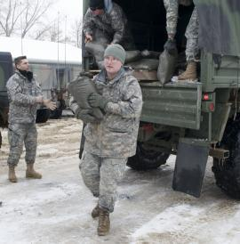
Communication is Important
Communicate effectively
Protect community
Save lives
Notes:
Communication is fundamental in any successful effort but especially important to you brave men and women who serve as emergency responders. Effective communication protects the communities in which you serve and helps you to save lives.

Slide 3
Introduction to Radio Basics
Getting to Know Your Radio and How to Use It Effectively
Module 1
Notes:
Module 1, Introduction to Radio Basics, provides a general explanation of radio anatomy and proper programming. Although radios may vary depending on the agency or department, the information and examples in this training will apply. You are encouraged to review the information specific to the radio you use.

Slide 4
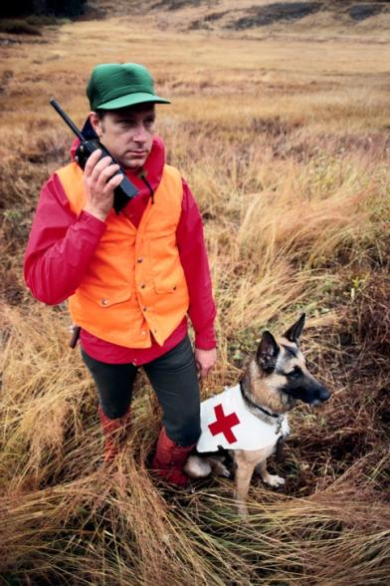
Walkie-talkies, Phones and Radios
Notes:
Trainers: The four photos automatically fade into this slide.
Many of you likely have had experience with walkie-talkies during your lifetime, and most of you are probably comfortable using a cell phone. Two-way radios are not much different than these everyday technologies.

Slide 5
Portable Radio
Battery powered
Hand held
Carried by person
Notes:
If you are on foot or a mobile radio is not workable, a portable radio may be used for communication. Portable radios are battery-powered, hand-held radio units that may be carried by a person.

Slide 6
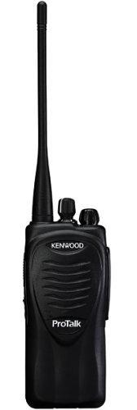
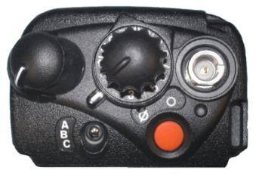
Power
Power “ON” and “OFF”
Different styles
Push button
Control knob
Turn off when changing batteries
Notes:
Trainers: The two circles and arrow automatically fade into the slide.
All this technology begins with turning the radio on. Power switches vary by radio, but the most common are push-button and knob styles. In some cases, the volume control and power knob are combined. Make sure the power is turned off when changing batteries.

Slide 7
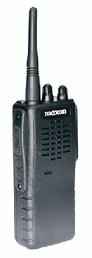
Squelch
Eliminates noise on analog radios
“Open” for white noise
“Close” to reduce noise
Separate knob or ring under volume knob
Notes:
Trainers: The circles and oval automatically fade into the slide.
At times, the incoming voice may not be clear. On analog radios, the squelch is a control that eliminates noise. Since squelch is only on analog radios, most newer radios, which are digital, don’t have squelch. On some analog radios, the squelch control is a separate knob. On others, it may be a ring under the volume control. When the squelch is wide open, you will hear a loud, hissing white noise. After you have adjusted the speaker volume to a level that you can hear, close the squelch control gradually until the noise disappears.

Slide 8
Push-to-Talk (PTT)
Wait 2 seconds
Speak in normal voice
Incoming messages lost if PTT is activated
Notes:
Trainers: The two ovals automatically fade into the slide.
Once the radio is on, use the push-to-talk button, or PTT, to transmit an outgoing signal. Press the PTT, wait 2 seconds and begin speaking in a normal voice. Once the message has been relayed, wait 2 seconds, then stop pushing the PTT and listen intently. Incoming messages will not be heard if the PTT is pressed.

Slide 9
Analog vs. Digital Signals
Analog
Digital
Signal unaltered
Heard simultaneously
Human voice is analog
Not continuous
Signal encoded
Converted back to plain audio
Notes:
Sound is transmitted naturally as an analog signal. These signals are sent over the air in an unaltered form and are heard as they are communicated. Unlike analog signals, digital signals are not continuous and leave out some surrounding sound. The signal is encoded using specific values representing pitch and volume that are transmitted and then converted back to intelligible sound.

Slide 10
Battle of the Bands
UHF
VHF
Ultra-high Frequency
450 MHz to 470 MHz
Very High Frequency
150 MHz to 170 MHz
Respond to and recover from:
ALL Hazards
ALL Disasters
Notes:
Whether digital or analog, the signals transmitted must travel by a specific frequency. The Ultra High Frequency, or UHF band, ranges from 450 Megahertz (MHz) to 470 MHz. Emergency responders also use Very High Frequency, or VHF band, that ranges from 150 MHz to 170 MHz. In North Dakota, most emergency communications occur on the VHF frequency. Frequencies in the 700 and 800 range have been allocated through the federal Department of Homeland Security to use in all-hazard disaster response and recovery.

Slide 11
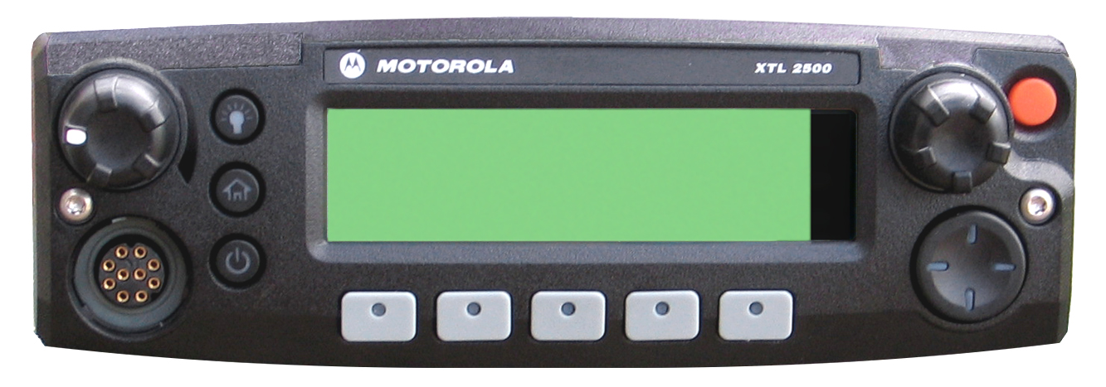
Channel Scanning
Channel/Mode
Select Knob
Push-button
Dial control
Automatic scanning
Notes:
Trainers: The arrow and its text automatically fade into the slide.
Channel selection on some models is with push buttons. Other models may use a dial control. Some radios even allow the user to scan frequencies automatically.

Slide 12
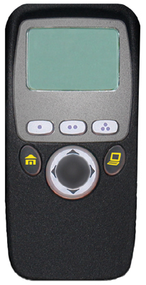
Selecting Frequency
Channel/Mode
Name
One frequency at a time
Must be on same channel
Special-use frequencies
Channel/Mode
Select Knob
POL
DISP NW
PAGE
MUTE
CALL
Notes:
Trainers: The two arrows and their text automatically fade into the slide.
Most radios can work off only one frequency at a time. Radios can communicate only when the frequencies match. Correct frequencies need to be in place to talk to each other. Generally, each jurisdiction has designated channels, which are programmed locally, for general use and specific uses. This will be discussed more in the local training in Module 4.

Slide 13
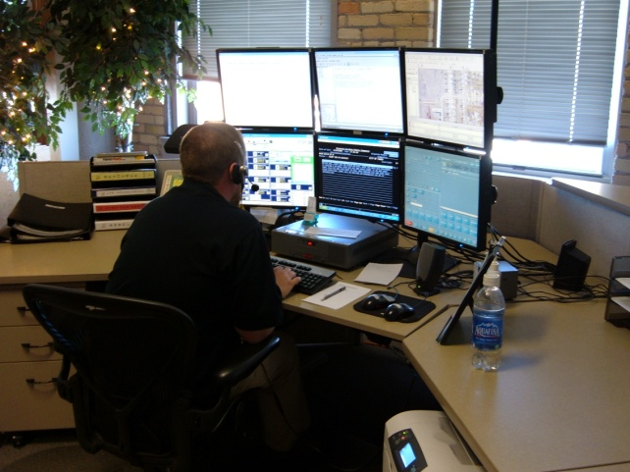
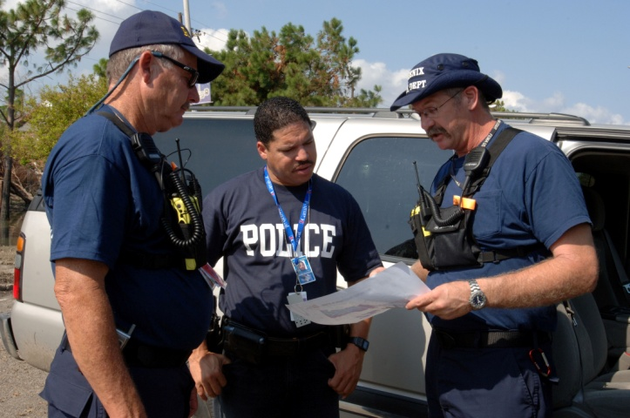
Introduction to Radio Basics
Review
General radio communication
Anatomy of a radio
Programming the radio
Notes:
This is the conclusion of Module 1, Introduction to Radio Basics. This module has looked at general radio communication, the anatomy of a radio and programming the radio. Module 2, Radio Protocol Guidelines, aims to improve communication practices by looking at real-world scenarios.

